Slide 1
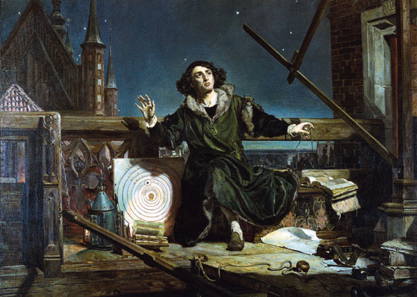
Astronomer Copernicus, or Conversations with God, by Matejko (19th c)
New Art & The Scientific Revolution
Unit 1 Part II AP European History

Slide 2
Mannerism
Started as a criticism from 16th C. critics who thought contemporary artists were painting in the “manner” of Michelangelo and Raphael but lacked the substance.

Slide 3
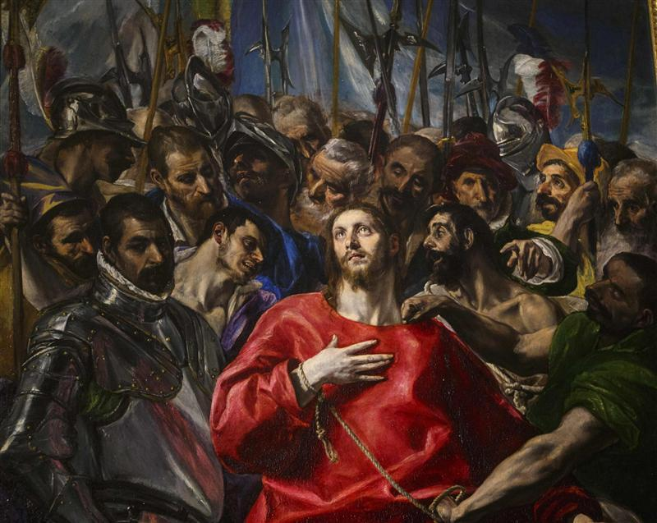
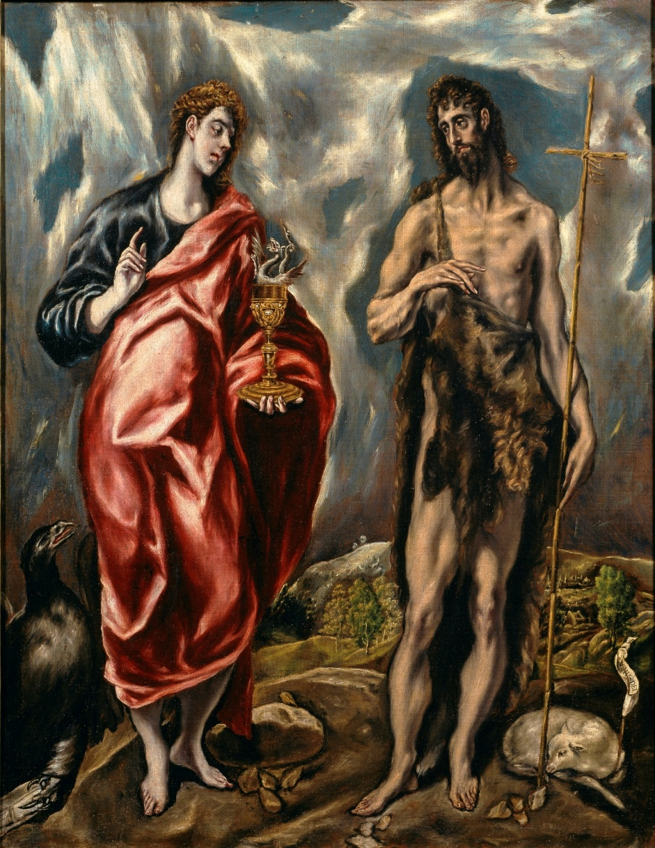
Mannerist Artists
Replace the principles of balance and harmony
More distortion and illusion
Dramatic results
Reflected spiritual and political turmoil following the Protestant Reformation in 1520-30s
El Greco (1541-1614) considered one of the greats
Elongated figures and dark, eerie colors created feelings of intense emotion
By 1570, Mannerism gave way to Baroque art, also beginning in Italy.

Slide 4
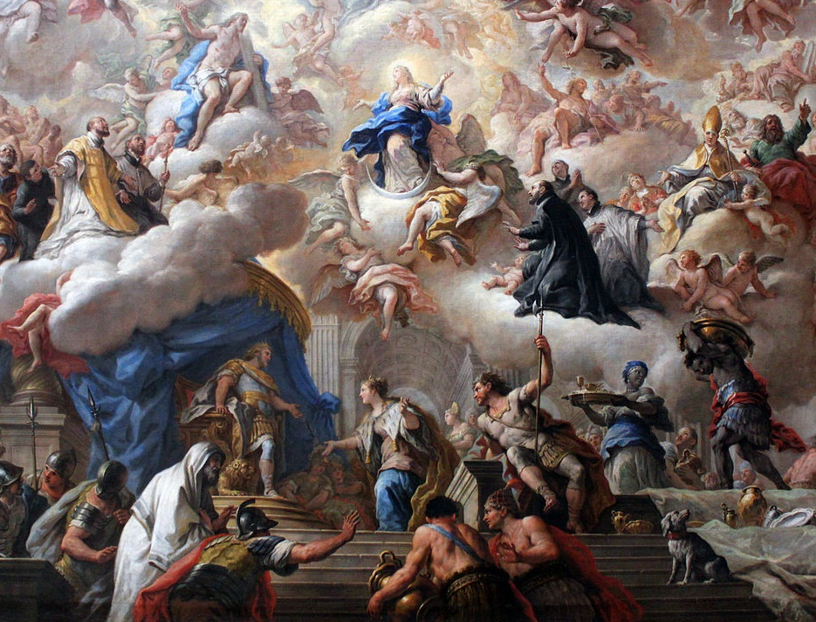
The Baroque

Slide 5
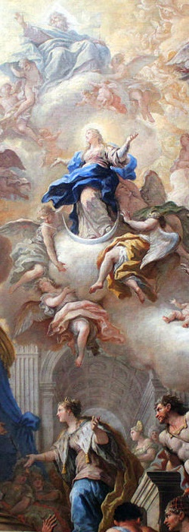
The Baroque
When? 1600-1750
Origins: Italy
Historical Context:
  Counter-Reformation
  Absolutism

Slide 6
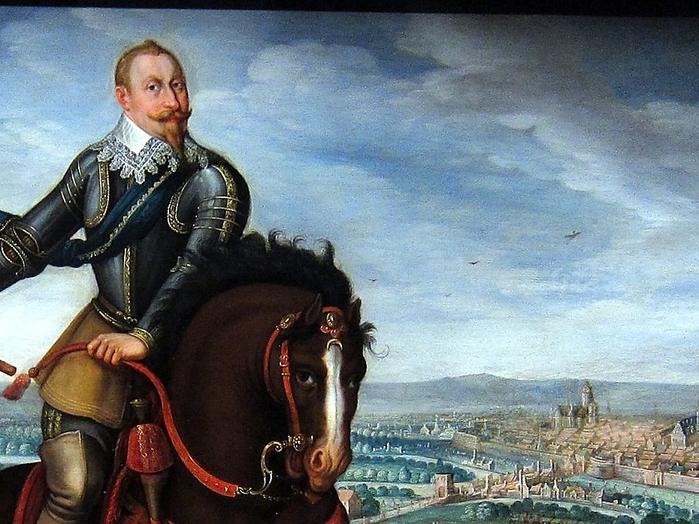
TURBULENT
TIMES

Slide 7
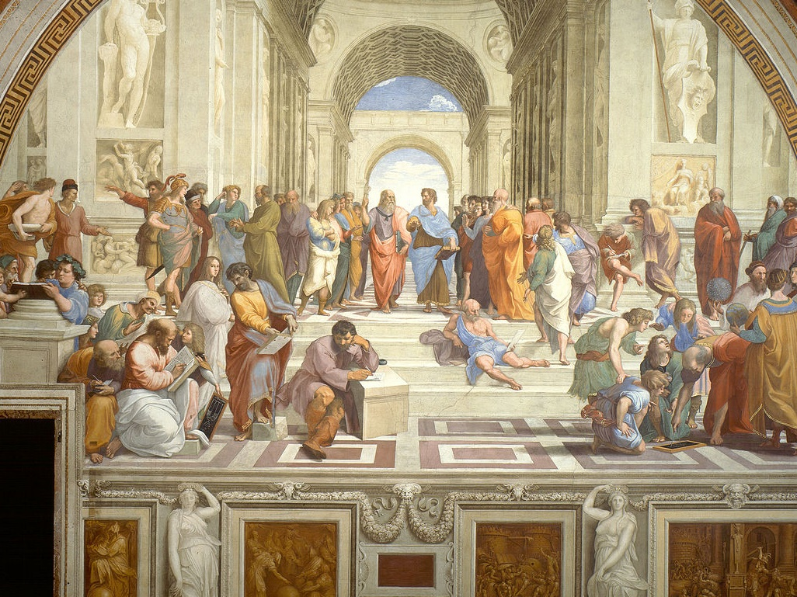
REJECTION
OF RENAISSANCE RATIONALITY
Departing from realism and naturalism

Slide 8
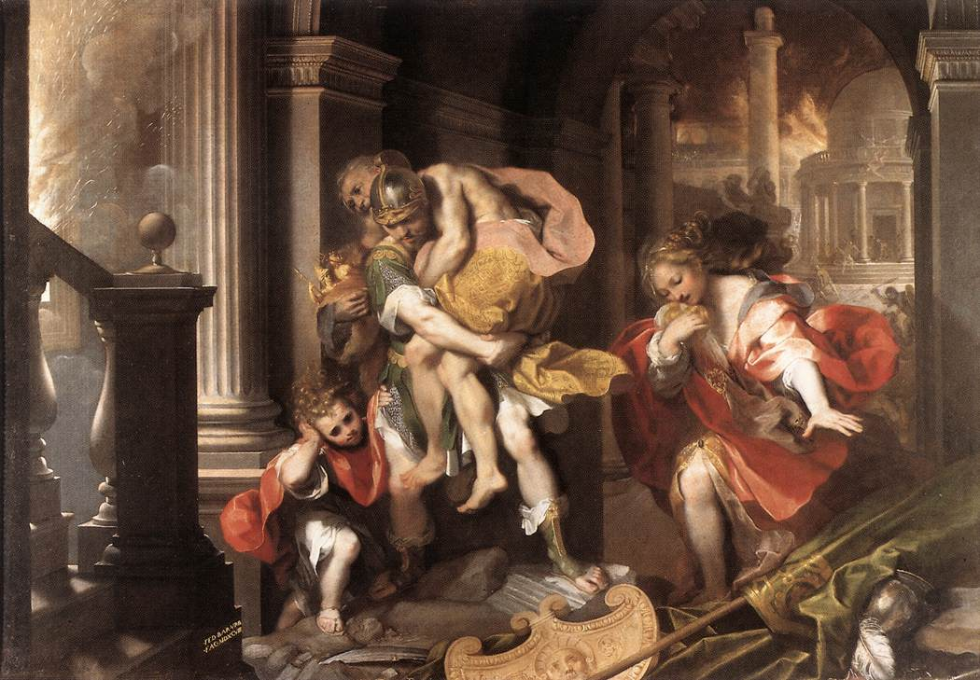
(BUT NOT OF RENAISSANCE SUBJECT MATTER IN ITS DRAMATICALLY COMPLEX APPEAL TO THE SENSES)
Aeneas Flees Burning Troy, Federico Barocci, 1598

Slide 9
Baroque
Motion
Emotion
TurBuLEnCe
GRANDEUR
Contrast

Slide 10
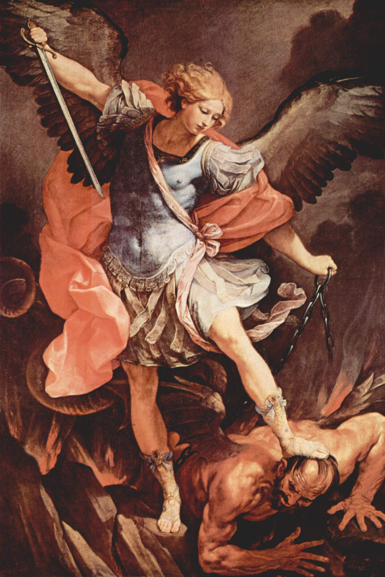
EMBRACE of the EXTRA
Guido Reni, St. Michael the Archangel (1636)

Slide 11
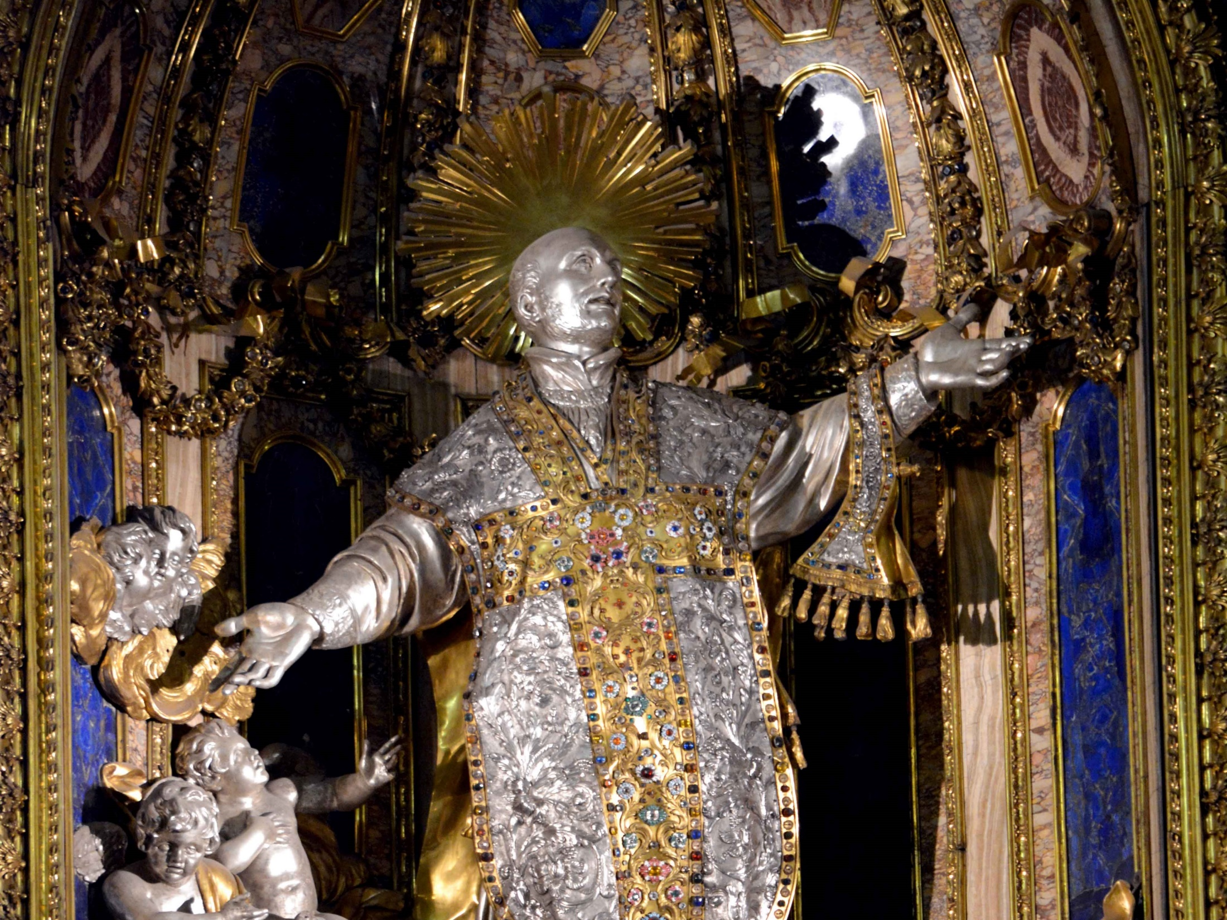
BLING IT ON
Photo by Roy Sebastian, SJ

Slide 12

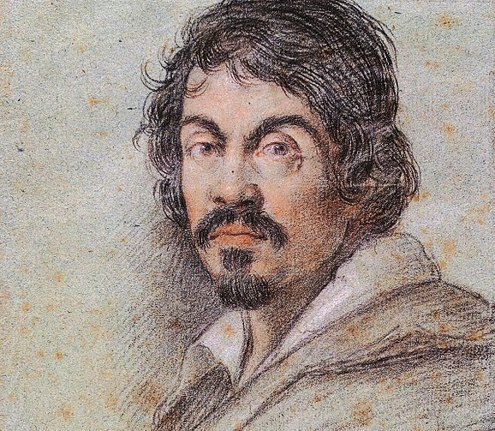
Caravaggio
Baroque Painter

Slide 13
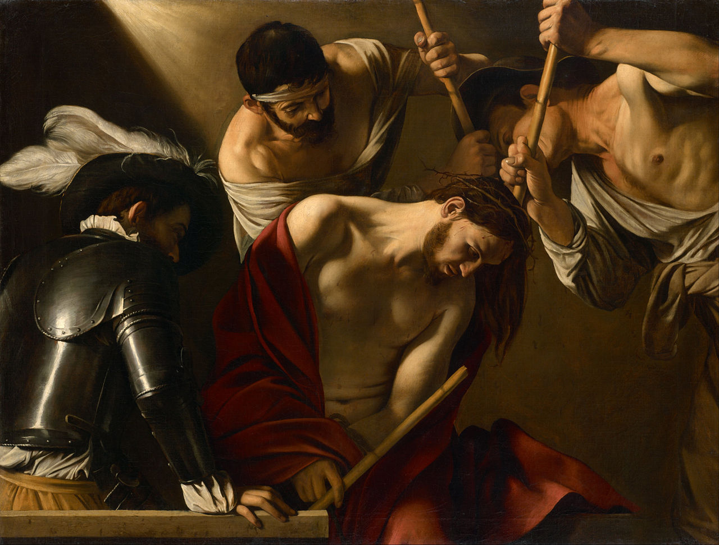
Caravaggio, The Crowning with Thorns (1602-1604)

Slide 14
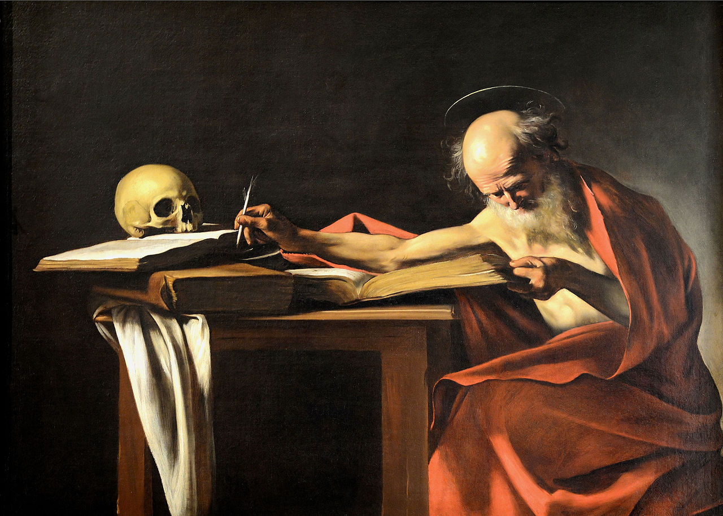
Caravaggio, St. Jerome (1610)

Slide 15
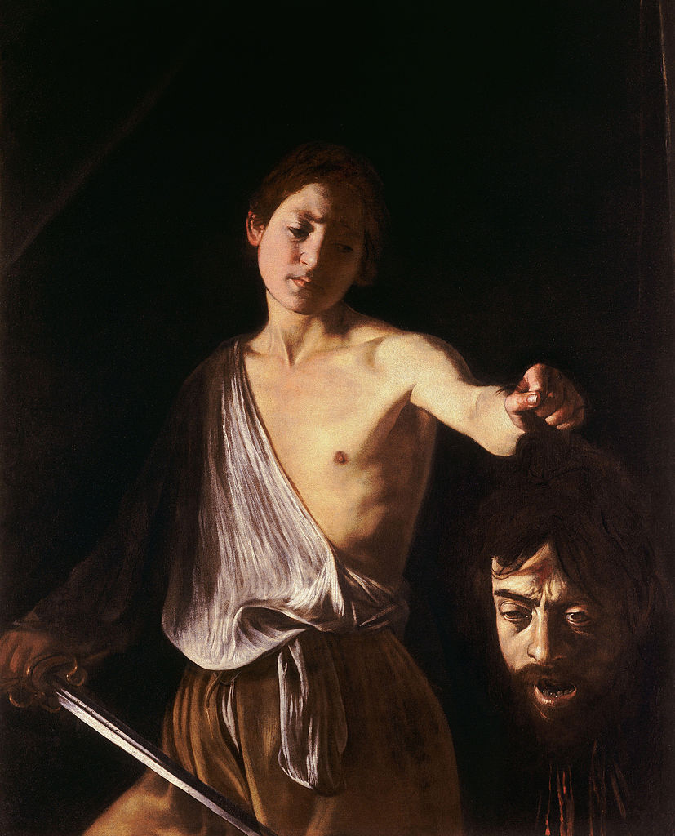
Caravaggio, David with the
head of Goliath (1606-1607)

Slide 16
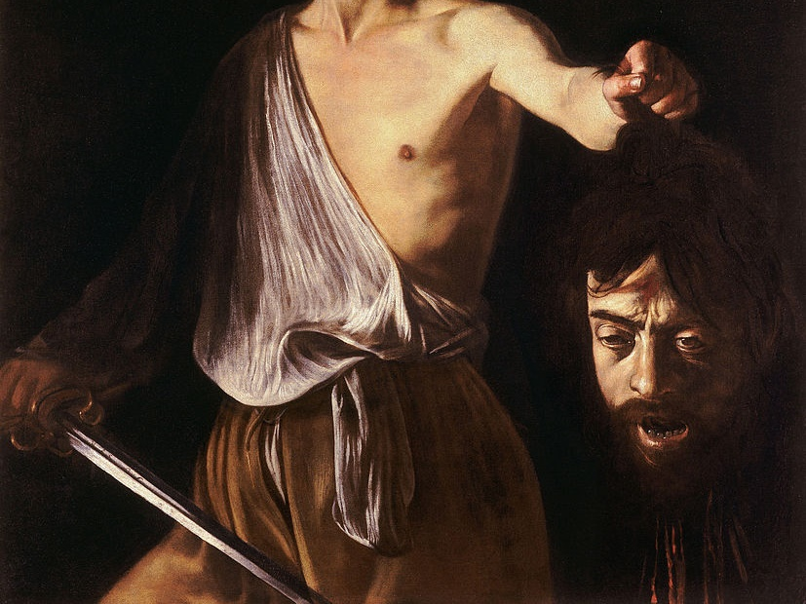
WHEN YOUR NECK FEELS
A LITTLE BAROQUE

Slide 17
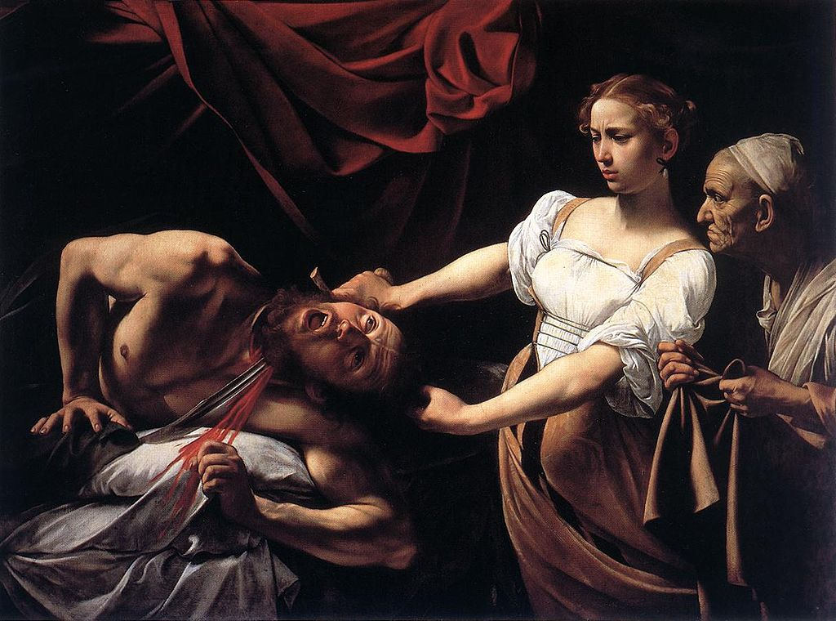
A Moment of Action and Emotion
Caravaggio, Judith Beheading Holofernes (1598-1599)

Slide 18
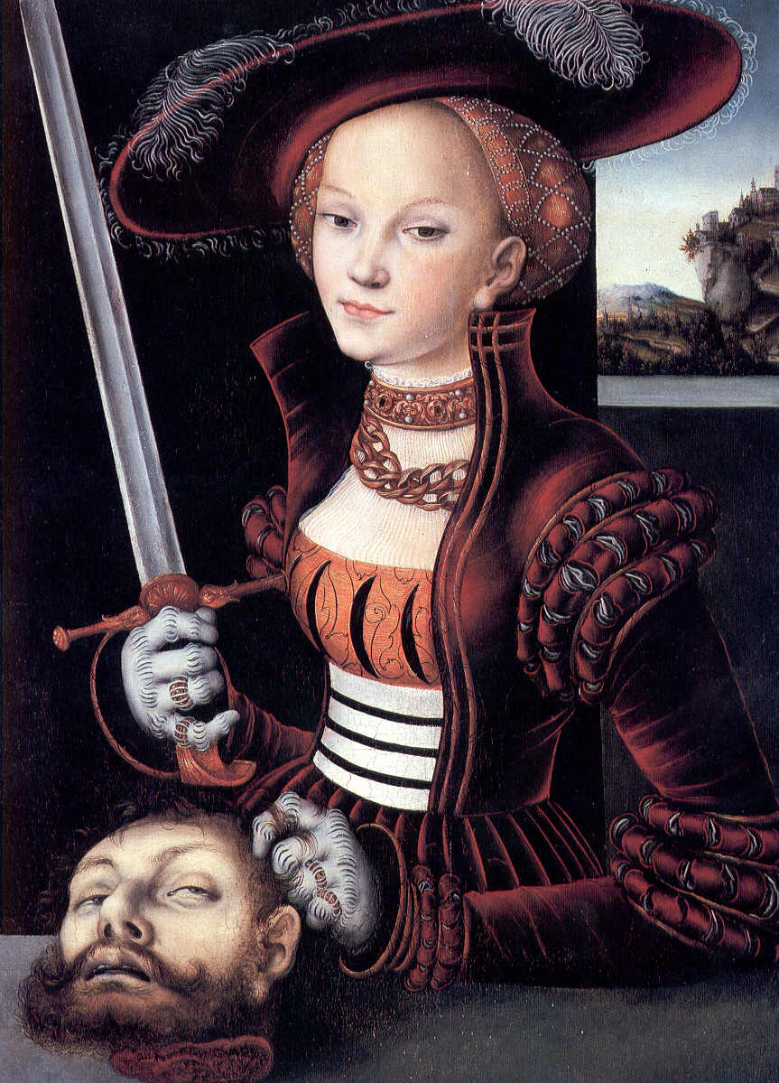
COMPARE
How does Caravaggio’s artistic interpretation of this story compare with Cranach’s?
Judith with the Head of Holofernes,
Lucas Cranach the Elder, 1530

Slide 19
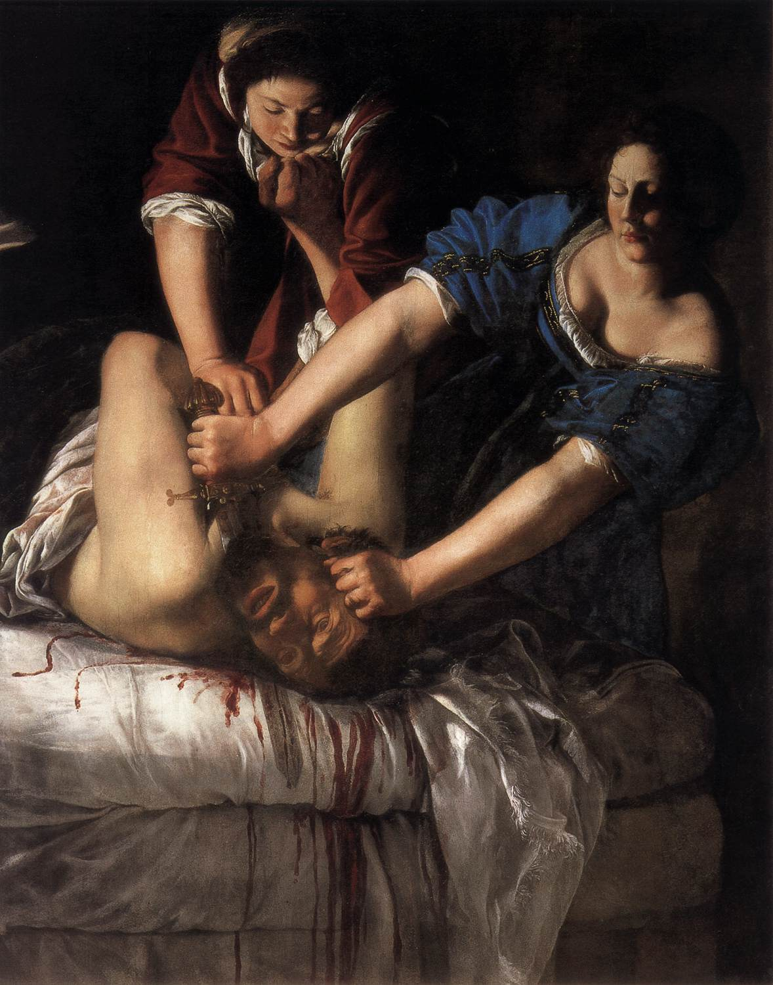
A Woman’s Interpretation
Artemisia Gentileschi’s painting of the same event was based on Caravaggio’s but
offers a more intense perspective.
Judith Slaying Holofernes,
Artemisia Gentileschi, c. 1620

Slide 20
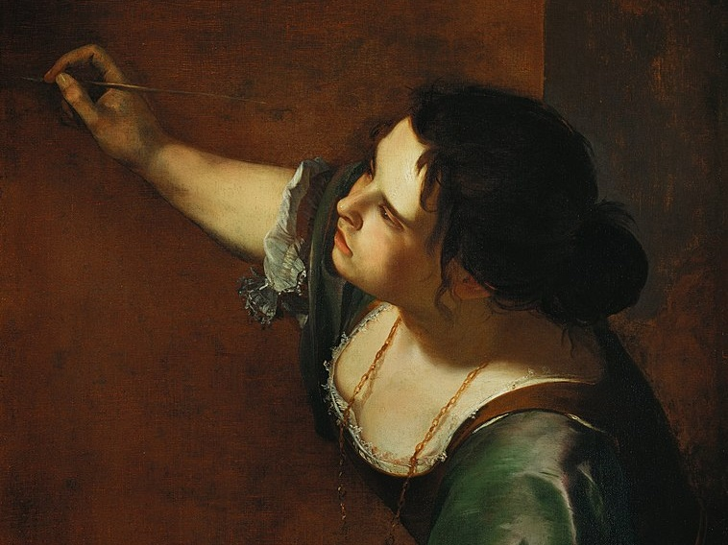
Artemisia
Gentileschi
Self-Portrait as the Allegory of Painting, 1638–9

Slide 21
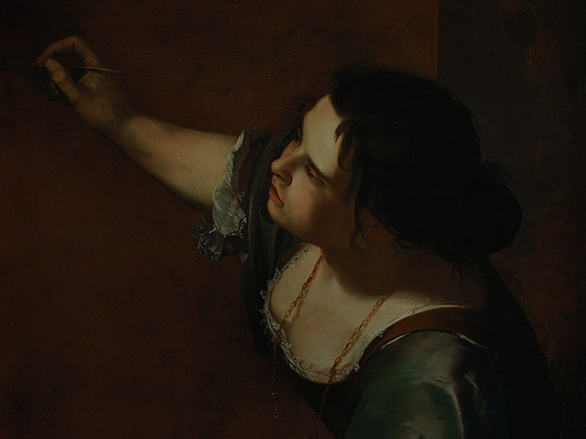
Artemisia Gentileschi, the daughter of a painter, was the first woman to be admitted into the Academy of Fine Arts of Florence.
As a young woman, she was raped by the man who was hired to be her tutor.
Self-Portrait as the Allegory of Painting, 1638–9

Slide 22
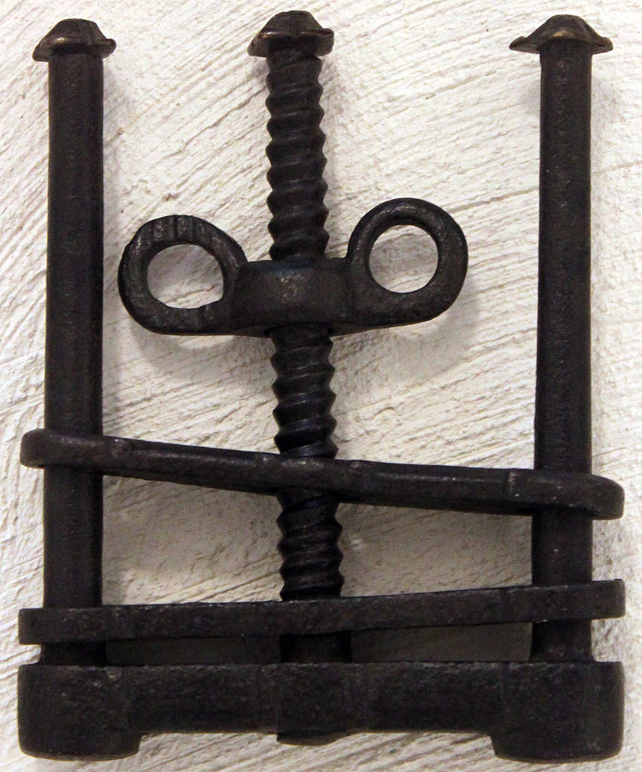
TORTURE
During the course of a seven month trial, Gentileschi was tortured with thumbscrews to test the veracity of her testimony against her rapist.
Photo by Anagoria

Slide 23
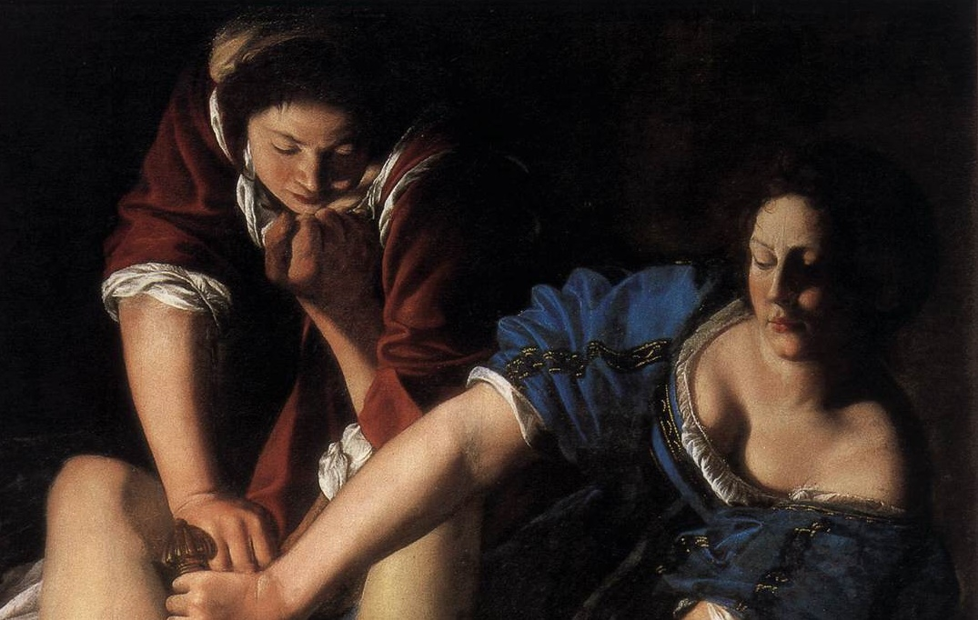
Let’s Take a
Closer Look
Artemisia Gentileschi’s painting of the same event was based on Caravaggio’s but
offers a more intense perspective.

Slide 24
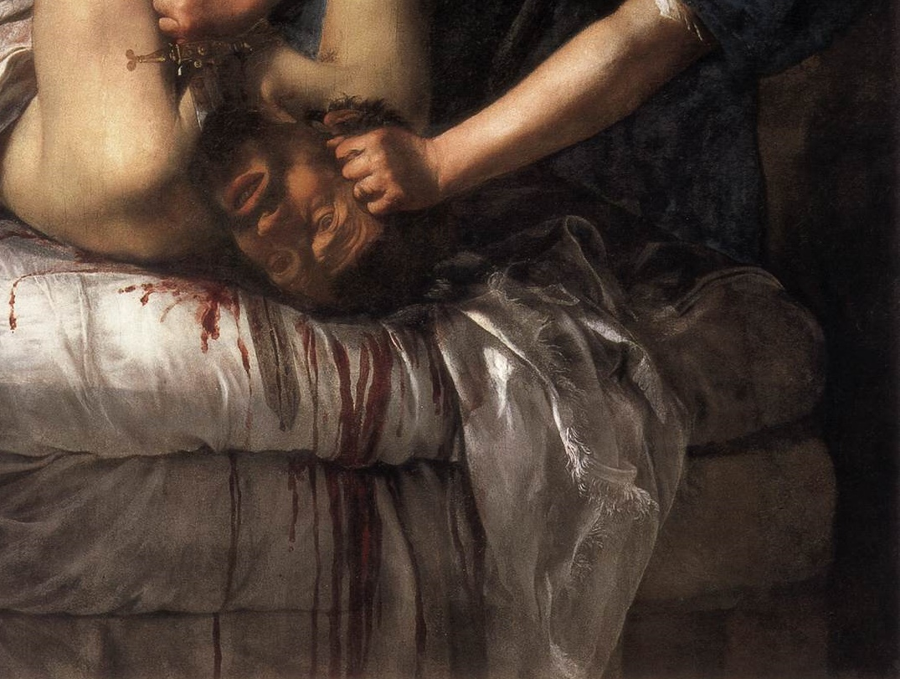
RAPIST
The Face of Her

Slide 25
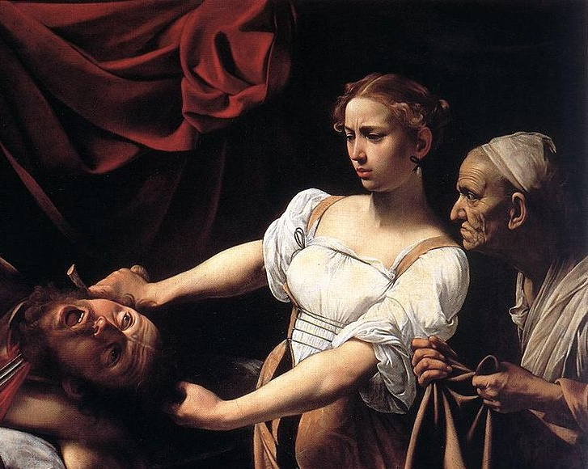
COMPARE
Artemisia Gentileschi’s painting of the same event was based on Caravaggio’s but
offers a more intense perspective.

Slide 26
REVENGE

Slide 27
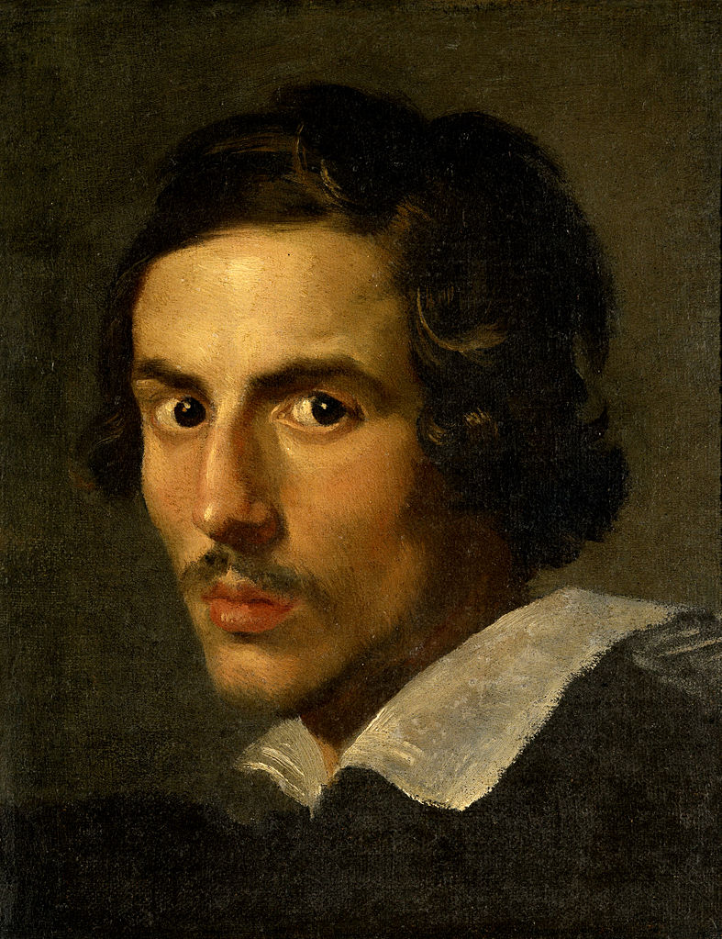
Bernini
Baroque Sculptor

Slide 28
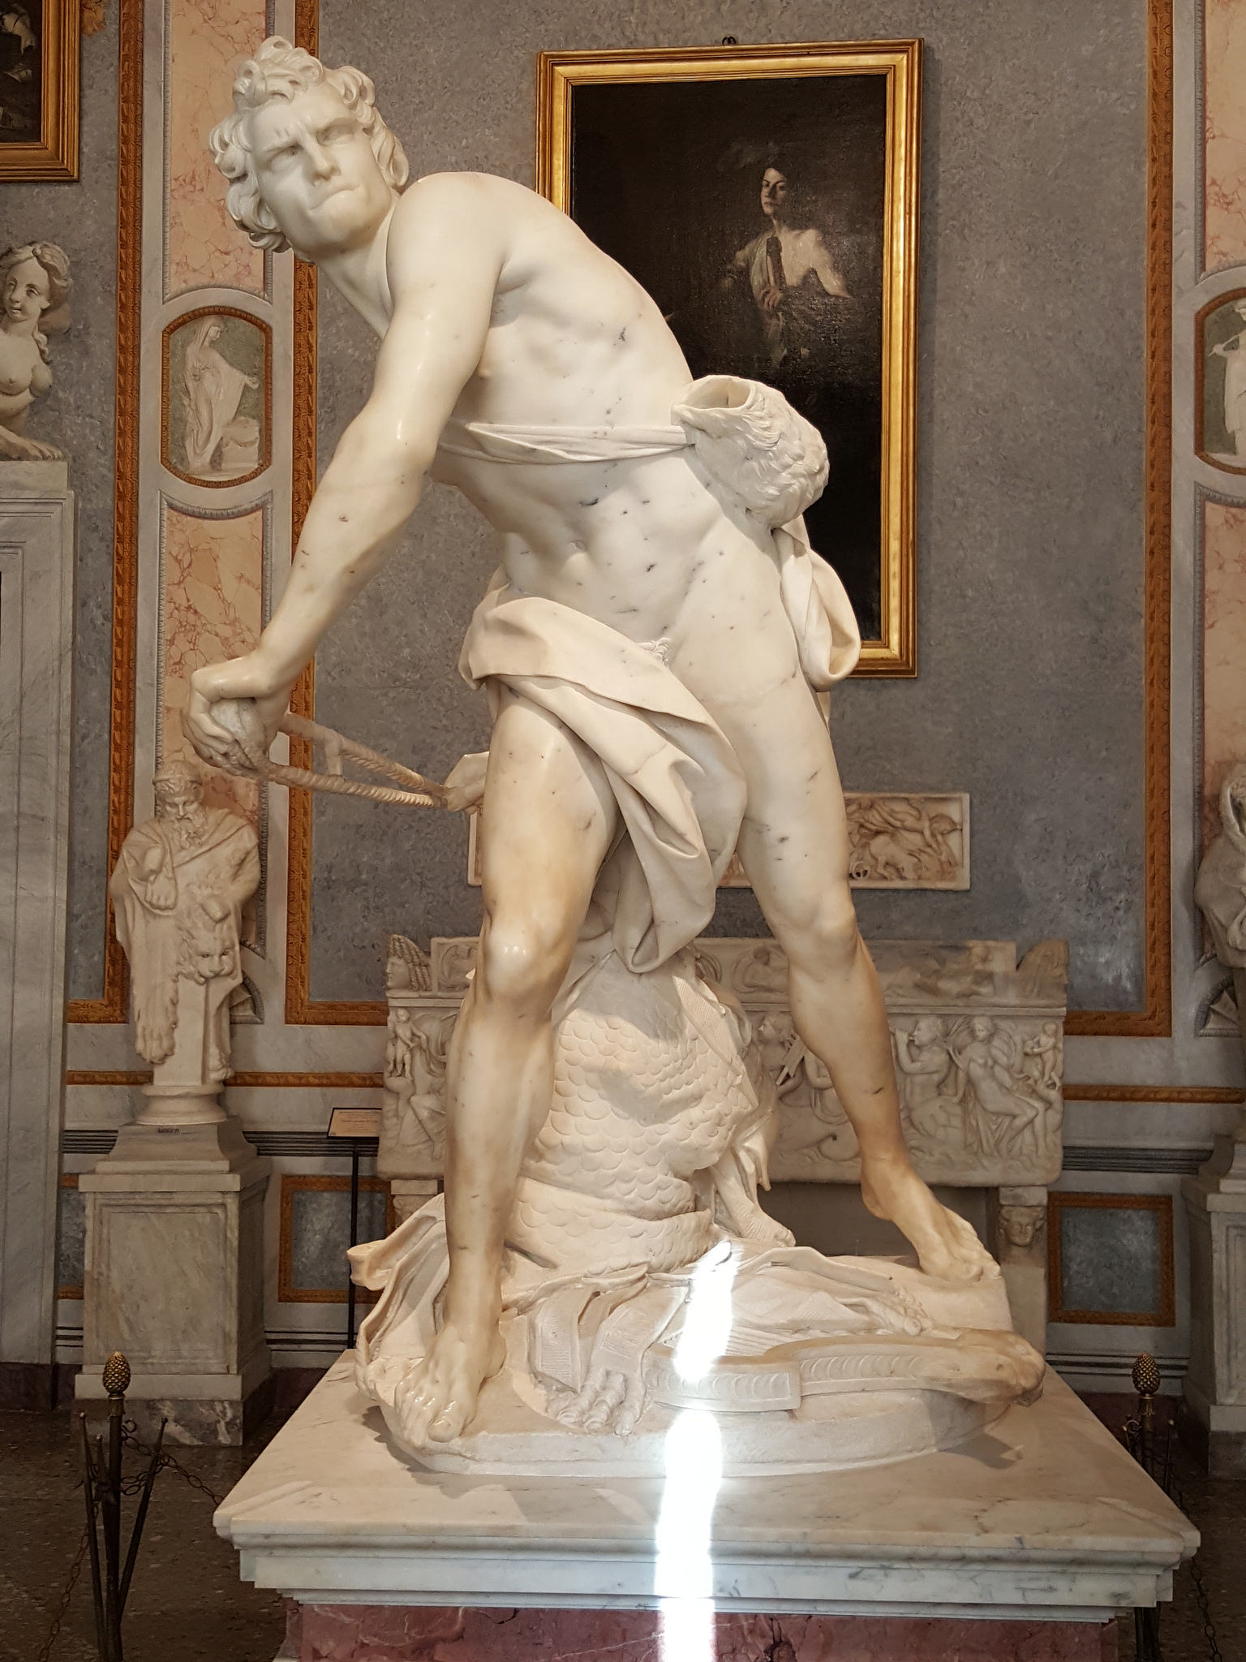
David
(Bernini)
Photo by Dennis Heller

Slide 29

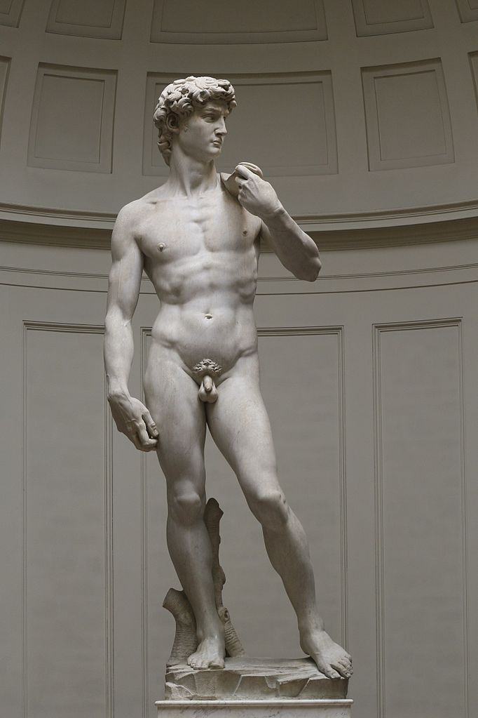
Compare
Photo by Dennis Heller
Photo by:
Jörg Bittner Unna

Slide 30
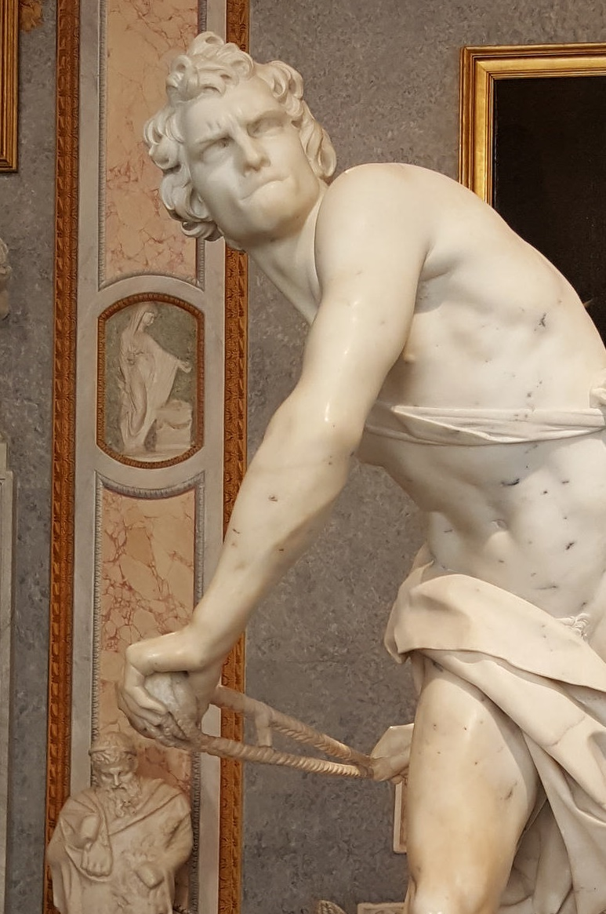
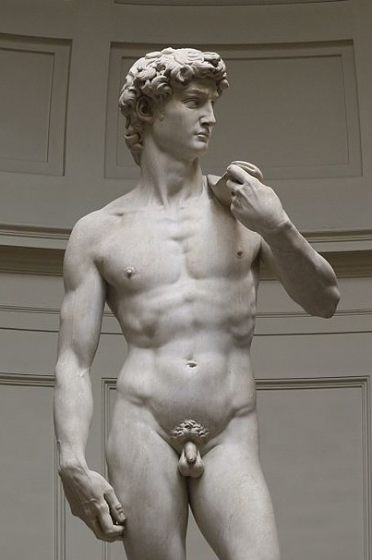

Slide 31


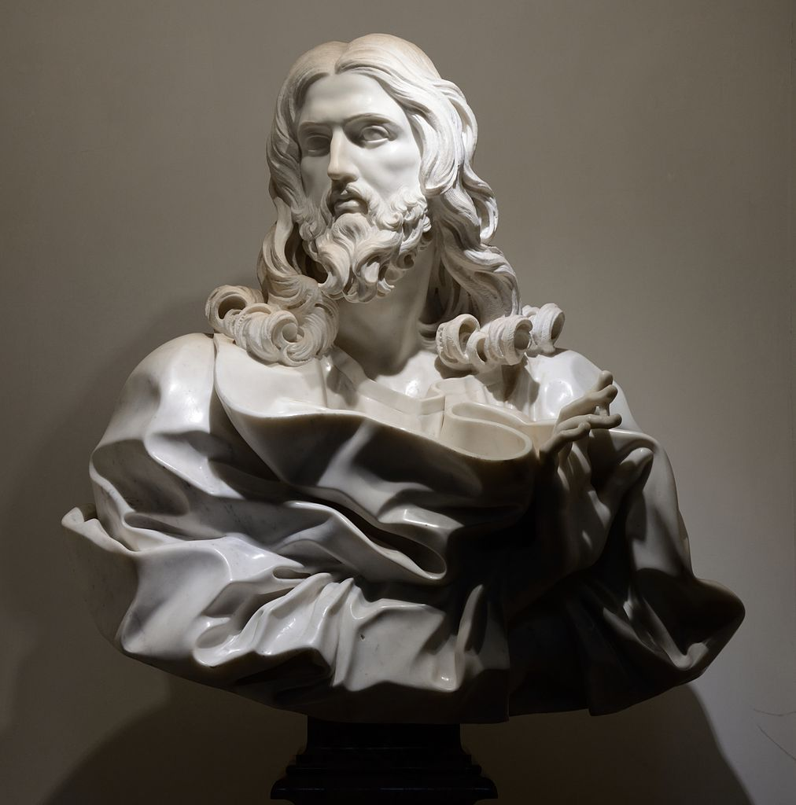
Bernini’s Jesus
Photo by Livioandronico2013

Slide 32
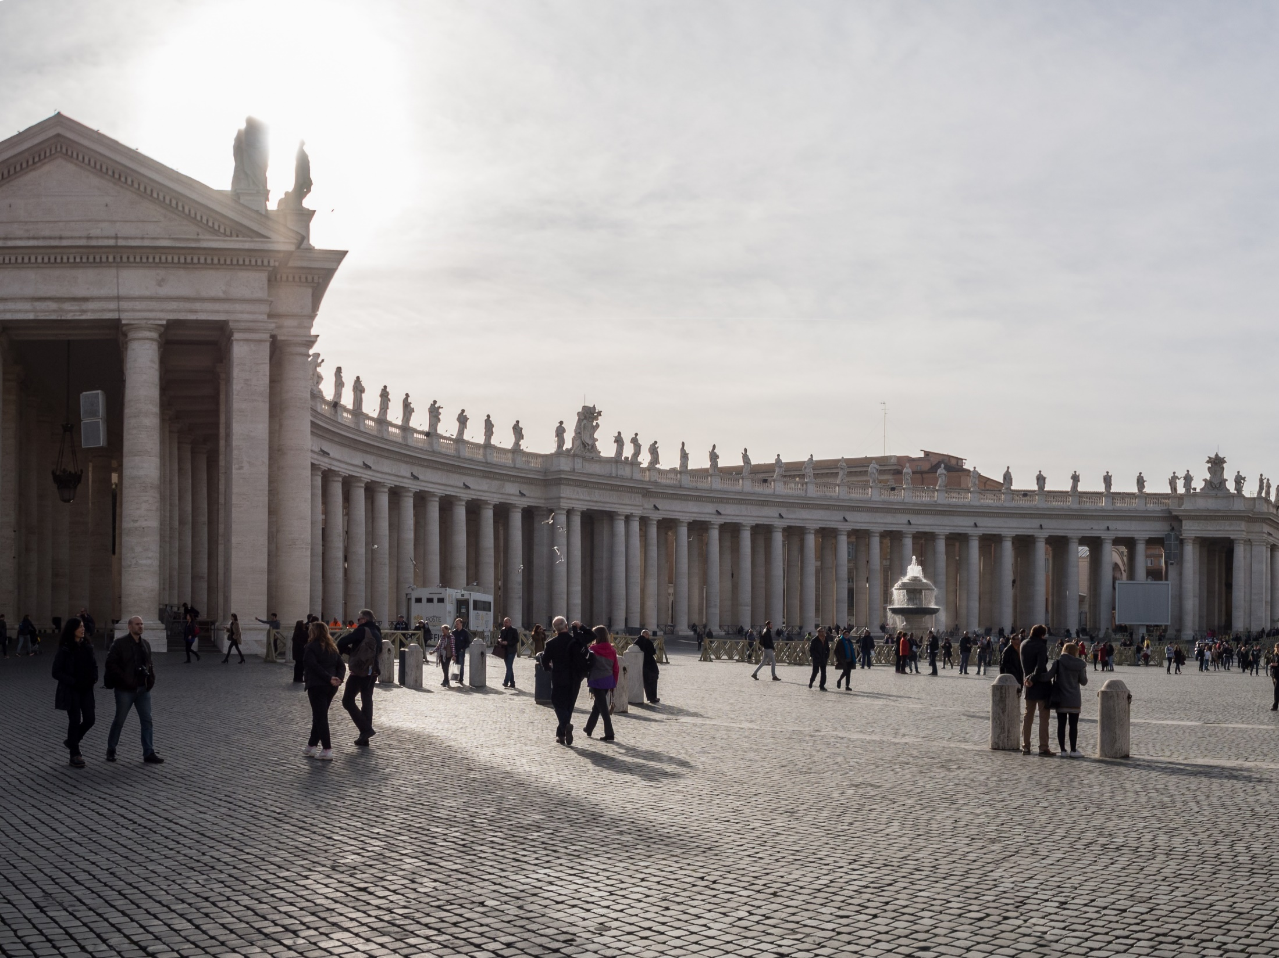
St. Peter’s Square
Bernini as Architect
Photo by Matt Brisher

Slide 33
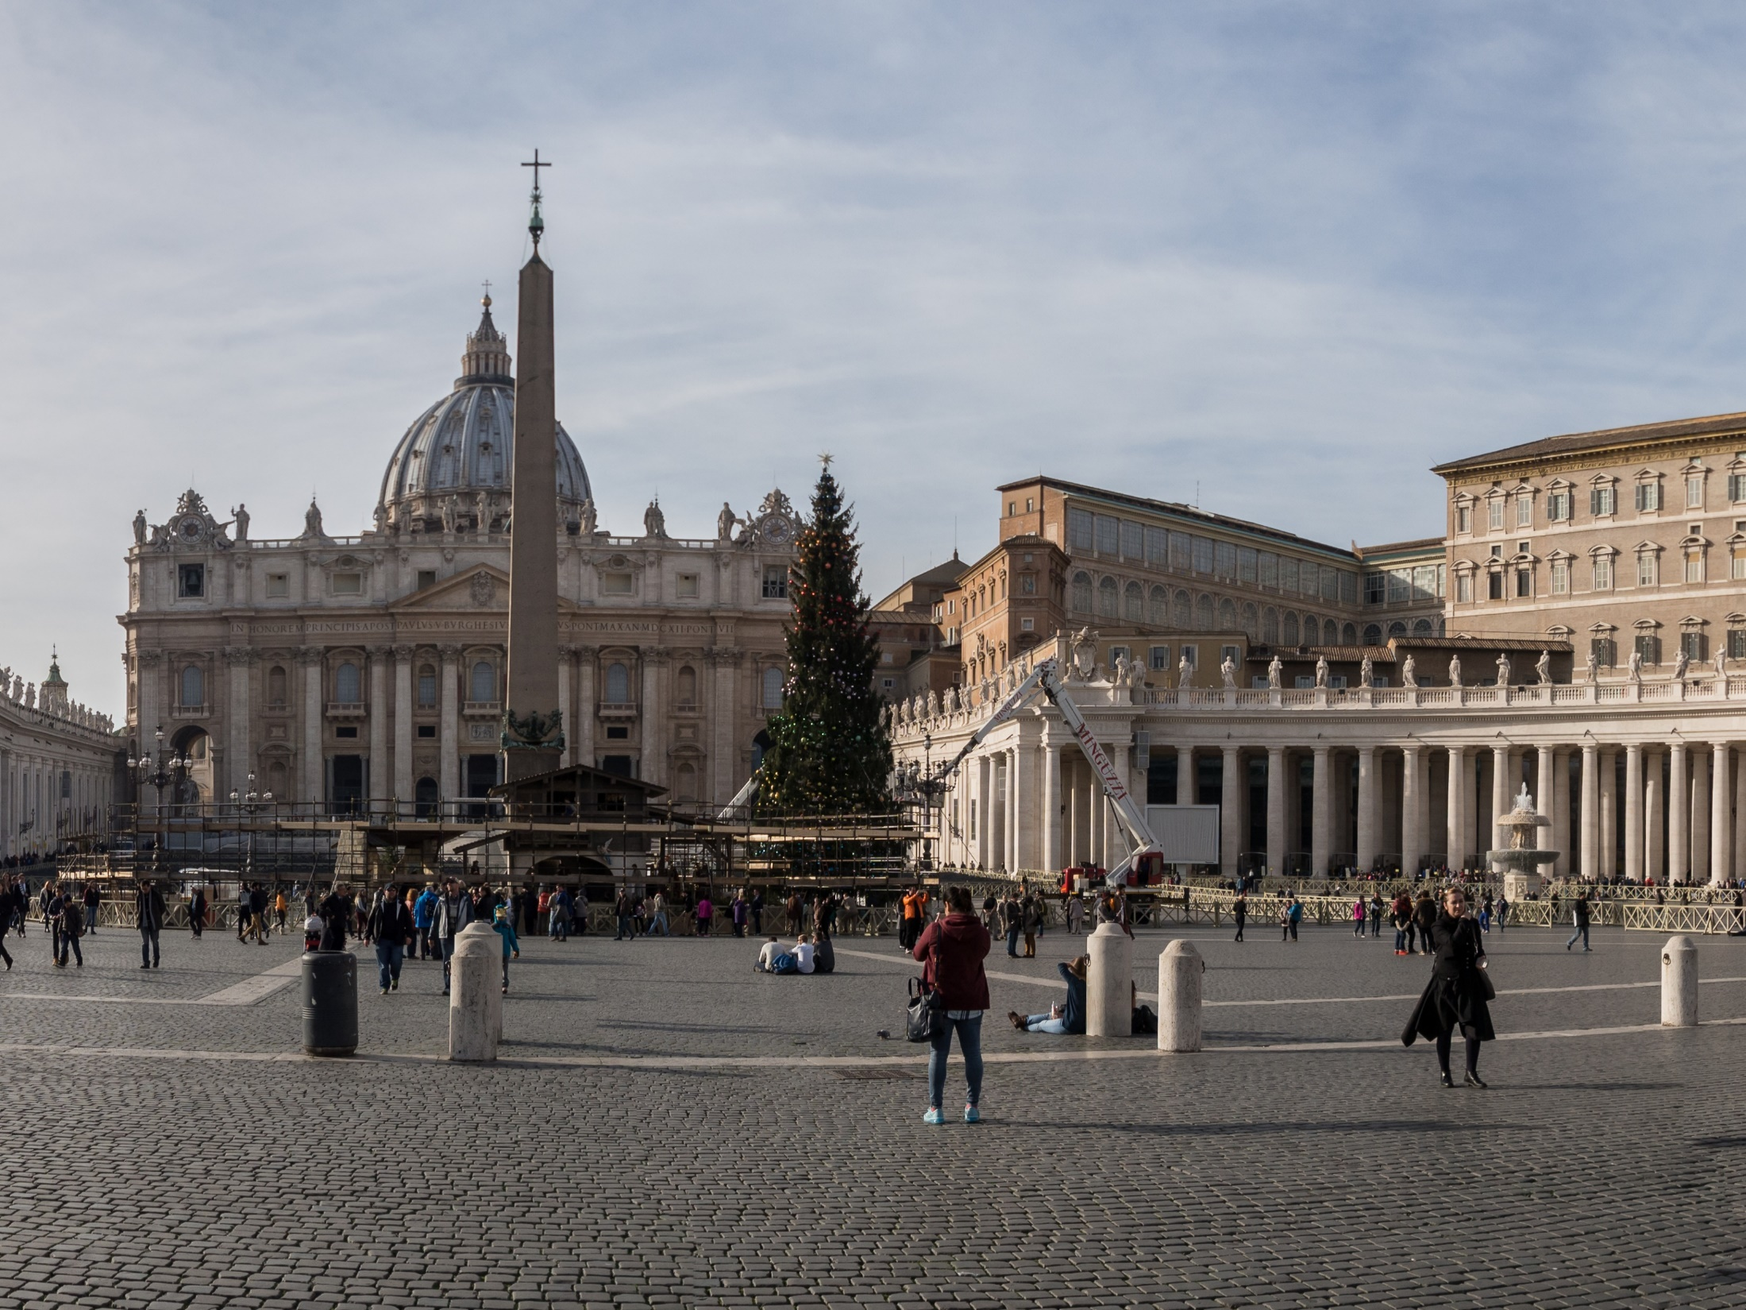

Slide 34
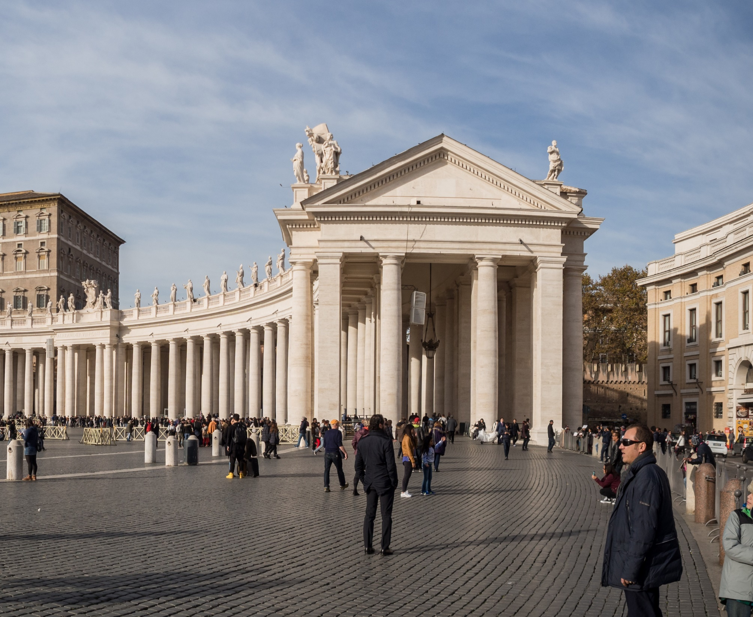
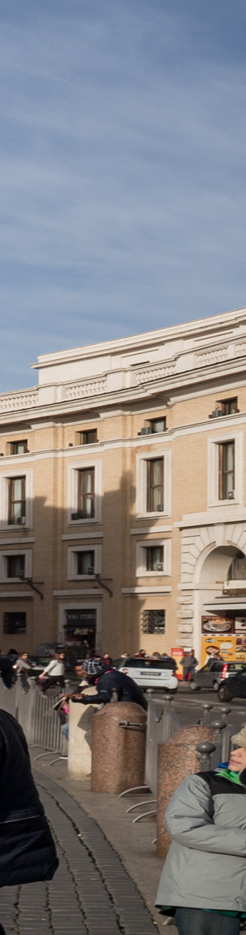
Wealth and Power
of the Catholic Church

Slide 35
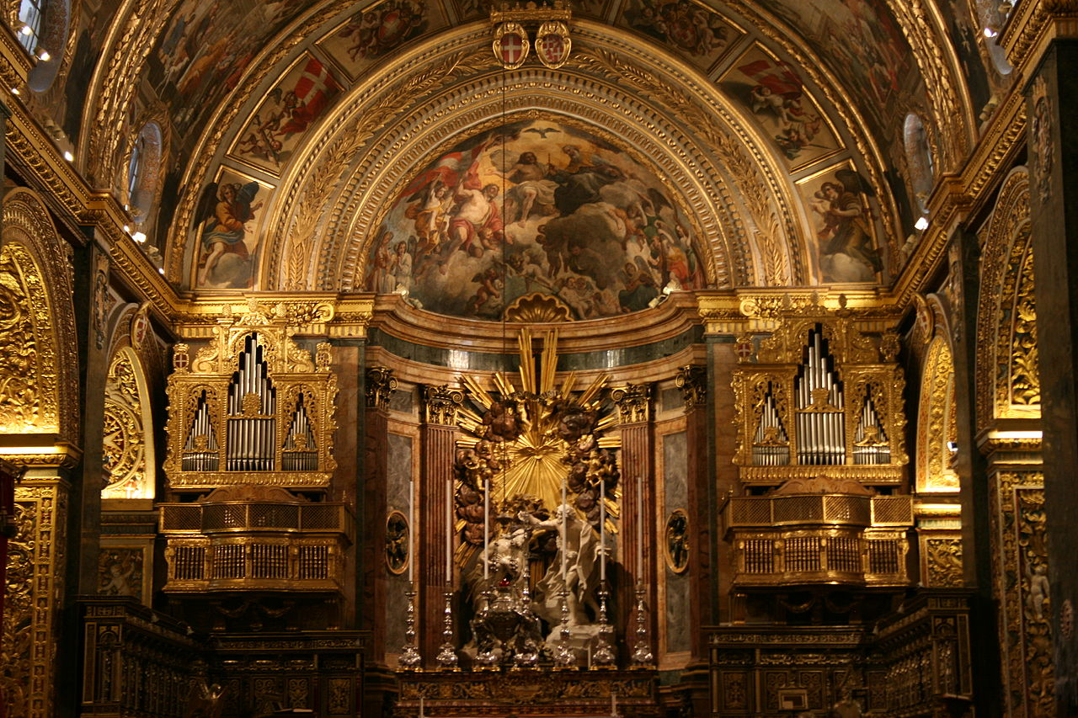
ALL GOLD
EVERYTHING
The High Baroque altar of Saint John's Co-Cathedral
Photo by A,Ocram

Slide 36
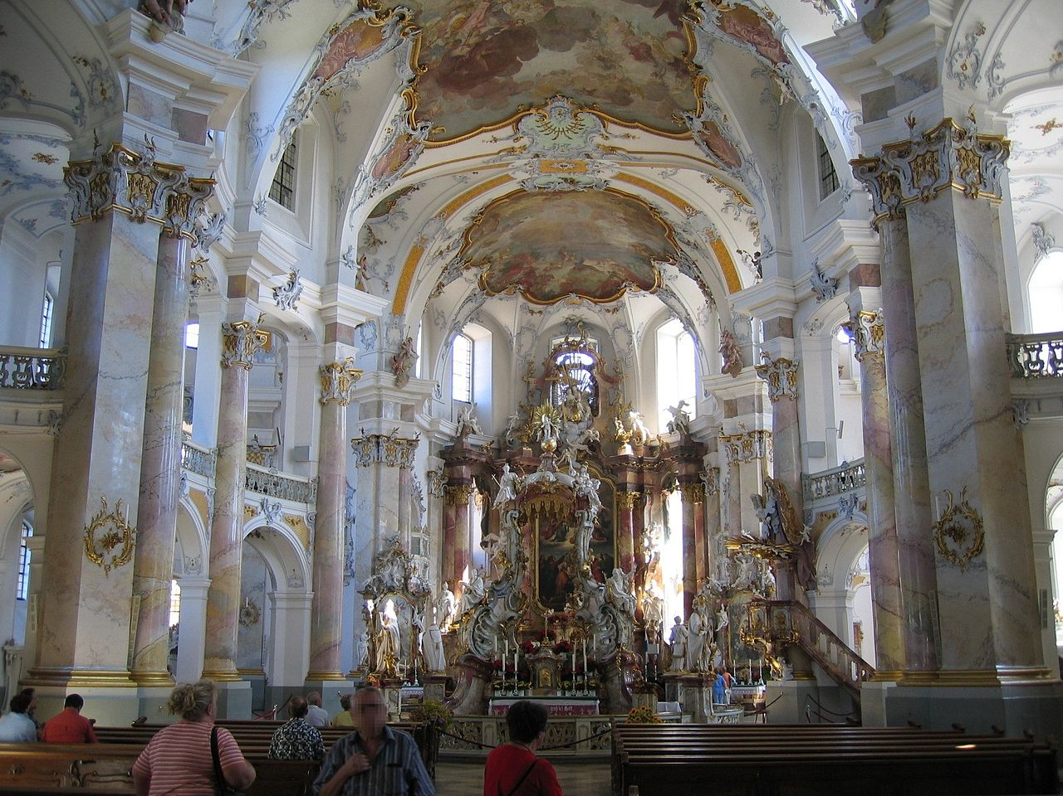
Interior of Vierzehnheiligen church in Bavaria
Photo by Asio otus

Slide 37
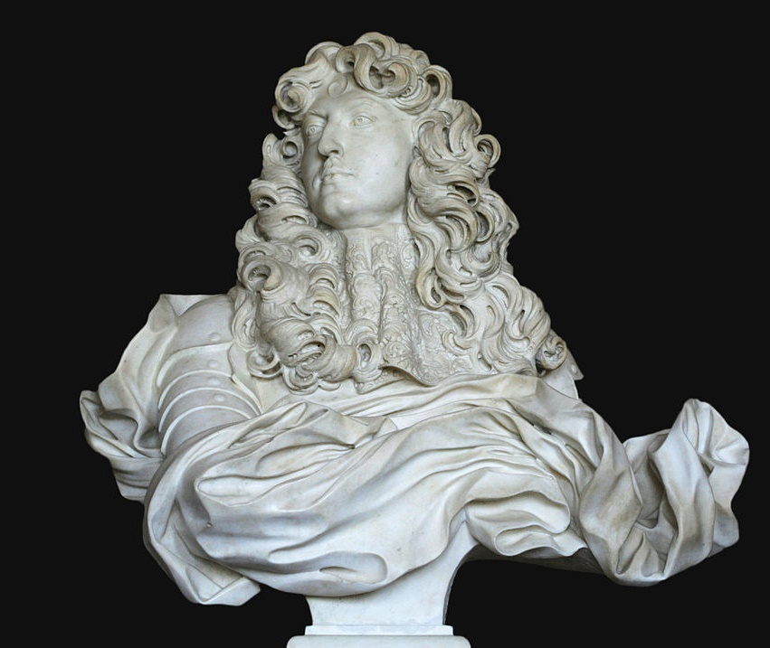
APPROPRIATED
BY THE ABSOLUTISTS
The grandeur of the Baroque style suited the purposes of absolute monarchs.
Bust of Louis XIV by Bernini
Photo by Coyau

Slide 38
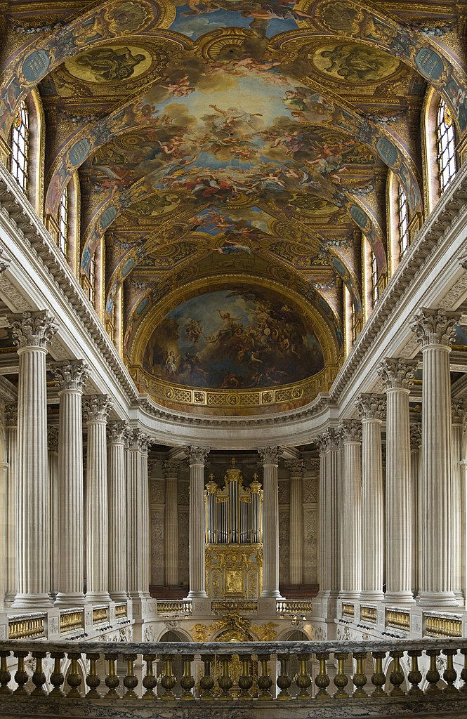
The Chapel at Versailles
The French Court adapted the Baroque style to project an unprecedented sense of grandeur.
Photo by Diliff

Slide 39
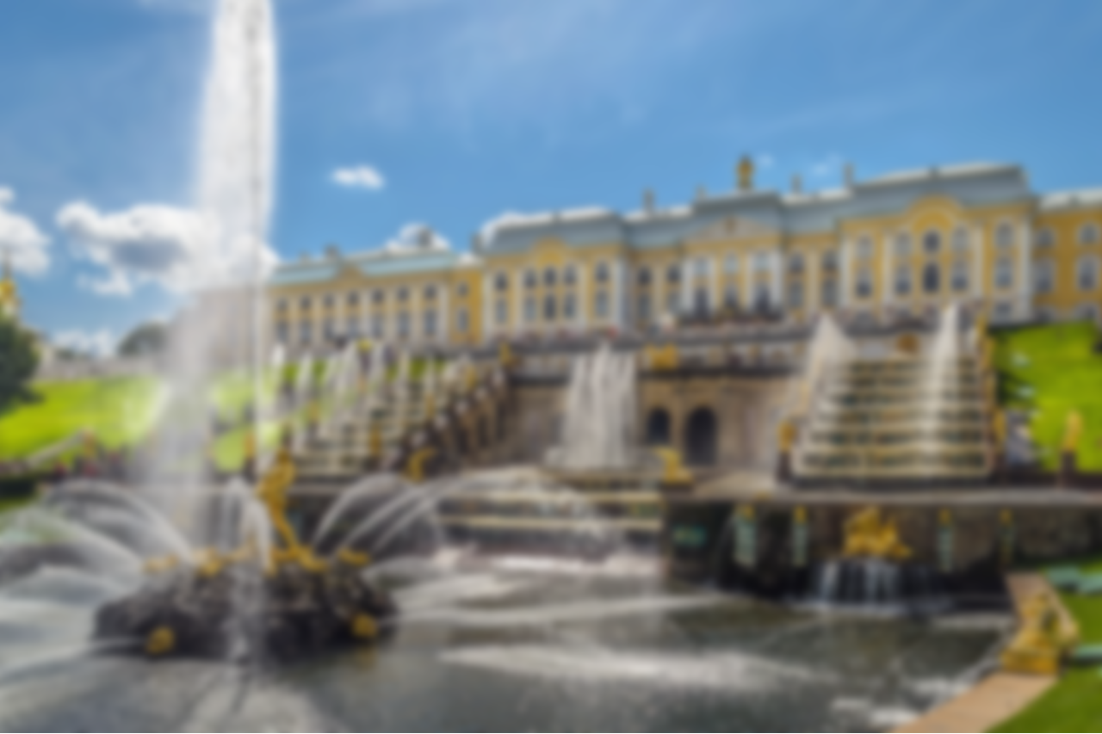
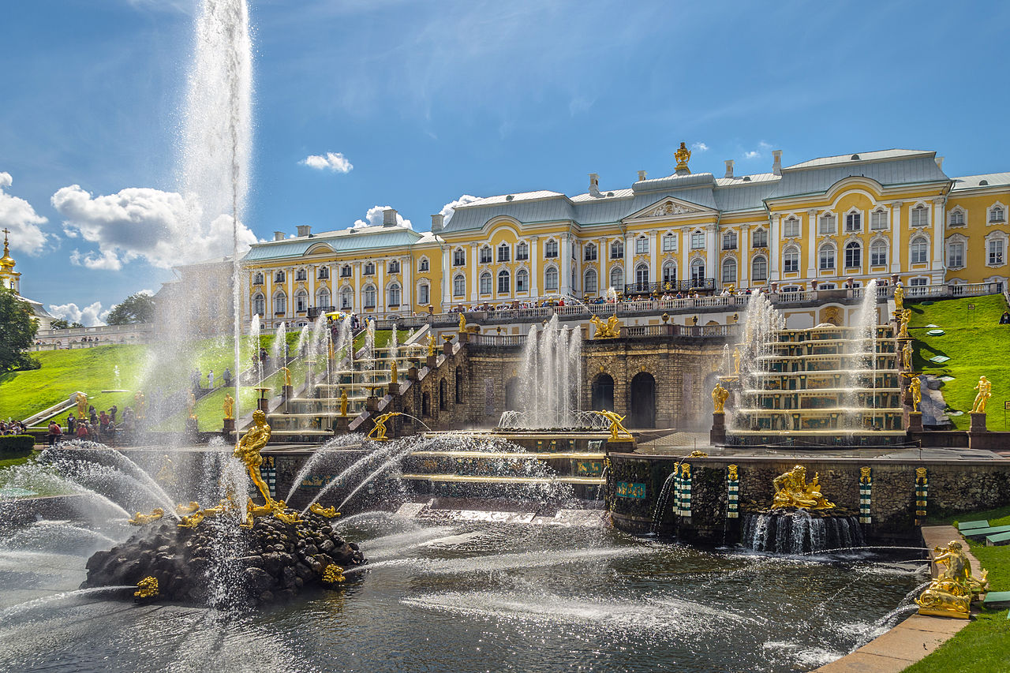
Grand Cascade of Peterhof
Photo by Florstein

Slide 40
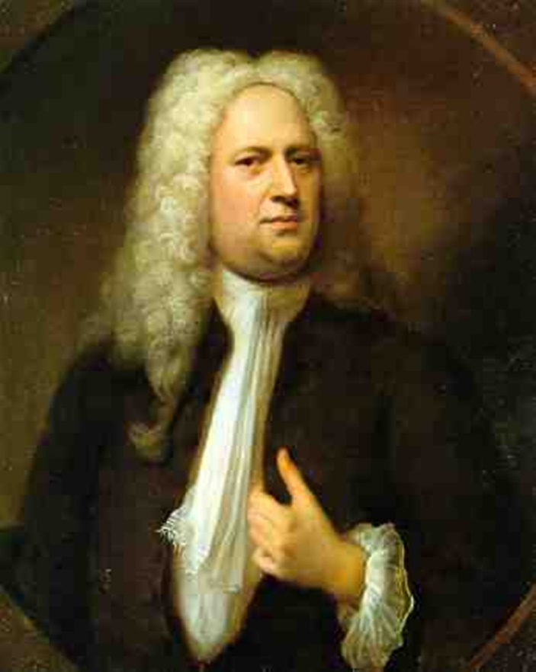
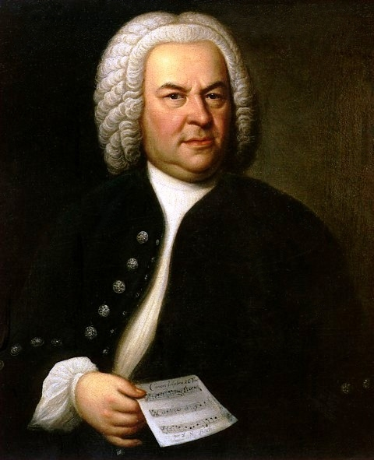
Baroque Music
Handel
Bach

Slide 41
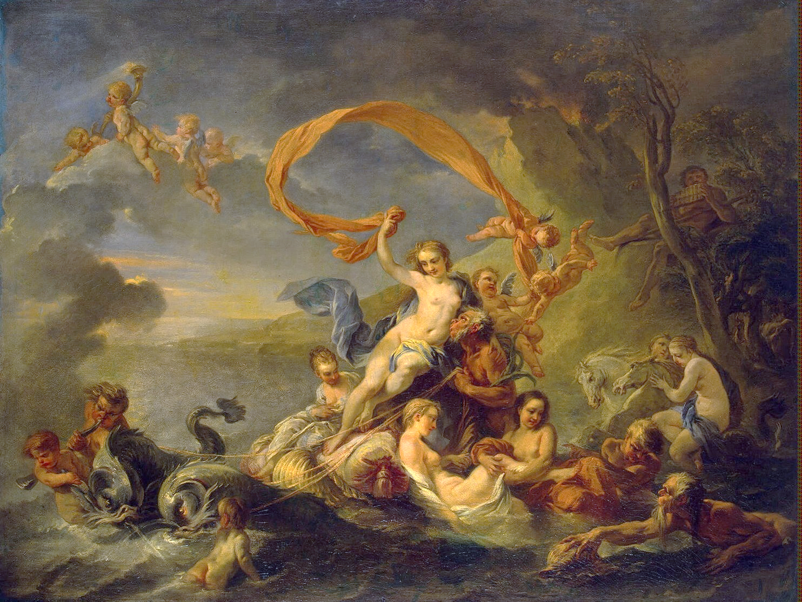
Rococo
“Late Baroque”
Jean-Baptiste van Loo, The Triumph of Galatea (1720)

Slide 42
Rococo art pushed the Baroque to new limits of rejecting symmetry and restraint.

Slide 43
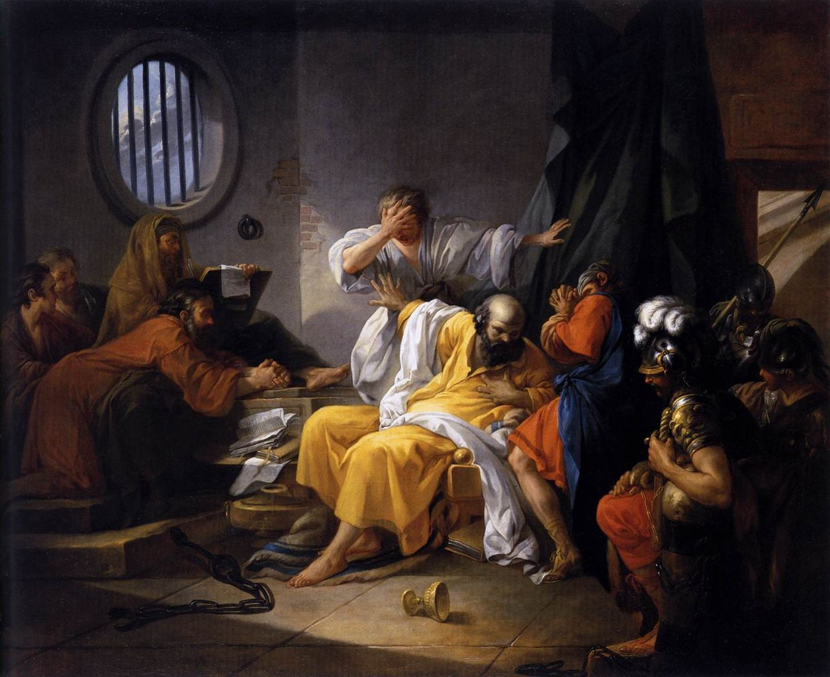
Jacques-Philippe-Joseph de Saint-Quentin,
The Death of Socrates (1762)

Slide 44
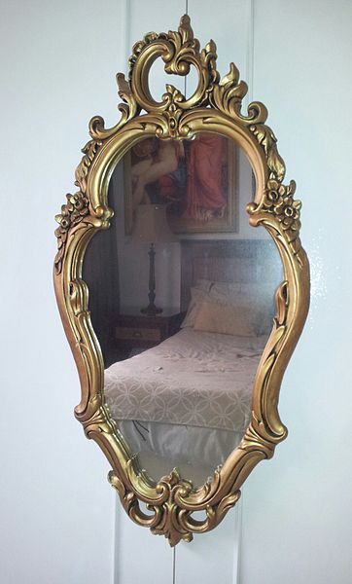
Rococo Mirror
Note the Asymmetrical Design
Photo by Aleph500Adam

Slide 45
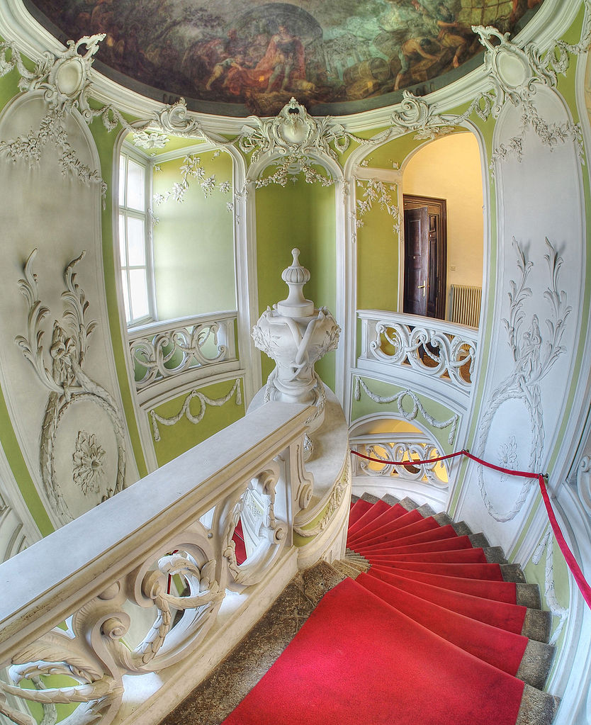
STAIRCASE
Photo by Petar Milošević

Slide 46
REVIEW
Baroque artists rejected Renaissance conventions to create art that projected a greater sense of grandeur, motion, and emotion.

Slide 47
REVIEW
Both the Catholic Church and absolute monarchs used Baroque art and architecture to suit their own purposes.

Slide 48
REVIEW
Rococo art pushed the Baroque to new limits of rejecting symmetry and restraint.

Slide 49
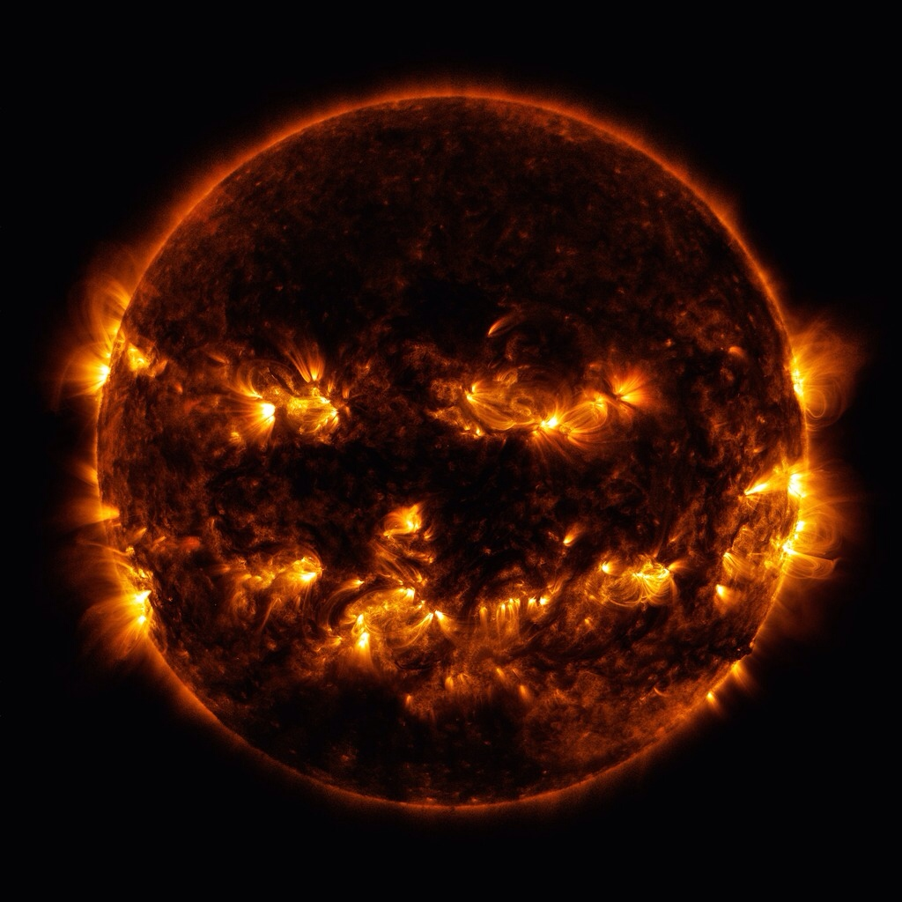
Renaissance humanism and art laid the groundwork for new ideas in science to emerge in the 16th and 17th C.
A Scientific Revolution
Photo Credit: NASA

Slide 50
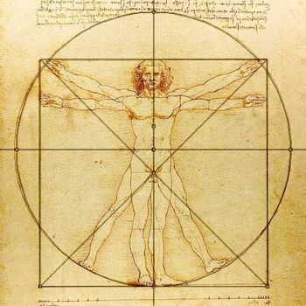
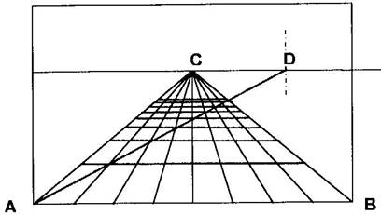
Observation-Based Science
Reading a broader range of classical texts, provided a source of ideas that challenged the existing worldview.
Artists’ close observations of the natural world and use of math to develop techniques, such as perspective, established new way to learn about the world.
Later thinkers expanded use of experimentation that Da Vinci and others developed in late 15th C.
These new methods for studying the natural world were the core of the Scientific Revolution

Slide 51
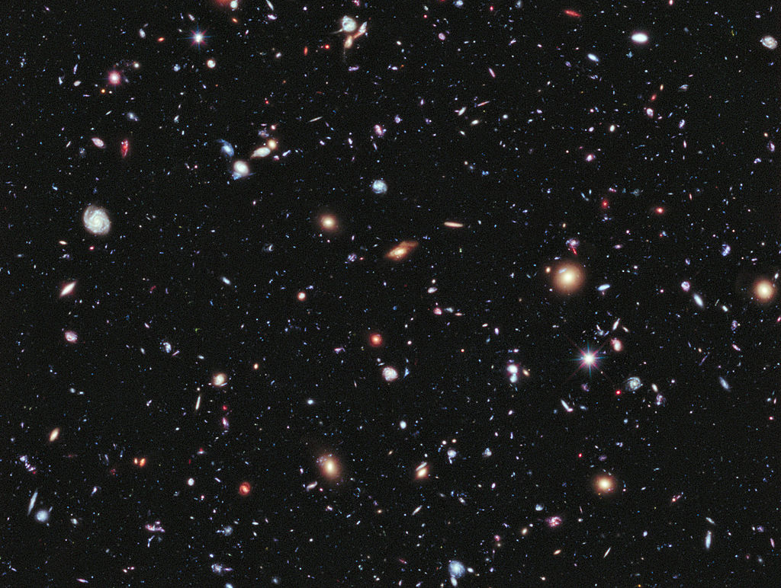
Astronomy
-Comes from Ancient Greek meaning “arrangement of the stars”
-General term for the study of the universe beyond the earth

Slide 52
COSMOLOGY
-Branch of Astronomy concerned with the origins and structure of the universe

Slide 53


Medieval Worldview
Ptolemy (2nd c. AD)
Greco-Egyptian mathematician & astronomer
Aristotle (4th c. BC)
Greek philosopher and scientist – authority on Physics
Classical cosmology went unchallenged for 1400 years
This formed basis of medieval scholastic philosophers.
Portrayed a geocentric universe—one with earth at the center of a system of concentric spheres, including the sun, circling around it.
Planets were bodies of light.
Christian beliefs taught that God and the souls of those who had been saved existed beyond the outermost sphere of the system

Slide 54

Geocentrism
The belief that the earth is at the center of the Universe
Photo by NASA

Slide 55

SOURCE

Slide 56
SCIENTIFIC REVOLUTION
Fresh Inquiries into
Natural Philosophy

Slide 57


Nicolaus Copernicus (1473-1543)
Among the first Europeans to challenge the classical view.
Polish mathematician and natural philosopher—a scholar who studied the physical world.
Found references to ancient Greeks who questioned the geocentric views of Aristotle and Ptolemy.
Believed in a heliocentric, or sun-centered universe.
Using advanced mathematics, he proved that the perceived motion of the sun came from the earth’s spinning on its axis and its annual orbit around the sun.
On the Revolution of the Heavenly Spheres (published right before his death)

Slide 58

Heliocentrism
The earth revolves around the sun.
Photo by NASA

Slide 59

Johannes Kepler (1571-1630)
Assistant to Danish astronomer Tycho Brahe
German astronomer built on Copernicus’s work
Analyzed precise measurements of planetary orbits and found them to be elliptical rather than circular
By demonstrating these orbits Kepler further supported Copernicus’s heliocentric model and disputed the religious belief that the circle was the “perfect shape” and reflected the Divine order
Kepler shares his published work with Italian mathematician Galileo Galilei in 1597

Slide 60

Elliptical Orbits
Art Credit: Hankwang

Slide 61

Galileo Galilei
Italian Astronomer and Physicist
Photo by JoJan

Slide 62


The Starry Messenger
First European to build and use a telescope for the purpose of observing planets.
Discovered details never known such as the moons that circled Jupiter, and craters on the moon.
He showed that planets were not ethereal bodies but similar to Earth in their composition.
Published in 1610, this reaffirmed the heliocentric system and wide attention to these new ideas.

Slide 63

Refracting Telescope
Galileo’s improved telescope allowed him to see things in space that others had not been able to see.
Art Credit: Tamasflex

Slide 64

Lunar Mountains and Craters
The moon’s surface was not smooth as was traditionally believed.
Photo by Brian

Slide 65

Galilean Moons
Galileo discovered four moons orbiting Jupiter, proving that objects orbited planets other than earth.

Slide 66

The Phases of Venus

Slide 67
Technology
DRIVING SCIENCE
Art Credit: Tamasflex

Slide 68



The Center of the Universe?
Ptolemy (Roman) Egypt
Copernicus 16th c. Poland
Galileo 17th c. Italy
GEOcentric
Theory
HELIOcentric Theory
CONFIRMED
Heliocentric Theory

Slide 69

Empiricism
Francis Bacon

Slide 70
FACT
Not Theory

Slide 71

The Bible
(clashes with scholasticism teaching)
John Martin, Joshua Commanding the Sun to Stand Still (1816)

Slide 72

Galileo vs. the Inquisition

Slide 73


Photo by MatthiasKabel

Slide 74
Science vs. the Church?
Galileo recanted under pressure from the Church and remained under house arrest in his later years.

Slide 75

Tomb of Galileo
Florence, Italy
Photo by stanthejeep at en.wikipedia

Slide 76

Very Obviously Catholic
Photo by stanthejeep at en.wikipedia

Slide 77

Science vs. Religion?
“A little philosophy inclineth man’s mind to atheism; but depth in philosophy bringeth men’s minds about to religion."
-- Sir Francis Bacon

Slide 78

A New Worldview
The Church’s condemnation of Galileo diminished the growth of science in Italy.
As Galileo dies in 1642, the English mathematician, Isaac Newton is born the same year and will bring together the ideas of Copernicus, Kepler and Galileo.
Newton is credited with discovery of the universal law of gravitation, and published his proofs for this law in Principia (1687).
Demonstrated that gravity applied to objects on earth and in space and was the force that held the planets in orbit around the sun.
Isaac Newton

Slide 79

Isaac Newton
Newton saw the universe as a giant machine with God as the prime mover who set the planets in motion.
Newton’s ideas were accepted rather quickly in England, but took a century before they were generally accepted on the European continent, due to skepticism.
Many in science community felt it sounded too much like mysticism (invisible force of gravity).
Such rapid change from 1,400 years of beliefs shook foundation of knowledge.

Slide 80

Anatomy and Physiology
Medicine of medieval times was dominated from ideas from ancient Greece.
Greek physician Galen (2nd c. BC) dominates field of anatomy and physiology.
Anatomy – structure of the bodies of humans, animals, and plants.
Physiology – refers to how those systems function

Slide 81


Galen’s Theories
Galen dissected animals rather than humans so his ideas of human anatomy were often incorrect.
Thought there were two different systems of blood flowing through the arteries and veins.
Humoral Theory – body composed of four humors, blood, yellow bile, phlegm, and black bile.
According to Galen disease was caused by an imbalance of the humors.

Slide 82

Challenges to Galen’s Ideas
Three physicians most notable in challenging Galen’s theories.
Paracelsus used observation and experiments to develop a theory based on chemical imbalances in organs rather than humoral, that could be treated with chemicals.
Andreas Vesalius publishes On the Structure of the Human Body (1543), 200 drawings of human anatomy disproving Galen’s anatomy.
William Harvey corrected Galen’s ideas on the circulatory system with his On the Movement of the Heart and Blood, 1628.
Demonstrated that the heart was the starting point of a single system of blood that completes circuit through the body’s arteries and veins.

Slide 83


Methods of Science
Francis Bacon
Renee Descartes
Inductive Reasoning (empiricism) – moves from the specific to the general.
Scholars should combine careful observation and systematic experimentation to collect small bits of information.
Use the information to support valid general conclusions. Find truth at the end.
In 1660 followers of Bacon created the Royal Society
Deductive Reasoning – moves from the general to the specific
“I think, therefore I am.” Essential truth.
Start with general principles (geometric axioms) and then apply them using strict logic to understand particular cases.
Though both reasoning’s had flaws, Newton was able to combine both and create Natural laws, or general principles about the way the world worked.

Slide 84
Before and After
Science Before and After the Renaissance
 | Medieval Science | Post-Renaissance Science
Goal | To demonstrated the truth of traditional Christian beliefs | To understand the natural world
Background of Natural Philosophers | Most were clergy members | Most were secular
Classical Sources | Relied on Aristotle, Ptolemy and Galen | Drew on a broad range of classical sources
Methods | Relied primarily on logical analysis | Combined observation and experiments with logic and mathematical calculations
Relationship with Religious Authorities | The Catholic Church judged the validity of scientific ideas | Science and religion were separate paths of inquiry

Slide 85

Persistent Traditional Views
All this new reasoning and inquiry based knowledge did not generally clash with more traditional ideas about how people learned.
Europeans continued to believe that spiritual forces governed the cosmos.
Most scientists believed in God and accepted a role for religion.
Not until 19th C., did people disagree over boundary between science and religion

Slide 86


Alchemy and Astrology
Alchemy – medieval and Renaissance approach to chemistry focused on discovering a method to turn common metals into gold.
Astrology – during Renaissance came to mean the study of the heavenly bodies as they influenced human activity.
Elites and natural philosophers were intrigued by both.
Kepler studied astrology and was interested in the ideas of a sacred geometry in the universe.
Newton wrote extensively about his alchemy experimentations.
These views persisted because they supported the idea that humans could understand the universe and make predictions about it.

