Slide 1
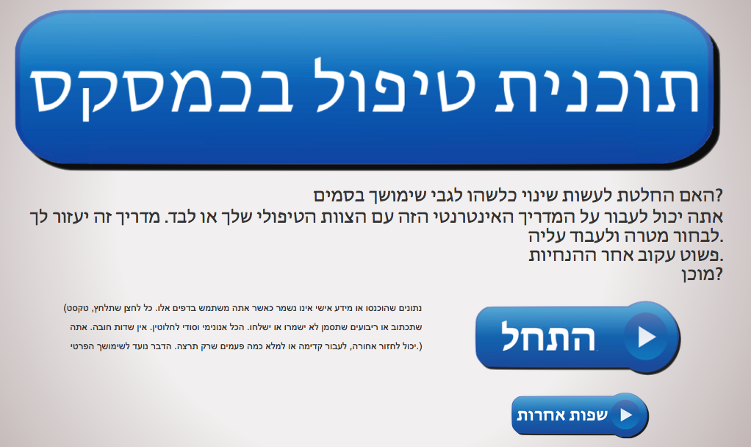
Making changes; a Care Plan
www.davidstuart.org/care-plan
Notes:
The first page of the site welcomes you. This Care Plan is also in 18 other languagres

Slide 2
Choose a goal
Notes:
This pag helps the person to identify a goal to work towards...
Let’s assume the person chooses Abstinence

Slide 3
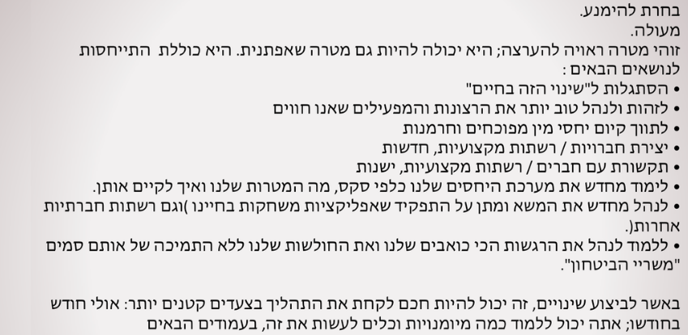
Support with abstinence
Notes:
The “Abstinence” page explores what a big commitment it is, requiring big life changes and learning some skills. It also suggests it might be easier to take this project in smaller, goals.

Slide 4
Choose a goal
Notes:
Another option is to learn to “play” more safely; or to learn how to avoid harm, reduce harm. To help keep people safe who do not plan to stop using drugs, but want to be safer.

Slide 5
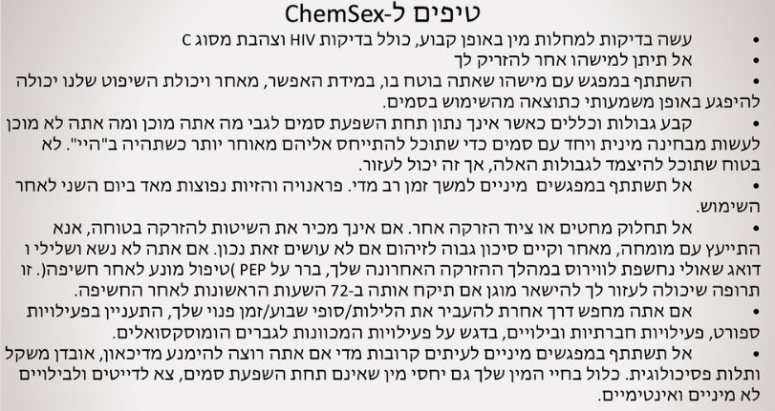
Play more safely
Safer ChemSex
Crystal meth
GHB/GBL
Mephedrone
Sexual wellbeing
Safer injecting
Safer sex
Safer App use
Notes:
This page has some tips to help reduce harm

Slide 6
Choose a goal
Notes:
Many people are unsure of what they want to do about their use. They are ambivalent, or exploring their feelings.

Slide 7
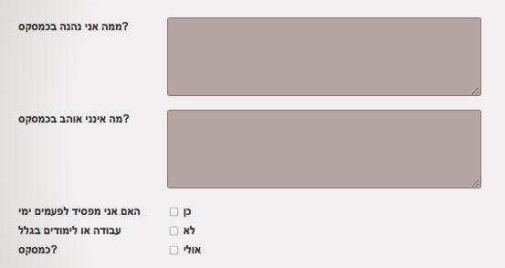
Reflecting on drug use/behaviour
Notes:
The questions on this page help a person to reflect upon the consequences of their chemsex. Reflective questions, decisional balances, pros and cons, help a person to consider their choices more objectively.

Slide 8
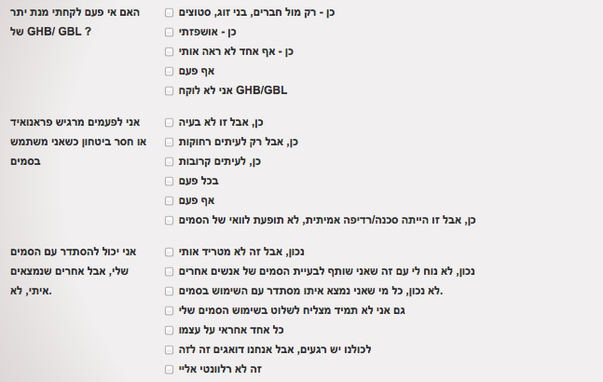
Reflecting on drug use/behaviour
Notes:
The questions on this page help a person to reflect upon the consequences of their chemsex. Reflective questions, decisional balances, pros and cons, help a person to consider their choices more objectively.

Slide 9
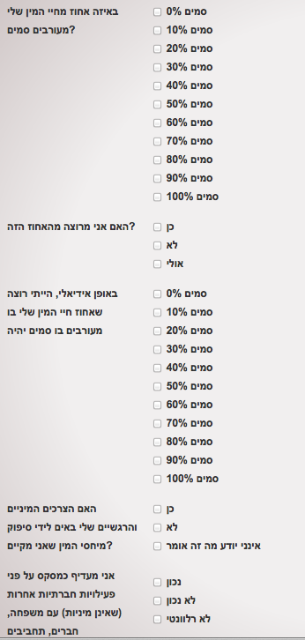
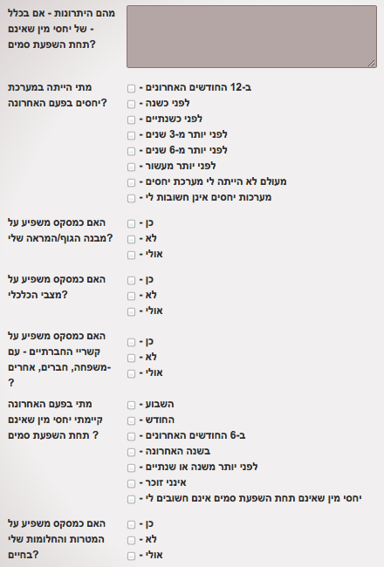
Notes:
The questions on this page help a person to reflect upon the consequences of their chemsex. Reflective questions, decisional balances, pros and cons, help a person to consider their choices more objectively.

Slide 10
Reflecting on drug use/behaviour
Notes:
The questions on this page help a person to reflect upon the consequences of their chemsex. Reflective questions, decisional balances, pros and cons, help a person to consider their choices more objectively.

Slide 11
Choose a goal
Notes:
The most active choice, for a person ready to make changes, is to TAKE A SHORT BREAK from chems, and to learn some skills to help them achieve this.

Slide 12
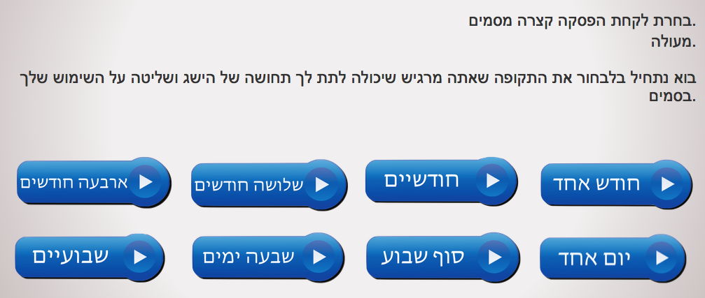
Take a break/identify a goal
Notes:
This page invites a person to choose a goal they’d like to work towards; eg, a 3 month break from chem use.

Slide 13
Rate your own confidence
-decisional balance
Notes:
The next page asks them how CONFIDENT they are to achieve this goal... In this case, let’s assume the person is NOT very confident; 3 out of 10

Slide 14
Not very confident?
Choose a more achievable goal
Notes:
The next page suggests that their confidence might be improved if they chose a SMALLER, more achievable goal; it’s better to return in 7 days a “success”, rather than return in 3 months a “failure”.

Slide 15
Now rate confidence level again
Notes:
Now that a smaller, more achievable goal has been chosen, it is more likely the person will feel much more confident and emboldened to achieve the goal.

Slide 16
How important is it to you?
Notes:
The next page asks the person how IMPORTANT it is to them, to achieve this goal; in this case, let’s assume it’s not important to the person...

Slide 17
Not very important?
Come back another time
Notes:
If it is not important to the person, they are advised to try a different page. It is not helpful to PRESCRIBE behaviour change upon a person who does not WANT it.

Slide 18
Rate how important it is to you
(-decisional balance)
But perhaps it IS important......
Notes:
But if they feel it IS important (it is very helpful at this stage, to have that AFFIRMED.)

Slide 19
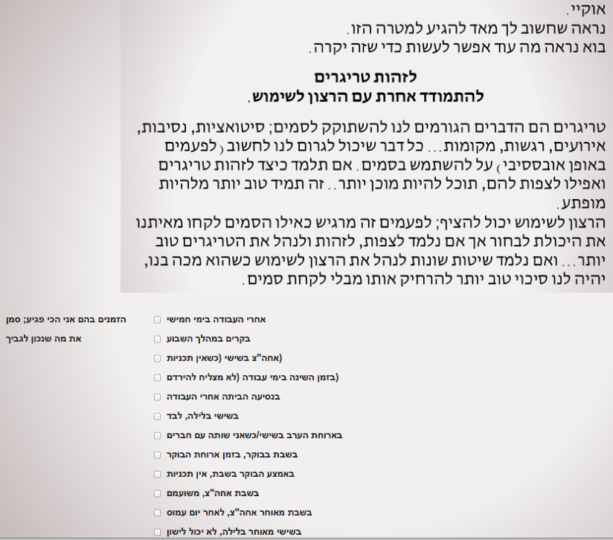
Identify your most vulnerable times
Notes:
Now we begin to learn SKILLS to achieve our goal. The first stage is to identify the times within the next 7 days, that the person feels MOST VULNERABLE to cravings.

Slide 20
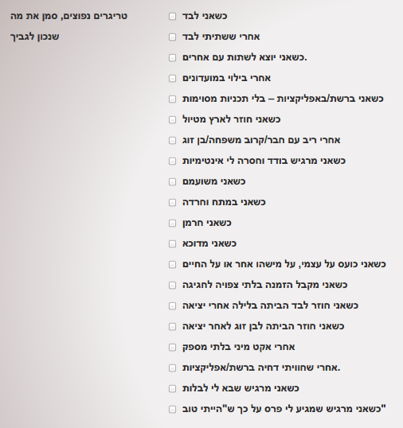
Identifying triggers
Notes:
Once the person knows the most vulnerable times they will experience cravings, they can identify some triggers that are likely to cause cravings...

Slide 21
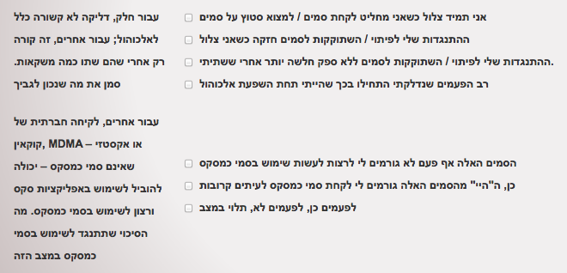
OTHER TRIGGERS;
ALCOHOL? NON-CHEMSEX DRUGS?
Notes:
Sometimes alcohol or other drugs (which are not considered chemsex drugs) can be gateways or triggers to chemsex. These questions can help to identify this.

Slide 22
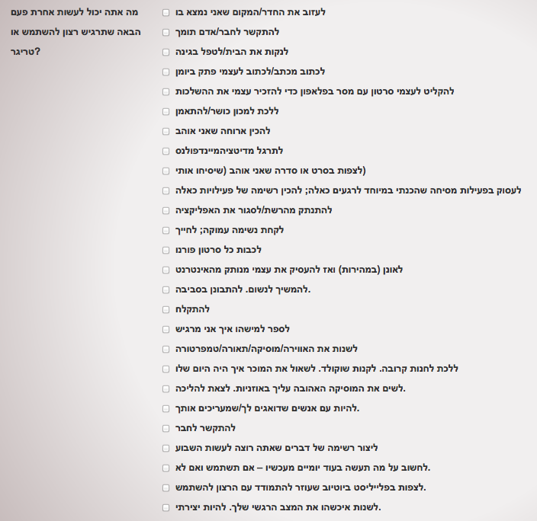
Managing cravings differently
Notes:
Regardless hoe prepared a person is, cravings to use chems WILL HAPPEN; here, the person is encouraged to identify actions they can take, to help cravings go away. So they do not “re-act” to the cravings by using drugs.

Slide 23
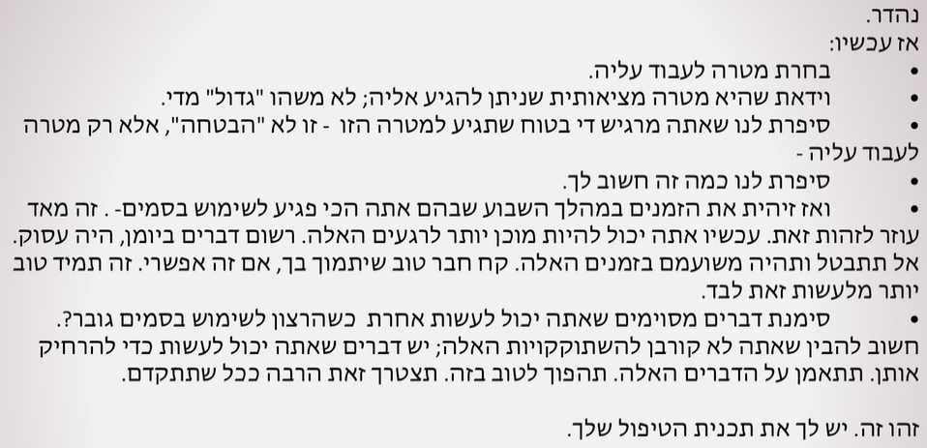
DONE! Online Care Plan created
Notes:
That’s it; in just 15 minutes, a plan for change has been made with the online support. A person can come back again and again, change the goal depending on whether it was success or failure, or too easy or too difficult. The more a person uses it, the more skills they learn to be in control of their choices.

Slide 24
FOR CHEM USERS
www.DavidStuart.org/care-plan
@davidastuart
DS17

Slide 25
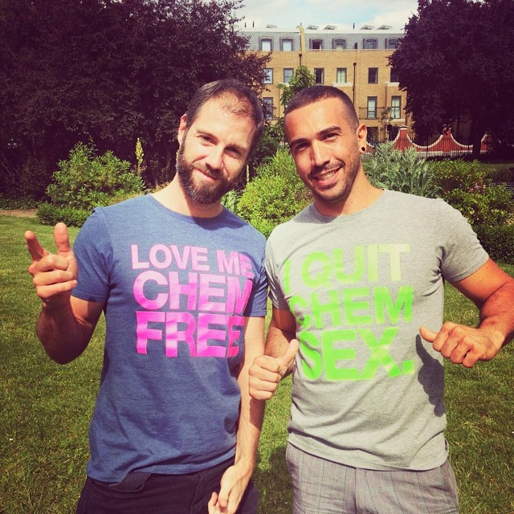
FOR PROFESSIONALS
www.davidstuart.org/professionals
@davidastuart
DS16

Slide 26
OUTCOMES/Successes
Patients are generally invited to a 6 week “Take a break” programme of abstinence.
Adjusted according to degree of success or failure to achieve goals
Goals re-assessed at 6 week completion; invitation to extend programme.
Outcomes monitored at 6 sessions;
Reduced frequency of ChemSex episodes
Confidence in negotiating sexual health risks
Confidence in negotiating injecting risks
Sense of control over drug use
Experienced less sexually transmitted infections
Confidence to introduce chem-free (sober) sex into their lives.
Improvement in non-sexual/non-clubbing social life
Cessation of ChemSex
Ceased injecting use only
Referrals to structured therapy/keywork/support groups

Slide 27
OUTCOMES/Successes
The most successful interventions included;
Motivational Interviewing techniques
The repeated achievement of short term goals (most often, “taking a short break from chems”)
Lightweight discussions focused on;
gay life
gay sex
Grindr
gay scene pressures and expectations
sex, desire, relationships & intimacy
HIV stigma
pursuing sex a little differently.
Encouraged to repeat-attend on drop-in basis for an ongoing dialogue about their sexual wellbeing/Chem-use

