Slide 1
RECOVERY EDITION
Notes:
Family Feud Template
Introduction Slide – Family Feud!

Slide 2
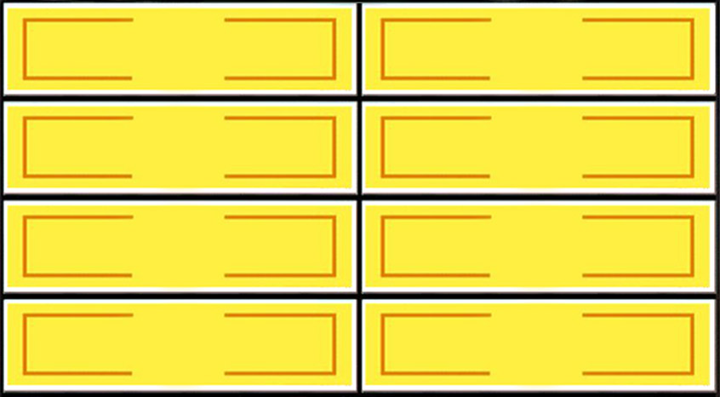
Besides drugs and alcohol, name something that people get addicted to:
Round 1
X
X
X
X
X
X
X
X
X
RECOVERY EDITION
Love
50
Gambling
25
Coffee
15
Food
10
X
X
X
Win
Lose
Cheer
Boo
Silence
Notes:
Family Feud Template
4 Panel Slide

Slide 3
Things that people do to distract from triggers to use:
Round 2
X
X
X
X
X
X
X
X
X
RECOVERY EDITION
Read a Book
35
Listen to Music
30
Go for a Walk
20
Play a Game
15
X
X
X
Win
Lose
Cheer
Boo
Silence
Notes:
Family Feud Template
4 Panel Slide

Slide 4
Things that will lead to relapse:
Round 3
X
X
X
X
X
X
X
X
X
RECOVERY EDITION
People
40
Places
30
Media
20
Skipping Meetings
10
X
X
X
Win
Lose
Cheer
Boo
Silence
Notes:
Family Feud Template
4 Panel Slide

Slide 5
Coping skills to use when you have a craving:
Round 4
X
X
X
X
X
X
X
X
X
RECOVERY EDITION
Meditation
50
Journaling
25
Pick up the Phone
15
Exercise
10
X
X
X
Win
Lose
Cheer
Boo
Silence
Notes:
Family Feud Template
4 Panel Slide

Slide 6
Whats the best part of IOP?
Round 5
X
X
X
X
X
X
X
X
X
RECOVERY EDITION
Learning
50
Check In
25
Jokes
15
Interns
10
X
X
X
Win
Lose
Cheer
Boo
Silence
Notes:
Family Feud Template
4 Panel Slide

Slide 7
Places a relapse could lead you to:
Round 6
X
X
X
X
X
X
X
X
X
RECOVERY EDITION
Jail
50
Hospital
25
Court
15
IDRC
10
X
X
X
Win
Lose
Cheer
Boo
Silence
Notes:
Family Feud Template
4 Panel Slide

Slide 8
Things that recovery leads you to:
Round 7
X
X
X
X
X
X
X
X
X
RECOVERY EDITION
Happiness
50
Good Job
25
Being with Family
15
More money
10
X
X
X
Win
Lose
Cheer
Boo
Silence
Notes:
Family Feud Template
4 Panel Slide

