Slide 1
Build on a Strong Foundation Matthew 7:24 - 27 Friday, February 5, 2021 @ 11 a.m. Church Women United of Columbia, South Carolina Rev. Angela Ford Nelson, Facilitator www.angelafordnelson.com
Build on a Strong Foundation

Slide 2
Welcome to Church Women United’s Annual Bible Study
Congratulations! You made it!
You carved out time in your busy schedule to SHOW UP at this sacred space and in this sacred time:
John 15:1 – 17 – The Vine
To Reconnect with the Vinedresser & the Vine
To Recommit to the Process of Bearing Much Fruit
Being Lifted
Being Pruned
Being Still – Abiding
To Relaunch into the Deep

Slide 4
Welcome to Church Women United’s Annual Bible Study
Our Bible Study Text: Matthew 7:24 – 27
The Evangelist Matthew was inspired by the Holy Spirit to write a LOVE LETTER
1ST Century Church
Persecuted by the Jews | Religious Leaders
Remember WHO YOU ARE – The Seed of Abraham
Matthew 1:1 - 17
The Blessing of Abraham are your INHERITANCE AS WELL
Remember WHOSE YOU ARE – Children of God
The Blessing of God in Jesus Christ are YOURS!
Jesus is the Messiah you’ve been waiting on! HE’S THE ONE!
Matthew 1:18 -25
YOUR FOUNDATION IS STRONG!

Slide 6
Welcome to Church Women United’s Annual Bible Study
Our Bible Study Text: Matthew 7:24 – 27
After Jesus’s baptism by John the Baptist – Matthew 3:13 - 17
After His time of temptation in the Wilderness – Matthew 4:1 - 11
His PUBLIC MINISTRY BEGAN – Matthew 4:12 - 17
Calling of the 1st 4 Disciples – Matthew 4:18 - 22
Simon-Peter, Andrew, James and John
“Immediately they left their nets, boats and followed HIM

Slide 7
Welcome to Church Women United’s Annual Bible Study
Our Bible Study Text:
Matthew 7:24 – 27
Everywhere Jesus went, there was a crowd:
Believers, Deceivers, and Receivers
Disciples, Religious Leaders, Seekers
Sick, Persecuted, Afflicted

Slide 8
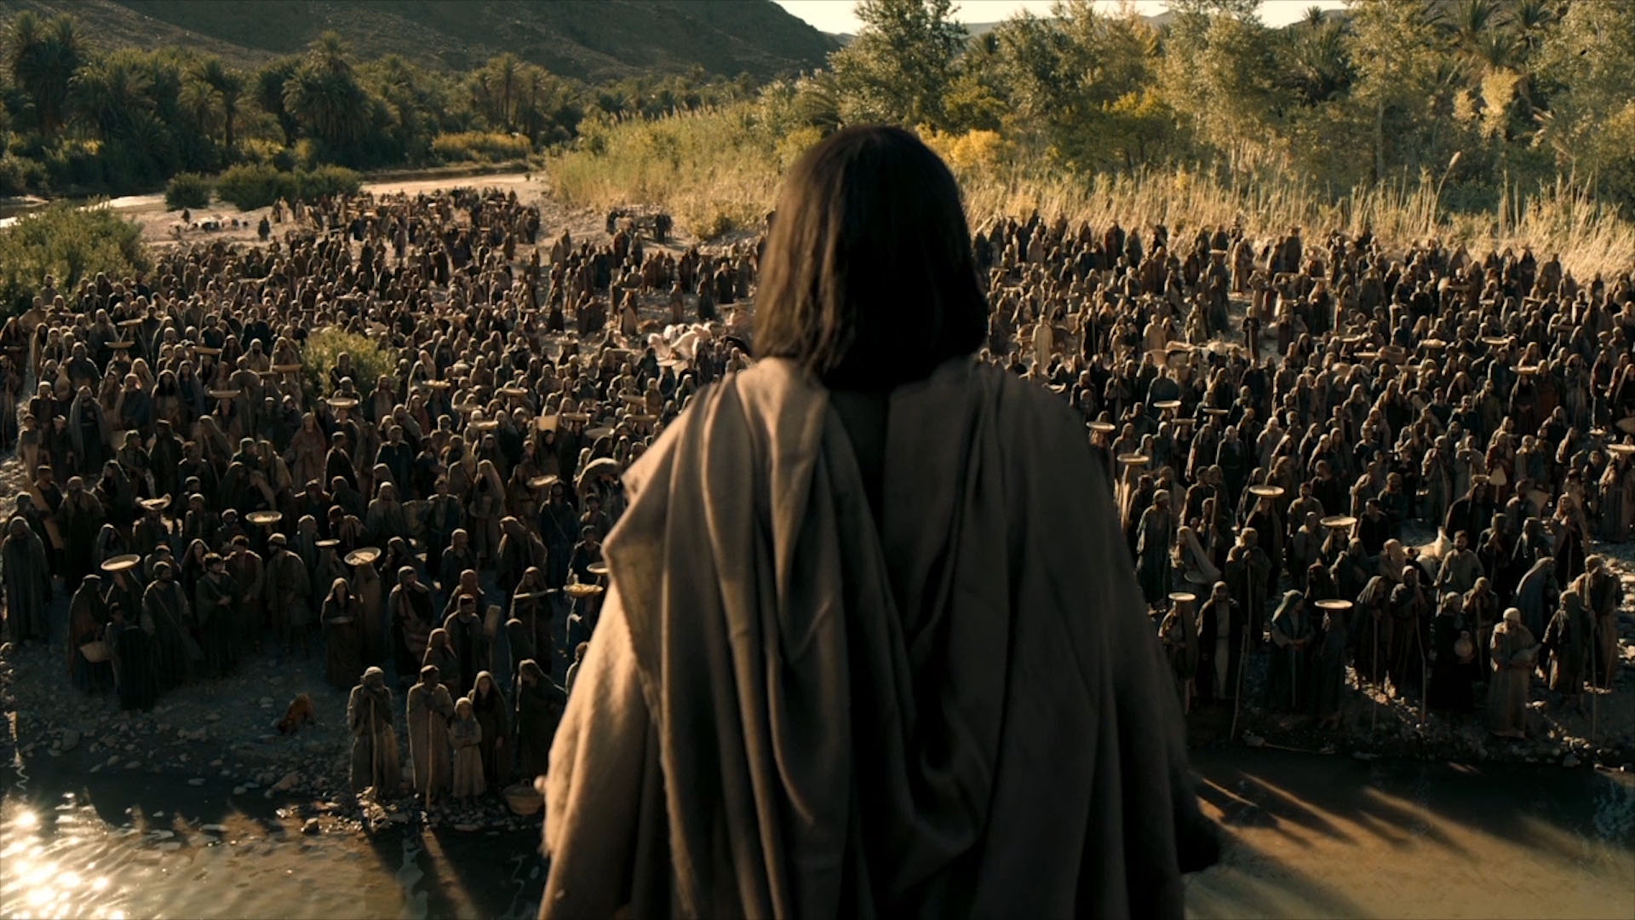
Welcome to Church Women United’s Annual Bible Study
Our Bible Study Text: Matthew 7:24 – 27
Jesus ministered to their physical and spiritual needs
To build a strong foundation of faith
Matthew 5:1 – 7:28
The Sermon on the Mount
Revelation of God’s Will
A Collection of Teaching about
Identity, Lifestyle and Blessings of the WAY!

Slide 9
Welcome to Church Women United’s Annual Bible Study
Our Bible Study Text: Matthew 7:24 – 27
You must know who you are and whose you are to have a strong foundation!
Identity: Matthew 5:1 - 12
The heart of a Christian looks like this:
Poor in spirit, mourning, hungry and thirsty for righteousness, merciful, pure, peacemaker, and yes – persecuted!
Those with hearts like this will be BLESSED!

Slide 10
Welcome to Church Women United’s Annual Bible Study
Our Bible Study Text: Matthew 7:24 – 27
Identity: Matthew 5:13 - 15
Salty
Lit
A city on a hill
Cannot be hidden
“Let your light shine before others so that they may see your good works and give glory to your father in heaven!”
We are SALTY LIGHTS!

Slide 11
Welcome to Church Women United’s Annual Bible Study
Lifestyle: Matthew 5:17 – 7:29
Law and the Prophets
Anger
Adultery
Divorce
Retaliation
The Golden Rule
Love for our enemies
Almsgiving
Prayer
Fasting
Treasures
Worry
Judging
The Golden Rule
Self Deception
BUILDING ON FIRM FOUNDATION!

Slide 12
Welcome to Church Women United’s Annual Bible Study
The Vanautu Women
South Pacific Ocean
Cyclone Prone Area
80 Islands, 65 inhabited
Nation’s Motto:
“In God Do We Stand!”
Know something about the importance of building on Solid Foundation
Pictured:
“Cyclone Pam II: 13th of March 2015
Mother protecting her child, shield by a DEEPLY ROOTED Palm Tree with cross marked graves in the background!

Slide 13
Welcome to Church Women United’s Annual Bible Study
As Jesus Concludes His TEACHING
Identity, Lifestyle, Blessings
Hearers and Doers
Respond to Jesus’ teachings
Build their lives on THE ROCK
Rain falls
Floods come
Winds blow and beat
We don’t fall!

Slide 14
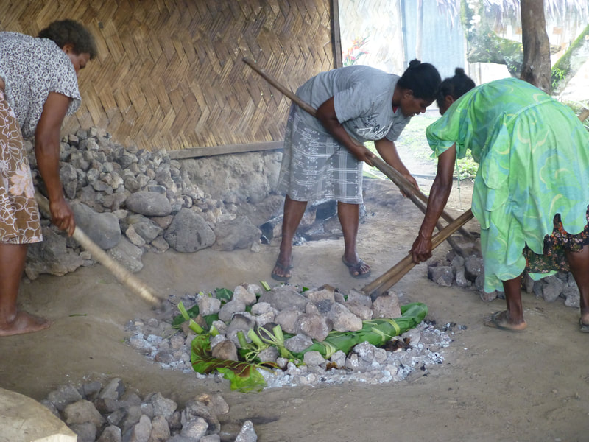
Welcome to Church Women United’s Annual Bible Study
As Jesus Concludes His TEACHING
Identity, Lifestyle, Blessings
Matthew 7:24 - 28
Hearers and Doers
Respond to Jesus’ teachings
Build their lives on
THE ROCK
Rain falls
Floods come
Winds blow and beat
We – THE HOUSE OF GOD – WON’T fall!

Slide 15
Welcome to Church Women United’s Annual Bible Study
As Jesus Concludes His TEACHING
Identity, Lifestyle, Blessings
Hearers and NOT DOERS
RESIST Jesus’ teachings
Build their lives on
THE SAND
Rain falls
Floods come
Winds blow and beat
THEY WILL FALL
GREAT IS THE FALL!

Slide 16
Welcome to Church Women United’s Annual Bible Study
As Jesus Concludes His TEACHING
What is our Response?
Don’t be distracted
Pandemic, pandemonium, political unrest, people, persuasion, broken pieces or the process
Hold to His Hand…Build your life on things eternal!
Seek ye first the Kingdom of God – Matthew 6:33
Do this often:
RECONNECT
RECOMMIT
RELAUNCH

Slide 17
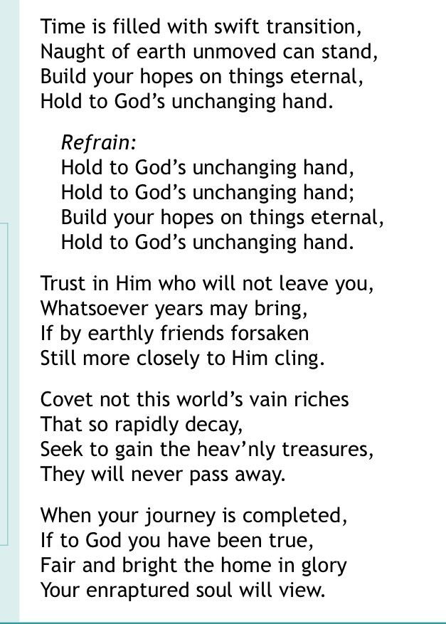
Welcome to Church Women United’s Annual Bible Study

Slide 18
Matthew 7:24 - 27 Friday, February 5, 2021 @ 11 a.m. Church Women United of Columbia, South Carolina Rev. Angela Ford Nelson, Facilitator www.angelafordnelson.com
Build on a Strong Foundation

