Slide 1
Local Flood Representative Meeting
08 October 2015
Notes:
Thanks all for coming.
Great to see so many of you.
Thanks for sending in suggestions for topics.
We hope you will find the afternoon useful.
intro team.

Slide 2
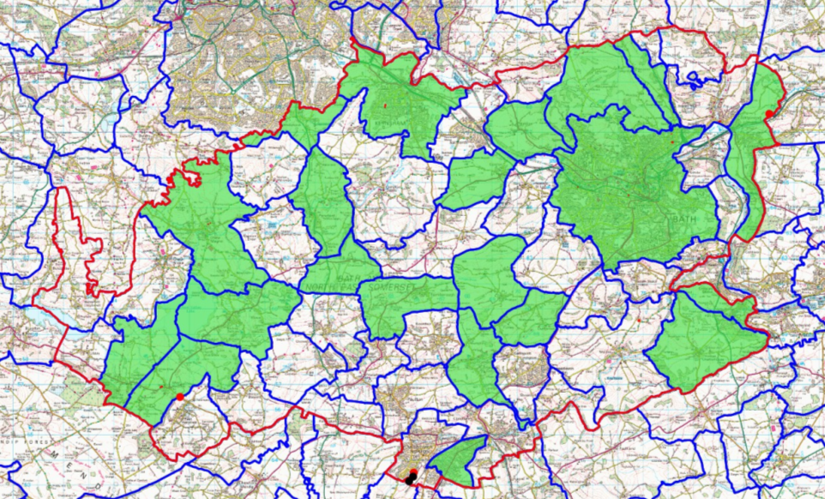
Notes:
Before we start. A bit of context
This is a map showing all the parishes in BANES. Every parish that is green is where we have a Local Flood Rep –with the exception of City of bath (misleading on this image).
As you can see we have pretty good coverage. 26 Reps in total (48 parishes). We’re really pleased with this, it means we have a great communication link with all these areas. There are a few more areas that we want to target and our coverage in Bath is a not ideal (map is misleading).
We don’t expect Flood Reps to know everything in their area but over time hopefully information will filter through you guys.
Because there are so many of you and you’re doing such a good job we can use you as a way to encourage more Parishes to get on board.

Slide 3
Agenda
Our team, the work we do and your role
Watercourse management and ‘riparian responsibilities’
Works that affect watercourses
Any issues to discuss?
Useful information for the winter months
Notes:
Here’s what we hope to cover today.
Watercourse focus – did you get a chance to read ‘Living on the Edge?
Going to focus on watercourses today and there is a chance for you to ask any questions.

Slide 4
Drainage and Flooding team (as the Lead Local Flood Authority)
Work with others to manage flood risk from:
Surface water
Groundwater
‘Ordinary watercourses’ (smaller rivers, streams and ditches) NOT ‘Main Rivers’ e.g. Avon, Chew – Environment Agency responsibility To see main Rivers: http://maps.environment-agency.gov.uk/wiyby/wiybyController?x=357683.0&y=355134.0&scale=1&layerGroups=default&ep=map&textonly=off&lang=_e&topic=floodmap&utm_source=Poster&utm_medium=FloodRisk&utm_campaign=FloodMonth13#x=368054&y=162696&lg=1,2,10,&scale=6
Notes:
Quick reminder of what our team does.
I think most of you have seen before so I don’t intend to spend much time on it but will be chance to ask questions later.

Slide 5
Flood Risk Management Authorities
Notes:
Here are the other organisations who have a role to play in managing flood risk from other sources.

Slide 6
The sorts of things we do…
Practical work - identify places where there is a risk to property flooding and where improvements to drainage or flood risk can be made (prioritised)
Review planning applications and promote sustainable drainage systems
Watercourse management and enforcement (ordinary watercourses)
Notes:
We have what is called permissive powers to carry out works on ordinary watercourses and indeed works to improve drainage, discuss more later.

Slide 7
Why Local Flood Reps?
We want to work with local communities so that we can share information to improve our understanding of flooding issues and help manage flood risk.
Our ‘eyes and ears on the ground’
Notes:
Its difficult for us to know precisely what’s happening in the area.
We have quite a lot of modelling data and some reported flood incidents but no one knows better than people in your community where any flooding issues are.
It’s more efficient and likely to be more accurate if we can get information directly from local people.
Having people like you, over the long term, will hopefully enable messages about flood risk to get to more people. If you feel comfortable doing this?

Slide 8
How you can help us
Alerting us to long-standing drainage or flooding issues that put properties or critical infrastructure at risk
Educating communities on their flood risk and how to manage it
Helping us and your Parish Council to make sure that watercourses are being looked after (e.g. by raising awareness of ‘Riparian’ responsibilities)

Slide 9
When to get in touch with us
Where flooding has led to internal property flooding.
Where there is a maintenance issue with a watercourse that may result in flooding of properties. For instance overgrown vegetation impeding flows, or other restrictions or blockages such as fallen trees or urban trash that could result in property flooding.
Maintenance issues with watercourse structures that may result in flooding of properties (e.g. blocked culverts or trash screens).
If you need support to produce a community or individual flood plan.
Notes:
Our team does not have an emergency response role.
Our work is mainly ‘after the flood’ and preventative measures.

Slide 10
Watercourse management

Slide 11
Are you a Riparian owner?
Notes:
Are you a riparian owner
If your property is adjacent to a watercourse or drainage ditch of any description you are a riparian owner and should be maintaining it regularly.
This will have the benefit of reducing the risk of flooding from the watercourse at times of wet weather - both for you and your neighbours.
This is often know of river channels but ditches next to highways are also under the responsibility of the adjacent land owner.
High ways are permitted to discharge surface water into the ditches but maintenance falls to the land owner.

Slide 12
Your Responsibilities
landowner should not obstruct or deliberately divert flood flows
responsibility to remove any debris that collects on their land even if it originated elsewhere
to pass on flow without obstruction, pollution or diversion affecting the rights of others
banks clear from any matter that could cause an obstruction
maintaining the bed and banks of the watercourse
protecting your property from seepage through banks
Notes:
Your Responsibilities
A landowner should not obstruct or deliberately divert flood flows. There is a general duty upon both land drainage bodies and riparian owners not to take an action which would have the effect of increasing the amount of damage which would have occurred if no action was taken.
It is their responsibility to remove any debris that collects on their land even if it originated elsewhere. This is why the EA, IDB’s, & Local Authorities, have been given permissive powers to instruct a landowner to maintain their channel to reduce flood risk. Highways also have their own legislation to ensure drainage from roads is not obstructed.
You have the responsibility to pass on flow without obstruction, pollution or diversion affecting the rights of others
You have a responsibility for maintaining the bed and banks of the watercourse (including trees and shrubs growing on the banks) and for clearing any debris, natural or otherwise, including litter and animal carcasses, even if they did not originate from your land. You must not cause any obstructions to the free passage of fish
You are responsible for keeping the bed and banks clear from any matter that could cause an obstruction, either on your land or by being washed away by high flow to obstruct at a structure downstream. Watercourses and their banks should not be used for the disposal of any form of garden or other waste.
You have the responsibility for protecting your property from seepage through banks. Where such seepage threatens the structural integrity of a flood defence, it may become the concern of the Environment Agency

Slide 13
2
1
Fields
3
4
North Roadside Ditch
Road
South Roadside Ditch
River
River
Notes:
Rights on land drainage and surface water management
Where the landowner 1 improves the drainage on there land causing more water to enter the roadside ditch he only has to ensure his stretch of ditch can adequately convey the flow.
The downstream landowners 2 & 4 have no duty to improve their stretch of ditch.
If 3 drains his land 4 must accept and pass on flows.
If this leads to flooding of the highway the authority can instruct the landowners to maintain their ditches. If flooding still occurs due to insufficient capacity of the ditch could be diverted under the road through a culvert to discharge into the south ditch.
If flooding occurs from the river and is due to channel capacity being exceeded the authority has to accept and deal with the consequences.

Slide 14
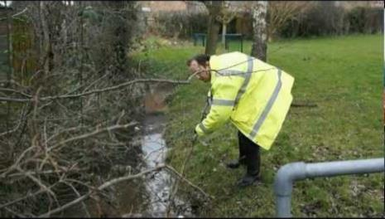
Watercourse management
Notes:
Example of blocked trash screen doing its job structure
Local water course being maintained

Slide 15
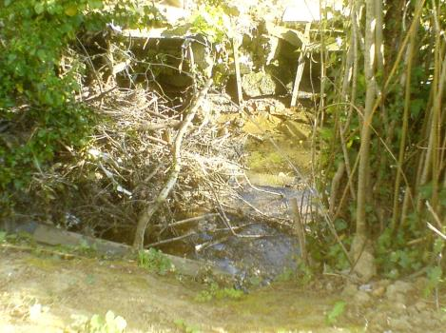
Impeded water courses
Notes:
Examples of impeded watercourses

Slide 16
Approximate timeline
Issue spotted by Local Flood Rep or member of community
Report to Parish/ Ward
One week
Identify riparian owner(s)
Make contact (in person or by letter)
Check up
Resolved?
Unresolved?
Two weeks
Thank riparian owner
Follow up with second letter/ other comms.
And make the Drainage and Flooding team (or Environment Agency) aware
Check up
Two weeks
Resolved?
Unresolved?
Thank riparian owner
Refer to Drainage and Flooding team (ordinary watercourse) or Environment Agency (Main river)
Notes:
Suggested flow chart for parishes/ communities to help manage watercourse issues.

Slide 17
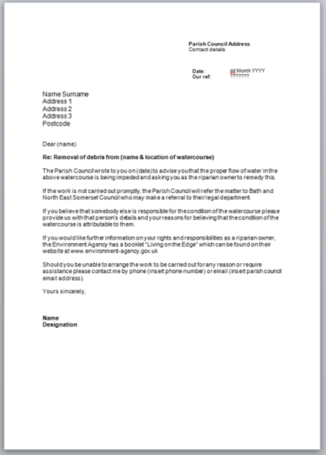
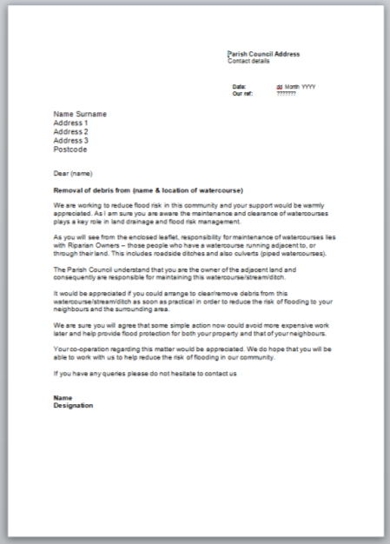
Notes:
Example template letters. Will be issued to Parish Clerks in due course.

Slide 18
Works affecting watercourses
Land Drainage Consent
and
Flood Defence Consent

Slide 19
Why consent is required
Consent is required to ensure that any works to a watercourse do not have an adverse effect on flood risk or the environment
Water must be allowed to flow through land without any obstruction, pollution or diversion which affects the rights of others
There is a legal obligation to notify the Environment Agency or the Drainage and Flooding Team if you would like to build, or alter, a structure that acts as an obstruction to a watercourse
Consideration for the requirements under the Water Framework Directive to ensure that water quality is maintained. This is looked at by the B&NES Ecology Team
Planning Approval may also be required, as well as a Flood Defence Consent. Check with the Local Planning Authority (B&NES)

Slide 20
Works requiring consent

Slide 21
Works not requiring consent

Slide 22
How to request for consent
Flood Defence Consent is required for works in, over, under or adjacent to main rivers. This is achieved through contact with the Environment Agency
Land Drainage Consent is required for any works that will create or alter a mill dam, weir or other similar obstruction to the flow of an ordinary watercourse, including any proposals to install culverts or alter them in a manner that would be likely to affect the flow of water. This is achieved through contact with the Lead Local Flood Authority (B&NES)
Environment Agency - https://www.gov.uk/flood-defence-consent-england-wales
B&NES - drainage&flooding@bathnes.gov.uk

Slide 23
Further information
Living on the Edge - https://www.gov.uk/government/uploads/system/uploads/attachment_data/file/454562/LIT_7114.pdf
BANES flooding site - http://www.bathnes.gov.uk/services/environment/land-drainage
Planning Portal - http://www.planningportal.gov.uk/permission/responsibilities/beforeyoustart/otherpermissions/flooddefence
BANES planning site - http://www.bathnes.gov.uk/services/planning-and-building-control/do-i-need-planning-permission

Slide 24
Over to you…
Notes:
Prompts for discussion…
Anything you are unclear about?
Anything you are uncomfortable with?
Anything we can do to help you in this role? Information you need etc? Communications?
How can we work together to improve our own understanding of flood risk and vulnerability in your communities?

Slide 25
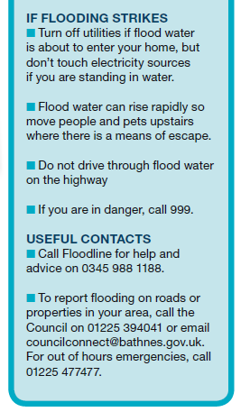
Winter 2015
Promoting flood awareness – can you help?
https://www.gov.uk/floodsdestroy
Notes:
We will be promoting flood awareness over the next couple of months. Can you help?

Slide 26
Please report flooding
Highway drainage and flooding issues (blocked gulleys, pot holes, and water ponding on highways)
Council Connect
Online forms: www.bathnes.gov.uk/reportit
Email: councilconnect@bathnes.gov.uk
Twitter: @ccbathnes
Telephone: 01225 39 40 41
Text (SMS): 07797 806 545
Property flooding stemming from watercourses, land, surface water
Report to Council Connect (as above), then…
Drainage and Flooding team
drainage&flooding@bathnes.gov.uk
01225 39 4409
Where is it?
Any idea of the root cause?
Who/ what has been affected?
Photos and video really useful
Notes:
Please report flooding.

Slide 27
Thank you
Next meeting planned for Spring 2016, please send us any subjects you would like to discuss.

