Slide 1
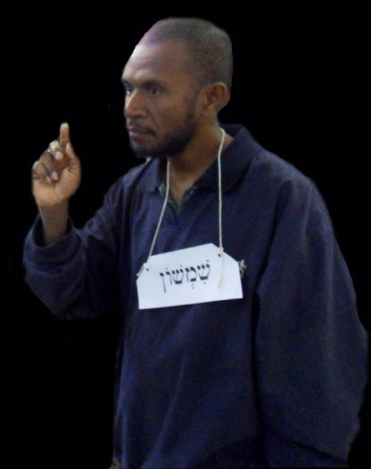
Linguistic Reflections on Teaching Hebrew in a Melanesian Context
Phil King, SIL
LSPNG, 27th September 2012

Slide 2
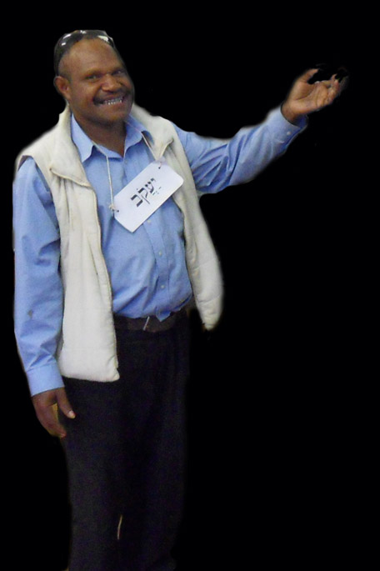
Background
Hebrew: original language of Old Testament; Semitic family
Taught at Ukarumpa since 2003; students gr. 6 – degree level
Teaching to fit Melanesian language learning styles (e.g. oral basis)
Discovered PNGans have different challenges from English MT speakers

Slide 3
‘How well you understand [your native] language is one of the most powerful influences on how well you will be able to learn other languages. The languages that have similar features to your primary language will be much easier to learn. Languages that possess an extremely small similarity to your native language will be more difficult.’ http://www.effectivelanguagelearning.com/language-guide/differences-in-difficulty

Slide 4
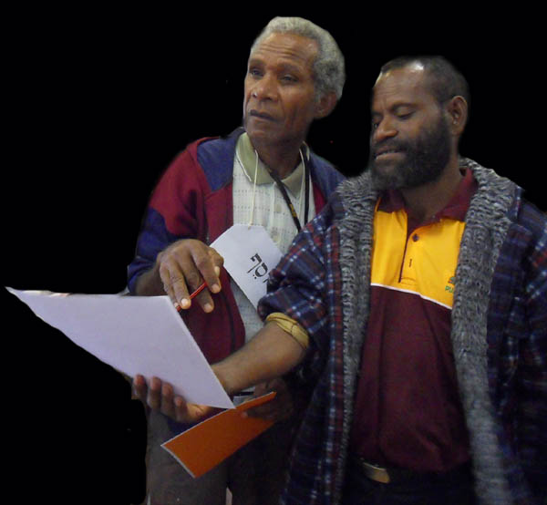
Comparative difficulty in language learning
May depend on:
Writing system (orthography)
Phonology
Morphology
Syntax
Lexicology
(NSA report on comparative difficulty of language learning)

Slide 5
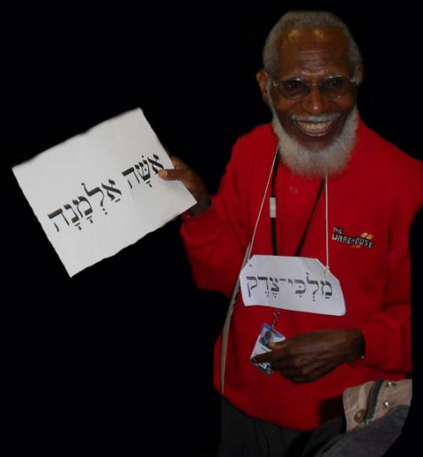
1. What are the particular challenges / benefits when learning Hebrew if you speak a Papua New Guinean mother tongue?

Slide 6
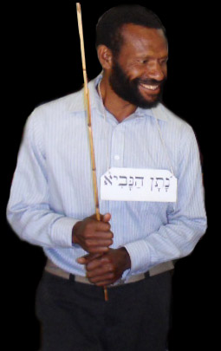
2. How do we teach Hebrew in order to move from known to unknown?

Slide 7
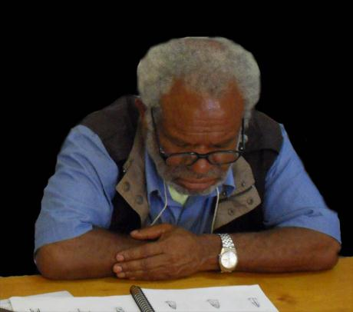
Linguistics resources PNGns bring to learning Hebrew:
THE KNOWN
Tok Pisin
Mother tongue (230 Austronesian, 600 Non-Austronesian)
Varying abilities in English
Notes:
So, what I’ve been looking at is the typologies of Austronesian and Papuan languages, and the linguistic features of Tok Pisin

Slide 8
Methodology
Look at linguistic features in typologies of Austronesian languages and Non-Austronesian languages, and Tok Pisin.
Compare with linguistic features of Hebrew
Look for points of contact and of dissimilarity.

Slide 9
Orthography
It’s just difficult…

Slide 10
Phonetics/ phonology
ISSUES
Some sounds totally unfamiliar
Xenemic confusion (thanks Syd!) - learners fit Hebrew sounds into their own phonemic systems
Particularly hard to learn sounds that are different phonemes in Hebrew, but allophones in your mother tongue.
For example [l]~[r] is one phoneme in many Non-Austronesian PNG languages, but separate phonemes in Hebrew.
Notes:
Recall Mavis’ presentation on dialects for bridging to English. I’m focusing on consonants not vowels, because the vowel phonemes are close enough to the five basic vowels which occur in most PNG languages.
In Austronesian languages, these phonemes are in at least 15 of the 18 languages.

Slide 11
Phonetics / phonology
AUSTRONESIAN (in Western Melanesia, based on 18 langs in Lynch et al):
/p/ /t/ /k/ /b/ /d/ /m/ /n/ /r/ /s/
But /r/ usu. alveolar trill, /s/ is [s]~[ʃ]
Less than half have /ʔ/ (4 of 18) or /h/ (8 of 18, but four only as allophones or only in loanwords)
Rarely /z/
No uvular or pharyngeal sounds (…except Bipi?!)
Notes:
Recall Mavis’ presentation on dialects for bridging to English. I’m focusing on consonants not vowels, because the vowel phonemes are close enough to the five basic vowels which occur in most PNG languages.
In Austronesian languages, these phonemes are in at least 15 of the 18 languages.

Slide 12
Phonetics / phonology
NON-AUSTRONESIAN (based on Foley):
/p/ /t/ /k/ /s/ /m/ /n/ /y/
Highlands often have /ʔ/, less common elsewhere
Often one liquid [r]~[l]
Rarely /z/
No uvular or pharyngeal sounds (except Angan family)
Notes:
Recall Mavis’ presentation on dialects for bridging to English. I’m focusing on consonants not vowels, because the vowel phonemes are close enough to the five basic vowels which occur in most PNG languages.
In Austronesian languages, these phonemes are in at least 15 of the 18 languages.

Slide 13
Phonetics / phonology
TOK PISIN:
No glottal stop
Initial /hV/ in free variation with /V/ in some dialects (hamamas / amamas)
No /z/
Notes:
Recall Mavis’ presentation on dialects for bridging to English. I’m focusing on consonants not vowels, because the vowel phonemes are close enough to the five basic vowels which occur in most PNG languages.
In Austronesian languages, these phonemes are in at least 15 of the 18 languages.

Slide 14
Phonetics / phonology
HEBREW:
Phoneme | Orthography | Allophones | Phoneme | Orthography | Allophones
/ʔ/ | א | [ʔ] | /l/ | ל | [l]
/b/ | ב | [b] [v] | /m/ | מ ם | [m]
/g/ | ג | [g] | /n/ | נ ן | [n]
/d/ | ד | [d] | /s/ | ס | [s]
/h/ | ה | [h] | /ʕ/ | ע | [ʕ]
/v/ | ו | [v] | /p/ | פ ף | [p] [f]
/z/ | ז | [z] | /ts/ | צ ץ | [t͜s]
/ħ/ | ח | [ħ] | /q/ | ק | [k]
/t/ | ט | [t] | /r/ | ר | [ʀ],
/y/ | י | [j] | /s/ | שׂ | [s]
/k/ | כ ך | [k] [x] | /ʃ/ | שׁ | [ʃ]
 |  |  | /t/ | ת | [t]

Slide 15
Phonetics / phonology
HEBREW:
Uvular and pharyngeal sounds v. difficult e.g. /ħ/ and /ʕ/ (for English speakers too!)
/r/ is uvular in modern Hebrew, but much easier for PNGans to use an alveolar trill
Glottal stop and fricative also difficult, as these are often not present or only allophones of other sounds in PNG, need a lot of practice, in different environments.

Slide 16
Phonetics / phonology
HEBREW:
/z/ is very uncommon in PNG languages, voiced affricates (ʤ or ʣ) or voiced postalveolar fricatives (ʒ) are more common. /z/ can be taught with similarity to /s/
/s/ and /ʃ/ are separate phonemes in Hebrew, but often allophones in PNG. So teach by drilling with different vowels.

Slide 17
Pronouns
AUSTRONESIAN:
Distinguish 1st, 2nd, 3rd person, singular, plural and often dual.
Rarely distinguish gender
1st person plural has inclusive and exclusive

Slide 18
Pronouns
NON-AUSTRONESIAN (more variety!):
Eg. Wiru (Foley 1986)
But some distinguish 3rd person gender, some even distinguish second person gender (Iatmul)
 | sg | du | Pl
1 | no | tota | tote
2 | ne | kita | kiwi
3 | one

Slide 19
Pronouns
TOK PISIN
No gender distinctions
First person plural has exclusive / inclusive
Some dual forms
 | sg | du | Pl
1 | mi | yumitupela | yumi
 |  | mitupela | mipela
2 | yu | yutupela | yupela
 |  |  | ol
3 | em

Slide 20
Pronouns
Pronouns
1SG
2MSG
2FSG
3MSG
3FSG
1PL
2MPL
2FPL
3MPL
3FPL
HEBREW:
BIG issue: gender distinctions (and this goes throughout the verbal system).
In second person as well as third.
Teach interactively, beginning with second person, to build the concept.

Slide 21
Pronouns
A new idea…
Begin working on a linguistic metalanguage in Tok Ples?
Single person ⓪ |  |  | Several people ⓪⓪⓪
Hebrew |  | Tok Ples | Hebrew |  | Tok Ples
 | אֲנִי |  |  | אֲנַחְנוּ
⓪ | אַתָּה |  | ⓪⓪ | אַתֶּם
① | אַתְּ |  | ①① | אַתֶּן
⓪ | הוּא |  | ⓪⓪ | הֵם
① | הִיא |  | ①① | הֵנָּה

Slide 22
Possession
Austronesian languages and many Non-Austronesian languages have examples of direct possession
Usually for inalienably possessed body parts and kinship terms
AWAD BING (Austr.): dima-haw ‘hand-1SG.POSS’
KASUP (NA): ti-kan ‘1SG.POSS-leg’
Often have possessive suffixes (but note Kasup…)

Slide 23
Possession
HEBREW:
All nouns take possessive suffixes.
Beginning with the known – possessive suffixes for body parts, kinship terms.
Move to houses, horses etc.
Tok Pisin better for glossing than English – the possessor comes after the possessed.

Slide 24
Morphology I
Verb structure
AUSTRONESIAN: Often polysynthetic, fairly agglutinative - root + derivational/inflectional affixes
NON-AUSTRONESIAN: Polysynthetic and agglutinative – root + derivational/inflectional affixes
Notes:
I often have peope in my courses say – my language is like Hebrew! – when we get onto this subject.

Slide 25
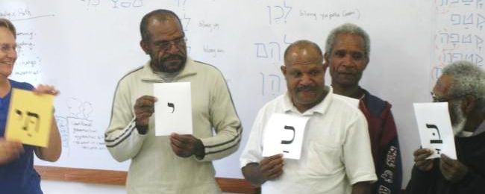
Morphology I
Verb structure
HEBREW: Polysynthetic, root + derivational/inflectional morphemes
BUT: NON-LINEAR. Root is the consonants, derivational/inflectional morphemes given by vowels and affixes.
Notes:
I often have peope in my courses say – my language is like Hebrew! – when we get onto this subject.

Slide 26
Morphology I
Verb structure examples
English (isolating) | Gapapaiwa (Austr) | Kamano-Kafe (Non-Austr) | Hebrew
I walked | ababa | vu’noe | halakti
He walked | ibaba | vu’ne | halak
We walked | kababa | vu’none | halaknu
I am walking | abababa | nevue | holek
We are walking | kabababa | nevune | holkim
I will walk | anababa | vugahue | ‘elek
He will walk | inababa | vugahie | yelek

Slide 27
Morphology I
Teaching verb structure
Notes:
I often have peope in my courses say – my language is like Hebrew! – when we get onto this subject.

Slide 28
Morphology II
Subject and object marking on verb
PNG languages frequently mark subject and object on the verb (both in Austronesian and Non-Austronesian)
Hebrew also shows subject agreement on the verb, and uses object suffixes.
This should be easier for speakers of PNG languages to grasp than for speakers of English.
Notes:
I often have people in my courses say – my language is like Hebrew! – when we get onto this subject.

Slide 29
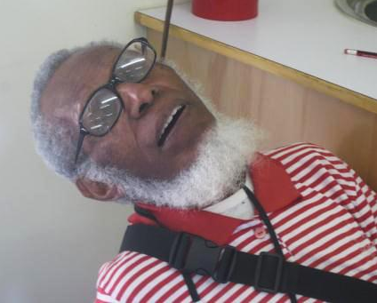
Morphology III
PASSIVES are a nightmare!
Virtually unheard of in PNG languages
Hebrew is full of them. 3 different passive stems, plus passive forms of non-passive stems…
Resort to making sure learners understand the English passive first??

Slide 30
Morphology IV
CAUSATIVES much better
Several PNG languages have a morpheme to derive a causative from a verb root
Eg. BANONI (Austr.) butsu ‘fall’ / va-butsi- ‘CAUS-fall (drop)’
Eg. MONI (NA) bitiya ‘shut’ / ma-bitiya ‘CAUS-shut’
Even TOK PISIN: slip / slipim
Hebrew also has a morphologically derived causative stem, so can connect with these vernaculars.

Slide 31
Polar questions
Many PNG languages have an interrogative particle at the end of a sentence (Austronesian) or affixed to verb (Non-Austronesian)
Tok Pisin has sentence final a?
Hebrew has sentence initial ‘ha…’ – very comparable to Tok Pisin.

Slide 32
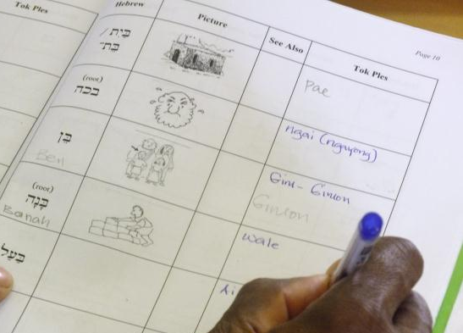
Vocabulary / Lexicology
Develop a Hebrew - Tok Ples dictionary.
Some easy: eg. yashav ‘sit / stay’
But… camel, vineyard, desert, shepherd…

Slide 33
Vocabulary / Lexicology
A typical challenge when building a Hebrew – Tok Ples dictionary:
How do you gloss a word like Hebrew אַח ‘brother’, when your Tok Ples:
Has inalienable possession for kinship terms?
Distinguishes older and younger siblings?
Has different words for same sex and opposite sex, not male vs. female?
Suggestion for Awad Bing: ‘te- / tawe- (tamuol)’ [younger sibling / elder sibling (male)]
What about Motu??

Slide 34
Conclusions
Based on linguistic similarities:
Some aspects of Biblical Hebrew are easier for speakers of PNG languages to grasp than for speakers of English – e.g. possessive suffixes, subject and object morphology on the verb.
Some aspects are easier for speakers of English – e.g. passives, gender-specific pronouns
The best teaching practice uses all the linguistic resources of the learners to help them grasp new concepts.

Slide 35
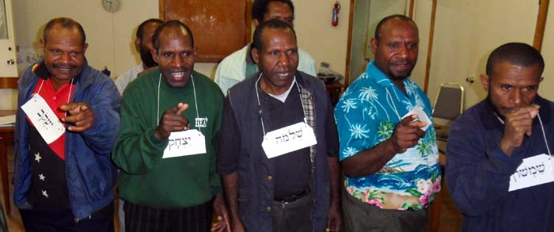
Conclusions
Hopefully, this also gives some ideas for using PNGan linguistic resources when teaching other languages (English, French…?)

