Slide 1
The Case for Optimism in Arizona K-12
Matthew Ladner

Slide 3
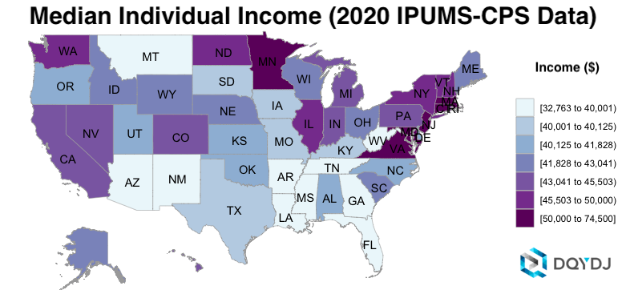

Slide 4
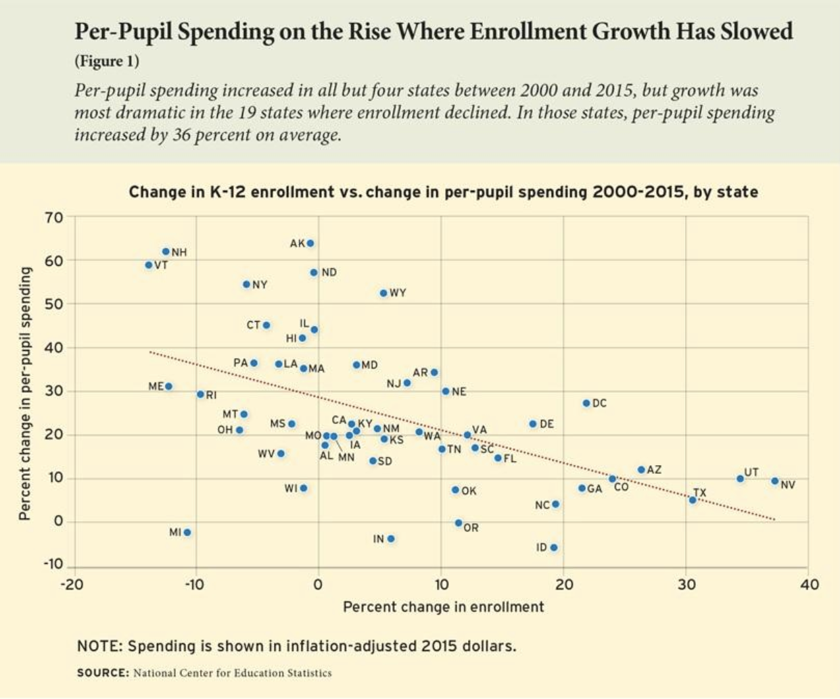

Slide 6
Unique Things about Arizona K-12 education
Rapid Student Population Growth
Nation’s Largest Charter School Sector (21.8% of students)
Private choice programs
4. Active district open enrollment

Slide 7
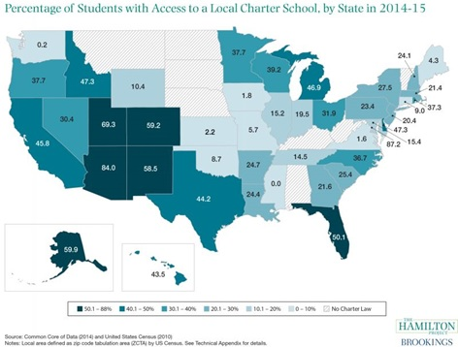

Slide 9
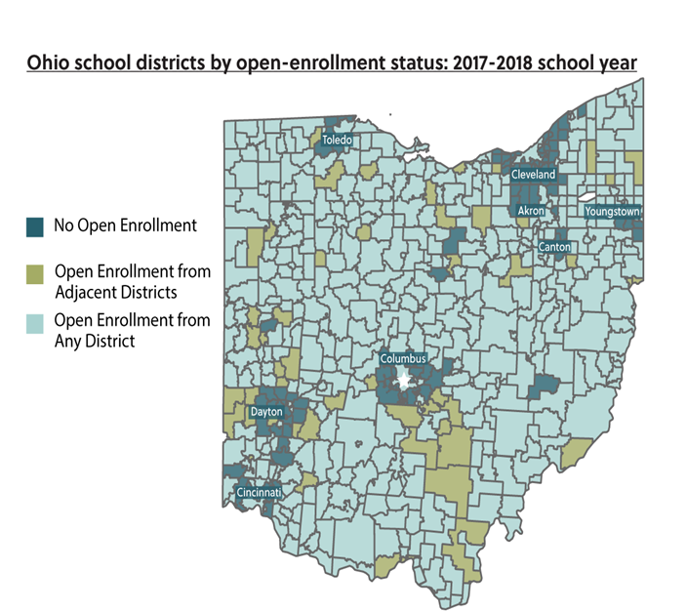

Slide 10
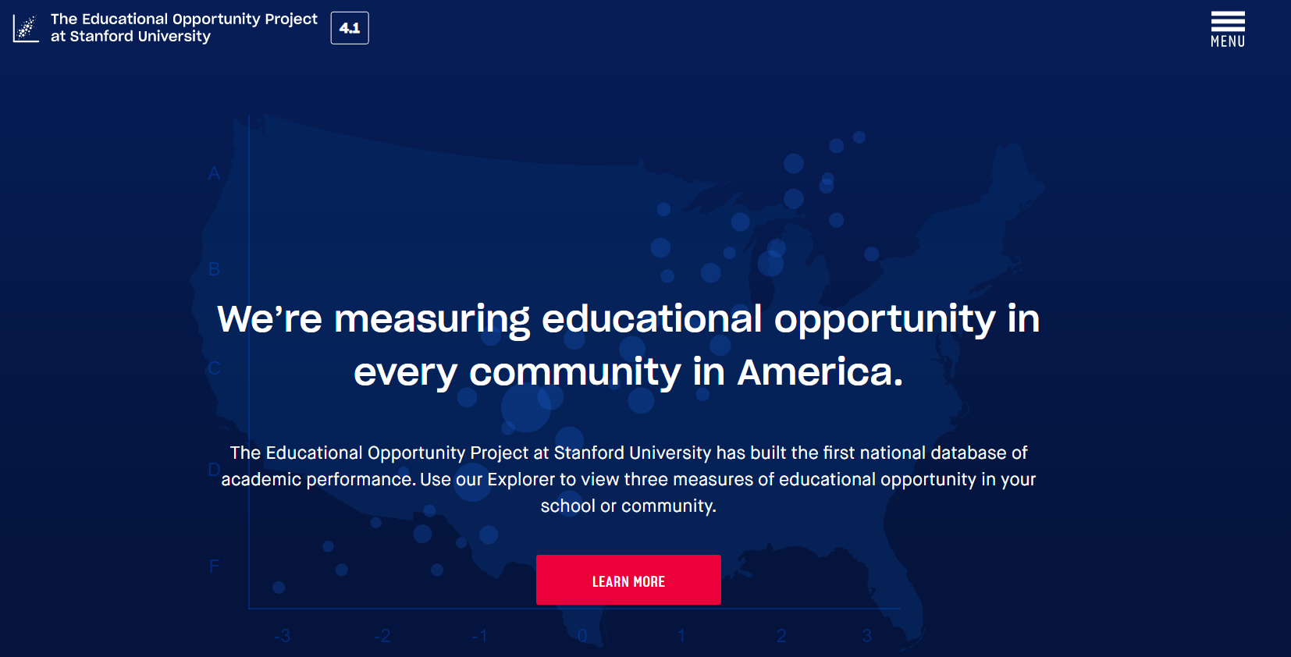

Slide 14
Stanford Opportunity Project Has 2008-2018 data at the county level. Maricopa County has the highest rate of academic growth among the 100 highest population counties at 19% above the national average.

Slide 15
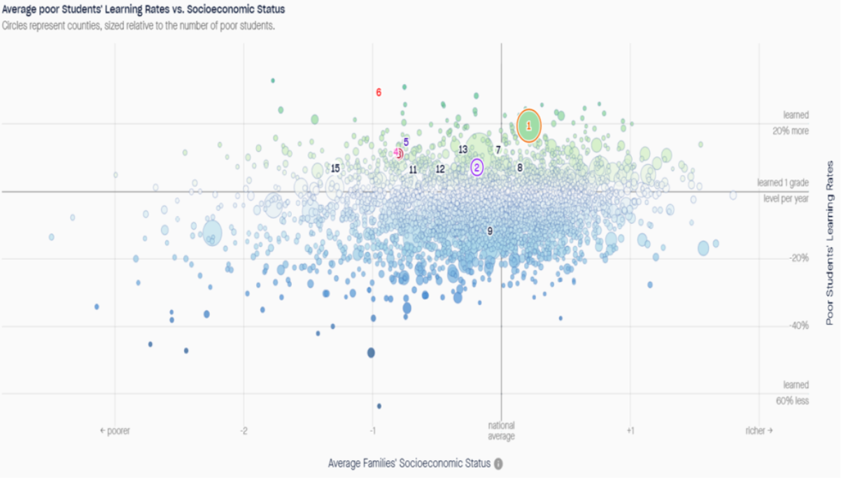

Slide 18
In fiscal year 2012, Scottsdale USD had total school building capacity of about 38,000 students but only had about 25,000 students enrolled, or in other terms, the District was using about 66 percent of its building capacity…Had Scottsdale USD maintained a similar amount of school building space per student as its peer districts averaged, it could have saved approximately $3.8 million, monies that the District otherwise potentially could have spent in the classroom.
-Arizona Auditor General Report, 2015

Slide 19
Choice of schools gave Arizona the most robust system of accountability in the country.
The healthy tension in the system is not between district and choice schools, but rather between low-demand schools and high-demand schools.

