Slide 1
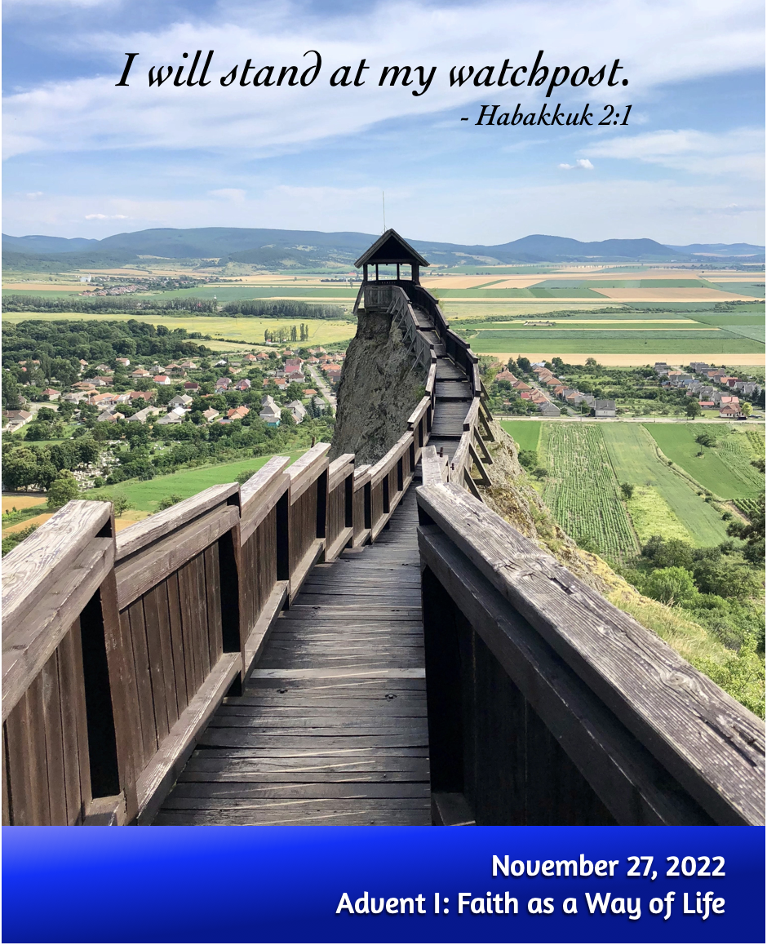
Welcome to Trinity
Order for Worship
November 27, 2022

Slide 2
Prelude by Roxanne Groff
Office of the Acolyte
Ringing of the Bell
Scripture Focus:
Habakkuk 1:1-4, 2:1-4; 3:3b-19
Notes:
Image: Preparing yeast dough. Copyright © tomasworks/iStock/Thinkstock. Used by permission.

Slide 3
Lighting of the Advent Wreath
Reader: Just as the prophet Habakkuk stood at the watchpost to see what you would say, O God,
C: So we, too, see the brokenness of the world and long for your message to be made plain.
Notes:
Image: Five Loaves by Caroline Coolidge Brown. Copyright © Caroline Coolidge Brown. All rights reserved. Used by permission of the artist.

Slide 4
Lighting of the Advent Wreath
Reader: (light candle 1) We light this first candle as a sign of hope that you have heard your people and will answer us in our distress.
C: Let this light be a beacon to all who wait, a sure sign that our redemption is coming to us.
Notes:
Image: Five Loaves by Caroline Coolidge Brown. Copyright © Caroline Coolidge Brown. All rights reserved. Used by permission of the artist.

Slide 5
CONFESSION AND FORGIVENESS
All may make the sign of the cross, the sign marked at baptism…
P: We confess our sins before God and one another.
Pause for silence and reflection.
P: Radiant God,
Notes:
Image: Five Loaves by Caroline Coolidge Brown. Copyright © Caroline Coolidge Brown. All rights reserved. Used by permission of the artist.

Slide 6
CONFESSION AND FORGIVENESS
C: You have come to live among us, yet we fail time and again to see you in the faces of our neighbors. We look to ourselves instead of those in need. We seek the shallow comforts of things we can buy instead of the deep and lasting comfort of your presence.
Notes:
Image: Five Loaves by Caroline Coolidge Brown. Copyright © Caroline Coolidge Brown. All rights reserved. Used by permission of the artist.

Slide 7
CONFESSION AND FORGIVENESS
C: Forgive our stubborn refusal to see, and open our eyes to the joy and wonder of your incarnation.
Notes:
Image: Five Loaves by Caroline Coolidge Brown. Copyright © Caroline Coolidge Brown. All rights reserved. Used by permission of the artist.

Slide 8
CONFESSION AND FORGIVENESS
L: Do not be afraid, for I bring you good news of great joy. The God of boundless grace forgives you all your sins, renewing your spirit for the sake of Immanuel, God with us.
C: Amen.
☩
Notes:
Image: Five Loaves by Caroline Coolidge Brown. Copyright © Caroline Coolidge Brown. All rights reserved. Used by permission of the artist.

Slide 9
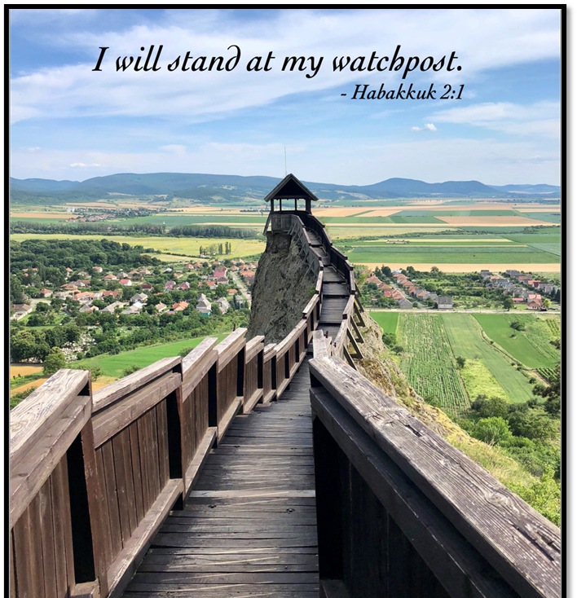
Hymn of Praise
“Joyful, Joyful, We Adore Thee”
LBW 551
Notes:
Image: Five Loaves by Caroline Coolidge Brown. Copyright © Caroline Coolidge Brown. All rights reserved. Used by permission of the artist.

Slide 10
“Joyful, Joyful We Adore Thee” LBW 551
1 Joyful, joyful we adore thee,
God of glory, Lord of love!
Hearts unfold like flow’rs before thee,
praising thee, their sun above.
Melt the clouds of sin and sadness,
drive the gloom of doubt away.
Giver of immortal gladness,
fill us with the light of day.
Notes:
Image: Five Loaves by Caroline Coolidge Brown. Copyright © Caroline Coolidge Brown. All rights reserved. Used by permission of the artist.

Slide 11
“Joyful, Joyful We Adore Thee” LBW 551
2 All thy works with joy surround thee,
earth and heav’n reflect thy rays,
stars and angels sing around thee,
center of unbroken praise.
Field and forest, vale and mountain,
flow’ry meadow, flashing sea,
chanting bird, and flowing fountain
call us to rejoice in thee.
Notes:
Image: Five Loaves by Caroline Coolidge Brown. Copyright © Caroline Coolidge Brown. All rights reserved. Used by permission of the artist.

Slide 12
“Joyful, Joyful We Adore Thee” LBW 551
3 Thou art giving and forgiving,
ever blessing, ever blest,
wellspring of the joy of living,
ocean-depth of happy rest!
Thou our Father, Christ our brother,
all who live in love are thine;
teach us how to love each other,
lift us to the joy divine!
Notes:
Image: Five Loaves by Caroline Coolidge Brown. Copyright © Caroline Coolidge Brown. All rights reserved. Used by permission of the artist.

Slide 13
APOSTOLIC GREETING
P: The grace of our Lord Jesus Christ, the love of God, and the communion of the Holy Spirit be with you all.
C: And also with you.
Notes:
Image: Five Loaves by Caroline Coolidge Brown. Copyright © Caroline Coolidge Brown. All rights reserved. Used by permission of the artist.

Slide 14
PRAYER OF THE DAY
P: Let us pray… God of grace and mercy, with Habakkuk we cry out to you in despair at the evil in the world. As we begin our waiting for your promised savior, give us hope that all will be made right in you.
C: Amen.
Notes:
Image: Five Loaves by Caroline Coolidge Brown. Copyright © Caroline Coolidge Brown. All rights reserved. Used by permission of the artist.

Slide 15
Notes:
Image: Preparing yeast dough. Copyright © tomasworks/iStock/Thinkstock. Used by permission.

Slide 16
Scripture Reading
R: The Scripture reading is from the Book of Habakkuk Chapters 1, 2, and 3.
C: Glory to you O’ Lord! (Spoken)
Notes:
Image: Five Loaves by Caroline Coolidge Brown. Copyright © Caroline Coolidge Brown. All rights reserved. Used by permission of the artist.

Slide 17
Habakkuk 1:1-4; 2:1-4; 3:[3b-6], 17-19
Narrator: The oracle that the prophet Habakkuk saw.
Habakkuk: O Lord, how long shall I cry for help, and you will not listen? Or cry to you “Violence!” and you will not save? Why do you make me see wrong-doing and look at trouble? Destruction and violence are before me; strife and contention arise. So the law becomes slack and justice never prevails.
Notes:
Image: Five Loaves by Caroline Coolidge Brown. Copyright © Caroline Coolidge Brown. All rights reserved. Used by permission of the artist.

Slide 18
Habakkuk 1:1-4; 2:1-4; 3:[3b-6], 17-19
Habakkuk: The wicked surround the righteous— therefore judgment comes forth perverted. I will stand at my watchpost, and station myself on the rampart; I will keep watch to see what he will say to me, and what he will answer concerning my complaint. Then the Lord answered me and said:
Notes:
Image: Five Loaves by Caroline Coolidge Brown. Copyright © Caroline Coolidge Brown. All rights reserved. Used by permission of the artist.

Slide 19
Habakkuk 1:1-4; 2:1-4; 3:[3b-6], 17-19
Lord: Write the vision; make it plain on tablets, so that a runner may read it. For there is still a vision for the appointed time; it speaks of the end, and does not lie. If it seems to tarry, wait for it; it will surely come, it will not delay. Look at the proud! Their spirit is not right in them, but the righteous live by their faith.
Notes:
Image: Five Loaves by Caroline Coolidge Brown. Copyright © Caroline Coolidge Brown. All rights reserved. Used by permission of the artist.

Slide 20
Habakkuk 1:1-4; 2:1-4; 3:[3b-6], 17-19
Narrator: God came from Teman, the Holy One from Mount Paran. His glory covered the heavens, and the earth was full of his praise. The brightness was like the sun; rays came forth from his hand, where his power lay hidden. Before him went pestilence, and plague followed close behind. He stopped and shook the earth; he looked and made the nations tremble.
Notes:
Image: Five Loaves by Caroline Coolidge Brown. Copyright © Caroline Coolidge Brown. All rights reserved. Used by permission of the artist.

Slide 21
Habakkuk 1:1-4; 2:1-4; 3:[3b-6], 17-19
Narrator: The eternal mountains were shattered; along his ancient pathways the everlasting hills sank low.
Habakkuk: Though the fig tree does not blossom, and no fruit is on the vines; though the produce of the olive fails and the fields yield no food; though the flock is cut off from the fold and there is no herd in the stalls,
Notes:
Image: Five Loaves by Caroline Coolidge Brown. Copyright © Caroline Coolidge Brown. All rights reserved. Used by permission of the artist.

Slide 22
Habakkuk 1:1-4; 2:1-4; 3:[3b-6], 17-19
Habakkuk: yet I will rejoice in the Lord; I will exult in the God of my salvation. God, the Lord, is my strength; he makes my feet like the feet of a deer, and makes me tread upon the heights. To the choirmaster: with stringed instruments.
Notes:
Image: Five Loaves by Caroline Coolidge Brown. Copyright © Caroline Coolidge Brown. All rights reserved. Used by permission of the artist.

Slide 23
Habakkuk 1:1-4; 2:1-4; 3:[3b-6], 17-19
P: This is the Word of the Lord.
C: Praise to You, O Christ (Spoken)
Notes:
Image: Five Loaves by Caroline Coolidge Brown. Copyright © Caroline Coolidge Brown. All rights reserved. Used by permission of the artist.

Slide 24
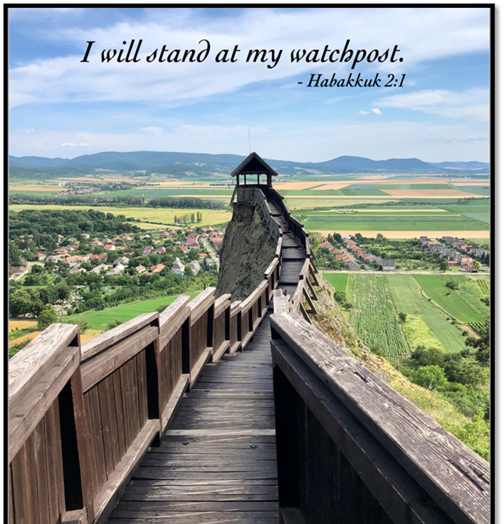
Sermon
Notes:
Image: Five Loaves by Caroline Coolidge Brown. Copyright © Caroline Coolidge Brown. All rights reserved. Used by permission of the artist.

Slide 25
APOSTLE’S CREED
C: I believe in God, the Father almighty, creator of heaven and earth.

Slide 26
APOSTLE’S CREED
C: I believe in Jesus Christ, his only Son, our Lord. He was conceived by the power of the Holy Spirit and born of the virgin Mary. He suffered under Pontius Pilate, was crucified, died, and was buried.

Slide 27
APOSTLE’S CREED
C: He descended into hell. On the third day he rose again. He ascended into heaven, and is seated at the right hand of the Father. He will come again to judge the living and the dead.

Slide 28
APOSTLE’S CREED
C: I believe in the Holy Spirit, the holy catholic Church, the communion of saints, the forgiveness of sins, the resurrection of the body, and the life everlasting. Amen.

Slide 29
NICENE CREED
C: We believe in one God, the Father, the Almighty, maker of heaven and earth, of all that is, seen and unseen.

Slide 30
NICENE CREED
C: We believe in one Lord, Jesus Christ, the only Son of God, eternally begotten of the Father, God from God, Light from Light, true God from true God, begotten, not made, of one Being with the Father.

Slide 31
NICENE CREED
C: Through him all things were made. For us and for our salvation he came down from heaven; by the power of the Holy Spirit he became incarnate from the virgin Mary, and was made man. For our sake he was crucified under Pontius Pilate;

Slide 32
NICENE CREED
C: he suffered death and was buried. On the third day he rose again in accordance with the Scriptures; he ascended into heaven and is seated at the right hand of the Father. He will come again in glory to judge the living and the dead, and his kingdom will have no end.

Slide 33
NICENE CREED
C: We believe in the Holy Spirit, the Lord, the giver of life, who proceeds from the Father and the Son. With the Father and the Son he is worshiped and glorified. He has spoken through the prophets. We believe in one holy catholic and apostolic Church.

Slide 34
NICENE CREED
C: We acknowledge one Baptism for the forgiveness of sins. We look for the resurrection of the dead, and the life of the world to come. Amen.

Slide 35
PRAYERS OF INTERCESSION
Each petition will end with the words,
A: We call on our God,,
The congregation will respond with:
C: O come, o come Immanuel.

Slide 36
PRAYERS OF INTERCESSION
The prayer concludes…
P: In faith, hope, and love, we lift our prayers to you, in the name of your promised savior, Jesus Christ.
C: Amen.

Slide 37
SHARING OF THE Peace
The Sharing of the Peace that began when the congregation arrived is now shared with the Pastor at this time...
P: The peace of the Lord be with you always.
C: And also with you.

Slide 38
Offering Prayer
Notes:
Image: Five Loaves by Caroline Coolidge Brown. Copyright © Caroline Coolidge Brown. All rights reserved. Used by permission of the artist.

Slide 39
THE LORD’S PRAYER
P: Jesus is the “tie that Binds us together”, let us pray as Jesus taught…
C: Our Father, who art in heaven, hallowed be thy name, thy kingdom come, thy will be done, on earth as it is in heaven. Give us this day our daily bread; and forgive us our trespasses,

Slide 40
THE LORD’S PRAYER
C: as we forgive those who trespass against us; and lead us not into temptation, but deliver us from evil. For thine is the kingdom, and the power, and the glory, forever and ever. Amen.

Slide 41
Announcements
Notes:
Image: Five Loaves by Caroline Coolidge Brown. Copyright © Caroline Coolidge Brown. All rights reserved. Used by permission of the artist.

Slide 42
SENDING BLESSING
P: God the eternal Word, who dwells with us in Jesus, and who holds us in the grace of the Holy Spirit, bless you now and forever.
C: Amen.
☩

Slide 43
Sending Song
“Here I Am, Lord”
ELW 574
Notes:
Image: Five Loaves by Caroline Coolidge Brown. Copyright © Caroline Coolidge Brown. All rights reserved. Used by permission of the artist.

Slide 44
Here I Am, Lord ELW 574
1 "I, the Lord of sea and sky,
I have heard my people cry.
All who dwell in dark and sin
my hand will save.
I, who made the stars of night,
I will make their darkness bright.
Who will bear my light to them?
Whom shall I send?"
Notes:
Image: Five Loaves by Caroline Coolidge Brown. Copyright © Caroline Coolidge Brown. All rights reserved. Used by permission of the artist.

Slide 45
Here I Am, Lord ELW 574
Refrain
Here I am, Lord. Is it I, Lord?
I have heard you calling in the night.
I will go, Lord, if you lead me.
I will hold your people in my heart.
Notes:
Image: Five Loaves by Caroline Coolidge Brown. Copyright © Caroline Coolidge Brown. All rights reserved. Used by permission of the artist.

Slide 46
Here I Am, Lord ELW 574
2 "I, the Lord of snow and rain,
I have borne my people's pain.
I have wept for love of them.
They turn away.
I will break their hearts of stone,
give them hearts for love alone.
I will speak my word to them.
Whom shall I send?"
Notes:
Image: Five Loaves by Caroline Coolidge Brown. Copyright © Caroline Coolidge Brown. All rights reserved. Used by permission of the artist.

Slide 47
Here I Am, Lord ELW 574
Refrain
Here I am, Lord. Is it I, Lord?
I have heard you calling in the night.
I will go, Lord, if you lead me.
I will hold your people in my heart.
Notes:
Image: Five Loaves by Caroline Coolidge Brown. Copyright © Caroline Coolidge Brown. All rights reserved. Used by permission of the artist.

Slide 48
Here I Am, Lord ELW 574
3 "I, the Lord of wind and flame,
I will tend the poor and lame.
I will set a feast for them.
My hand will save.
Finest bread I will provide
till their hearts be satisfied.
I will give my life to them.
Whom shall I send?"
Notes:
Image: Five Loaves by Caroline Coolidge Brown. Copyright © Caroline Coolidge Brown. All rights reserved. Used by permission of the artist.

Slide 49
Here I Am, Lord ELW 574
Refrain
Here I am, Lord. Is it I, Lord?
I have heard you calling in the night.
I will go, Lord, if you lead me.
I will hold your people in my heart.
Notes:
Image: Five Loaves by Caroline Coolidge Brown. Copyright © Caroline Coolidge Brown. All rights reserved. Used by permission of the artist.

Slide 50
DISMISSAL
P: Until we gather again as God’s people to offer our worship and praise, depart in Christ’s Love,
C: Seeking, welcoming, and serving all. Amen!
Postlude by Roxanne Groff
Copyright © 2022 Augsburg Fortress. All rights reserved. Reprinted by permission under Augsburg Fortress Liturgies Annual License #SAS023830. New Revised Standard Version Bible, Copyright © 1989, Division of Christian Education of the National Council of the Churches of Christ in the United States of America. Used by permission. All rights reserved. Revised Common Lectionary, Copyright © 1992 Consultation on Common Texts, admin Augsburg Fortress. Used by permission.

