Slide 1
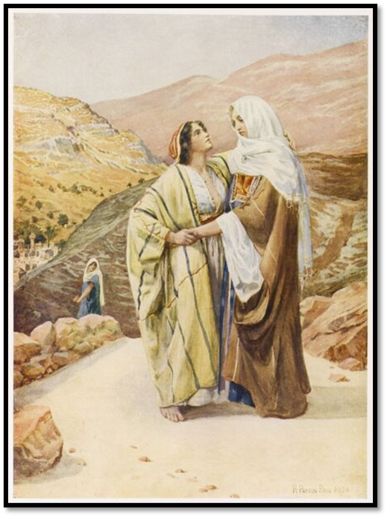
Welcome in the Name of
The Triune God
August 14, 2022
Ruth and Naomi
Prelude by Roxanne Groff
Office of the Acolyte
Ringing of the Bell
Scripture Focus: Ruth, Chapter 1
Notes:
Image: Preparing yeast dough. Copyright © tomasworks/iStock/Thinkstock. Used by permission.

Slide 2
CONFESSION AND FORGIVENESS
All may make the sign of the cross, the sign marked at baptism…
P: We confess our sins before God and one another.
Pause for silence and reflection.
P: Saving God,
Notes:
Image: Five Loaves by Caroline Coolidge Brown. Copyright © Caroline Coolidge Brown. All rights reserved. Used by permission of the artist.

Slide 3
CONFESSION AND FORGIVENESS
C: Too often we have turned away from you and toward ourselves. We have not had unity of spirit, sympathy, love for one another, a tender heart, or a humble mind. We have repaid evil for evil. We have failed to serve. Draw us back into the joy of your beloved community, and give us eager hearts to love our neighbors.
Notes:
Image: Five Loaves by Caroline Coolidge Brown. Copyright © Caroline Coolidge Brown. All rights reserved. Used by permission of the artist.

Slide 4
CONFESSION AND FORGIVENESS
L: God who redeems all flesh gives you new life in Christ and forgives you all your sins. Rejoice in the grace and mercy of God, through Jesus Christ, our savior.
C: Amen.
☩
Notes:
Image: Five Loaves by Caroline Coolidge Brown. Copyright © Caroline Coolidge Brown. All rights reserved. Used by permission of the artist.

Slide 5
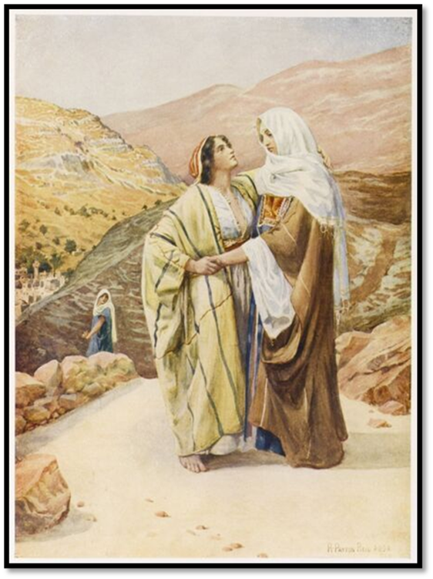
Hymn of Praise
“I Love You, Lord”
WOV 67
Notes:
Image: Five Loaves by Caroline Coolidge Brown. Copyright © Caroline Coolidge Brown. All rights reserved. Used by permission of the artist.

Slide 6
I Love You, Lord W&P 67
I love you, Lord
And I lift my voice To worship You Oh, my soul, rejoice!
Take joy my King In what You hear Let it be a sweet, sweet sound In Your ear
Notes:
Image: Five Loaves by Caroline Coolidge Brown. Copyright © Caroline Coolidge Brown. All rights reserved. Used by permission of the artist.

Slide 7
APOSTOLIC GREETING
P: The grace of our Lord Jesus Christ, the love of God, and the communion of the Holy Spirit be with you all.
C: And also with you.
Notes:
Image: Five Loaves by Caroline Coolidge Brown. Copyright © Caroline Coolidge Brown. All rights reserved. Used by permission of the artist.

Slide 8
PRAYER OF THE DAY
P: Let us pray… Merciful God, You have called to be stewards of your grace. Inspire us to serve one another with whatever gifts we have received, for the sake of your son, Jesus Christ.
C: Amen.
Notes:
Image: Five Loaves by Caroline Coolidge Brown. Copyright © Caroline Coolidge Brown. All rights reserved. Used by permission of the artist.

Slide 9
Notes:
Image: Preparing yeast dough. Copyright © tomasworks/iStock/Thinkstock. Used by permission.

Slide 10
Scripture Reading
R: The Scripture reading is from the book of Ruth, Chapter 1.
C: Glory to you O’ Lord! (Spoken)
Notes:
Image: Five Loaves by Caroline Coolidge Brown. Copyright © Caroline Coolidge Brown. All rights reserved. Used by permission of the artist.

Slide 11
Ruth 1
¹ In the days when the judges ruled, there was a famine in the land, and a certain man of Bethlehem in Judah went to live in the country of Moab, he and his wife and two sons. ²The name of the man was Elimelech and the name of his wife Naomi, and the names of his two sons were Mahlon and Chilion; they were Ephrathites from Bethlehem in Judah. They went
Notes:
Image: Five Loaves by Caroline Coolidge Brown. Copyright © Caroline Coolidge Brown. All rights reserved. Used by permission of the artist.

Slide 12
Ruth 1
into the country of Moab and remained there. ³But Elimelech, the husband of Naomi, died, and she was left with her two sons. ⁴These took Moabite wives; the name of the one was Orpah and the name of the other Ruth. When they had lived there about ten years, ⁵both Mahlon and Chilion also died, so that the woman was left without her two sons and her husband.
Notes:
Image: Five Loaves by Caroline Coolidge Brown. Copyright © Caroline Coolidge Brown. All rights reserved. Used by permission of the artist.

Slide 13
Ruth 1
⁶Then she started to return with her daughters-in-law from the country of Moab, for she had heard in the country of Moab that the Lord had considered his people and given them food. ⁷So she set out from the place where she had been living, she and her two daughters-in-law, and they went on their way to go back to the land of Judah. ⁸But Naomi said to her two
Notes:
Image: Five Loaves by Caroline Coolidge Brown. Copyright © Caroline Coolidge Brown. All rights reserved. Used by permission of the artist.

Slide 14
Ruth 1
daughters-in-law, “Go back each of you to your mother’s house. May the Lord deal kindly with you, as you have dealt with the dead and with me. ⁹The Lord grant that you may find security, each of you in the house of your husband.” Then she kissed them, and they wept aloud. ¹⁰They said to her, “No, we will return with you to your people.” ¹¹But Naomi said, “Turn back,
Notes:
Image: Five Loaves by Caroline Coolidge Brown. Copyright © Caroline Coolidge Brown. All rights reserved. Used by permission of the artist.

Slide 15
Ruth 1
my daughters, why will you go with me? Do I still have sons in my womb that they may become your husbands? ¹²Turn back, my daughters, go your way, for I am too old to have a husband. Even if I thought there was hope for me, even if I should have a husband tonight and bear sons, ¹³would you then wait until they were grown? Would you then refrain from
Notes:
Image: Five Loaves by Caroline Coolidge Brown. Copyright © Caroline Coolidge Brown. All rights reserved. Used by permission of the artist.

Slide 16
Ruth 1
marrying? No, my daughters, it has been far more bitter for me than for you, because the hand of the Lord has turned against me.” ¹⁴Then they wept aloud again. Orpah kissed her mother-in-law, but Ruth clung to her. ¹⁵So she said, “See, your sister-in-law has gone back to her people and to her gods; return after your sister-in-law.” ¹⁶But Ruth said, “Do not press me to leave
Notes:
Image: Five Loaves by Caroline Coolidge Brown. Copyright © Caroline Coolidge Brown. All rights reserved. Used by permission of the artist.

Slide 17
Ruth 1
you or to turn back from following you! Where you go, I will go; Where you lodge, I will lodge; your people shall be my people, and your God my God. ¹⁷Where you die, I will die— there will I be buried. May the Lord do thus and so to me, and more as well, if even death parts me from you!” ¹⁸When Naomi saw that she was determined to go with her, she said no more to her.
Notes:
Image: Five Loaves by Caroline Coolidge Brown. Copyright © Caroline Coolidge Brown. All rights reserved. Used by permission of the artist.

Slide 18
Ruth 1
¹⁹So the two of them went on until they came to Bethlehem. When they came to Bethlehem, the whole town was stirred because of them; and the women said, “Is this Naomi?” ²⁰She said to them, “Call me no longer Naomi, call me Mara, for the Almighty has dealt bitterly with me. ²¹I went away full, but the Lord has brought me back empty; why call me Naomi when
Notes:
Image: Five Loaves by Caroline Coolidge Brown. Copyright © Caroline Coolidge Brown. All rights reserved. Used by permission of the artist.

Slide 19
Ruth 1
the Lord has dealt harshly with me, and the Almighty has brought calamity upon me?” ²²So Naomi returned together with Ruth the Moabite, her daughter-in-law, who came back with her from the country of Moab. They came to Bethlehem at the beginning of the barley harvest.
Notes:
Image: Five Loaves by Caroline Coolidge Brown. Copyright © Caroline Coolidge Brown. All rights reserved. Used by permission of the artist.

Slide 20
Ruth 1
P: This is the Word of the Lord.
C: Praise to You, O Christ (Spoken)
Notes:
Image: Five Loaves by Caroline Coolidge Brown. Copyright © Caroline Coolidge Brown. All rights reserved. Used by permission of the artist.

Slide 21
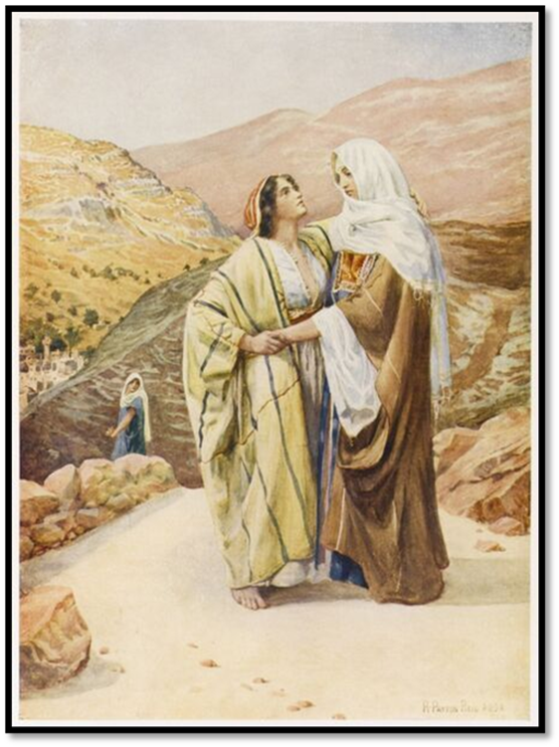
SERMON
Notes:
Image: Five Loaves by Caroline Coolidge Brown. Copyright © Caroline Coolidge Brown. All rights reserved. Used by permission of the artist.

Slide 22
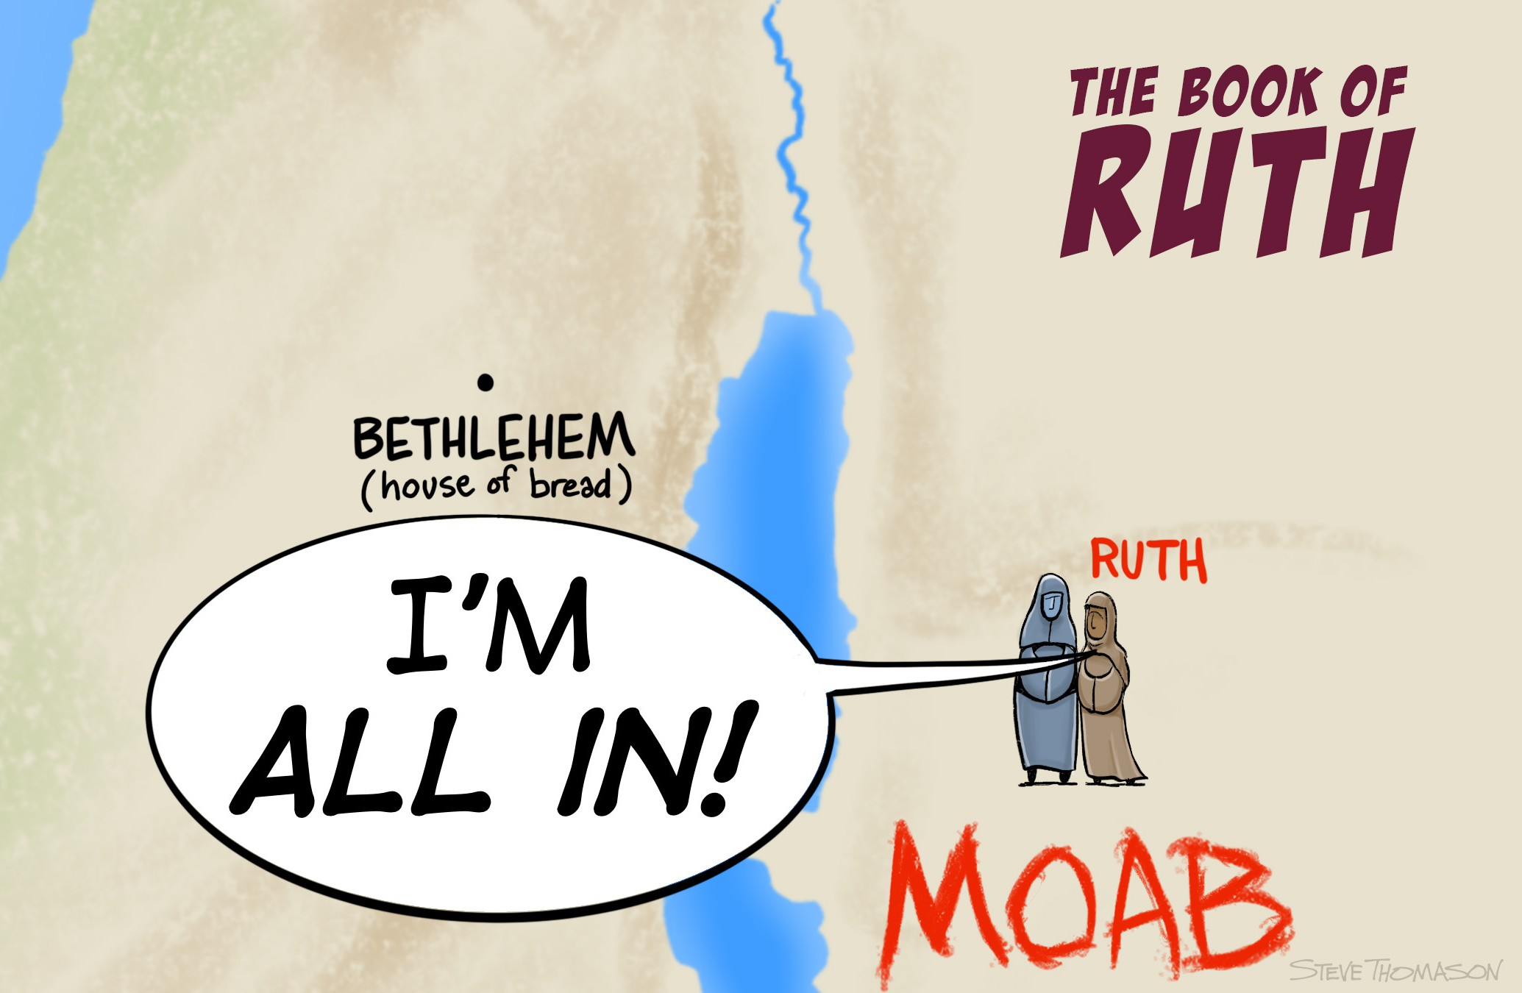
Sermon
Notes:
Image: Five Loaves by Caroline Coolidge Brown. Copyright © Caroline Coolidge Brown. All rights reserved. Used by permission of the artist.

Slide 23
SERMON
Notes:
Image: Five Loaves by Caroline Coolidge Brown. Copyright © Caroline Coolidge Brown. All rights reserved. Used by permission of the artist.

Slide 24
SPECIAL MUSIC
LARRY HARTER
Notes:
Image: Five Loaves by Caroline Coolidge Brown. Copyright © Caroline Coolidge Brown. All rights reserved. Used by permission of the artist.

Slide 25
APOSTLE’S CREED
C: I believe in God, the Father almighty, creator of heaven and earth.

Slide 26
APOSTLE’S CREED
C: I believe in Jesus Christ, his only Son, our Lord. He was conceived by the power of the Holy Spirit and born of the virgin Mary. He suffered under Pontius Pilate, was crucified, died, and was buried.

Slide 27
APOSTLE’S CREED
C: He descended into hell. On the third day he rose again. He ascended into heaven, and is seated at the right hand of the Father. He will come again to judge the living and the dead.

Slide 28
APOSTLE’S CREED
C: I believe in the Holy Spirit, the holy catholic Church, the communion of saints, the forgiveness of sins, the resurrection of the body, and the life everlasting. Amen.

Slide 29
NICENE CREED
C: We believe in one God, the Father, the Almighty, maker of heaven and earth, of all that is, seen and unseen.

Slide 30
NICENE CREED
C: We believe in one Lord, Jesus Christ, the only Son of God, eternally begotten of the Father, God from God, Light from Light, true God from true God, begotten, not made, of one Being with the Father.

Slide 31
NICENE CREED
C: Through him all things were made. For us and for our salvation he came down from heaven; by the power of the Holy Spirit he became incarnate from the virgin Mary, and was made man. For our sake he was crucified under Pontius Pilate;

Slide 32
NICENE CREED
C: he suffered death and was buried. On the third day he rose again in accordance with the Scriptures; he ascended into heaven and is seated at the right hand of the Father. He will come again in glory to judge the living and the dead, and his kingdom will have no end.

Slide 33
NICENE CREED
C: We believe in the Holy Spirit, the Lord, the giver of life, who proceeds from the Father and the Son. With the Father and the Son he is worshiped and glorified. He has spoken through the prophets. We believe in one holy catholic and apostolic Church.

Slide 34
NICENE CREED
C: We acknowledge one Baptism for the forgiveness of sins. We look for the resurrection of the dead, and the life of the world to come. Amen.

Slide 35
PRAYERS OF INTERCESSION
Each petition will end with the words,
A: God in your mercy,
The congregation will respond with:
C: You hear our prayer.

Slide 36
PRAYERS OF INTERCESSION
The prayer concludes…
P: With gratitude for your faithfulness, we pray these things in the name of Jesus Christ, our savior.
C: Amen.

Slide 37
SHARING OF THE Peace
The Sharing of the Peace that began when the congregation arrived is now shared with the Pastor at this time...
P: The peace of the Lord be with you always.
C: And also with you.

Slide 38
OFFERING PRAYER
Notes:
Image: Five Loaves by Caroline Coolidge Brown. Copyright © Caroline Coolidge Brown. All rights reserved. Used by permission of the artist.

Slide 39
THE LORD’S PRAYER
P: Jesus is the “tie that Binds us together”, let us pray as Jesus taught…
C: Our Father, who art in heaven, hallowed be thy name, thy kingdom come, thy will be done, on earth as it is in heaven. Give us this day our daily bread; and forgive us our trespasses,

Slide 40
THE LORD’S PRAYER
C: as we forgive those who trespass against us; and lead us not into temptation, but deliver us from evil. For thine is the kingdom, and the power, and the glory, forever and ever. Amen.

Slide 41
ANNOUNCEMENTS
Notes:
Image: Five Loaves by Caroline Coolidge Brown. Copyright © Caroline Coolidge Brown. All rights reserved. Used by permission of the artist.

Slide 42
SENDING BLESSING
P: The God of peace, Father, ☩ Son, and Holy Spirit, bless you, comfort you, and show you the path of life this day and always.
C: Amen.
☩
☩

Slide 43
Sending Song
“Amazing Grace”
LBW 448
Notes:
Image: Five Loaves by Caroline Coolidge Brown. Copyright © Caroline Coolidge Brown. All rights reserved. Used by permission of the artist.

Slide 44
Amazing Grace LBW 448
1 Amazing grace, how sweet the sound,
that saved a wretch like me!
I once was lost, but now am found;
was blind, but now I see.
Notes:
Image: Five Loaves by Caroline Coolidge Brown. Copyright © Caroline Coolidge Brown. All rights reserved. Used by permission of the artist.

Slide 45
Amazing Grace LBW 448
2 ’Twas grace that taught my heart to fear,
and grace my fears relieved;
how precious did that grace appear
the hour I first believed!
Notes:
Image: Five Loaves by Caroline Coolidge Brown. Copyright © Caroline Coolidge Brown. All rights reserved. Used by permission of the artist.

Slide 46
Amazing Grace LBW 448
3 Through many dangers, toils, and snares
I have already come;
’tis grace has brought me safe thus far,
and grace will lead me home.
Notes:
Image: Five Loaves by Caroline Coolidge Brown. Copyright © Caroline Coolidge Brown. All rights reserved. Used by permission of the artist.

Slide 47
Amazing Grace LBW 448
4 The Lord has promised good to me;
his word my hope secures;
he will my shield and portion be
as long as life endures.
Notes:
Image: Five Loaves by Caroline Coolidge Brown. Copyright © Caroline Coolidge Brown. All rights reserved. Used by permission of the artist.

Slide 48
DISMISSAL
P: Until we gather again as God’s people to offer our worship and praise, depart in Christ’s Love,
C: Seeking, welcoming, and serving all. Amen!
Postlude by Roxanne Groff
Copyright © 2022 Augsburg Fortress. All rights reserved. Reprinted by permission under Augsburg Fortress Liturgies Annual License #SAS023830. New Revised Standard Version Bible, Copyright © 1989, Division of Christian Education of the National Council of the Churches of Christ in the United States of America. Used by permission. All rights reserved. Revised Common Lectionary, Copyright © 1992 Consultation on Common Texts, admin Augsburg Fortress. Used by permission.

