Slide 1

Drugs used in the treatment of gastrointestinal diseases
University of Split
School of Medicine
Department of Pharmacology

Slide 2
Gastrointestinal system - drugs
1. Drugs used in acid peptic diseases
2. Mucosal protective agents
3. Antiemetic agents
4. Laxatives
5. Antidiarrheal agents
6. Drugs used in the irritable bowel syndrome (IBS)
7. Drugs used in the inflammatory bowel disease

Slide 3
Causes of GERD and peptic ulcers (gastric and duodenal)
Overwhelming of defensive factors of the gastrointestinal mucosa: mucus, bicarbonate secretion, prostaglandins, regeneration of damaged cells
Helicobacter pylori 90%
NSAID
Stress
Reflux of bile into the stomach and acid into the gut (duodenum)
Gastrinoma

Slide 4
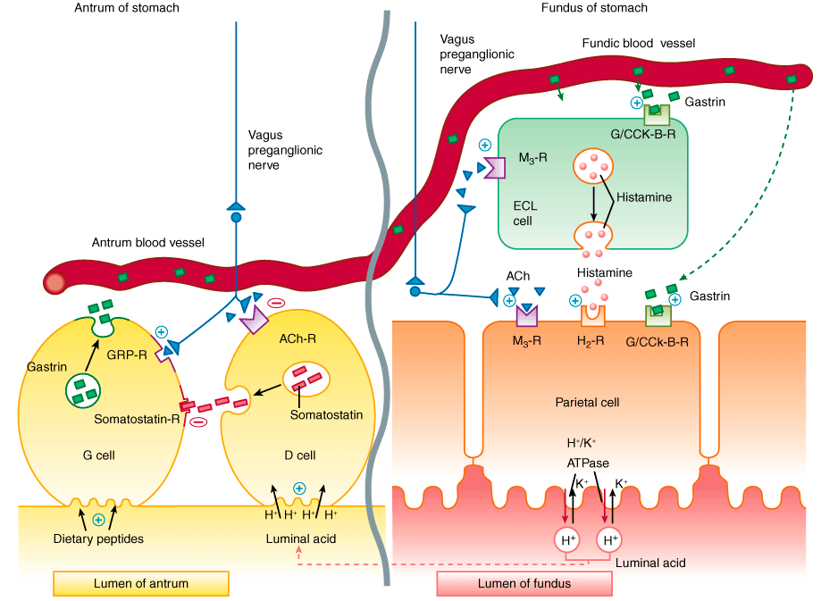
Physiologic control of acid secretion
Notes:
Zuc osteti zeludac a zelucana kiselina dvanaesnik

Slide 5
Drugs that reduce intragastric acidity
ANTACIDS – sodium-bicarbonate, calcium-carbonate, Mg(OH)2 i Al(OH)3
are weak bases that react with gastric acid and neutralize it
Indications: addition to peptic ulcer disease therapy and dyspepsia, Mg and Al do not generate gas
Notes:
CO2 i NaCl; Mg(Al)Cl i H2O

Slide 6
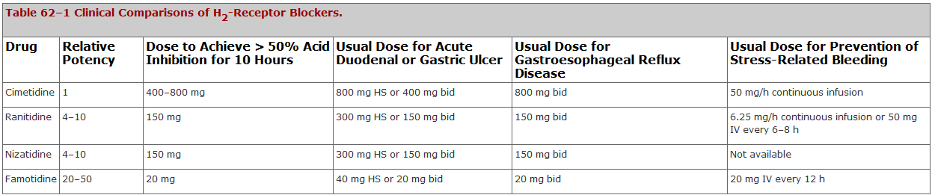
Drugs that reduce intragastric acidity
H2 RECEPTOR ANTAGONISTS -
famotidine, ranitidine, cimetidine
Indications: peptic ulcer, GERD
ADRs: safe drugs. Cimetidine – inhibits microsomal enzymes, gynecomastia, impotence

Slide 7
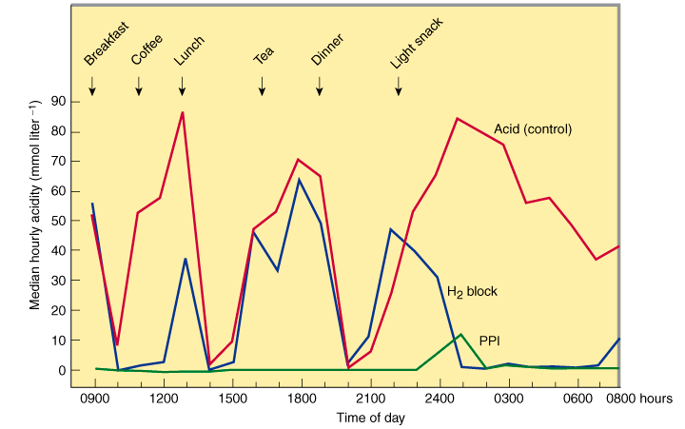

Slide 8
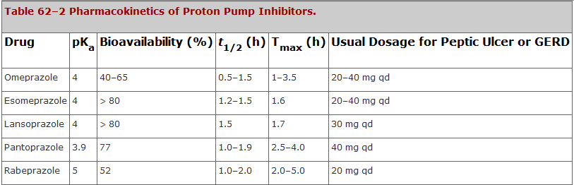
Drugs that reduce intragastric acidity
PROTON PUMP INHIBITORS
omeprazole, pantoprazole
indications:
  peptic ulcer, ezophagitis, GERB, gastrinoma, prevention of stress related mucosal bleeding
are most effective in the treatment respective diseases
extremely safe

Slide 9
Triple therapy for H.pylori
10 or 14 days regimen
omeprazole, amoxicillin, metronidazole
omeprazole, amoxicillin, clarithromycin
If a bacterium is the cause why can’t we treat it only with antibiotics?
Because the antibiotic can’t achieve sufficient MIC in acid environment

Slide 10
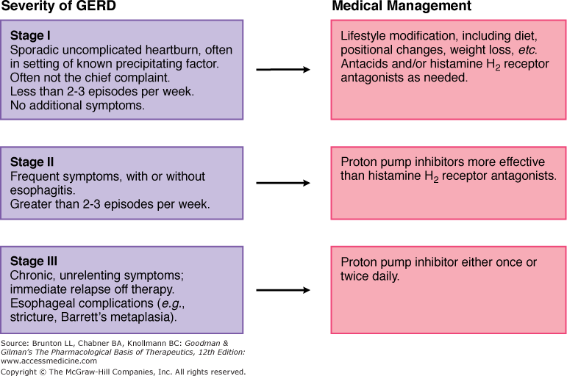

Slide 11
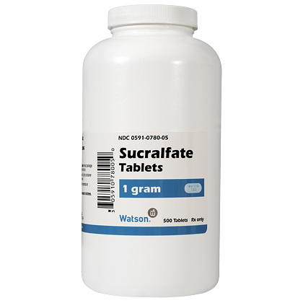
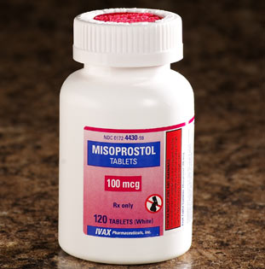
Mucosal protective agents
Sucralfate = salt of sucrose +sulfate + Al(OH)3
Misoprostol
(analog of PGE1)

Slide 12
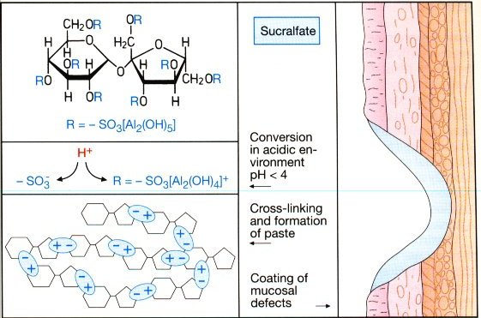

Slide 13
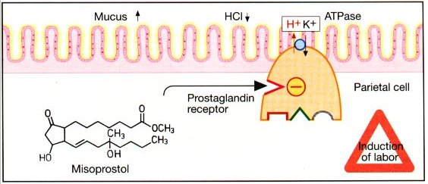

Slide 14
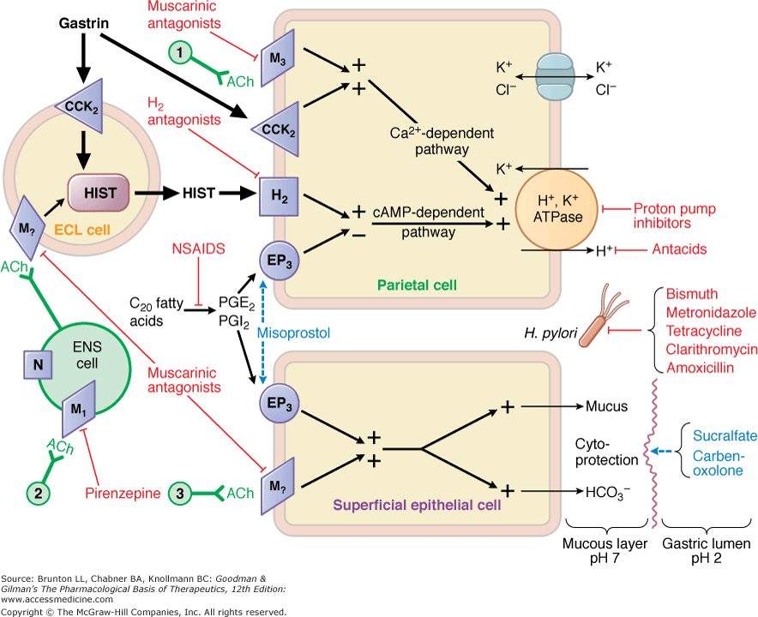

Slide 15
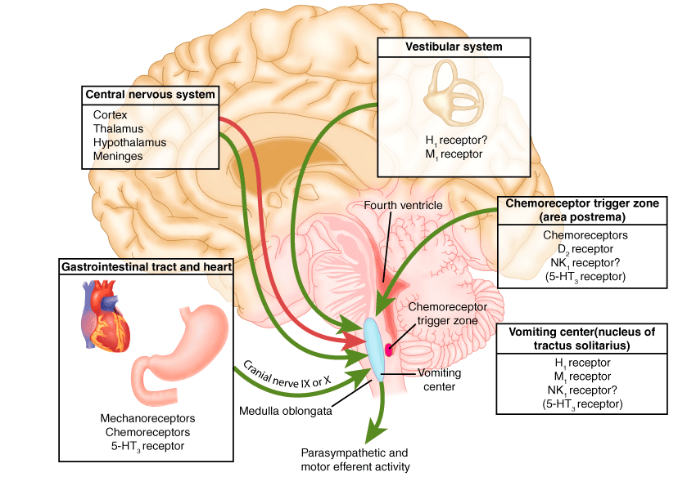
Antiemetics

Slide 17
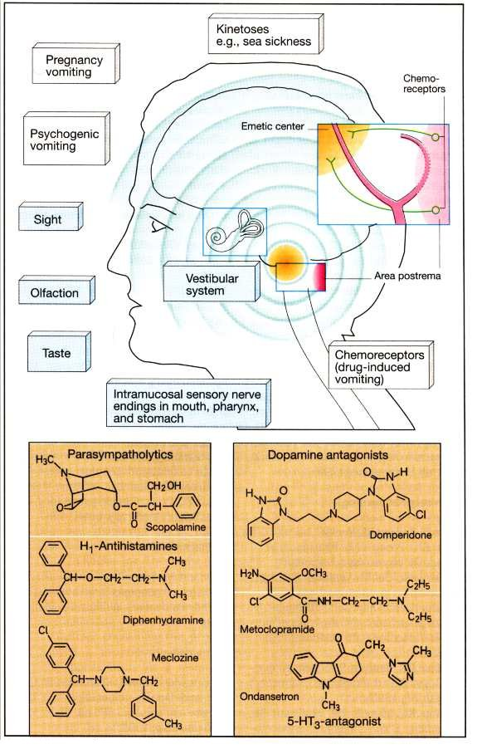
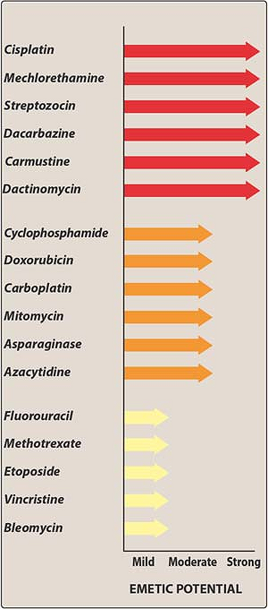

Slide 18
Antiemetics
H1 receptor antagonists (diphenhydramine)
M1 receptor antagonists (scopolamine)
5-HT3 receptor antagonists (ondansetron)
D2 receptor antagonists (phenothiazines : thiethylperazine; substituted benzamides: metoclopramid; and domperidone)
NK1 receptor antagonists (aprepitant, fosaprepitant)
Corticosteroids (dexamethasone, prednizolon)
Cannabinoids (dronabinol, nabilone)
Benzamides (metoclopramide)
Antipsychotics (phenothiazines: promethazine butirophenones: droperidol)
Benzodiazepines (lorazepam, diazepam)

Slide 19
H1 – together with others for chemotherapy; vertigo;
M- vertigo and kinetosis (motion sickness);
5HT3 – postoperative and chemo,
D2 - postoperative

Slide 21
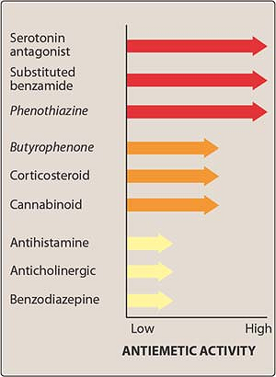
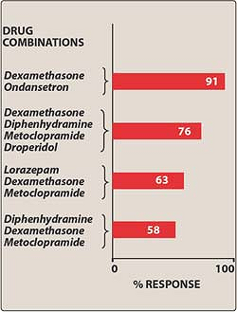

Slide 22
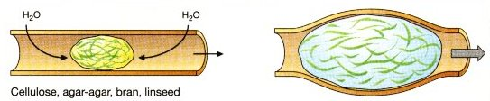
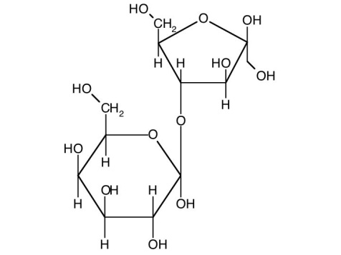
Laxatives
Bulk-forming: methyl-cellulose
Osmotic: laktulose, Mg(OH)2

Slide 23
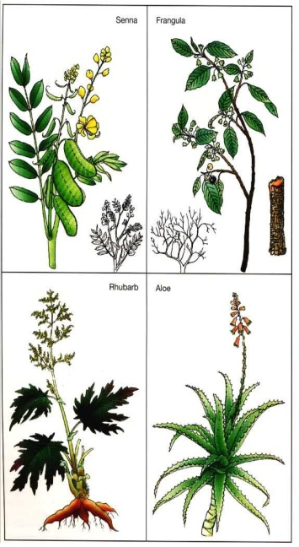
Laxatives
Stool surfactants
(softeners): Na docusate, glycerin suppository
Stimulats: senna plant, bisacodil
Enema!

Slide 24
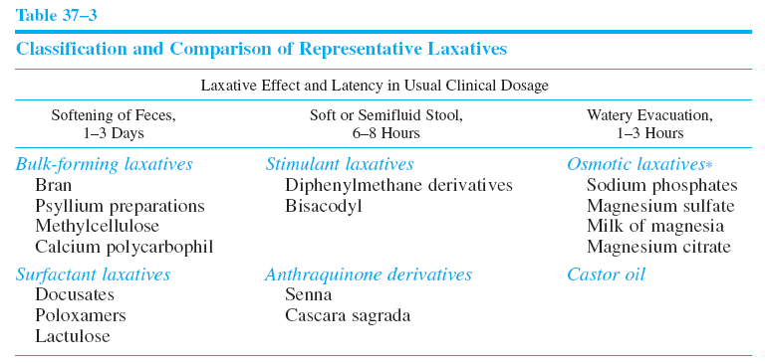

Slide 26
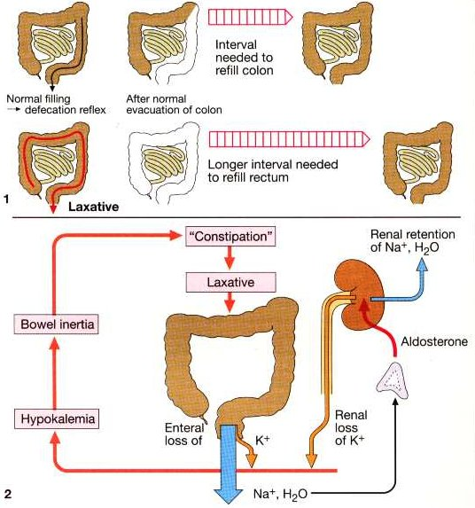

Slide 27
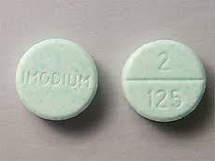
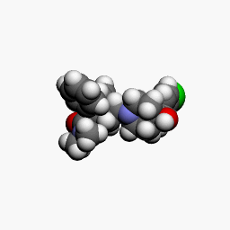
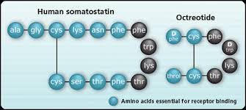
Antidiarrheal agents
Opioids
loperamide, diphenoxylate
somatostatin - octreotide

Slide 28
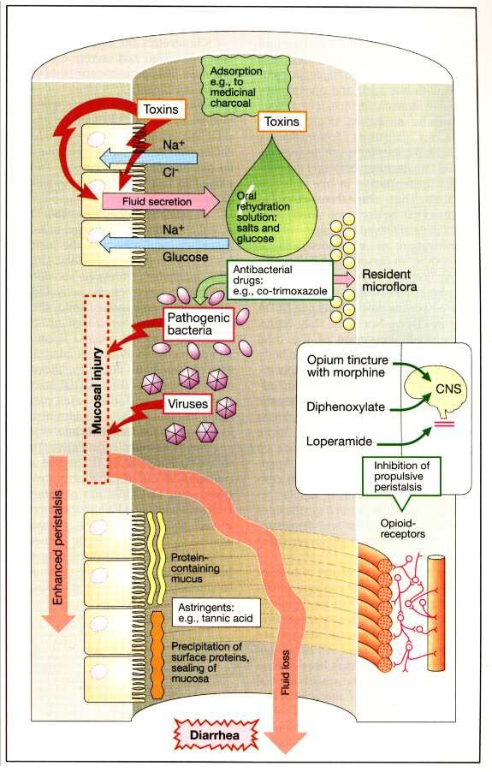

Slide 29
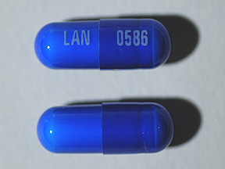
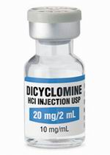
Antispasmodic agents
M receptor antagonists
  Dicyclomine and hyoscyamine
Ca channel blockers
Analgesics and anxiolytics

Slide 30
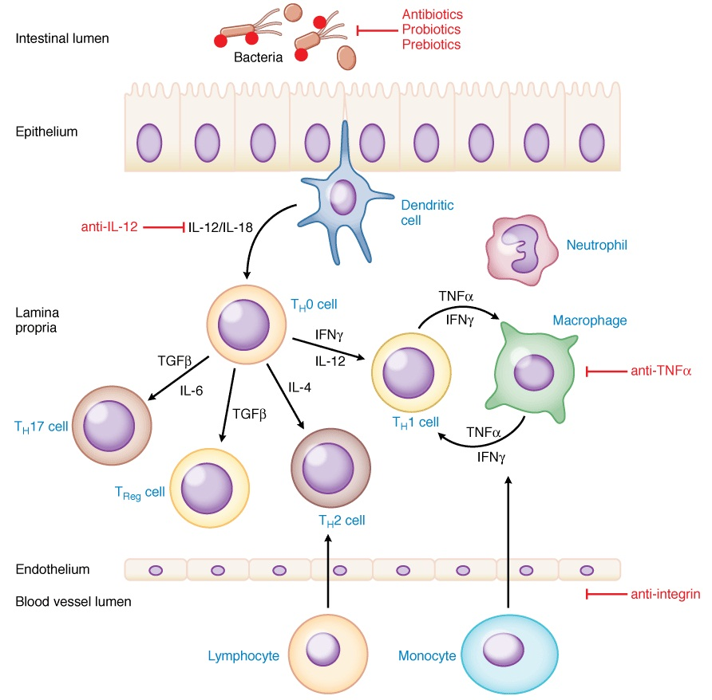
Drugs used to treat inflammatory bowel disease

Slide 31
Drugs used to treat inflammatory bowel disease
Aminosalicylates: sulfasalazine, mesalamine
Purine analogs: azathioprine & methotrexate
Glucocorticoids: budesonide
Anti-tumor necrosis factor therapy (TNF): infliximab, adalimubab

Slide 32
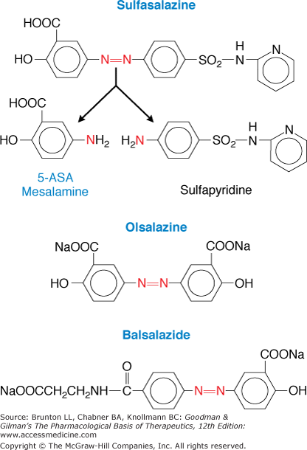
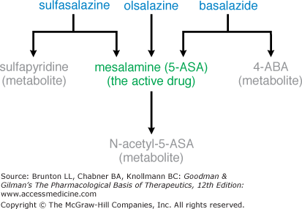
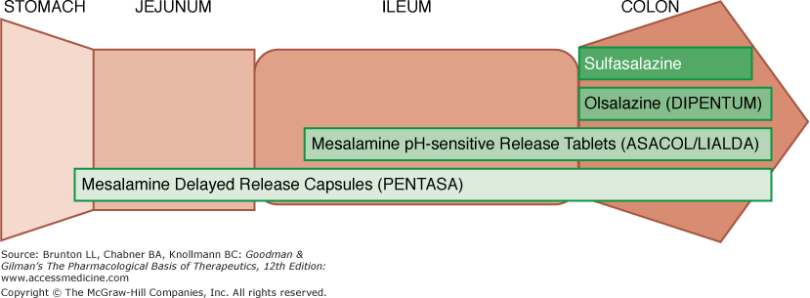

Slide 33
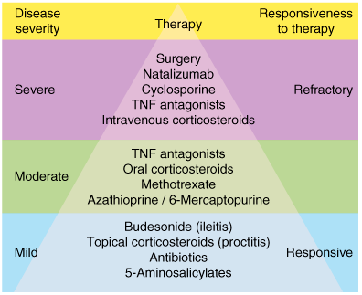
Therapeutic pyramid approach to inflammatory bowel diseases
Natalizumab is reserved for patients with severe Crohn's disease who have failed immunomodulators and TNF antagonists.
Cyclosporine is used primarily for patients with severe ulcerative colitis who have failed a course of intravenous corticosteroids, TNF, tumor necrosis factor.
Treatment choice is predicated on both the severity of the illness and the responsiveness to therapy
Agents at the bottom of the pyramid are less efficacious but carry a lower risk of serious adverse effects
Drugs may be used alone or in various combinations.

