Slide 1
Effectiveness of Mandibular Advancement Device vs Positive Airway Pressure for Treatment of Moderate Sleep Apnea (OSA) Mariam T Siddiqui BDS, MS (CR) Fellow TMD Orofacial Pain Thesis Defense

Slide 2
Most Common Sleep Disorders
•80 different kinds of sleep disorders
•Inadequate sleep (46%)
•Insomnia (35%)
•Obstructive sleep apnea:
Men (3-7%) Women (2-5%)

Slide 3
Sleep Patterns
Newborns; Polyphasic
Toddlers; Biphasic
Adults; Monophasic
Notes:
REASON: Adaptation to environment, particularly after industrialization

Slide 4
Normal sleep
•Physiologically: NREM & REM
•NREM divided into N1,N2, N3 sleep
•NREM & REM alternate, each cycle lasting 90-100 min – 4 to 6 cycles during a normal period
•Adult NREM: 75% of total sleep
•Adult REM: 25% of total sleep
Notes:
Physiologically sleep is segrated into NREM & REM
NREM:
N1: 3-8% of total sleep, EMG Activity diminishes
End of N1: slow rolling eye movements + vertex sharp waves noted
N2: two key EEG findings: sleep spindles & Biphasic K complexes intermixed with vertex sharp edges (N2 lasts 30-60 mins)
N3: slow waves, delta activity occupies 20-100% of the epoch activity
REM Sleep ( R ): 20-25% of total sleep
occurs 60-90 minutes after onset of sleep
REM divided into Tonic REM & Phasic REM
Tonic REM: Desynchronized EEG, Hypotonia/ Atonia of the major skeletal muscle groups & depression of monosynaptic & polysynaptic reflexes
Phasic REM: REM in all directions + Phasic fluctuation in autonomic activity (B.P, Heart Rate, Irregular Respiration), Spontaneous middle ear muscle activity, tongue movements

Slide 5
Normal Breathing:
Patent airway
Obstructive sleep apnea:
•Relaxation of the upper airway (tongue & soft palate)
•partial or complete blockage of airway (10 secs) up to hundreds of time at night
•Prevention/ shallow breathing followed by awakening to breathe
•Results in Snoring
•Reduction in blood O2 levels-awakening to breath
•Chronic tiredness & fatigue
Notes:
Obstructive sleep apnea is a condition where there are repetitive pauses or reductions in breathing during sleep, due to collapse of the upper airway when the muscles of the upper airway (including tongue and soft palate) become relaxed during sleep narrowing significantly or completely blocking the airway, and preventing breathing usually accompanied by reduction in blood oxygen levels and followed by an awakening to breathe resulting in chronic tiredness and fatigue.

Slide 6
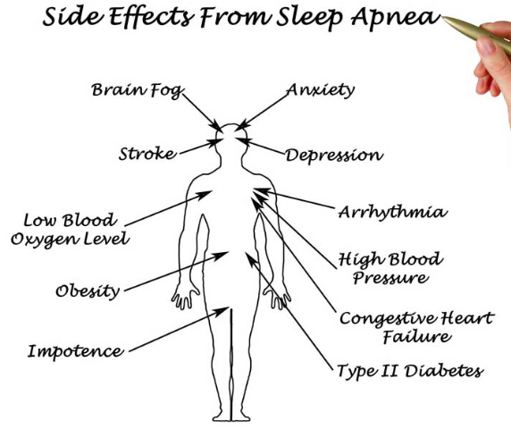
Notes:
If left untreated, sleep apnea can result in a growing number of health problems, including: High blood pressure, Stroke, Heart failure, irregular heart beats, and heart attacks. We need to treat the cause and not the outcome.

Slide 7
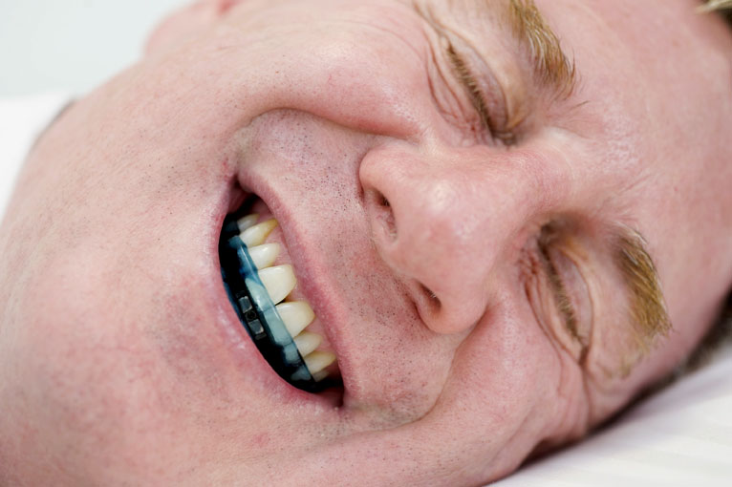
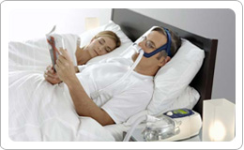
MAD vs CPAP?
Notes:
Obstructive sleep apnea is a problem in the U.S as well as globally….the suggestive intervention in current health care practice is 1,2,3. Both interventions are important in decreasing the symptoms of obstructive sleep apnea.
It is Rxed in three different ways in our health care system:
1.sleep clinic (with the aid of CPAP with positive airway pressure ventilation)
2.TMD orofacial pain clinic (with mandibular advancement device which opens the airway).
3.ENT (surgical option)
Sleep apnea is the cause of hypertension, diabetes, day time sleepiness, night grinding,TMJ disorders. A lot of times patients receive treatments for these, we need to treat the cause (which is sleep apnea) not the outcome.
For our study we want to see the effectiveness of mandibular advancement device versus CPAP for the treatment of moderate sleep apnea in non compliant patients.
Talk about superiority/ non inferiority

Slide 8
Hypothesis:
MAD is non-inferior to CPAP for Treatment of moderate Sleep Apnea (OSA) in non-compliant patients
Notes:
Read only

Slide 9
Methods - Search & Screening
PubMed
465 results
Embase
239 results
Combinedn=594
Duplicatesremoved
Full textreview
n=16
Removed after full text review=8
No outcomes of interest
2 cohort studies
8 RCTs
Discoveredfromfurtherreview
n=1
Included in final review
8RCTs

Slide 10
PICOTs Table
Population: | Adult patients (18-75yrs) with obstructive sleep apnea
Intervention: | Mandibular advancement devices
Comparator: | Positive airway pressure ventilation.
Outcome: | Daytime sleepiness, High blood pressure, TMD, fatigue, snoring (reported by partner)
Timing: | Duration of treatment from diagnosis including the length of follow-up.
Setting: | Patients receiving treatment at sleep & orofacial pain clinics for obstructive sleep apnea.
Notes:
PICOTS table help us understand the intervention & implementation factors associated with our treatment modalities

Slide 11
KQ Pathway
KQ: MAD produces positive outcomes compared to CPAP ventilation in non-compliant patients with moderate sleep apnea in presence of confounding variables
KQ2: MAD produces better outcomes compared to CPAP in non-compliant patients with moderate sleep apnea
KQ3: Intermediate outcomes (RDI, AHI, day time sleepiness, hypertension, metabolic disorders) are related to clinically important outcomes (fatigue, snoring, clenching, night grinding, TMD)
KQ4:Harms associated with MAD in patients with moderate sleep apnea?
Notes:
Talkabout it in 25 page draft,
Must talk about framing causal Questions.

Slide 12
(Confounding variables)
Notes:
KQ1:May include confounders

Slide 13
Materials and Methods
Target Population
Individuals* diagnosed with mild to moderate sleep apnea, aged 18-75.
Intervention:
MAD
Comparator:
CPAP
Timing to assess the outcomes:
1-2 months
Primary outcome:
AHI
Secondary outcome:
Compliance
Notes:
Primary outcomes (should normally reflect at least one potential benefit in mortality, morbidity, and quality of life, and at least one potential area of harm, and should be as few as possible (5orless)
We only have individuals from Australia and US
The appropriate comparator will ideally be placebo or no treatment in order to identify and evaluate those effects which are truly related to the intervention. However, sometimes it is important to explore differences between active treatments. A reliable investigation of the differences between active treatments can only be undertaken for specific adverse effects within well-defined populations. so when we R comparing two types of treatments we may call it a superiority trial or a non inferior trial
ContinuousPositiveAirwayPressure(CPAP) is the leading therapy for sleep apnea. Patients wear a face ornasalmaskduringsleep.Themask,connectedtoapump,providesapositiveflowofairintothenasalpassagesinordertokeeptheairwayopen.
APAP:APAPstandsforAutomaticPositiveAirwayPressure,APAPmachinesareanon-invasivetreatmentforsleepapneathatdeliverpressurizedair,viaamask,tokeepyourairwaysfreeofobstructionsasyousleep.Theairpressuredeliveredfromthemachinesactsasasplint,keepingyourthroatfromcollapsinginonitselfsothatyoucanbreathefreelythroughthenightwithoutanyapneaevents.
BiPAP(alsoreferredtoasBPAP)standsforBilevelPositiveAirwayPressure,andisverysimilarinfunctionanddesigntoaCPAPmachine(continuouspositiveairwaypressure).SimilartoaCPAPmachine,ABiPAPmachineisanon-invasiveformoftherapyforpatientssufferingfromsleepapnea.
Uvuloplastyissurgerytotakeouttheuvula.Theuvulaisthesmallbitoffleshdanglingdowninthebackofthethroat.ThissurgeryiscalledLASUPforshortwhenalaserisusedtodothesurgery.
Uvulopalatoplastyisasurgicalprocedureperformedwiththeaimofreducingoreliminatingsnoring.Itisanout-patientprocedure,inwhichalaserisusedtoremovepartsoralloftheuvulaattherearofthemouth.
Atracheotomyoratracheostomyisanopeningsurgicallycreatedthroughtheneckintothetrachea(windpipe)toallowdirectaccesstothebreathingtubeandiscommonlydoneinanoperatingroomundergeneralanesthesia.
MaxillomandibularAdvancement(MMA)ororthognathicsurgery,alsosometimescalledBimaxillaryAdvancement(Bi-Max),orMaxillomandibularOsteotomy(MMO),isasurgicalprocedureorSleepSurgerywhichmovestheupperjaw(maxilla)andthelowerjaw(mandible)forward.

Slide 14
Materials and Methods
Setting:
-For our study, we will use all RCTs published during the last twenty five years in the English language.
-We used two cross over studies

Slide 15
Materials and Methods
Patient centered Outcomes:
Sleep latency, min
Subject sleep, hrs/night
Compliance with treatment modality
Objective/ Intermediate outcomes:
Effect on blood pressure.
Apnea hypopnea index,AHI
3% oxygen desaturation index–ODI
Mean SpO2%.
Notes:
Settings (context) of the review:
When placing your topic in context, it is often useful to think about the following:
What is the scope of the topic?
What is the purpose of the research?
Who is the intended audience?
What is the time period?
What is the geographical coverage?
What are the relevant/ related disciplines?
Exclusion:

Slide 16
Inclusion Criteria
Patients > 18 years diagnosed with OSA.
Direct comparison between CPAP and MAD.
Patients with newly diagnosed OSA (AHI 10-60 events/h)
Greater than or equal to two symptoms of OSA (snoring, fragmented sleep, witnessed apneas, or day time sleepiness)
Willingness and Ability to use both treatments.

Slide 17
Exclusion criteria
Central sleep apnea
Previous OSA treatment or a need for immediate treatment
A co-existing sleep disorder
Regular use of sedatives or narcotics
Pre-existing lung or psychiatric disease;
Any contraindication for oral appliance therapy (e.g.,periodontal disease or insufﬁcient dentition).
Body mass index (BMI) ≥35 kg·m⁻²
Unstable medical illness e.g.heart failure and severe sleepiness which may constitute risk to self or others

Slide 18
Sources of Bias
Selection Bias
Allocation concealment
Performance
Detection
Attrition
Selective Reporting
Notes:
I might have intellectual bias, due to knowledge of the subject

Slide 19
 | Selection | Allocation concealment | Performance | Detection | Attrition | Selective Reporting
study1 | ✅ | ✅ | x | ✅ | ✅ | ✅
study2 | ✅ | ✅ | x | ✅ | ✅ | x
study3 | ? | ? | x | ✅ | ✅ | ✅
study4 | ✅ | ✅ | x | x | ✅ | ✅
study5 | ✅ | ✅ | x | ✅ | x | ✅
study6 | ✅ | ✅ | x | x | x | x
study7 | ? | ? | x | ? | ? | ?
study8 | ✅ | ? | x | ? | ✅ | ✅
study9 | ✅ | ? | x | ? | ✅ | ✅
study10 | ✅ | ✅ | x | ? | ? | ?
Study11 | ✅ | ✅ | x | ✅ | x | ✅
Notes:
Checks represent low biasis
selection bias I rated selection bias generally as low if they were crossover studies, if they that mentioned block randomization ----high for observational studies
Allocation Concealment is a technique used to prevent selection bias in Randomised Controlled Trials (RCT's) by concealing the allocation sequence from those assigning participants to the intervention groups, until the moment of assignment.
Performance bias: is high in all as blinding is not possible (Performance bias refer to the fact that participants can change their responses if they know which group they are allocated in.
Detection/Ascertainment bias: Systematic differences between groups in how outcomes are determined
It may cause an overestimate/ underestimate of the size of the effect. But in this case AHI being objectively measured, we can rate it as low risk of bias
Attrision bias: Systematic error is caused by unequal loss of participants from randomized clinical trials. Pts may with draw due to unsatisfactory Rx efficacy ,intolerable adverse effects, or death, with drawls from the study leads to incomplete outcome data.
In our collected studies, some of the studies we rate them as low as they have very few suspicious withdrawals. Some of the studies were rated as medium/ high risk of attrision bias as many patients in CPAP are not adherent, large number of people with drew with no details given for them, and were not analyzed
Selective reporting bias: Selective reporting bias can result when only a subset of the original out comes are measured and analyzed and are fully reported on magnitude of the Rx effect or the statistical significance of selected outcomes. The checked ones are rated as low risk of selective reporting bias,as we don’t suspect a cherry picking event, there is adequate reporting of results, no evidence of purposeful exclusion of results.
In case large # of patients withdrew, and for the studies here that had no details given were at high risk of selective reportive bias.

Slide 20
GRADE: Factors in deciding quality of evidence
Study limitations
Inconsistency of results
Indirectness of evidence
Imprecision
Publication bias
Factors that might increase quality of evidence
Large magnitude of effect
Plausible confounding, which would reduce a demonstrated effect.
Dose response gradient
Notes:
Judgments about evidence and recommendations are complex. e.g., the choice between SSRIs and TCAs for the treatment of moderate depression. We need to decide which outcomes to consider, which evidence to include for each outcome, how to assess the quality of that evidence, and how to determine if SSRIs do more good than harm compared with TCAs. Because resources are always limited and money that is spent on SSRIs cannot be used elsewhere, they may also need to decide whether any incremental health benefits are worth the additional costs.

Slide 21
GRADE: Factors for quality of evidence
AHRQ | Outcome | NumberOf Studies | Quality | Direct/ Indirect | Consistency | Effect size | Conclusion
Study | AHI | 8 | We couldn't blind it except 1,sometime have questionable practices. Some studies reporting means and medians.Throwing people out, where treatment wasn't effective, we deduct-2 points | All seem to be direct studies. garde 0 | Most of the studies show better AHI scores for CPAP vs MAD, however few are giving opposite results in non-compliant patients, grade it 0 | Need to do meta-analysis for it and calculate OR/ RR/ HR | Overall quality of papers are fine, it is not the best ever. There is enough good quality data that if there is a strong effect size,we should be able to draw an evidence based conclusion from it.
 | Epworth Sleepiness Scale ESS | 4
 | min SaO2(%) lowest oxyhemoglobin saturation during sleep | 3

Slide 22
MAD | baseline MAD | st.dev baseline MAD | Rx-MAD | st.dev Rx-MAD | Delta MAD | st.dev delta-MAD | st.error delta-MD | n-MAD
Phillips et al | 25.6 | 12.3 | 11.1 | 12.1 | -14.5 | 17.3 | 1.7 | 108
Gagnadoux et al | 34.2 | 13.0 | 6.0 | 8.1 | -28.2 | 15.3 | 2.1 | 56
Sutherland et al | 30.0 | 12.7 | 9.7 | 11.4 | -20.3 | 17.1 | 1.9 | 78
Trzepizur et al | 40.0 | 13.3 | 2.0 | 5.2 | -38.0 | 14.3 | 4.1 | 12
Barnes et al | 21.5 | 1.6 | 14.0 | 1.1 | -7.5 | 1.9 | 0.3 | 36
Randerath et al | 17.5 | 7.7 | 13.8 | 11.1 | -3.7 | 13.5 | 2.7 | 25
Del Fabbro et al | 42.3 | 4.5 | 26.7 | 4.8 | -15.6 | 6.6 | 1.1 | 39
Aarab et al | 22.1 | 10.8 | 5.8 |  | -16.3 | 10.3 | 2.3 | 20
Anandam et al | 44.5 | 7.7 | 16.3 | 5.1 | -28.2 | 9.2 | 1.1 | 72
Notes:
The studies reported the baseline MAD, st.dev of MAD, Rx MAD (after Rx value) was reported.
We calculated Delta MAD by using the formula for pooled standard. dev, SD pooled = (SD1 sq+ SD2sq divided by 2 ) sq root
St.error was calculated: st.dev/ sq root of n

Slide 23
CPAP | baselie CPAP | st.dev baseline CPAP | Rx-CPAP | st.dev Rx-CPAP | Delta CPAP | st.dev delta- CPAP | st.error delta CPAP | n-CPAP
Phillips et al | 25.6 | 12.3 | 4.5 | 6.6 | -21.1 | 14.0 | 1.3 | 108
Gagnadoux et al | 34.2 | 13.0 | 2.0 | 5.2 | -32.2 | 14.0 | 1.8 | 60
Sutherland et al | 30.0 | 12.7 | 1.6 | 1.4 | -28.4 | 12.8 | 1.4 | 78
Trzepizur et al | 40.0 | 13.3 | 0.0 | 0.7 | -40.0 | 13.4 | 3.9 | 12
Barnes et al | 21.5 | 1.6 | 4.8 | 0.5 | -16.7 | 1.7 | 0.3 | 36
Randerath et al | 17.5 | 7.7 | 3.2 | 2.9 | -14.3 | 8.2 | 1.6 | 25
DelFabbro et al | 42.3 | 4.5 | 3.2 | 0.4 | -39.1 | 4.5 | 0.7 | 39
Aarab et al | 21.0 | 9.8 | 1.5 |  | -19.5 | 8.7 | 2.1 | 18
Anandam et al | 44.8 | 9.4 | 4.5 | 2.3 | -40.3 | 9.7 | 0.7 | 177
Notes:
The studies reported the baseline CPAP, st.dev of CPAP, Rx CPAP (after Rx value) was reported.
We calculated Delta CPAP by using the formula for pooled standard. dev, SD pooled = (SD1 sq+ SD2sq divided by 2 ) sq root
St.error was calculated: st.dev/ sq root of n

Slide 24
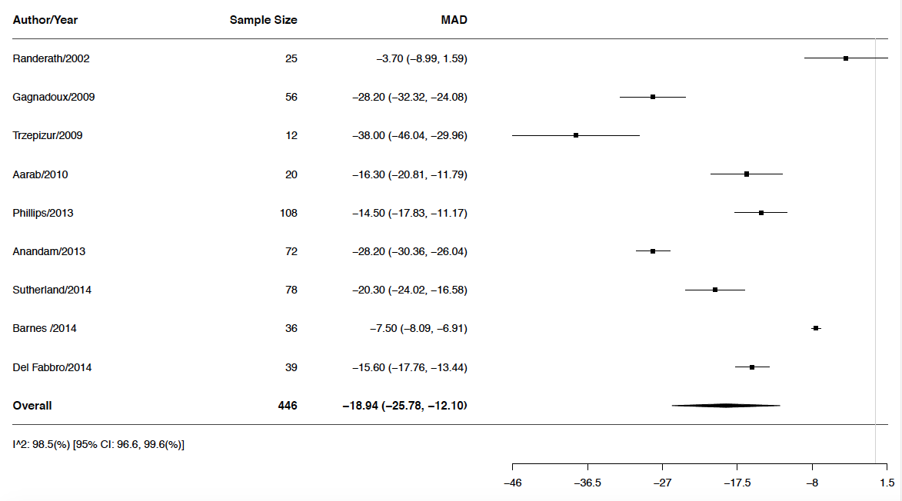
Forest Plot MAD

Slide 25
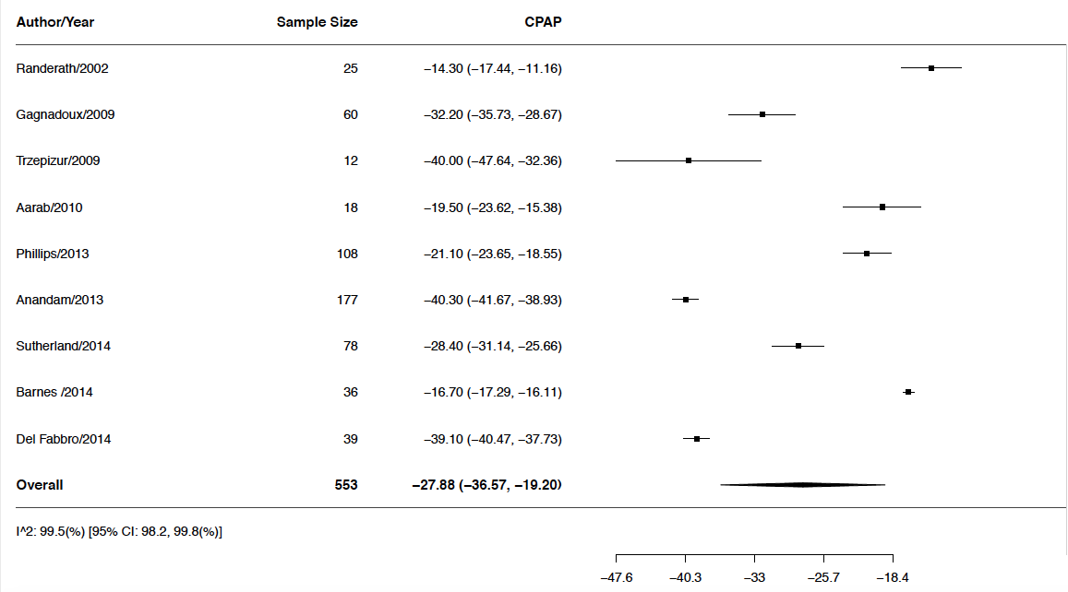
Forest Plot CPAP

Slide 26
Meta-analysis:
AHI of MAD vs CPAP
Notes:
The random effect meta-analysis method we used is "DL"
Full name is: DerSimonian-Laird estimato
MAD vs CPAP: All these studies showed some improvement, on the far right hand side is a reduction of 0 AHI, so no change from baseline
On the far left-hand side is a reduction of about 45 AHI so some improvement was very large.
One contributing factor to the variation between the studies is the base-line population, some baseline populations had very high AHI, so much improvement could be made; other baseline populations had more moderate AHI, so the expected improvement is much smaller.
I2 higher means heterogeneity,but because we are using random effects method, so it will take care of heterogeniety

Slide 27
Conclusion:
MAD is non-inferior to CPAP in Moderate OSA non- compliant patients
Future Work: More RCTs needed
Continued follow-up for > 2 years, preferably 5 years to see the difference
Need to Include other populations with propensity for high grade evidence & effect size

Slide 28
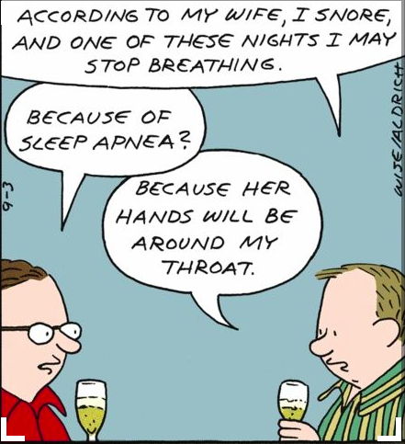
Questions?

