Slide 1
Galenic preparations
Galenic preparations are preparations made in galenic labarotory of pharmacy or galenical laboratory of institution.
They can also be used as vechicles of the “apothecary” preparations (Zynci oxydum pasta)
They are already produced and stored in the quantity from 1 up to 100 unit forms according to instructions written in Pharmacopoeia.

Slide 2
Recipe: galenic preparation
solution for the internal use (Solutio usui interno (S.))
Task: Noscapini chloridi sirupus, sirupus (antiitussive, to prevent or relieve a cough)
Rp
Noscapini chloridi sirupi
50,0
D.S. Ujutro i navečer nakon obroka popiti 1 malu žlicu
(Take one teaspoon in the morning and in the
evening after a meal)

Slide 3
recipe: galenic preparation solution for the external use (Solutio usui externo (Se.))
Task: Iodi solutio aquosa, solutio (antiseptic agent)
Rp
Iodi solutionis aquosae
50,0
D.S. Izvana! Mazati oboljeli dio kože 2x dnevno.
(External use! Put on the affected area of the skin
twice a day.)

Slide 4
recipe: galenic prepration
eye drops (oculoguttae (O.))
Task: Pilocarpini chloridi oculoguttae, oculoguttae (parasympathomimetic, for the treatment of glaucoma)
Rp
Pilocarpini chloridi oculoguttarum
10,0
D.S. Kapi za oči. Ujutro i navečer
ukapati 1-2 kapi u bolesno oko.
(Eye drops. In the morning and in the evening instil 1 to 2 drops in the affected eye.)

Slide 5
recipe: galenic preparation
inserts (suppository) (suppositoria (Su.))
Task: Methadoni chloridum suppositoria, suppositoria (analgetic agent)
Rp
Methadoni chloridi suppositoriorum No X
D. S..1 x dnevno uvesti 1 čepić u debelo crijevo
(Once a day insert one suppository into the colon.)

Slide 6
REGISTRED DRUGS
tablets (pills) (tablettae (T. ili Tbl.)) capsules (capsulae (Caps.))
solid dosage forms of drugs
administered orally
behind the name and form of the drug indicate the name of the company
If a tablet contains more than one medicinal substance, you don’t have to indicate the amount of certain substance because the factory name is always one precise combination patented by the company
In subscription you write a number of packages (numbers and also letters in parentheses) and then the size of the package in the same way. If you do not write a size of the package, pharmacist will issue a minimum package

Slide 7
Recipe: registered drug “Plicet” (paracetamol)
Composition:
One tablet has 500 mg of paracetamol. Excipients : microcrystalline cellulose, potassium sorbate.
Pharmaceutical form and size of the package
tablets; 10 tablets.
Rp
Plicet tablettae “Pliva” a 500 mg
D. scatulam originalem No I (unam)
S. Popiti 3 tablete dnevno kod povišene temperature
(In the case of fever take 3 tablets a day)

Slide 8
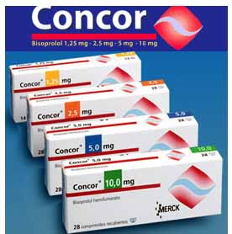
Recipe: Registered drug “Concor” (bisoprolol)
Concor 5 mg Packing: 30 tablets 5 mg
Concor 10 mg
Packing: 30 tablets 10 mg
Concor 5 mg
Packing: 100 tablets 5 mg
Rp
Concor tablettae “Merck” a 5mg
D. scatulas originales No II (duas) a tablettis XXX (triginta)
S. Popiti jednu tabletu dnevno
Take one tablet every day.
Necesse est !

Slide 9
Registered drugs
injections / Ampoules (injectio i.m. i.v. i.sc.)
steril drug dosage forms for parenteral administration
they can be solutions, suspensions or emulsions
prescribed as tablets
always issued in the hands of physicians (except insulin) and therefore in the signature is always written: Ad manum medici

Slide 10
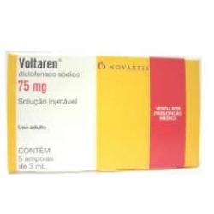
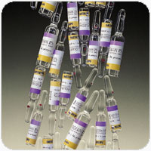
Recipe: ampoules “Voltaren” (diclofenak)
Voltaren 75 mg Packing: 5 ampules 3 ml
Rp
Voltaren ampullae “Novartis” a 75mg / 3ml
D. scatulam originalem No I (unam) a ampullis V (quinque)
S. Ad manum medici

Slide 11
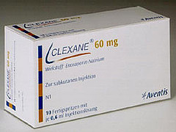
recipe: injection “Clexane” (enoksaparin)
Clexane 60 mg Packing: 10 injections 0,6 ml
Rp
Clexane injectiones “Aventis” a 60 mg / 0,6 ml
D. scatulam originalem No I (unam) a injectionis X (decem)
S. Ad manum medici

Slide 12
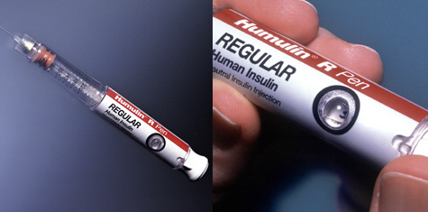
recipe: injection “Humulin R” (inzulin)
Humulin R 100 IU/ml Packing: 1 injection 10 ml
Rp
Humulin R injectiones “Eli Lilly” a 10ml (100 IU/ml)
D. scatulam originalem No X (decem) a injectionis I (unam)
Sukladno protokolu
S. According to the protocol

