Slide 1
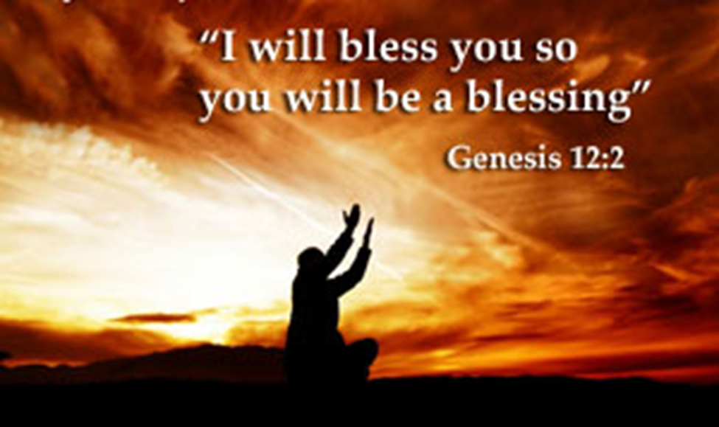
Trinity Evangelical Lutheran Church September 18, 2022
WELCOME!
Genesis Chapter 12, verses 1-9
Notes:
Image: Five Loaves by Caroline Coolidge Brown. Copyright © Caroline Coolidge Brown. All rights reserved. Used by permission of the artist.

Slide 2
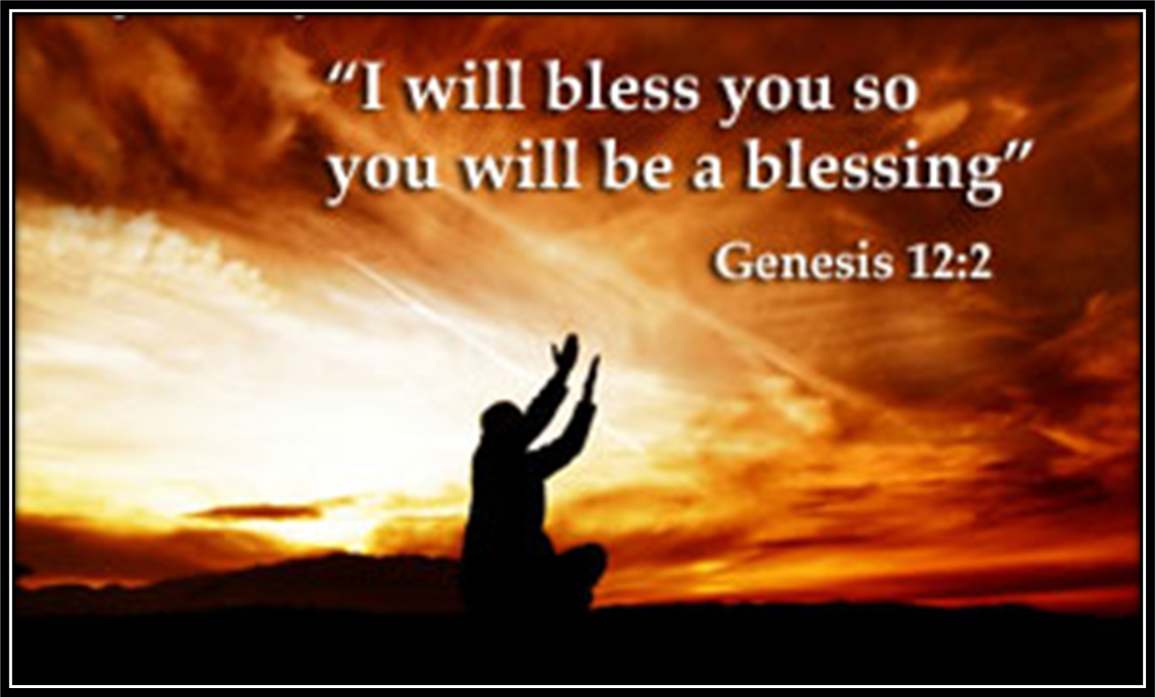
= Please stand if able
= Please be seated
Prelude – Roxanne Groff
Office of the Acolyte
Ringing of the Bell
Welcome
Notes:
Image: Five Loaves by Caroline Coolidge Brown. Copyright © Caroline Coolidge Brown. All rights reserved. Used by permission of the artist.

Slide 3
CONFESSION AND FORGIVENESS
All may make the sign of the cross, the sign marked at baptism…
L: We confess our sins before God and one another.
Pause for silence and reflection.
L: God of promise…
Notes:
Image: Five Loaves by Caroline Coolidge Brown. Copyright © Caroline Coolidge Brown. All rights reserved. Used by permission of the artist.

Slide 4
CONFESSION AND FORGIVENESS
C: You have given us all we are and all we have, and still we have not trusted you fully. We have tried to be god in our own lives, hurting ourselves and those around us in our attempts to control. Wash us clean in the waters of your salvation, and bring us back into right relationship with you.
Notes:
Image: Five Loaves by Caroline Coolidge Brown. Copyright © Caroline Coolidge Brown. All rights reserved. Used by permission of the artist.

Slide 5
CONFESSION AND FORGIVENESS
L: God welcomes you home with open arms, and forgives you all your sin, for the sake of Jesus Christ. By the power of the Holy Spirit, live in the promise of God’s love, freely given.
C: Amen.
Notes:
Image: Five Loaves by Caroline Coolidge Brown. Copyright © Caroline Coolidge Brown. All rights reserved. Used by permission of the artist.

Slide 6
Hymn of Praise
“Take My Life, That I May Be”
LBW 406
(Verses 1, 3, 4, & 6)
Notes:
Image: Five Loaves by Caroline Coolidge Brown. Copyright © Caroline Coolidge Brown. All rights reserved. Used by permission of the artist.

Slide 7
Take My Life, That I May Be LBW 406
1 Take my life, that I may be
consecrated, Lord, to thee;
take my moments and my days;
let them flow in ceaseless praise.
3 Take my voice and let me sing
always, only, for my King;
take my lips and let them be
filled with messages from thee.
Notes:
Image: Preparing yeast dough. Copyright © tomasworks/iStock/Thinkstock. Used by permission.

Slide 8
Take My Life, That I May Be LBW 406
4 Take my silver and my gold,
not a mite would I withhold;
take my intellect and use
ev'ry pow'r as thou shall choose.
6 Take my love; my Lord, I pour
at thy feet its treasure store;
take myself, and I will be
ever, only, all for thee.
Notes:
Image: Preparing yeast dough. Copyright © tomasworks/iStock/Thinkstock. Used by permission.

Slide 9
APOSTOLIC GREETING
P: The grace of our Lord Jesus Christ, the love of God, and the communion of the Holy Spirit be with you all.
C: And also with you.
Notes:
Image: Five Loaves by Caroline Coolidge Brown. Copyright © Caroline Coolidge Brown. All rights reserved. Used by permission of the artist.

Slide 10
KYRIE
A: In peace let us pray to the Lord.
C: Lord have mercy.
A: For the peace from above, and for our salvation, let us pray to the Lord.
C: Lord have mercy.
A: For the peace of the whole world, for the well being of the Church of God, and for the unity of all, let us pray to the Lord.
C: Lord have mercy.
Notes:
Image: Five Loaves by Caroline Coolidge Brown. Copyright © Caroline Coolidge Brown. All rights reserved. Used by permission of the artist.

Slide 11
KYRIE
A: For this Holy House, and for all who offer here their worship and praise, let us pray to the Lord.
C: Lord have mercy.
A: Help, save, and defend us, gracious Lord.
C: Amen.
Notes:
Image: Five Loaves by Caroline Coolidge Brown. Copyright © Caroline Coolidge Brown. All rights reserved. Used by permission of the artist.

Slide 12
PRAYER OF THE DAY
P: Let us pray… God of blessing, you called Abraham and Sarah to leave all they knew in order to follow you, and without hesitation, they went. Give us that same trust in you, that we might follow where you lead.
C: Amen.
Notes:
Image: Five Loaves by Caroline Coolidge Brown. Copyright © Caroline Coolidge Brown. All rights reserved. Used by permission of the artist.

Slide 13
Notes:
Image: Preparing yeast dough. Copyright © tomasworks/iStock/Thinkstock. Used by permission.

Slide 14
Scripture Reading
R: The Scripture reading is from the Book of Genesis, Chapter 12.
C: Glory to you O’ Lord! (Spoken)
Notes:
Image: Five Loaves by Caroline Coolidge Brown. Copyright © Caroline Coolidge Brown. All rights reserved. Used by permission of the artist.

Slide 15
Genesis 12:1-9
Now the Lord said to Abram, “Go from your country and your kindred and your father’s house to the land that I will show you. ²I will make of you a great nation, and I will bless you, and make your name great, so that you will be a blessing. ³I will bless those who bless you, and the one who curses you I will curse; and in you all the families of the earth shall be blessed.”
Notes:
Image: Five Loaves by Caroline Coolidge Brown. Copyright © Caroline Coolidge Brown. All rights reserved. Used by permission of the artist.

Slide 16
Genesis 12:1-9
⁴So Abram went, as the Lord had told him; and Lot went with him. Abram was seventy-five years old when he departed from Haran. ⁵Abram took his wife Sarai and his brother’s son Lot, and all the possessions that they had gathered, and the persons whom they had acquired in Haran; and they set forth to go to the land of Canaan. When they had come to the land of Canaan,
Notes:
Image: Five Loaves by Caroline Coolidge Brown. Copyright © Caroline Coolidge Brown. All rights reserved. Used by permission of the artist.

Slide 17
Genesis 12:1-9
⁶Abram passed through the land to the place at Shechem, to the oak of Moreh. At that time the Canaanites were in the land. ⁷Then the Lord appeared to Abram, and said, “To your offspring I will give this land.” So he built there an altar to the Lord, who had appeared to him.
Notes:
Image: Five Loaves by Caroline Coolidge Brown. Copyright © Caroline Coolidge Brown. All rights reserved. Used by permission of the artist.

Slide 18
Genesis 12:1-9
⁸From there he moved on to the hill country on the east of Bethel, and pitched his tent, with Bethel on the west and Ai on the east; and there he built an altar to the Lord and invoked the name of the Lord. ⁹And Abram journeyed on by stages toward the Negeb.
Notes:
Image: Five Loaves by Caroline Coolidge Brown. Copyright © Caroline Coolidge Brown. All rights reserved. Used by permission of the artist.

Slide 19
Genesis 12:1-9
P: This is the Word of the Lord.
C: Praise to You, O Christ (Spoken)
Notes:
Image: Five Loaves by Caroline Coolidge Brown. Copyright © Caroline Coolidge Brown. All rights reserved. Used by permission of the artist.

Slide 20
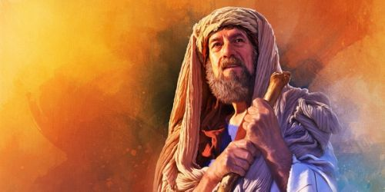
Sermon
Notes:
Image: Five Loaves by Caroline Coolidge Brown. Copyright © Caroline Coolidge Brown. All rights reserved. Used by permission of the artist.

Slide 21
APOSTLE’S CREED
C: I believe in God, the Father almighty, creator of heaven and earth.

Slide 22
APOSTLE’S CREED
C: I believe in Jesus Christ, his only Son, our Lord. He was conceived by the power of the Holy Spirit and born of the virgin Mary. He suffered under Pontius Pilate, was crucified, died, and was buried.

Slide 23
APOSTLE’S CREED
C: He descended into hell. On the third day he rose again. He ascended into heaven, and is seated at the right hand of the Father. He will come again to judge the living and the dead.

Slide 24
APOSTLE’S CREED
C: I believe in the Holy Spirit, the holy catholic Church, the communion of saints, the forgiveness of sins, the resurrection of the body, and the life everlasting. Amen.

Slide 25
NICENE CREED
C: We believe in one God, the Father, the Almighty, maker of heaven and earth, of all that is, seen and unseen.

Slide 26
NICENE CREED
C: We believe in one Lord, Jesus Christ, the only Son of God, eternally begotten of the Father, God from God, Light from Light, true God from true God, begotten, not made, of one Being with the Father.

Slide 27
NICENE CREED
C: Through him all things were made. For us and for our salvation he came down from heaven; by the power of the Holy Spirit he became incarnate from the virgin Mary, and was made man. For our sake he was crucified under Pontius Pilate;

Slide 28
NICENE CREED
C: he suffered death and was buried. On the third day he rose again in accordance with the Scriptures; he ascended into heaven and is seated at the right hand of the Father. He will come again in glory to judge the living and the dead, and his kingdom will have no end.

Slide 29
NICENE CREED
C: We believe in the Holy Spirit, the Lord, the giver of life, who proceeds from the Father and the Son. With the Father and the Son he is worshiped and glorified. He has spoken through the prophets. We believe in one holy catholic and apostolic Church.

Slide 30
NICENE CREED
C: We acknowledge one Baptism for the forgiveness of sins. We look for the resurrection of the dead, and the life of the world to come. Amen.

Slide 31
PRAYERS OF INTERCESSION
Each petition will end with the words,
A: God of promise,
The congregation will respond with:
C: You hear our prayer.

Slide 32
PRAYERS OF INTERCESSION
The prayer concludes…
P: Trusting in your grace and mercy, we lift these prayers to you, in the name of Jesus Christ.
C: Amen.

Slide 33
Offering Prayer
Notes:
Image: Five Loaves by Caroline Coolidge Brown. Copyright © Caroline Coolidge Brown. All rights reserved. Used by permission of the artist.

Slide 34
THE GREAT THANKSGIVING
Communion by pre-packaged Communion Cups. All the Baptized are welcome to celebrate this Holy Meal.

Slide 35
DIALOGUE
P: The Lord be with you.
C: And also with you.
P: Lift up your hearts.
C: We lift them to the Lord.
P: Let us give thanks to the Lord our God.
C: It is right to give him thanks and praise.

Slide 36
Preface
P: It is indeed right…
…join their unending hymn

Slide 37
Sanctus
C: Holy, holy, holy Lord, God of power and might: Heaven and earth are full of your glory. Hosanna. Hosanna. Hosanna in the highest. Blessed is he who comes in the name of the Lord. Hosanna in the highest.

Slide 38
Eucharistic Prayer
P: Holy God, our Maker, Redeemer, and Healer…
…in your holy Church, both now and forever.
C: Amen

Slide 39
THE LORD’S PRAYER
C: Our Father, who art in heaven, hallowed be thy name, thy kingdom come, thy will be done, on earth as it is in heaven. Give us this day our daily bread; and forgive us our trespasses, as we forgive those who trespass against us; and lead us not into temptation, but deliver us from evil.

Slide 40
THE LORD’S PRAYER
C: For thine is the kingdom, and the power, and the glory, forever and ever. Amen.

Slide 41
INVITATION TO COMMUNION
P: God nourishes us with this meal that we may be a blessing to all the world. Come share in the blessing of Jesus body and blood.

Slide 42
POST COMMUNION BLESSING
P: May this Body and Blood of our Lord and Savior, Jesus Christ, strengthen, keep, and unite us, now and forever.
C: Amen.

Slide 43
POST COMMUNION PRAYER
P: Let us pray… Life-giving God, through this meal you have bandaged our wounds and fed us with your mercy. Now send us forth to live for others, both friend and stranger, that all may come to know your love. This we pray in the name of Jesus.
C: Amen

Slide 44
Announcements
Notes:
Image: Five Loaves by Caroline Coolidge Brown. Copyright © Caroline Coolidge Brown. All rights reserved. Used by permission of the artist.

Slide 45
SENDING BLESSING
P: God, who gives life to all things and frees us from despair, bless you with truth and peace. And may the holy Trinity, ☩ one God, guide you always in faith, hope, and love.
C: Amen.

Slide 46
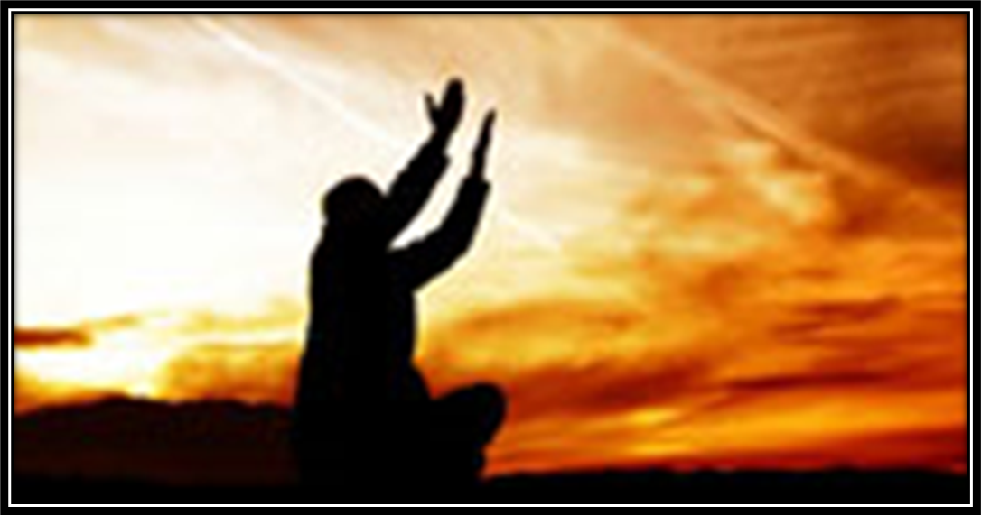
Sending Song
“Here I Am, Lord” ELW 574
Notes:
Image: Five Loaves by Caroline Coolidge Brown. Copyright © Caroline Coolidge Brown. All rights reserved. Used by permission of the artist.

Slide 47
“Here I Am, Lord” ELW 574
1 "I, the Lord of sea and sky,
I have heard my people cry.
All who dwell in dark and sin
my hand will save.
I, who made the stars of night,
I will make their darkness bright.
Who will bear my light to them?
Whom shall I send?"
Notes:
Image: Five Loaves by Caroline Coolidge Brown. Copyright © Caroline Coolidge Brown. All rights reserved. Used by permission of the artist.

Slide 48
“Here I Am, Lord” ELW 574
Refrain
Here I am, Lord. Is it I, Lord?
I have heard you calling in the night.
I will go, Lord, if you lead me.
I will hold your people in my heart.
Notes:
Image: Five Loaves by Caroline Coolidge Brown. Copyright © Caroline Coolidge Brown. All rights reserved. Used by permission of the artist.

Slide 49
“Here I Am, Lord” ELW 574
2 "I, the Lord of snow and rain,
I have borne my people's pain.
I have wept for love of them.
They turn away.
I will break their hearts of stone,
give them hearts for love alone.
I will speak my word to them.
Whom shall I send?"
Notes:
Image: Five Loaves by Caroline Coolidge Brown. Copyright © Caroline Coolidge Brown. All rights reserved. Used by permission of the artist.

Slide 50
“Here I Am, Lord” ELW 574
Refrain
Here I am, Lord. Is it I, Lord?
I have heard you calling in the night.
I will go, Lord, if you lead me.
I will hold your people in my heart.
Notes:
Image: Five Loaves by Caroline Coolidge Brown. Copyright © Caroline Coolidge Brown. All rights reserved. Used by permission of the artist.

Slide 51
“Here I Am, Lord” ELW 574
3 "I, the Lord of wind and flame,
I will tend the poor and lame.
I will set a feast for them.
My hand will save.
Finest bread I will provide
till their hearts be satisfied.
I will give my life to them.
Whom shall I send?"
Notes:
Image: Five Loaves by Caroline Coolidge Brown. Copyright © Caroline Coolidge Brown. All rights reserved. Used by permission of the artist.

Slide 52
“Here I Am, Lord” ELW 574
Refrain
Here I am, Lord. Is it I, Lord?
I have heard you calling in the night.
I will go, Lord, if you lead me.
I will hold your people in my heart.
Notes:
Image: Five Loaves by Caroline Coolidge Brown. Copyright © Caroline Coolidge Brown. All rights reserved. Used by permission of the artist.

Slide 53
DISMISSAL
P: … depart in Christ’s Love.
C: Seeking, welcoming, and serving all. Amen!
POSTLUDE
By
Darrell Fryman
From sundaysandseasons.com. Copyright © 2022 Augsburg Fortress. All rights reserved. Reprinted by permission under Augsburg Fortress Liturgies Annual License #SAS023830. New Revised Standard Version Bible, Copyright © 1989, Division of Christian Education of the National Council of the Churches of Christ in the United States of America. Used by permission. All rights reserved. Revised Common Lectionary, Copyright © 1992 Consultation on Common Texts, admin Augsburg Fortress. Used by permission.

