Slide 1
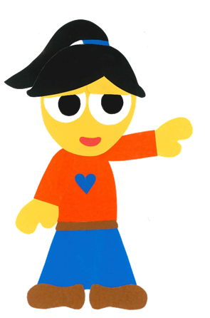
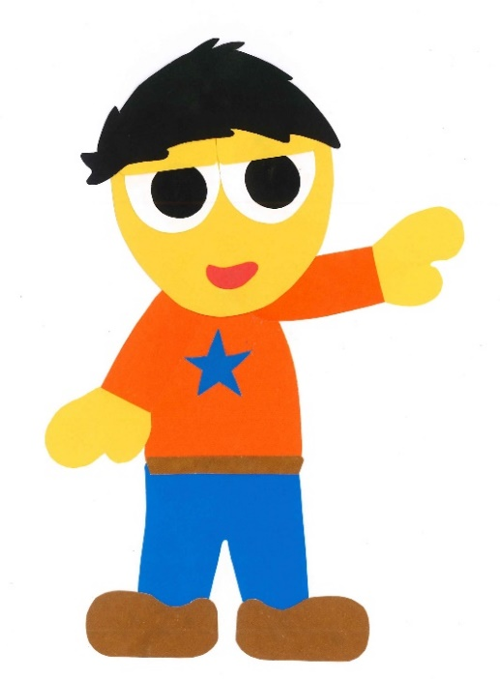
WE
CAN
READ
Teacher Donald

Slide 2
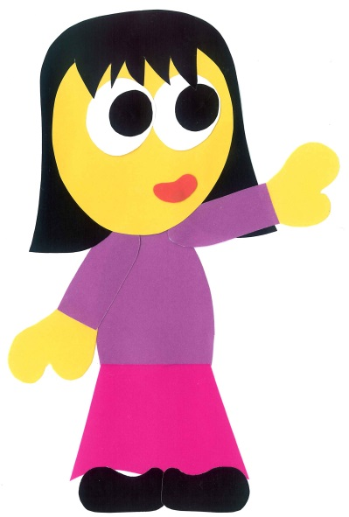
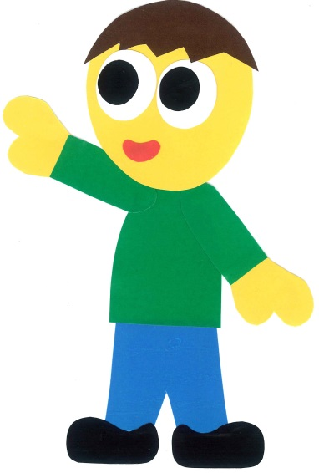
WE
CAN
READ
with…
Donald Joyce

Slide 3
Today’s story…

Slide 4
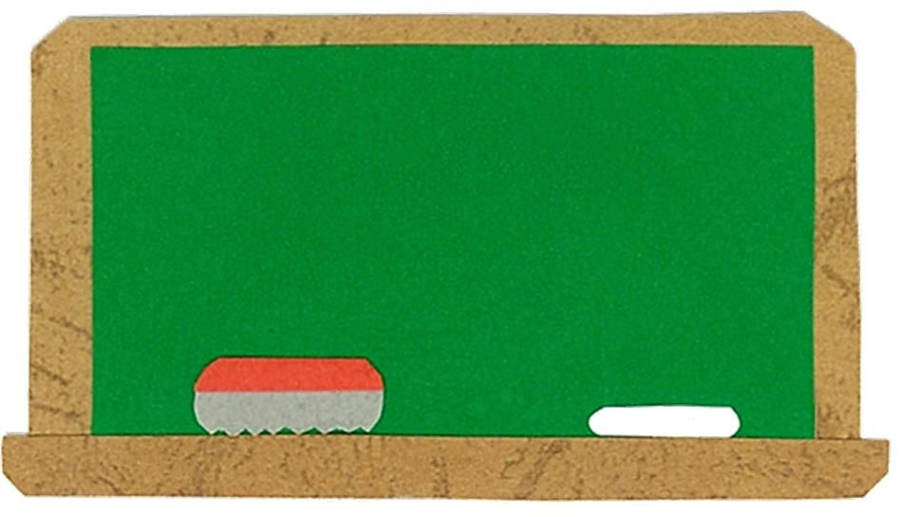
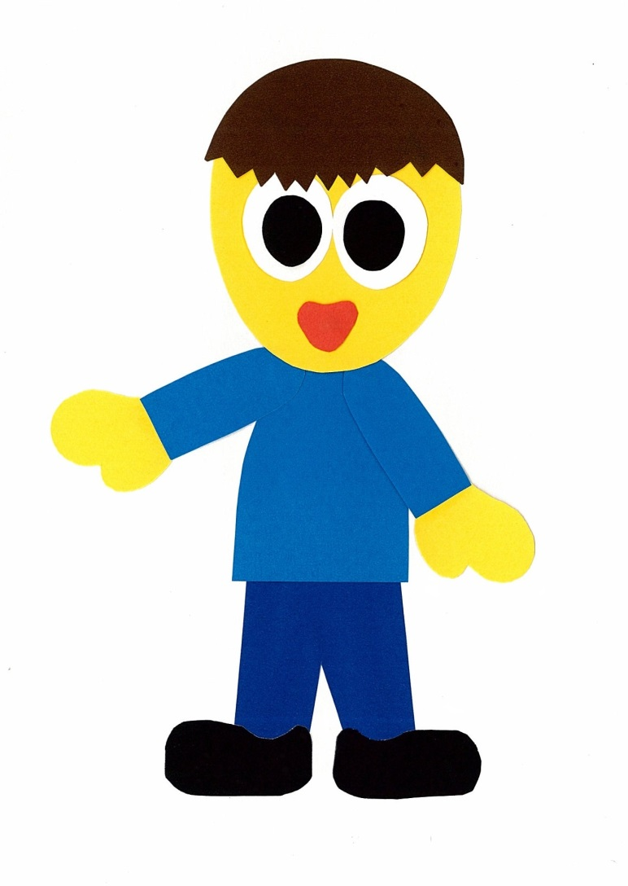
Let’s
Talk!

Slide 5
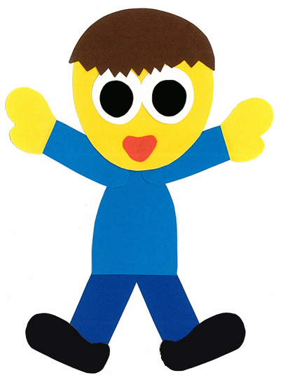
What are the parts
of the body?
This is my ___.

Slide 6
Let’s
Learn!

Slide 7
1
head
1
2
hand
hands
2
2
3
arm
arms
3
3
4
stomach
4
5
leg
legs
5
5
6
6
6
foot
feet

Slide 8
Let’s
Read!

Slide 9
Do You Feel Better?
By:
Donald Joyce
WE CAN READ

Slide 10
Doctor! Doctor!
My feet hurt!

Slide 11
Do you feel better?

Slide 12
My legs hurt, too!

Slide 13
Do you feel better, now?

Slide 14
My hands hurt, too!

Slide 15
Do you feel better, now?

Slide 16
My arms hurt, too!

Slide 17
Do you feel better, now?

Slide 18
My stomach hurts, too!

Slide 19
Do you feel better, now?

Slide 20
My head hurts, too!

Slide 21
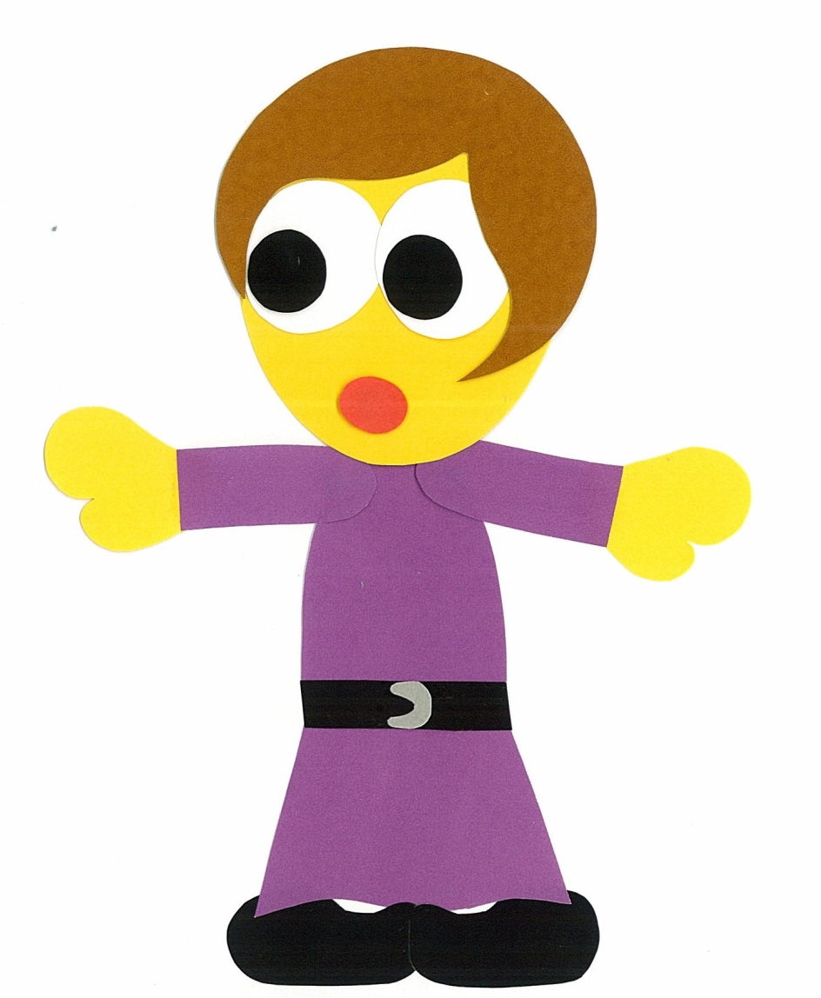
Mommy, Mommy!
I feel better, now!

Slide 22
Do You Feel Better?
By:
Donald Joyce
WE CAN READ

Slide 23
Let’s
Review!

Slide 24
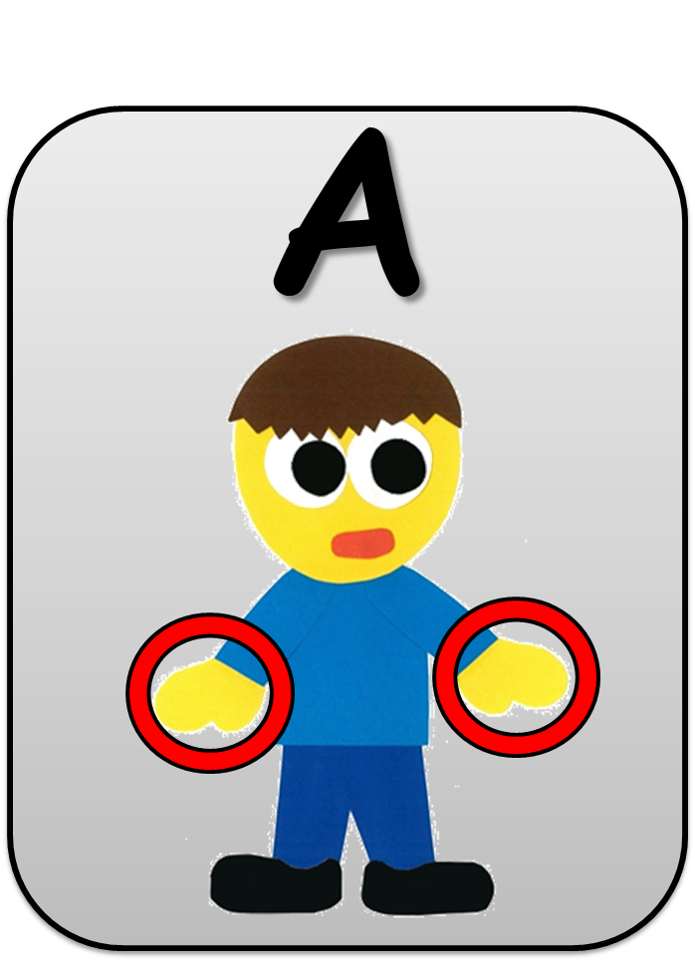
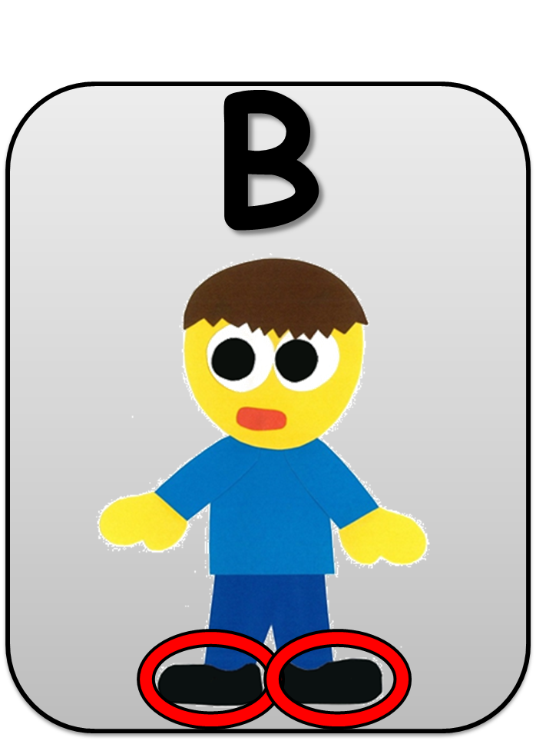
His hands hurt.

Slide 25
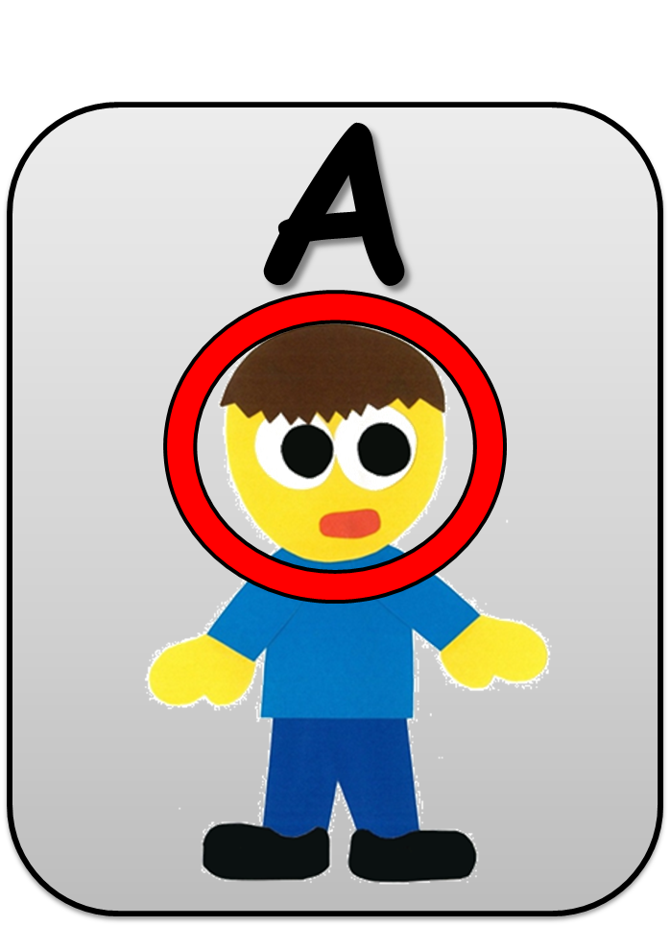
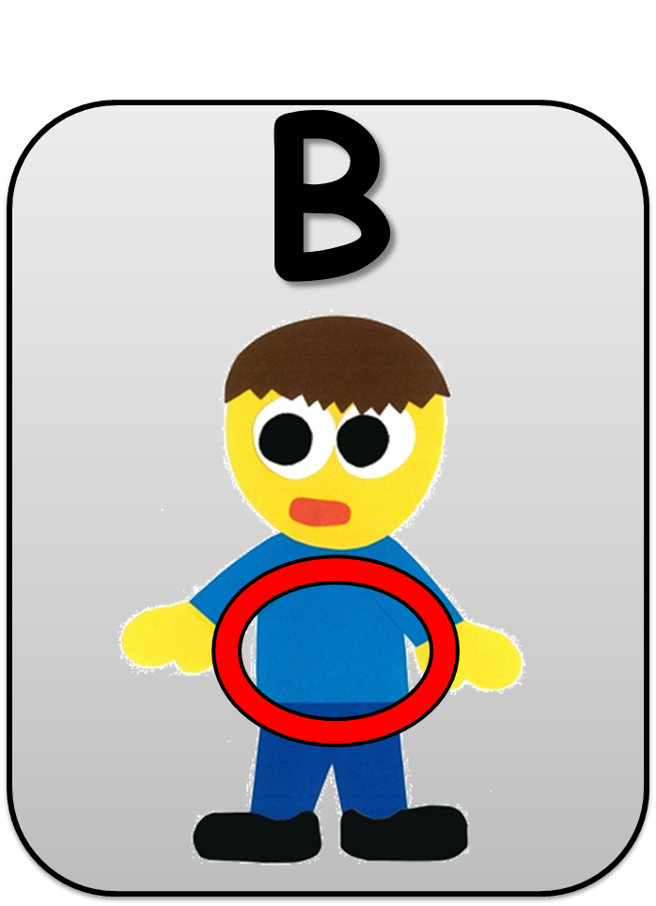
His stomach hurts.

Slide 26
His feet hurt.

Slide 27
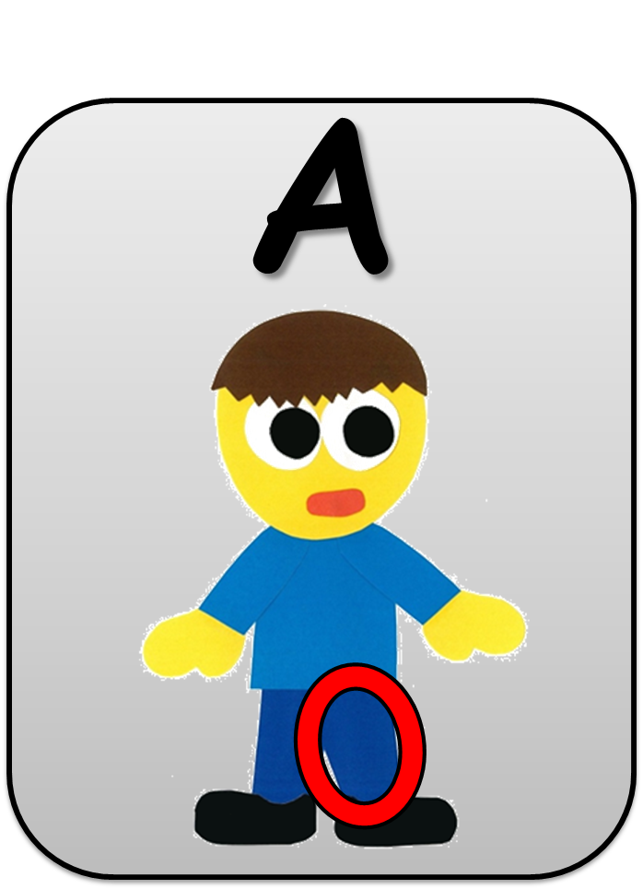
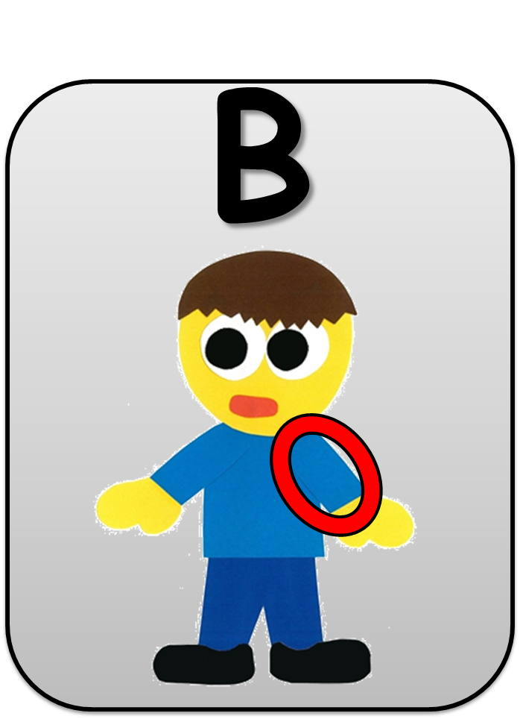
His arm hurts.

Slide 28
His leg hurts.

Slide 29
His head hurts.

Slide 30
Let’s
Connect!

Slide 31
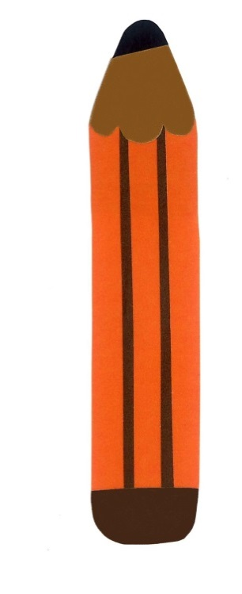
Get a pencil and paper!

Slide 32
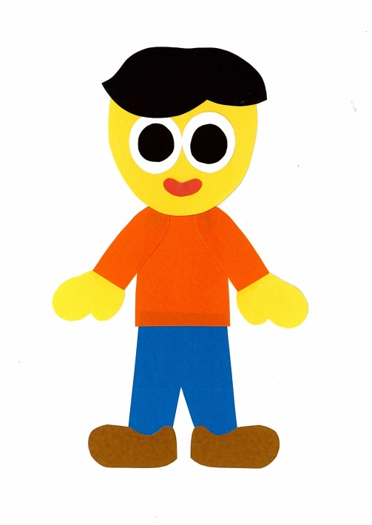
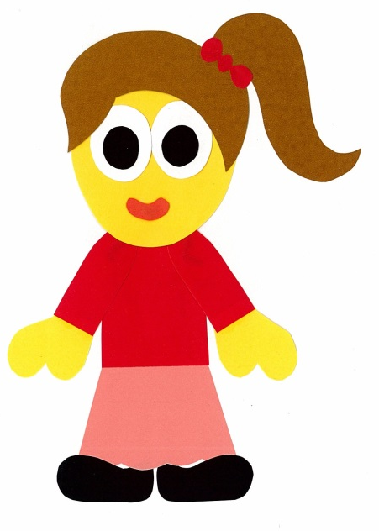
Draw a picture
of YOU.
Circle 1 part of your body.

Slide 33
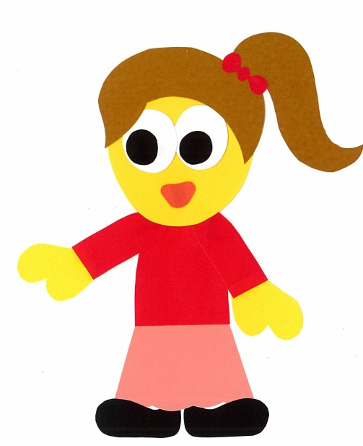
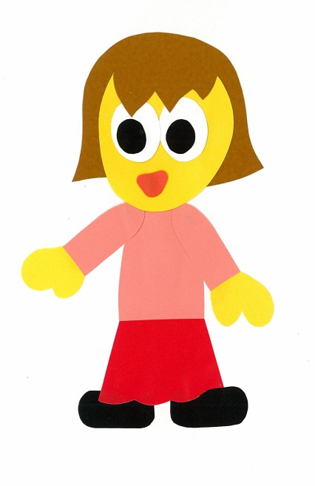
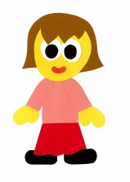
Find a friend. Play a guessing game.
Does your foot hurt?
No, it doesn’t.

Slide 34
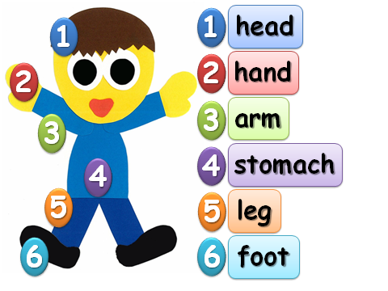
Does your __ hurt?
Yes, it does.
No, it doesn’t.

Slide 35
WE
CAN
READ
Donald Joyce
www.teacherdonald.com

