Slide 1
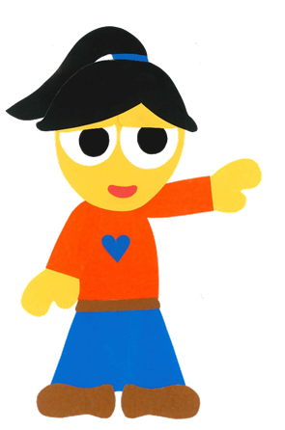
WE
CAN
READ
Donald Joyce

Slide 2
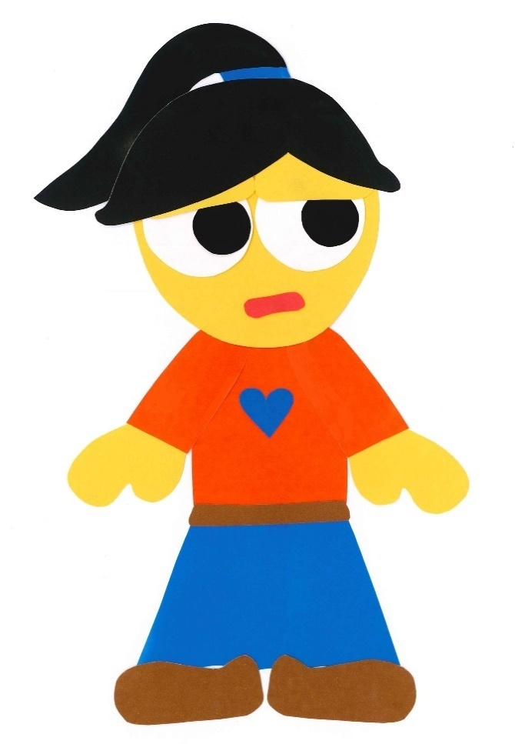
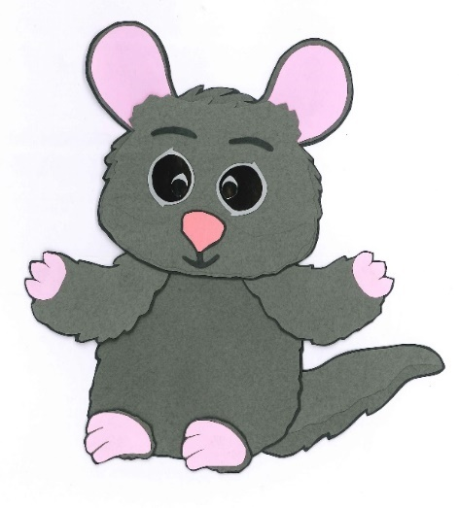
Where Is Mr. Chilly?
By:
Donald Joyce
WE CAN READ

Slide 3
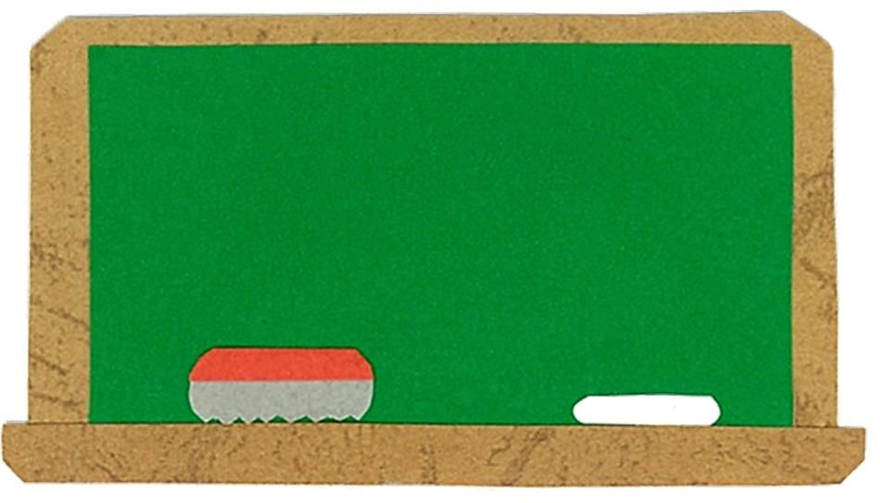
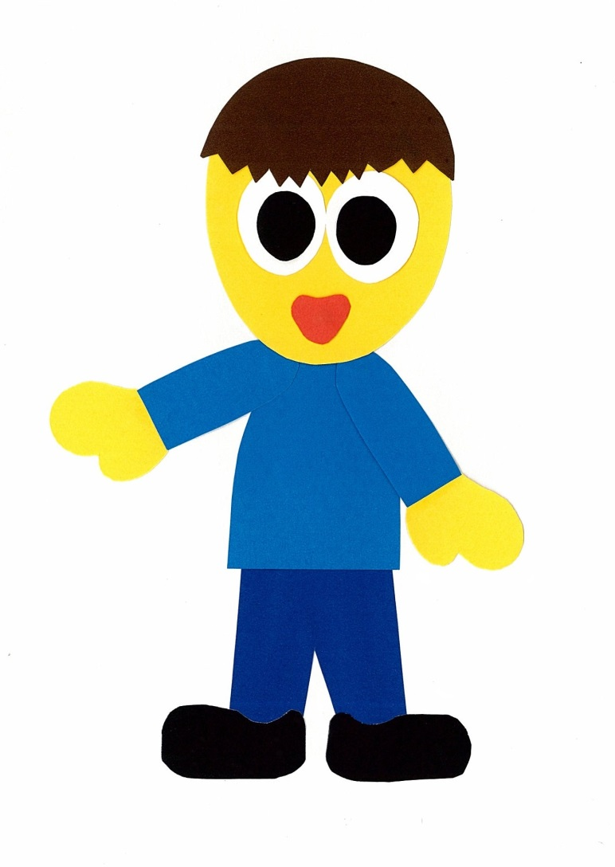
Let’s
Learn!

Slide 4
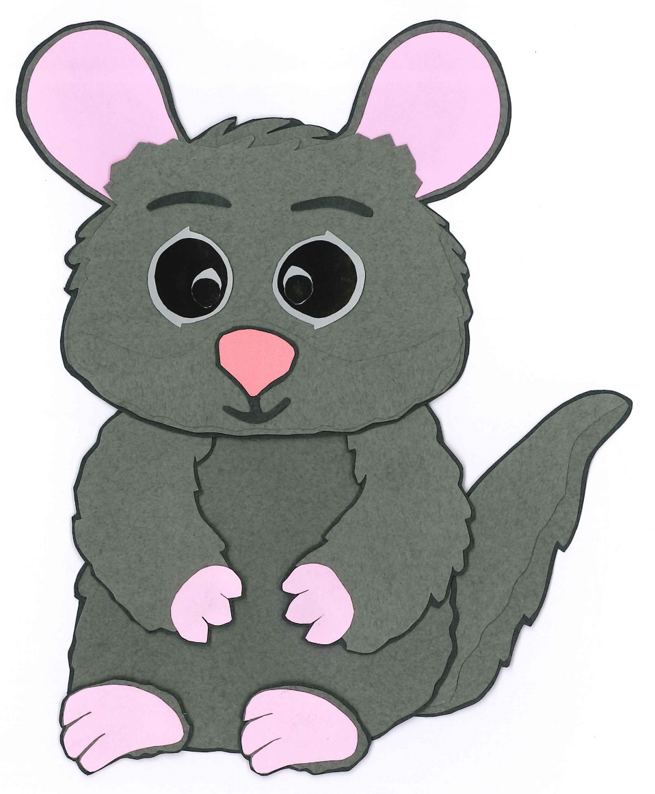
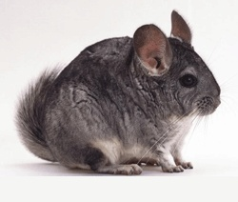
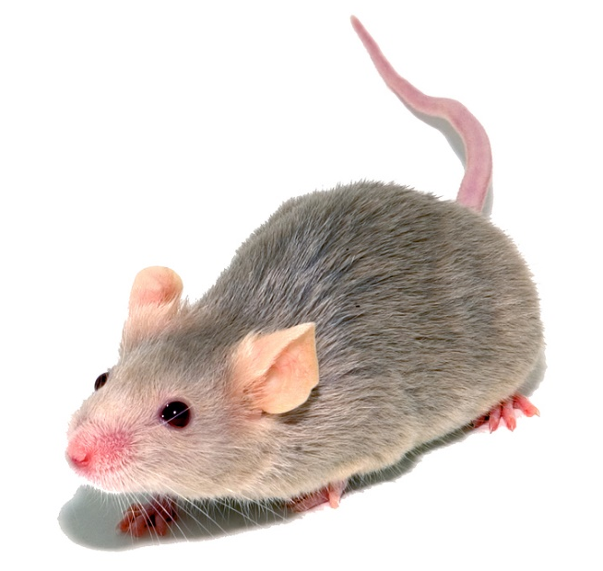
Mr. Chilly
a chinchilla
a mouse

Slide 5
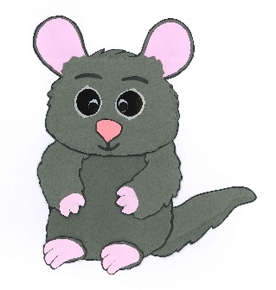
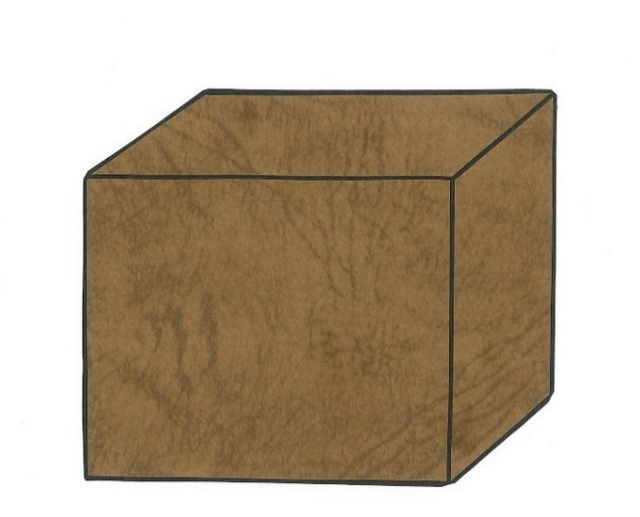
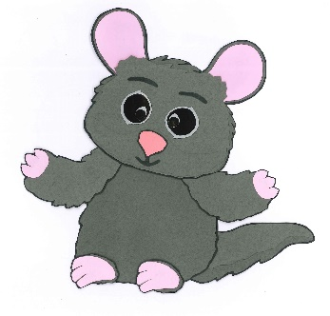
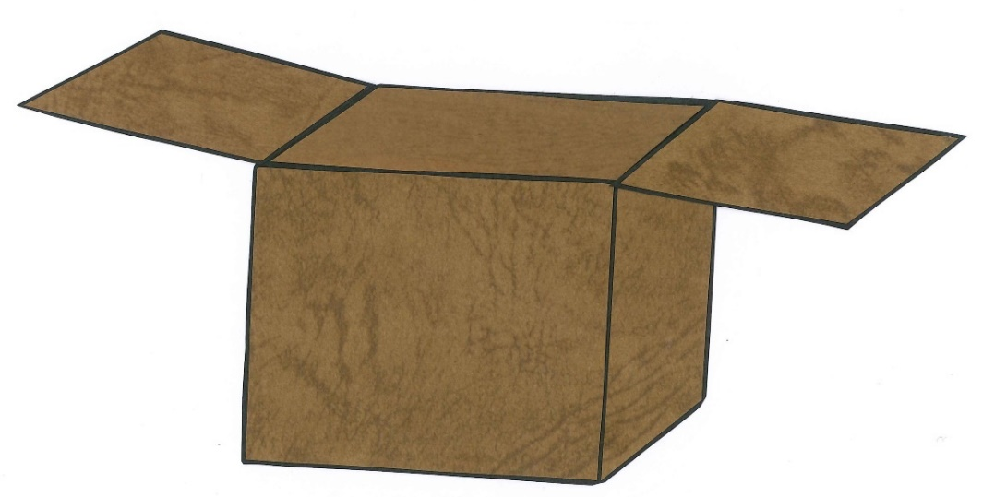
behind
on
in front of
under
in

Slide 6
Let’s
Read!

Slide 7
Where Is Mr. Chilly?
By:
Donald Joyce
WE CAN READ

Slide 8
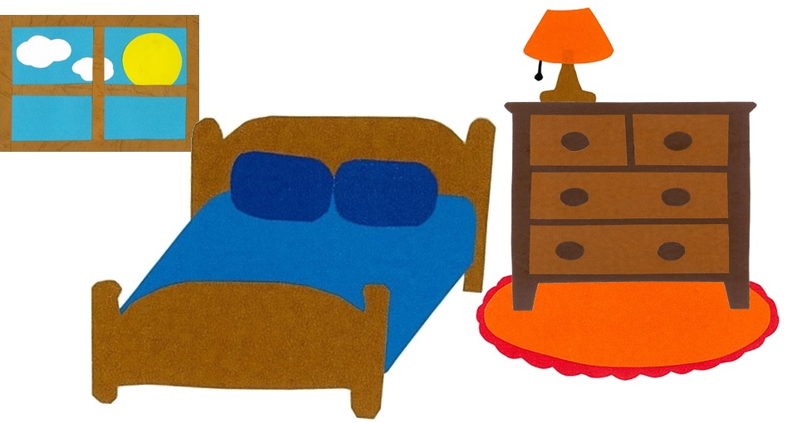
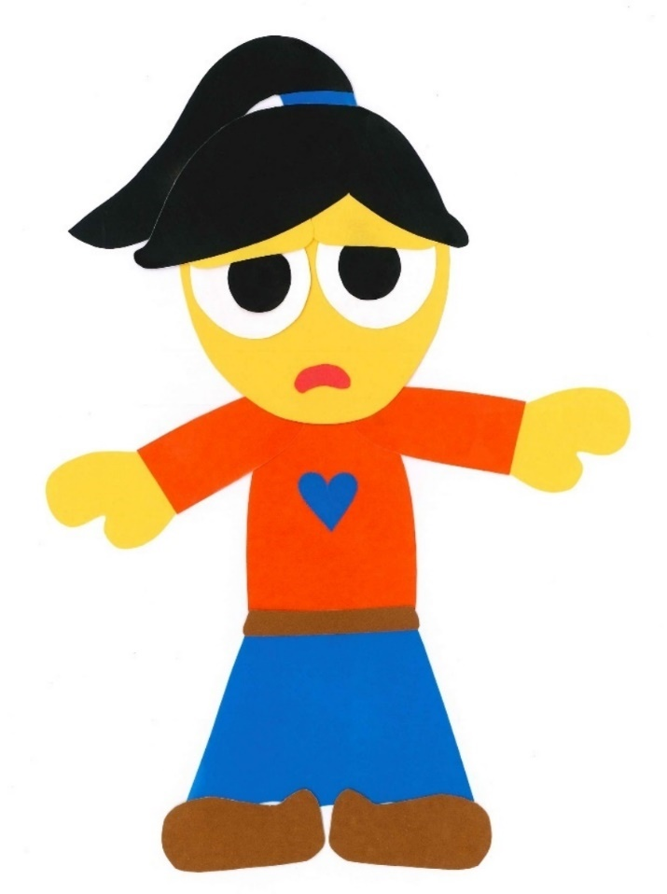
Where is Mr. Chilly?

Slide 9
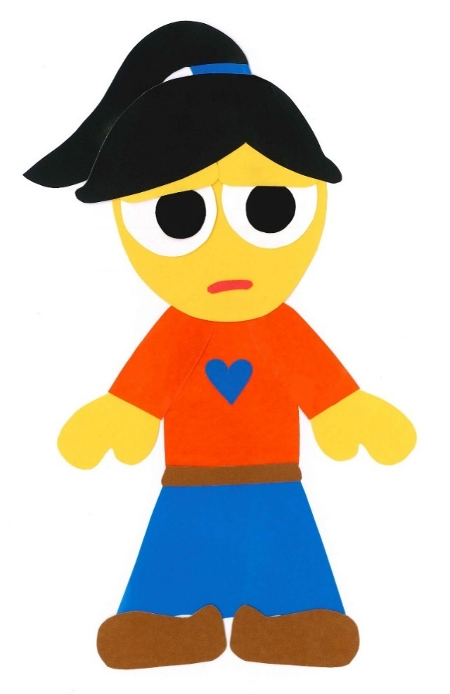
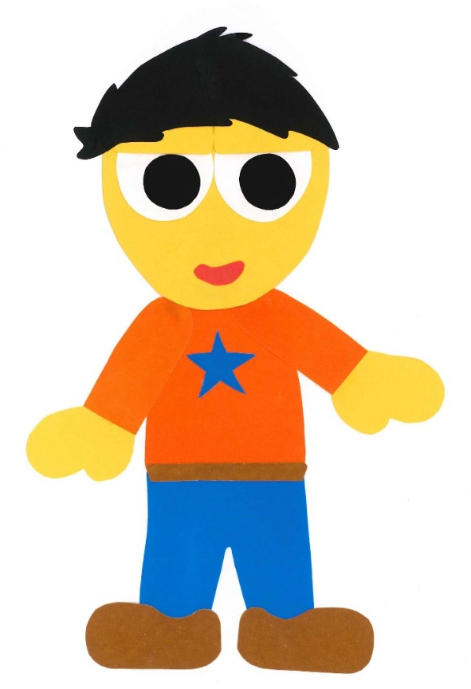
What is the matter?

Slide 10
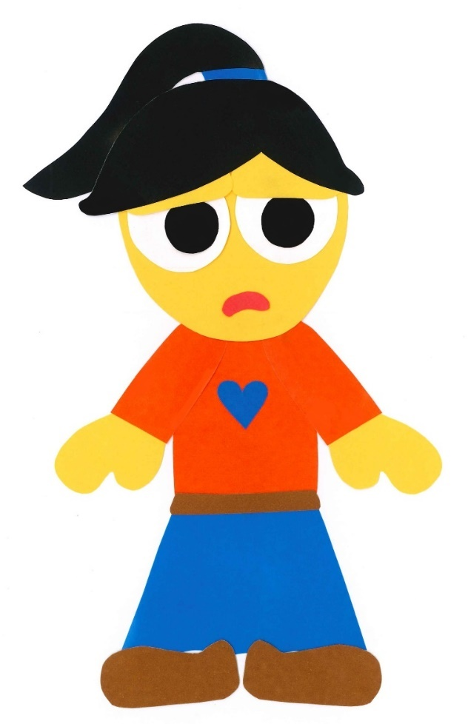
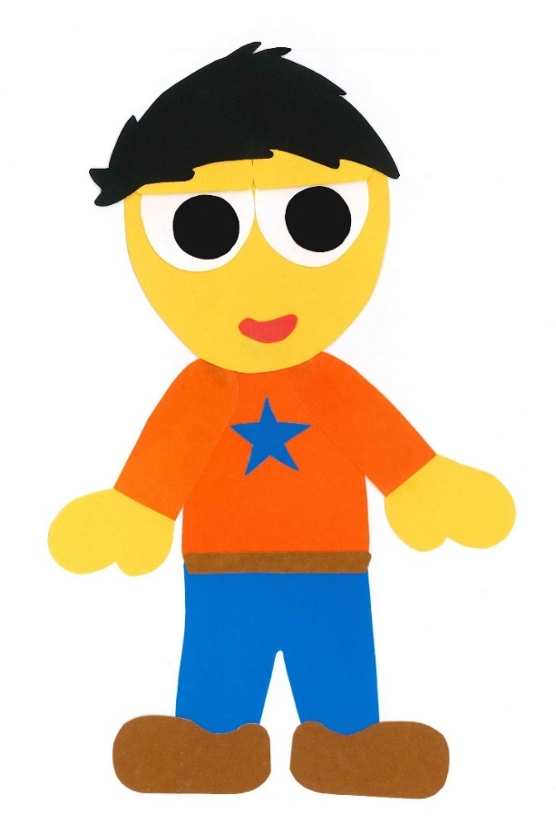
I can’t find
Mr. Chilly.

Slide 11
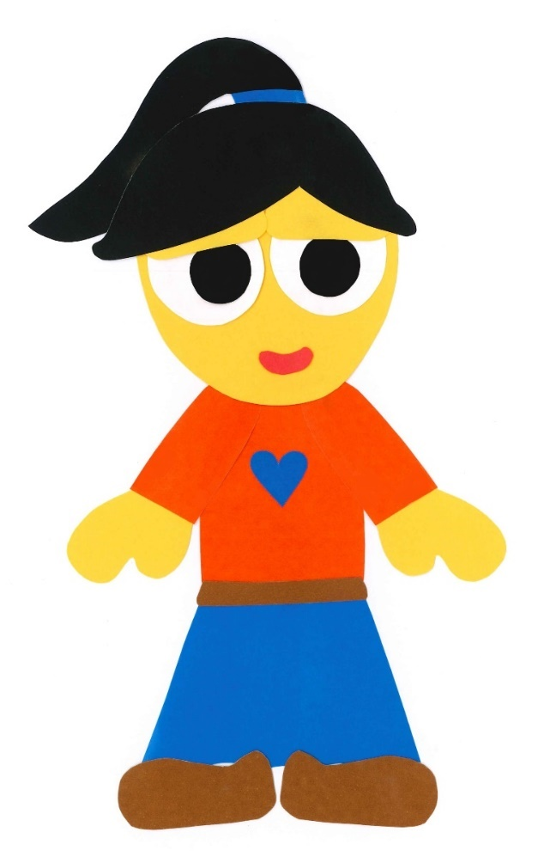
I will help you
find him.

Slide 12
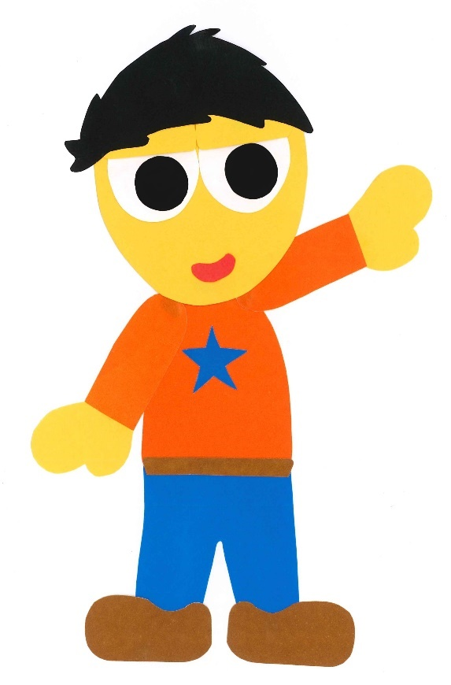
Look!

Slide 13
Mr. Chilly is on
the bed!

Slide 14
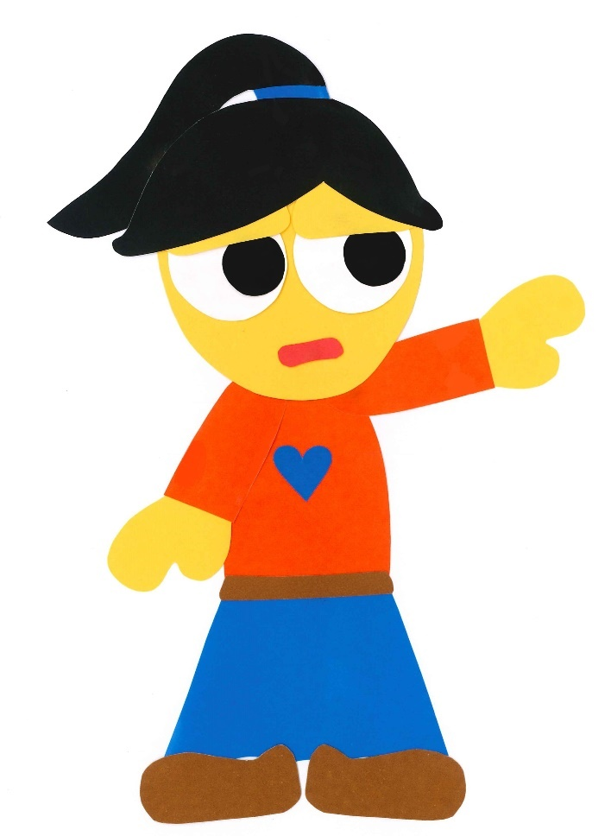
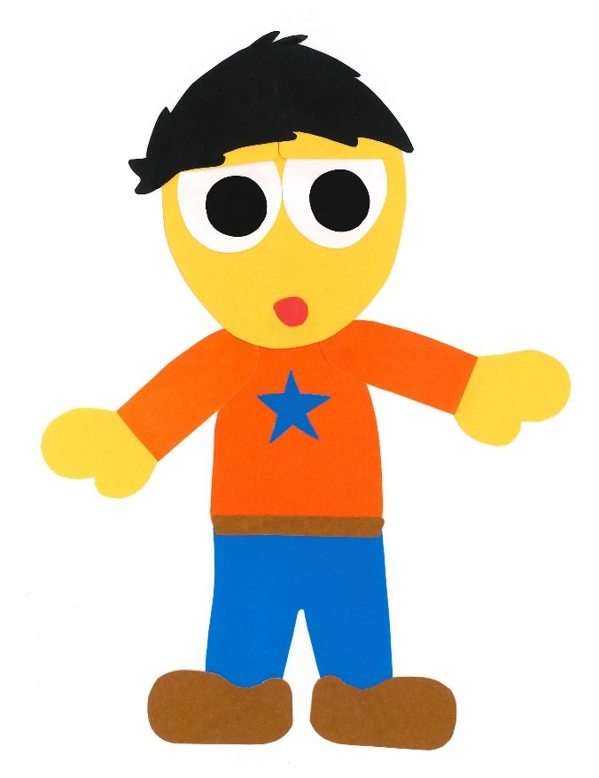
He is not on
the bed.

Slide 15
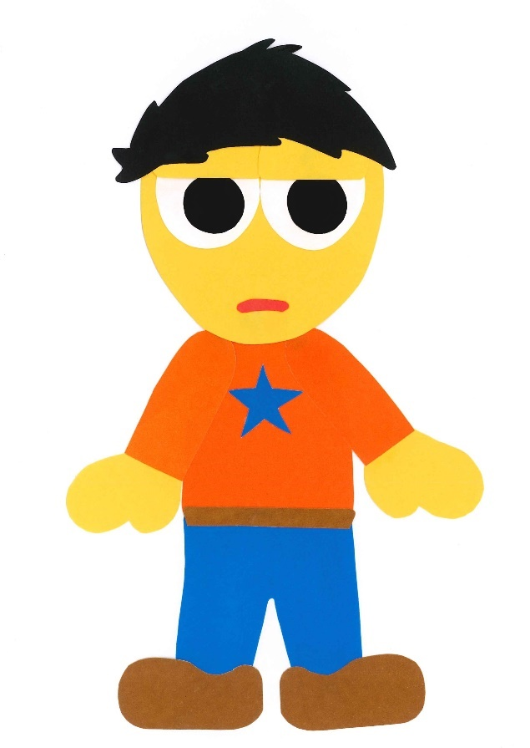
Let’s keep looking.

Slide 16
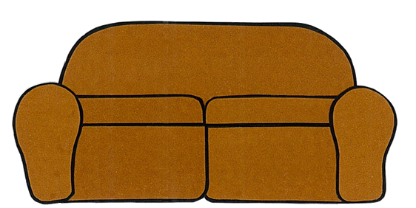
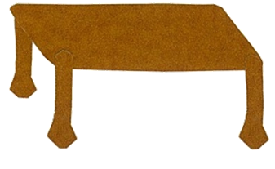
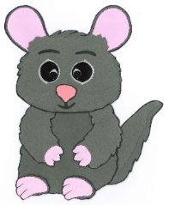
I see Mr. Chilly!

Slide 17
He is under
the table.

Slide 18
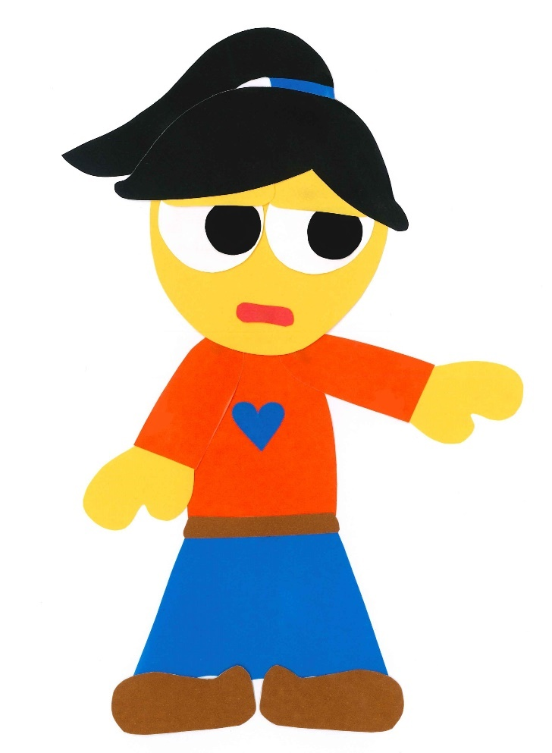
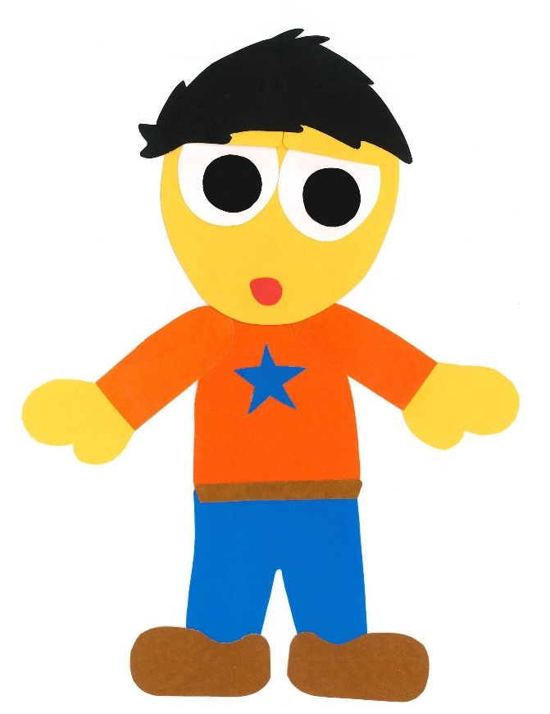
He is not under
the table.

Slide 19
Let’s keep looking.

Slide 20
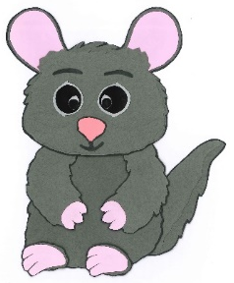
Look!

Slide 21
Mr. Chilly is behind
the refrigerator.

Slide 22
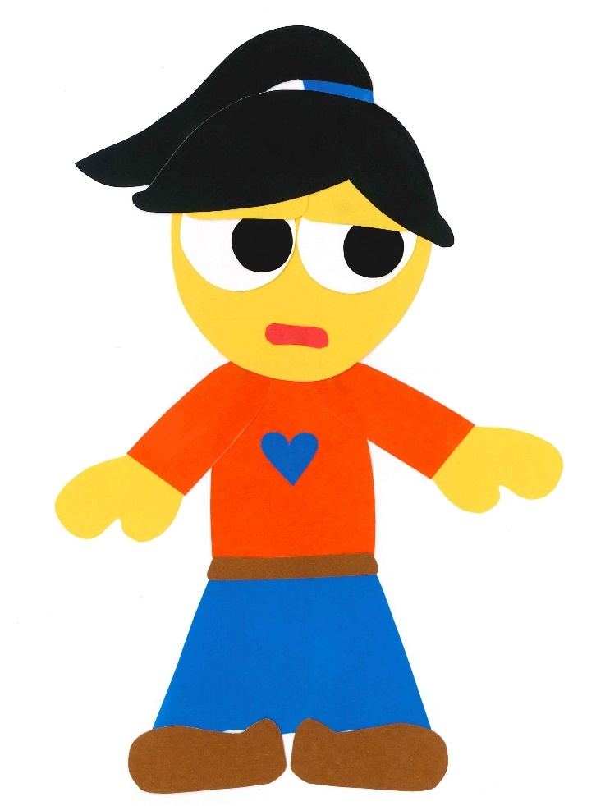
He is not behind
the refrigerator.

Slide 23
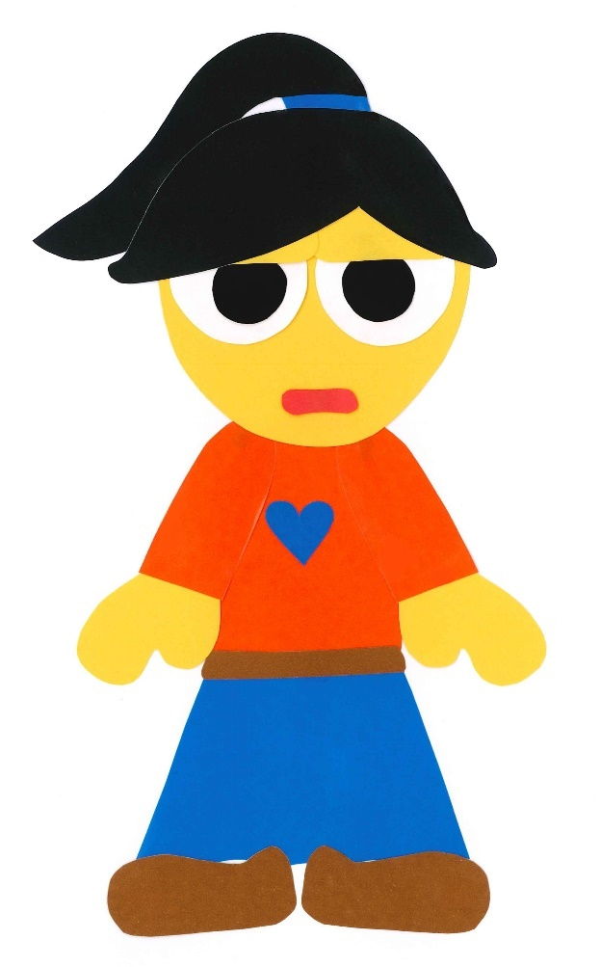
Let’s keep looking.

Slide 24
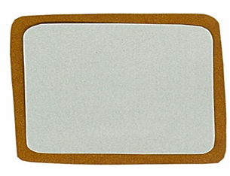
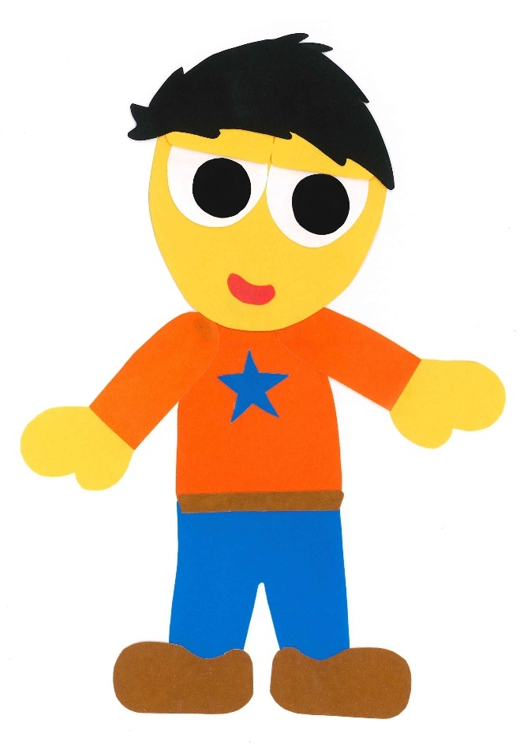
I see Mr. Chilly!

Slide 25
He is in front of
the bathtub.

Slide 26
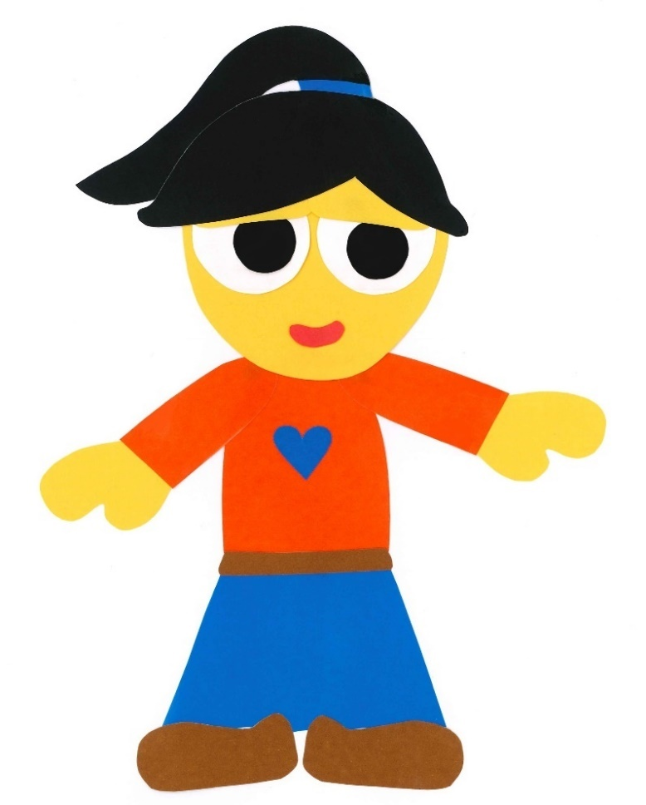
I see him, too!

Slide 27
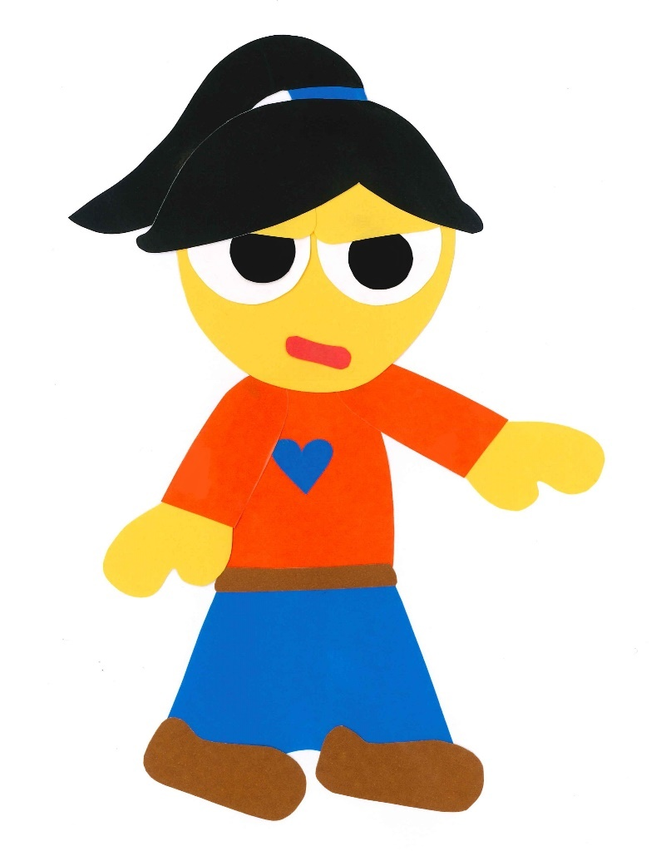
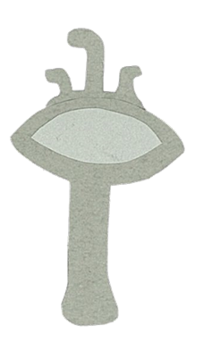
We got you!

Slide 28
SPLASH!

Slide 29
Look!

Slide 30
We are in
the bathtub!

Slide 31
Where Is Mr. Chilly?
By:
Donald Joyce
WE CAN READ

Slide 32
Let’s
Review!

Slide 33
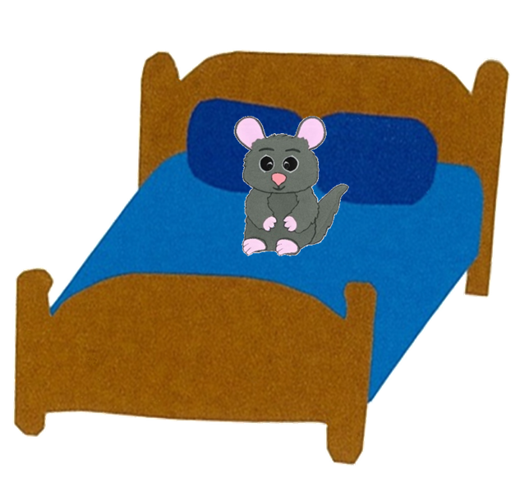
Where is Mr. Chilly?
under
on
He is ___
the bed.

Slide 34
Where is Mr. Chilly?
He is on
the bed.

Slide 35
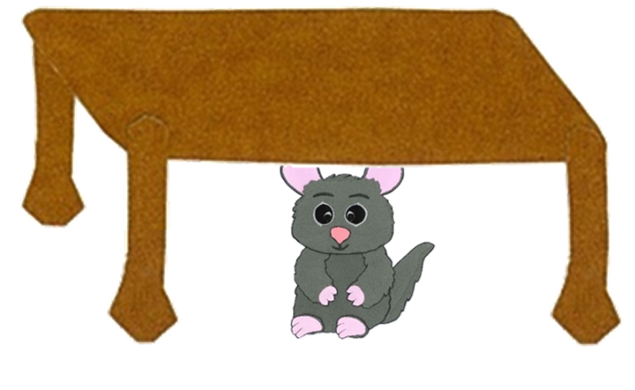
Where is Mr. Chilly?
in front of
under
He is ___
the table.

Slide 36
Where is Mr. Chilly?
He is under
the table.

Slide 37
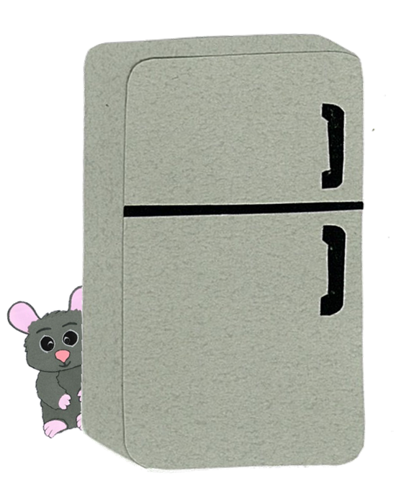
Where is Mr. Chilly?
in
behind
He is ___
the refrigerator.

Slide 38
Where is Mr. Chilly?
He is behind
the refrigerator.

Slide 39
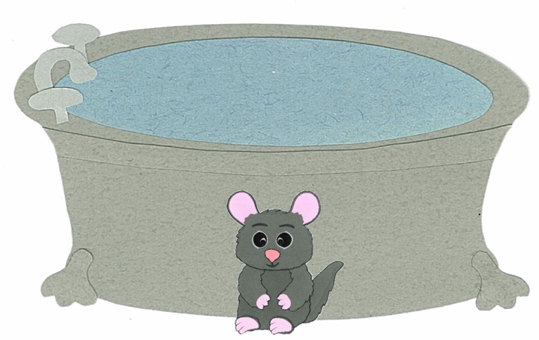
Where is Mr. Chilly?
in front of
on
He is ___
the bathtub.

Slide 40
Where is Mr. Chilly?
He is in front of
the bathtub.

Slide 41
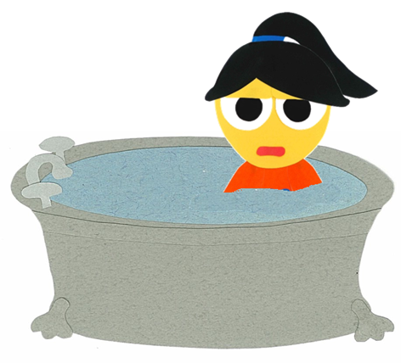
Where is Kelly?
in
behind
She is ___
the bathtub.

Slide 42
Where is Kelly?
She is in
the bathtub.

Slide 43
Let’s
Connect!

Slide 44
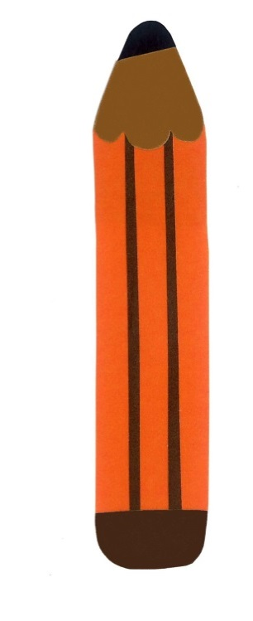
Get a pencil and paper!

Slide 45
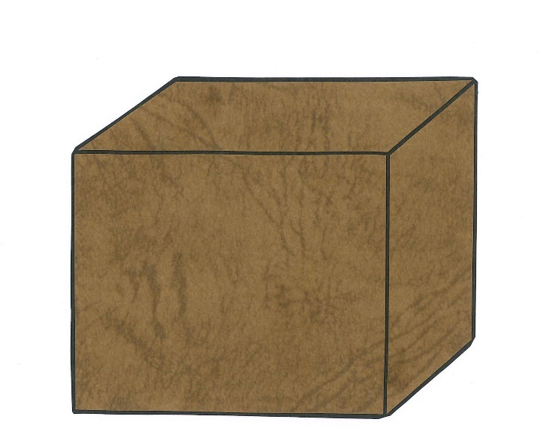
Draw a box…

Slide 46
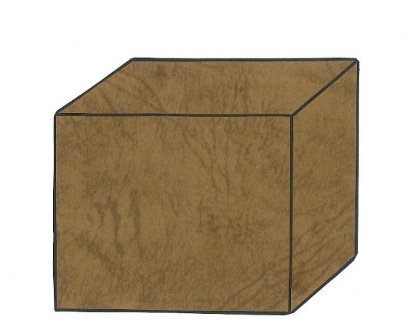
Draw a chinchilla.
in front of
under
on
in
behind

Slide 47
Draw a chinchilla.
in front of
under
on
behind
in

Slide 48
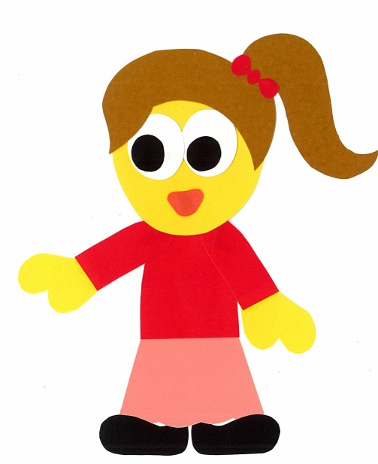
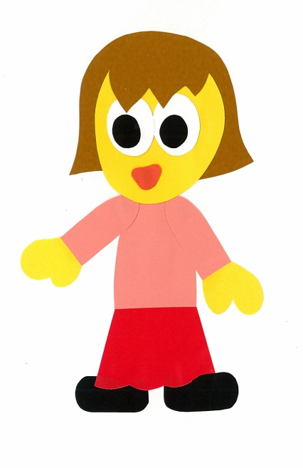
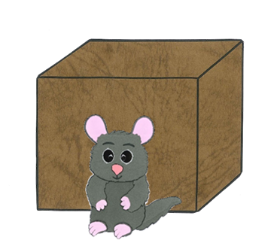
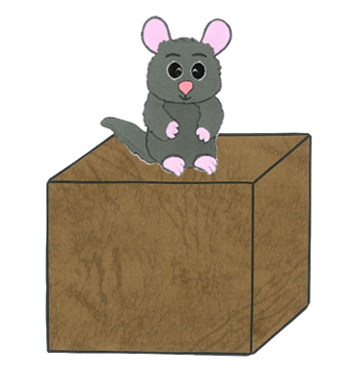
Find a friend. Play a guessing game.
Is the chinchilla in the box?
No, it isn’t.

Slide 49
Is the chinchilla
___ the box?
in front of
under
on
behind
in
Yes, it is.
No, it isn’t.

Slide 50
WE
CAN
READ
Donald Joyce
www.teacherdonald.com

