Slide 1
Information Blocking
And….Its Intersections with Interoperable Health Information Exchange!
Presented by:
Desla Mancilla, DHA, RHIA

Slide 2
Agenda
Interoperability
What
Why
Where are we now?
A few foundational terms (talk the talk)
Information Blocking
Defined
Interference
Exceptions
Enforcement
Reporting
Current statistics
HIM areas of consideration
Q&A

Slide 3
Interoperability
What is it?
Why is interoperability important?
Where are we in the journey toward full interoperability?
What are the intersecting points of interoperability and information blocking?

Slide 4
Foundational Interoperability terms/lingo
Consumer focused healthcare
B2B
B2C
Certified Health IT
USCDI

Slide 5
Important Information Blocking Terms/Lingo
Enforcement
Reporting
Exceptions
EHI
Actors
21st century Cures Act

Slide 6
Information Blocking
Definition
(a) Information blocking means a practice that:
(1) Except as required by law or covered by an exception, is likely to *interfere* with access, exchange, or use of electronic health information (EHI); and
(2) If conducted by a health information technology developer of certified health IT, health information network or health information exchange, such developer, network or exchange knows, or should know, that such practice is likely to interfere with access, exchange, or use of EHI; or
(3) If conducted by a health care provider, such provider knows that such practice is unreasonable and is likely to interfere with the access, exchange, or use of EHI.
(b) Until date specified in 45 CFR 171.103 (b), EHI for purposes of § 171.103 (that date is set to be 10/5/22)
(a) is limited to the EHI identified by the data elements represented in the USCDI standard adopted in § 170.213.
Defined
*Interfere with or Interference means to prevent, materially discourage, or otherwise inhibit.

Slide 7
Electronic Health Information (EHI)
Electronic Health Information (EHI) is electronic protected health information (ePHI) that would be included in a designated record set, regardless of whether it is maintained by or for an “actor” required to comply with HIPAA.
Until October 6, 2022, United States Core Data for Interoperability (USCDI) describes what electronic health information is within scope for the information blocking regulations.
Any data represented by data elements described within USCDI is in-scope for information blocking now.
Does not limit EHI to what is recorded or exchanged consistent with any specific interoperability standard.
Note: EHI excludes (now and after October 5, 2022):
Psychotherapy notes; or
Information compiled in reasonable anticipation of legal proceedings
RESOURCE: https://www.ahima.org/media/ztqh1h2q/final-ehi-task-force-report.pdf

Slide 8
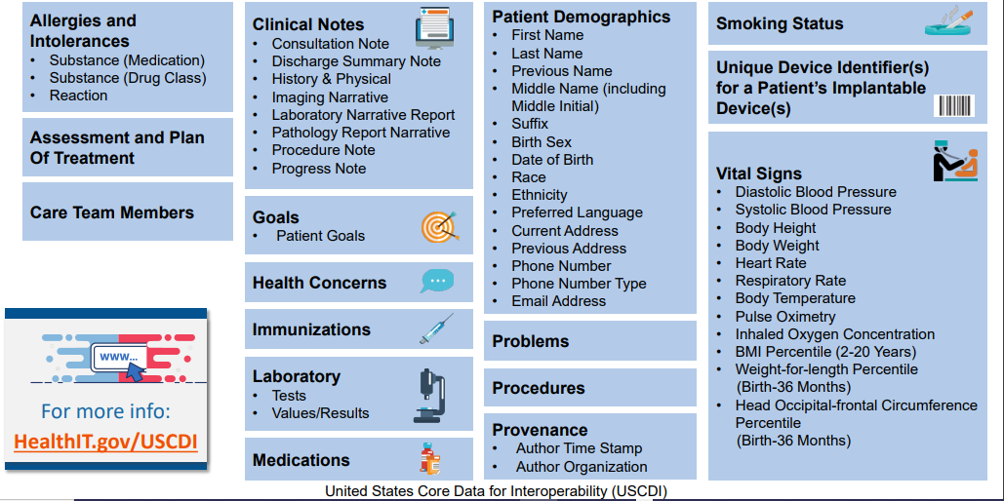
Data elements represented in uscdi (V1)

Slide 9
All about the actors
Health IT Developers of Certified Health IT
Health Information Networks (HIN) and Health Information Exchanges (HIE)
Health Care Providers
FAQ: https://www.healthit.gov/cures/sites/default/files/cures/2020-08/Health_Care_Provider_Definitions_v3.pdf

Slide 10
Making it ReaL for providers
Which healthcare providers are covered by the information blocking rule?
I am a pharmacist. Am I considered a health care provider subject to the information blocking regulations?
Is a clinician, hospital, or other type of provider who does not participate in Medicare or Medicaid still an “actor” under the information blocking regulations?

Slide 11
The Exceptions to the rule
Applicable to delaying, restricting, or denying access, exchange, or use
Preventing Harm Exception
Privacy Exception
Security Exception
Infeasibility Exception
Procedures for fulfilling access, exchange, or use of EHI
Content and Manner Exception
Fees Exception
Licensing Exception

Slide 12
Making it real….the exceptions
Question 1: If my organization implements a patient portal that has the capability to allow patients to directly transmit or request direct transmission of their chronic health information to a third party, but we choose not to enable that capability, is that information blocking?
Question 2: If I can provide same day access to information in the manner it was requested, but take several days to respond is this information blocking?
Question 3: If we establish an organization wide policy to delay the release of all lab test results until the ordering clinician reviews the results for potential risk of harm associated with the release, is this information blocking?
Question 4: If I (as a provider) tailor the amount of EHI that is sought, without artificially restricting or otherwise influencing the scope of EHI sought, is this information blocking?
Question 5: Is it information blocking if I charge an individual for electronic access to their EHI?

Slide 13
Penalties and enforcement
Penalties are only for Actors
Providers – Penalties include disincentives to be further defined
HIN/HIE – Civil monetary penalties up to 1 Million dollars
HIT Developers and certified health it – Civil monetary penalties up to 1 Million dollars, certification ban for violation of the conditions on certification, public listing of certification
To ask a question or report a concern:
www.Healthit.gov/feedback

Slide 14
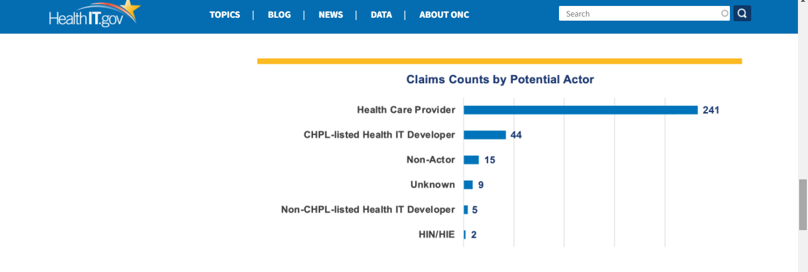
Some current stats on claims of information blocking
306/381 submissions deemed as information blocking claims (4/5/21-2/28/22)
Most claims filed by patients or their representatives against providers or developers
Examples:
Providers reported being charged “excessive” fees to access or export EHI to a new EHR, and unnecessary delays in receiving requested EHI
Patients and their representatives assert being charged fee for electronic access to their EHI
And….an interesting tidbit….The President’s proposed budget (far from being final) includes $5M for investigation and enforcement of information for the next budget year

Slide 15
Considerations
Review your policies and processes
Are they optimized for you, your staff, and your patients to access, exchange, and use EHI whenever it is legally permissible? •
Review your technology
Are you making the most of its capabilities for facilitating information access, exchange, and use
Engage your colleagues and patients
Are you talking to your developer about enhancing the capabilities?
Are you empowering clinical and non-clinical staff to help patients understand when and how they can choose to access their EHI?
Has your organization informed your patients what EHI is available to them in their portal and how to get EHI they want that’s not in the portal?

Slide 17
Resources
Office of the National Coordinator for Health IT: https://www.healthit.gov/
Topics Information Blocking: https://www.healthit.gov/topic/information-blocking
Information Blocking FAQ: https://www.healthit.gov/curesrule/resources/information-blocking-faqs
USCDI (current version 1): https://www.healthit.gov/isa/sites/isa/files/2020-10/USCDI-Version-1-July-2020-Errata-Final_0.pdf
Health IT Certification Program: https://www.healthit.gov/sites/default/files/PUBLICHealthITCertificationProgramOverview.pdf

