Slide 1
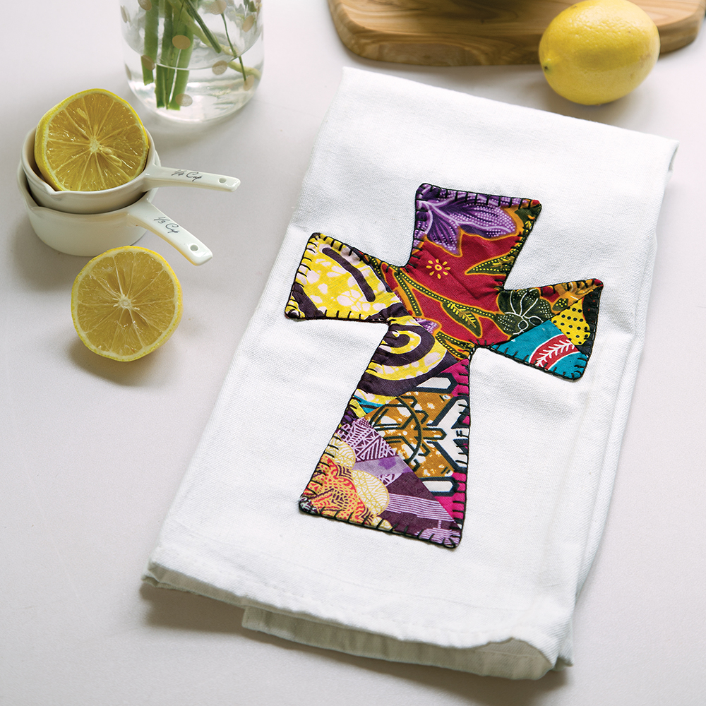
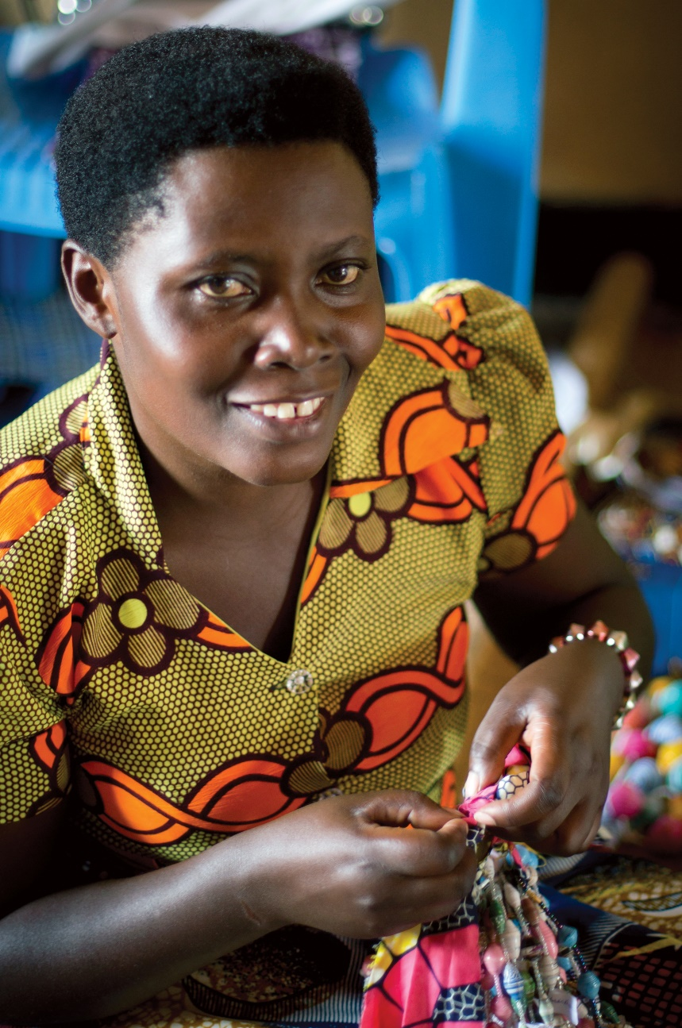
More Than Sparrows
Rwanda
Rwandan Cross Towel
WorldCrafts.org
WorldCrafts is a compassion ministry of WMU

Slide 2
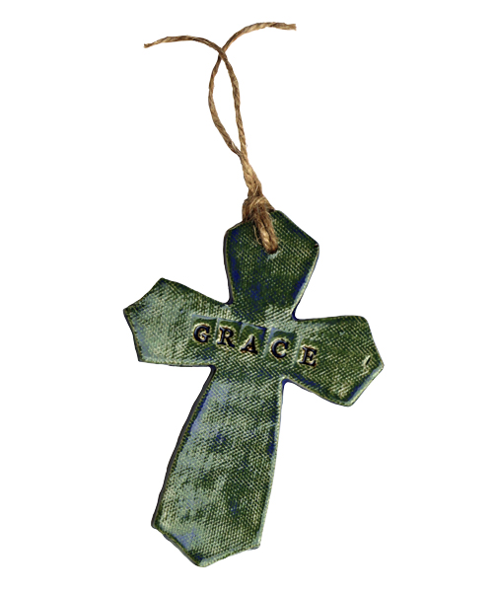
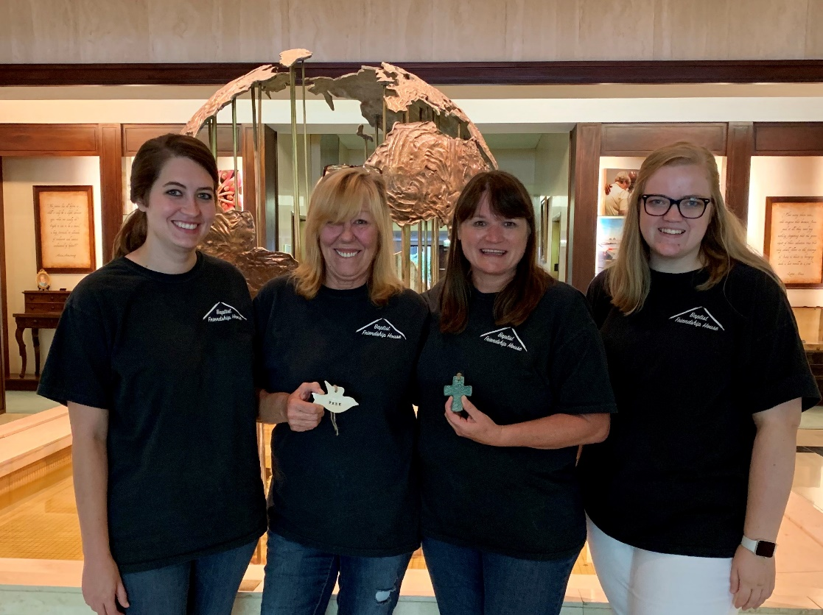
Baptist Friendship House
New Orleans, Louisiana
Grace Cross
WorldCrafts.org
WorldCrafts is a compassion ministry of WMU

Slide 3
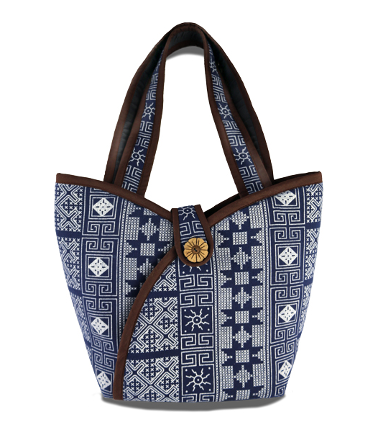
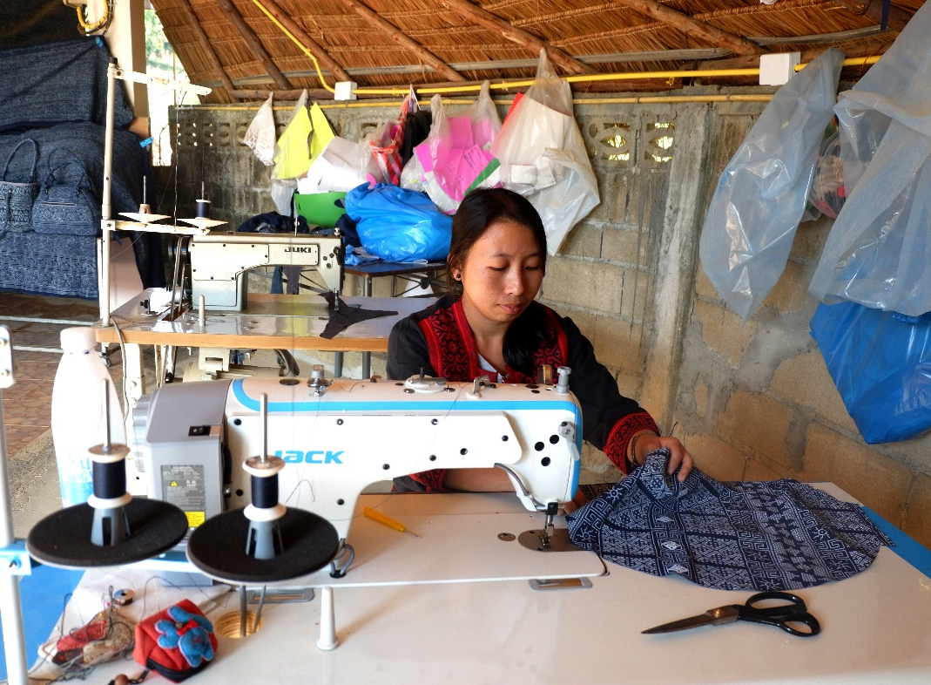
Hill Top Crafts
Thailand
Midnight
Bloom Purse
WorldCrafts.org
WorldCrafts is a compassion ministry of WMU

Slide 4
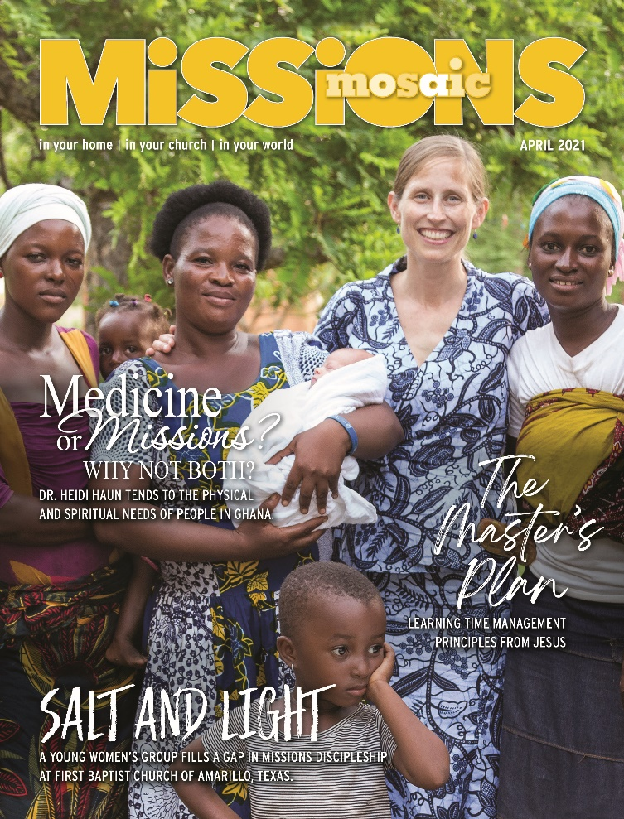


Missions Mosaic
Be inspired by
missions-focused
Bible studies, prayer features, ministry ideas, and daily devotions.
Download the March and April issues for FREE at swcchatt.org.
April 2021
March 2021

