Slide 1

Phase Is, All Appropriate Inquiries & ASTM E1527-21
Environmental Due Diligence in Commercial Real Estate Transactions
Thursday, January 20, 2022

Slide 2

Daniel J. Brown
Daniel J. Brown, L.L.C.
Law Practice Focused on Environmental, Health & Safety
Over 25 years of experience in helping clients navigate complex EHS regulatory obstacles to meet their business goals

Slide 3
Disclaimer
This presentation contains information on a topic of general interest, and does not constitute legal advice. © 2022 Daniel J. Brown, L.L.C. All rights reserved.

Slide 4

Due Diligence
What Is Known? What Is Knowable?
“… as we know, there are known knowns; there are things that we know we know. We also know there are known unknowns; that is to say we know there are some things we do not know. But there are also unknown unknowns – the ones we don’t know we don’t know.”
-- Former U.S. Secretary of Defense, Donald Rumsfeld at Department of Defense news briefing, February 12, 2002

Slide 5
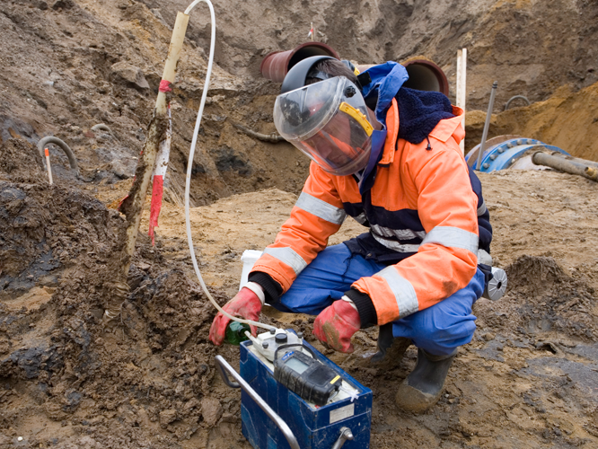
Environmental Due Diligence
Importance in a Commercial Real Estate Transaction
Environmental Contamination Can Interfere With Business Uses of Property
Disruption Caused By Pollution May Impair Prospective Landowner’s Ability to Service Loan
CERCLA – “Innocent” Landowner Can Be Liable for Cleanup
Engaging in “All Appropriate Inquiries” (AAI) May Allow Landowner to Achieve Certain Liability Protections

Slide 6


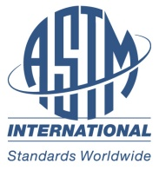


All Appropriate Inquiries Timeline
Initial Effort By Congress to Establish Innocent Landowner Protections
This Photo by Unknown Author is licensed under CC BY-SA
EPA Promulgates All Appropriate Inquiries Rule; References ASTM E1527-05
1986
2005
1980
2002
2021
CERCLA (Superfund) Signed Into Law
Brownfield Amendments – More Liability Protections; Defines “All Appropriate Inquiries”
ASTM Issues Revised Phase I ESA Standard – E1527-21
This Photo by Unknown Author is licensed under CC BY-SA-NC

Slide 7
Overview of Landowner Liability Protections
Characteristic | Innocent Landowner (ILO) | Bona Fide Prospective Purchaser (BFPP) | Contiguous Property Owner (CPO)
Knowledge of Contamination | Disqualifying | Not Disqualifying | Disqualifying
All Appropriate Inquiries | Required | Required | Required
Post-acquisition Responsibilities? | Yes | Yes | Yes
No Affiliation Demonstration? | No | Yes | Yes

Slide 8
Landowner Liability Protections – Post-acquisition Responsibilities
Responsibility | Innocent Landowner (ILO) | Bona Fide Prospective Purchaser (BFPP) | Contiguous Property Owner (CPO)
Disposal Activities After Acquisition | Prohibited | Prohibited | Not Prohibited
Compliance With Land Use Restrictions and ICs | Required | Required | Required
Taking Reasonable Steps to Manage Releases | Required | Required | Required
Cause/Contribute to Contamination | Not Disqualifying | Disqualifying | Not Disqualifying

Slide 9
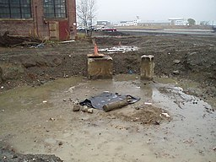
Phase I Environmental Site Assessments – Purpose & Goal
Purpose
  ASTM E1527-21 – Conform With “All Appropriate Inquiries”
  Assess “Business Environmental Risks” – i.e., Non-scope Considerations
Goal
  Identify “Recognized Environmental Conditions” or RECs

Slide 10
Phase I Environmental Site Assessments: The Lender’s Role
Process Often Driven By Lender
Qualifying For Landowner Liability Protections Reduces Risks Associated With Ability to Service the Loan
Lender Also Often Interested in Business Environmental Risks
  Beyond Scope of What Is Required to Comply With AAI
  Thus, Beyond Scope of ASTM Standard

Slide 11


The ASTM Phase I ESA Standard & the CRE Professional
“Knowledge itself is power”
-- Francis Bacon – Meditationes Sacrae (1597)
“Time is the enemy of all deals”
ASTM E1527-21 Has a Unique Role In the Environmental Due Diligence Process
Baseline Knowledge of the Standard Can Empower CRE Professional to Continue to Drive Deal Process If an Issue Arises
Ask Fundamental Questions Before Environmental Experts Are on Board and Fully Up to Speed

Slide 12
The ASTM Phase I ESA Standard & the CRE Professional:
Key Concepts
Understanding Recognized Environmental Conditions (RECs)
  Basic Definition
  Different Types of RECs
  Related Concepts
Who Can Rely on a Phase I ESA? When Can They Rely on it?
The Special Case of Dry Cleaning Facilities
All Appropriate Inquiries Versus Business Environmental Risks
Vapor Intrusion as a Business Environmental Risk

Slide 13
What is a REC?
REC – Recognized Environmental Condition
3-Part Definition:
  Presence of Covered Hazardous Substances or Petroleum Products Due to Release to the Environment
  (i) Likely Presence of Hazardous Substances or Petroleum Products (ii) Due to Likely Release to the Environment
  Presence of Hazardous Substances or Petroleum Products Under Conditions Posing a Material Threat of a Future Release to the Environment
More Detail in Revised Standard About What Likely Means

Slide 14
Other Types of RECs
HREC – Historical Recognized Environmental Condition
  REC That Has Been Completely Remediated
CREC – Controlled Recognized Environmental Condition
  REC That (i) Has Been Remediated (ii) But With Certain Controls Still in Place
No such thing as an Off-site REC
Logic Diagram in Revised Standard to Aid in Determining What Type of REC Applies

Slide 15
REC Versus De Minimis Condition
De Minimis Condition
  Condition Related to Release That Does Not Pose Threat to Human Health or Environment
  Would Not Be the Subject of an Enforcement Action
De Minimis Condition Is Not a REC

Slide 16

Presumed Viability of Prior Phase I ESAs
Conducted Within 180 Days of Acquisition – Presumed Viable
Conducted Within 1 Year of Acquisition – Presumed Viable, So Long As Following Components Are Updated Within 180 Days:
  Interviews
  Searches for Recorded Environmental Cleanup Liens
  Reviews of Governmental Records
  Visual Inspections of Subject Property & Adjoining Properties
  Declaration By Environmental Professional
Based on Date of Completion of Activity; Not Date of Report

Slide 17
Who Can Rely on a Phase I ESA?
ASTM Standard – Definition of User May Include the Following:
  Potential Purchaser
  Potential Tenant
  Owner
  Lender
Contractual Issue
  Typically Defined in Service Agreement Between Environmental Professional and Party Commissioning the Report (i.e., Lender, Buyer, or Seller)

Slide 18
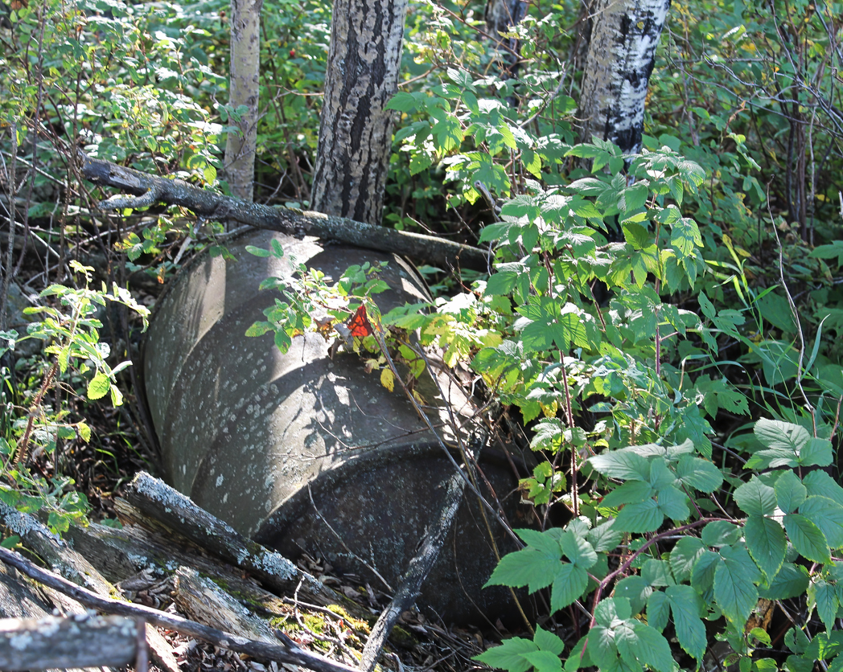
The Revised Standard – ASTM E1527-21
Three Most Important Revisions
Clarifications and Illustrations Re RECs, HRECs, CRECs, and De Minimis Conditions
Focus on Dry Cleaning Facilities
More Discussion About Considerations Beyond Scope and Business Environmental Risks

Slide 19
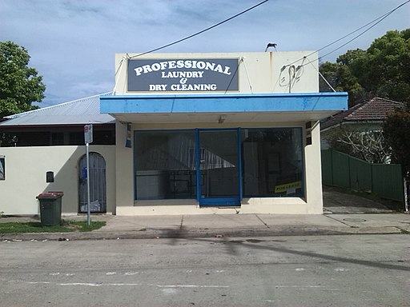
Revised Standard’s Focus on Dry Cleaning Facilities
Revised Standard’s Focus on Dry Cleaners Manifests Itself In Two Ways:
  Increased Scrutiny on Current or Former Retail Properties
  Dry Cleaning Facility Operating (i) for Significant Period of Time (ii) Prior to Existence of Regulatory Controls Cited as Example of a Possible REC
Implications For Other Commercial Sites Where Solvents Were Used?

Slide 20
Why the Focus on Dry Cleaning Facilities?
Leading Source of New Superfund Sites in U.S.
Dry Cleaning Solvent TCE (Perc) Contamination Is Difficult and Costly to Remediate
Comparison With Gasoline Stations
  Gasoline Components More Amenable to Natural Degradation Processes Than Perc
  Cost of Remediating a Dry Cleaning Site Significantly Greater Than Cost of Remediating a Gasoline Station Site (≈5x or more)

Slide 21
Considerations Beyond Scope and Business Environmental Risks
Desire to Understand Environmental Risks Beyond Those That Must Be Addressed in Order to Achieve AAI
Contaminants of Concern Other Than Hazardous Substances or Petroleum Products
Emphasis in Revised Standard Driven By Concerns With Poly- and Perfluoroalkyl Substances (PFAS)

Slide 22
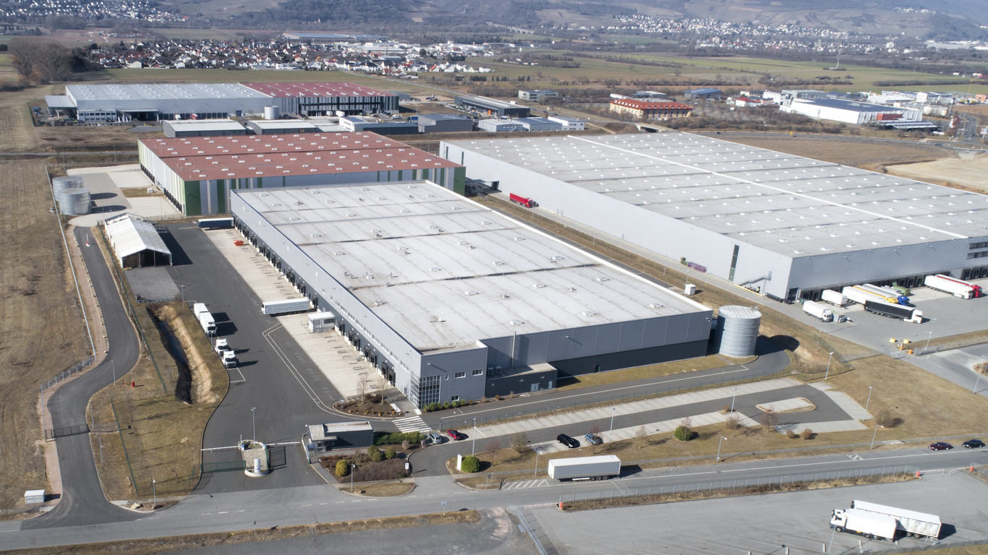
Examples of Non-scope Considerations
Asbestos
Mold
Lead
Environmental Compliance
State/Local Issues
PFAS
Vapor Intrusion?

Slide 23
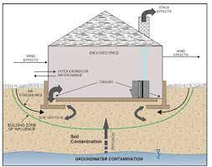
Vapor Intrusion
Nature of the Risk
Seepage of Potentially Toxic or Hazardous Vapors Into Buildings From Underlying Groundwater
Higher Concentrations as Compared to Outdoor Air
Expensive Assessment
Expensive Mitigation Measures
Assessment May Lead to Discovery of Groundwater Plumes Requiring Cleanup

Slide 24
How Vapor Intrusion Issues Might Arise
Phase II Investigation Following Finding of REC in Phase I ESA
Addressed Under Voluntary Remediation Program or Brownfield Program
  Per New Georgia EPD Vapor Intrusion Technical Guidance Document
Perform Vapor Encroachment Screening (VES) in Conjunction With Phase I ESA
  E2600-15 – ASTM’s Vapor Encroachment Screening Standard

Slide 25
Addressing Contaminated Property in Georgia
Voluntary Remediation Program – Current Owners
Brownfield Program – Prospective Owners
  Liability Protections and Tax Incentives
  Clean Up Soil and Source Materials to Applicable Risk Reduction Levels
  Conditional Determination of Limitation of Liability From EPD
Vapor Intrusion Must Be Addressed in Both Programs

Slide 26
Phase I ESA Toolkit for CRE Professionals
What’s the REC? What Kind of REC?
Is it a REC? Or, is it a De Minimis Condition?
No Such Thing as an “Off-site REC”
Existing Phase I Reports: More Than 180 Days Old? More Than One Year Old?
All Appropriate Inquiries? Or, Non-scope Consideration?
Try to Nip Issues in the Bud – the Sooner, the Better

Slide 27

Final Wrap-up
Questions & Answers

Slide 28
Contact Information
Mailing Address:
4062 Peachtree Rd.,
Suite A #304
Atlanta Georgia 30319
(404) 850-1111
dan@djbrownlaw.com
https://djbrownlaw.com

