Slide 1

Chemical Screening – Design & Implementation
Designing & Implementing a Chemical Screening Program Within a Risk Management Framework
Thursday, April 28, 2022

Slide 2

Daniel J. Brown
Daniel J. Brown, L.L.C.
Law Practice Focused on Environmental, Health & Safety
Over 25 years of experience in helping clients navigate complex EHS regulatory obstacles to meet their business goals

Slide 3
Disclaimer
This presentation contains information on a topic of general interest, and does not constitute legal advice. © 2022 Daniel J. Brown, L.L.C. All rights reserved.

Slide 4
Part I
Chemical Screening Programs – Introduction and Basics – Daniel J. Brown
Part II
Risk Assessment Tools for a Regulatory Environment – Stephen B. Ellingson, Ph.D. Vatten Associates
Table of
Contents
Part III
ESG, Compliance & Enforcement Considerations – Daniel J. Brown
Final Workshop and Q&A
Application to a Hypothetical Facility

Slide 5

Part I:
Chemical Screening Programs – Introduction & Basics
Daniel J. Brown

Slide 6

Chemical Screening: Knowing What You Have
“… as we know, there are known knowns; there are things that we know we know. We also know there are known unknowns; that is to say we know there are some things we do not know. But there are also unknown unknowns – the ones we don’t know we don’t know.”
-- Former U.S. Secretary of Defense, Donald Rumsfeld at Department of Defense news briefing, February 12, 2002

Slide 7
Chemical Screening in an Ideal World
Simple Chemical Process – A + B → C
  Only 3 Substances
  Used or Produced in Large Volumes
  Nothing Likely to Slip Through Cracks
Reactant A
A + B → C
Product C
Reactant B

Slide 8
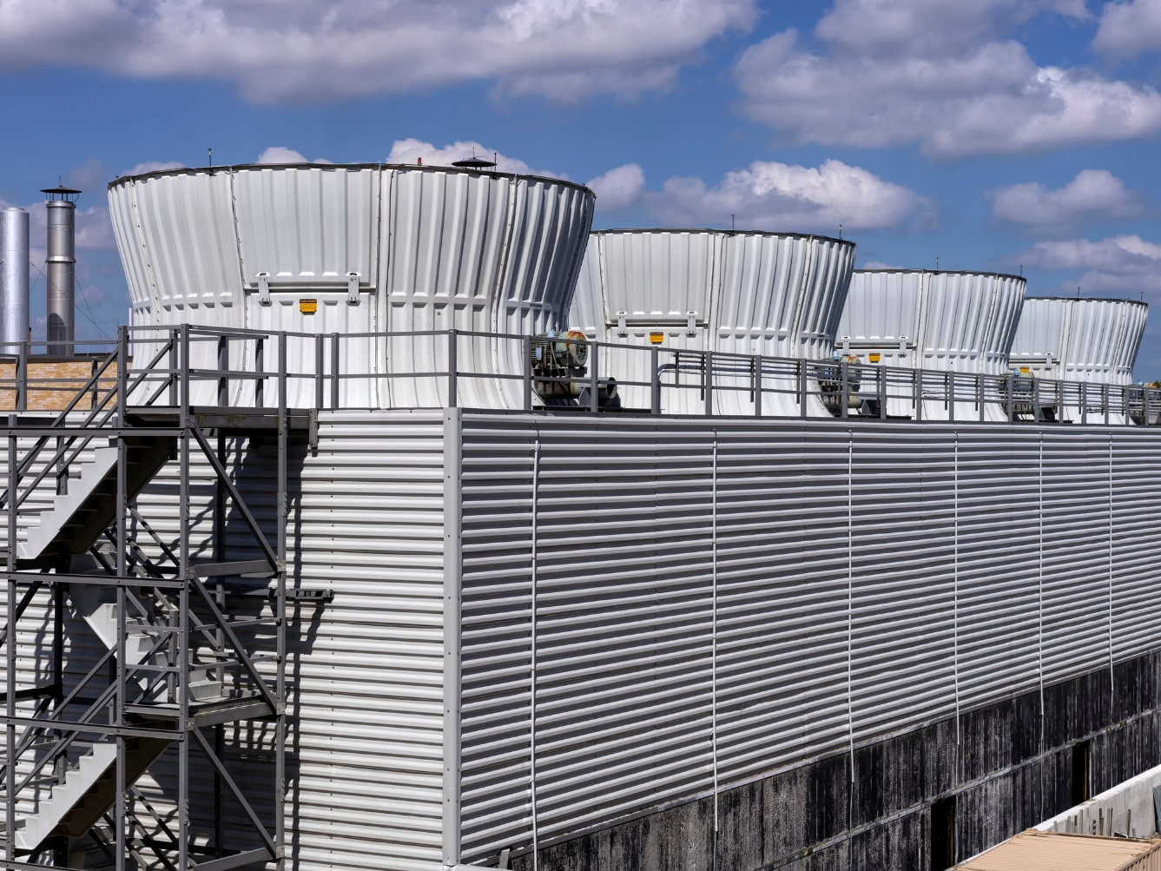
Chemical Screening in the Real World
Examples of Materials Used in Manufacturing Facilities
Lots of Chemical Substances and Mixtures
Examples:
  Biocides, Corrosion Treatment Chemicals & Other Water Treatment Chemicals
  Solvents & Other Cleaning Agents
  Processing Aids

Slide 9
Chemical Screening & The Pareto Principle
20% of benefit
80% of volume
80% of benefit
20% of volume

Slide 10
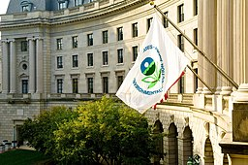
Chemical Screening: Regulatory Enablers & Drivers
Sources of Information – Safety Data Sheets (SDSs)
Hazard/Risk Assessment Requirements
  OSHA Process Safety Management (PSM)
  EPA Risk Management Plan Rule (RMP)
Inventory Management
  Tier II
  Spill Planning, Control & Countermeasure
Usage
  Toxic Release Inventory (TRI) Reporting
  California Proposition 65

Slide 11
Sources of Information: Safety Data Sheets (SDSs)
Required to Be Provided by Supplier
Employer Required to Maintain SDSs and Ensure That They Are Readily Accessible
Content/Ingredients in Mixtures:
  Found in Section 3 of an SDS
  Ingredient Present Above Applicable Cut-off Concentration
  Ingredient Present Below Cut-off Concentration if Still a Health Risk

Slide 12
Safety Data Sheets (SDSs): Composition Section

Slide 13
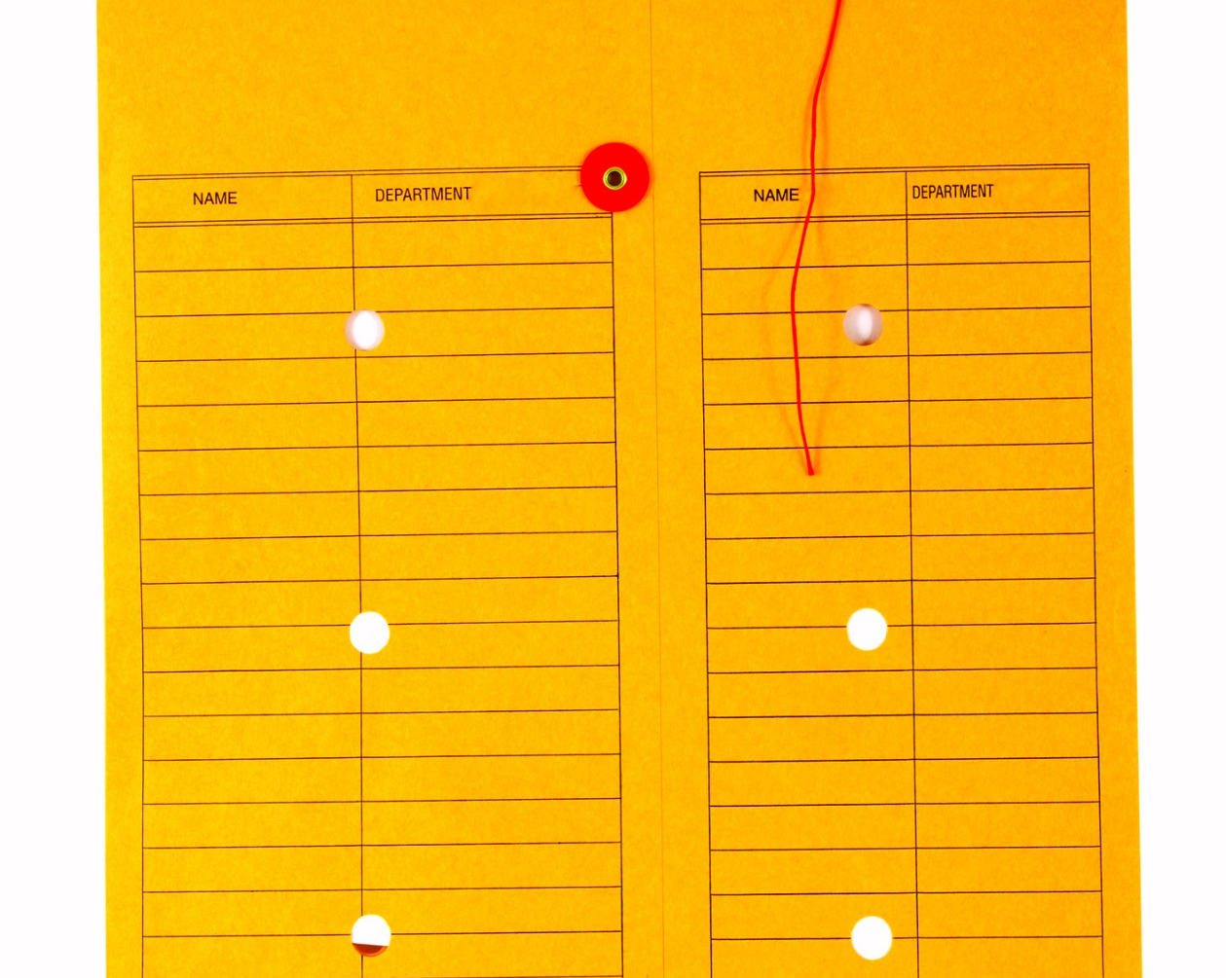
Chemical Screening: A Simple Model
Review & Evaluate, Approve, Capture Information, Initiate Usage
Request for Review of a New Chemical or Mixture – Operations/Maintenance
Initiate Screening Program – Procurement
Review & Evaluate Operational Hazards & Risks – Operations/Maintenance & EHS
Review & Evaluate Regulatory Risks – EHS
Approve – Operations/Maintenance, EHS & Procurement
Capture Information About New Chemical or Mixture – EHS

Slide 14

Developing and Implementing a Chemical Screening Program: What Type of Management Framework to Apply?
ISO 9001/14001
Responsible Care
  Responsible Care Management System – RC 14001
Deming Cycle – Plan, Do, Check, Adjust
7-Element Risk Management System

Slide 15
Mini-Workshop Session #1
What Systems/Processes Do You Have for Chemical Screening at Your Facility
  Describe systems/processes
  Which functions are involved? Operations? Procurement? EHS? Quality? Finance and Accounting? Others?
  How is process initiated?
  What data is used to evaluate candidate substances, mixtures & agents?
  Is ingredient information used to comply with other requirements? Used to comply, or evaluate compliance, with ESG goals?
  Is performance periodically evaluated?

Slide 16
Part II:
Risk Assessment Tools for a Regulatory Environment
Stephen Ellingson

Slide 17
Risk Assessment Tools for a
Regulatory Environment
7-Element Risk Management System
American Society for Quality, Atlanta Section
April 28, 2022
Notes:
This is title of workshop on ASQ webpage

Slide 18

Introduction and Overview
Introduction
  Steve Ellingson
What’s a Management System and Why Implement?
  Systematic Processes Used to Ensure Organization Meets its Objectives
    Compliance Obligations
    Improve Performance Efficiently
  High Quality People are Critical
    However, Do Not Become Dependent on One or Few People
One Potential Management Approach
  7-Element Risk Management System
    Based on Plan-Do-Check-Act Cycle
Stephen B. Ellingson, PhD
(678)512-9688
Steve.Ellingson@VattenAssociates.com
Notes:
The international standard ISO 9000:2015 (Title: Quality management systems - fundamentals and vocabulary) defines the term in chapter 3.5.3 as a "set of interrelated or interacting elements of an organization to establish policies and objectives, and processes to achieve those objectives"

Slide 19

7-Element Risk Management System
E1: Leadership & Management Commitment
E2: Employee Ownership
E3: Compliance & Risk Assessment
E4: Compliance & Risk Management
E5: Communications & Training
E6: Change Management
E7: Continuous Improvement

Slide 20
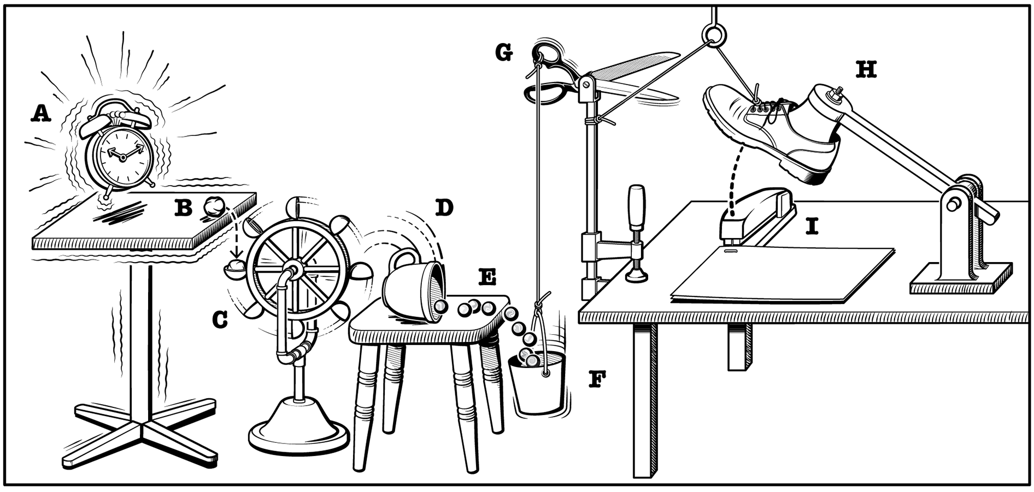
Make everything as simple as possible, but not simpler. Albert Einstein

Slide 21
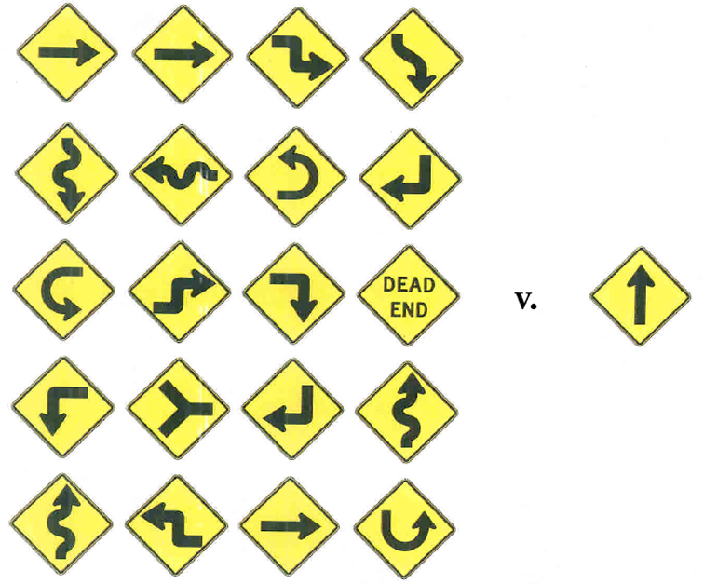
E1 – Leadership & Management Commitment
Communicate Vision & Align Culture
  What to Work On and Why?
Provide Sufficient Resources
  Staff, Financial and Other Tools
Set Clear Accountabilities and Performance Expectations
Drive Continuous Improvement
Capability Leaders
  Environmental, Health & Safety
  Quality
  Procurement
  Operations
Lead
by Example

Slide 22
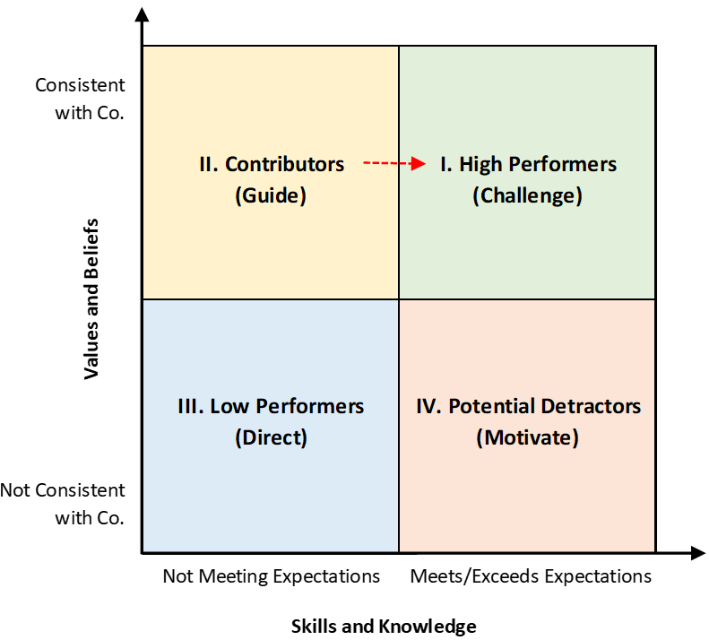
E2 – Employee Ownership
Align with Vision and Align Culture
  Leader/Employee Collaborative Engagement
    “Employees” are “Leaders”
  All Employees Must “Buy-In”
Take Responsibility and Initiative
  Proactively Design and Develop Programs, Procedures, etc.
Contribute to Continuous Improvement
Get the Right People on the Bus . . .

Slide 23

E3 – Compliance & Risk Assessment
What Do We Do?
  What Applies to Us and Why?
Risk Assessment
  Risk = Chance of Occurrence and Consequence
  Used for Risk-Based Resource Allocation
Interested Parties’ Compliance Obligations
  Mandatory Requirements
    Laws, Regulations, etc.
  Voluntary Commitments
    Contracts, Codes of Practices, etc.

Slide 24
E3 – Example Interested Parties
Government
  Law, Regulations, etc.
Shareholders
Customers
Suppliers
Neighbors/Community
Investors
Insurers
Non-Governmental Organizations (NGOs)
Employees
Contractors
Unions/Trade Associations
Codes of Practice
Industry Standards
Commercial Agreements

Slide 25

E3 - Someday you will be gone . . .

Slide 26

E3 - Not In Your Head !
If it isn’t systematically documented. . .
. . . it didn’t happen!
Notes:
26

Slide 27
E4 – Compliance & Risk Management
How do We Manage Risk?
  Core of 7-Element Risk Management System
Risk Management Controls or Procedures
  Systematic, Generic Processes
    Work Instructions, Guidance, Standard Operating Procedures
    Completed Records and Forms
  Examples
    Hazard Communication (Safety Data Sheets), Inventory Management, Record Keeping, Compliance Calendar, etc.
Think “Both Ways”
  Risk Mitigation and Opportunity Capture

Slide 28

E5 – Communications & Training
Knowledge Sharing
  No Silos
Don’t Train Just to Train
  Should Continuously Improve Performance
Identify, Deliver and Assess Training
Required Training
  Laws, Regulations, Permits, etc.
Voluntary Training
  Risk Management System and Other Compliance Obligations

Slide 29

E6 – Change Management
Ensure Responsibility and Accountability
  Who are the Gatekeepers?
Changes
  Routine and Nonroutine
  Permanent and Temporary/Interim
Examples
  Compliance Obligations, Chemicals, Technology, Equipment, Procedures, Staff, etc.
Inform and Train Those Impacted
Don’t Forget Emerging or Future Issues
  Discover, Analyze, Accept/Influence and Comply

Slide 30
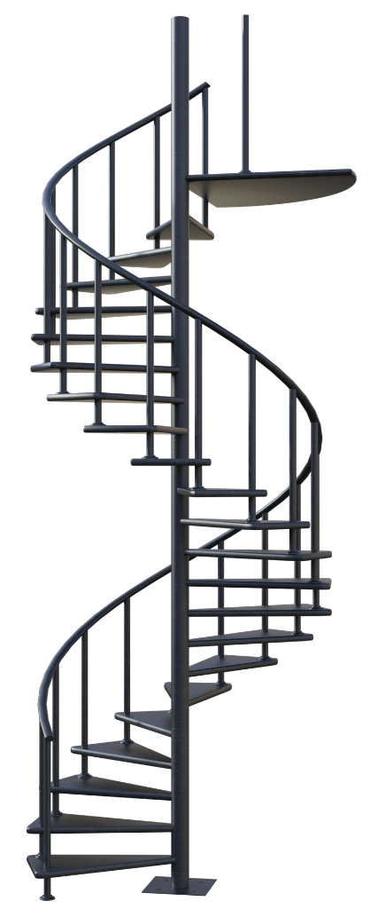
E7 – Continuous Improvement
Create Long-Term Value for Your Organization
Monitor, Measure, Analyze and Evaluate
  Leading and Lagging Indicators
Root Cause Analysis and Corrective Action
Audits and Self-Assessments
  Compliance and Management System Conformance
Advice and Reporting
  Employee Initiated
  Management Reviews

Slide 31

Don’t Play Whack-a-Mole
You Will Never Win!
Have a prioritized, management system-based approach and stick with it.
File: CLM Ellingson 2022-04-28.ppt
31

Slide 32

Stephen B. Ellingson, PhD
(678)512-9688
Steve.Ellingson@VattenAssociates.com

Slide 33
Mini-Workshop Session #2
How Might You Develop or Evaluate a Chemical Screening System at Your Facility Within a 7-Element Risk Management System Framework?
  Are there similarities between the risk management frameworks at your facility and the 7-Element System? If so, briefly describe.
  Do you see commonalities between the 7-Element System and other well-known systems such as the Deming Cycle or ISO 9001/14001?
  Which elements of the 7-Element System could you see adopting at your facility? Briefly describe why.
  Which elements of the 7-Element System do you believe might not fit at your facility? Briefly describe why.

Slide 34
Part III:
ESG, Compliance & Enforcement Considerations
Daniel J. Brown

Slide 35

ESG Considerations
ESG – Environment, Social, Governance
Corporate or Facility ESG Goals May Include:
  Limits on Use of Materials & Substances Containing Volatile Organic Carbons (VOCs)
  Limits or Prohibitions on Use of Persistent & Bio-accumulative Substances
  Limits or Prohibitions on Extremely Hazardous Substances
Chemical Screening Program Can Be a Key Tool in Ensuring That Such Goals Are Met

Slide 36
Compliance & Enforcement
Example: Audit of EMS reveals some nonconformance with facility’s Chemical Screening Program. This nonconformance has resulted in noncompliance with TRI reporting requirements. Failure to report for several chemicals that have been otherwise used at levels exceeding applicable thresholds.
Options:
  Do nothing
  Prepare and submit reports
  Voluntary disclosure to EPA

Slide 37
Compliance & Enforcement – Voluntary Disclosure
EPA Self-audit Policy
  Up to 100% reduction in the gravity-based component of a penalty if certain criteria are met
Key Criteria
  Disclosure must be voluntary
  Timely disclosure – 21 days
  No similar violations within previous 3 years
Even if Self-audit Policy Criteria Cannot Be Met, Limited Relief Available Under Program-specific Penalty Policies

Slide 38
Final Workshop and Q&A:
Application to a Hypothetical Facility

Slide 39
Final Workshop
Substitution of new coatings agent at a coatings facility. Facility is covered by synthetic minor operating permit that contains limits and monitoring requirements for total VOC consumption.
Facility has chemical screening program in place. Substitution of coatings agent, and its implications, are considered as part of facility’s chemical screening program – see Handouts
If there’s any noncompliance with permit limits, voluntary disclosure may not be a viable option.

Slide 40
Contact Information
Mailing Address:
4062 Peachtree Rd.,
Suite A #304
Atlanta Georgia 30319
(404) 850-1111
dan@djbrownlaw.com
https://djbrownlaw.com

