Slide 1
WE
CAN
READ
Donald Joyce

Slide 2
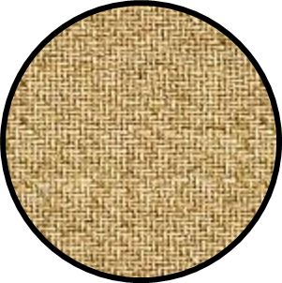
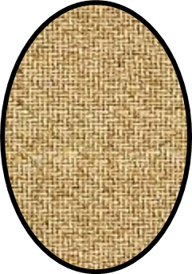
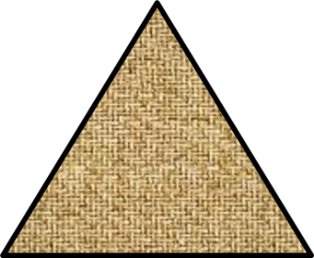
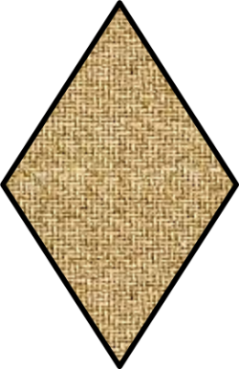
What Can You Make
With These Shapes?
By:
Donald Joyce
WE CAN READ

Slide 3
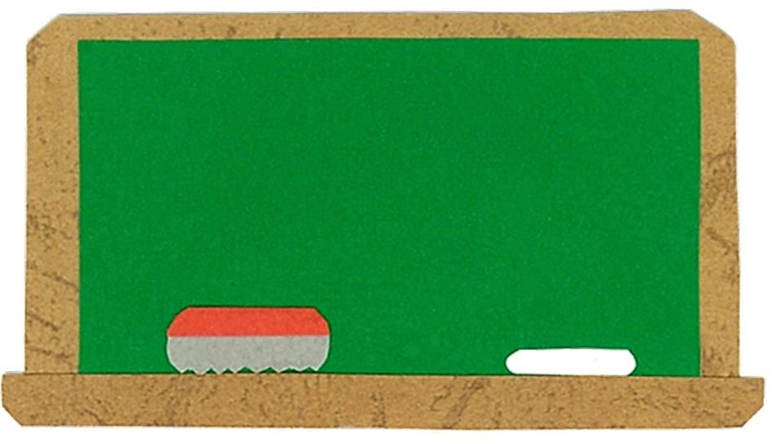
Let’s
Talk!

Slide 4
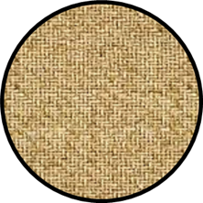
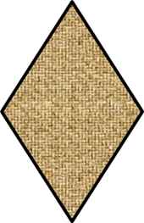
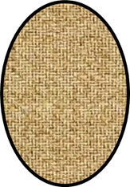
What shapes can you see?
I can see ___.

Slide 5
Let’s
Learn!

Slide 6
a circle
a square
an oval
a star
a triangle
a heart
a rectangle
a diamond

Slide 7
Let’s
Read!

Slide 8
What Can You Make
With These Shapes?
By:
Donald Joyce
WE CAN READ

Slide 9
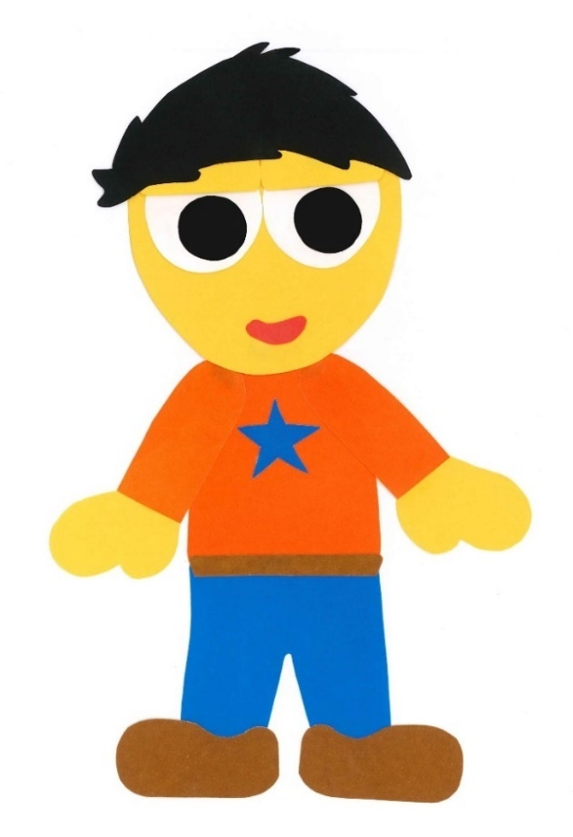
This is a triangle.

Slide 10
This is a square.

Slide 11
What can you make with these shapes?

Slide 12
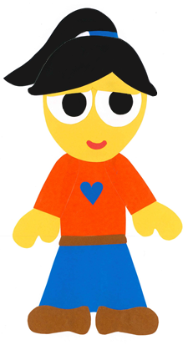
I can make a house.

Slide 13
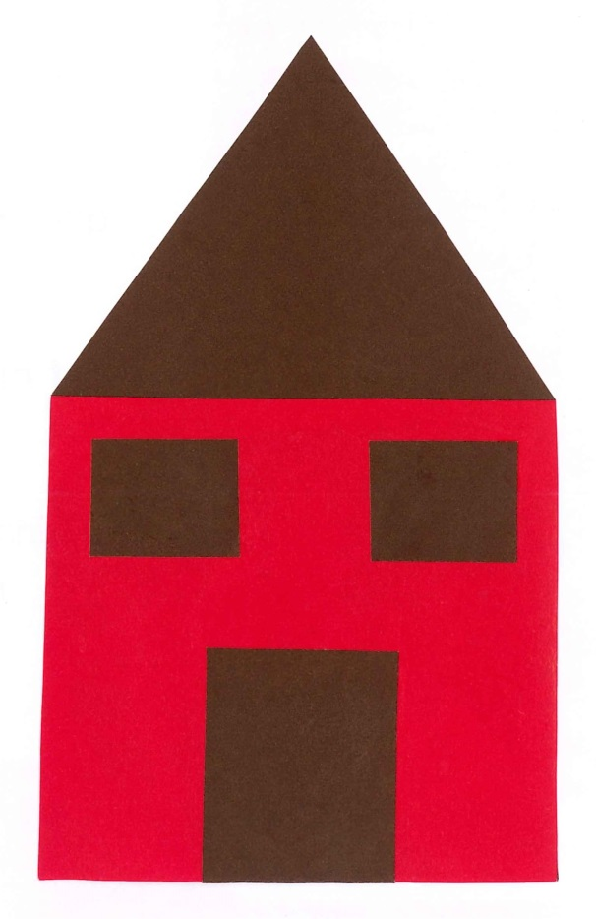

Slide 14
This is a triangle.

Slide 15
This is a circle.

Slide 16
What can you make with these shapes?

Slide 17
I can make
an ice cream cone.

Slide 19
This is a square.

Slide 20
This is a star.

Slide 21
These are triangles.

Slide 22
What can you make with these shapes?

Slide 23
I can make
a Christmas tree.

Slide 24
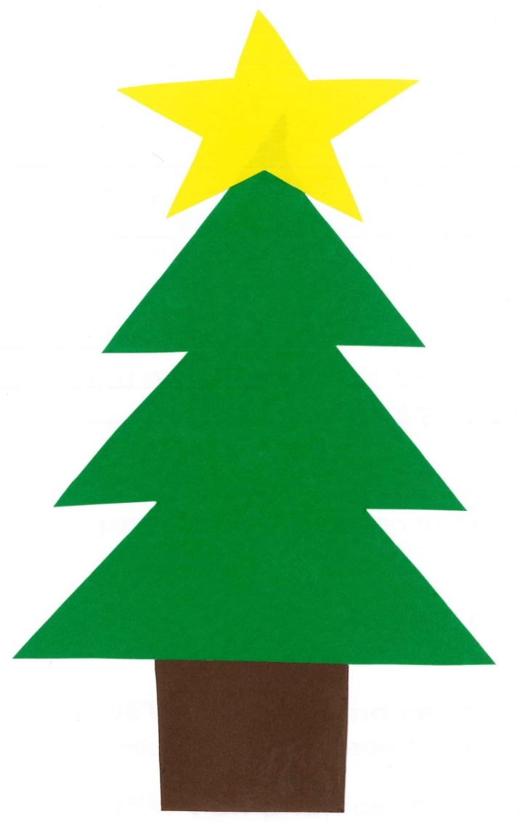

Slide 25
This is a circle.

Slide 26
This is a rectangle.

Slide 27
These are hearts.

Slide 28
What can you make with these shapes?

Slide 29
I can make a flower.

Slide 31
This is an oval.

Slide 32
This is a diamond.

Slide 33
These are triangles.

Slide 34
What can you make with these shapes?

Slide 35
I can make a fish.

Slide 38
What Can You Make
With These Shapes?
By:
Donald Joyce
WE CAN READ

Slide 39
Let’s
Review!

Slide 40
This is a circle.

Slide 41
This is a square.

Slide 42
This is an oval.

Slide 43
This is a rectangle.

Slide 44
This is a triangle.

Slide 45
This is a heart.

Slide 46
This is a diamond.

Slide 47
This is a star.

Slide 48
Let’s
Connect!

Slide 49
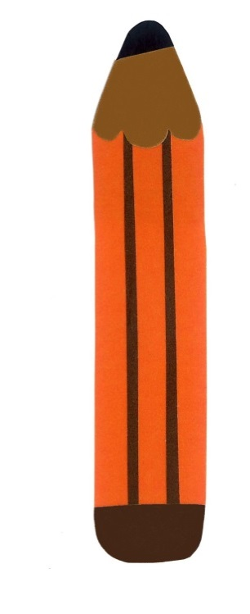
Get a pencil and paper!

Slide 50
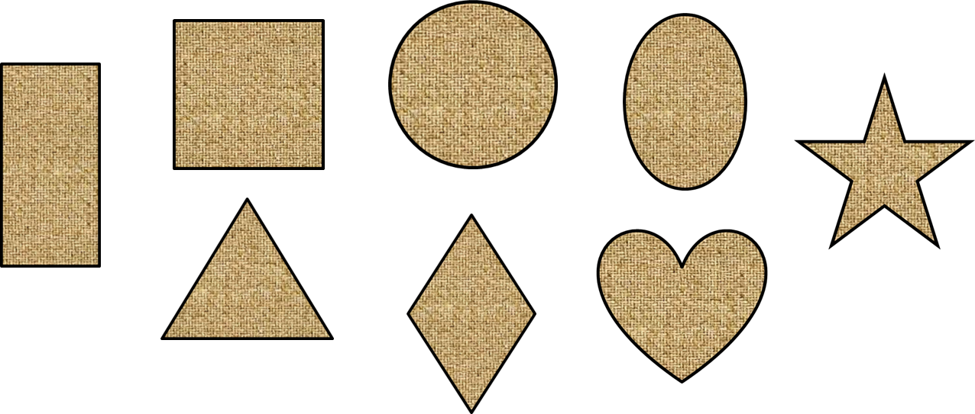
What can you make with these shapes?
I can make ___.

Slide 51
WE
CAN
READ
www.teacherdonald.com

