Slide 1
Abnormal coagulation results
Real or Fake?

Slide 2
objectives
Discuss common preanalytical variables that may affect coagulation testing
Recognize analytical variables that may interfere with coagulation results
Correlate coagulation results with patient condition

Slide 3
Lab detectives
Coagulation can be tricky and sometimes the unexpected happens
Coagulation samples are less forgiving than chemistry and hematology samples
Knowing what can effect coagulation assays is important
Preanalytical and analytical phases of testing

Slide 4
Preanalytical errors
All factors that may affect a patient specimen or sample analysis from the point of ordering to the point of analysis
Largest contribution (60-70%) to total laboratory error in the total testing process
Clotting assays are particularly susceptible due to complex enzymatic reactions
Sometimes divided into pre- preanalytical phase (test ordering) and preanalytical phase (from sample collection to analysis)

Slide 5
Standards
International Council for Standardization in Haematology recommendations for processing of blood samples for coagulation testing
CLSI document H21 Collection, Transport and Processing of Blood Specimens for Testing Plasma Based Coagulation Assays and Molecular Hemostasis Assays
5th ed.
Published 2005

Slide 6
Cost of errors
Cost of each preanalytical error ~ $200
$1.2 million for a 650 bed hospital
Around 5% of samples

Slide 7
Analytical Errors
Those which occur during the testing phase
Analyzer
Reagent
Sample
Does this make sense???

Slide 8
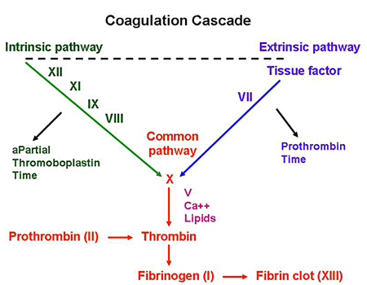

Slide 9
Role of Vitamin k
Adds a binding site to
Factors 2,7,9,10
Protein C and S
Without binding site, factors are impaired
Vitamin K
Diet
Gut bacteria

Slide 10
Sample collection
Coagulation samples should be collected with 19-21 gauge needle with good access
22-23 gauge for children
Mixed gently 3-4 times
Tube should be 90% full
Catheter draws
Heparin contamination

Slide 11
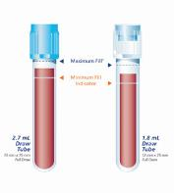
UNDERFILLED AND OVERFILLED TUBES
3.2% Na citrate anticoagulant in ratio of 9 parts of whole blood to 1 part anticoagulant (9:1 ratio)
Requires 90% tube fill followed by 3-4 gentle inversions for mixing
Incorrect ratio of whole blood to citrate
Under-filled (<90%): falsely prolonged
clotting times due to reduced calcium and dilutional effect
High hematocrit (>55%) can have the same effect
Over-filled: uncommon with vacuum tubes
but can occur with opened tubes/ syringe fills and result in falsely shortened clotting times

Slide 12
Collection tubes
Different manufacturers
Different plastic
Different siliconized glass
Composition of stoppers
Difference in vacuum
All tube types must be validated

Slide 13
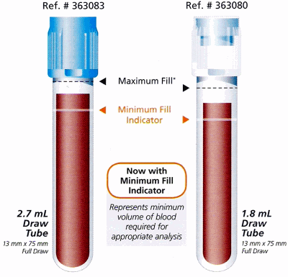
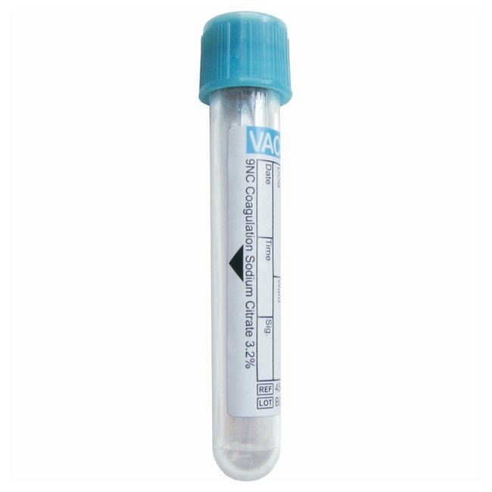

Slide 14
Transport of fresh samples
Fresh samples should be transported to the laboratory promptly at ambient temperatures (18-24degrees C)
Transporting at colder temperatures or on ice is not recommended
Cold precipitate of fibrinogen, factor 8 and vonWillebrand factor
Cold activation of factor 7 and 12 which leads to a shortened PT and PTT
High temps degrade factors 5 and 8

Slide 15
Sample ANALYSIS
Avoid storage of whole blood samples for coagulation testing at 2-8 º C prior to analysis
Time dependent loss of factor 8 and vonWillebrand factor
One study classified normal subjects as being misclassified as having vWD in 50% of samples stored at 2-8º prior to processing and analysis

Slide 16
Clots in Citrated Samples
Coagulation process can be activated during collection and processing of samples
Leads to generation of activated clotting factors
Results in shortened clotting times
Fibrin clots are pale in color and may appear in the plasma after a freeze-thaw cycle
Partial clotting or activation may be difficult to detect
ICSH recommends that any PTT results 4 or more seconds below lower limit of reference range should be recollected due to the possibility of partial clotting

Slide 17
Centrifugation
Centrifugation should be sufficient to deliver platelet poor plasma
Residual platelet count of <10,000
Platelets can interfere with certain testing
Platelets absorb unfractionated heparin out samples
Fresh samples can be tested after a single spin

Slide 18
Sample stability
PT: stable for 24 if at room temperature and capped
4 hours if uncapped
aPTT: stable for 4 hours at room temperature
If heparinized, sample must be spun within 1 hour but run within 4 hours
Xa: unfractionated heparin, spun within 1 hour and run within 4
Low molecular weight heparin: 24 hours
Fibrinogen and D-dimer: 4 hours at room temperature
Factor assays: 4 hours

Slide 19
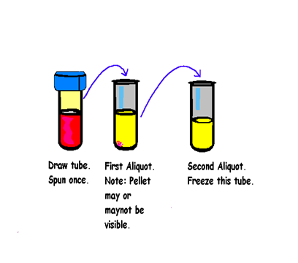
Centrifugation
If samples are to be frozen prior to testing, essential that a second spin be performed to remove any residual platelets
Platelets rupture after freezing and release contents which can interfere with testing
Centrifuge the draw tube.
Take plasma layer off to an aliquot tube. Be careful not to disturb the platelet layer.
Centrifuge the First Aliquot tube.
Take off plasma leaving a small amount at the bottom of the tube. Use care not to aspirate the pellet of Platelets/RBC at the bottom of the tube.

Slide 20
hemolysis
Cause of hemolysis
Due to in vivo RBC disruption as a consequence of disease process
In vitro lysis due to collection, transport, storage or processing
Visual checks can be operator dependent
Manufacturers are adding automated detection of hemolysis
Can interfere with optical measurement
Hemolysis can multi-factoral
Clotting factor activation
Recommended to recollect hemolyzed samples

Slide 21
Icterus and lipemia
Interferes with photo optical methods
Irrelevant in mechanical methods
Lipemic samples can be double spun using a high speed centrifuge to remove lipids
Validated at each site prior to use

Slide 22
Other interfering substances
Package inserts
CRP
Rheumatoid factor

Slide 23
Secondary aliquots
Sodium citrate anticoagulant only
No EDTA, Heparin or serum
Polypropylene aliquot tubes (translucent)
tubes have double-walls to minimize evaporation, especially for
coagulation-based tests: polypropylene inner surface to prevent surface activation and prevent anticoagulant evaporation, and outer polyethylene layer to prevent breakage during freezing or centrifugation
Do not use polysterene (transparent)

Slide 24
Sample thawing
Frozen citrated plasma should not be allowed to thaw slowly at room temperature
Precipitation of fibrinogen, factor 8, vWF and Antithrombin
Samples should be thawed in a 37º C waterbath for 5 minutes
Mixed by gentle inversion 6-8 times
Check for bubbles or fibrin clots

Slide 25
Visual checks
Proper fill
Bubbles
Hemolysis/icterus/lipemia
Clots
High hematocrit

Slide 26
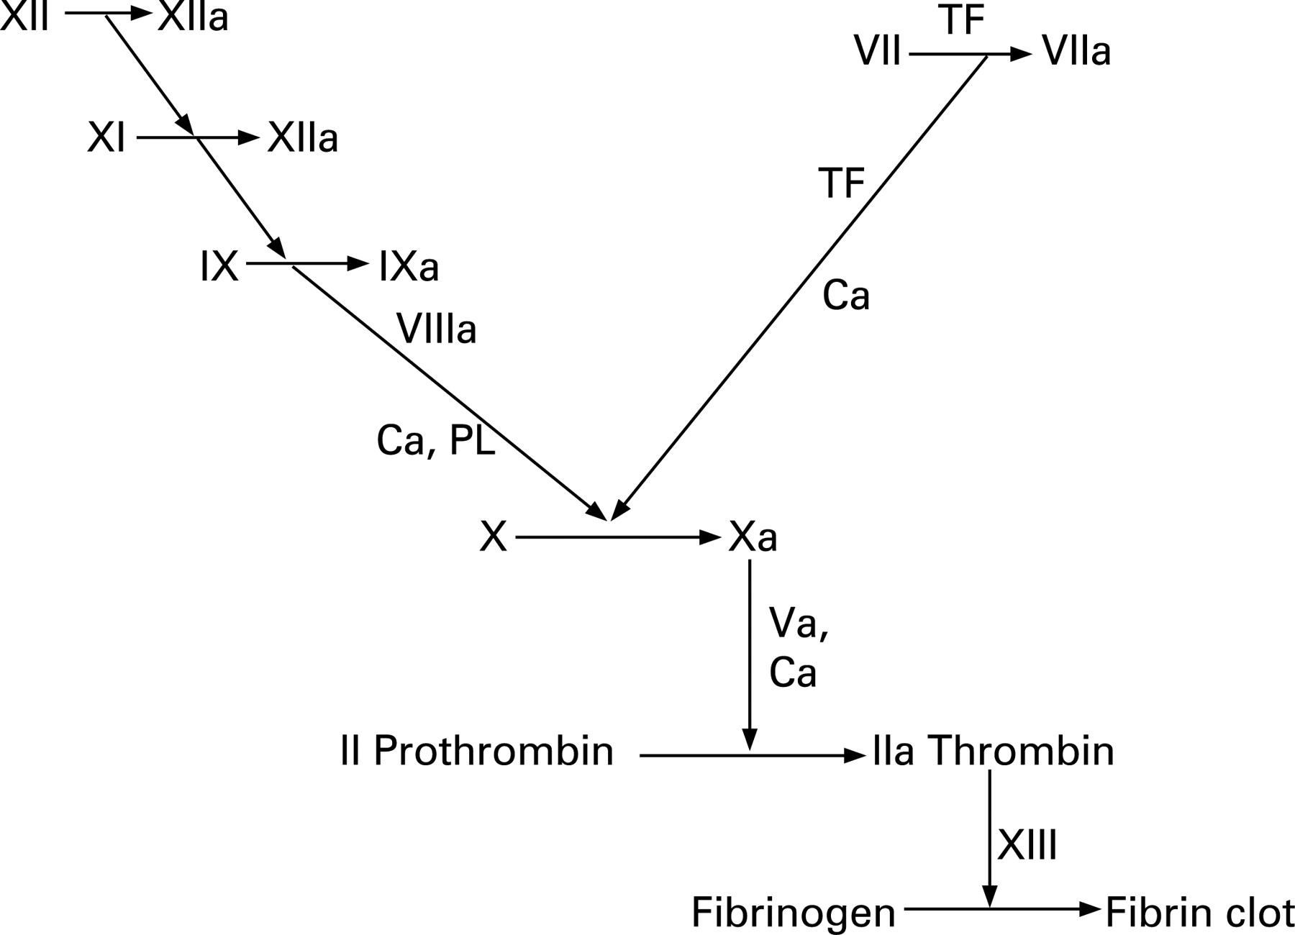
Anticoagulants
Coumadin
Oral
Vitamin K antagonist
Half-life = ~3 days
Clearance = liver
K
K
K
K

Slide 27
Anticoagulants
Heparin
Intravenously or Sub-q
Indirect irreversible inhibition of thrombin and Factor Xa through antithrombin
Half-life = 30-150 min
Clearance = renal

Slide 28
Anticoagulants
Direct thrombin inhibitors
Direct Xa inhibitors
Xarelto
Eliquis

Slide 29
Patient condition
Underlying condition
Inflammatory conditions
Undiagnosed liver disease
Myeloproliferative disease or leukemia
Anticoagulant therapy
Herbal supplements
Estrogen supplements
Dietary
Other interfering substances

Slide 30
Case #1
A 60 year old female presents to the Walk-In clinic with respiratory illness that has lasted 10 days
Lab work revealed
Normal CBC, Chemistries, PT, PTT, PLT count
Dimer >20 mg/L. (<0.5)
Cat scan revealed no PE or DVT
Antibiotic therapy initiated
Repeat dimer 2 weeks later
>20 mg/L

Slide 31
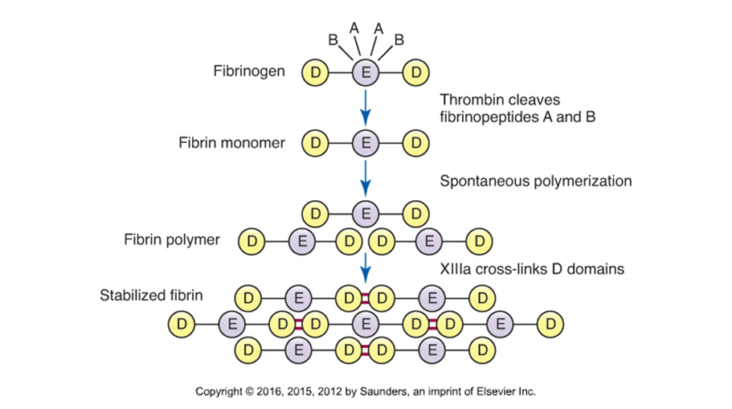

Slide 32
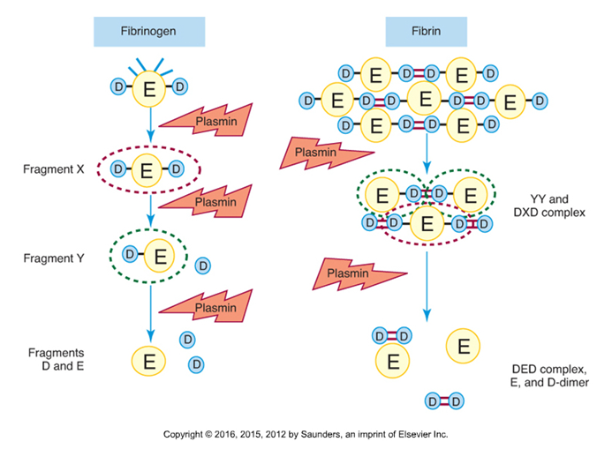
Fibrinolysis
Tissue Plasminogen Activator
Tpa
Activates plasminogen to plasmin
Fibrin Degradation products
D-Dimer

Slide 33
D-DIMER
Demonstrates both generation of fibrin and plasmin
A negative predictor test
Most often used to rule out a DVT or PE
Easy and automated
Latex immuno-turbidometric assay

Slide 34
Elevated Dimer levels
DVT or PE
Arterial Clot
Cardiovascular disease
Infection
Inflammation
Liver disease
Malignancy
Renal disease
Pregnancy
Excessive exercise
DIC
Aging

Slide 35
Acute DIC
Rapid consumption of factors leads to sudden bleeding
Bleeding occurs at multiple sites
Fibrin (microclots) are formed and can disrupt organ function
Patients may have renal, liver or respiratory failure
Purpura fulminans-skin necrosis due to the depletion of protein C

Slide 36
D-Dimer Levels
If the Dimer is negative, it rules out DIC
If the Dimer level is moderately elevated -1.0-4.0 mg/L FEU, DIC is unlikely
If the Dimer level is in the range of 8.0-10.0 mg/L or more, DIC is increasingly likely

Slide 37
D-Dimer
Limitations
Cloudy plasma may cause false negative results
Presence of rheumatoid factor may cause false positives
Hemolysis, icterus may interfere

Slide 38
Case study 2
A 40 year old woman is set to have a hysterectomy so the physician orders pre op labs
PT = 48 sec INR = >5.0
PTT = 34 sec (24-35)
Fibrinogen = 350 mg/dL
Patient is not on any anticoagulants
No other medications
No bleeding with prior surgeries or childbirth

Slide 39
Case Study 2
Possibilities
Sample
Processing
Transport
Anticoagulants
Instrument
Patient condition

Slide 40
Case study 2
Patient referred to Hematology to figure out cause of prolonged PT
Repeat PTINR = >5.0
Mixing study= indicated factor deficiency
7 = 25%
10 = 30%
5 = 90%
2 = 40%

Slide 41
Case Study 2
Patient was diagnosed with an acquired Vitamin K deficiency
Patient stated that she had been diagnosed with malabsorption issues
Vitamin K not being absorbed in the gut

Slide 42
Case study 3
A 15 year old female presents to her physician with heavy periods
PT = 60 sec INR 6.1
PTT = 70 sec
Fibrinogen 60
Dimer = .30
Patient otherwise healthy
No family history of bleeding disorders
Sample was drawn at another facility and frozen

Slide 43
Case study 3
Possibilities
Sample
Processing
Transport
Patient condition
Anticoagulants
Instrument

Slide 44
Case study 3
Tested another aliquot
Results were all normal

Slide 45
Case study 4
A 74 year old female who has been in the hospital for 1 week starts to have bleeding issues so the physician orders lab work
PT = 13.5
PTT = 90
Fibrinogen = 300
Not on any anticoagulants
History of chronic kidney disease

Slide 46
Case study 4
Results consistent with an acquired factor inhibitor or a non specific inhibitor
Further studies revealed what appeared to be a non specific factor inhibitor
Rule out anticoagulant contamination

Slide 47
Case study 4
Doctor insisted the patient was not on any anticoagulant
Heparin Xa level = 0.3. (0.3-0.7) ???????
Patient was receiving some sub cutaneous heparin to prevent clotting due to being bed ridden
Very small amount, should not interfere with coagulation results
Sample was drawn via veinapuncture
Transported and processed correctly

Slide 48
Case study 4
Patient was admitted with kidney failure
Cre = 2.5
Heparin is cleared by the kidneys

Slide 49
Case study 5
A 8 year old child has a family history of thrombosis so the physician orders some labs to see if they are at risk. The child had not had a thrombotic event
PT = 14.0. (12.0-14.5)
PTT = 28 (24-35)
Fibrinogen = 375 (200-450)
AT = 9%. (83-150%)
Lower linearity of test
AT are only run on certain days, so sample was frozen

Slide 50
Case study 5
Patient was diagnosed with AT deficiency
1 month later, another sample was drawn to recheck AT level
AT = 103%
Not being treated

Slide 51
Case study 5
Possibilities
Sample
Transport
Processing
Patient condition

Slide 52
Case study 5
Looked back at other AT that were performed that day
Determined that there were bubbles in the tube

Slide 53
Case 6
A 37 year old male presents to the physician with a complaint of recent bruising episodes. Doctor orders routine blood work and a vonWillebrand panel
PT = 14.7 (12.0-14.5)
PTT= 40 (24-35)
Fibrinogen = 249 (200-450)
Dimer = 0.27 (<0.5)

Slide 54
Case 6
Technologist noticed the hematocrit seemed high
63.4 %

Slide 55
Case 6
CORRECTION FOR HIGH HEMATOCRIT
Often needed in patients with cyanotic heart disease or polycythemia vera
When hematocrit > 55%, plasma volume/ citrate volume is decreased, leading to an anticoagulant effect of the excess citrate (reduced calcium with dilutional component)

Slide 56
Case 6
• Citrate volume correction required:
Formula in CLSI guidelines H21-A5: c = (1.85 x 103)*(100-HCT)*(Vblood) Where: -c is the volume of citrate remaining in the tube (mL) -HCT is the hematocrit of the patient (%)
-Vblood is the volume of blood added (mL) - 1.85 x 103 is constant
Acceptable to remove 100 µL sodium citrate for HCT between 55-65%
3 mL tube

Slide 57
Case 6
Patient redrawn in a corrected tube
PT = 14.5 (14.7)
PTT = 36.0 (40)
Fibrinogen = 275 (249)
Dimer = 0.27 (0.29)

Slide 58
conclusion
Labs should have good policies regarding collection, processing, transport, etc for coagulation samples
Be aware of policies
Does this make sense???

Slide 59
References
Keohane, E. M., Walenga, J. M., & Otto, C. N. (2020). Chapter 35. In Rodak's hematology: Clinical principles and applications (pp. 637–643). essay, Elsevier.
Kitchen, S., Adcock, D. M., Dauer, R., Kristoffersen, A. H., Lippi, G., Mackie, I., Marlar, R. A., & Nair, S. (2021). International Council for Standardisation in Haematology (ICSH) recommendations for collection of blood samples for coagulation testing. International Journal of Laboratory Hematology, 43(4), 571–580. https://doi.org/10.1111/ijlh.13584
Seheult J, MB BCh BAO, MSc, MS, MD. 2021, October 6. “UNDERSTANDING PREANALYTICAL VARIABLES IN THE COAGULATION LABORATORY A CASE-BASED APPROACH “. Mayo Clinic Labs Bleeding and Thrombosing Diseases Conference and Workshop
Kottke-Marchant, K. (2016). Specimen Collection and Processing. In An algorithmic approach to hemostasis testing (pp. 43–54). essay, CAP Press.

Slide 60
This Photo by Unknown Author is licensed under CC BY-NC-ND

