Slide 1
Information Governance
by
Helen Streck
President and CEO Kaizen InfoSource LLC

Slide 2
What is an IG Program?
Information Governance is the set of multi-disciplinary structures, policies, procedures, processes and technology implemented to manage information at an enterprise level, supporting an organization's regulatory, legal, risk, environmental and operational requirements.
Notes:
Strategic approach – big picture (enterprise level), see where the pain is with a focused attention that connects the dots on all the aspects of the business that are engaged in creating and managing information.

Slide 3
Answering the Proverbial WHY?
Why spend money on an IG/IM Program:
Lowest productivity of employees in U.S. ever –
Different departments trying to solve their part of the puzzle alone
Least effective team work in solving an enterprise issue
Ever evolving technology and company demands
Duplicate work by employees
Cost of chaos – hard numbers and total lost value
Inoperability between systems – no info connection
Bad press – is it worth the risk?
Is compliance real – how do you demonstrate that you are in compliance

Slide 4
Value Proposition
A mature Information Governance structure can be used to align and coordinate all your data-focused initiatives
One governance facilitates financial transparency and ROI opportunities :
Policies – fewer, aligned, global, and defensible
Processes – transparently and directly traceable to policies
People – trained, educated, and empowered to succeed
Technology – managed, simplified, scalable
Controls – applied where needed most, effective, comprehensive
Data – data quality and investment is focused where it is needed most
Big Data - Address all of the V's (Volume, Velocity, Variety, etc.)
Goal: Sustainable profitability, steady growth, minimized costs, compliance, transparency

Slide 5
ROI(s) of IG
Where is money going to be saved?
Reduced storage needs
Improved regulatory response and minimal fines or rework
Reduce and/or eliminate redundant processes and governance
Streamline and simplified governance
Improved compliance
Improved system selection and implementation
Increased use of data over time (analytics)

Slide 6
Conflict of Ownership and Accountability
Departments own the work process and product deliverables
Organization “owns” the data
Organization is responsible for compliance
Understanding the risk of poor documentation
Productivity vs. compliance (us vs them)

Slide 7
IG Partnership
Information Classification – what do you have and where is it?
Retention
Privacy
Understanding data sensitivity
Protection and security
Evaluating risks for compliance and company position in the industry
eDiscovery responses
Notes:
This document has all the types or categories of information in a company and then tells the employees how long those categories of information are to be held.

Slide 8
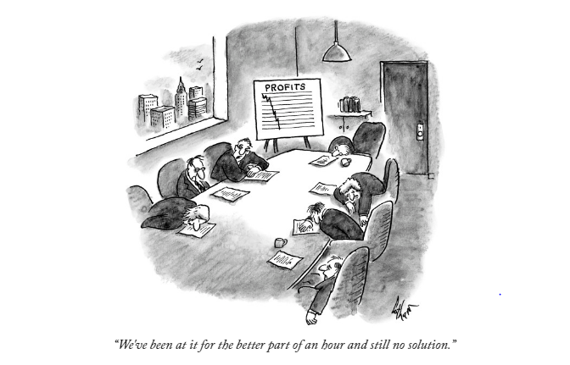
IG Team
Notes:
I am always amazed at how often people want technology they saw on the show room floor to solve their problems, but they are not willing to spend the time defining the rules, determining what metrics provide meaningful information to evaluate success.

Slide 9
Information
Technology
Risk
Legal
Information
Governance
Compliance
Information
Management
Notes:
Increasingly, the larger organizations are retaining compliance help or having a CCO.

Slide 10
Reality of IG Programs
Who decides what rules? Getting everyone to agree.
What is the scope of the IG program – who is the leader?
Balancing risk and innovation – a big ticket item is email
Executive support for implementation
Buy in from employees
Having a goal of taking owners out of the end processes
Notes:
Conundrums
Starting after years of amassing data
Needs resources for a time before ROI
Getting management’s attention to the need
Building in “doable” steps
Defining who is in charge of the team – accountability
Applying change management so employees are enabled to make change

Slide 11
Case Studies
First case study, Sangeet Rajan, KPMG, will provide you with a study on using metrics to show an IG program’s maturity – large organization
Second case study, Pilar McAdam, Kaizen, will walk you through implementation of an IG Program for a small public agency

Slide 12
Closing Notes
The scope of IG for information is broader than just storing the records.
There are many factors that affect good recordkeeping—technology, litigation, disasters, privacy.
Pilar’s case study will addressed building an IG program.
Sangeet’s case study will show you how to use metrics to measure your success

Slide 13
THANK YOU!
Helen Streck
President and CEO
Kaizen InfoSource LLC
www.2kaizen.com

