Slide 1
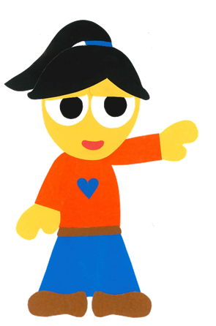
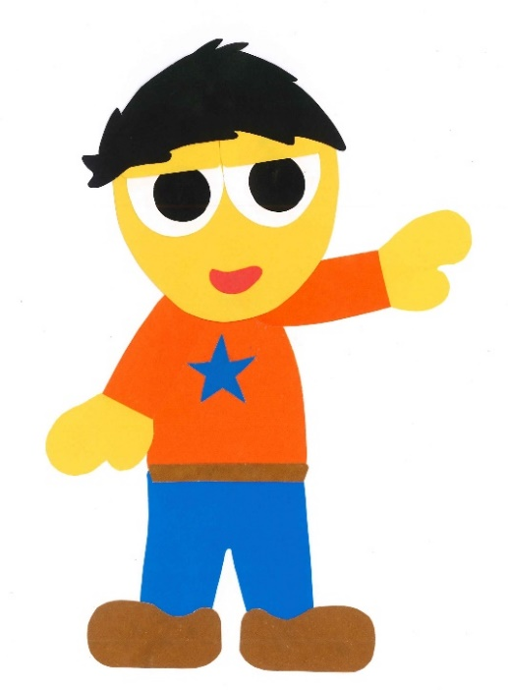
WE
CAN
READ
Donald Joyce
www.teacherdonald.com

Slide 2
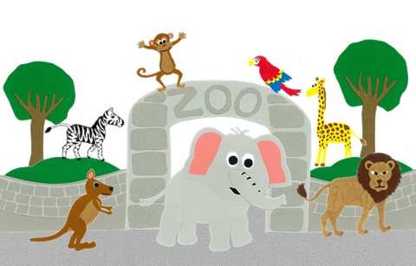
At The Zoo
By:
Donald Joyce
WE CAN READ

Slide 3
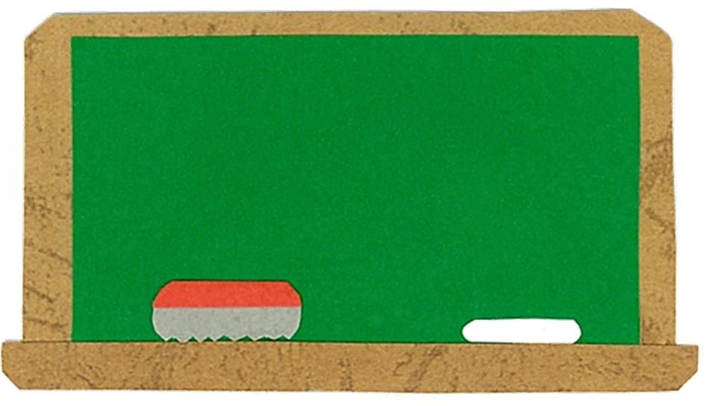
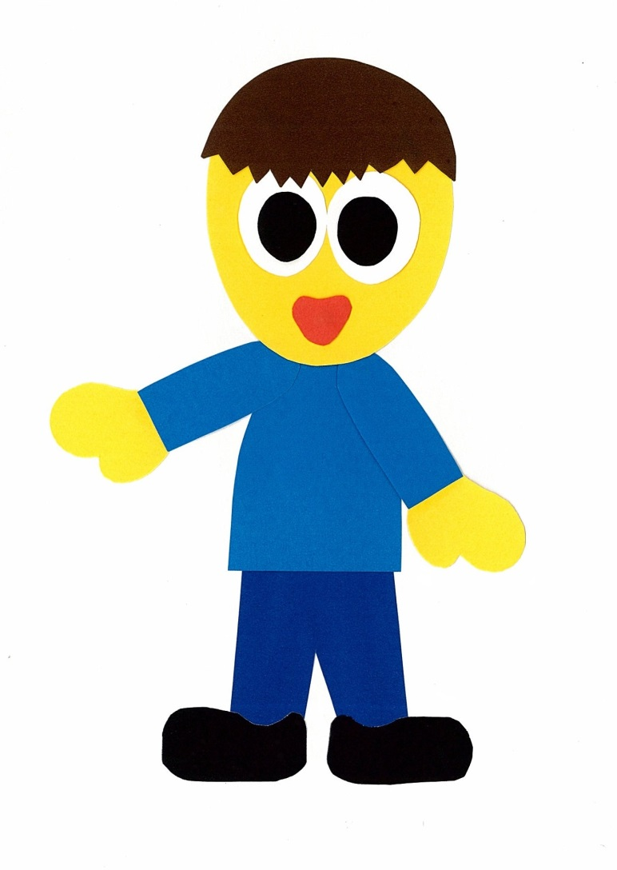
Let’s
Talk!

Slide 4
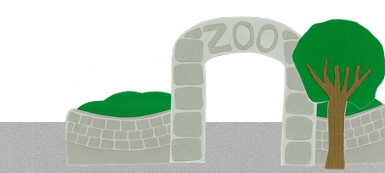
What can you see
at the zoo?
I can see __.

Slide 5
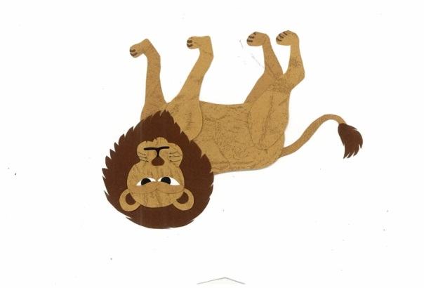
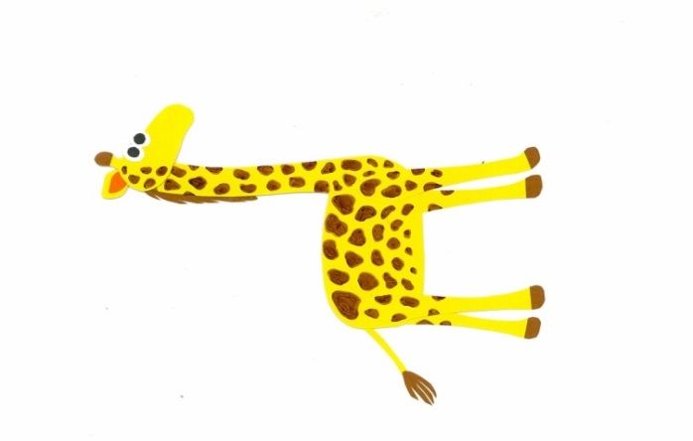
What’s your favorite
animal?
I like ___s.
Me too!

Slide 6
Let’s
Learn!

Slide 7
elephant
giraffe
monkey
parrot
zebra
panda
kangaroo
lion

Slide 8
Let’s
Read!

Slide 9
At The Zoo
By:
Donald Joyce
WE CAN READ

Slide 10
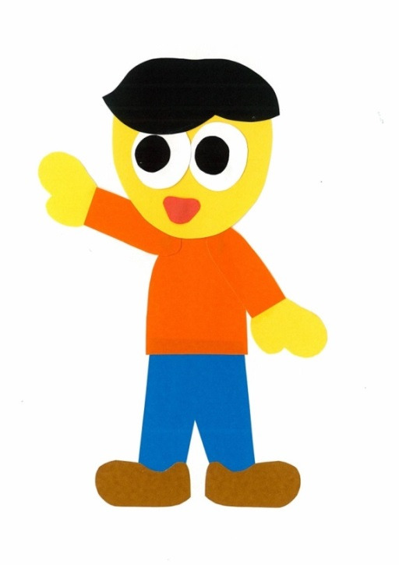
Let’s see what the animals are doing.

Slide 11
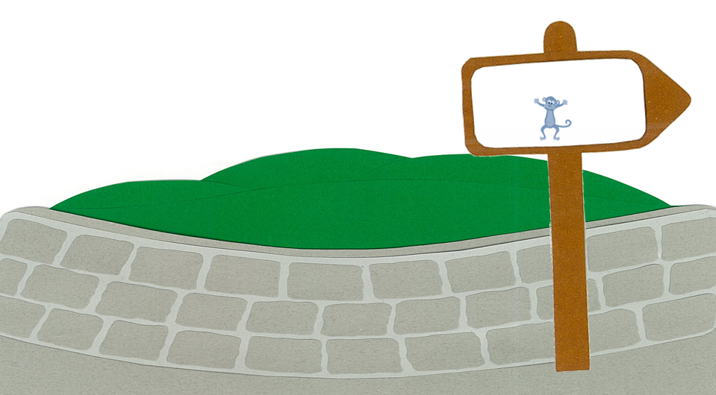
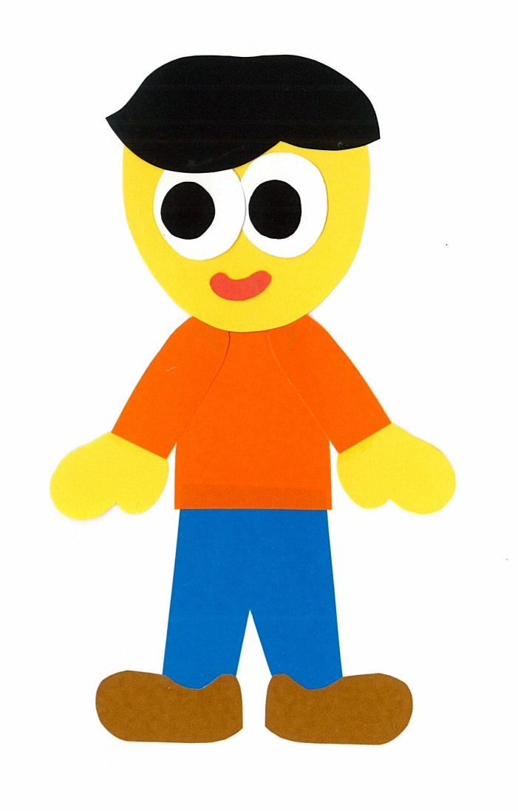
What is the monkey doing?
MONKEY

Slide 12
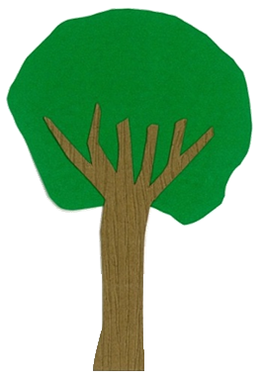
It is climbing.
NO STEALING THE MONKEY’S BANANAS

Slide 13
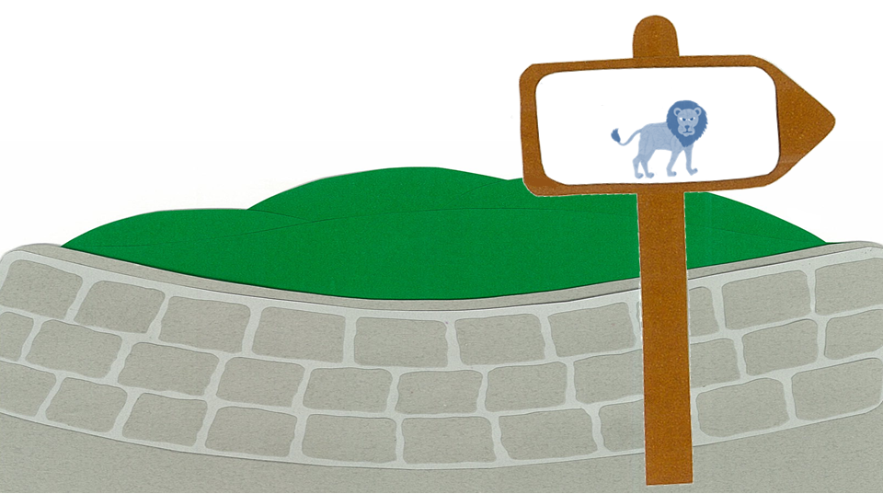
What is the lion doing?
LION

Slide 14
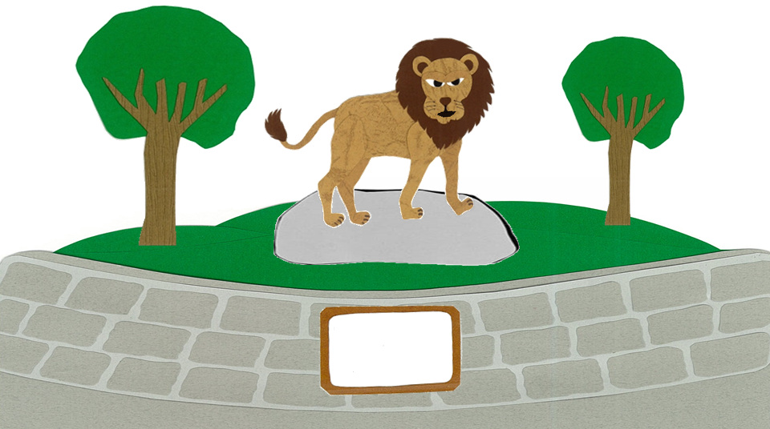
It is roaring.
NO HUGGING THE LION

Slide 15
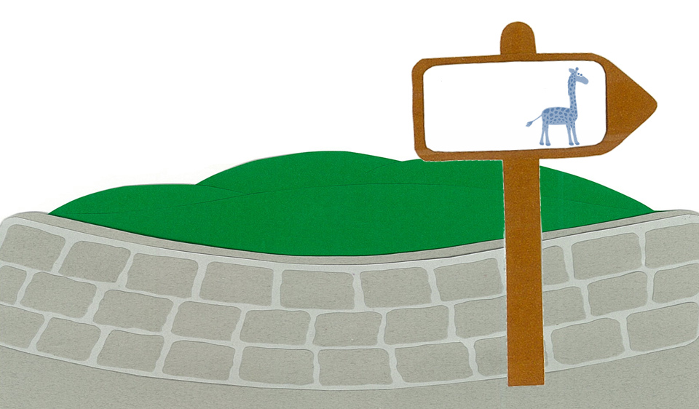
What is the giraffe doing?
GIRAFFE

Slide 16
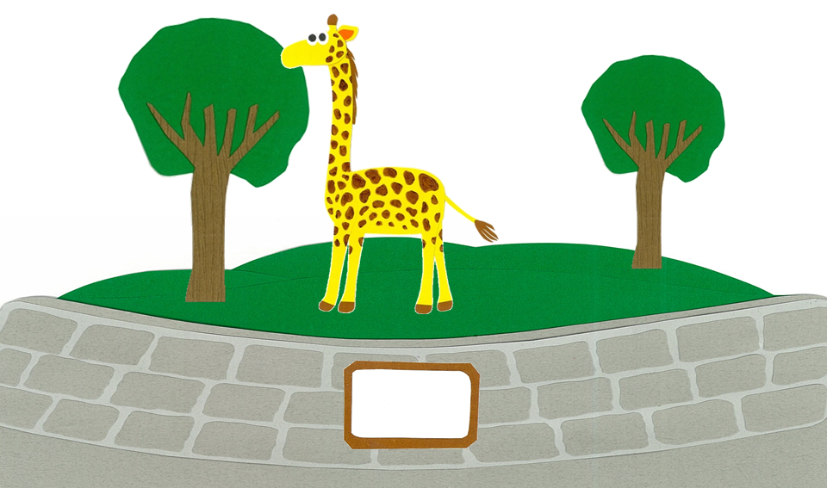
It is eating.
NO CLIMBING THE GIRAFFE

Slide 17
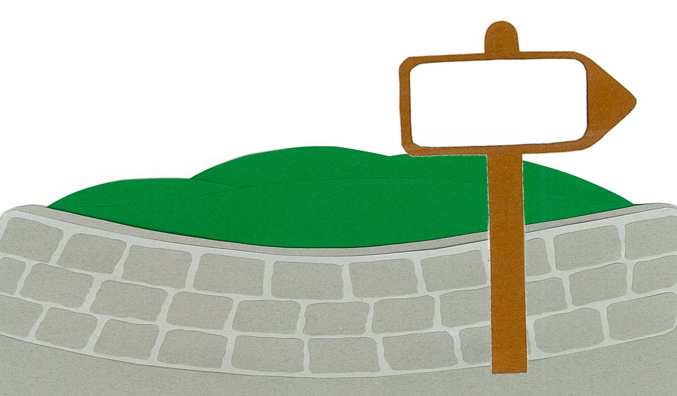
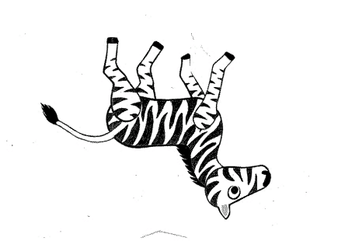
What is the zebra doing?
ZEBRA

Slide 18
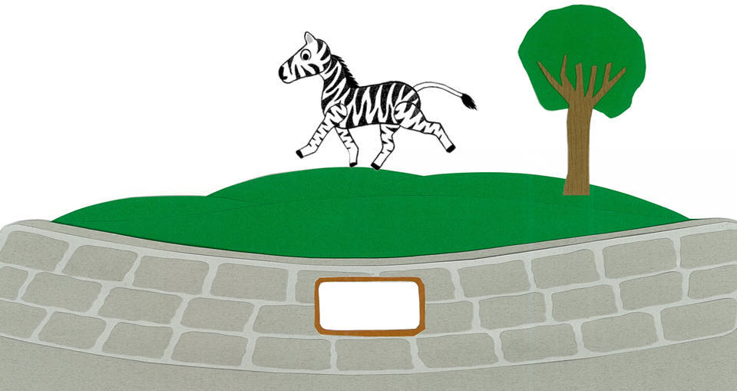
It is running.
NO RIDING THE ZEBRA

Slide 19
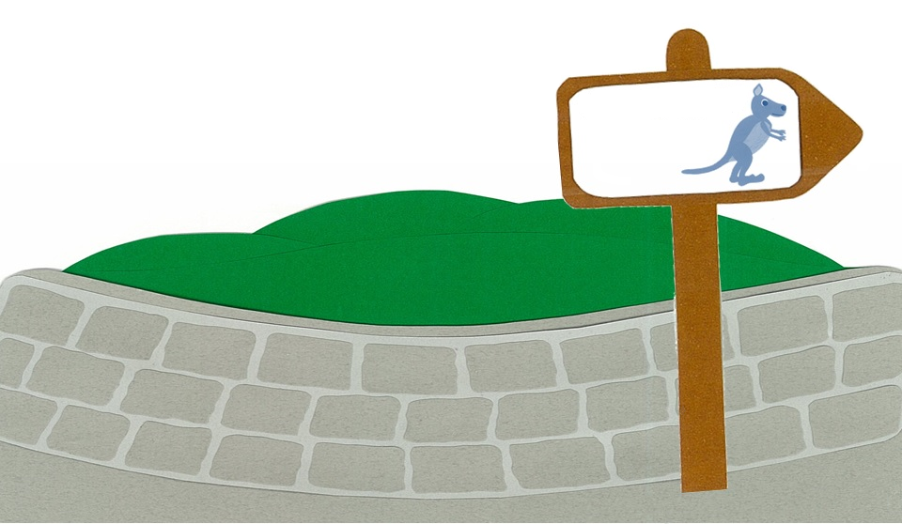
What is the kangaroo doing?
KANGAROO

Slide 20
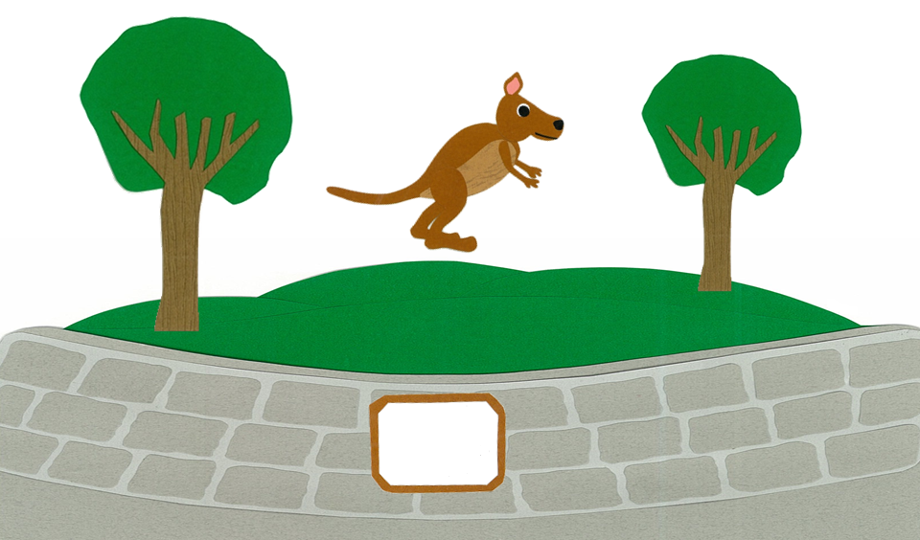
It is jumping.
NO RIDING
IN THE KANGAROO’S POUCH

Slide 21
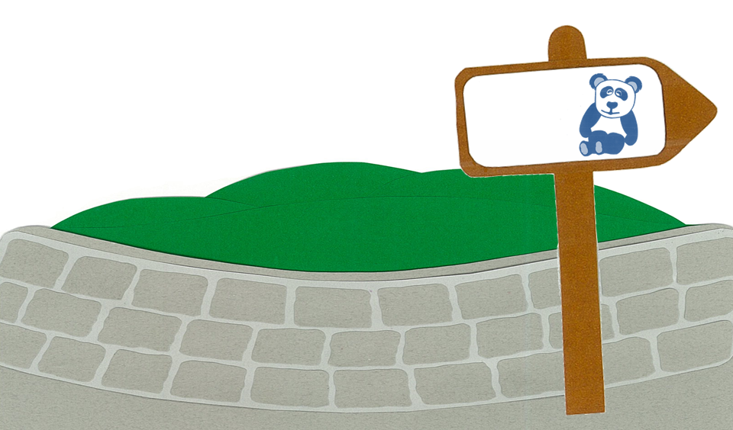
What is the panda doing?
PANDA

Slide 22
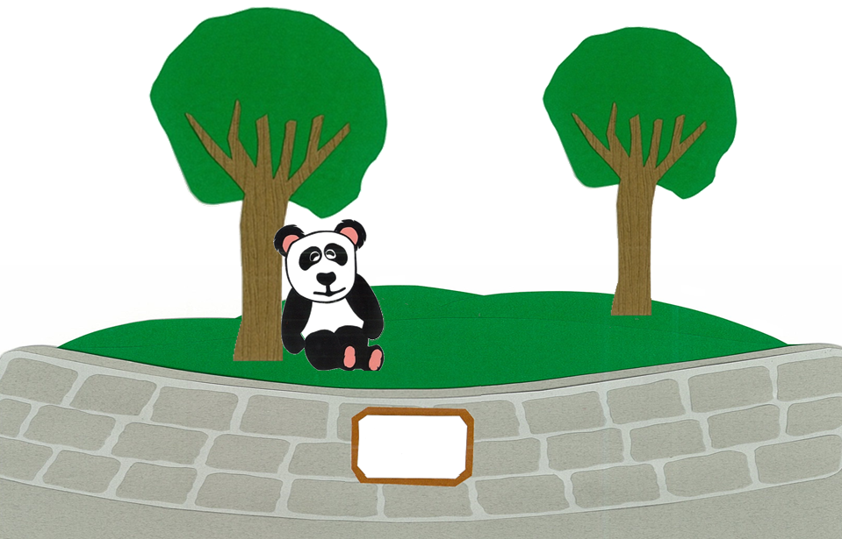
It is sleeping.
DO NOT DISTURB
THE PANDA

Slide 23
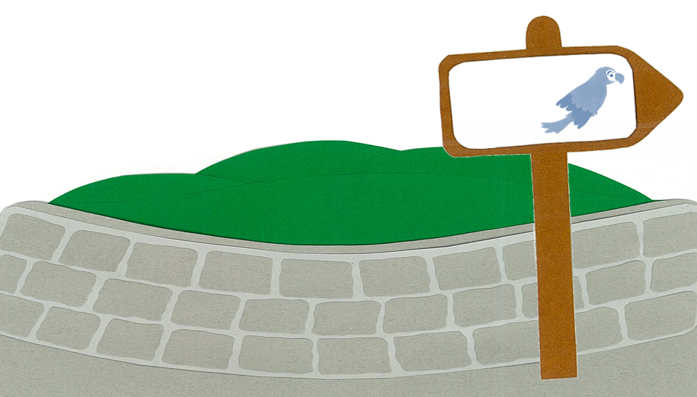
What is the parrot doing?
PARROT

Slide 24
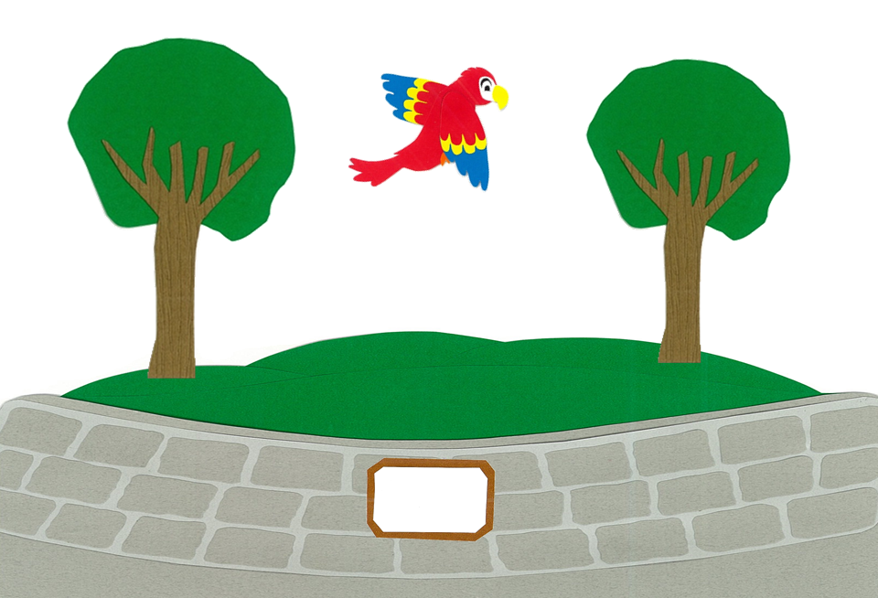
It is flying.
NO SINGING WITH THE PARROT

Slide 25
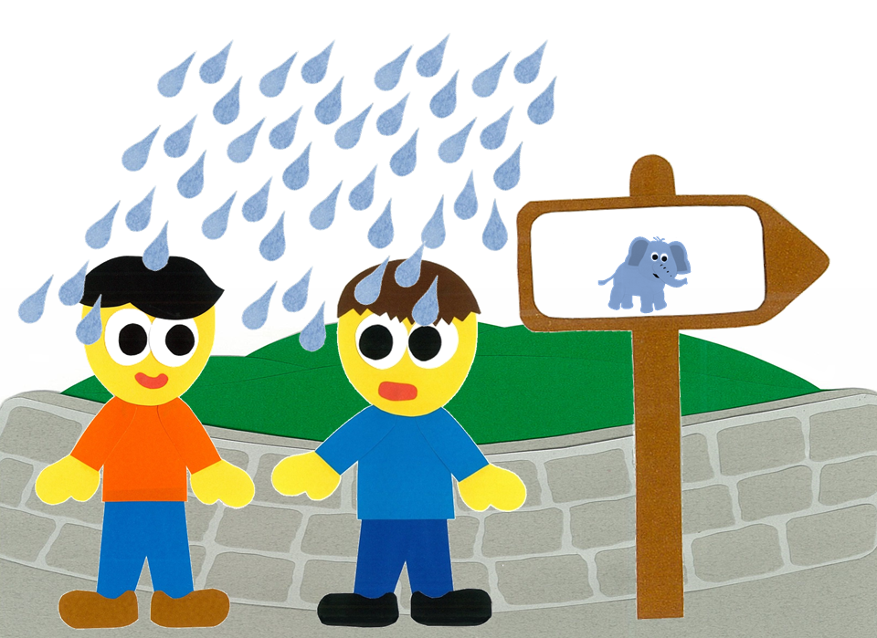
Uh oh! It is raining!
ELEPHANT

Slide 26
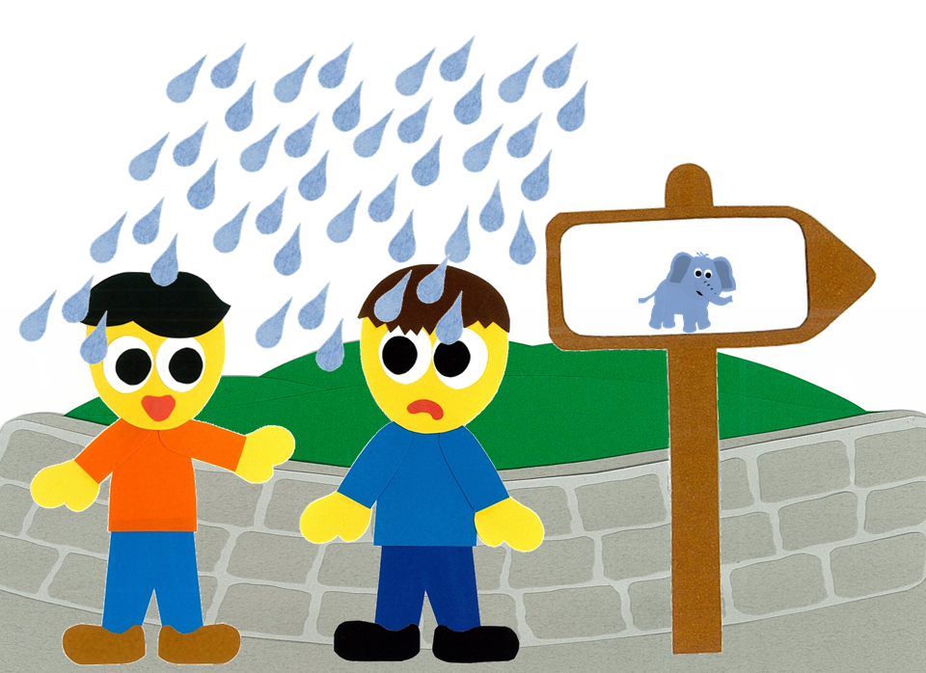
It is not raining.
ELEPHANT

Slide 27
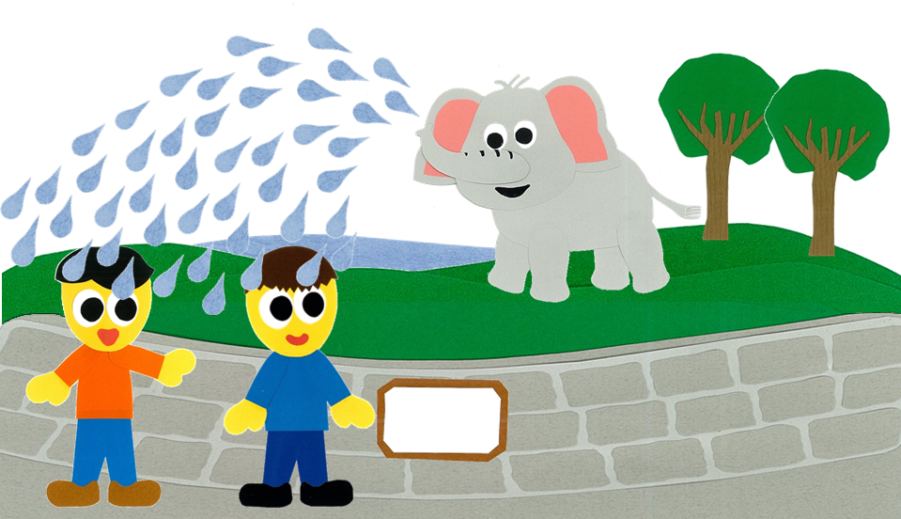
The elephant is playing with water!
NO SLIDING DOWN THE ELEPHANT’S TRUNK

Slide 28
At The Zoo
By:
Donald Joyce
WE CAN READ

Slide 29
Let’s
Review!

Slide 30
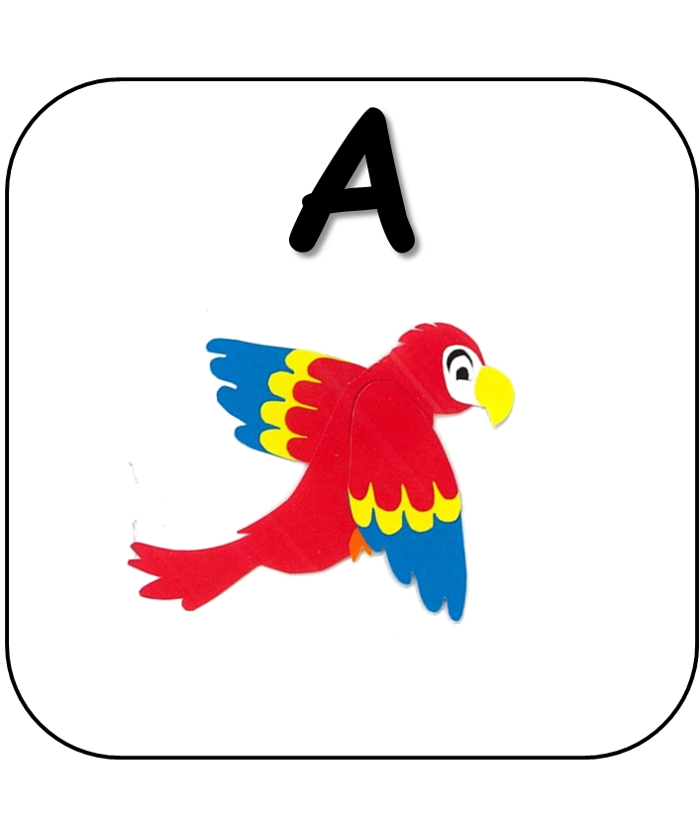
Which animal is flying?

Slide 31
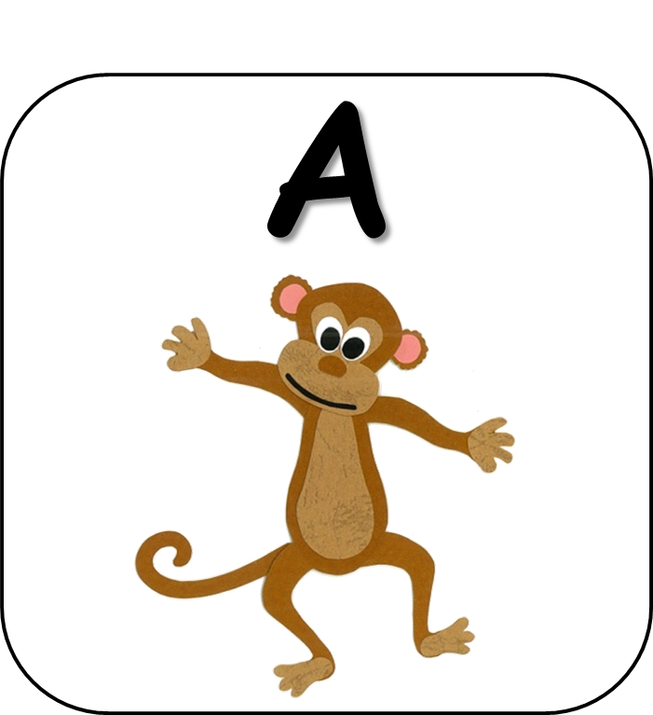
Which animal is running?

Slide 32
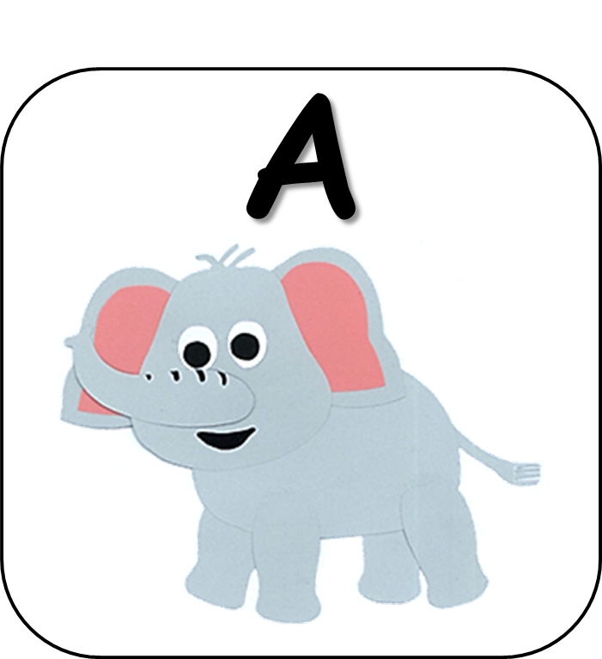
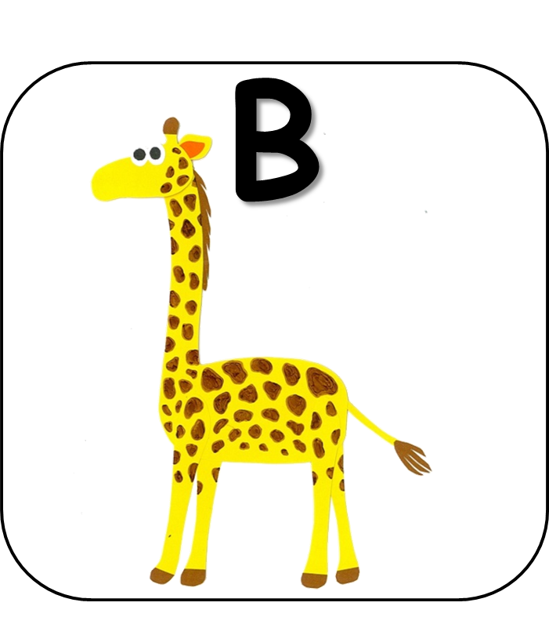
Which animal is eating?

Slide 33
Which animal is climbing?

Slide 34
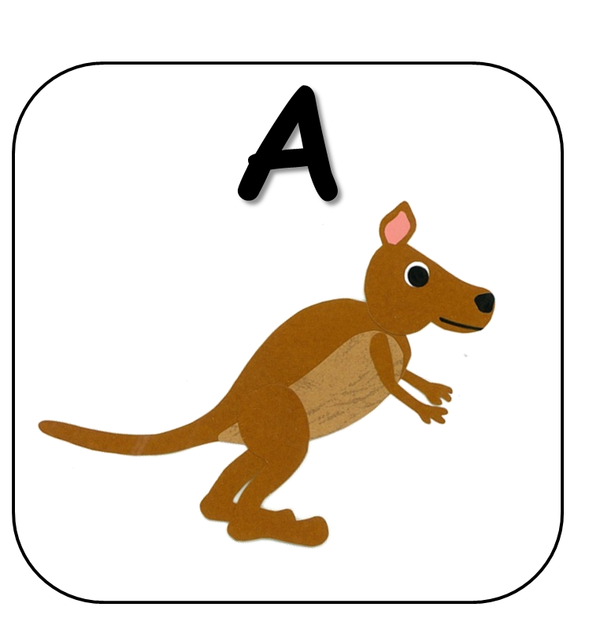
Which animal is jumping?

Slide 35
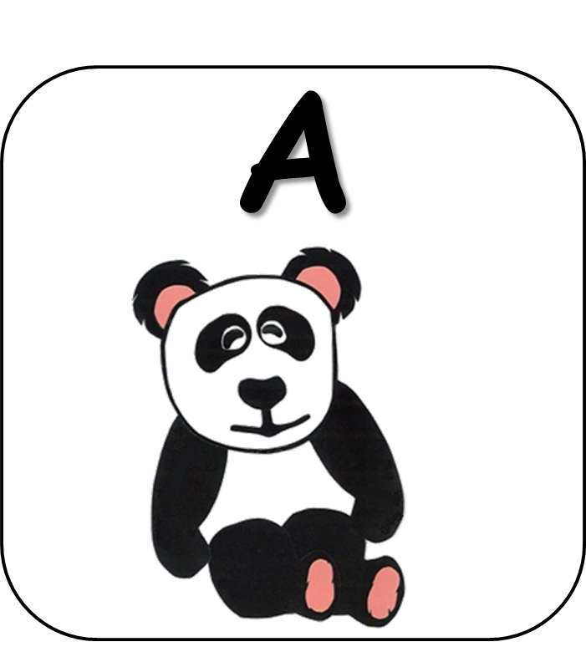
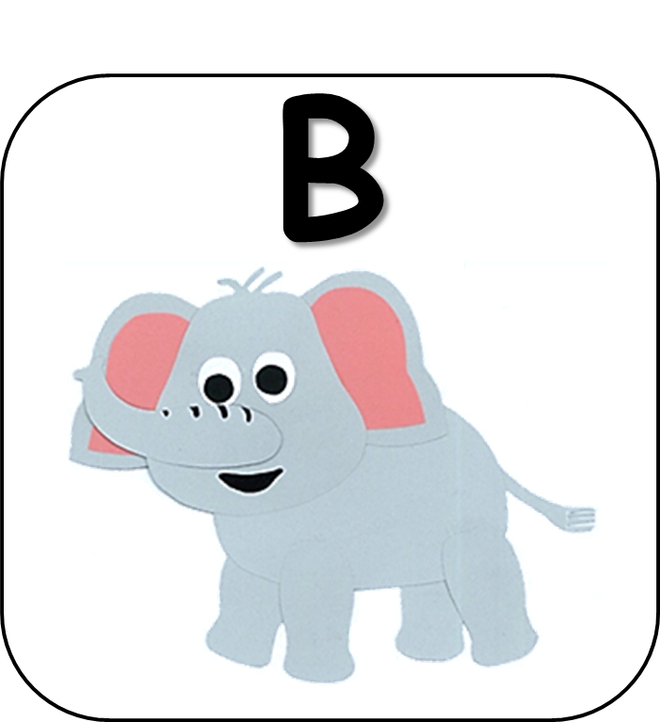
Which animal is playing with water?

Slide 36
Let’s
Connect!

Slide 37
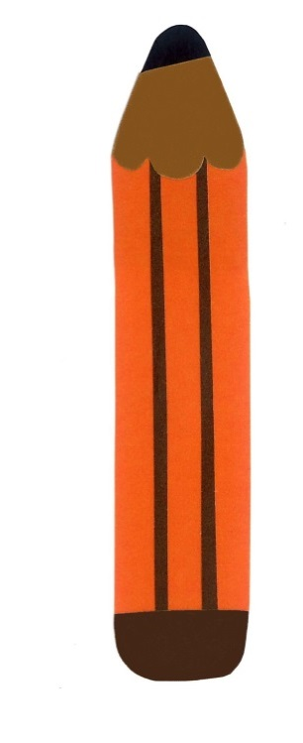
Get a pencil and paper!

Slide 38
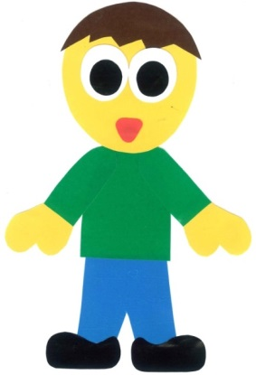
Draw a zoo.

Slide 39
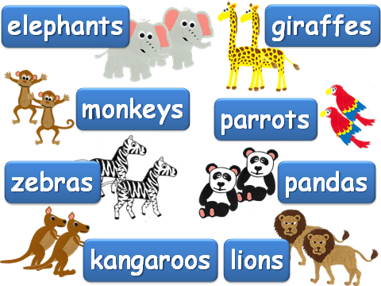
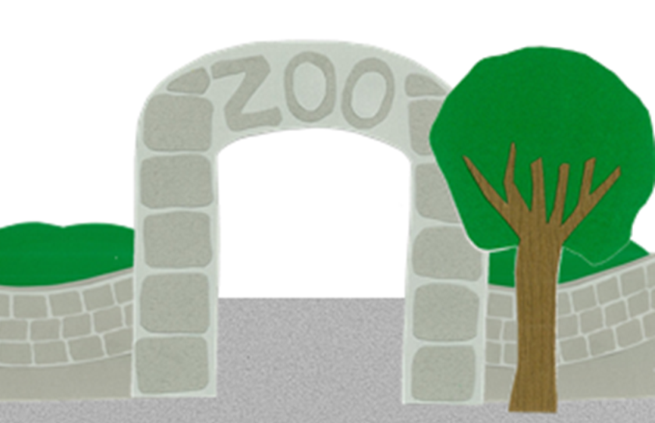
Draw some animals at
the zoo.

Slide 40
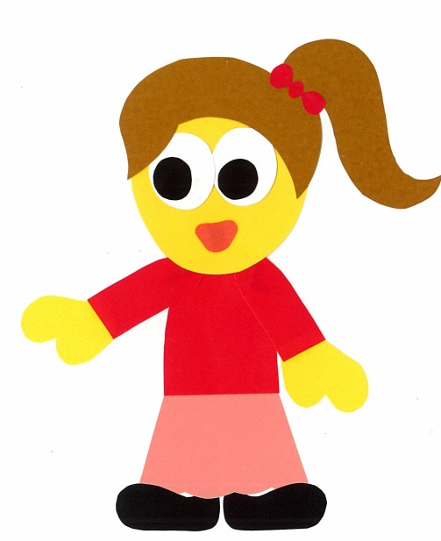
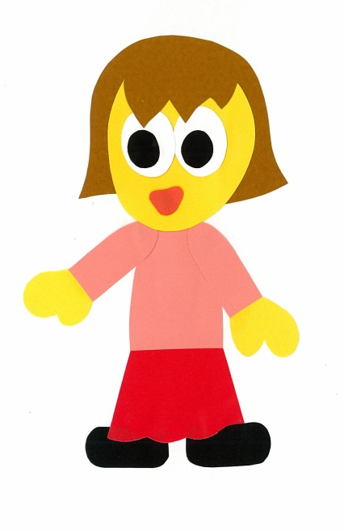
Find a friend. Play a guessing game.
Are there lions at the zoo.
No, there aren’t.

Slide 41
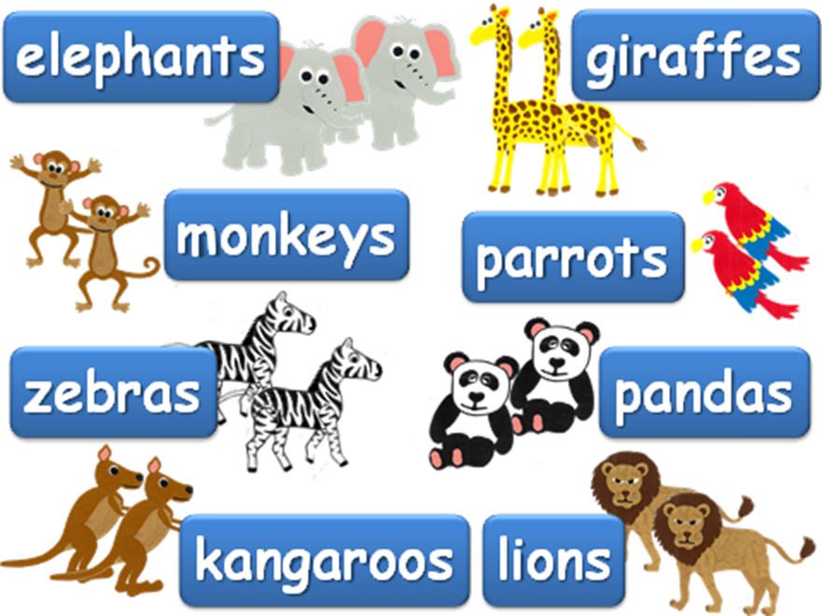
Are there ___
at the zoo?
Yes, there is.
No, there aren’t.

Slide 42
WE
CAN
READ
Donald Joyce
www.teacherdonald.com

