Slide 1
Physical principles of gas exchange

Slide 2
Partial pressure of individual gas
Gas pressure
Caused by multiple impacts of moving molecules against a surface
Directly proportional to the concentration of the gas molecule
Partial pressure of a gas
In mixture of gases
Proportional to the percentage of the gas in the mixture
21 % O2 → 160 mmHg; 79 % N2 → 600 mmHg
When dissolved in water
Depends also on solubility (Henry’s law)
CO₂ is 20x more soluble than O₂
Concentration of dissolved gas
Partial pressure =
Solubility coefficient

Slide 3
Diffusion of gases
Always depends on difference in partial pressure!
Diffusion of gases through fluids and tissues:
Diffusion coefficient of a gas =S/√MW
Relative diffusion coefficients: O₂=1; CO₂= 20.3
∆P x A x S
D=
d x √MW

Slide 4
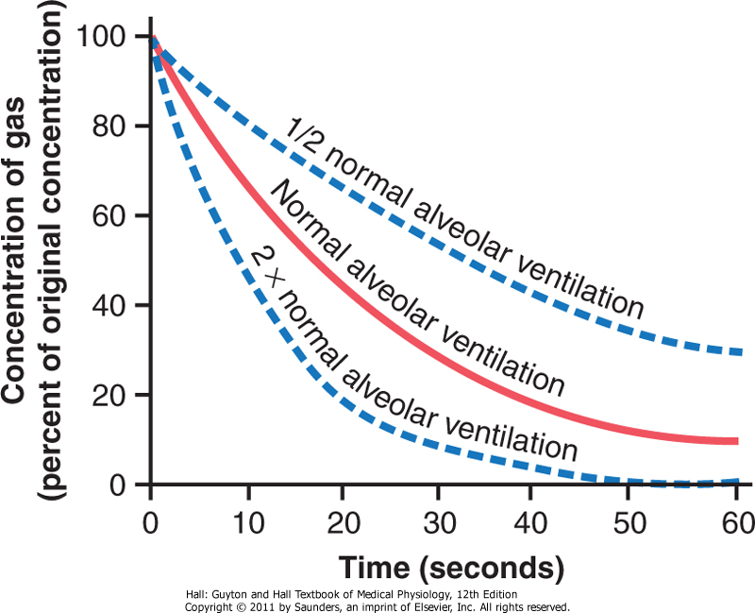
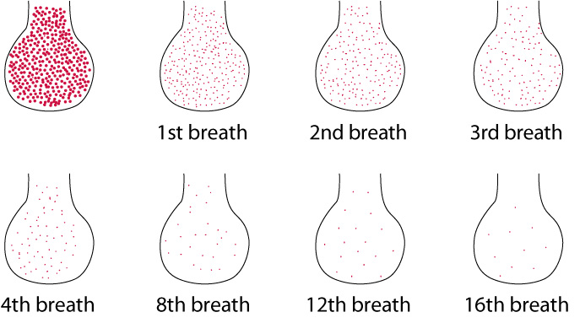
Composition of alveolar air
Combination of alveolar and dead space air

Slide 5
Composition of alveolar air
Different from atmospheric air:
Partial replacement of alveolar air by each breath
350 ml tidal volume; 2300 ml FRC
Prevents sudden changes of blood gases
Continuous absorption of O₂ from alveolar air to blood.
Continuous enrichment of alveolar air with CO₂.
Humidification of air while passing through airway
at 37°C: 47 mmHg vapor pressure
Decreases partial pressures for O₂ and CO₂

Slide 6
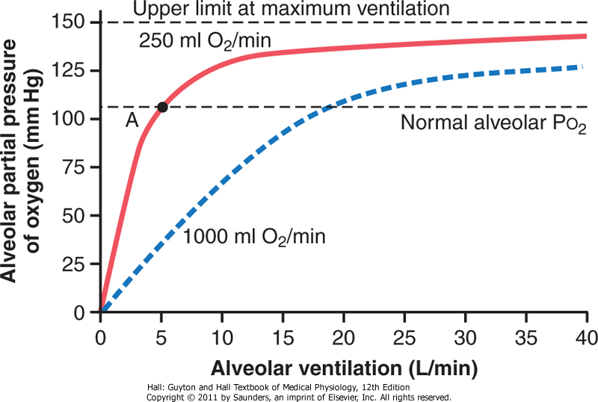
Determinants of alveolar partial pressure of O₂
Depends on:
Alveolar ventilation
Rate of O₂ consumption
At increased O₂ expenditure, higher V_{A} is required to keep normal P_{ALV}O₂

Slide 7
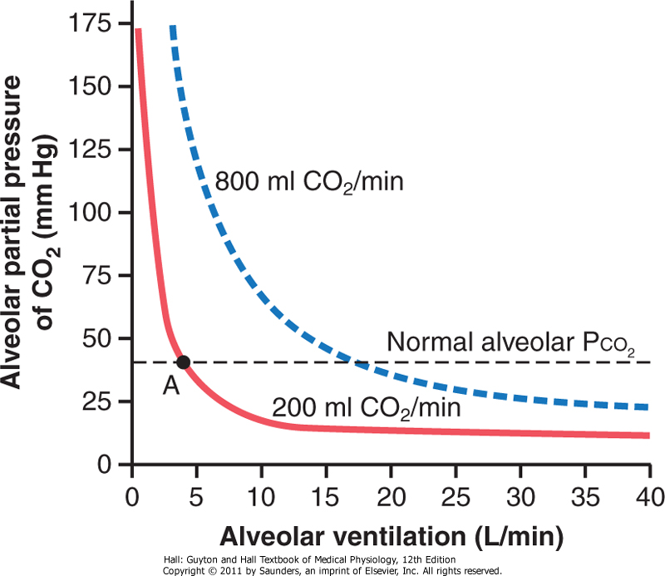
Determinants of alveolar partial pressure of CO₂
Depends on:
Alveolar ventilation
Rate of CO₂ production

Slide 8
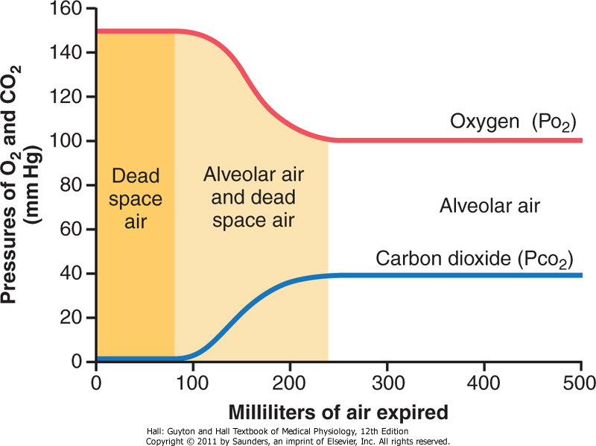
Exhaled air

Slide 9
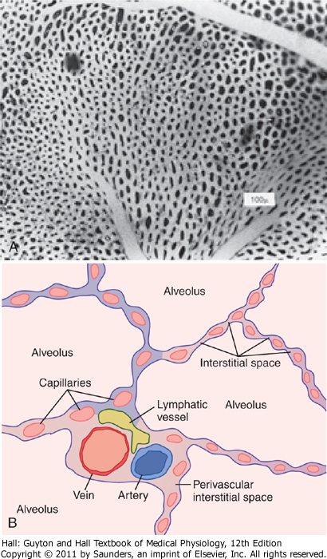
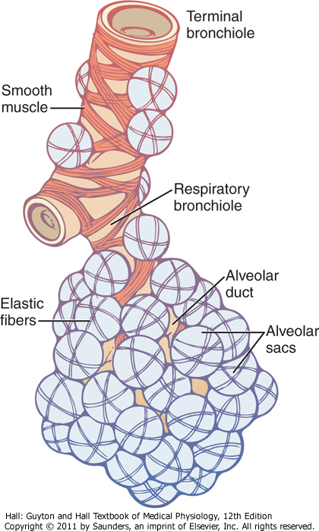
Diffusion of gases through respiratory membrane
300 million alveoli
Diameter: 0.2 mm
Respiratory unit

Slide 10
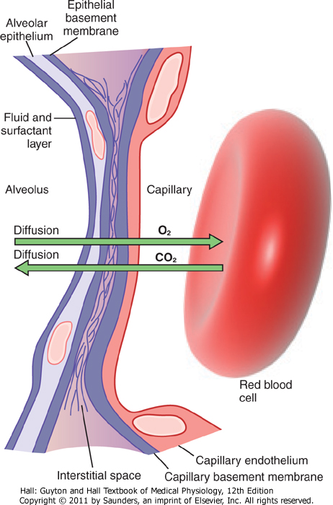
Respiratory membrane
Determinants of gas diffusion:
Total area: 70 m²
Blood flows as a sheet in alveolar walls
Capillary diameter: 5 microm
Decreases the distance for diffusion
∆P x A x S
D=
d x √MW
Thickness: ≈0,6μm

Slide 11
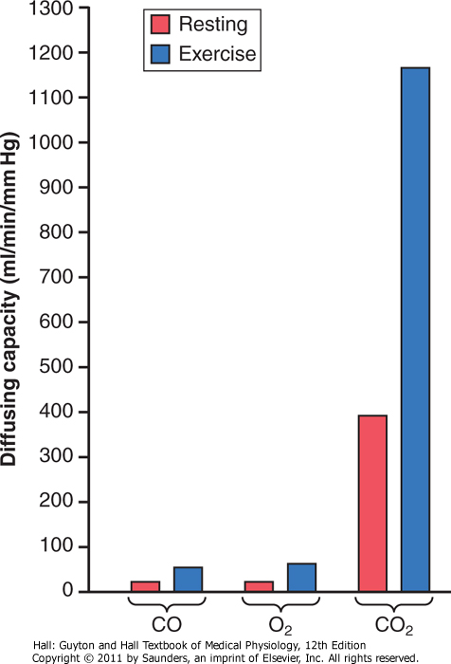
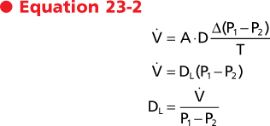
Diffusing capacity (D_{L})
A measure for the ability of a membrane to exchange gas.
Defined as the volume of gas that will diffuse through the respiratory membrane each minute for a ∆P of 1 mmGHg.
Depends on properties of respiratory membrane:
Total surface area available for diffusion
Membrane thickness
V_{A}/Q

Slide 12
Measurement of diffusing capacity for oxygen
Determination of diffusing capacity for carbon monoxide.
Low concentration CO inhaled
CO binds quickly to Hb
blood PCO equals zero
Pressure difference equals P_{ALV} CO
Measuremend of absorbed CO
D_{L}CO x 1.23 = D_{L}O₂

Slide 13
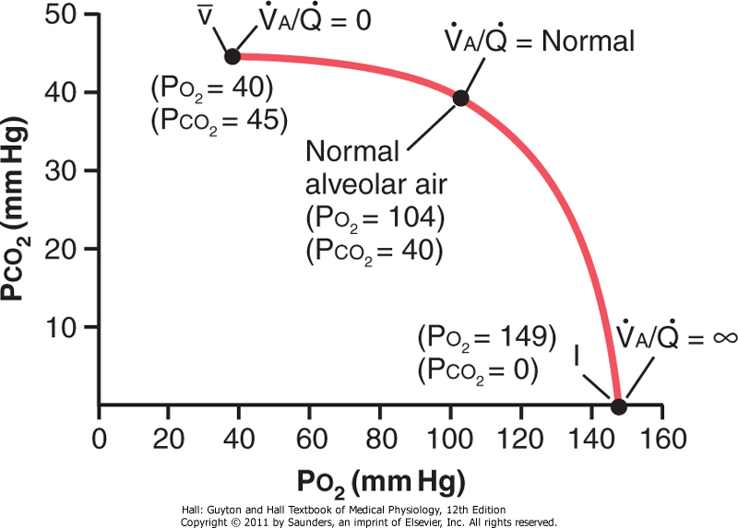
Ventilation-Perfusion ratio (V_{A}/Q)
Indicator of balance between ventilation and perfusion.

Slide 14
Normal V_{A}/Q

Slide 15
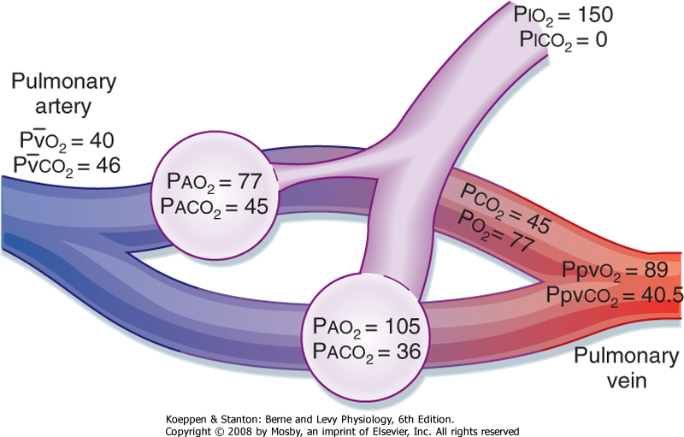
Reduced V_{A}/Q (hypoventilation)
Physiologic shunt
Blood passing through the lungs without gas exchange
Normally 1-2 % (bronchial circulation)

Slide 16
V_{A}/Q =
8
Physiologic dead space
Sum of anatomic dead space and non-perfused but ventilated alveoli (wasted ventilation)

Slide 17
Transport of oxygen and carbon dioxide in blood and tissue fluids

Slide 18
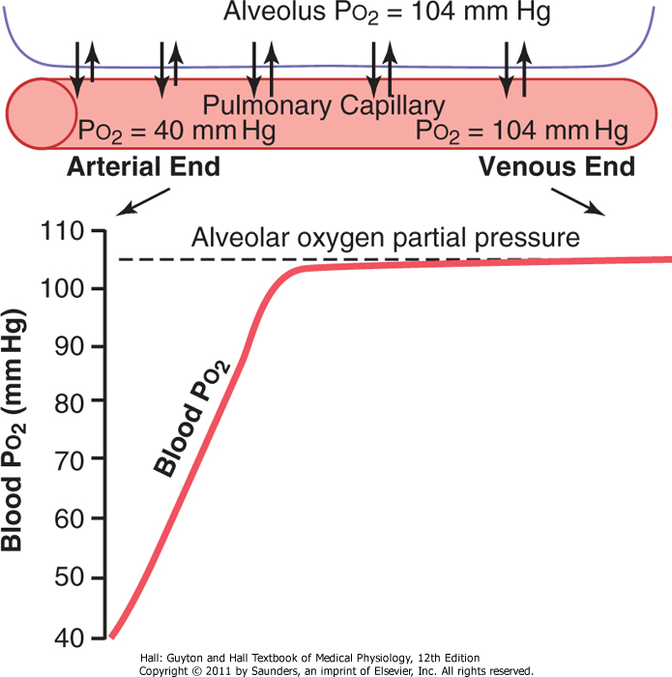
Diffusion of oxygen from alveoli to blood

Slide 19
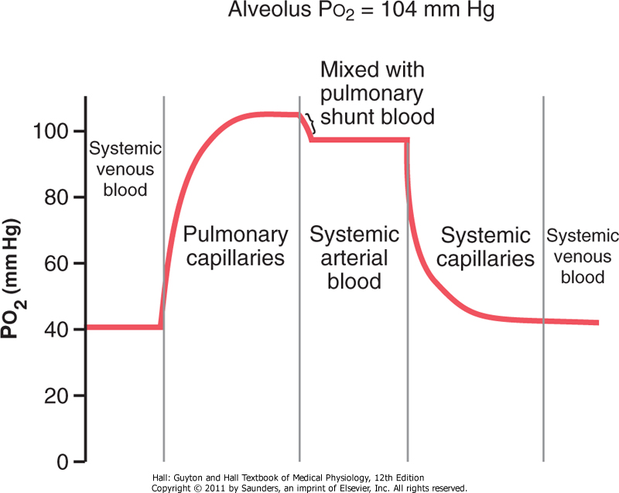
Changes in blood PO₂
venous admixture

Slide 20
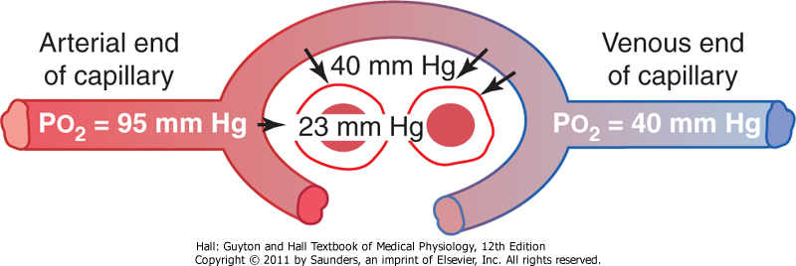
Diffusion of oxygen from peripheral capillaries to tissue interstitium

Slide 21
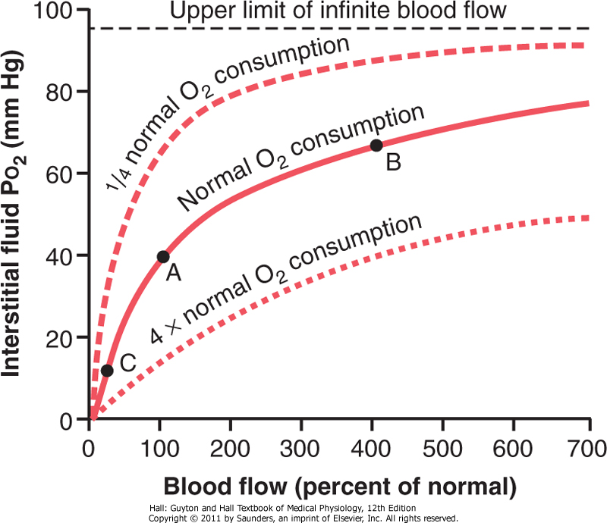
Interstitial PO₂ depends on blood flow and O₂ consumption

Slide 22
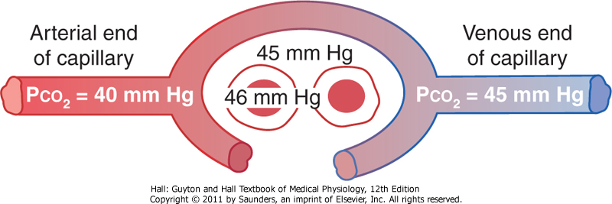
Diffusion of CO₂ from peripheral capillaries to tissue interstitium
20 x faster than O2
Requires smaller pressure difference

Slide 23
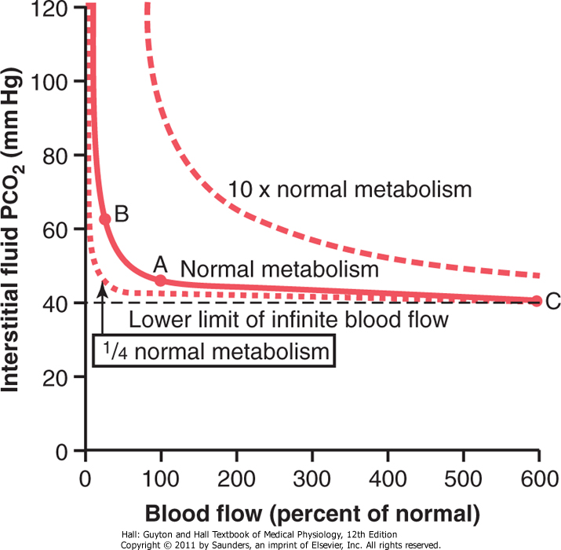
Interstitial PCO₂ depends on blood flow and metabolic rate

Slide 24
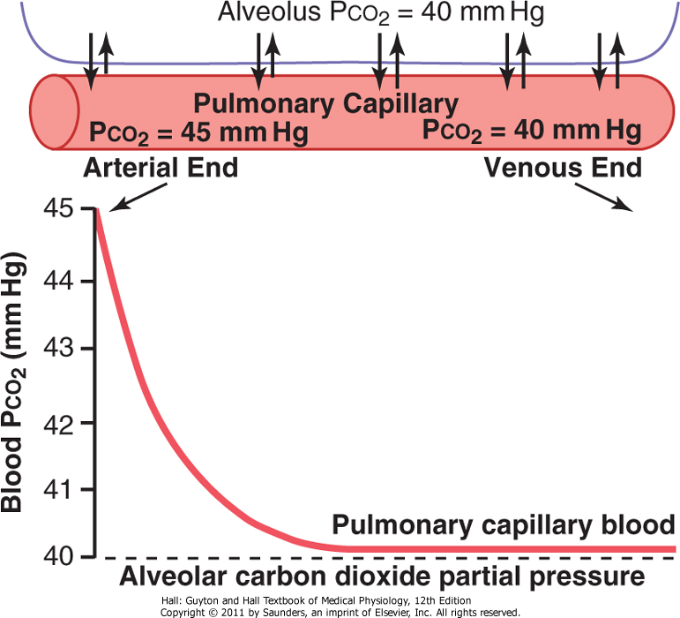
Diffusion of CO₂ from blood to alveoli

Slide 25
Oxygen transport in the blood
97 % of O2 is transported via hemoglobin.
3 % dissolved in plasma.
Binding to Hb is reversibe – depends on PO₂
Maximal amount of O2 that can bind to Hb:
c(Hb) = 15 g / 1oo ml of blood
1.34 ml of O2/1 g of Hb
1.34 x 15 g = 20 ml of O2 /100 ml of blood (20 volumes percent)

Slide 26
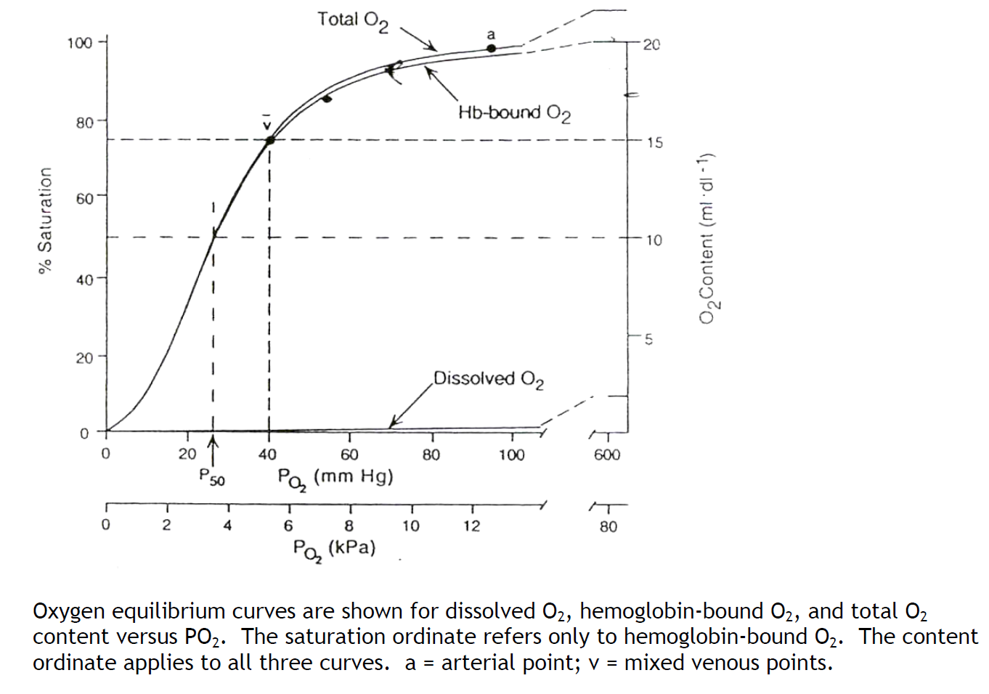
Oxygen transport in the blood
Hb dissociation curve
Sigmoid shape!
At low PO₂ – large change in saturation for a small change in PO₂
At high PO₂ – small change in saturation for a large change in pressure
Hb acts as a buffer for tissue PO₂

Slide 27
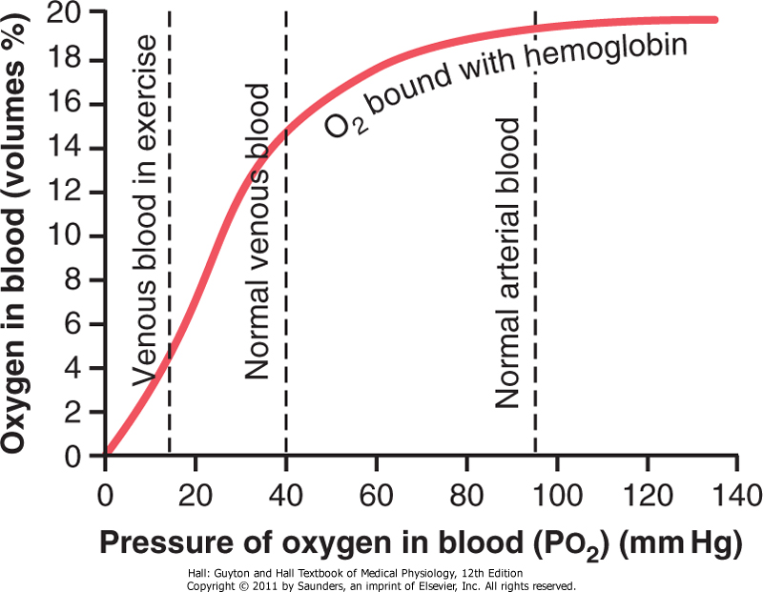
Transport of oxygen during strenuous exercise
20 x increase in oxygen transport to tissues:
Increased blood flow (6-7x)
Increased extraction of O2 from blood (3x)
Utilization coefficient
Normally 25 %
In exercise 75-80 %

Slide 28
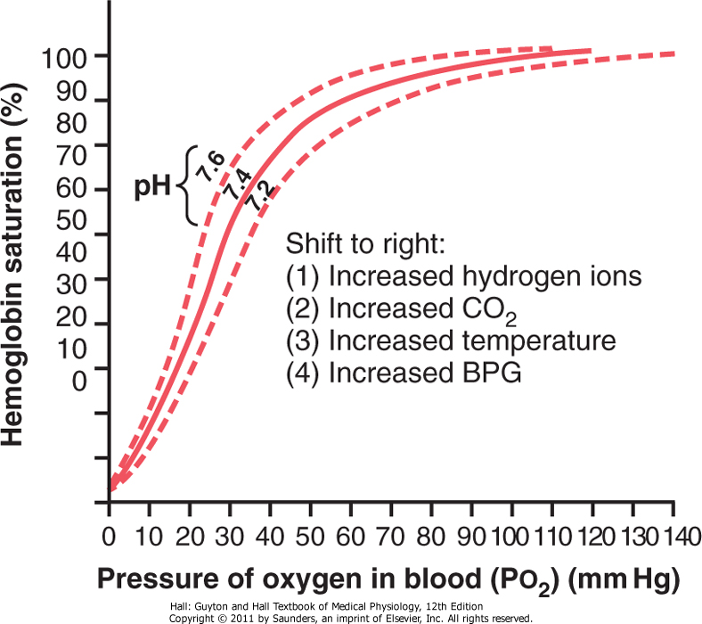
Shifting of HbO₂ dissociation curve
Bohr effect

Slide 29
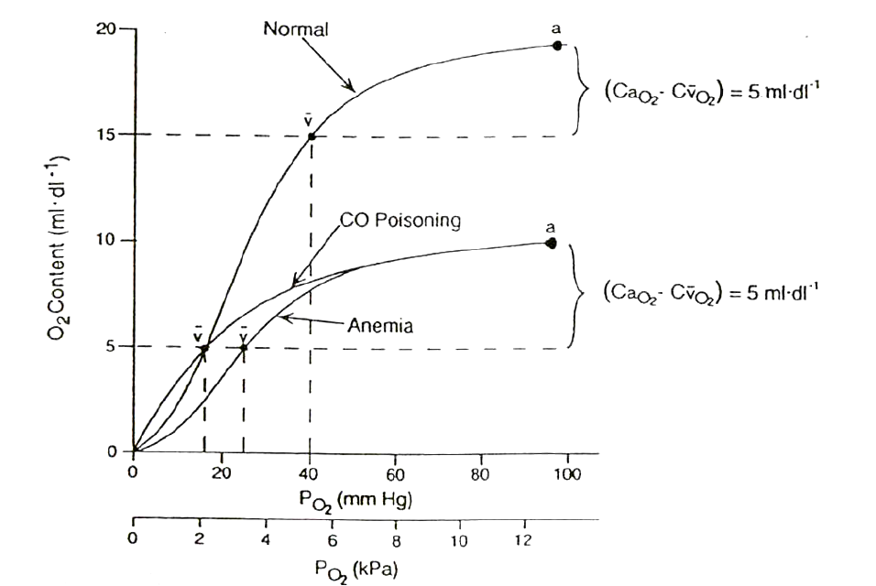
CO poisoning and anemia
Even with normal pO2 in blood, the amount of O2 content is significantly decreased to 50 %!

Slide 30
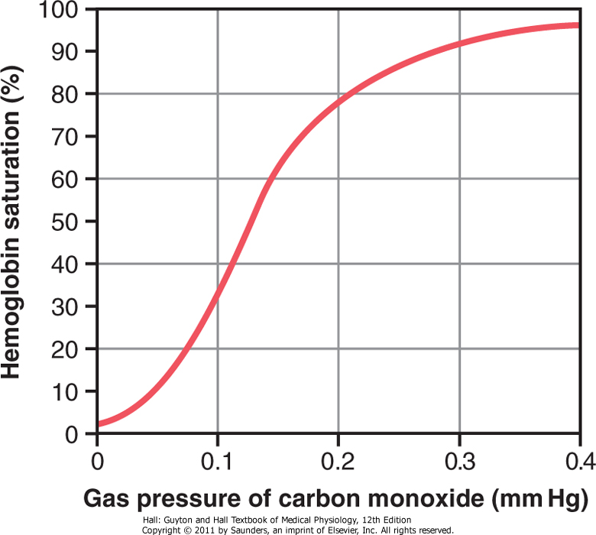
Carbon monoxide poisoning
Competitive inhibitor of O₂ binding to Hb
250x greater affinity of CO for Hb!
PaO₂ normal with loss of consciousness!
Therapy:
100 % O₂
Or , 95 % O₂ i 5 % CO₂

Slide 31
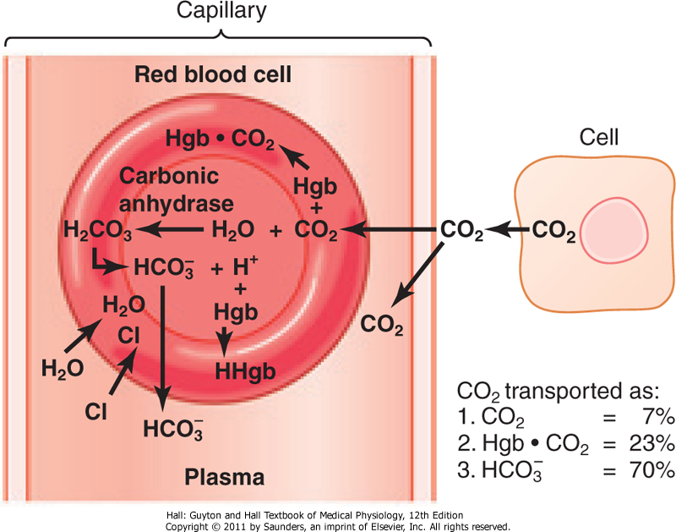
Transport of CO₂ in the blood

Slide 32
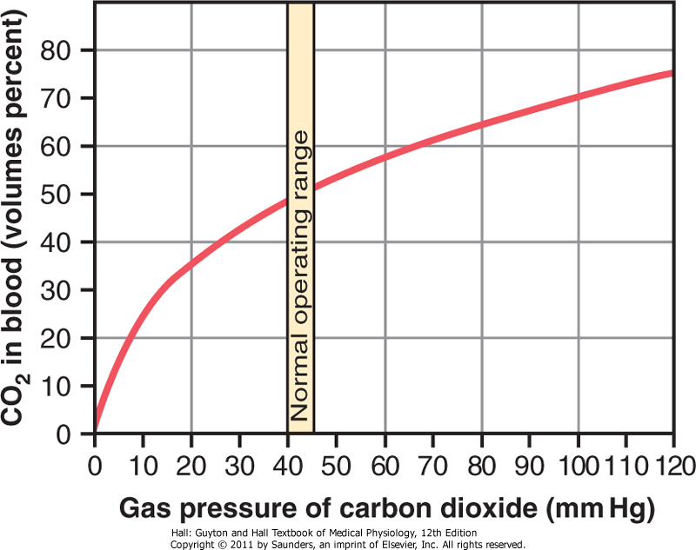
Carbon dioxide dissociation curve

Slide 33
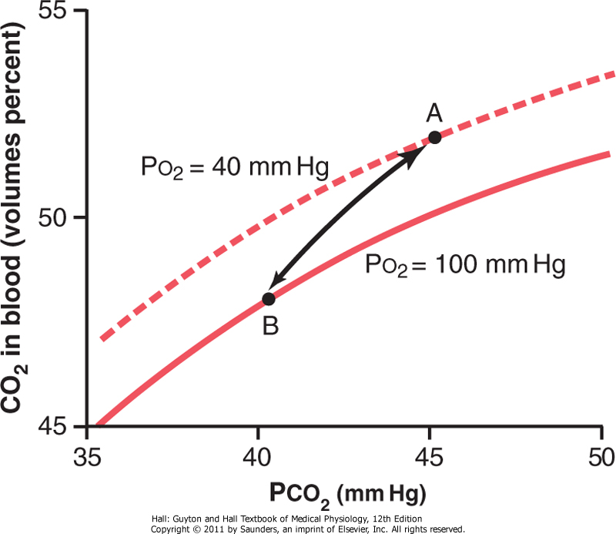
Haldane effect
Binding of oxygen tends to displace CO₂ from the blood.
Less tendency to form carbaminoHb
Release of H⁺ from Hb, reaction with HCO₃⁻
In the lungs , it enables more CO2 diffusion for a small change in pressure.

Slide 34
Respiratory exchange ratio
Reflection of the respiratory quotient of chemical reactions.
Varies under different metabolic conditions.
Utilization of fat: R=0.7
Utilization of carbohydrates: R=1

