Slide 1
2022 Civil Rights Overview for Conservation Districts Sonya Keith, KY NRCS Partnership Coordinator
Natural Resources Conservation Service

Slide 2
What is Civil Rights?
A compilation of rules, regulations, and laws that govern Agency actions related to program delivery and employment concerns.
Included are Title VI and Title VII of the 1964 Civil Rights Act, NRCS General Manual Title 230 Parts 401-405, USDA Departmental Regulation 4330-3, and others.

Slide 3
The Reason Behind Civil Rights
It’s the law
Educate and inform employees
Avoid discrimination and violations
Promote diversity in the workplace
Every employee is responsible for civil rights

Slide 4
NRCS Part
Conservation District Part
Ensure partners comply with federal program policies.
Support partners in their efforts.
As recipients of NRCS technical assistance, comply with Title VI and Title VII of the civil rights law.

Slide 5
This Requirement is in a Formal Agreement…
NRCS and every Conservation District has an MOA that has this included.
These MOAs were just recently updated (spring/summer 2021)
Two Part: Title VI and Title VII

Slide 6
Title VI Program Delivery
Purpose
To eliminate discrimination against applicants, participants, and beneficiaries of any program or activity receiving federal financial assistance.

Slide 7
Title VI Program Delivery
The NRCS policy is to encourage, support, provide training, and assist all CD boards, councils, and committees to achieve diverse representation of customer groups on such boards, councils, and committees.

Slide 8
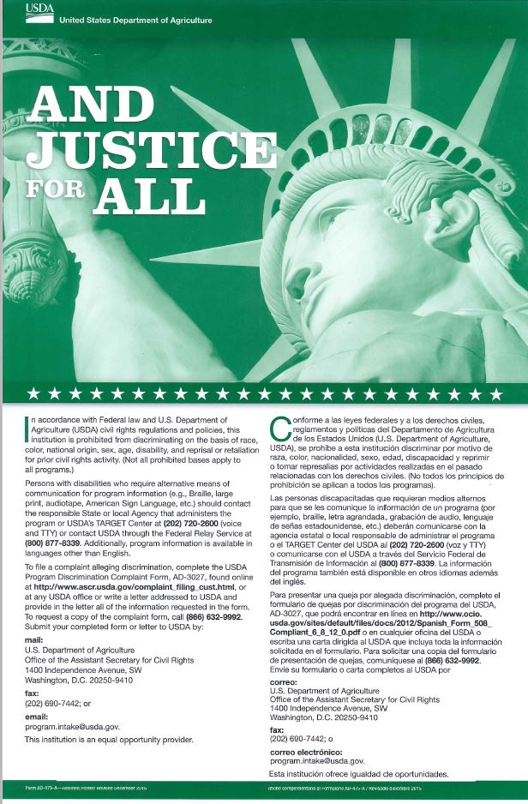
Title VI Program Delivery
Complaint Process
Procedures for filing and processing program discrimination complaints are outlined on this poster.

Slide 9
Title VII Equal Employment Opportunity (EEO)
Purpose
To provide equal opportunity for employees and applicants for employees and applicants for employment in every aspect of employment practices and working conditions, without regard for race, color, national origin, sex, religion, age (40+), physical or mental disability, retaliation (for prior participation in the equal employment opportunity complaint process), sexual orientation, marital or family status, political beliefs, parental status, and/or protected genetic information that has the purpose or effect of denying equal employment opportunity.

Slide 10
Title VII Equal Employment Opportunity (EEO)
“Just say no” to harassment!
Employees are entitled to work in a non-hostile environment, free of offensive or intimidating actions by supervisors, co-workers, or others.

Slide 11
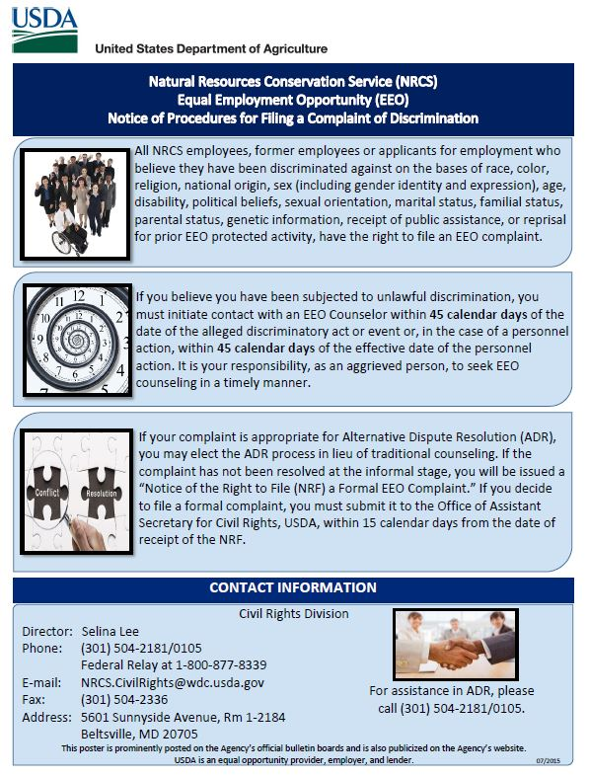
Title VII Equal Employment Opportunity (EEO)
Procedures for filing and processing an EEO complaint are outlined on this poster.

Slide 12
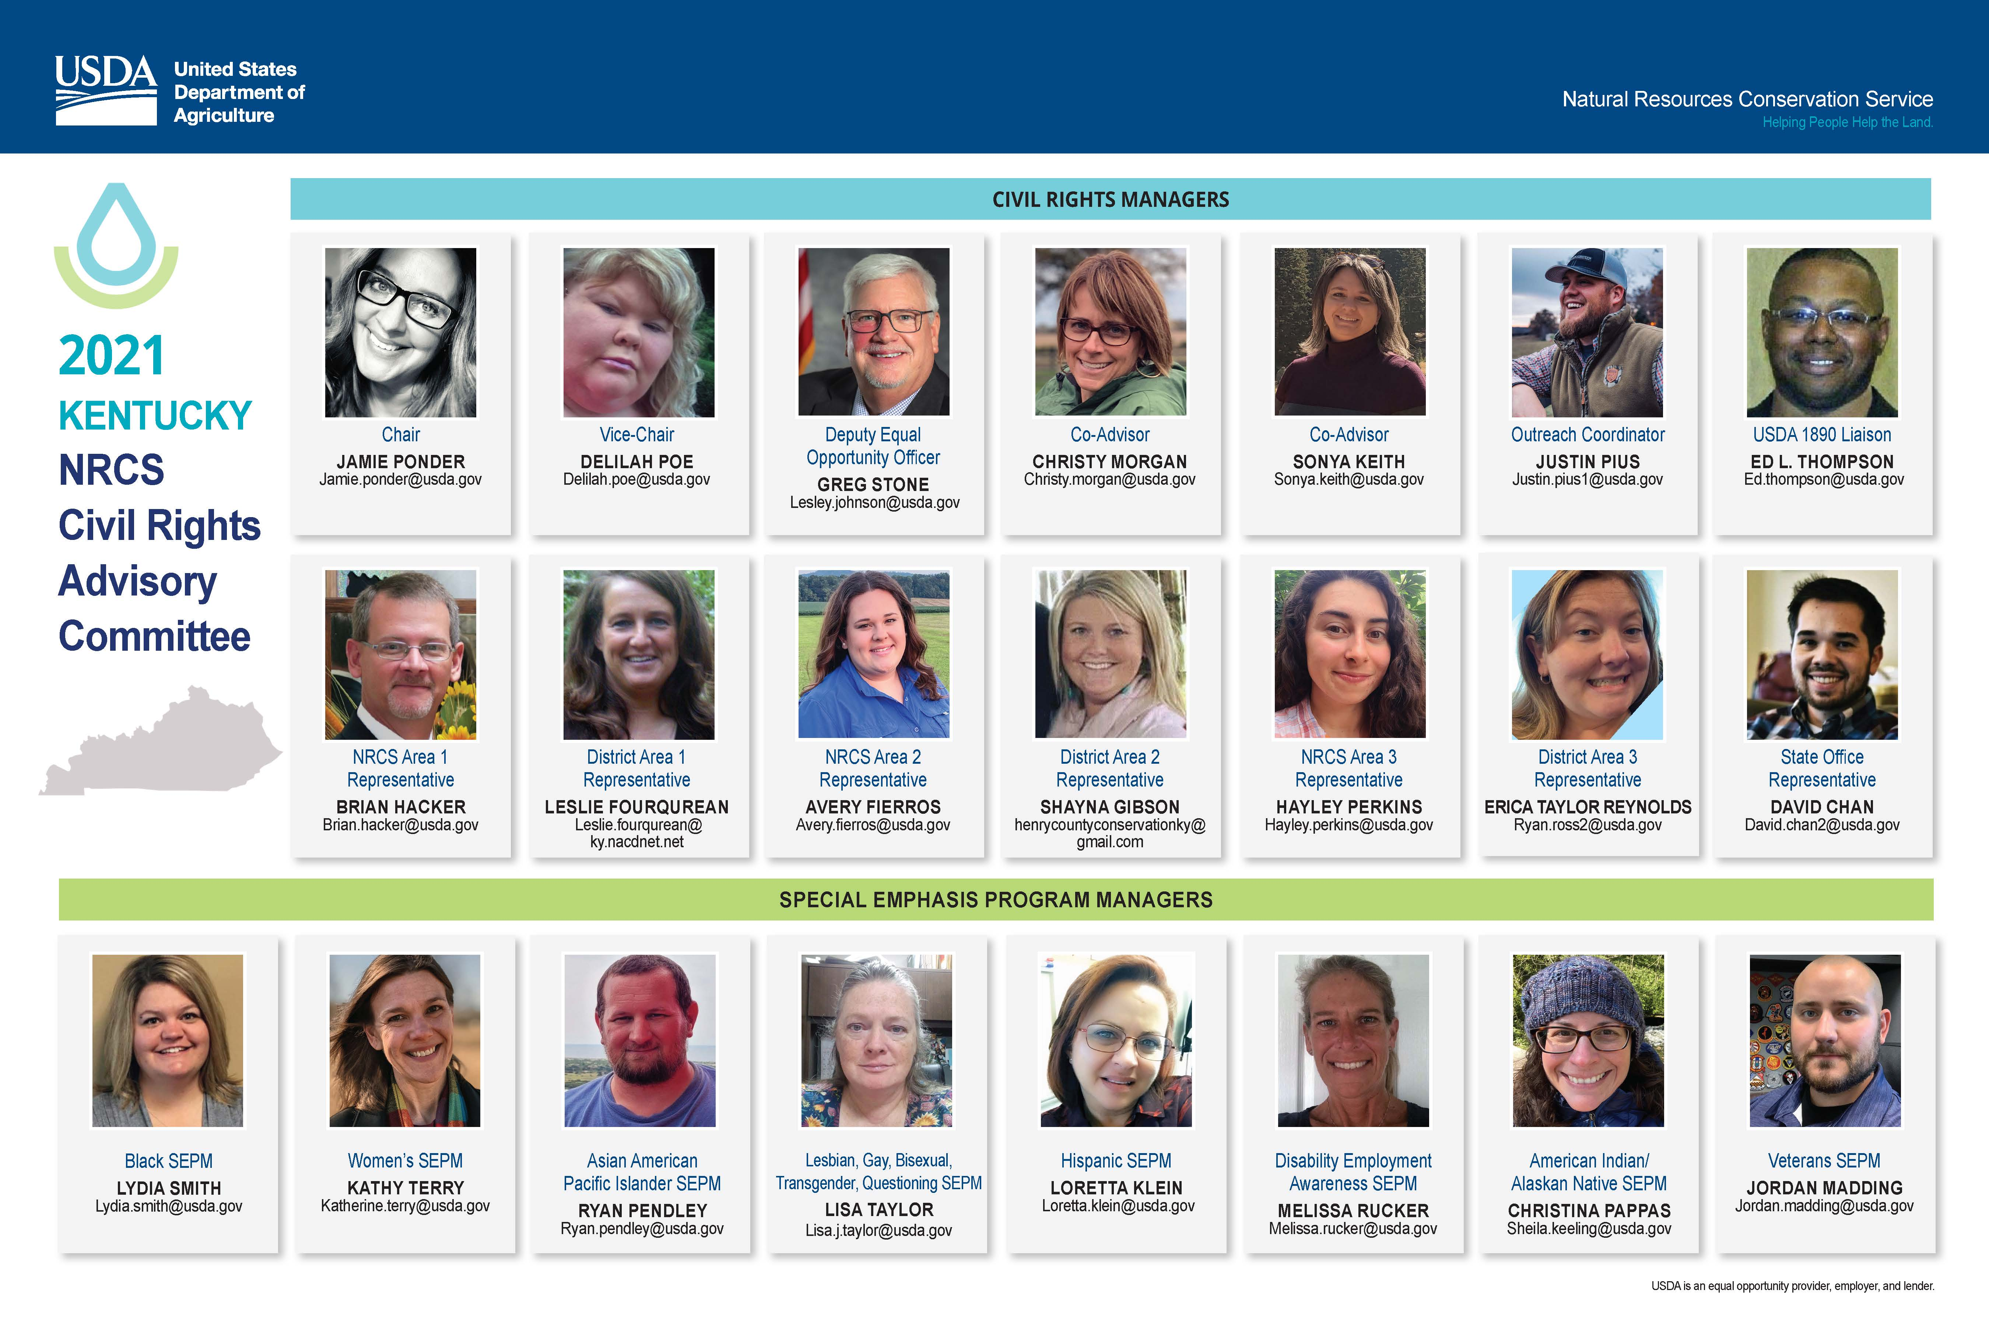
More Information
For additional information about USDA NRCS civil rights policies, visit: NRCS Civil Rights

Slide 13
Non-Discrimination Statement
In accordance with Federal civil rights law and U.S. Department of Agriculture (USDA) civil rights regulations and policies, the USDA, its Agencies, offices, and employees, and institutions participating in or administering USDA programs are prohibited from discriminating based on race, color, national origin, religion, sex, gender identity (including gender expression), sexual orientation, disability, age, marital status, family/parental status, income derived from a public assistance program, political beliefs, or reprisal or retaliation for prior civil rights activity, in any program or activity conducted or funded by USDA (not all bases apply to all programs). Remedies and complaint filing deadlines vary by program or incident.
Persons with disabilities who require alternative means of communication for program information (e.g., Braille, large print, audiotape, American Sign Language, etc.) should contact the responsible Agency or USDA’s TARGET Center at (202) 720-2600 (voice and TTY) or contact USDA through the Federal Relay Service at (800) 877-8339. Additionally, program information may be made available in languages other than English.
To file a program discrimination complaint, complete the USDA Program Discrimination Complaint Form, AD-3027, found online at How to File a Program Discrimination Complaint and at any USDA office or write a letter addressed to USDA and provide in the letter all of the information requested in the form. To request a copy of the complaint form, call (866) 632-9992. Submit your completed form or letter to USDA by mail:
U.S. Department of Agriculture
Office of the Assistant Secretary for Civil Rights
1400 Independence Avenue, SW
Washington, D.C. 20250-9410
(2) fax: (202) 690-7442 or
(3) email: program.intake@usda.gov
USDA is an equal opportunity provider, employer, and lender.

