Slide 1

GEORGIA STATE APPROVING AGENCY

Slide 2


Are we VA?
U.S. Department of Veterans Affairs
Georgia Department of Veterans Service

Slide 3


Georgia Department of Veterans Service
Commissioner Mike roby
The mission of the Department of Veterans Service is to serve Georgia's 752,000-plus veterans and their families in all matters pertaining to veterans benefits.

Slide 4
Georgia state approving agency
Protecting the gi bill
The SAA is responsible for approving and supervising all Georgia educational institutions and training establishments offering education and training to veterans under Titles 10 and 38 of the U.S. Code.

Slide 5
GA SAA & VA CONTACT INFO
Georgia Department of Veterans Service
State Approving Agency (SAA)
Floyd Veterans Memorial Bldg. Suite E-970
(2 MLK Jr. Drive)
Atlanta, Georgia 30334-4800
(404) 656-2306 or 2322
Fax (404) 657-6276
SAA State Supervisor:
Larry Edwards saaga@vs.state.ga.us
SAA Coordinators:
Barry Goode barry.goode@vs.state.ga.us
Bobby Davis saabjd@vs.state.ga.us
Frank Kollig fkollig@vs.state.ga.us
Lily Snyder saals@vs.state.ga.us
Atlanta VA Regional Office
1700 Clairmont Road NE
Decatur, Georgia 30033-4032
Education Liaison Representative:
Tracey Gross Tracey.Gross@va.gov
(404) 929-3109
Fax (404) 929-5811
Education Liaison Specialist:
Charmaine Francis Charmaine.Francis@va.gov
(404) 929-5715
Compliance Survey Specialists:
Michael A. Rogers Michael.Rogers1@va.gov
(404) 929-3006
Charles (Bill) Humble Charles.Humble@va.gov
(404) 929-6050

Slide 6
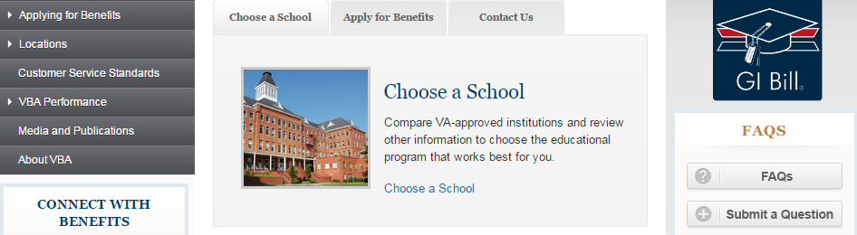
VA HOTLINE NUMBERS
School Certifying Officials Hotline
855-225-1159
Students
888-442-4551
VA Submit a Question
www.benefits.va.gov/gibill

Slide 7
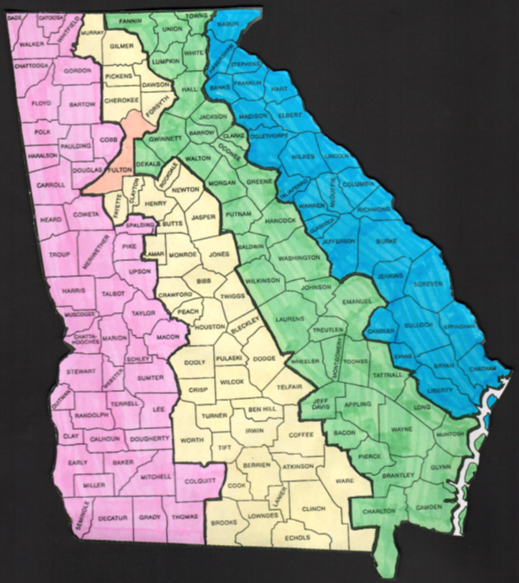
*
Area 1 – Barry Goode
Area 2 – Bobby Davis
Area 3 – Frank Kollig
Area 4 – Lily Snyder
Fulton County – All Coordinators
1
3
4
2

Slide 8
Georgia state approving agency
Over 1,700 schools and training establishments are approved for veterans to use their VA educational benefits
  Over 419 approved schools
  Over 1,290 approved training establishments
Over 20,296 veterans are currently using their VA educational benefits in Georgia
  15,936 are in the Post-9/11 GI Bill

Slide 9
VA Certifying Official
Is the Face of VA to the student.
Is the subject-matter expert on all VA issues.
Is responsible for all VA actions-Good or Bad.
Is the Schools “go-to” person for VA issues. And
In any situation concerning VA
    gets the blame And receives no credit.

Slide 10
Responsibilities of certifying officials
Certify Enrollment
Certify Changes in Enrollment
Secure program approval thru SAA
Keep the SAA informed of new programs, changes In programs, calendars, institutional changes, etc.
Keep up-to-date on current VA rules and benefits
Assist veterans and eligible dependents in applying for education benefits
  Maintain student’s VA folders
  Monitor student’s academic progress
  Provide veterans education benefits info
  Designation of Certifying Official VA Form 22-8794
  Refer to the GI Bill Web Site often
  Attend VA and SAA training opportunities.
  Enroll in VA on-line training
  Member of GAVCO

Slide 11
DEEMED APPROVED

Slide 12
CATALOG UPDATE
If the school publishes a new catalog you must send us (SAA) a catalog update.
Two CERTIFIED copies of the new catalog
  Hardcopy or PDF on CDs (NO LINKS)
VSO Form 70
VSO Form 70-1, VSO Form 70-2, VSO Form 70-3
  Only send in these forms if they apply to your school
VSO Form 70-5
VSO Form 70-6
VA Form 22-8794

Slide 13
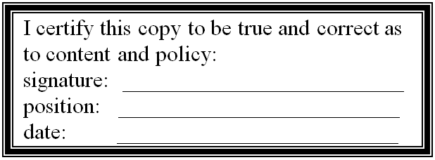
CERTIFICATION LABEL
Must be attached to both catalogs.
And student handbooks, if applicable.

Slide 14
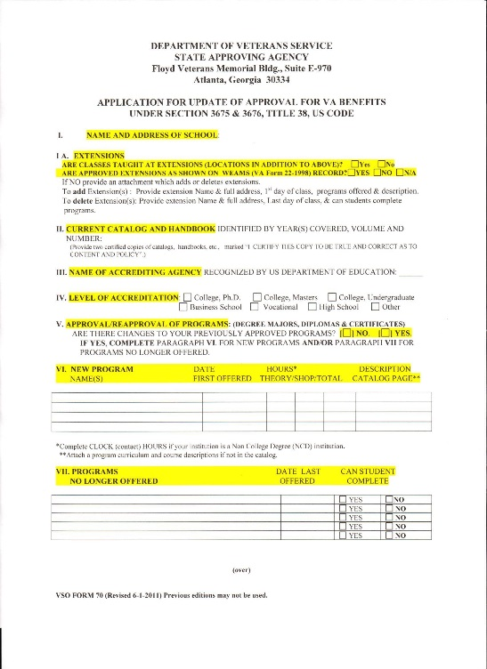
VSO FORM 70
Application for update of approval for va benefits

Slide 15
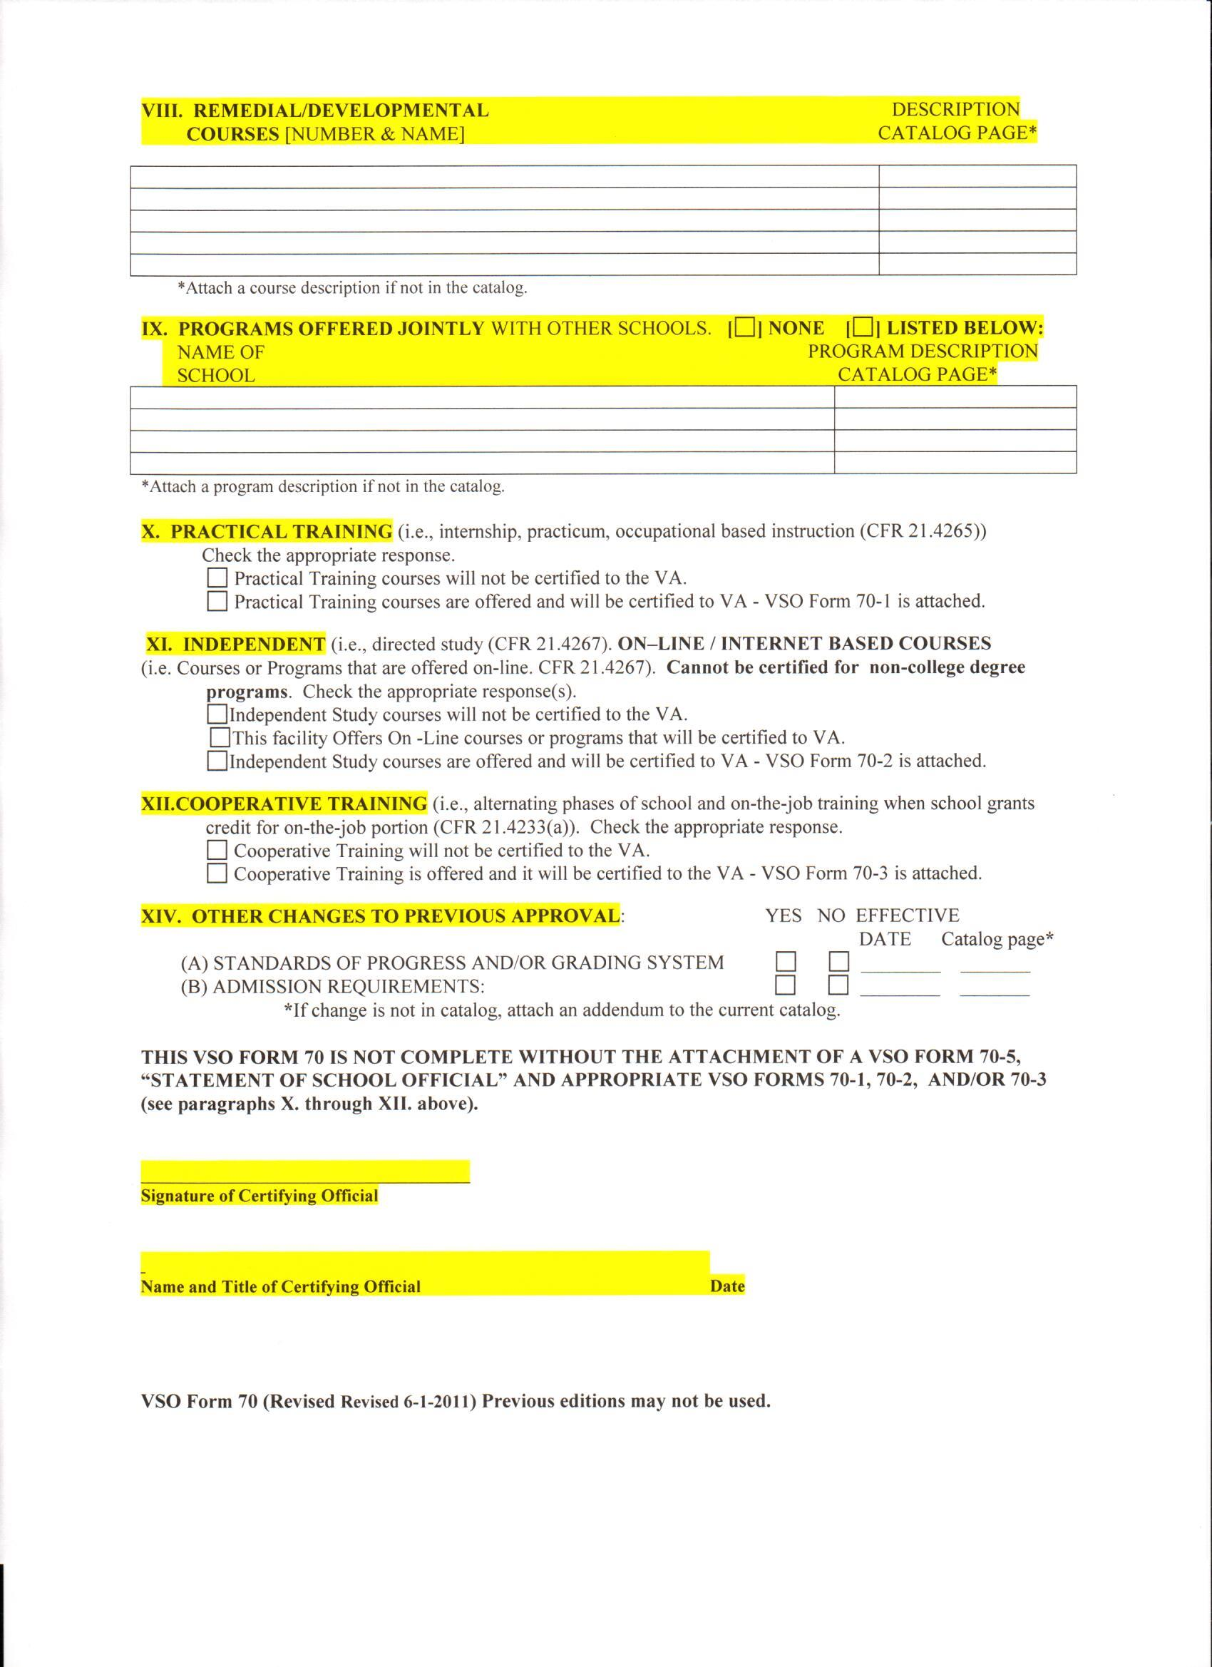
VSO FORM 70
Application for update of approval for va benefits

Slide 16
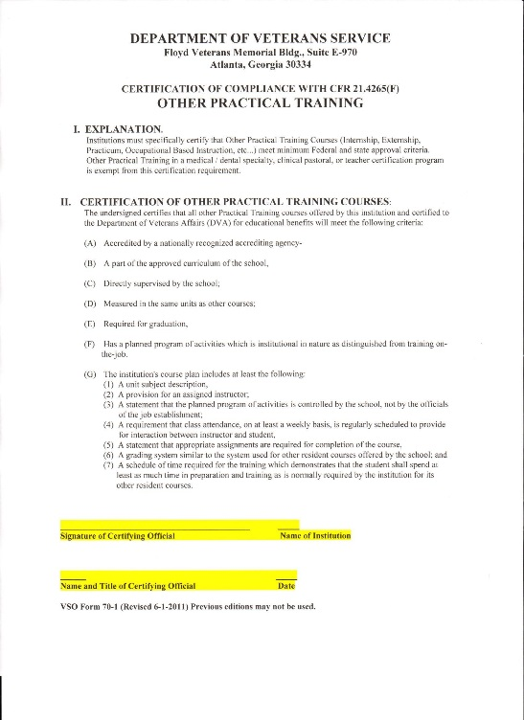
VSO FORM 70-1
Practical training

Slide 17
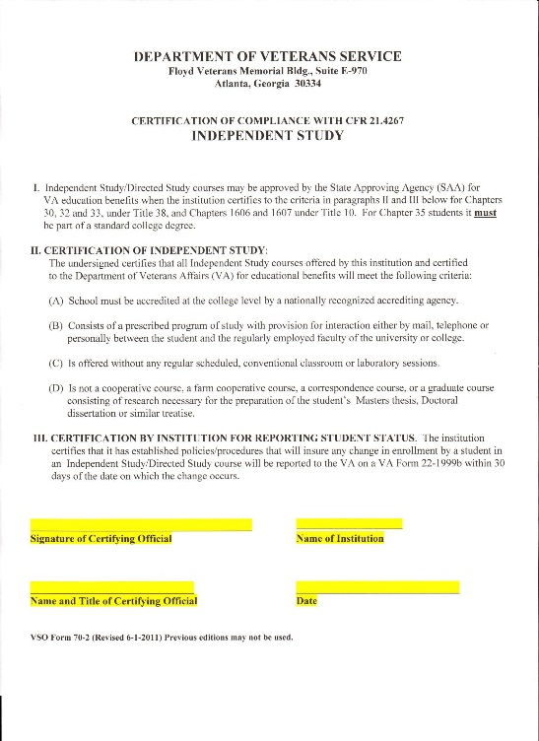
VSO FORM 70-2
Independent study

Slide 18
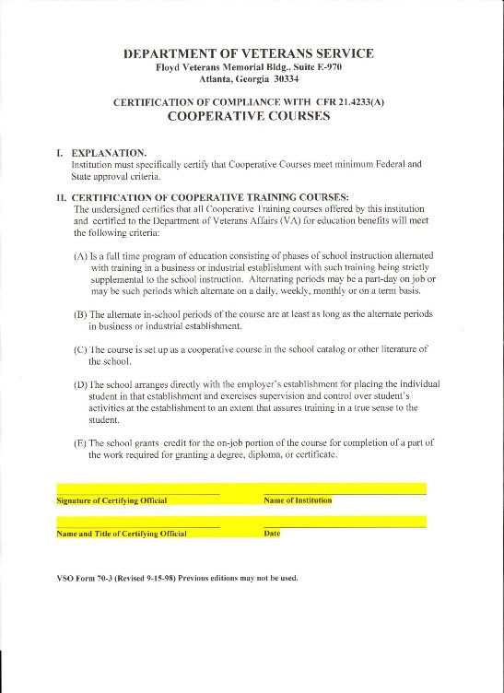
VSO FORM 70-3
Cooperative courses

Slide 19
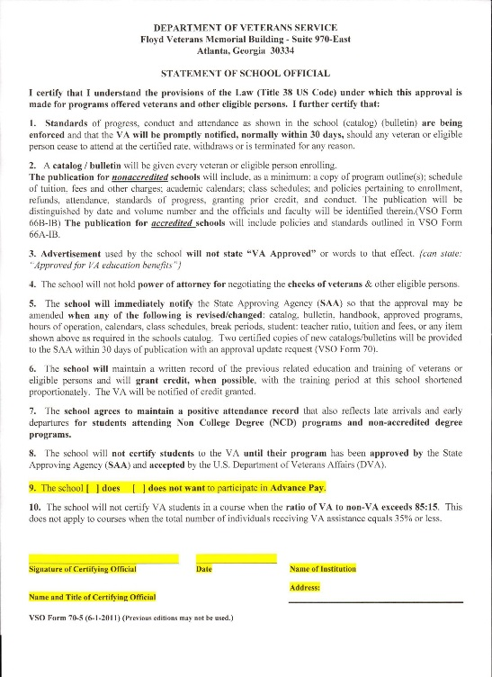
VSO FORM 70-5
Statement of school official

Slide 20
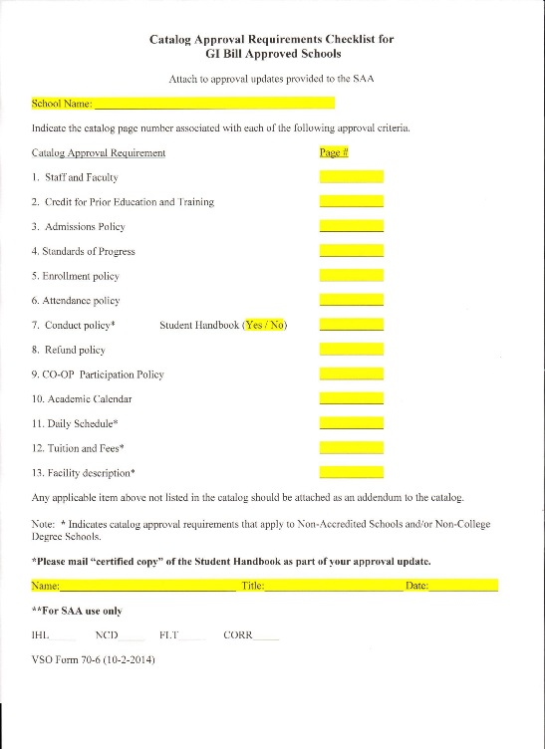
VSO FORM 70-6

Slide 21
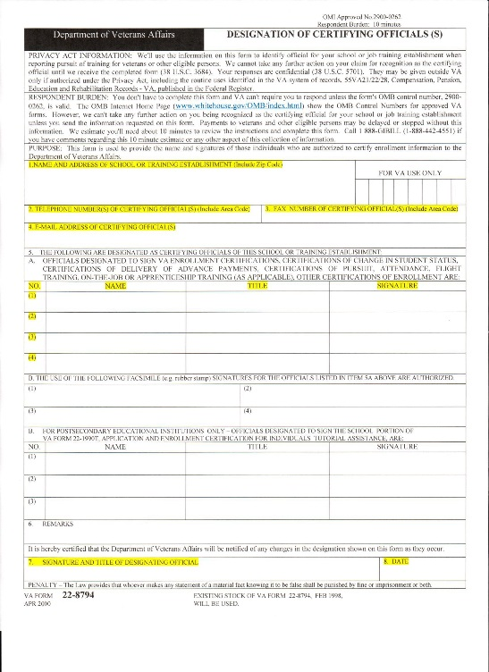
VA FORM
22-8794 designation of certifying official(S)

Slide 22
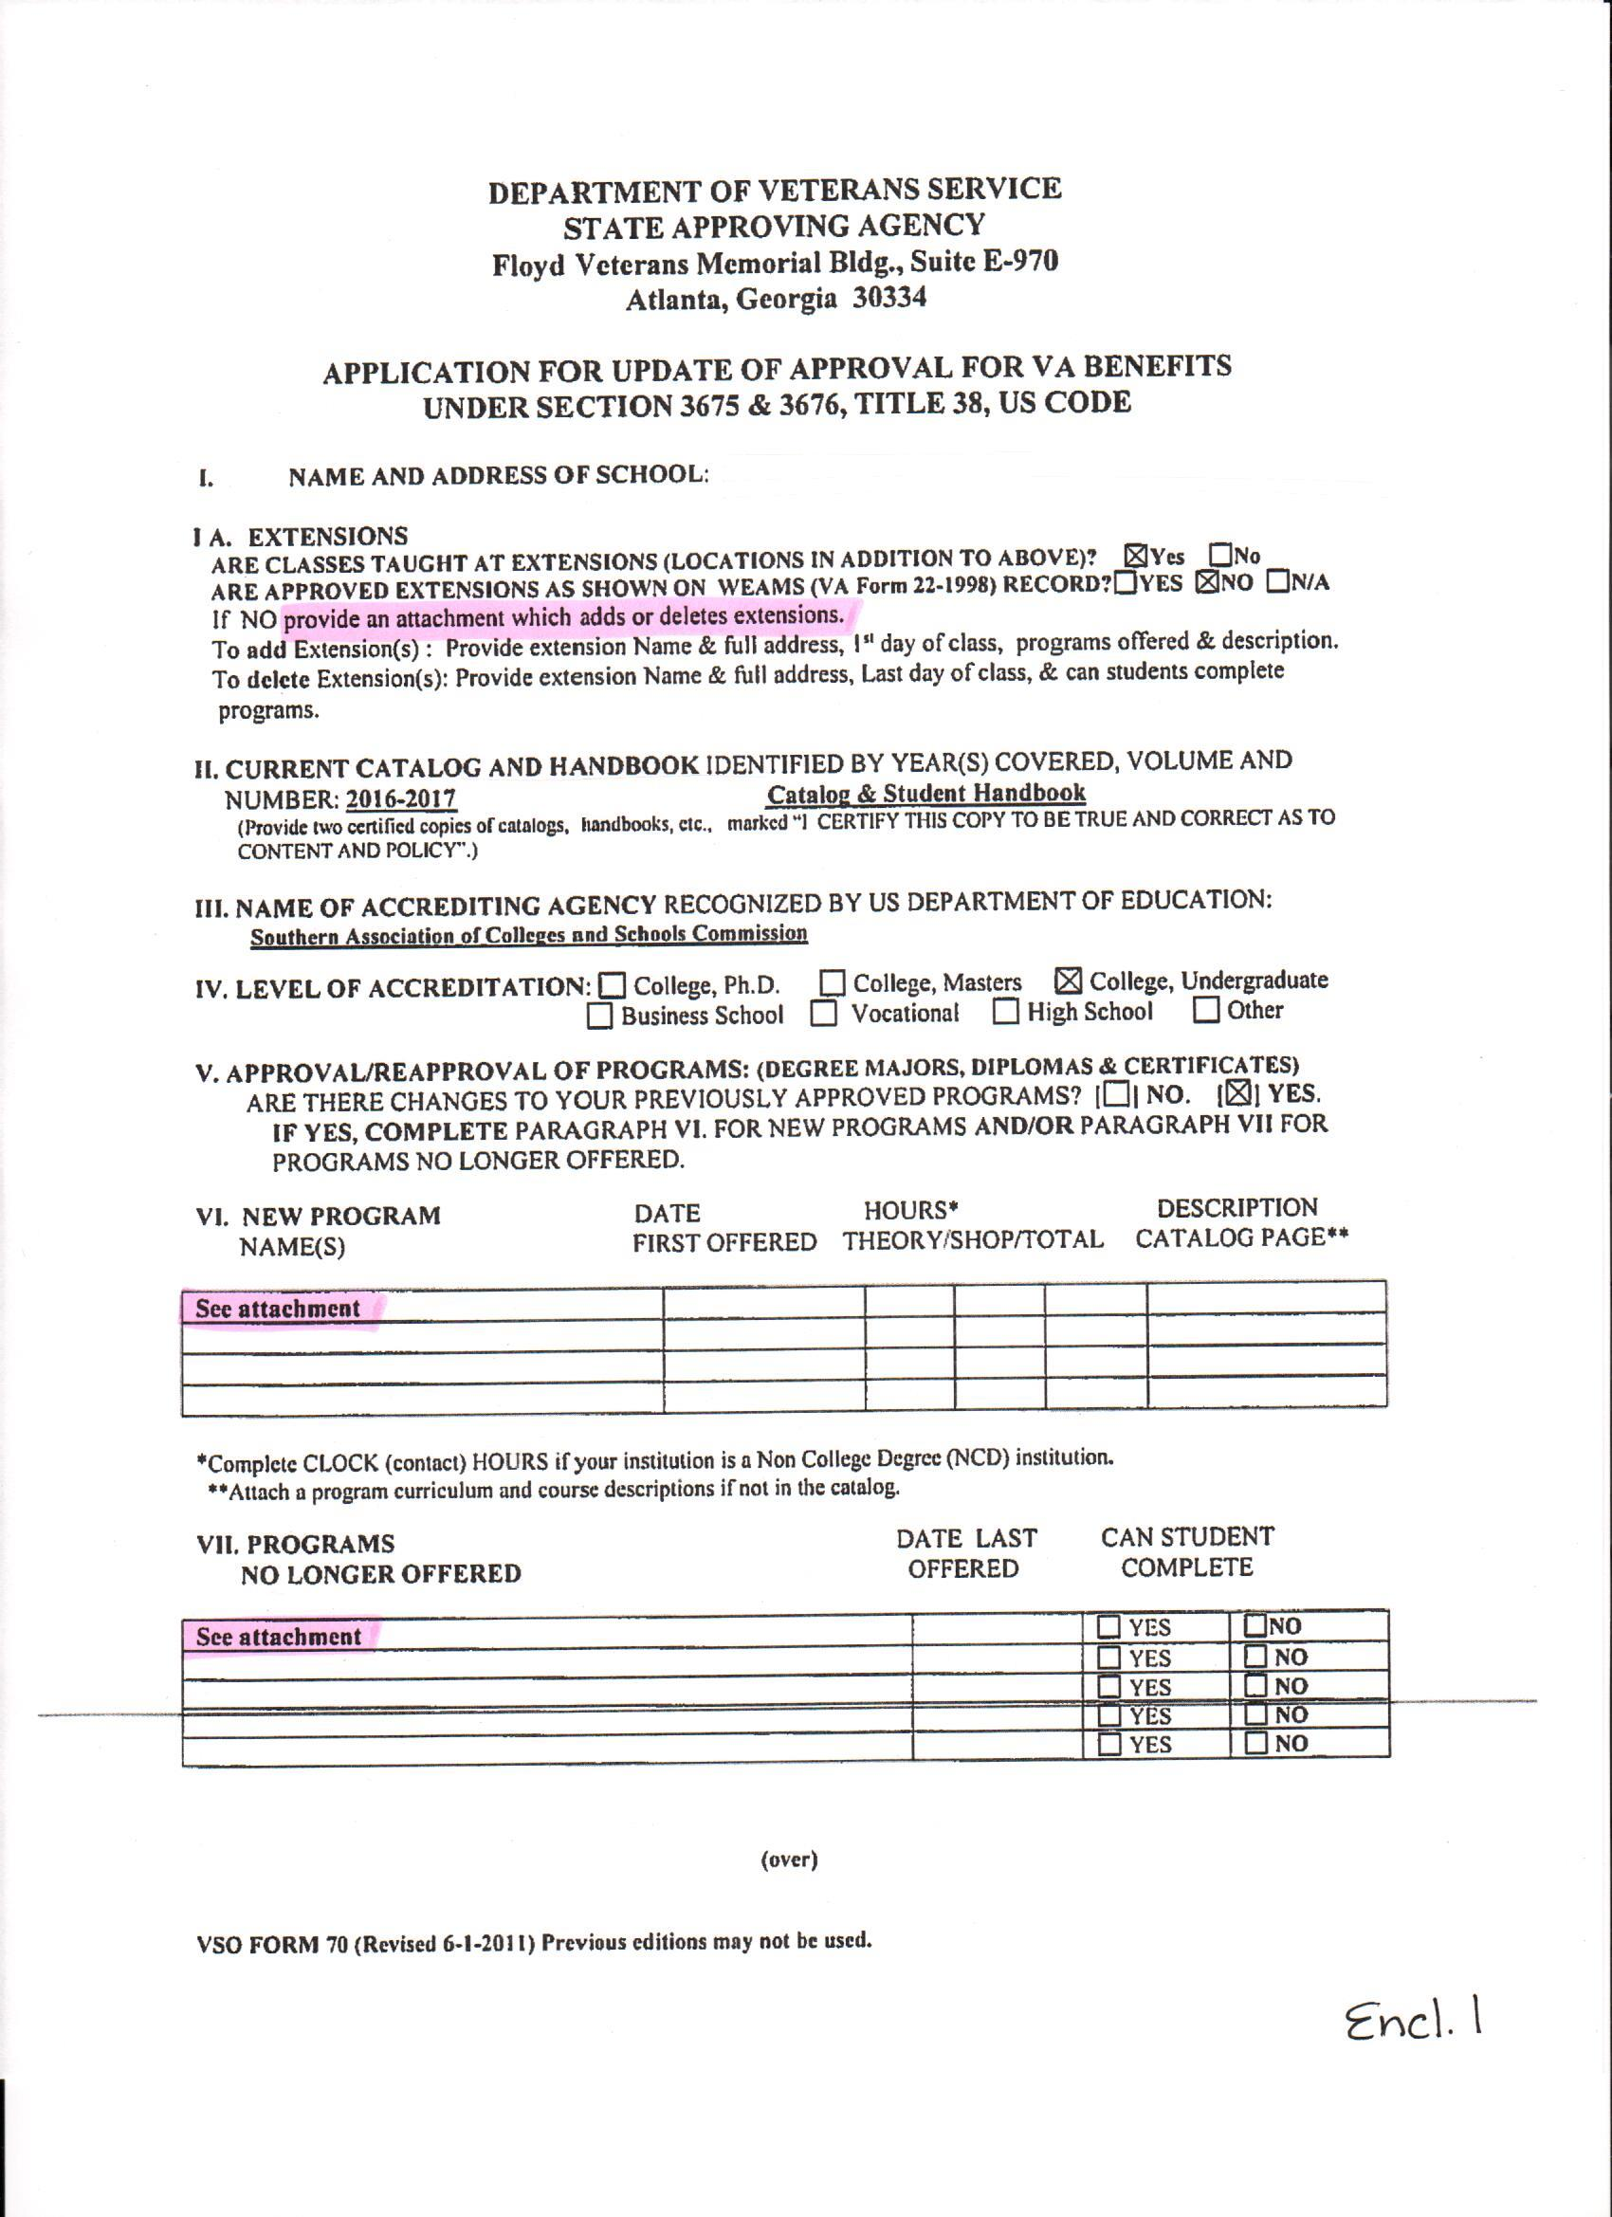
VSO FORM 70
Example

Slide 23
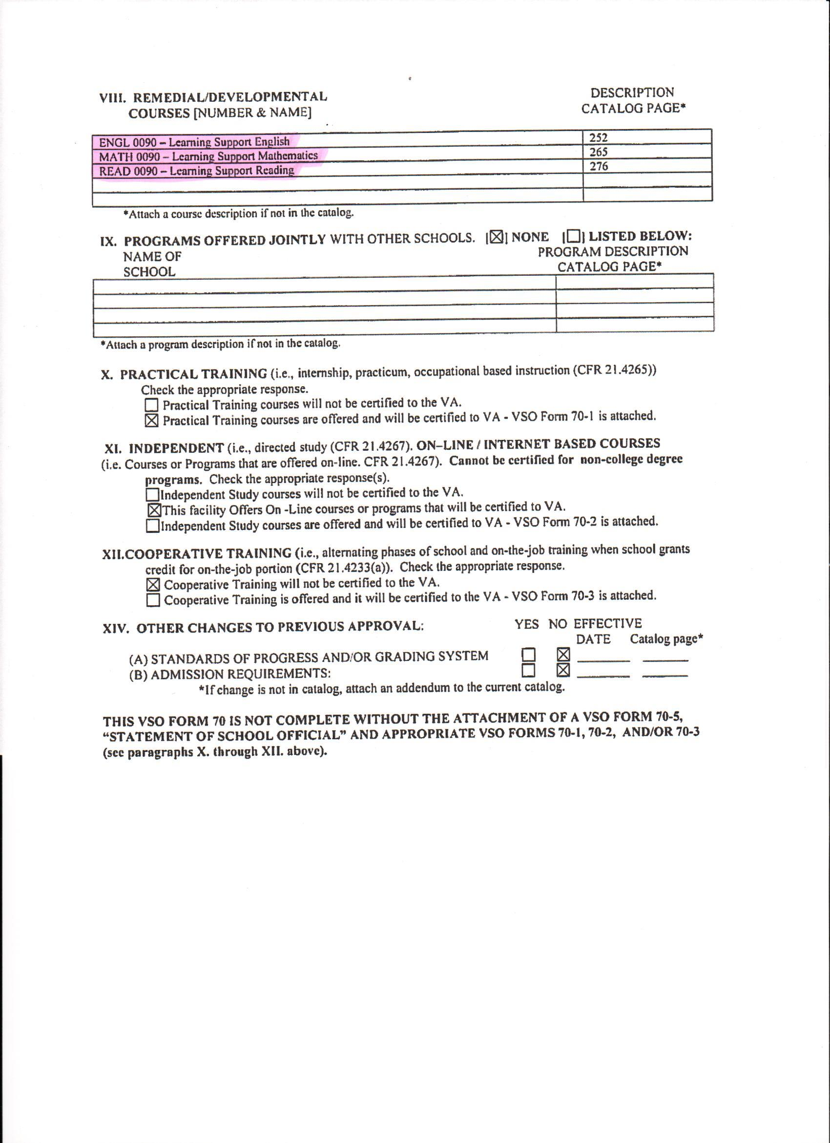
VSO FORM 70
Example

Slide 24
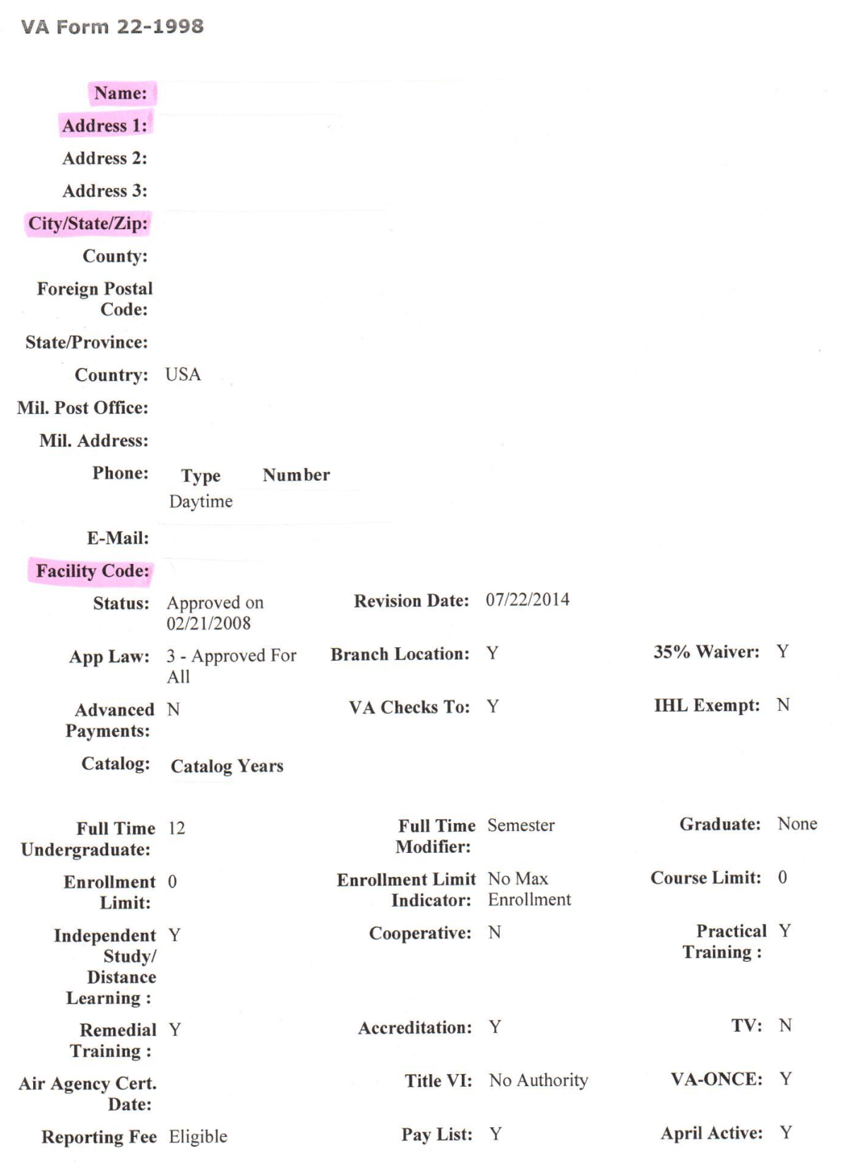
WEAMS
Example
Check your WEAMS
(VA Form 22-1998)
Name
Address
Etc.

Slide 25
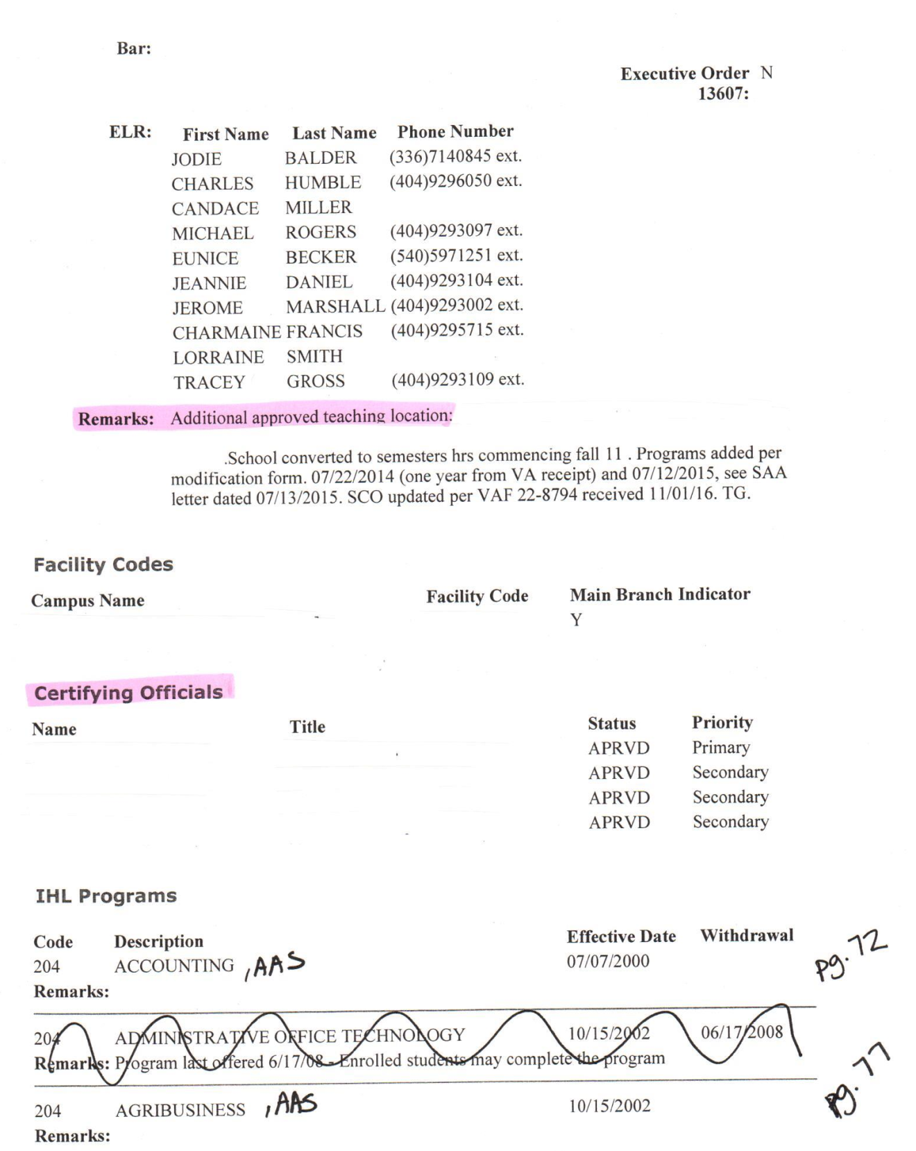
WEAMS
Example
Remarks: Where to find the addresses for your branches and/or extensions.
Check names under Certifying Officials.
Send in VA Form 22-8794 if the names aren’t correct.

Slide 26
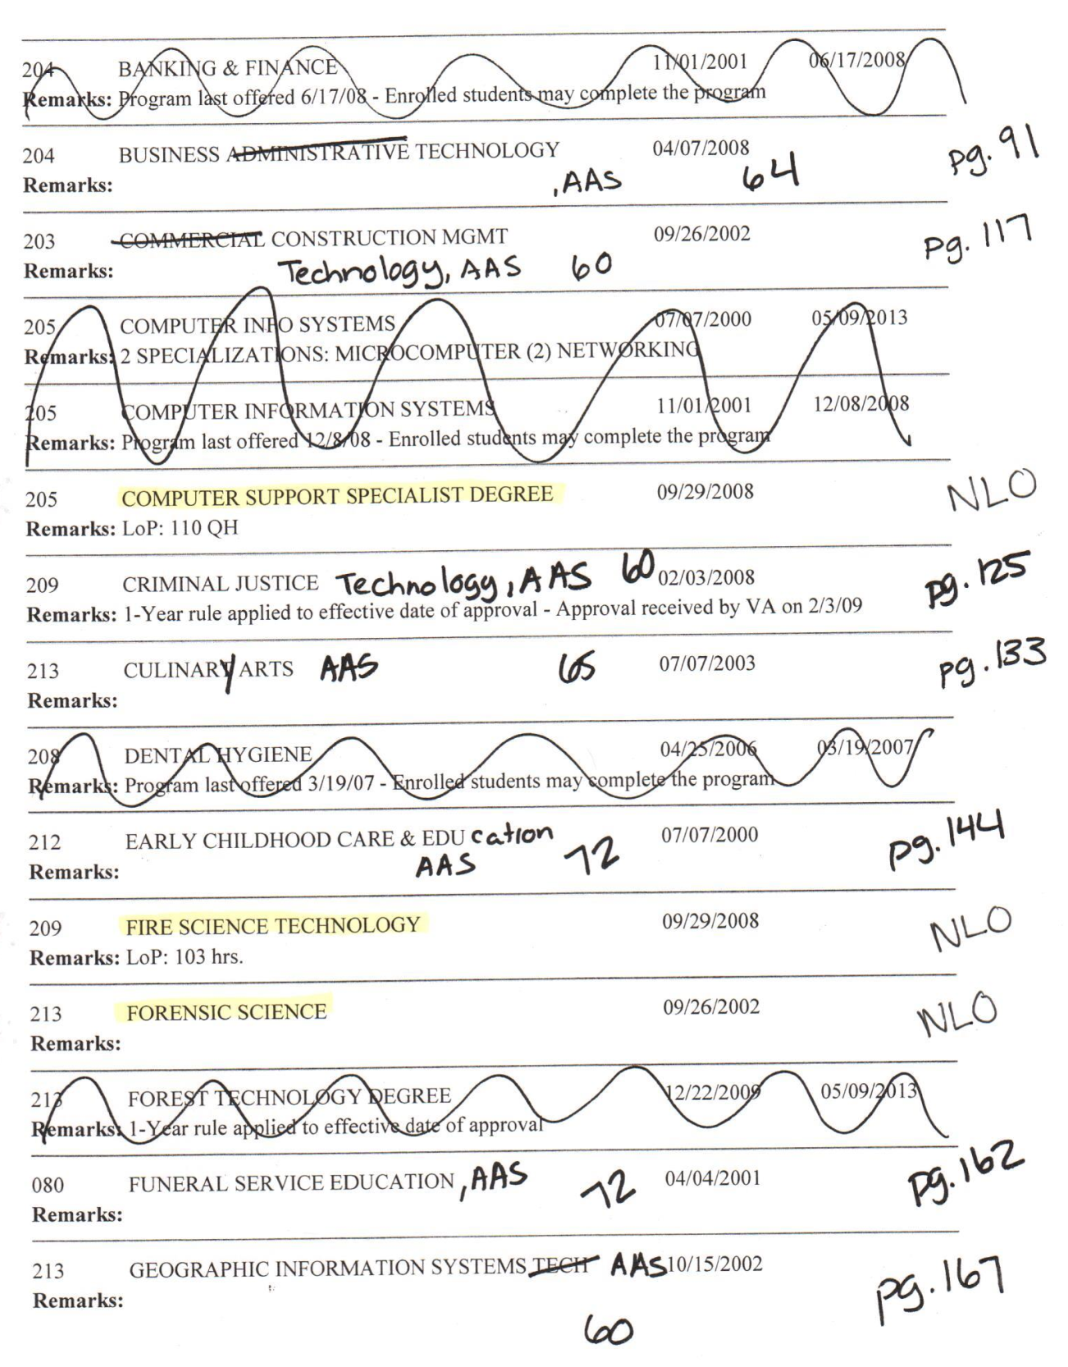
WEAMS
Example
1st
Mark out any withdrawn programs.
2nd
Go through your programs.
3rd
Mark up your WEAMS.
Name Changes, Program Hours Changes
4th
Make note of programs not found in your catalog.
5th
Make note of programs found in your catalog, but not on the WEAMS report.

Slide 27
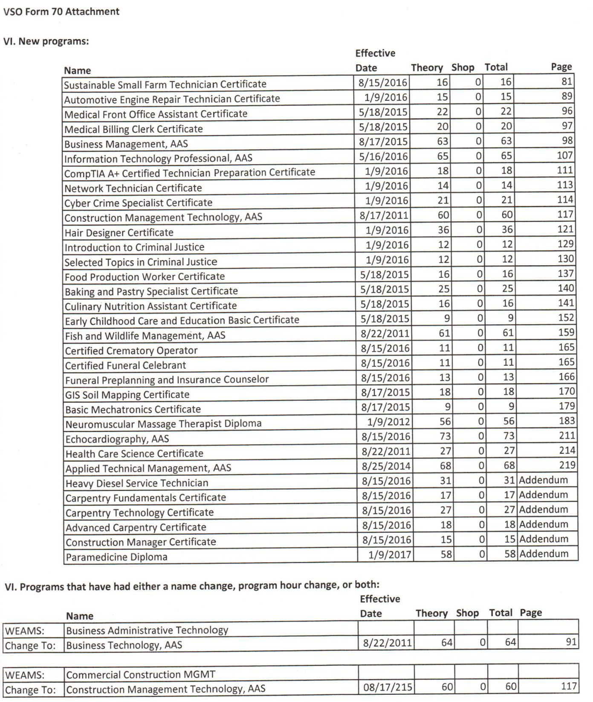
VSO FORM 70 Attachment
Example
If all the program changes don’t fit on the VSO Form 70, please submit an attachment.
Be sure to include full program name, date first offered (MM/DD/YYYY), program hours, and catalog page number where the program can be found.

Slide 28
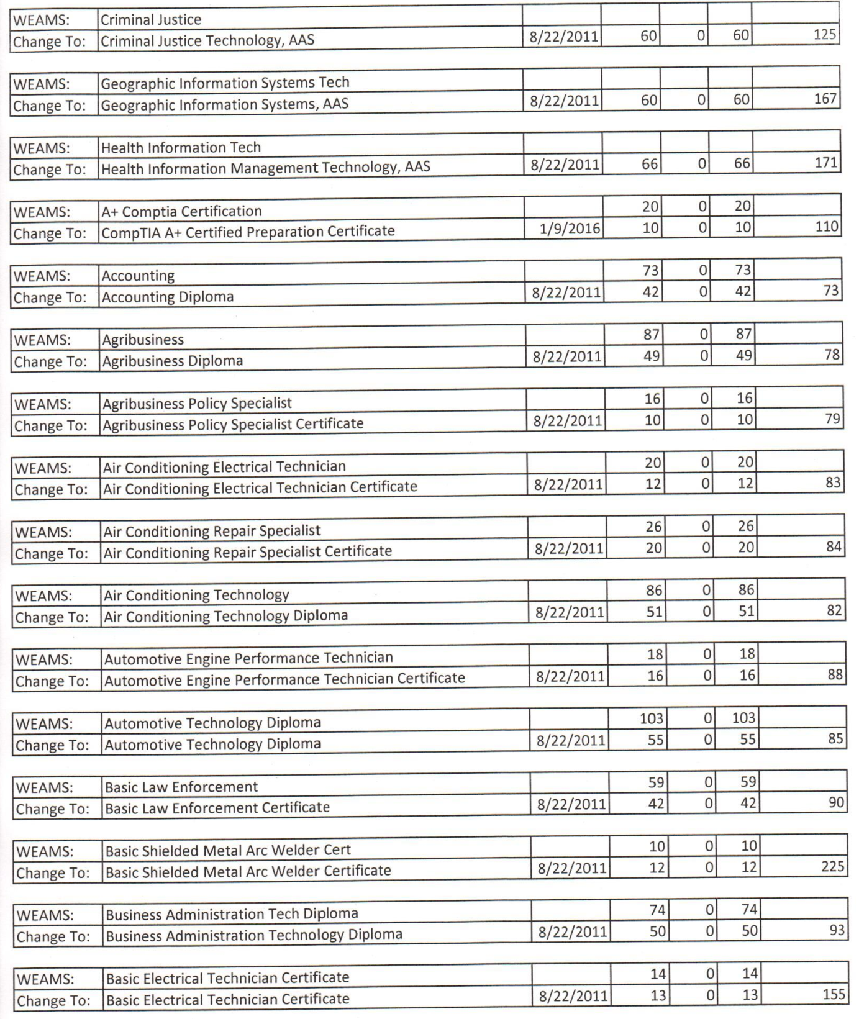
VSO FORM 70 Attachment
Example
Tell us what changed and the effective date of that change.

Slide 29
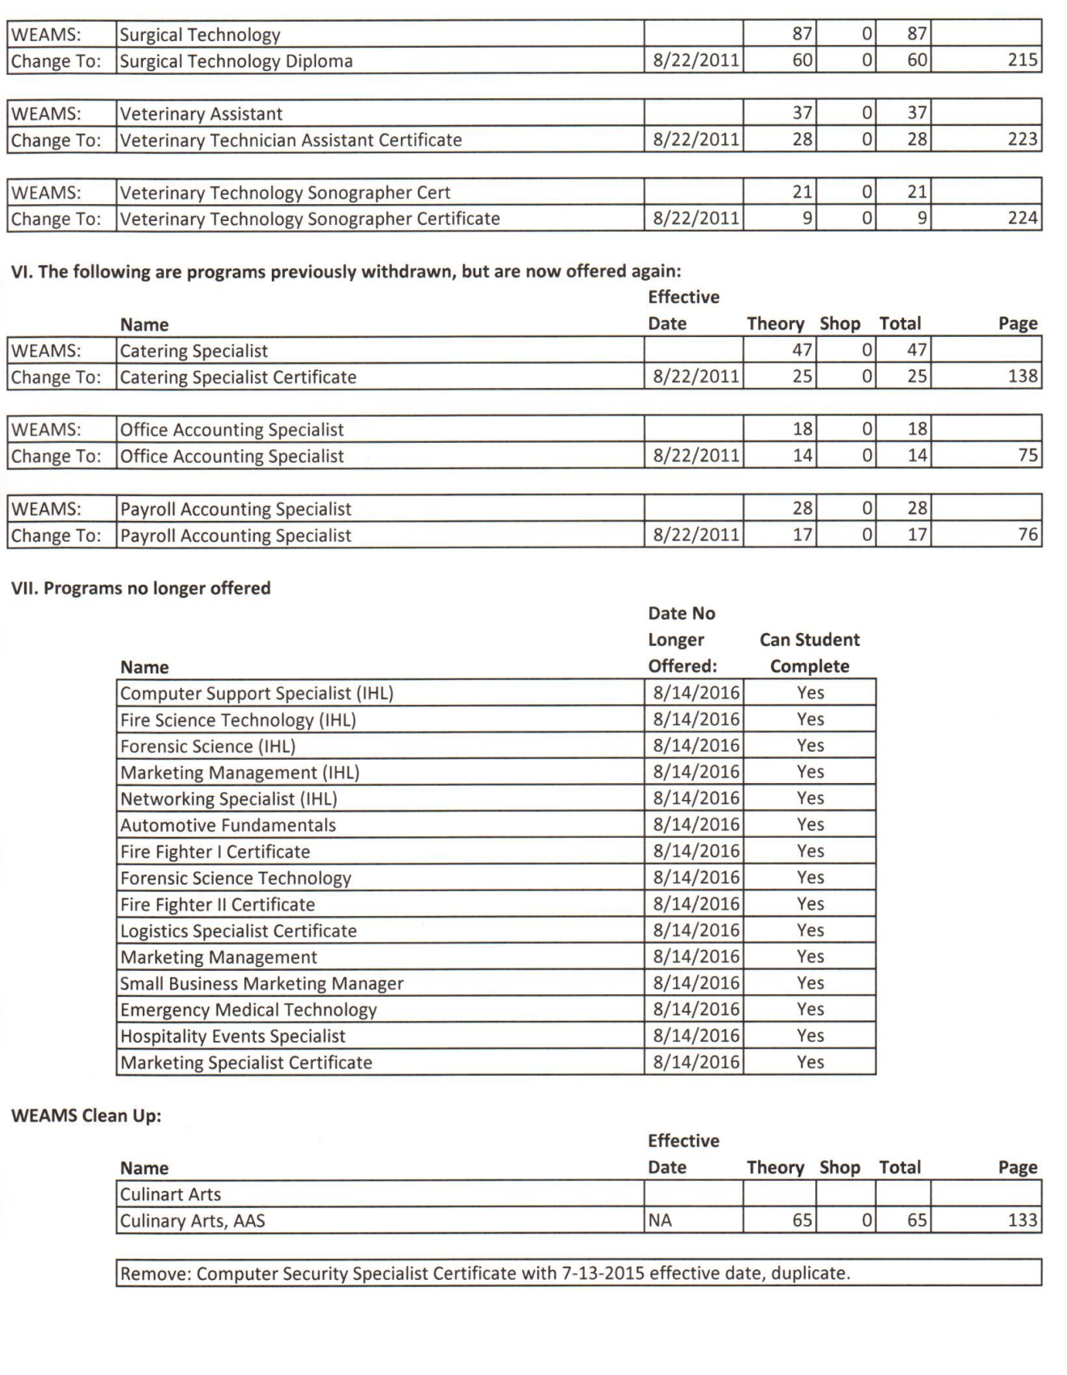
VSO FORM 70 Attachment
Example
List programs no longer offered
Date no longer offered (MM/DD/YYYY)
Whether a student can complete the program or not

Slide 30



Catalog Update, VA Form 22-8794, New Programs, Change of Name, Address, Ownership, Adding a Branch or Extension
Review submission g Request further information g Approve or Disapprove
Updated WEAMS sent to school.
If approved, we submit that approval to VA
Now, you can certify new programs or at new location.
If accepted, VA makes any changes needed in WEAMS.
VA then accepts or denies our approval.

Slide 31
SAA or VA
SAA
VA
Catalog Updates
Adding New Program
Name Change
Address Change
VA Form 22-8794
New Branch or Extension
Merger
Anything that has to do with APPROVAL
VA Form 22-8794
Memorandum of Understanding
VAONCE
  Access or Questions
Payment or Eligibility Questions
One thing that is the same: COMPLIANCE SURVEYS

Slide 32






Questions
Notes:
Light Bulb Questions
(Intermediate)
To reproduce the box effects on this slide, do the following:
On the Home tab, in the Slides group, click Layout, and then click Blank.
On the Design tab, in the Themes group, click the arrow next to Colors and then click Oriel.
On the Insert tab, in the Illustrations group click the arrow under Shapes, and then under Rectangles, select rectangle (first row, first option from left).
On the slide, drag to draw a rectangle.
Under Drawing Tools, in the Format tab, in the Size group, click the arrow at the bottom right corner launching the Format Shape dialog box.
In the Format Shape dialog box, select Size in the left pane, under Size and rotate in the right pane set Height to 1.88” and Width to 2”.
Also in the Format Shape dialog box, select Fill in the left pane, and under Fill in the right pane select No Fill.
Also in the Format Shape dialog box, select Line Color in the left pane, under Line Color in the right pane, select Solid Line, and then click the arrow to the right of Color, and under Theme Colors, select Black, Text 1 (first row, second option from left).
Also in the Format Shape dialog box, select Line Style in the left pane, under Line Style in the right pane set Width to 0.25 pt.
Close the Format Shape dialog box.
Select the rectangle. On the Home tab, in the Drawing group, click Arrange, point to Align, and then do the following:
Click Align Left.
Click Align Top.
Select the rectangle. On the Home tab, in the Clipboard group, click the arrow to the right of Copy, and then click Duplicate. Repeat this process three more times for a total of five rectangles.
Select duplicate on right side. On the Home tab, in the Drawing group, click Arrange, point to Align, and then do the following:
Click Align Right.
Click Align Top.
Select all five rectangles. On the Home tab, in the Drawing group, click Arrange, point to Align, and then do the following:
Click Align Top.
Click Distribute Horizontally.
Under Drawing Tools, on the Format tab, in the Arrange group, click the arrow to the right of Group and select Group.
Select the grouped rectangles. On the Home tab, in the Clipboard group, click the arrow to the right of Copy, and then click Duplicate. Repeat this process two more times for a total of four grouped sets.
Select one grouped set. On the Home tab, in the Drawing group, click Arrange, point to Align, and then do the following:
Click Align Center.
Click Align Bottom.
Select all other grouped sets, and also on the Home tab, in the Drawing group, click Arrange, point to Align, do the following:
Click Align Center.
Click Distribute Vertically.
Select all grouped rectangles. Under Drawing Tools, on the Format tab, in the Arrange group, click the arrow to the right of Group and select Ungroup.
To reproduce the video effects on this slide, do the following:
On the Insert tab, in the Media group, click Video, and then click Video from File.
In the left pane of the Insert Video dialog box, click the drive or library that contains the video. In the right pane of the dialog box, click the first video that you want, and then click Insert.
Under Video Tools, on the Format tab, in the Size group, click the arrow at the bottom right corner to launch the Format Video dialog box.
In the Format Video dialog box, select Size in the left pane, under Size and Rotate in the right pane, set Height to 1.88” and Width to 1.99”.
In the Animations tab, in the Animation group, select Play.
Also on the Animations tab, in the Timing group, click the arrow to the right of Start and select With Previous.
On the Home tab, in the Drawing group, click Arrange, point to Align, and then do the following:
Click Align Left.
Click Align Top.
Also on the Home tab, in the Drawing group, click Arrange, under Order Objects, click Send to Back.
On the Insert tab, in the Media group, click Video, and then click Video from File.
In the left pane of the Insert Video dialog box, click the drive or library that contains the video. In the right pane of the dialog box, click the second video that you want and then click Insert.
In the Format Video dialog box, select Size in the left pane, under Size and Rotate in the right pane, and set Height to 1.88” and Width to 1.99”.
In the Animations tab, in the Animation group, select Play.
Also on the Animations tab, in the Timing group, click the arrow to the right of Start and select With Previous.
On the Home tab, in the Drawing group, click Arrange, point to Align, and then click Align Top.
Press and hold CTRL, select second video and second rectangle from top left. On the Home tab, in the Drawing group, click Arrange, point to Align, and then select Align Left or Align Right (depending on which way the video needs to move to match up with rectangle).
Select the second video, on the Home tab, in the Drawing group, click Arrange, under Order Objects, click Send to Back.
On the Insert tab, in the Media group, click Video, and then click Video from File.
In the left pane of the Insert Video dialog box, click the drive or library that contains the video. In the right pane of the dialog box, click the third video that you want and then click Insert.
Under Video Tools on the Format tab, in the Size group, click the arrow at the bottom right corner to launch the Format Video dialog box.
In the Format Video dialog box, select Size in the left pane, under Size and Rotate in the right pane, set the Height to 3.75” and the Width to 4”.
In the Animations tab, in the Animation group, select Play.
Also on the Animations tab, in the Timing group, click the arrow to the right of Start and select With Previous.
On the Home tab, in the Drawing group, click Arrange, point to Align, and then do the following:
Click Align Right.
Click Align Top.
Also on the Home tab, in the Drawing group, click Arrange, under Order Objects, click Send to Back.
On the Insert tab, in the Media group, click Video, and then click Video from file.
In the left pane of the Insert Video dialog box, click the drive or library that contains the video. In the right pane of the dialog box, click the fourth video that you want and then click Insert.
In the Format Video dialog box, select Size in the left pane, under Size and Rotate in the right pane, set the Height to 1.88” and the Width to 1.99”.
In the Animations tab, in the Animation group, select Play.
Also on the Animations tab, in the Timing group, click the arrow to the right of Start and select With Previous.
On the Home tab, in the Drawing group, click Arrange, point to Align, and then click Align Bottom.
Press and hold CTRL, select fourth video and seventeenth rectangle (fourth row, second option from left). On the Home tab, in the Drawing group, click Arrange, point to Align, and then select Align Left or Align Right (depending on which way the video needs to move to match up with rectangle).
Select just the video, on the Home tab, in the Drawing group, click Arrange, under Order Objects, click Send to Back.
On the Insert tab, in the Media group, click Video, and then click Video from file.
In the left pane of the Insert Video dialog box, click the drive or library that contains the video. In the right pane of the dialog box, click the fifth video that you want and then click Insert.
In the Format Video dialog box, select Size in the left pane, under Size and Rotate in the right pane, set the Height to 1.88” and the Width to 1.99”.
In the Animations tab, in the Animation group, select Play.
Also on the Animations tab, in the Timing group, click the arrow to the right of Start and select With Previous.
Press and hold CTRL, select fifth video and thirteenth rectangle (third row, third option from left). On the Home tab, in the Drawing group, click Arrange, point to Align, and then select Align Left or Align Right, and then Align Top or Align Bottom (depending on which way the video needs to move to match up with rectangle).
Select just the video, on the Home tab, in the Drawing group, click Arrange, under Order Objects, click Send to Back.
On the Insert tab, in the Media group, click Video, and then click Video from file.
In the left pane of the Insert Video dialog box, click the drive or library that contains the video. In the right pane of the dialog box, click the sixth video that you want and then click Insert.
In the Format Video dialog box, select Size in the left pane, under Size and Rotate in the right pane, set Height to 1.88” and Width to 1.99”.
Close the Format Video dialog box.
In the Animations tab, in the Animation group, select Play.
Also on the Animations tab, in the Timing group, click the arrow to the right of Start and select With Previous.
On the Home tab, in the Drawing group, click Arrange, point to Align, and then click Align Bottom.
Press and hold CTRL, select sixth video and nineteenth rectangle (fifth row, fourth option from left). On the Home tab, in the Drawing group, click Arrange, point to Align, and then select Align Left or Align Right (depending on which way the video needs to move to match up with rectangle).
Select just the video, on the Home tab, in the Drawing group, click Arrange, under Order Objects, click Send to Back.
To reproduce the text effects on this slide, do the following:
Press and hold CTRL, select rectangles six, seven and eight (second row, first, second and third options from left), then under the Home tab, in the Clipboard group, click the Cut icon.
On the Insert tab, in the Text group, click Text Box, and then on the slide drag to draw your text box in the area you just cut.
Type text, Questions, in the text box, and then select the text. On the Home tab, in the Font group, select Book Antiqua from the Font list, with a Font Size of 88 pt.
Under Drawing Tools, on the Format tab, in the WordArt Styles group, click the arrow at the bottom right to launch the Format Text Effects dialog box.
In the Format Text Effects dialog box, select Text Fill in the left pane, under Text Fill in the right pane select Solid fill, then click the arrow to the right of Color and under Theme Colors, select Light Yellow, Background 2, Darker 75% (fifth row, third option from left).
Also in the Format Text Effects dialog box, select Shadow in the left pane, under Shadow in the right pane, click the arrow to the right of Color and under Theme Colors, select Black, Text 1 (first row, second option from left), and the do the following:
In the Transparency box, enter 35%.
In the Size box, enter 100%.
In the Blur box, enter 6 pt.
In the Angle box, enter 90 degrees.
In the Distance box, enter 4 pt.
Also in the Format Text Effects dialog box, select 3-D Format in the left pane, under 3-D Format in the right pane, click the arrow to the right of Top, under Bevel select Art Deco (third row, fourth option from left), and then do the following:
To the right of Top, in the Width box, enter 2 pt.
To the right of Top, in the Height box, enter 4.4 pt.
Under Contour, click arrow to right of Color and under Theme Colors, select Light Yellow, Background 2, Darker 10% (second row, third option from left), then set Size to 2pt.
Under Surface, click the arrow to the right of Lighting and under Neutral, select Soft (first row, third option from left).
Select text. On the Home tab, in the Paragraph group, select Center Text.
Close the Format Text Effects dialog box.
To reproduce the background effects on this slide, do the following:
On the Design tab, in the bottom right corner of the Background group, click the arrow at the bottom right to launch the Format Background dialog box.
In the Format Background dialog box, select Fill in the left pane, under Fill in the right pane, select Gradient fill, then click the arrow to the right of Type and select Radial.
Still in the Fill pane, under Gradient stops, click Add gradient stop or Remove gradient stop until four stops appear on the slider. Customize the gradient stops as follows:
Select the first stop on the slider, and then do the following:
In the Position box, enter 0%.
Click the button next to Color, and then under Theme Colors select Gold, Accent 4, Lighter 80% (second row, eighth option from the left).
Select the second stop on the slider, and then do the following:
In the Position box, enter 26%.
Click the button next to Color, and then under Theme Colors select Gold, Accent 4, Lighter 60% (second row, eighth option from the left).
Select the third stop on the slider, and then do the following:
In the Position box, enter 59%.
Click the button next to Color, and then under Theme Colors select Gold, Accent 4, Lighter 40% (fourth row, eighth option from the left).
Select the last stop on the slider, and then do the following:
In the Position box, enter 100%.
Click the button next to Color, and then under Theme Colors select Gold, Accent 4, Darker 25% (fifth row, eighth option from the left).
Close the Format Background dialog box.

