Slide 1
European Union and EU27/ EEA/ EFTA
EU Settlement Scheme for EU27/ EEA/ EFTA citizens after BREXIT
Presentation of information
Notes:
Thank you for inviting me to speak at this event today, to talk about the EU Settlement Scheme.
The Scheme fully opened on the 30 March 2019 and I will give you an update on what it is, who can apply, and what support is available to applicants and other stakeholder groups.

Slide 2
Applying to the Settlement Scheme
European Union and EU27/ EEA/ EFTA
Content:
PART 1 EXPLANATION OF THE POPULAR TERMS
PART 2 EU SETTLEMENT SCHEME
PART 3 EVIDENCE
Notes:
The EU Settlement Scheme is a free, simple, digital system through which EEA and Swiss citizens need to apply to get a status under UK law.
There is plenty of time to apply – in a deal scenario the date for applications to be made is 30 June 2021. In a no deal, applicants have until 31 December 2020.
We have worked with stakeholders on the design and development of the EU Settlement Scheme – to ensure that the needs of the end user are at the heart of the process.

Slide 3
Applying to the Settlement Scheme
European Union and EU27/ EEA/ EFTA
PART 1
EXPLANATION OF THE POPULAR TERMS
Notes:
The EU Settlement Scheme is a free, simple, digital system through which EEA and Swiss citizens need to apply to get a status under UK law.
There is plenty of time to apply – in a deal scenario the date for applications to be made is 30 June 2021. In a no deal, applicants have until 31 December 2020.
We have worked with stakeholders on the design and development of the EU Settlement Scheme – to ensure that the needs of the end user are at the heart of the process.

Slide 4
Applying to the Settlement Scheme
European Union and EU27/ EEA/ EFTA
United Kingdom will be leaving the European Union (EU) on 31st of January 2020. This is the fourth extension since March 29th 2019.
When the UK leaves the EU, all EU27/EEA/EFTA citizens must apply to EU Settlement Scheme to secure their right to stay in the UK after BREXIT by 31st December 2020 in case of no deal, by 30 June 2021 in case of a deal.
Travel to the EU, Switzerland, Norway, Iceland or Liechtenstein will change if the UK leaves the EU with no deal.
We still do not know if the UK will leave the EU with a deal or no deal.
On the day you travel, you’ll need your passport to both:
have at least 6 months left & be less than 10 years old (even if it has 6 months or more left)
After Brexit your European Health Insurance Card (EHIC) card may not be valid.
You’ll need an international driving permit (IDP) to drive in some countries.
After Brexit you will not be able to use the existing pet passport scheme. Instead you’ll need to follow
a different process, which takes 4 months.
Notes:
The EU Settlement Scheme is a free, simple, digital system through which EEA and Swiss citizens need to apply to get a status under UK law.
There is plenty of time to apply – in a deal scenario the date for applications to be made is 30 June 2021. In a no deal, applicants have until 31 December 2020.
We have worked with stakeholders on the design and development of the EU Settlement Scheme – to ensure that the needs of the end user are at the heart of the process.

Slide 5
Applying to the Settlement Scheme
European Union and EU27/ EEA/ EFTA
BREXIT - Brexit is popular name for the UK leaving the EU.
A portmanteau of the words “Britain” and “exit,” Brexit is shorthand for Britain’s split from the European Union, changing its relationship to the bloc on trade, security and migration.
First referendum on membership in what was then called the European Economic Community took place in 1975, less than three years after it joined, when 67 percent of voters supported staying in the bloc.
In 2013, Prime Minister David Cameron promised a national referndum on European Union membership with the idea of settling the question once and for all.
Remain or Leave — and Mr. Cameron was convinced that Remain would win handily.
British citizens voted on June 23, 2016, as a refugee crisis made migration a subject of political rage across Europe and amid accusations that the Leave campaign had relied on lies and broken election laws.
An ill-defined Brexit won 52 percent of the vote.
Notes:
The EU Settlement Scheme is a free, simple, digital system through which EEA and Swiss citizens need to apply to get a status under UK law.
There is plenty of time to apply – in a deal scenario the date for applications to be made is 30 June 2021. In a no deal, applicants have until 31 December 2020.
We have worked with stakeholders on the design and development of the EU Settlement Scheme – to ensure that the needs of the end user are at the heart of the process.

Slide 6
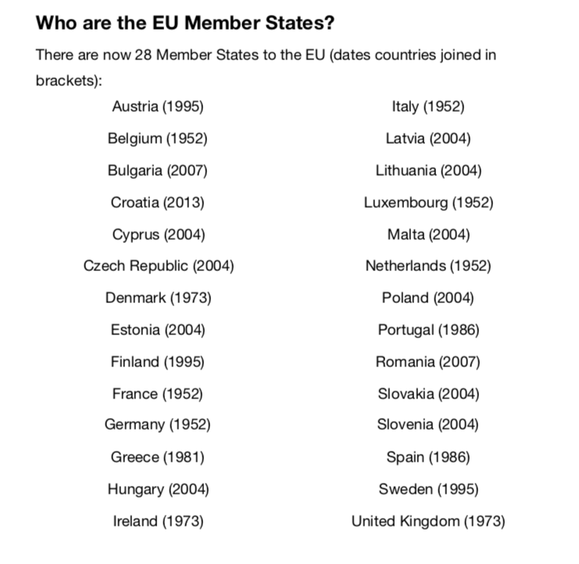

Slide 7
Applying to the Settlement Scheme
European Union and EU27/ EEA/ EFTA
EU/EEA list of countries / citizens who must apply to EU Settlement Scheme
If you are, regardless of your origin, a passport holder of EU/EEA country you still must apply (unless one of the passports is British) to the EU Settlement Scheme:
The countries are: Austria, Belgium, Bulgaria, Croatia, Republic of Cyprus, Czech Republic, Denmark, Estonia, Finland, France, Germany, Greece , Hungary, Ireland*, Italy, Latvia, Lithuania , Luxembourg, Malta , Netherlands, Poland, Portugal, Romania, Slovakia, Slovenia, Spain, Sweden
EEA: Iceland, Liechtenstein, Norway
EFTA states: Iceland, Liechtenstein, Norway, (+Switzerland)
Brexit means that the arrangements and agreements of the UK’s membership of the EU will end
This includes the right of EU citizens to freely live and work in the UK.
Zrzut ekranu 2019-11-10 o 17.22.18
Notes:
The EU Settlement Scheme is a free, simple, digital system through which EEA and Swiss citizens need to apply to get a status under UK law.
There is plenty of time to apply – in a deal scenario the date for applications to be made is 30 June 2021. In a no deal, applicants have until 31 December 2020.
We have worked with stakeholders on the design and development of the EU Settlement Scheme – to ensure that the needs of the end user are at the heart of the process.

Slide 8
Applying to the Settlement Scheme
DEAL OR NO DEAL – that’s the question…
A no-deal Brexit means the UK would leave the EU with no agreement in place and will become a third country.
If a special deal between EU leaders and UK politicians isn't agreed, then the UK could leave the EU with no deal in place. This would be a no-deal Brexit.
Changes in no deal BREXIT scenario example:
Some border checks could be re-introduced which means that a new immigration system will be introduces while going abroad
EHIC card won’t be acceptable if going abroad
New system in place for taking pets abroad
Transport and trade between the UK and the EU could be severely affected
Adults may not be able to drive in EU countries without a special driving licence
It could cost more money to use your phone abroad in EU countries no further funding for Universities from the EU
No free movement
Zrzut ekranu 2019-11-10 o 17.22.18
Notes:
The EU Settlement Scheme is a free, simple, digital system through which EEA and Swiss citizens need to apply to get a status under UK law.
There is plenty of time to apply – in a deal scenario the date for applications to be made is 30 June 2021. In a no deal, applicants have until 31 December 2020.
We have worked with stakeholders on the design and development of the EU Settlement Scheme – to ensure that the needs of the end user are at the heart of the process.

Slide 9
EU SETTLEMENT SCHEME
I work here, study here, pay taxes,
I have a permanent residency card
Why do I need to apply?

Slide 10
EU SETTLEMENT SCHEME
PART 2
EU SETTLEMENT SCHEME

Slide 11
Applying to the Settlement Scheme
NEW IMMIGRATION SYSTEM IN THE UK – EU SETTLEMENT SCHEME
As a EU27/EEA/EFTA citizen your rights are secured under the EU law. When the UK leaves the EU, domestic law applies. The freedom of movement for workers is a policy chapter of the of the European Union.
To secure your rights you must apply to EUSS EU SETTLEMENT SCHEME asap
the government urges as there is longer period to wait for a decision.
Support from Immigration Adviser Level 1
Notes:
The EU Settlement Scheme is a free, simple, digital system through which EEA and Swiss citizens need to apply to get a status under UK law.
There is plenty of time to apply – in a deal scenario the date for applications to be made is 30 June 2021. In a no deal, applicants have until 31 December 2020.
We have worked with stakeholders on the design and development of the EU Settlement Scheme – to ensure that the needs of the end user are at the heart of the process.

Slide 12
Applying to the Settlement Scheme
Residence
To obtain settled status EU citizens and their family members will generally need simply to have lived continuously in the UK for five years. Those with less than five years’ residence will be granted pre-settled status until they accumulate their five years. For a year to qualify as being resident in the UK, we need six months of evidence (half of year and 1 day) from that 12 month period.
To lessen the burden on applicants, Home Office checks the employment and benefits records the Government holds based on National Insurance Number to establish the period of residence, meaning most applicants won’t need to do anything to prove their residence.
Where there are gaps, a wide variety of documents can be photographed and uploaded as evidence. Applicants can upload different types of evidence to demonstrate different periods of residence. (link to the list of documents added at the end of the presentation under ‘’Useful Links’’ section
Caseworkers will work proactively with applicants to help them evidence their qualifying period of residence in the UK by the best means available to the applicant.
Notes:
Policy:
EU citizens, and their family members, who have been resident in the UK for five years will be granted settled status – effectively, indefinite leave to remain; those with less than five years residence will be granted pre-settled status – leave to remain – until they have their five years and can then convert this to settled status.
As announced by the Prime Minister on 21 January 2019, there will be no cost to the EU Settlement Scheme and those who have paid during the testing phases, will be refunded.
Further lines in Additional Information notes.
In most cases, residency will be proved either through tax or benefits records from HMRC and DWP. We will not be looking at the amount of tax paid or benefit received, but we will use the information about the periods of payments as a proxy to determine residence.
Applicants can also provide documentation to support this such as council tax or utility bills. Any additional evidence required can be submitted digitally. We will have published a non-exhaustive list of the types of evidence which will be most helpful, but recognising the diverse circumstances of citizens, we are not being prescriptive about what documents might prove residence.
The rights of Irish citizens are protected after the UK leaves the EU. Irish citizens have long held a special status in the UK, as have British citizens in Ireland, and these rights are to be protected. They will not be required to apply to the Settlement Scheme to protect their status and rights.
However, any non-EU family members of Irish citizens will need to apply.

Slide 13
Applying to the Settlement Scheme
EU SETTLEMENT SCHEME OUTCOME & SUMMARY
There are two categories within the EU Settlement Scheme:
You need to apply to the Scheme
You don’t apply for a Settled or Pre – Settled Status so applicants regardless of the time of residency in the UK go through the same application process and questions.
You will be ‘offered’ a certain status at the end of your application
You may be offered a lower status – if you live in the country over 5 years and a SYSTEM offered you the PRE – Settled – DO NOT ACCEPT IT – contact us for further questions.
The Settled Status is based only on residency - you do not need to work to qualify for the Settled Status
SETTLED STATUS for applicants with five years continuous residence in the UK when they apply.
PRE-SETTLED STATUS for those who have not yet lived continuously in the UK for five years.
You can apply for Settled Status when you reach five years of continuous residence or when your pre-Settled Status expires.
But you must have lived in the UK for at least six months in each year
Notes:
Policy:
EU citizens, and their family members, who have been resident in the UK for five years will be granted settled status – effectively, indefinite leave to remain; those with less than five years residence will be granted pre-settled status – leave to remain – until they have their five years and can then convert this to settled status.
As announced by the Prime Minister on 21 January 2019, there will be no cost to the EU Settlement Scheme and those who have paid during the testing phases, will be refunded.
Further lines in Additional Information notes.
In most cases, residency will be proved either through tax or benefits records from HMRC and DWP. We will not be looking at the amount of tax paid or benefit received, but we will use the information about the periods of payments as a proxy to determine residence.
Applicants can also provide documentation to support this such as council tax or utility bills. Any additional evidence required can be submitted digitally. We will have published a non-exhaustive list of the types of evidence which will be most helpful, but recognising the diverse circumstances of citizens, we are not being prescriptive about what documents might prove residence.
The rights of Irish citizens are protected after the UK leaves the EU. Irish citizens have long held a special status in the UK, as have British citizens in Ireland, and these rights are to be protected. They will not be required to apply to the Settlement Scheme to protect their status and rights.
However, any non-EU family members of Irish citizens will need to apply.

Slide 14
Applying to the Settlement Scheme
What does the EU Settlement Scheme mean?
Once an applicant has settled status, they are able to stay in the UK for as long as they wish. They can also leave the UK for up to five years without their settled status lapsing but they must not exceed 180 days outside of the UK continuously. Swiss citizens and their family members can spend up to four years outside the UK without their settled status lapsing. Those with pre-settled status will be given five years’ leave to accumulate the five years’ continuous residence generally required for settled status from the date they arrived. They will then be able to apply for a full settled status (ILR)
Those who hold Permanent Residence will need to convert this to settled status, by applying to the EU Settlement Scheme. Those who hold existing indefinite leave to remain do not need to apply to the EU Settlement Scheme, but may do so if they wish, to swap this for settled status – as this indefinite leave to remain granted under the scheme has additional benefits, like the period which can be spent outside the UK before it lapses.
Irish citizens do not need to apply to the EU Settlement Scheme to protect their status and rights. They are covered by Common Travel Area (CTA) arrangements.
Notes:
Policy:
EU citizens, and their family members, who have been resident in the UK for five years will be granted settled status – effectively, indefinite leave to remain; those with less than five years residence will be granted pre-settled status – leave to remain – until they have their five years and can then convert this to settled status.
As announced by the Prime Minister on 21 January 2019, there will be no cost to the EU Settlement Scheme and those who have paid during the testing phases, will be refunded.
Further lines in Additional Information notes.
In most cases, residency will be proved either through tax or benefits records from HMRC and DWP. We will not be looking at the amount of tax paid or benefit received, but we will use the information about the periods of payments as a proxy to determine residence.
Applicants can also provide documentation to support this such as council tax or utility bills. Any additional evidence required can be submitted digitally. We will have published a non-exhaustive list of the types of evidence which will be most helpful, but recognising the diverse circumstances of citizens, we are not being prescriptive about what documents might prove residence.
The rights of Irish citizens are protected after the UK leaves the EU. Irish citizens have long held a special status in the UK, as have British citizens in Ireland, and these rights are to be protected. They will not be required to apply to the Settlement Scheme to protect their status and rights.
However, any non-EU family members of Irish citizens will need to apply.

Slide 15
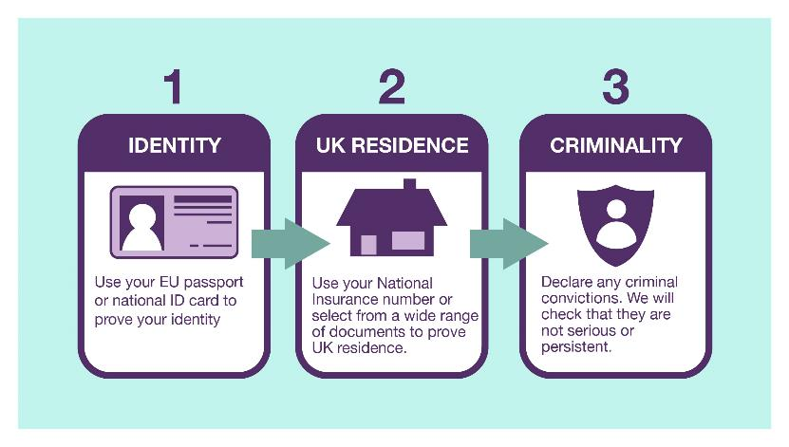
Notes:
As mentioned earlier, applicants will need to complete three key elements to make an application: confirm identity, prove residence and declare criminality.

Slide 16
Applying to the Settlement Scheme
Identity
There are three ways for applicants to verify their identity;
Using the ‘EU Exit ID Document Check app’: This option is currently available on android devices and iPhone 7 up and available to resident EU citizens (and their EU citizen family members) with a valid biometric passport, and to their non-EU citizen family members holding a valid biometric residence card, so that they can prove their identity remotely. There are also local hubs with android devices where applicants can go to have their identity checked remotely. (The closest one to Bradford is in Halifax; it might not be a free service)
Send an identity document in the post: This will allow caseworkers to check applicants identity as part of the application process.
Face to face: Applicants can have their identity verified face to face, in one of the passport offices across the UK. (it’s usually chargeable service)
You can apply to EU Settlement Scheme and complete the application on ANY device with an Internet Access.
Proving you identity and completing the application for Settled Status (Settled and Pre-settled – both called a Settled Status) is separate task.
On 21
Notes:
Policy:
EU citizens, and their family members, who have been resident in the UK for five years will be granted settled status – effectively, indefinite leave to remain; those with less than five years residence will be granted pre-settled status – leave to remain – until they have their five years and can then convert this to settled status.
As announced by the Prime Minister on 21 January 2019, there will be no cost to the EU Settlement Scheme and those who have paid during the testing phases, will be refunded.
Further lines in Additional Information notes.
In most cases, residency will be proved either through tax or benefits records from HMRC and DWP. We will not be looking at the amount of tax paid or benefit received, but we will use the information about the periods of payments as a proxy to determine residence.
Applicants can also provide documentation to support this such as council tax or utility bills. Any additional evidence required can be submitted digitally. We will have published a non-exhaustive list of the types of evidence which will be most helpful, but recognising the diverse circumstances of citizens, we are not being prescriptive about what documents might prove residence.
The rights of Irish citizens are protected after the UK leaves the EU. Irish citizens have long held a special status in the UK, as have British citizens in Ireland, and these rights are to be protected. They will not be required to apply to the Settlement Scheme to protect their status and rights.
However, any non-EU family members of Irish citizens will need to apply.

Slide 17
Applying to the Settlement Scheme
Criminality
The application form will ask if an applicant has any criminal convictions, both in the UK and overseas. Applicants will be checked against the UK’s crime databases.
If the applicant has any convictions including spent convictions it must be declared. Only Immigration Adviser LEVEL 2 and above can deal with the caseload. At the moment only CHAS @St Vincent and Garlington Advice Centre offers a free support on level 2 as those 2 organisations have been funded by BMDC and Home Office .
You can appoint your own private immigration adviser / solicitor but you would have to pay their standard fee
This is to determine an applicant is not a serious or persistent criminal, and that the applicant doesn’t pose a security threat. If an applicant has been convicted of a minor crime, they will still be eligible for either pre-settled status or settled status.
An applicant may still get pre-settled status or settled status even if they have other convictions. All of these applications will be assessed on a case-by-case basis.
If an applicant has been to prison, that time does not count as residence in the UK but they are still able to apply to the EU Settlement Scheme where they are released before the ‘specified date’.
Notes:
Policy:
EU citizens, and their family members, who have been resident in the UK for five years will be granted settled status – effectively, indefinite leave to remain; those with less than five years residence will be granted pre-settled status – leave to remain – until they have their five years and can then convert this to settled status.
As announced by the Prime Minister on 21 January 2019, there will be no cost to the EU Settlement Scheme and those who have paid during the testing phases, will be refunded.
Further lines in Additional Information notes.
In most cases, residency will be proved either through tax or benefits records from HMRC and DWP. We will not be looking at the amount of tax paid or benefit received, but we will use the information about the periods of payments as a proxy to determine residence.
Applicants can also provide documentation to support this such as council tax or utility bills. Any additional evidence required can be submitted digitally. We will have published a non-exhaustive list of the types of evidence which will be most helpful, but recognising the diverse circumstances of citizens, we are not being prescriptive about what documents might prove residence.
The rights of Irish citizens are protected after the UK leaves the EU. Irish citizens have long held a special status in the UK, as have British citizens in Ireland, and these rights are to be protected. They will not be required to apply to the Settlement Scheme to protect their status and rights.
However, any non-EU family members of Irish citizens will need to apply.

Slide 18
Applying to the Settlement Scheme
EU SETTLEMENT SCHEME – PROOF OF RESIDENCE
PART 3
EVIDENCE OF RESIDENCE
Notes:
Policy:
EU citizens, and their family members, who have been resident in the UK for five years will be granted settled status – effectively, indefinite leave to remain; those with less than five years residence will be granted pre-settled status – leave to remain – until they have their five years and can then convert this to settled status.
As announced by the Prime Minister on 21 January 2019, there will be no cost to the EU Settlement Scheme and those who have paid during the testing phases, will be refunded.
Further lines in Additional Information notes.
In most cases, residency will be proved either through tax or benefits records from HMRC and DWP. We will not be looking at the amount of tax paid or benefit received, but we will use the information about the periods of payments as a proxy to determine residence.
Applicants can also provide documentation to support this such as council tax or utility bills. Any additional evidence required can be submitted digitally. We will have published a non-exhaustive list of the types of evidence which will be most helpful, but recognising the diverse circumstances of citizens, we are not being prescriptive about what documents might prove residence.
The rights of Irish citizens are protected after the UK leaves the EU. Irish citizens have long held a special status in the UK, as have British citizens in Ireland, and these rights are to be protected. They will not be required to apply to the Settlement Scheme to protect their status and rights.
However, any non-EU family members of Irish citizens will need to apply.

Slide 19
Applying to the Settlement Scheme
EU SETTLEMENT SCHEME – PROOF OF RESIDENCE
Evidence that covers longer periods of time
Documents that cover a longer period of time between 2 dates include:
annual bank statement or account summary, showing at least 6 months of payments received or spending in the UK
employer letter confirming employment and evidence that the employer is genuine, for example, their Companies House Number
council tax bill
letter or certificate from your school, college, university or other accredited educational or training organisation showing the dates you enrolled, attended and completed your course
invoice for fees from your school, college, university or other accredited educational or training organisation and evidence of payment
document showing a UK address from a student finance body in England, Wales, Scotland or Northern Ireland or from the Student Loans Company
residential mortgage statement or rental agreement and evidence of payment
letter from a registered care home confirming your residence there
employer pension contributions
annual business account of a self-employed person
a P60 for a 12-month period – your P60 shows the tax you’ve paid on your salary in the tax year (6 April to 5 April). Home Office may ask you for additional evidence to confirm that you were resident here for at least 6 months of that period.
a P45 showing the length of your previous employment. You should get a P45 from your employer when you stop working for them.
Notes:
Policy:
EU citizens, and their family members, who have been resident in the UK for five years will be granted settled status – effectively, indefinite leave to remain; those with less than five years residence will be granted pre-settled status – leave to remain – until they have their five years and can then convert this to settled status.
As announced by the Prime Minister on 21 January 2019, there will be no cost to the EU Settlement Scheme and those who have paid during the testing phases, will be refunded.
Further lines in Additional Information notes.
In most cases, residency will be proved either through tax or benefits records from HMRC and DWP. We will not be looking at the amount of tax paid or benefit received, but we will use the information about the periods of payments as a proxy to determine residence.
Applicants can also provide documentation to support this such as council tax or utility bills. Any additional evidence required can be submitted digitally. We will have published a non-exhaustive list of the types of evidence which will be most helpful, but recognising the diverse circumstances of citizens, we are not being prescriptive about what documents might prove residence.
The rights of Irish citizens are protected after the UK leaves the EU. Irish citizens have long held a special status in the UK, as have British citizens in Ireland, and these rights are to be protected. They will not be required to apply to the Settlement Scheme to protect their status and rights.
However, any non-EU family members of Irish citizens will need to apply.

Slide 20
Applying to the Settlement Scheme
EU SETTLEMENT SCHEME – PROOF OF RESIDENCE
Evidence that covers shorter periods of time
These documents count as evidence for 1 month if they have a single date on. They can be used to cover a longer period of time if they have a start and end date covering longer than a month.
bank statement showing payments received or spending in the UK
payslip for a UK-based job
water, gas or electricity bill showing a UK address
landline or mobile telephone, TV or internet bill showing a UK address
domestic bill, such as for home repairs, vet’s services or insurance, and evidence of payment
card or letter from your GP, hospital or other healthcare professional confirming appointments you have made or attended
letter from a government department, public service or charity that show you dealt with them on a particular date or for a particular period (for example Job Centre Plus or Citizens Advice)
passport stamp confirming entry at the UK border
used travel ticket confirming you entered the UK from another country
invoice for work you have done in the UK and evidence of payment
Notes:
Policy:
EU citizens, and their family members, who have been resident in the UK for five years will be granted settled status – effectively, indefinite leave to remain; those with less than five years residence will be granted pre-settled status – leave to remain – until they have their five years and can then convert this to settled status.
As announced by the Prime Minister on 21 January 2019, there will be no cost to the EU Settlement Scheme and those who have paid during the testing phases, will be refunded.
Further lines in Additional Information notes.
In most cases, residency will be proved either through tax or benefits records from HMRC and DWP. We will not be looking at the amount of tax paid or benefit received, but we will use the information about the periods of payments as a proxy to determine residence.
Applicants can also provide documentation to support this such as council tax or utility bills. Any additional evidence required can be submitted digitally. We will have published a non-exhaustive list of the types of evidence which will be most helpful, but recognising the diverse circumstances of citizens, we are not being prescriptive about what documents might prove residence.
The rights of Irish citizens are protected after the UK leaves the EU. Irish citizens have long held a special status in the UK, as have British citizens in Ireland, and these rights are to be protected. They will not be required to apply to the Settlement Scheme to protect their status and rights.
However, any non-EU family members of Irish citizens will need to apply.

Slide 21
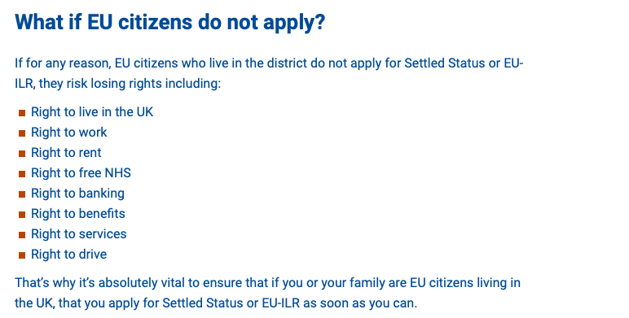
Applying to the Settlement Scheme
IF YOU DON’T APPLY YOU MAY LOSE RIGHTS…
Notes:
Policy:
EU citizens, and their family members, who have been resident in the UK for five years will be granted settled status – effectively, indefinite leave to remain; those with less than five years residence will be granted pre-settled status – leave to remain – until they have their five years and can then convert this to settled status.
As announced by the Prime Minister on 21 January 2019, there will be no cost to the EU Settlement Scheme and those who have paid during the testing phases, will be refunded.
Further lines in Additional Information notes.
In most cases, residency will be proved either through tax or benefits records from HMRC and DWP. We will not be looking at the amount of tax paid or benefit received, but we will use the information about the periods of payments as a proxy to determine residence.
Applicants can also provide documentation to support this such as council tax or utility bills. Any additional evidence required can be submitted digitally. We will have published a non-exhaustive list of the types of evidence which will be most helpful, but recognising the diverse circumstances of citizens, we are not being prescriptive about what documents might prove residence.
The rights of Irish citizens are protected after the UK leaves the EU. Irish citizens have long held a special status in the UK, as have British citizens in Ireland, and these rights are to be protected. They will not be required to apply to the Settlement Scheme to protect their status and rights.
However, any non-EU family members of Irish citizens will need to apply.

Slide 22
Online status checking – employers, landlords, third parties
During the Implementation Period, EU citizens will continue to be able to use their passports or ID cards to evidence their rights and entitlements. These online services provide them with an alternative way to demonstrate this
The Home Office is developing a range of online services, enabling migrants to access their immigration status, and prove their entitlement to a range of public and private services – such as work, rental accommodation, healthcare and benefits
An online Right to Work service – enabling holders of Biometric Residence Permits (BRP) and Biometric Residence Cards (BRC) to check their own right to work status and share this securely with employers went live in April 2018.
An online status service has been developed for those granted status under the EU Settlement Scheme – ‘view and prove your rights in the UK’. You can share you status with your employer (you would need work email address to do so). Employer then will be given the code via work email. Employer must download your proof of a status and keep it within your files.
This service will be further developed as the scheme launches, enabling users to share their rights with other service providers, such as landlords, and will continue to iterate and improve these services based on user feedback
Notes:
The Home Office has worked on a range of digital services, which will allow applicants to check their status and prove their entitlement to a range of public and private services.
The digital ‘Right to Work’ (RTW) service is one of these, which has been live since Spring 2018.
The system that EU citizens use to demonstrate settled status will be like this system.

Slide 23
Useful links
EU Settlement Scheme: www.gov.uk/eusettledstatus
Organisation providing free support around EUSS in Bradford District commissioned by Bradford Metropolitan District Council https://www.bradford.gov.uk/your-community/brexit-and-the-settlement-scheme/access-support/
Bradford Metropolitan District Council Information https://www.bradford.gov.uk/your-council/about-bradford-council/brexit-what-you-need-to-know/
Bradford Metropolitan District Council Information EU Settlement Scheme https://www.bradford.gov.uk/your-community/brexit-and-the-settlement-scheme/what-is-brexit/
Bradford Metropolitan District Council Information EU Settlement Scheme https://www.bradford.gov.uk/your-community/brexit-and-the-settlement-scheme/what-are-settled-status-or-pre-settled-status/
ID document scanner locations: www.gov.uk/government/publications/eu-settlement-scheme-id-document-scanner-locations
Applying for Settled and Pre – Settled Status https://www.gov.uk/settled-status-eu-citizens-families/applying-for-settled-status
Assisted Digital Service: www.gov.uk/government/publications/eu-settlement-scheme-assisted-digital-service
Citizens’ Rights in a no deal: www.gov.uk/government/publications/policy-paper-on-citizens-rights-in-the-event-of-a-no-deal-Brexit
Evidence of Residence if the system hasn’t found you https://www.gov.uk/guidance/eu-settlement-scheme-evidence-of-uk-residence
Visiting Europe after BREXIT https://www.gov.uk/visit-europe-brexit
Driving in Europe After BREXIT https://www.gov.uk/guidance/driving-in-the-eu-after-brexit-international-driving-permits
Pet Travel after BREXIT https://www.gov.uk/guidance/pet-travel-to-europe-after-brexit
Foreign Travel Advice https://www.gov.uk/foreign-travel-advice
Sign up for EUSS updates: https://gov.smartwebportal.co.uk/homeoffice/public/webform.asp?id=67&id2=627DF7

