Slide 1
Pulmonary circulation

Slide 2
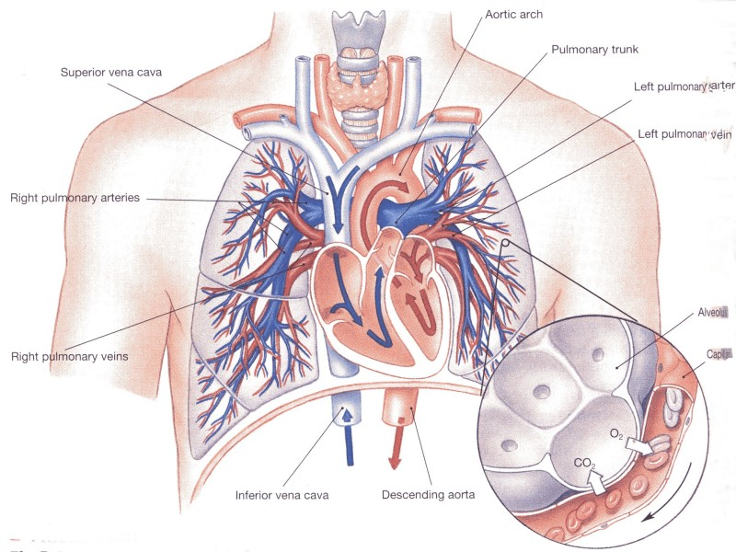
Anatomy of pulmonary circulation
Pulmonary vessels
Low-pressure, high-flow
Thin, distensible – high compliance
PA: venous, deoxygenated blood!
Function: gas exchange
Bronchial vessels
High-pressure, low-flow
Systemic circulation, 1-2% of CO
Function: nutritive!
Lymphatic vessels
Begin in connective tissue surrounding terminal bronchioles
Function: prevention of lung edema, removing particles

Slide 3
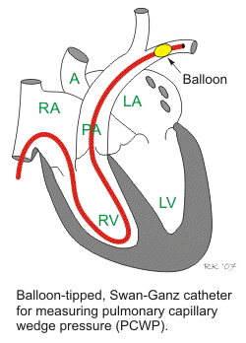
Pressures in the pulmonary system
Right ventricle:
P_{s}: 25 mm
P_{d}: 0 mmHg
Pulmonary artery:
P_{s}: 25 mmHg
P_{d}: 8 mmHg
P_{mean}: 15 mmHg
Left atrium:
1-5 mmHg ( 2 mmHg)
pulmonary wedge pressure

Slide 4
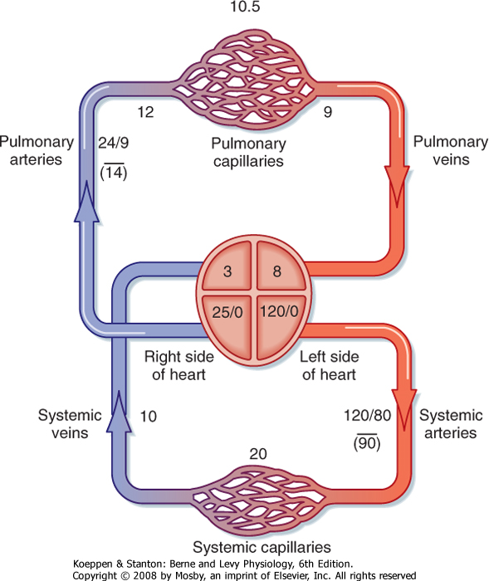
Overview of pressures
Large compliance
Low resistance
The same CO (flow) as in systemic circulation with substantially lower pressures!

Slide 5
Blood volume of the lungs
Normally ~ 450 ml.
Increase in alveolar pressure can decrease volume.
Influence cardiac pathology on blood volume:
Failure of left ventricle
Mitral stenosis
Mitral regurgitation

Slide 6
Distribution of blood flow trough the lungs
Influenced by gravity:
Hydrostatic pressure
30 cm lung height
Lung apex: 15 mmHg less pressure than heart level
Lung base: 8 mmHg greater pressure than heart level

Slide 7
Zones 1, 2 and 3 of pulmonary blood flow
Zone 1:
P_{A}>P_{s}>P_{d}
does not exist in healthy lungs.
Zone 2:
P_{s}>P_{A}>P_{d}
Top of the lungs
Zone 3:
P_{s}>P_{d}>P_{A}
From 10 cm above heart to bottom
In exercise, whole lungs are Zone 3.

Slide 8
Influence of cardiac output on pulmonary artery pressure
Increase in CO, small increase in pressure
Due to:
Capillary recruitment
Distension of already open vessels
Protection from pulmonary edema

Slide 9
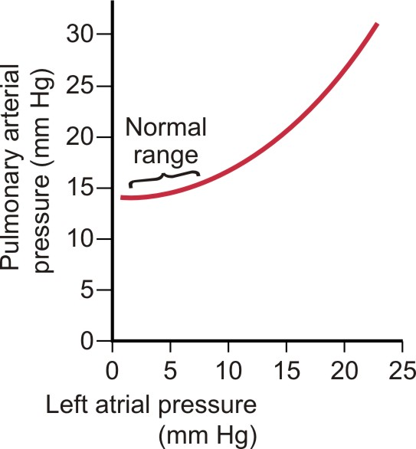
Influence of pressure in LA on pulmonary artery pressure
Small increases in LA pressure – almost no effect.
When P_{LA}>8 mmHg – increase in pulmonary arterial pressure
P_{LA}>30 mmHg – pulmonary edema

Slide 10
Regulation of resistance in pulmonary circulation
Resistance in pulmonary circulation is ~10x lower than sistemic.
Under regulation of:
Passive mechanisms
Capillary recruitment
previously closed vessels
Pulmonary capillaries make up 40 % of PVR
Passive distension
Previously open vessels
Active mechanisms
Hypoxia induces vasoconstriction!

Slide 11
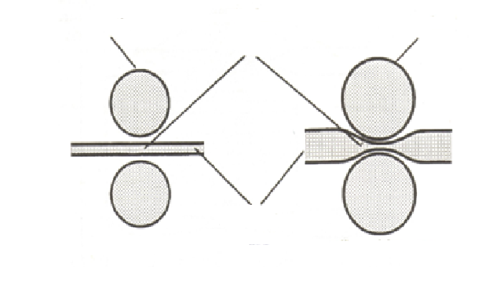
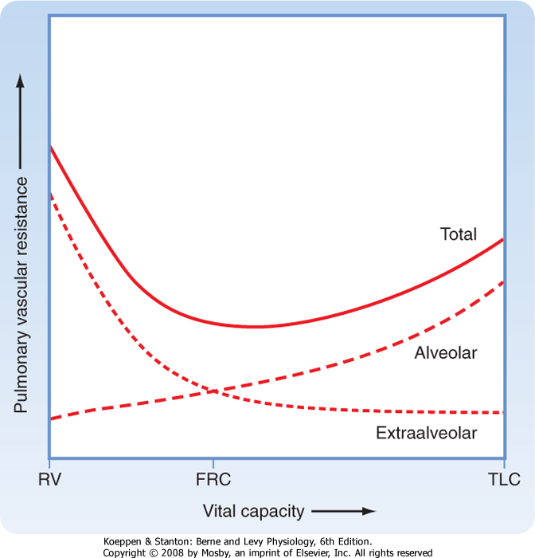
Influence of lung volume on PVR
alveola
intra-alveolar
vessels
alveola
Intra- alveolar vessels
capillaries
Influenced by alveolar pressure
greater lung volume and PA – greater resistance
Extra-alveolar vessels
Influenced by pleural pressure and elastic recoil
Greater lung volume – lower resistance
extra-alveolar
vessels
Small lung volume
Large lung volume

Slide 12
Pulmonary exchange of fluid
Prevention from pulmonary edema:
Low capillary pressure!
Negative interstitial hydrostatic pressure
due to lymphatics
High colloid osmotic interstitial pressure

Slide 13
Pulmonary edema
Causes:
Left-sided heart failure or mitral disease
Damage to pulmonary capillary barrier
Infection, toxins

Slide 14
Fluid in pleural cavity
Transudate of interstitial fluid.
Forms a liquid film in potential space of pleural cavity.
Pleural effusion
Blockage of lymphatic drainage
Cardiac failure
Great reduction in plasma colloid-osmotic pressure
infection

