Slide 1
International Recruitment Programme Overview of IR in NHS/Agenda on IR CNMA-UK
Wendy Olayiwola. BEM, FRSA, RM,RN
National Maternity Lead for Equality
CNO CMiDO BME co-chair/Midwifery Lead
Professional Midwifery Advocate
Chief Midwifery office NHS England and NHS Improvement

Slide 2
Global Context
Nurses are a critical part of healthcare and make up the largest section of the health profession.
World Health Statistics Report, there are approximately 29 million nurses and midwives globally
Nurses comprise half the global health workforce.
Nine million shortage estimated in 2014 is predicted to decrease by two million by 2030
Worldwide - shortage of nurses. An increase in the migration of nurses from their home countries to recipient countries is having a global effect on the healthcare system.
Global phenomenon stems from historical, economical, social, and political factors.
Migration has a significant impact on both the individual and national level
Notes:
Nurses are a critical part of healthcare and make up the largest section of the health profession. According to the World Health Statistics Report, there are approximately 29 million nurses and midwives globally
Nurses comprise half the global health workforce. A nine million shortage estimated in 2014 is predicted to decrease by two million by 2030 but disproportionality effect regions such as Africa.
A worldwide shortage of nurses has been acknowledged by the multidisciplinary Global Advisory Group of the World Health Organization. The shortage is caused by an increased demand for nurses, while fewer people are choosing nursing as a profession and the current nurses worldwide are aging.

Slide 3
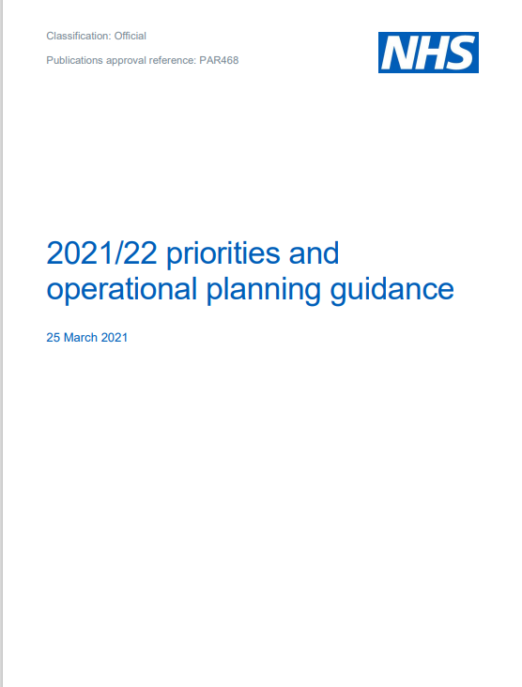
Introduction
Hx 1948
The NHS has always benefited from overseas recruitment and from nurses coming from other countries to live and work in England.
Notes:
Recruitment from outside of the UK continues to feature as an important part of the workforce supply strategy of NHS organisations, in line with the NHS People Plan. The NHS Long Term Plan set out the ambitions for the NHS over the next 10 years, identifying ethical international recruitment as a workforce priority.

Slide 4
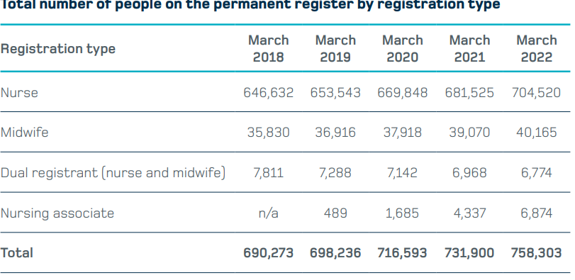
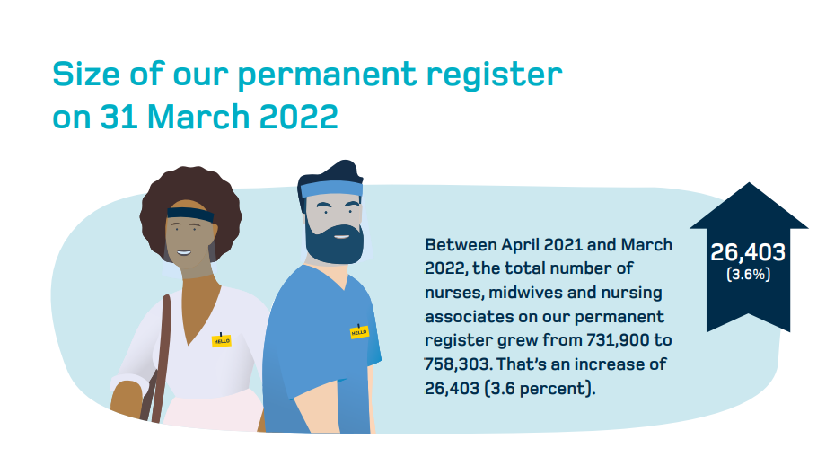
NMC data 2022
More than 758,000 nursing and midwifery professionals on the NMC register

Slide 5
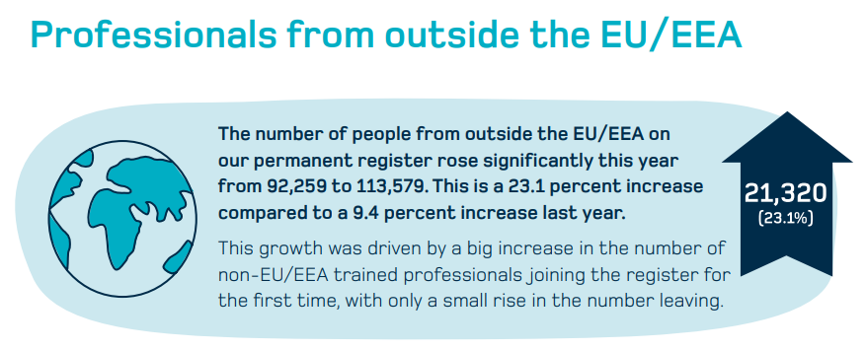
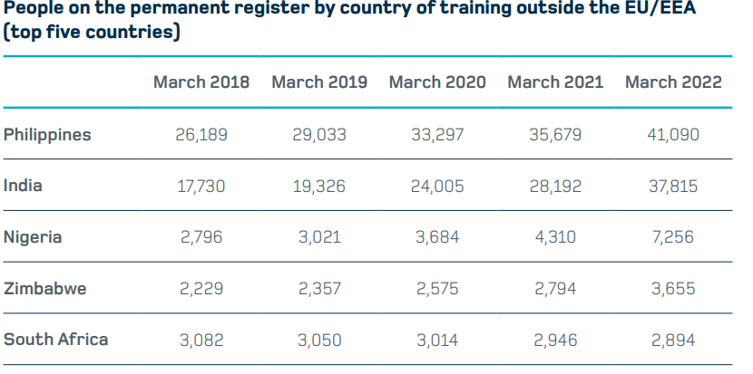
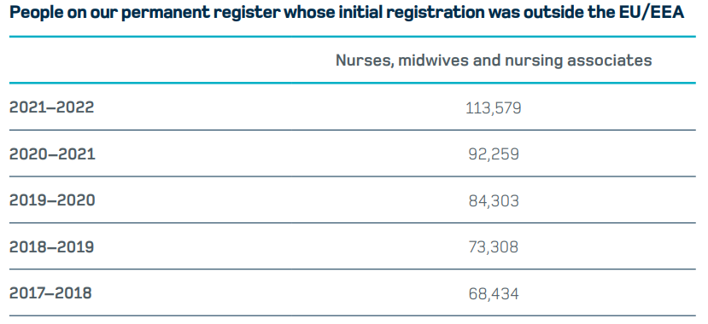
NMC data 2/2

Slide 6
Diaspora BAME Professional Association

Slide 7
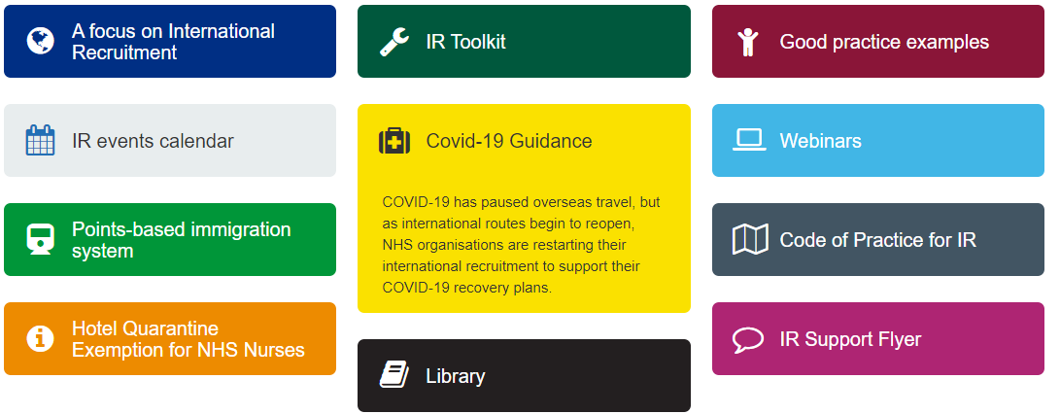
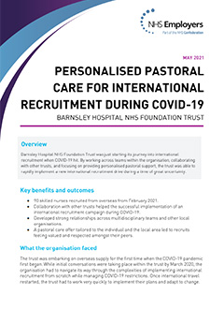
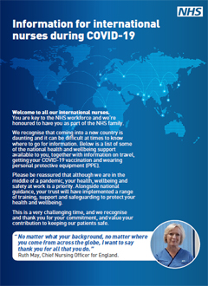
NHSE Offer to International Nurses
NHSEI and DHSC is committed to ensuring our nurses are supported and given the highest level of pastoral care, educational support and development opportunities possible. NHSEI have developed a wide range of workstreams and connections to promote this:
Developing our ethnic minority leaders:
NHSEI have worked with the Florence Nightingale Foundation (FNF) to deliver the FNF Ethnic Minority Groups NHS COVID-19 leadership programme to develop and sustain ethnic minority nursing leaders through the pandemic and beyond. The programme has sustained (and continues to sustain) leaders through these adverse times. In this publication and accompanying animations, some of these exceptional leaders share their experiences.
Support to International Nursing Association Diaspora Groups (INAD)
International Nursing Associations work to advance the pastoral and professional support, and health and wellbeing of international nurses in the NHS.
The IR programme has supported these organisations to enhance their offer to international nurses and their reach and enables a better understanding of the needs of international nurses and supports communities to be heard.
NHSEI partnered with Florence Nightingale Foundation to provide small grants (from £5,000 up to £12,000 per association) to international nursing associations.
NHSEI also provided 15 grants (ranging from £2,500 up to £5,000) to INADs to increase support to international nurses and midwives in response to the Omicron COVID-19 threat.
Pastoral Care Quality Award Scheme
The Scheme has been developed through engagement with key stakeholders including IR Leads, Clinical Educators and Pastoral Care Leads.
It provides criteria for assessment of minimum standards in pastoral care together with examples of evidence options.
IR Online Community
Universal offer to all NHS Trusts
Masterclasses on international recruitment to ensure best practice is widely adopted and encourage collaboration
An online community to encourage collaboration between Trusts and idea sharing
A plethora of resources to support those delivering international recruitment, including pastoral care checklist, organisational readiness assessment
Funding to develop NHSE/I Regional IR Resource.
Driving sustainable and ethical increases in their local regions to meet the regional IR aim (once agreed);
Identify trusts in need of further support;
Facilitate collaborative recruitment models with support from the Nursing Directorate Workforce Team;
Identifying and escalating local issues with NMC/Home Office pipelines.
IR Resources Available

Slide 8
Offer to International Nurses continued
IR Nurse Accelerated Development Transformation Fund
To be launched in 22/23 Q1, aims to support trusts to develop innovation and transformation projects that recognise prior experience, provide ethical opportunities to direct recruit to Band 6+ roles from in-country, and to accelerate the development of IR nurse talent in order to prepare for Band 6+ role opportunities.
This will support the WRES (Workforce Race Equality Standard) standards around improving career progression for ethnic minority staff in the NHS.
Cultural Readiness and Transition Workstream
To be launched in 22/23 Q1, aims to produce recommendations and guidance that will support organisations and staff receiving IENs to welcome, induct and support.
Enhanced support to regional accommodation
£100k has been awarded in early 2022 to each NHSEI IR regional team to support trusts to meet their IR targets, increase the amount accommodation for nurses and share recommendations for potential short/medium/long term accommodation solutions regionally and nationally. The funding also supports an improved international nurse experience and the retention of the international nurse within the workforce.
Shared Decision Making Council (SDMC)
NHSEI hosts a monthly Shared Decision-Making Council ensuring the IR Programme is designed to best support the sector in recruiting and retaining overseas nursing staff. The SDMC involves international nurses and international recruitment leads in trusts providing advice on planned overseas recruiting interventions and suggesting new and innovative approaches to ensure sustainability and it is done in a fair ethical manner.
English Language Support to international nurses working as health care support workers
NHSEI and HEE have identified international nurses currently working in the NHS as healthcare support workers as they did not have the English Language levels required
Supporting 2,045 individuals through English language training, a total of 870 have since taken an English Language exam, of which 350 have now successfully passed.
NHSEI, DHSC and HEE are continuing to explore further ways to support overseas registered nurses currently working in the NHS with English language training.

Slide 9
Pastoral Care Quality Award Scheme: Background and Purpose
Background
Based on feedback from internationally educated nurses and midwives (IENMs) and trust IR leads, we know the standard of pastoral care varies across the NHS.
Until now, there has been no definitive set of standards in place for trusts to follow and to protect the welfare of IENMs on arrival to the UK.
Following feedback from the IR Leads Survey, the IR Nurse Experience Survey, masterclasses, engagement events, and feedback gained from calls with trusts in our Direct Support Programme, this award scheme has been developed to support trusts to achieve a best practice set of standards in pastoral care.
Aim
This is a voluntary scheme, and all NHS trusts in England are invited to apply for the NHS Pastoral Care Quality Award.
This award scheme aims to encourage and support organisations to develop a high-quality pastoral care programme for internationally educated nurses and midwives.
Benefits
A mechanism to reflect upon and evaluate the level of pastoral care provided and its impact on retention
Use of a graphic device to demonstrate achievement of the award waving to internationally educated nurses and midwives the level of pastoral care they will receive at the organisation. This graphic device can be used on thier website and trust recruitment materials.
The opportunity for trusts to submit examples from their Pastoral Care Scheme best practice to the NHSEI IR improvement hub so successful initiatives can be shared across providers.

Slide 10
Pastoral Care Quality Award Scheme
The Pastoral Care Quality Award Scheme aims to encourage organisations to develop a pastoral care programme which benchmarks, enhances and standardises the quality and delivery of pastoral care to internationally educated nurses and midwives (IENMs).
The Scheme has been developed through engagement with key stakeholders including IR Leads, Clinical Educators and Pastoral Care Leads. 45+ stakeholders participated in an initial roundtable and subsequent Task and Finish Group meetings.
A pilot has been conducted and completed in December 2021.
All NHS trusts will be invited to participate in the Pastoral Care Quality Award Scheme.
The scheme is voluntary.
Successful applications of the Pastoral Care Quality Award will recieve a certificate and graphic logo for the Trusts to display. The award will be reviewed every 2 years to provide assurance that the pastoral support is maintained.
The Scheme provides criteria for assessment of minimum standards in pastoral care with examples of evidence options. The judging process includes a representation from both regional and national NHSEI teams and a Diaspora reprsentative
The award is being launched on the 1st March 2022, followed by a spotlight information event on the 16th March 2022

Slide 11
Pastoral Care Quality Award Scheme Criteria
Pre-joining webinar or pack provided to all IENMs in their home country before arrival - to include; information about the cost of living; take home salary; reasonable adjustments (if applicable); pension; local community information; maternity benefits; employment contract.
IR pastoral buddy support scheme in place on arrival and in place for six to eight weeks or until the new recruit has passed OSCE
Contact details provided to IR nurses and midwives of relevant International Nursing Association Diaspora groups on arrival for ongoing support
OSCE annual overall pass rate 100% (to exclude attrition rates)
Attendance by a IR lead or IR team member at a minimum of one IR Programme masterclass/spotlight session (may be recorded version)
On the NHS Staff Survey results (for nurses and midwives) for the question “Would you recommend this trust as a place to work?” achievement of above 50% for yes
Participates in the IENM Experience Survey. If actions were deemed to be required by the trusts, what action has been taken as a result of the survey?
Completion of the Pastoral Care Self-assessment available within the NHS Employers IR Toolkit, with clear actions where improvements are required
IR nurses and midwives provided with information on professional development and leadership opportunities available after completing their OSCE and obtaining their Pin number (not including preceptorship programmes)
Evidence of regular internal evaluation of the trust’s pastoral care processes. For example internal trust survey or focus group outputs.
Completion of the IR Pastoral Care Quality Charter signed by the Trust Board member and/or DON
Completion of the IR Organisational Cultural Readiness Self-Assessment Tool (provided with the application pack) together with clear actions where improvements are required by a nominated person (e.g. IR Lead/Professional Development Lead/HR)
Organisation has signed up to provide a minimum of one-month funded accommodation and provides support for IR nurses and midwives to find accommodation after this time
A minimum of 10% of IR nurses and midwives are given the opportunity to undertake professional development that will enhance their career progression within 12-18 months of obtaining their pin number. For example internal/external professional development (including but not limited to the Professional Nurse Advocate Course/Professional Midwifery Advocate Course, leadership or specialism programmes)

Slide 12
Accelerated Development Transformation Fund
This fund aims to support trusts to scope and develop innovation and transformation projects that focus on ways to identify talent and accelerate progression, provide ethical opportunities to direct recruit to Band 6+ roles from in-country, and to accelerate the development of IR nurse talent identified in the pipeline in order to prepare for Band 6+ role opportunities.
This work also aims to support the findings of the latest WRES Report outlining the continued lack of career progression for ethnic minority staff in the NHS. This Fund is available to all non-MH trusts. Funding to trusts of £1.05m (c.£150k per trust)
Funding is designed to support:
Identifying the opportunities and skills bridging gap to directly recruit to Band 6+ roles
Developing a framework for identifying talent in the pipeline and providing accelerated development to meet the needs of the service.
Developing programme for IENs who have prior leadership and management experience in their previous roles, but need a solution to bridge the knowledge gap and prepare to lead
All projects need clinical support and accountability together with board level approval at trust level
Timeline:
Expression of Interest promoted to Regional Leads w/c 29th February 2022
Roundtable on Direct Band 6 IR challenges and opportunities to be held Monday 7th March 2022
EOIs returned 25th March 2022
EOIs evaluated w/c 28th March 2022
Outcome of EOI and funding confirmed to trusts and regions w/c 11th April 2022
NHSEI Support Offer
Support from National IR Advisor
Bi-monthly knowledge sharing meeting with all regional projects represented
Sharing best practice via IR case study development and Spotlight webinars
An online community for IR Leads to allow easier sharing of ideas and discussion.
Bi-monthly reporting of progress via short online report
Evaluation of outputs and impact of the funding programme

Slide 13
Emergency Omicron funding for International Nursing and Midwifery Associations (INMA)
Grants ranged from £2,500 up to £5,000, the total amount distributed was £70,000
Grants aimed to increase support to international nurses and midwives in response to the Omicron COVID-19 threat.
Examples of project initiatives:
Deliver sessions to address vaccine hesitancy and myth-busting from a cultural and religious perspective
“You are not alone” wellbeing webinar
Purchase of groceries for nurses who tested positive in isolation
Befriending scheme
Virtual meditation classes
Virtual multi-faith groups
Procure IT equipment and upgrade online content
The Project Initiatives were shared with INMA peers on the January INMA network meeting
15 INMAs grants in December 2021
BINA (British Indian Nurses Association)
GHM UK (Gambia Healthcare Matters UK)
UNMA-UK (Uganda Nurses Midwives Association)
British Sikh Nurses
PNAUK (Philippine Nurses Association of United Kingdom)
FNA (Filipino Nurses Association United Kingdom)
MUNAA (Malawian-UK Nurses Association for Advancement)
Association Isabel Zendal: Association of Spanish Nurses and Health Workers
HKNA UK (Hong Kong Nursing Association UK
ZINMA UK (Zimbabwean Midwives And Nurses Association)
NNCAUK (Nigerian Nurses Charitable Association UK)
CNMA UK ( Caribbean Nurses& Midwives Association UK)
NNAUK (Nepalese Nursing Association UK)
UUKMA (Union of UK Malayalee Associations)
KENMA-UK (Kenyan Nurses And Midwives Association UK)

Slide 14
Supporting INMAs 2022-2023
INMA Representatives working on ALL IR workstreams
Members of INADs are now embedded in each of our IR workstreams, with representatives involved in design, development and implementation
Business start-up advice, comms and social media training
Procurement of objective, expert advice for INMAs regarding setting up an association, membership models and support to improve reach and improve communications
Coaching for INMA Leaders
The Florence Nightingale Foundation was commissioned to provide support and to promote a culture of psychological safety to enable INMA members to exert their influence and find their voice. The programme runs from 2021-2024
INMA Fellowship
Programme 2022-2023
The INMA Fellowship aims to provide protected time and an opportunity for up to 15 active INAD officers to focus on developing their organisation’s marketing and business development and to support their association’s sustainability.
Fellows will have 15 hours or 2 days/month to work on their association
Backfill pay (Band 5-6) will be awarded to trusts who consent to their INMA staff member to participate

