Slide 1
Welcome in the Name of
The Triune God
January 1, 2023
Prelude by Roxanne Groff
Office of the Acolyte
Ringing of the Bell
Scripture Focus: Matthew 1:1-17
Notes:
Image: Preparing yeast dough. Copyright © tomasworks/iStock/Thinkstock. Used by permission.

Slide 2
CONFESSION AND FORGIVENESS
All may make the sign of the cross, the sign marked at baptism…
P: We confess our sins before God and one another.
Pause for silence and reflection.
P: Radiant God,
Notes:
Image: Five Loaves by Caroline Coolidge Brown. Copyright © Caroline Coolidge Brown. All rights reserved. Used by permission of the artist.

Slide 3
CONFESSION AND FORGIVENESS
C: You have come to live among us, yet we fail time and again to see you in the faces of our neighbors. We look to ourselves instead of those in need. We seek the shallow comforts of things we can buy instead of the deep and lasting comfort of your presence.
Notes:
Image: Five Loaves by Caroline Coolidge Brown. Copyright © Caroline Coolidge Brown. All rights reserved. Used by permission of the artist.

Slide 4
CONFESSION AND FORGIVENESS
C: Forgive our stubborn refusal to see, and open our eyes to the joy and wonder of your incarnation.
Notes:
Image: Five Loaves by Caroline Coolidge Brown. Copyright © Caroline Coolidge Brown. All rights reserved. Used by permission of the artist.

Slide 5
CONFESSION AND FORGIVENESS
P: Do not be afraid, for I bring you good news of great joy. The God of boundless grace forgives you all your sins, renewing your spirit for the sake of Immanuel, God with us.
C: Amen.
Notes:
Image: Five Loaves by Caroline Coolidge Brown. Copyright © Caroline Coolidge Brown. All rights reserved. Used by permission of the artist.

Slide 6
Baptismal Hymn
“Borning Cry” - ELW 732
(Verses 1 & 2)
Baptismal party gathers at the font.
This Photo by Unknown Author is licensed under CC BY-SA
Notes:
Image: Five Loaves by Caroline Coolidge Brown. Copyright © Caroline Coolidge Brown. All rights reserved. Used by permission of the artist.

Slide 7
Borning Cry
1 "I was there to hear your borning cry,
I'll be there when you are old.
I rejoiced the day you were baptized
to see your life unfold.
I was there when
you were but a child,
with a faith to suit you well;
in a blaze of light you wandered off
to find where demons dwell."
Notes:
Image: Five Loaves by Caroline Coolidge Brown. Copyright © Caroline Coolidge Brown. All rights reserved. Used by permission of the artist.

Slide 8
Borning Cry
"When you heard
the wonder of the Word
I was there to cheer you on;
you were raised to praise
the living Lord,
to whom you now belong.
If you find someone to share your time
and you join your hearts as one,
I'll be there to make your verses rhyme
from dusk till rising sun."
Notes:
Image: Five Loaves by Caroline Coolidge Brown. Copyright © Caroline Coolidge Brown. All rights reserved. Used by permission of the artist.

Slide 9
HOLY BAPTISM
P: In Holy Baptism our gracious heavenly Father liberates us from sin and death by joining us to the death and resurrection of our Lord Jesus Christ. We are born children of a fallen humanity; in the waters of Baptism we are reborn children of God and inheritors of eternal life. By water and the Holy Spirit, we are made members of the Church which is the body of Christ.

Slide 10
HOLY BAPTISM
PE: As we live with him and with his people, we grow in faith, love, and obedience to the will of God. Who presents this child for Holy Baptism?
Sponsors and Parents present Emerson for Baptism
Sponsors and Parents:
We present Eleanor Louise Kemper to receive the Sacrament of Holy Baptism.

Slide 11
HOLY BAPTISM
The minister addresses the sponsors and guardians.
P: In Christian love you have presented Eleanor for Holy Baptism. You should, therefore, faithfully bring her to the services of God’s house, and teach her the Lord’s Prayer, the Creed, and the Ten Commandments.

Slide 12
HOLY BAPTISM
P: As she grows in years, you should place in her hands the Holy Scriptures and provide for her instruction in the Christian faith, that, living in the covenant of her Baptism and in communion with the Church, she may lead a godly life until the day of Jesus Christ.

Slide 13
HOLY BAPTISM
P: Do you promise to fulfill these obligations?
Sponsors and Parents: We do.
P: Congregation of Trinity Lutheran Church, do you promise to assist these sponsors and parents to fulfill these obligations?
C: We do and we ask God to help and guide us.

Slide 14
HOLY BAPTISM - THANKSGIVING
P: The Lord be with you.
C: And also with you.
P: Let us give thanks to the Lord our God.
C: It is right to give him thanks and praise.
Water is poured into the Baptismal Font as the prayer is said.
P: Holy God, mighty Lord, gracious Father: We give you thanks, for in the beginning your Spirit moved over the waters and you created heaven and earth.

Slide 15
HOLY BAPTISM
P: By the gift of water, you nourish and sustain us and all living things.
By the waters of the flood you condemned the wicked and saved those whom you had chosen, Noah and his family. You led Israel by the pillar of cloud and fire through the sea, out of slavery into the freedom of the promised land.

Slide 16
HOLY BAPTISM
P: In the waters of the Jordan your Son was baptized by John and anointed with the Spirit. By the baptism of his own death and resurrection your beloved Son has set us free from the bondage to sin and death, and has opened the way to the joy and freedom of everlasting life. He made water a sign of the kingdom and of cleansing and rebirth.

Slide 17
HOLY BAPTISM
P: In obedience to his command, we make disciples of all nations, baptizing them in the name of the Father, and of the Son, and of the Holy Spirit.
Pour out your Holy Spirit, so that Eleanor Louise Kemper who is about to be here baptized may be given new life.

Slide 18
HOLY BAPTISM
P: Wash away her sins, cleans her by this water, and bring her forth as an heir of your glorious kingdom.
To you be given praise and honor and worship through your Son, Jesus Christ our Lord, in the unity of the Holy Spirit, now and forever.
C: Amen

Slide 19
Profession of Faith
The minister addresses the baptismal group and the congregation.
P: I ask you to profess your faith in Christ Jesus, reject sin, and confess the faith of the church, the faith in which we baptize. Do you renounce all the forces of evil, the devil, and all his empty promises?
C: I do.

Slide 20
Profession of Faith
P: Do you believe in God the Father?
C: I believe in God, the Father almighty, creator of heaven and earth.

Slide 21
Profession of Faith
P: Do you believe in Jesus Christ, the Son of God?
C: I believe in Jesus Christ, his only Son, our Lord. He was conceived by the power of the Holy Spirit and born of the virgin Mary. He suffered under Pontius Pilate, was crucified, died, and was buried. He descended into hell.*
*Or, He descended to the dead.

Slide 22
Profession of Faith
C: On the third day he rose again. He ascended into heaven, and is seated at the right hand of the Father. He will come again to judge the living and the dead.

Slide 23
Profession of Faith
P: Do you believe in God the Holy Spirit?
C: I believe in the Holy Spirit, the holy catholic church, the communion of saints, the forgiveness of sins, the resurrection of the body, and the life everlasting. Amen

Slide 24
THE BAPTISM
The minister baptizes each child.
P: Eleanor Louise Kemper, I baptize you in the name of the Father, and of the Son, and of the Holy Spirit. Amen.

Slide 25
THE BLESSING (Please be seated)
P: The Lord be with you.
C: And also with you.
The minister lays both hands on the head of each of the baptized and prays for the Holy Spirit:
P: God, the Father of our Lord Jesus Christ, we give you thanks for freeing your sons and daughters from the power of sin and for raising them up to a new life through this holy sacrament.

Slide 26
THE BLESSING
P: Pour your Holy Spirit upon Eleanor Louise Kemper: the spirit of wisdom and understanding, the spirit of counsel and might, the spirit of knowledge and the fear of the Lord, the spirit of joy in your presence.
C: Amen

Slide 27
THE ANNOINTING
P: Eleanor Louise Kemper, child of God, you have been sealed by the Holy Spirit and marked with the cross of Christ forever.
C: Amen

Slide 28
THE COMMISIONING
A lighted candle is given to the baptized (to the sponsor of a young child) by a representative of the congregation who says:
R: Eleanor, let your light so shine before others that they may see your good works and glorify your Father in heaven.

Slide 29
THE COMMISIONING
PE: Let us pray… O God, the giver of all life, look with kindness upon Nicholas and Rebecca. Let them ever rejoice in the gift you have given them. Make them teachers and examples of righteousness for these children you have given to them.

Slide 30
THE COMMISIONING
PE: Strengthen them in their own Baptism so they may share eternally with Marie and Russell, the salvation you have given them, through Jesus Christ our Lord.
C: Amen.

Slide 31
Welcome
The ministers and the baptismal group turn toward the congregation; a representative of the congregation says:
P: Through Baptism God has made Elena and Ian our new siblings in Christ and fellow members of the priesthood we all share in Christ Jesus, that together we may proclaim the praise of God and bear his creative and redeeming Word to all the world.

Slide 32
Welcome
C: We welcome you into the Lord’s family. We receive you as fellow members of the body of Christ, children of the same heavenly Father, and workers with us in the kingdom of God.
Applause is appropriate as the pastor presents the newly Baptized to the congregation. All return to their places.

Slide 33
Borning Cry
3 "In the middle ages of your life,
not too old, no longer young,
I'll be there to guide you
through the night,
complete what I've begun.
When the evening gently closes in
and you shut your weary eyes,
I'll be there as I have always been,
with just one more surprise."
Notes:
Image: Five Loaves by Caroline Coolidge Brown. Copyright © Caroline Coolidge Brown. All rights reserved. Used by permission of the artist.

Slide 34
Borning Cry
"I was there to hear
your borning cry,
I'll be there when you are old.
I rejoiced the day
you were baptized
to see your life unfold."
Notes:
Image: Five Loaves by Caroline Coolidge Brown. Copyright © Caroline Coolidge Brown. All rights reserved. Used by permission of the artist.

Slide 35
APOSTOLIC GREETING
P: The grace of our Lord Jesus Christ, the love of God, and the communion of the Holy Spirit be with you all.
C: And also with you.
Notes:
Image: Five Loaves by Caroline Coolidge Brown. Copyright © Caroline Coolidge Brown. All rights reserved. Used by permission of the artist.

Slide 36
KYRIE
Notes:
Image: Five Loaves by Caroline Coolidge Brown. Copyright © Caroline Coolidge Brown. All rights reserved. Used by permission of the artist.

Slide 37
KYRIE
Notes:
Image: Five Loaves by Caroline Coolidge Brown. Copyright © Caroline Coolidge Brown. All rights reserved. Used by permission of the artist.

Slide 38
KYRIE
Notes:
Image: Five Loaves by Caroline Coolidge Brown. Copyright © Caroline Coolidge Brown. All rights reserved. Used by permission of the artist.

Slide 39
PRAYER OF THE DAY
P: God of all, as we read of Jesus’ family, full of men and women both wonderful and flawed, give us gratitude for all who have come before us and made us who we are. Help us to remember that, more than anything, we are a part of your beloved family.
C: Amen
Notes:
Image: Five Loaves by Caroline Coolidge Brown. Copyright © Caroline Coolidge Brown. All rights reserved. Used by permission of the artist.

Slide 40
Gospel Reading
R: A Reading From the Gospel According To Saint Matthew, the first chapter.
C: Glory to you O’ Lord! (Spoken)
Notes:
Image: Five Loaves by Caroline Coolidge Brown. Copyright © Caroline Coolidge Brown. All rights reserved. Used by permission of the artist.

Slide 41
Matthew 1:1-17
An account of the genealogy of Jesus the Messiah, the son of David, the son of Abraham. ²Abraham was the father of Isaac, and Isaac the father of Jacob, and Jacob the father of Judah and his brothers, ³and Judah the father of Perez and Zerah by Tamar, and Perez the father of Hezron, and Hezron the father of Aram, ⁴and Aram the father of Aminadab, and
Notes:
Image: Five Loaves by Caroline Coolidge Brown. Copyright © Caroline Coolidge Brown. All rights reserved. Used by permission of the artist.

Slide 42
Matthew 1:1-17
Aminadab the father of Nahshon, and Nahshon the father of Salmon, ⁵and Salmon the father of Boaz by Rahab, and Boaz the father of Obed by Ruth, and Obed the father of Jesse, ⁶and Jesse the father of King David. And David was the father of Solomon by the wife of Uriah,⁷and Solomon the father of Rehoboam, and Rehoboam the father of Abijah, and Abijah the
Notes:
Image: Five Loaves by Caroline Coolidge Brown. Copyright © Caroline Coolidge Brown. All rights reserved. Used by permission of the artist.

Slide 43
Matthew 1:1-17
father of Asaph, ⁸and Asaph the father of Jehoshaphat, and Jehoshaphat the father of Joram, and Joram the father of Uzziah, ⁹and Uzziah the father of Jotham, and Jotham the father of Ahaz, and Ahaz the father of Hezekiah, ¹⁰and Hezekiah the father of Manasseh, and Manasseh the father of Amos, and Amos the father of Josiah, ¹¹and
Notes:
Image: Five Loaves by Caroline Coolidge Brown. Copyright © Caroline Coolidge Brown. All rights reserved. Used by permission of the artist.

Slide 44
Matthew 1:1-17
Josiah the father of Jechoniah and his brothers, at the time of the deportation to Babylon. ¹²And after the deportation to Babylon: Jechoniah was the father of Salathiel, and Salathiel the father of Zerubbabel, ¹³and Zerubbabel the father of Abiud, and Abiud the father of Eliakim, and Eliakim the father of Azor, ¹⁴and Azor the father of Zadok, and Zadok the
Notes:
Image: Five Loaves by Caroline Coolidge Brown. Copyright © Caroline Coolidge Brown. All rights reserved. Used by permission of the artist.

Slide 45
Matthew 1:1-17
father of Achim, and Achim the father of Eliud, ¹⁵and Eliud the father of Eleazar, and Eleazar the father of Matthan, and Matthan the father of Jacob, ¹⁶and Jacob the father of Joseph the husband of Mary, of whom Jesus was born, who is called the Messiah.
Notes:
Image: Five Loaves by Caroline Coolidge Brown. Copyright © Caroline Coolidge Brown. All rights reserved. Used by permission of the artist.

Slide 46
Matthew 1:1-17
¹⁷So all the generations from Abraham to David are fourteen generations; and from David to the deportation to Babylon, fourteen generations; and from the deportation to Babylon to the Messiah, fourteen generations.
Notes:
Image: Five Loaves by Caroline Coolidge Brown. Copyright © Caroline Coolidge Brown. All rights reserved. Used by permission of the artist.

Slide 47
Matthew 1:1-17
R: This is the Word of the Lord.
C: Praise to You, O Christ (Spoken)
Notes:
Image: Five Loaves by Caroline Coolidge Brown. Copyright © Caroline Coolidge Brown. All rights reserved. Used by permission of the artist.

Slide 48
Sermon
Notes:
Image: Five Loaves by Caroline Coolidge Brown. Copyright © Caroline Coolidge Brown. All rights reserved. Used by permission of the artist.

Slide 49
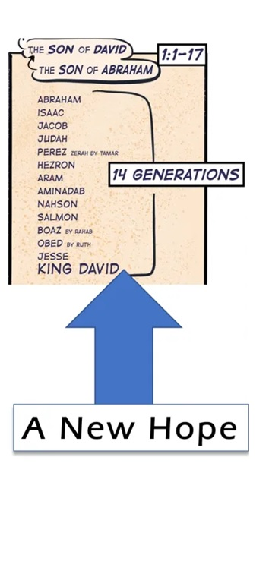
Notes:
Image: Five Loaves by Caroline Coolidge Brown. Copyright © Caroline Coolidge Brown. All rights reserved. Used by permission of the artist.

Slide 50
A New Hope
About…
2000 BC – 950 BC
Notes:
Image: Five Loaves by Caroline Coolidge Brown. Copyright © Caroline Coolidge Brown. All rights reserved. Used by permission of the artist.

Slide 51
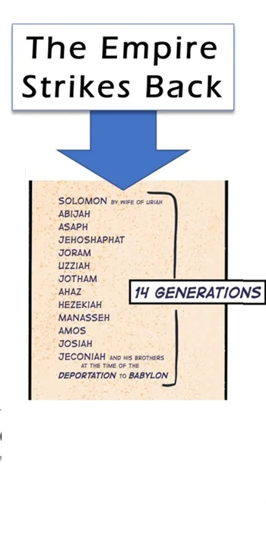
Notes:
Image: Five Loaves by Caroline Coolidge Brown. Copyright © Caroline Coolidge Brown. All rights reserved. Used by permission of the artist.

Slide 52
A New Hope
The Empire Strikes Back
About…
2000 BC – 1050 BC
About…
1050 BC – 586 BC
Notes:
Image: Five Loaves by Caroline Coolidge Brown. Copyright © Caroline Coolidge Brown. All rights reserved. Used by permission of the artist.

Slide 53
Notes:
Image: Five Loaves by Caroline Coolidge Brown. Copyright © Caroline Coolidge Brown. All rights reserved. Used by permission of the artist.

Slide 54
A New Hope
The Empire Strikes Back
The Return of the Messiah
About…
600 BC – 0 AD
About…
2000 BC – 950 BC
About…
950 BC – 600 BC
Notes:
Image: Five Loaves by Caroline Coolidge Brown. Copyright © Caroline Coolidge Brown. All rights reserved. Used by permission of the artist.

Slide 55
Notes:
Image: Five Loaves by Caroline Coolidge Brown. Copyright © Caroline Coolidge Brown. All rights reserved. Used by permission of the artist.

Slide 56
Notes:
Image: Five Loaves by Caroline Coolidge Brown. Copyright © Caroline Coolidge Brown. All rights reserved. Used by permission of the artist.

Slide 57
PJ’s Family Tree Before
Discovering Her Ancestry
Notes:
Image: Five Loaves by Caroline Coolidge Brown. Copyright © Caroline Coolidge Brown. All rights reserved. Used by permission of the artist.

Slide 58
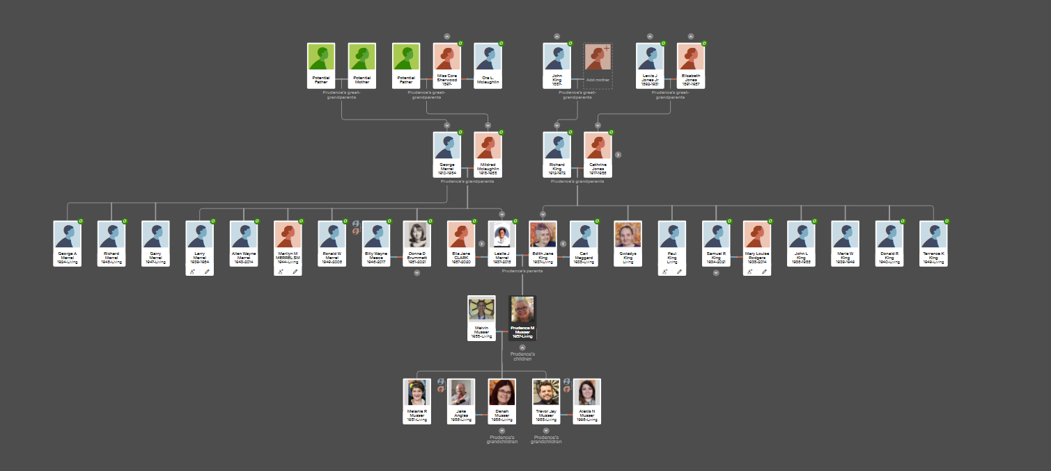
PJ’s Family Tree After
Discovering Her Ancestry
Notes:
Image: Five Loaves by Caroline Coolidge Brown. Copyright © Caroline Coolidge Brown. All rights reserved. Used by permission of the artist.

Slide 59
Sermon
Notes:
Image: Five Loaves by Caroline Coolidge Brown. Copyright © Caroline Coolidge Brown. All rights reserved. Used by permission of the artist.

Slide 60
PRAYERS OF INTERCESSION
Each petition will end with the words,
A: Immanuel, God with us,
The congregation will respond with:
C: You hear our prayer.

Slide 61
PRAYERS OF INTERCESSION
The prayer concludes…
P: In faith, hope, and love, we lift our prayers to you, in the name of your promised savior, Jesus Christ.
C: Amen.

Slide 62
SHARING OF THE Peace
The Sharing of the Peace that began when the congregation arrived is now shared with the Pastor at this time...
P: The peace of the Lord be with you always.
C: And also with you.

Slide 63
OFFERING
OFFERING PRAYER
Notes:
Image: Five Loaves by Caroline Coolidge Brown. Copyright © Caroline Coolidge Brown. All rights reserved. Used by permission of the artist.

Slide 64
THE GREAT THANKSGIVING
Communion “By Station”. All the Baptized are welcome to celebrate this Holy Meal.

Slide 65
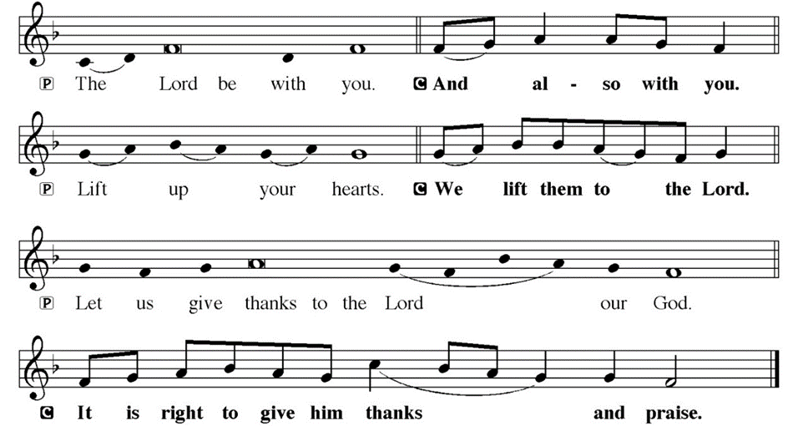
DIALOGUE

Slide 66
THE PREFACE
P: It is indeed right and salutary…
… we praise your name and join their unending hymn.

Slide 67
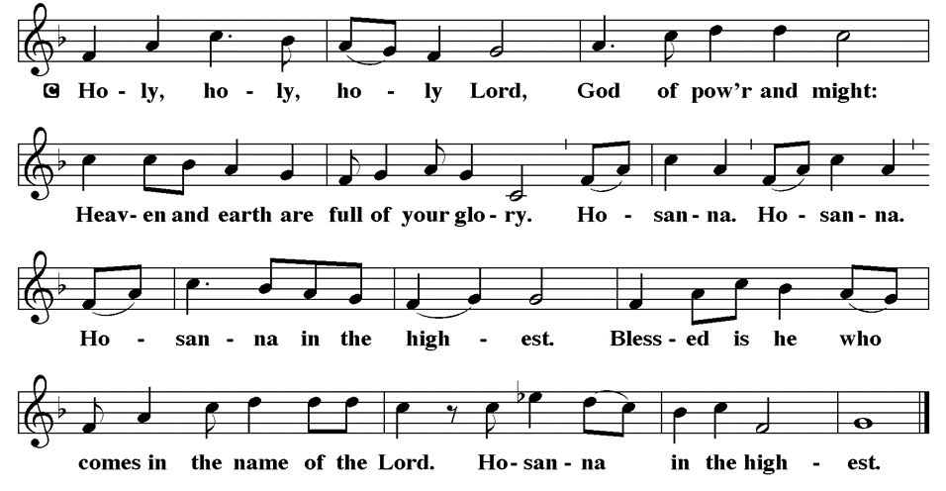
THE SANCTUS

Slide 68
EUCHARISTIC PRAYER
P: Holy God, Creator of all…
…both now and forever.
C: Amen.
THE LORD’S PRAYER
P: United into one through this heavenly food, we pray as Jesus taught…

Slide 69
THE LORD’S PRAYER
C: Our Father, who art in heaven, hallowed be thy name, thy kingdom come, thy will be done, on earth as it is in heaven.

Slide 70
THE LORD’S PRAYER
C: Give us this day our daily bread; and forgive us our trespasses, as we forgive those who trespass against us; and lead us not into temptation, but deliver us from evil.

Slide 71
THE LORD’S PRAYER
C: For thine is the kingdom, and the power, and the glory, forever and ever. Amen.

Slide 72
INVITATION TO COMMUNION
P: God invites all people, from all times and places, to the feast of salvation. Come join the throng and be filled.

Slide 73
COMMUNION DISTRIBUTION
The Communion follows. The bread may be broken for distribution. As the ministers give the bread and wine, they say these words to each communicant:
The body of Christ, given for you.
The blood of Christ, shed for you.
The communicant may say: Amen.

Slide 74
POST COMMUNION BLESSING
P: May Christ, the Sun of righteousness, shine upon you and scatter the darkness from before your path. Almighty God, ☩ Father, Son, and Holy Spirit, bless you now and forever.
C: Amen.

Slide 75
POST COMMUNION PRAYER
P: Let us pray… God our redeemer, you have fed us at this table with gifts of grace, truth, and life. As you have gathered us in joy, send us forth as messengers of your peace. Make us shine with the good news of your glory, born to us in Jesus Christ, our Savior and Lord.
C: Amen

Slide 76
ANNOUNCEMENTS
Notes:
Image: Five Loaves by Caroline Coolidge Brown. Copyright © Caroline Coolidge Brown. All rights reserved. Used by permission of the artist.

Slide 77
SENDING BLESSING
P: Christ the Savior is born! Go in peace. Proclaim this good news!
C: Thanks be to God!

Slide 78
Sending Song
Earth And All Stars
LBW 558
(Verses 1, 4, & 5 Only)
Notes:
Image: Five Loaves by Caroline Coolidge Brown. Copyright © Caroline Coolidge Brown. All rights reserved. Used by permission of the artist.

Slide 79
Earth And All Stars LBW 558
1 Earth and all stars! Loud rushing planets!
Sing to the Lord a new song!
Hail, wind, and rain! Loud blowing snowstorm!
Sing to the Lord a new song!
Refrain
God has done marvelous things.
I too sing praises with a new song!

Slide 80
Earth And All Stars LBW 558
4 Classrooms and labs! Loud boiling test tubes!
Sing to the Lord a new song!
Athlete and band! Loud cheering people!
Sing to the Lord a new song!
Refrain
God has done marvelous things.
I too sing praises with a new song!

Slide 81
Earth And All Stars LBW 558
5 Knowledge and truth! Loud sounding wisdom!
Sing to the Lord a new song!
Daughter and son! Loud praying members!
Sing to the Lord a new song!
Refrain
God has done marvelous things.
I too sing praises with a new song!

Slide 82
DISMISSAL
P: Thank you all for joining us…
… Until we gather again as God’s people to offer our worship and praise, depart in Christ’s Love,
C: Seeking, welcoming, and serving all. Amen!
Postlude by Roxanne Groff
Copyright © 2023 Augsburg Fortress. All rights reserved. Reprinted by permission under Augsburg Fortress Liturgies Annual License #SAS023830. New Revised Standard Version Bible, Copyright © 1989, Division of Christian Education of the National Council of the Churches of Christ in the United States of America. Used by permission. All rights reserved. Revised Common Lectionary, Copyright © 1992 Consultation on Common Texts, admin Augsburg Fortress. Used by permission.

