Slide 1
Inflammation

Slide 2
1. Explain why inflammation cannot occur in an ameba or in a dead body.

Slide 3
Inflammation represents the coordinated response of many cell types in a multicellular organism, including nerves, capillary endothelial cells, and blood cells. It is a vital reaction occurring in living organisms. It cannot occur in single cells or in dead tissue.

Slide 4
2. Does inflammation have beneficial or noxious effects on the human body?

Slide 5
Inflammation has a protective and healing role, helping to remove pathogens and repair injured tissue. However, it may occasionally overshoot its mark or become uncontrollable.

Slide 6
3. What are the cardinal signs of inflammation?

Slide 7
4. Explain the sequence of events that leads to active hyperemia in inflamed tissues.

Slide 8
Injury stimulates nerves to signal smooth muscle cells to contract, causing immediate vasoconstriction. This is followed within seconds by vasodilatation (relaxation of precapillary sphincters), allowing blood to rush into the capillaries. This process of increased blood flow is termed active hyperemia. It is responsible for the redness and warmth (calor) that is observed at sites of acute inflammation.

Slide 9
5. What happens to the leukocytes inside the blood vessels in inflamed tissue?

Slide 10
During acute inflammation, white blood cells (polymorphonuclear leukocytes) move to the periphery of the bloodstream (marginate) and attach to activated endothelial cells (pavement). This process of cell-cell adhesion facilitates the movement of leukocytes out of the blood and into sites of tissue injury.

Slide 11
6. Why does the permeability of blood vessels increase during acute inflammation?

Slide 12
Increased vascular permeability is mediated primarily by vasoactive chemicals that (1) increase intra­capillary hydrostatic pressure and (2) cause retraction of adjacent endothelial cells forming microscopic gaps.

Slide 13
7. Describe the consequences of activation of Hageman factor in acute inflammation.

Slide 14
Hageman factor (clotting factor XII) is a blood protein that becomes activated at sites of tissue injury. Hageman factor stimulates increased vascular permeability (bradykinin formation), clotting (fibrin deposition), and thrombolysis (plasmin formation).

Slide 15
8. Why are some complement fragments called opsonins, anaphylatoxins, or chemotactic factors?

Slide 16
(1) opsonization (coating bacteria to improve recognition by phagocytes),
(2) anaphylaxis (direct stimulation of mast cells to release histamine),
(3) chemotaxis (directed cell mobility).

Slide 17
9. How is membrane attack complex (MAC) formed, and how does it damage red blood cells?

Slide 18
The MAC is the end product of the complement cascade. The MAC assembles within the lipid bilayer of a target cell, creating a cytotoxic pore. In patients with autoimmune hemolytic anemia, antibody binding to the RBC surface stimulates the assembly of the MAC, which causes rapid hemolysis.

Slide 19
10. Explain the formation of leukotrienes and prostaglandins in acute inflammation.

Slide 20
Leukotrienes and prostaglandins are small molecular weight mediators of inflammation that are synthesized de novo in activated leukocytes. They are derived by enzymatic modification of arachidonic acid, which is liberated from plasma membrane phospholipids by phospholipases. Leukotrienes are synthesized via the lipooxygenase pathway, whereas prostaglandins are synthesized via the cyclooxygenase pathway.

Slide 21
11.How does a transudate differ from an exudate?

Slide 22
Transudates and exudates are examples of extravascular edema fluid. A transudate is a clear sterile filtrate of the blood, whereas an exudate is rich in proteins and acute inflammatory cells.

Slide 23
12. How do polymorphonuclear neutrophils emigrate from blood vessels toward bacteria in the tissue?

Slide 24
Polymorphonuclear leukocytes (also referred to as segmented neutrophils) emigrate through the walls of blood vessels (postcapillary venules) at sites of tissue injury through an active process that includes (1) endothelial cell adhesion (margination), (2) insertion of pseudopods between the tight junctions of endothelial cells, (3) passage through the capillary basement membrane, and finally (4) ameboid movement toward bacteria (chemotaxis).

Slide 25
13. What are the most important chemotactic substances, and how do they promote inflammation?

Slide 26
The most important neutrophil chemotactic factors are (1) bacterial products (e.g., formylated amino acids and lipopolysaccharides); (2) complement fragments (C5, C6, C7); and (3) cytokines, polypeptide signaling molecules released by natural killer cells, and tissue macrophages (e.g., gamma interferon and tumor necrosis factor-alpha).

Slide 27
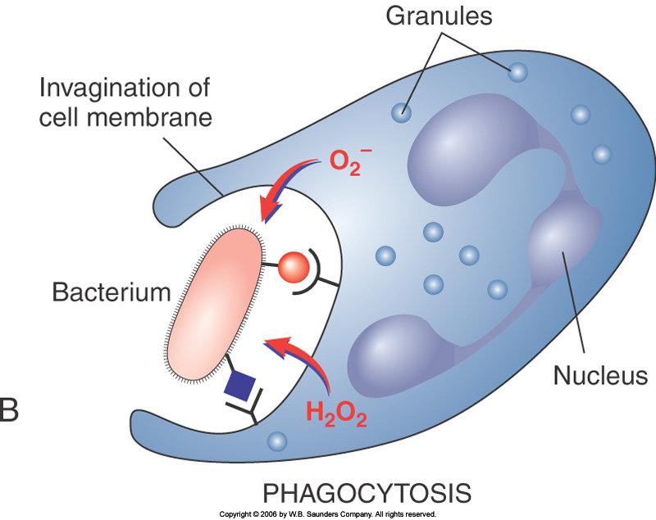
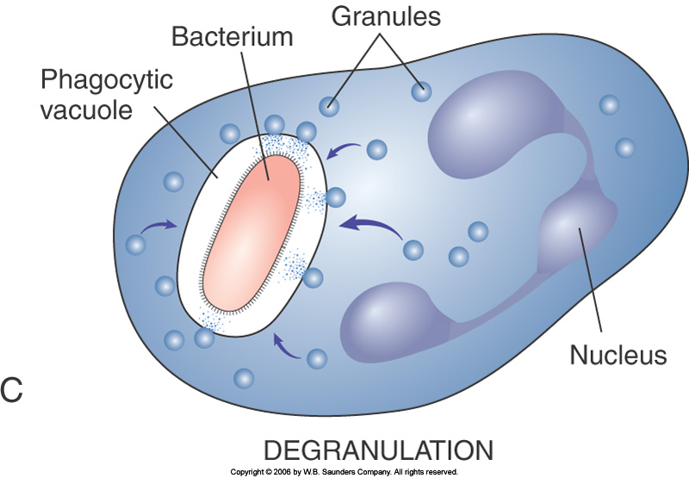
14. How do polymorphonuclear neutrophils engulf and kill bacteria?

Slide 28
Polymorphonuclear neutrophils engulf and digest bacteria through several steps. First, the phagocyte attaches to opsonins on the bacterial cell surface. Invagination of the phagocyte cell membrane draws the bacterium into a phagocytic vacuole. Oxygen radicals generated through an oxygen burst kill the ­bacterium, and lysosome digestive enzymes finish the demolition processes within the heterophagosome.

Slide 29
15. What is pus, and how is it formed?

Slide 30
Pus represents the accumulation of a leukocyte-rich exudate, lytic enzymes released from dying leukocytes, and necrotic tissue debris. Inflammation dominated by pus formation is called purulent or suppurative.

Slide 31
16. Why are polymorphonuclear neutrophils best suited to combat acute bacterial infection?

Slide 32
Polymorphonuclear leukocytes are best suited to combat acute bacterial infections because they are highly mobile cells, armed with preformed stores of hydrolytic enzymes, and able to generate toxic oxygen radicals. In addition, they are capable to ingesting bacteria and secrete long-range mediators of inflammation such as interleukin-1 (IL-1), the endogenous pyrogen.

Slide 33
17. How do eosinophils differ from polymorphonuclear neutrophils?

Slide 34
Eosinophils account for 2% of circulating white cells, whereas polymorphonuclear neutrophils (PMNs) account for 60% to 70% of circulating white cells. During acute inflammation, eosinophils appear 2 to 3 days after PMNs and live longer. In contrast to PMNs, eosinophils have a single nucleus. They are prominent in allergic and parasitic infections.

Slide 35
18. Which inflammatory reactions are mediated by eosinophils and basophils?

Slide 36
Eosinophils and basophils are both prominent in allergic reactions and parasitic infections.
Basophils are the precursors of tissue mast cells.

Slide 37
19. What are the main functions of macrophages?

Slide 38
Macrophages are tissue histiocytes derived from blood monocytes. They appear at the site of inflammation 3 to 4 days after the onset of infection or tissue injury. The principle functions of macrophages are bacterial engulfment and killing and the secretion of numerous cytokines, which help regulate inflammation and acquired immunity.

Slide 39
20. How do platelets differ from other white blood cells?

Slide 40
Unlike other white blood cells, platelets are non-nucleated fragments of cytoplasm derived from megakaryocytes in the bone marrow. Their cytoplasm contains vacuoles rick in histamine, polypeptide growth factors, and coagulation proteins. Platelets release the contents of these granules upon contact with extracellular matrix, activated endothelial cells, or thrombin. This process is termed degranulation.

