Slide 1
“Reconnecting, Recommitting & Relaunching” Thursday, February 4, 2021 at Eastminster Presbyterian Church 3200 Trenholm Road, Columbia, SC Rev. Dr. Brad Smith, Pastor Rev. Angela Ford Nelson, Facilitator
Welcome to
“The Vine!”

Slide 2
Welcome to “The Vine!”
Congratulations! You made it!
You carved out time in your busy schedule to SHOW UP at this sacred space and in this sacred time:
To Reconnect with the Vinedresser & the Vine
To Recommit to the Process of Bearing Much Fruit
Being Lifted
Being Pruned
Being Still – Abiding
To Relaunch into the Deep

Slide 3
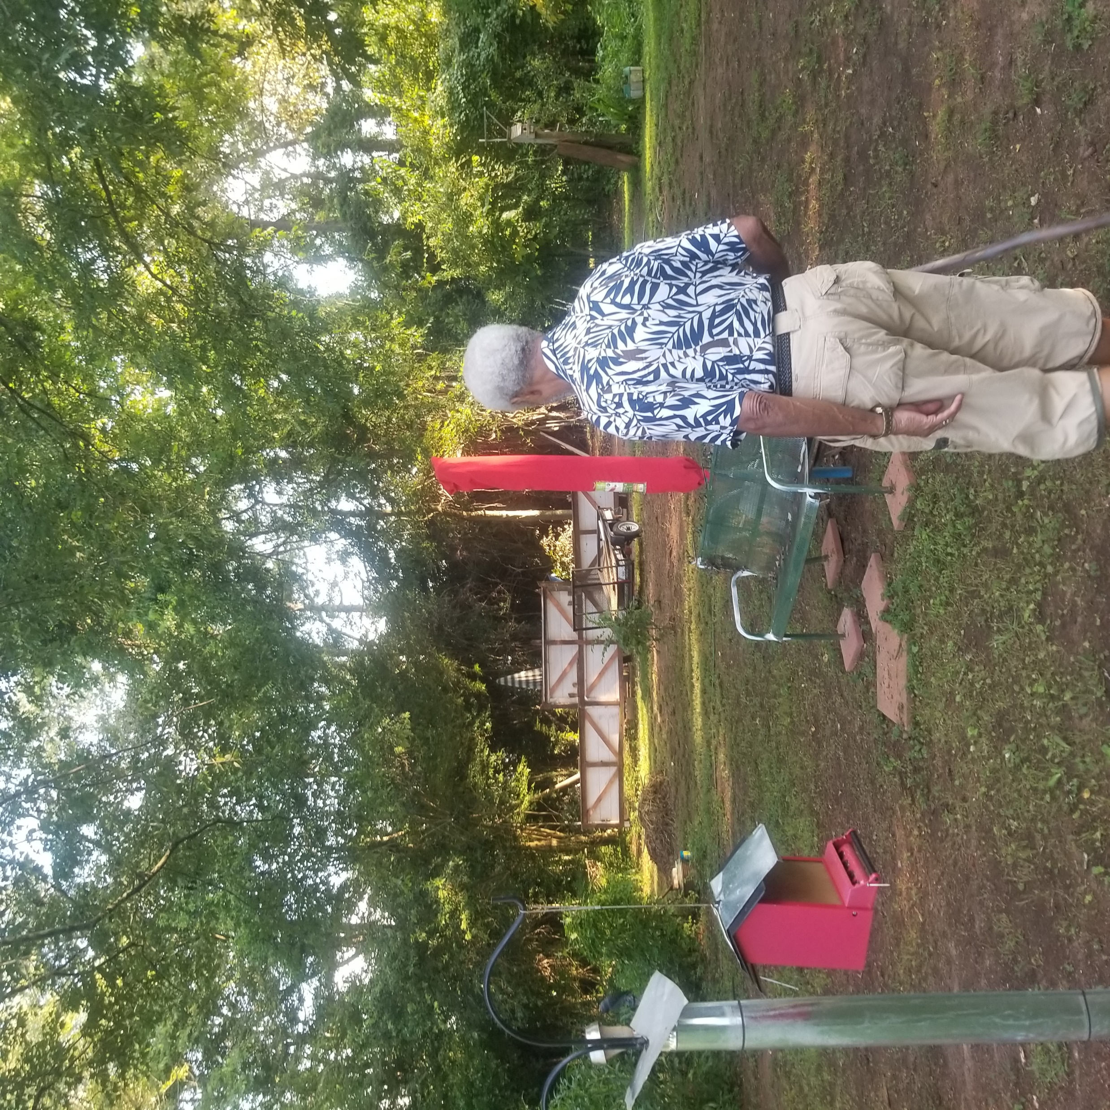
Welcome to “The Vine!”
I’m Your Vineyard Tour Guide –
Rev. Angela Ford Nelson
A COUNTRY-GIRL from Wedgefield, South Carolina
The Red Dirt that I witnessed the heart of a Farmer - Daddy
Vegetables
Bullet Grapes
Oranges
Watermelons
More than Enough for us and others

Slide 4
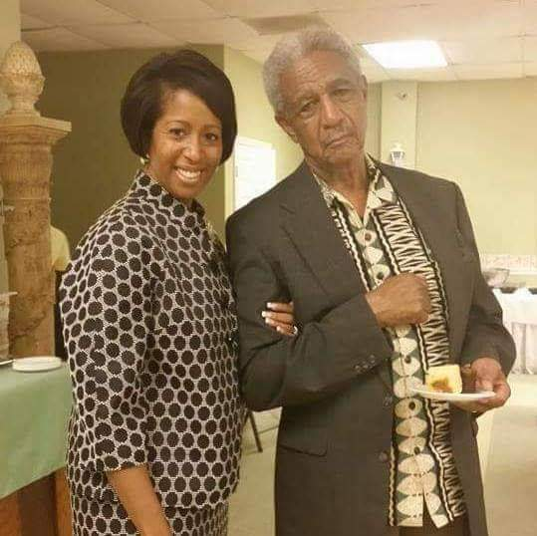
Welcome to “The Vine!”
The Farmer - Daddy
Always tended the soil
Always cared for the plants
Always took pride in what he was growing
Always desired for a great harvest to share
I didn’t realize how difficult and time-consuming
Until the Quarantine of 2020

Slide 5
Welcome to “The Vine!”
The Vinedresser – God | John 15:1 – 17
Always tends the soil
Always cares for the VINE AND THE BRANCHES
Is Always Glorified by our Fruitfulness
Desires that we bear much Fruit to SHARE!

Slide 6
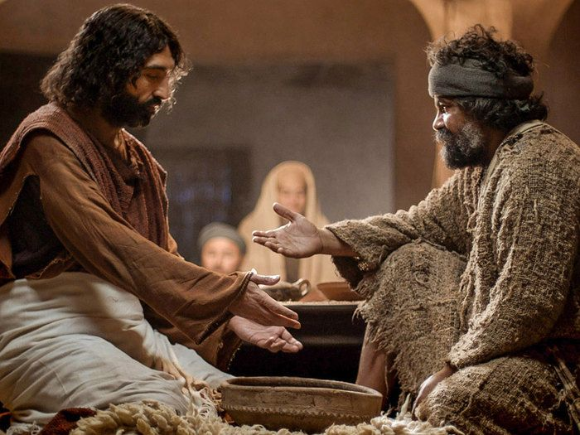
Welcome to “The Vine!”
Before the Cross --the Table and the Vineyard
Right Before the festival of Passover
Knowing His hour had come
Prepared His disciples
During Supper
Washed their feet
Foretold of what was to come
Promised the Holy Spirit
Rise, let us be on our way…(John 14:31c)

Slide 7
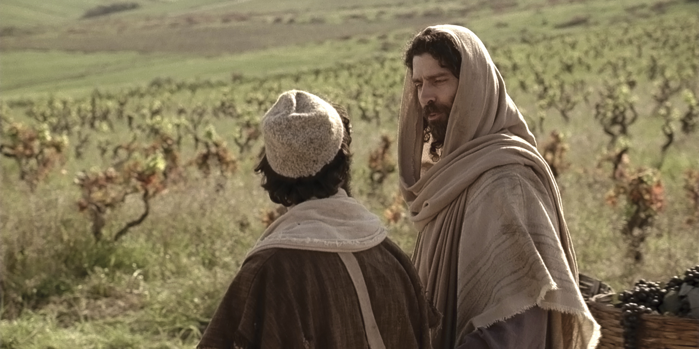
Welcome to “The Vine!”
As they were going…
Jesus was still teaching
No longer in parables
This time with a METAPHOR
A Vineyard…
I am the Vine
My Father is the Vinedresser

Slide 8
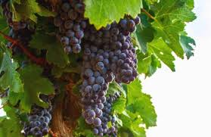
Welcome to “The Vine!”
As they were going…
4 types of Branches
No fruit
Takes Away – lifts up
Some fruit
Prunes
More Fruit
Invites into deeper relationship - ABIDING

Slide 9
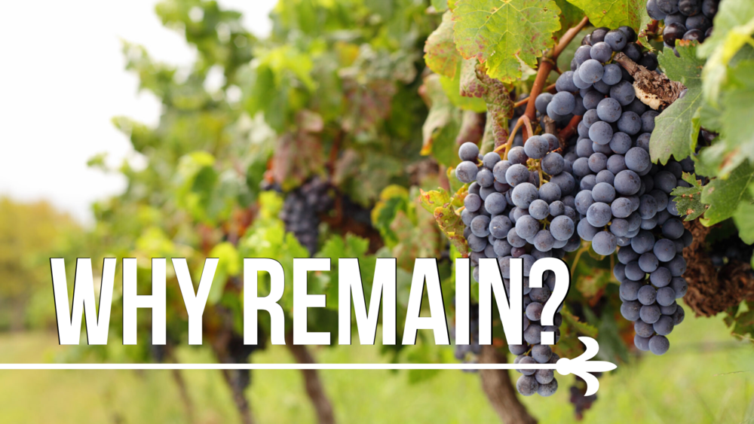
Welcome to “The Vine!”
As they were going…
4 types of Branches
MUCH Fruit
“Those who abide [REMAIN} in me and I in them bear much fruit, because apart from me you can do nothing. Whoever doesn’t abide in me is thrown away like a branch and withers; such branches are gathered, thrown into the fire and burned. Abid in me, and my words abide in you, ask for whatever you wish, and it will be done for you.”
John 15:7

Slide 10
Welcome to “The Vine!”
As they were going…
The Disciples are the Branches
No fruit
Caused by hanging in the dirt (sin)
Takes Away – lifts up
Disciplines
“My son, do not regard lightly the discipline of the Lord, nor be weary when reproved by him. 6For the Lord disciplines the one he loves, and chastises every son whom he receives.” Hebrews 12:5

Slide 11
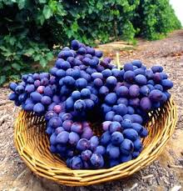
Welcome to “The Vine!”
As they were going…
4 types of Branches
More Fruit
Pruned branches grow
Through the pruning we learn that all things are working together for our good! Romans 8:28
Prepared to ABIDE - REMAIN

Slide 12
Welcome to “The Vine!”
As they were going…
4 types of Branches
Much Fruit
Which is our destiny
John 10:10 – Abundant Life
Abiding
Surrender All
Remain
Love

Slide 13
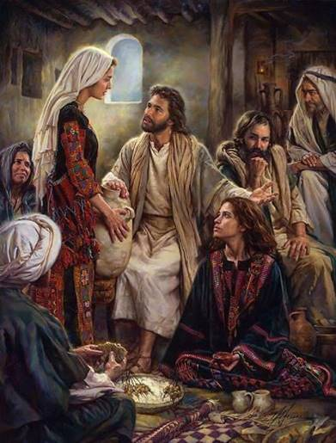
Welcome to “The Vine!”
How do we Abide? Luke 10:38 - 42
“Deepen the quality of my devoted time with God
Mary in a Martha World
Set apart the kind of time needed to build a relationship
At Jesus’ Feet
Savor God’s Words
Listening and not distracted”

Slide 14
Welcome to “The Vine!”
How do we Abide?
Keep Jesus’ Commandment
Love one another as I have loved you! No one has greater love than this, to lay down one’s life for one’s friends. John 15:13
For they will know we are CHRISTIANS by our love!
Secrets of the Vine: Breaking through to Abundance by Bruce Wilkinson

Slide 15
Welcome to “The Vine!”
What does FRUITFULNESS LOOK LIKE?

Slide 16
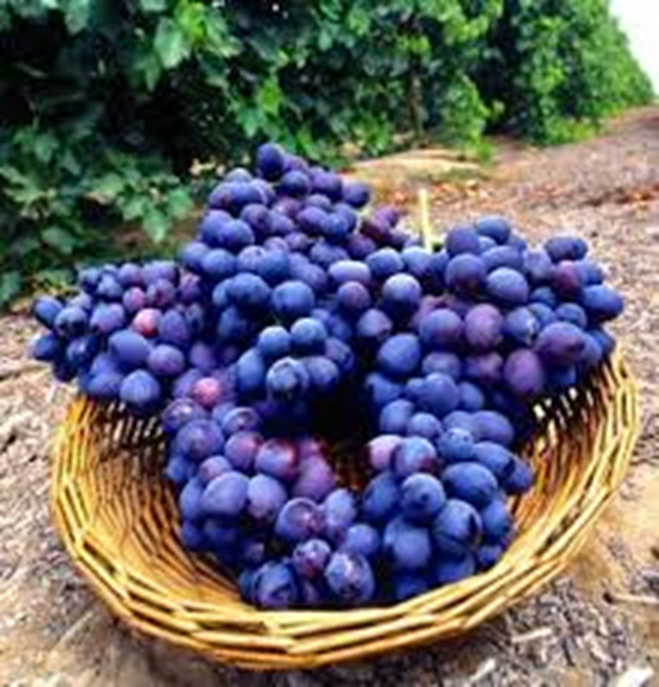
Welcome to “The Vine!”
Why is Fruitfulness Necessary?
So that we would have Jesus’ Joy
So that our Joy would be complete
Because we are appointed to go and bear fruit, fruit that will last
So whatever we ask for in Jesus’ Name shall be given
Secrets of the Vine: Breaking through to Abundance by Bruce Wilkinson

Slide 17
Welcome to “The Vine!”
Reconnect
What do you need to do to reconnect to the Vine?
Recommit
What do you need to do to ABIDE?
Relaunch - LEAP
What is your next step?

Slide 18
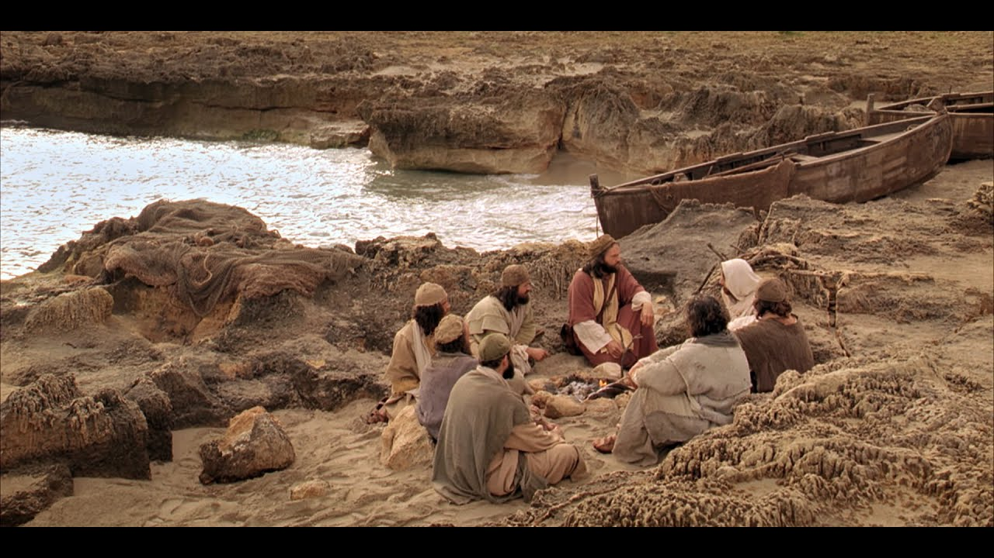
Welcome to “The Vine!”
Relaunch – LEAP
Gone back fishing! John 21

Slide 19
“Reconnecting, Recommitting & Relaunching Thursday, February 4, 2021 at Eastminster Presbyterian Church 3200 Trenholm Road, Columbia, SC Rev. Dr. Brad Smith, Pastor Rev. Angela Ford Nelson, Facilitator www.angelafordnelson.com www.angelafordnelson@yahoo.com 864-787-4633
Welcome to
“The Vine!”

