Slide 1
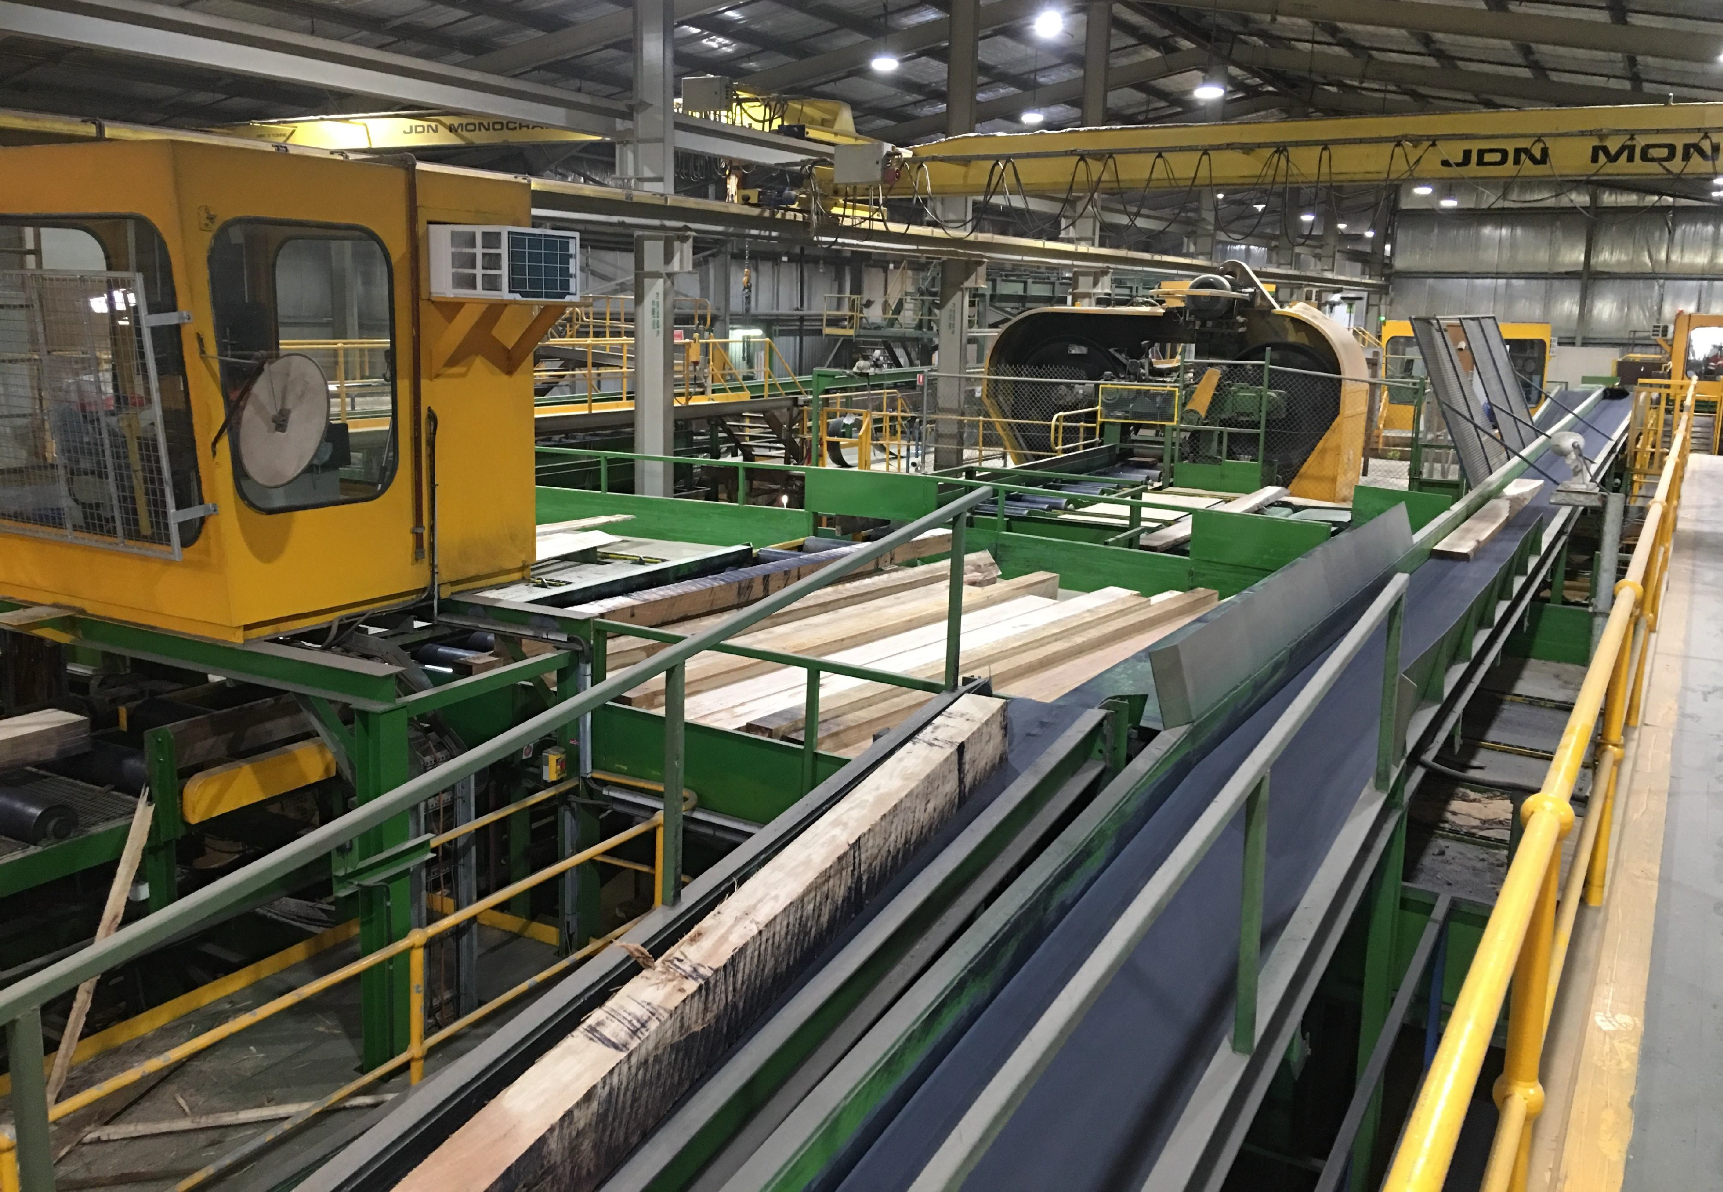


Proposed Great Koala National Park
Timber NSW presentation to MNCJO Board
July 2020

Slide 2
3 million hectares of public forest on the north coast
the reserve system on the north coast is already comprehensive, adequate and representative
only 10% is subject to timber harvesting
3,000 direct jobs in forest management, timber harvesting, transport and processing
NSW North Coast currently supply ¾ of the State’s hardwood

Slide 3
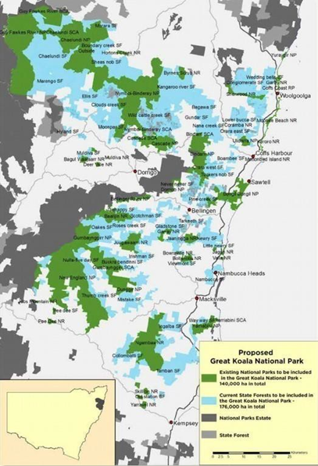
GKNP will remove a further 175,000 hectares
(10% of NSW’s remaining State forest)

Slide 4
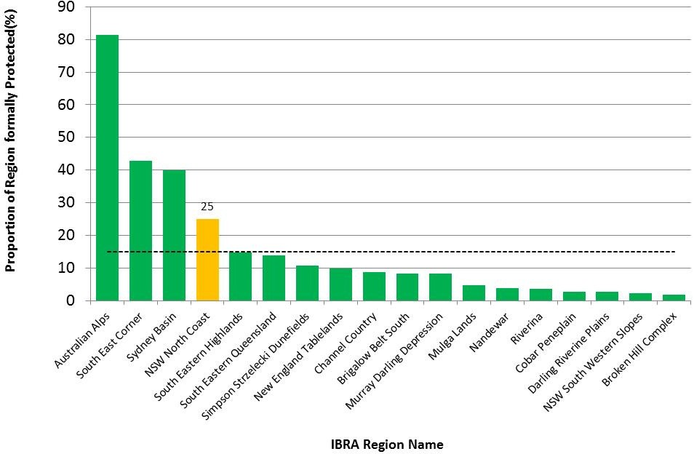
North Coast Interim Biogeographic Regionalisation for Australia (IBRA) Region already exceeds the International Union for Conservation of Nature 15% protected area threshold target by 10%

Slide 5
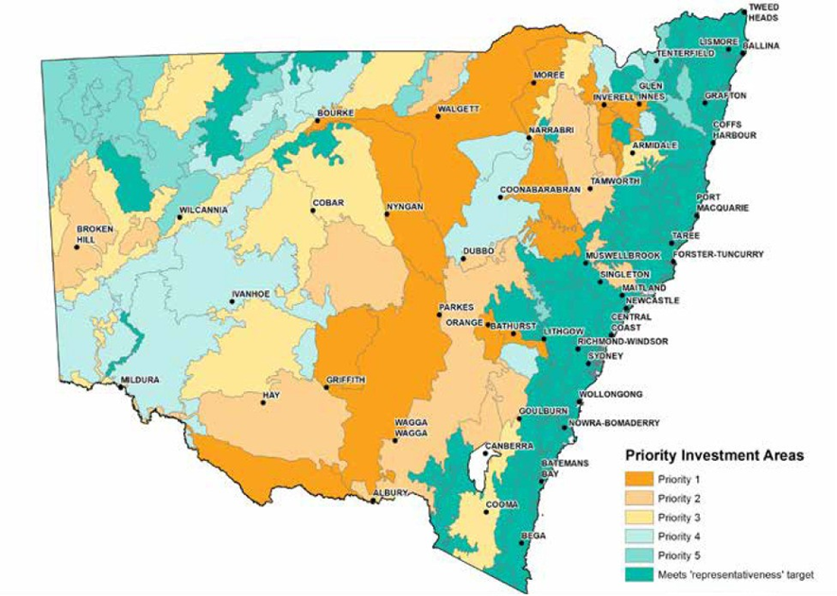
Map of Priority Investment areas for private land conservation shows GKNP area already meets the ‘representativeness’ target (i.e. investment in more protected areas is not a priority for this bioregion)
(Source: NSW Government 2017)

Slide 6
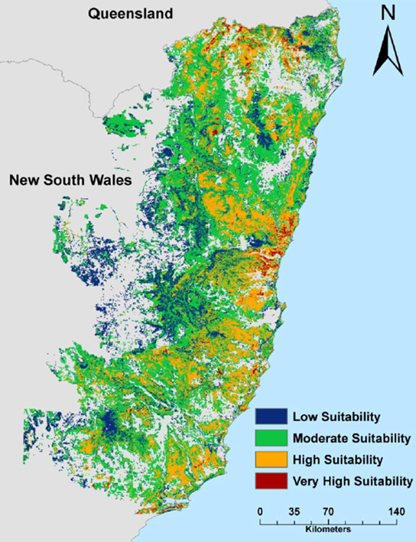
NSW DPI Forest Science produced a model for koala habitat right across the North Coast.
The good news is that there was more than 1.5Million hectares classified as moderate to high suitability for koalas.
That’s 3 Million football fields
Last summers fires saw only 17% of this area burnt in severe wildfire.

Slide 7
The vast majority of the best koala habitat on NSW public forest is already in reserves.
The 17% remaining on state forest is critical to timber supply
More than half of the best koala habitat is on private / council lands

Slide 8
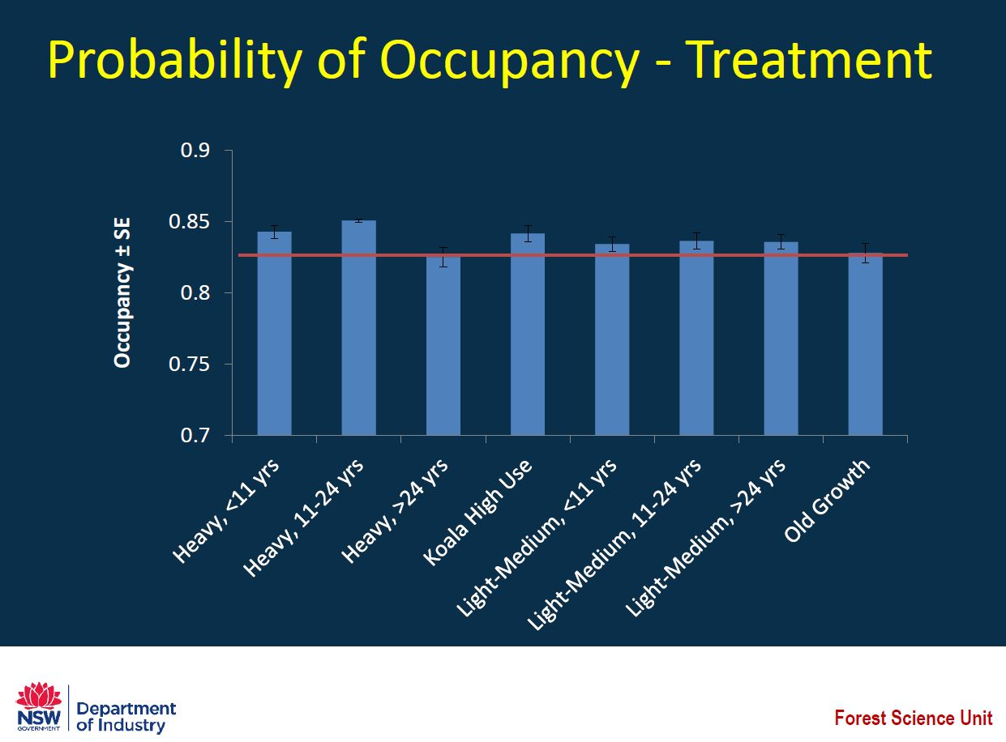
DPI Koala Research & Monitoring
DPI Forest Science Unit – extensive field studies found:
No significant difference in Koala numbers between areas where logging has occurred and where it hasn’t.
https://www.dpi.nsw.gov.au/forestry/science/koala-research

Slide 9
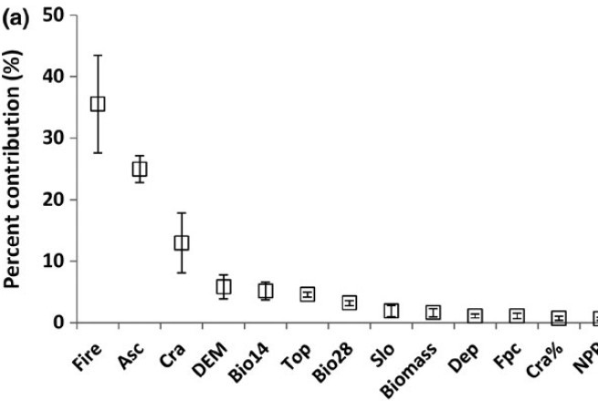
Percent contribution of the 14 predictor variables –
Fire (wildfire frequency),
Asc (soil type),
Cra (vegetation type)
(Source: Law et al. 2017)

Slide 10
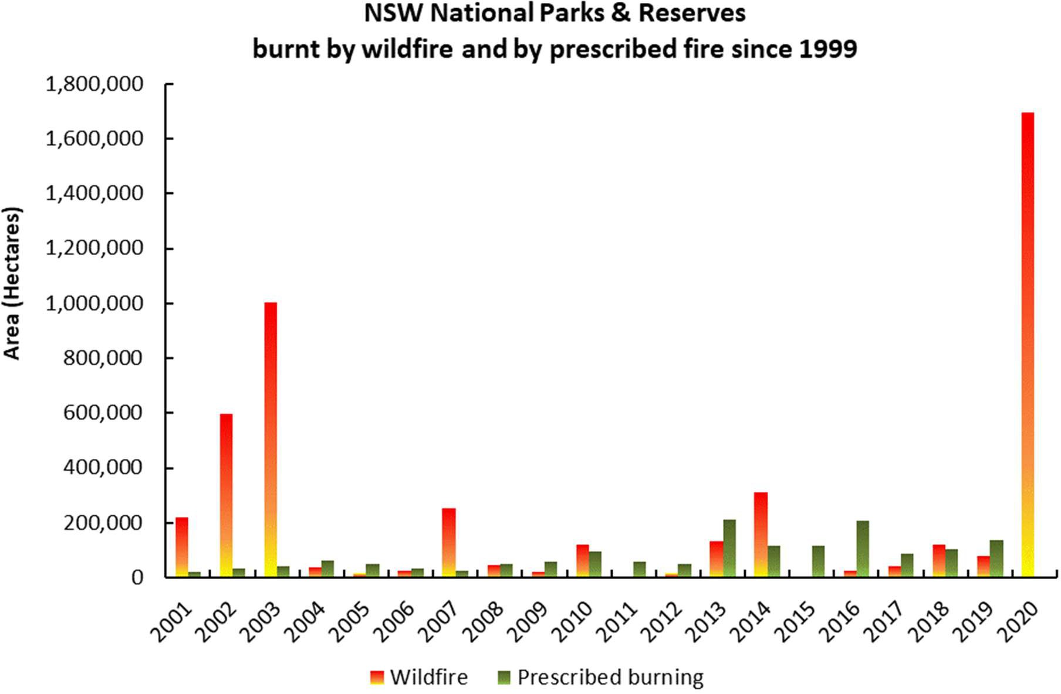
Millions of hectares of koala habitat within NSW National Parks and Reserves has been destroyed as a consequence of failure to suppress wildfire

Slide 11
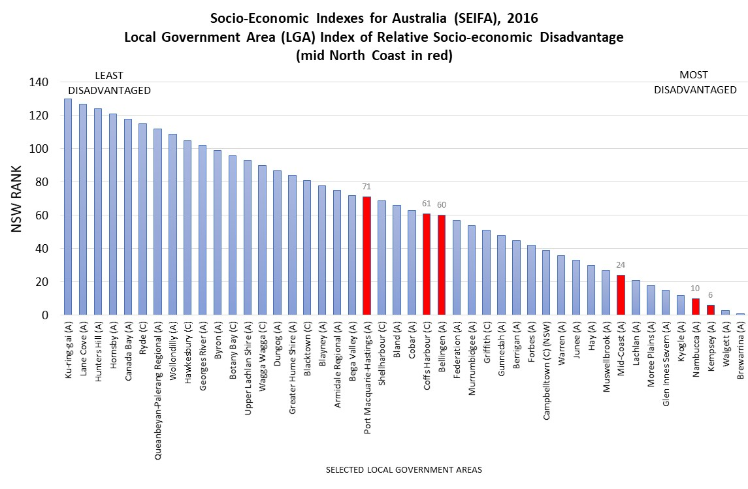

Slide 12
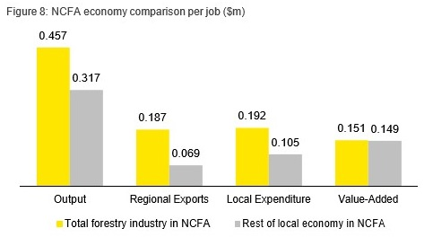
The forestry industry generates $0.5m in output for every employee,
$0.2m in value add and $0.2m in regional exports for every employee.
These indicators are higher than those for the rest of the NCFA economy

Slide 13
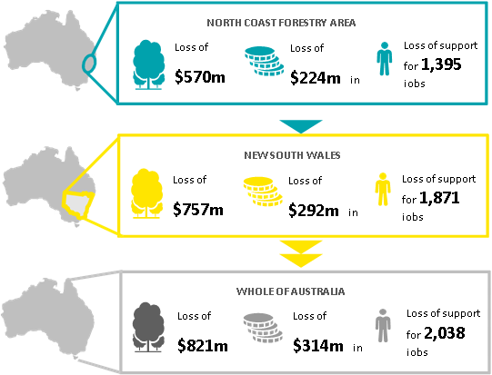
The Impacts
The annual direct impact of the cancellation of WSAs is estimated to be a reduction in output of hardwood production of $57m (i.e. forestry and logging) and a reduction in output of hardwood processing of
$268m (i.e. sawmill and other wood manufacturing). This is made up of $217m in the NCFA, $37m in the rest of NSW and $14m in the rest of Australia).
The flow on impacts include:
Estimated reduction in total output of:
$570m loss in economic output per annum in the NCFA.
A further $187m loss in output per annum in the rest of NSW.
A further $64m loss in output per annum in the rest of Australia.
Estimated reduction in total value add of:
$224m loss in value add per annum in the NCFA.
A further $68m loss in value add per annum in the rest of NSW.
A further $23m loss in value add per annum in the rest of Australia.
Estimated reduction in employment through the loss of support of:
1,395 jobs in the NCFA.
A further 476 jobs in the rest of NSW.
A further 167 jobs in the rest of Australia.
Source: The economic impact of the cancellation of NSW North Coast Wood Supply Agreements due to the creation of the Great Koala National Park, Ernst & Young, Australia, March 2019

Slide 14
Case study: River Red Gum National Park
resulted in a decimation of the region’s timber industry and affiliated businesses, without any of the forecast conservation and tourism benefits
the management of 117,000 hectares of River Red Gum transferred to NP in 2010
POPULATION
The population of Mathoura declined by 20 per cent
EMPLOYMENT
Agriculture, forestry and fishing jobs declined by 47 per cent and overall employment in industry has declined by 34 per cent, while six Arts & Recreation jobs were created
TOURISM
The Mathoura Visitor Centre has recorded a decrease from 32,000 visits annually (in 2010) to 23,000 visits (in 2014).
In 2019, Council data from January to March show that 55 visitors from out of town pass through Mathoura each month.
INDIGENOUS COMMUNITIES
The Cummeragunja timber cutters near Barmah lost a viable firewood business when the thinning and harvesting operations ceased in the region.
DOWNSTREAM BUSINESSES
Local community businesses – cafes, supermarket, pubs, newsagency – have all suffered or closed as a result of the conversion.
FIREWOOD SUPPLY CRISIS
The collection of woody debris for firewood is now heavily restricted, creating a crisis in local firewood supplies and increasing bushfire risk.

