Slide 1
LIVER

Slide 2
LEARNING OBJECTIVES
The liver anatomy
The investigation of liver disease
The liver tumors
The liver cancer
Hydatid disease of the liver

Slide 3
Liver anatomy
Two anatomical lobes - separate blood supply, bile duct and venous drainage
Dual blood supply
20% hepatic artery , 80% portal vein
The liver regenerates fully after partial resection
Resection is based on anatomical lines to preserve maximal functioning liver

Slide 4
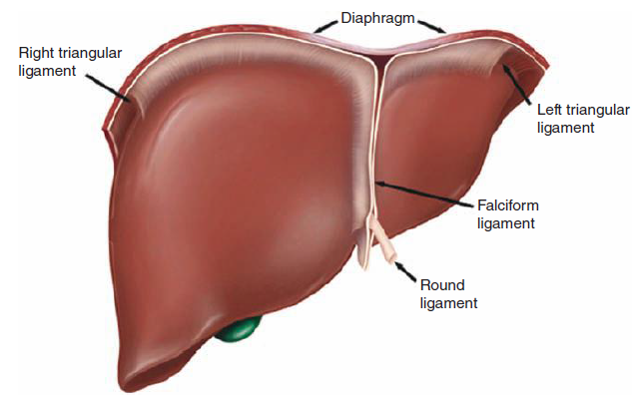
LIVER ANATOMY

Slide 5
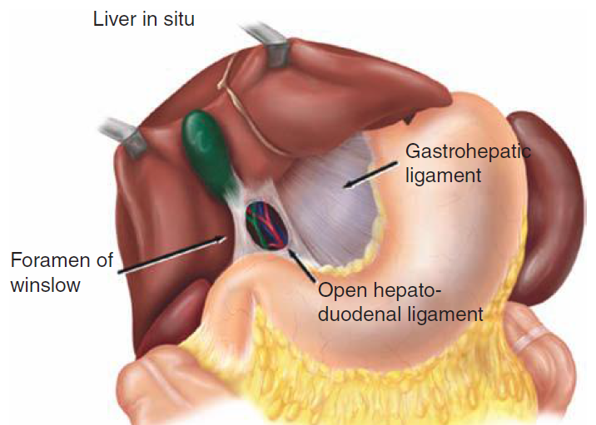
LIVER ANATOMY

Slide 6
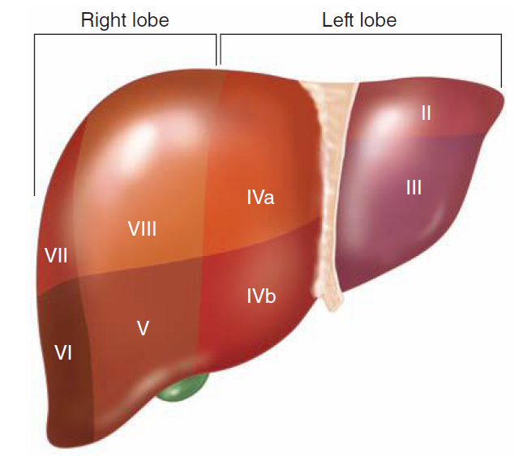
Couinaud’s liver segments

Slide 7
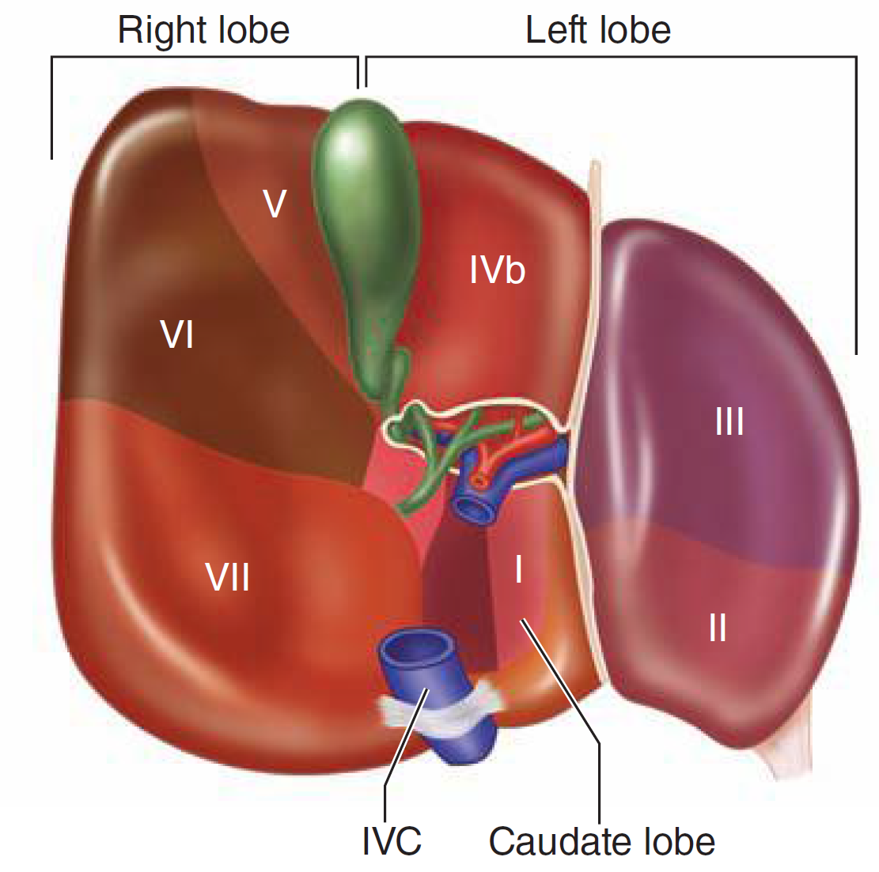
Couinaud’s liver segments

Slide 8
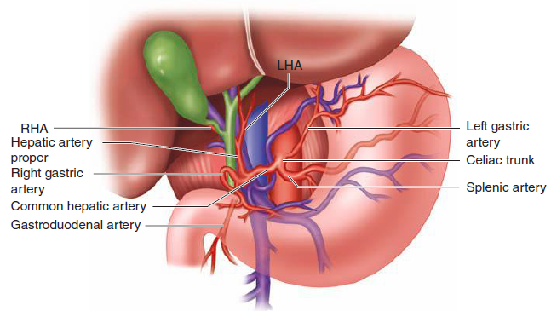
ARTERIAL ANATOMY

Slide 9
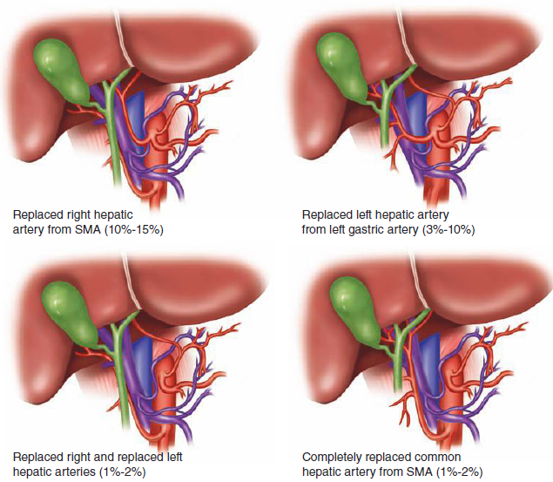
Common hepatic artery anatomic variants

Slide 10
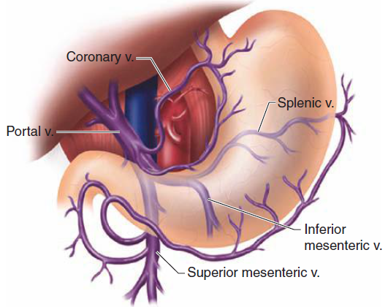
Portal vein anatomy

Slide 11
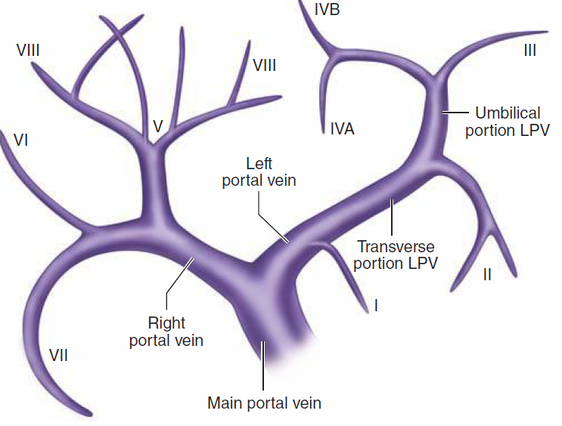
Anatomy of left portal vein

Slide 12
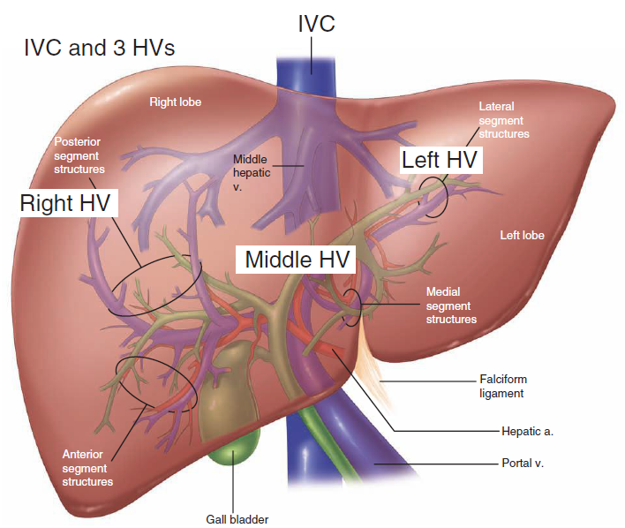
Confluence of three hepatic veins and inferior vena cava

Slide 13
Main functions
Maintaining core body temperature
pH balance and correction of lactic acidosis
Synthesis of clotting factors
Glucose metabolism, glycolysis and gluconeogenesis
Urea formation from protein catabolism
Bilirubin formation from haemoglobin degradation
Drug and hormone metabolism and excretion
Removal of gut endotoxins and foreign antigens

Slide 14
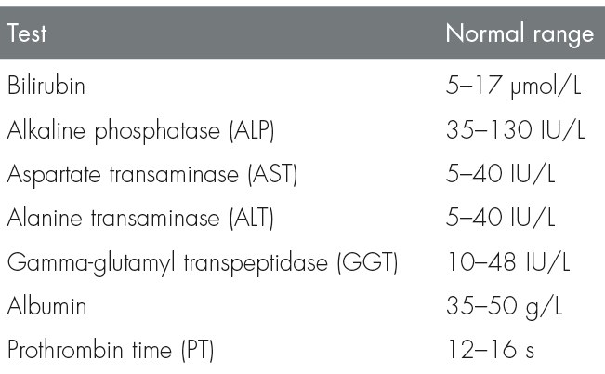
Routinely available tests of liver function

Slide 15
BENIGN LIVER TUMORS

Slide 16
PATHOLOGY
BENIGN LIVER TUMORS
Hepatocellular adenoma
Focal nodular hyperplasia
Lipoma
Hemangioma
Capillary type: no clinical consequence
Cavernous type: capable of attaining large size and rupturing

Slide 17
EPIDEMIOLOGY
5% of liver tumors benign
Hemangioma the most common
~7% of people have cavernous hemangioma at autopsy
Adenoma
Incidence: 1/1,000,000 in women without history of oral contraceptive use
Most commonly in women between 30-50 years
Adenoma and focal nodular hyperplasia 5x more common in female patients

Slide 18
HISTORY and PHYSICAL EXAMINATION
Large lesions can be palpated
Jaundice occur in patients if tumor causes bile duct obstruction
Adenomas and hemangiomas
Asymptomatic or dull pain
Rupture - sudden onset of severe abdominal pain
Large cause jaundice or symptoms of gastric outlet obstruction, nausea and vomiting
Focal nodular hyperplasia rarely symptomatic

Slide 19
DIAGNOSTIC EVALUATION
Often found incidentally at laparotomy or on imaging studies
Laboratory evaluation often unremarkable
Hemorrhage in adenoma can lead to hepatocellular necrosis and increase in transaminase levels
Hemangioma can cause consumptive coagulopathy

Slide 20
DIAGNOSTIC EVALUATION
Ultrasound differentiates cystic from solid lesions
Triple-phase CT: best for distinguishing between various types of benign and malignant lesions
Adenomas low-density lesions
Focal nodular hyperplasias - filling defect or central scar
Hemangiomas - early peripheral enhancement after contrast administration
should not be biopsied, risk of bleeding

Slide 21
TREATMENT
Adenoma: risk of malignant degeneration or hemorrhage
Stop oral contraceptives – if lesion doesn`t regress, consider resection in otherwise healthy individuals,.
Relative contraindications to resection:
technically difficult
large size
Hemangiomas: symptomatic should be resected
Focal nodular hyperplasia: not malignant, rarely causes symptoms, should not be resected unless it found incidentally at laparotomy, small and peripheral enough

Slide 22
LIVER CANCER

Slide 23
PATHOLOGY
Liver cancers are:
hepatomas, also known as hepatocellular carcinoma
metastases from other primaries

Slide 24
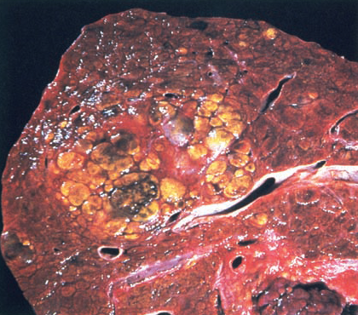
Hepatocellular carcinoma
Cross-section of cirrhotic liver
Poorly circumscribed, nodular area of yellow, partially hemorrhagic HCC

Slide 25
EPIDEMIOLOGY
95% liver tumors malignant
Hepatoma is one of the most common malignancies in the world, in US relatively low ( ~2/100,000)
More common in male than in female patients

Slide 26
ETIOLOGY
Cirrhosis is a predisposing factor to hepatoma
Hepatitis B and alcoholism - leading causes of cirrhosis
Fungal-derived aflatoxins implicated as causes
Hemochromatosis
Smoking
Vinyl chloride
Oral contraceptives

Slide 27
HISTORY
Weight loss
Right upper quadrant or shoulder pain
Weakness
Hepatic metastases often indistinguishable from primary hepatocellular carcinoma

Slide 28
PHYSICAL EXAMINATION
Hepatomegaly may be appreciable
Signs of portal hypertension
splenomegaly and ascites
Jaundice occurs in approximately half of patients

Slide 29
DIAGNOSTIC EVALUATION
Abnormal liver function tests
Fetoprotein - specific marker for hepatoma, also elevated in embryonic tumors
Radiographic studies used to differentiate benign and malignant lesions
Ultrasonography distinguish cystic from solid lesions

Slide 30
DIAGNOSTIC EVALUATION
CT or MRI reveal multiple lesions and clarify anatomic relationships
Nodularity of the liver, hypersplenism, portal hypertension
Hepatic arteriography can diagnose hemangioma
Important to perform viral studies for hepatitis - most cancers occur in the setting of liver disease and cirrhosis

Slide 31
TREATMENT
Child-Turcotte-Pugh score assess before consideration of resection
Child class C disease: not tolerate resection
Child class B disease may tolerate limited resection
Treatment involves resection of tumor
Survival without treatment averages 3 months
Resection can extend survival to 3 years
5-year survival rate 11% - 46%

Slide 32
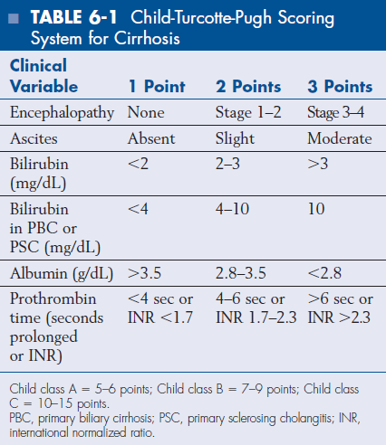

Slide 33
TREATMENT
Decision to resect depends on comorbid disease, location and size of tumor
Wedge resection when possible - formal hepatic lobectomy doesn`t provide additional survival benefit.
Liver transplantation for patients with small tumors who are not candidates for resection because of location or concomitant cirrhosis
Provide good long-term survival

Slide 34
TREATMENT
Metastatic disease occurs: lung, colon, pancreas, breast, stomach
Colon cancer with liver meta - resection of up 3 lesions shown to improve survival, should be attempted as long as the operative risk is not prohibitive
Liver metastases from other tumors should not be resected

Slide 35
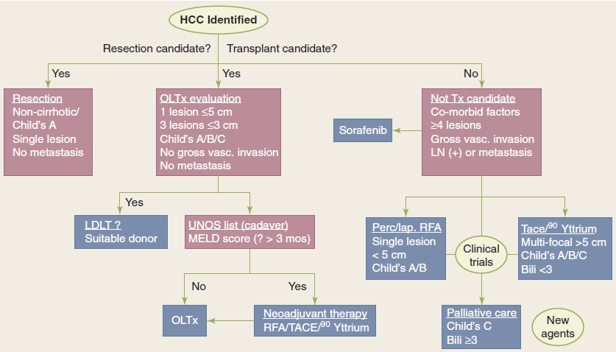

Slide 36
Hydatid disease of the liver

Slide 37
Pathology
Liver is site of 75% of hydatid cysts in humans
Dogs infected with ova of Echinococcus granulosus (result of eating sheep offal) - tapeworms develop in small intestine - ova discharged in dog`s faeces
Humans ingest ova from contaminated vegetables - ova penetrate stomach wall - invade portal tributaries and pass to liver
Hydatids may pass on to lungs, brain, bones, other organs
Hydatid common in sheep-rearing communities

Slide 38
Clinical features
Cyst may present as symptomless mass
With contents dead and walls calcified, inactive structure may be harmless postmortem finding
Active cyst may
rupture into peritoneal cavity, pleural cavity, alimentary canal or biliary tree
become infected
produce obstructive jaundice by pressure on intrahepatic bile ducts, or more often intrabiliary rupture and release of cysts

Slide 39
Special investigations
Plain X-ray of liver: clear zone produced by the cyst, or flecks of calcification in the cyst wall
Ultrasound and CT: localize the cyst
Serological tests: depend on sensitization of patient to hydatid fluid, which contains specific antigen, leakage of which induces production of antibodies.
Eosinophil count: may be eosinophilia, not specific, but arouse clinical suspicion

Slide 40
Treatment
Calcified cyst should be left alone
Other cysts should be treated to prevent complications.
Treatment with albendazole may result in shrinkage or disappearance of cysts
Indications for surgery:
Failure to respond
Presence of complications
The cyst is exposed and aspirated, then it is possible to excise the cyst, taking care not to liberate daughter cysts present within

Slide 41
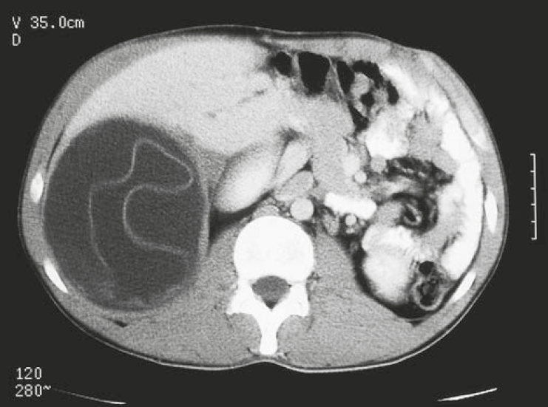
Hydatid liver cyst

Slide 42
SURGICAL RESECTIONS OF THE LIVER

Slide 43
Surgical resections
RIGHT LOBECTOMY: removal of segments V to VIII by dividing the liver along line between gallbladder fossa and vena cava and leaving the left lobe
LEFT LOBECTOMY: resection of left lobe segments II, III, IV
caudate lobe (segment I) may be removed
TRISEGMENTECTOMY: misnomer, indicates resection of most of the liver, leaving just left lateral segments (II and III)
This resection removes most liver, care has to be taken to ensure sufficient viable liver

Slide 44
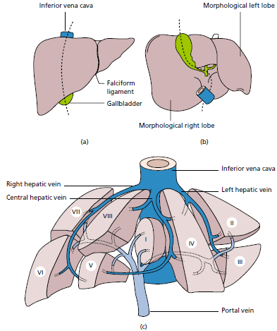
Segmental anatomy of THE liver

Slide 45
KEY POINTS
The liver is the largest gland in the body and performs a diverse spectrum of functions: energy metabolism, protein synthesis, digestion, and detoxification
Only 5% of liver tumors are benign and include cysts, hemangiomas, focal nodular hyperplasia, and hepatocellular adenomas.
Hepatocellular carcinoma is extremely common worldwide but is relatively rare in the United States
Causes of hepatocellular carcinoma include cirrhosis, aflatoxin, smoking, and vinyl chloride.
The prognosis for hepatocellular carcinoma is poor.

Slide 46
Key points
Many options exist for the treatment of hepatocellular carcinomas, and these are best managed by multidisciplinary liver transplant team.
Surgical resection is the treatment of choice for hilar cholangiocarcinoma.
Patients with unresectable tumors can be considered for liver transplantation following neoadjuvant chemoradiation, with survival rates that compare favorably with the rates for resection.

Slide 47
Key points
The resectability of colorectal cancer metastases is primarily determined by the volume and health of future liver remnant and not actual tumor number.
Laparoscopic liver resections can be performed safely by experienced surgeons in selected patients with comparable morbidity and mortality rates to open resections.

Slide 48
KEY POINTS
Cirrhosis is the end result of chronic hepatic insult, and further deterioration can lead to development of end-stage liver disease, with high mortality rate.
Liver abscesses are most commonly caused by bacteria, amebas, or Echinococcus.
CT and MR imaging with contrast enhancement constitute the mainstays for the radiologic evaluation of the liver

Slide 49
GALLBLADDER AND BILE DUCTS

Slide 50
LEARNING OBJECTIVES
The anatomy and physiology of gallbladder and bile ducts
The pathophysiology and management of gallstones
Malignant disease of the gallbladder

Slide 51
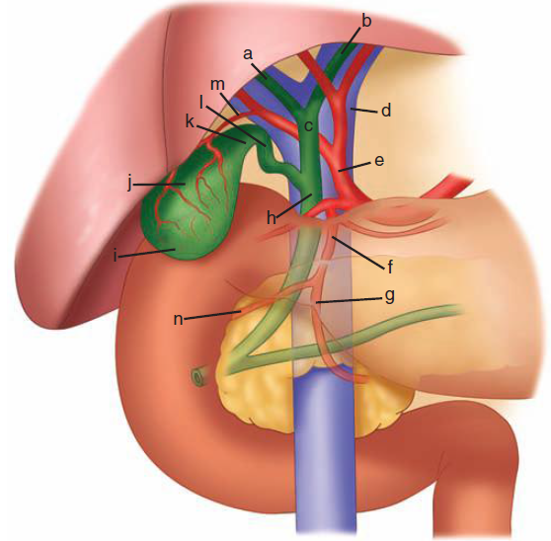
Anterior aspect of the biliary anatomy

Slide 52
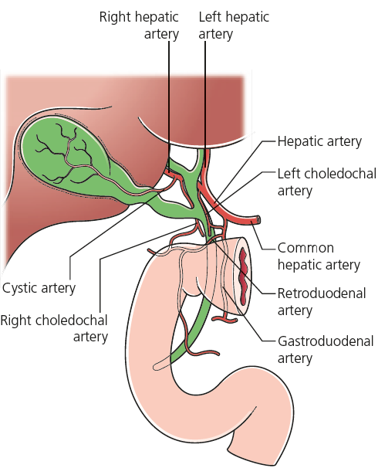

Slide 53
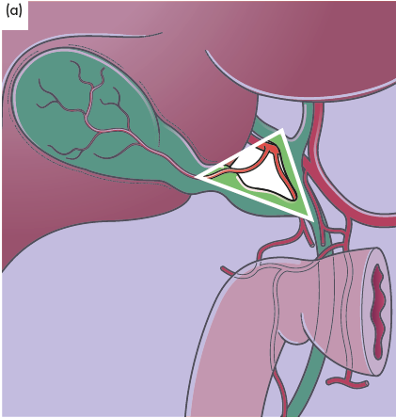
Calot’s triangle

Slide 54
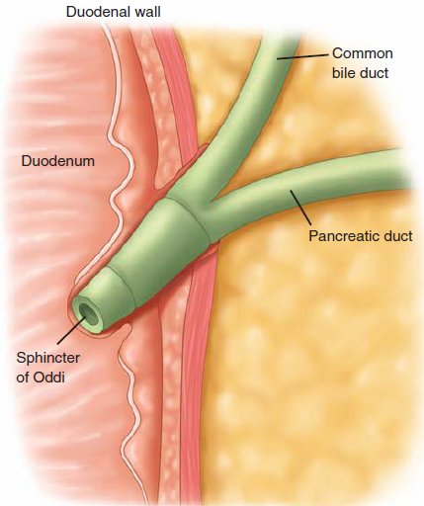

Slide 55
Cholelithiasis (gallstones)

Slide 56
Investigation of the biliary tree
Ultrasound: stones and biliary dilation
Plain radiograph: calcification
MRCP: anatomy and stones
MDR-CT scan: anatomy liver, gallbladder and pancreas cancer
Radioisotope scanning (HIDA scan): function
ERCP: anatomy, stones and biliary strictures
PTC: anatomy and biliary strictures
Endoscopic ultrasound (EUS): anatomy, stones

Slide 57
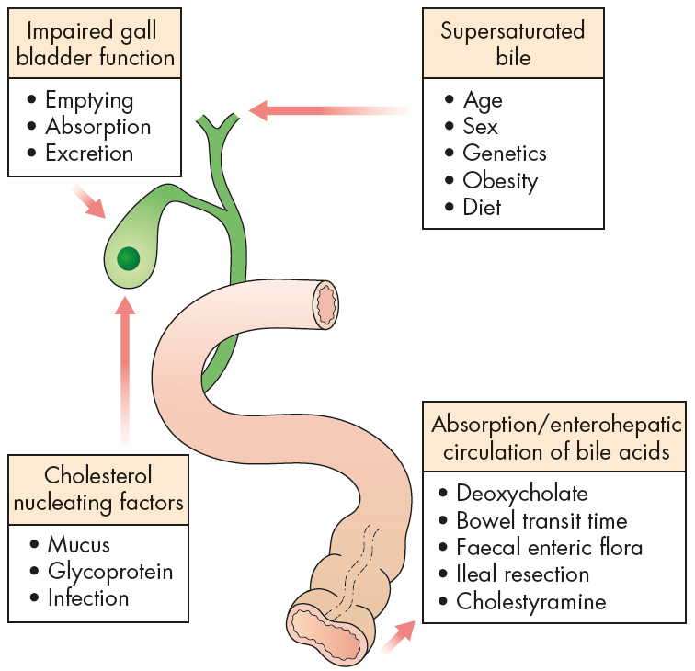
Factors associated with gallstone formation

Slide 58
Effects and complications of gallstones
Biliary colic
Acute cholecystitis
Chronic cholecystitis
Empyema of the gall bladder
Mucocoele
Perforation
Biliary obstruction
Acute cholangitis
Acute pancreatitis
Intestinal obstruction (gallstone ileus)

Slide 59
Definitions
Gallstones
round, oval or faceted concretions found in the biliary tract
contain cholesterol, calcium carbonate, calcium bilirubinate or a mixture of these
Microlithiasis: presence of small/microscopic solid elements within the bile

Slide 60
Epidemiology
Male : female 1:2
Age 40 years onwards
High incidence of mixed stones in Western world
Pigment stones more common in the East

Slide 61
Pathogenesis
Cholesterol stones: imbalance in bile between cholesterol, bile salts and phospholipids, producing lithogenic bile
May be associated with IBD
Mixed stones: associated with anatomical abnormalities, stasis, previous surgery, previous infections
Bilirubinate (pigment) stones: chronic haemolysis

Slide 62
Clinical features
90% of gallstones (probably) asymptomatic
Biliary colic: severe upper abdominal pain radiating around the right costal margin ± vomiting.
Often onset at night, spontaneously resolves after several hours.

Slide 63
Clinical features
Acute cholecystitis: right hypochondrial pain, pyrexia, nausea, RUQ tenderness (positive Murphy’s sign), leucocytosis
Unresolved may lead to an empyema of the gallbladder
‘Chronic cholecystitis’: uncertain diagnosis, vague, intermittent, RUQ abdominal pain, abdominal distension, flatulence, fatty food intolerance

Slide 64
Clinical features
Obstructive jaundice: upper abdominal pain, pale/clay-like stools, dark brown urine, pruritus.
May progress to cholangitis
Charcot’s triad: abdominal pain, high fever/rigors, jaundice if CBD remains obstructed
Pancreatitis: central/epigastric pain, back pain, fever, tachycardia, epigastric tenderness
Gallstone ileus: clinical features of small bowel obstruction, elderly patients

Slide 65
Investigations
FBC: acute inflammatory complications, haemolytic (microcytic) anaemia
U+E/creatinine: in jaundice to monitor renal function
LFTs: obstructive jaundice pattern
Plain abdominal X-ray: shows only 10% of gallstones
Ultrasound: 90% of gallstones will be detected
Assesses CBD size and possible CBD stones

Slide 66
Investigations
MRCP indicated for suspected CBD stones
If positive ERCP is indicated for CBD stone removal or stent placement
Endoluminal/transduodenal ultrasound: diagnosis of small ductal stones
EGD: to exclude peptic ulcer as a cause for uncomplicated disease symptoms

Slide 67
Essential management
Asymptomatic: no treatment required
Biliary colic: analgesia and elective laparoscopic cholecystectomy
Acute cholecystitis: analgesia, IV fluids, antibiotics + early or interval cholecystectomy
Chronic cholecystitis: elective laparoscopic cholecystectomy after other possible causes excluded

Slide 68
Essential management
Empyema: early cholecystectomy or cholecystostomy (surgical or radiological drainage) ± interval cholecystectomy
Ascending cholangitis: IV fluids, antibiotics, ductal drainage (by ERCP, sphincterotomy and extraction of stones) + early laparoscopic cholecystectomy
Pancreatitis: early laparoscopic cholecystectomy once pancreatitis resolved
Gallstone ileus: laparotomy removal of obstructing stone only – no treatment for biliary-enteric fistula
Mortality of 5–25% with gallstone ileus

Slide 69
Complications of cholecystectomy
Conversion: 5–10% of laparoscopic cholecystectomies converted to open operation
Leakage of bile from cystic duct or gallbladder bed
ERCP + temporary CBD stent
Jaundice due to retained ductal stones
ERCP or if T-tube in place by extraction with Dormia basket down the T-tube track (Burhenne manoeuvre)
Bleeding from cystic artery or gallbladder bed (may require re-operation)
Injury to CBD; major reconstructive surgery

Slide 70
Preparation for operation
Full blood count
Renal profile and liver function tests
Prothrombin time
Chest x-ray and electrocardiogram (if over 45 years or medically indicated)
Antibiotic prophylaxis
Deep vein thrombosis prophylaxis
Informed consent

Slide 71
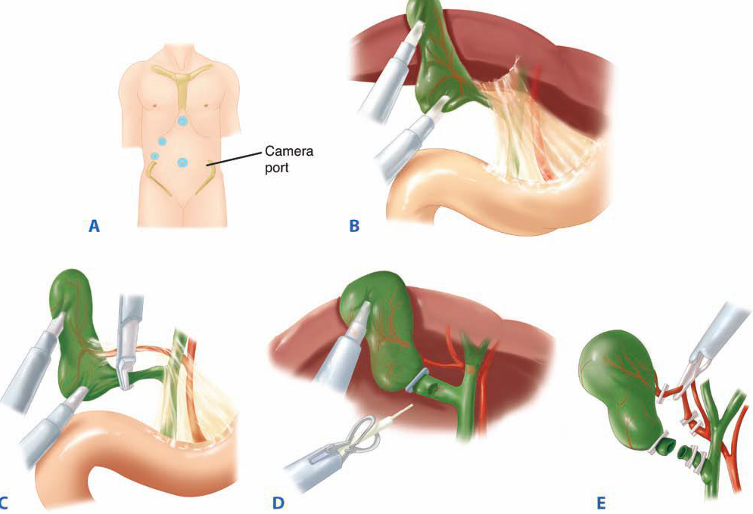
Laparoscopic cholecystectomy

Slide 72
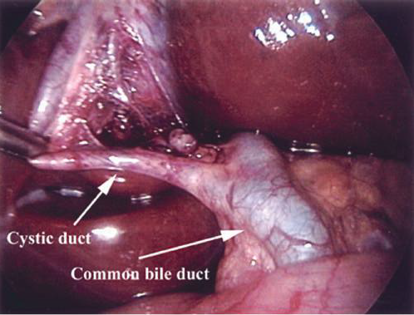
Laparoscopic cholecystectomy

Slide 73
Gallbladder CANCER

Slide 74
EPIDEMIOLOGY
The most common malignancy of biliary tract
Cancer of the gallbladder 3x more common in females
Incidence: 2.5/100,000
Risk factors include: gallstones, porcelain gallbladder and adenoma
1% of all patients who undergo cholecystectomy for gallstones will be found to have gallbladder carcinoma

Slide 75
PATHOLOGY
Adenocarcinoma the most common histologic type
80% adenocarcinomas
10% anaplastic
5% squamous cell

Slide 76
HISTORY
Most patients usually present with late-stage disease
complain of vague right upper quadrant pain,
weight loss, anorexia, and nausea may be present

Slide 77
PHYSICAL EXAMINATION
Right upper quadrant mass may be present
Obstructive jaundice represents invasion or compression of the common bile duct
Ascites seen in advanced cases

Slide 78
STAGING
Stage I: confined to mucosa/submucosa
Stage II: involvement of muscle layer of gallbladder wall
Stage III: lymph node involvement or extension into the liver (2 cm liver invasion)
Stage IV: liver invasion 2 cm or distant metastasis

Slide 79
TREATMENT
The mainstay of treatment for gallbladder cancer: surgical - early detection and complete resection are only chance for cure
Extent of resection controversial, based on stage of disease
Options: simple cholecystectomy, radical resection of gallbladder + partial hepatic resection, or palliative operation
Early-stage disease found incidentally after elective laparoscopic cholecystectomy

Slide 80
TREATMENT
Cancer stage I, confined to the mucosa/submucosa: no additional surgery indicated
Stage II and III, muscle layer involved: en-bloc resection of gallbladder + hepatic segments 4 and 5 + radical lymph node dissection
Stage IV: no benefit from attempts at radical resection (except perhaps in patients with T4N0 disease)

Slide 81
PROGNOSIS
Chance of long-term survival low
For all patients diagnosed with gallbladder cancer, only 4% will be alive after 5 years
Incidentally found in situ disease on cholecystectomy have survival rates of 88%
Overall survival rates of patients:
stage I disease 60%
stage II 24%
stage III 9%
stage IV 1%

Slide 82
KEY POINTS
Cholelithiasis is asymptomatic gallstones within gallbladder
The most common type of gallstones are cholesterol stones, in Western countries
The pathogenesis of these stones relates to supersaturation of bile with cholesterol and subsequent precipitation
Biliary colic is symptomatic gallstones causing transient RUQ pain without inflammation or infection.

Slide 83
KEY POINTS
Complications include: cholecystitis, choledocholithiasis, cholangitis, and biliary pancreatitis
Cholecystitis is inflammation and often infection of gallbladder; symptoms include persistent RUQ pain and signs of infection
Choledocholithiasis is stones in CBD; serum studies often show elevated liver function tests
Cholangitis is infection in bile ducts extending into liver; patients have RUQ pain, fever, and jaundice
Gallstone pancreatitis is complication of choledocholithiasis

Slide 84
KEY POINTS
Incidentally found asymptomatic gallstones should not be treated
Attack of biliary colic/cholecystitis, acute pancreatitis, cholangitis or obstructive jaundice is indication for prophylactic cholecystectomy
Laparoscopic cholecystectomy is treatment of choice for symptomatic gallstones
Proper exposure of Calot’s triangle and careful identification of anatomic structures are keys to avoid bile duct injury

Slide 85
KEY POINTS
Carcinoma of gallbladder and bile duct generally have poor prognosis because patients usually present late and have poor response to chemo- and radiation therapy.
A jaundiced patient with distended palpable non-tender gallbladder indicates distal common bile duct obstruction (Courvoisier law).
Surgery offers the best chance for survival and has good long-term survival in patients with early-stage disease

Slide 86
PANCREAS

Slide 87
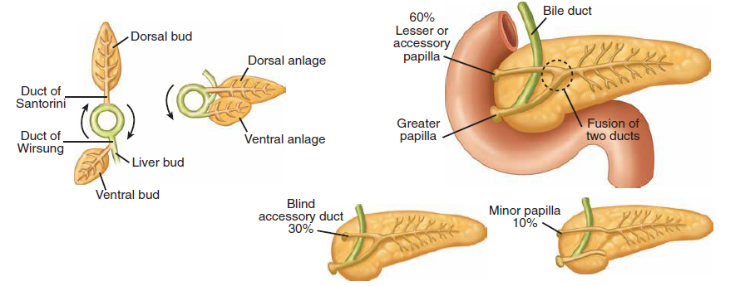
Embryology of pancreas and duct variations

Slide 88
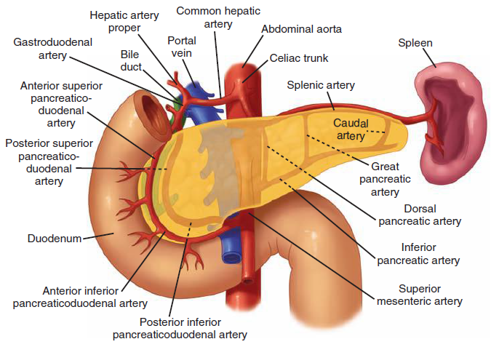
ARTERIAL SUPPLY

Slide 89
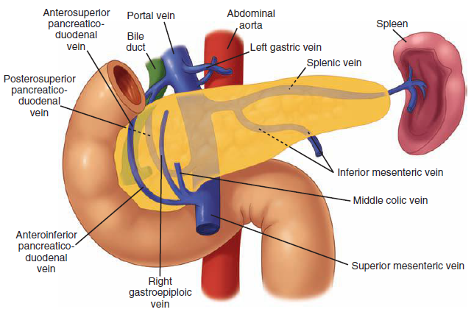
VENOUS DRAINAGE

Slide 90
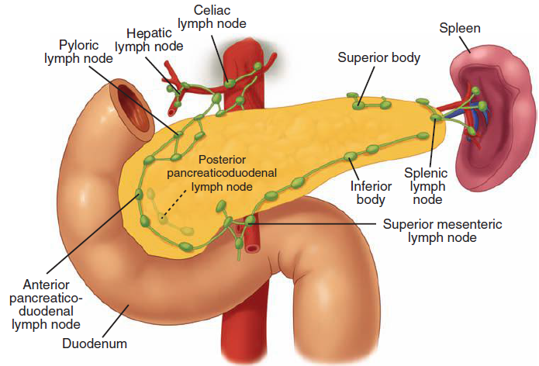
LYMPHATIC SUPPLY

Slide 91
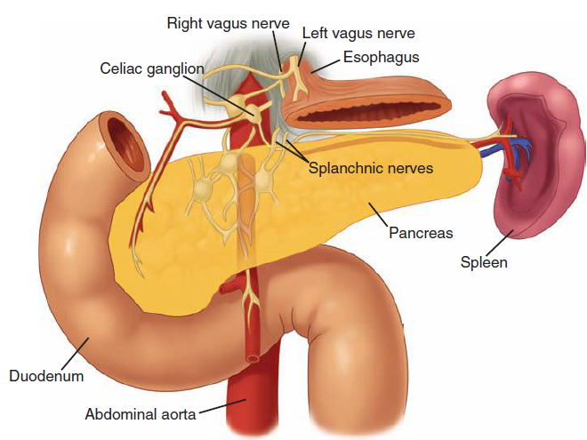
INNERVATION

Slide 92
Pancreatitis

Slide 93
Acute pancreatitis
Acute inflammation of the pancreas - disease of glandular enzymatic autodigestion
Common cause of acute abdominal pain
Significant morbidity and mortality
Presentations range from mild parenchymal edema to life-threatening hemorrhagic pancreatitis

Slide 94
PATHOGENESIS
The exact pathogenesis remains unclear.
One possibility:
Obstruction of ampulla of vater (gallstones, spasm, edema)
Elevated intraductal pressure and bile reflux into the pancreatic duct
Activation and extravasation of intraparenchymal enzymes
Tissue destruction and ischemic necrosis of pancreas and retroperitoneal tissues

Slide 95
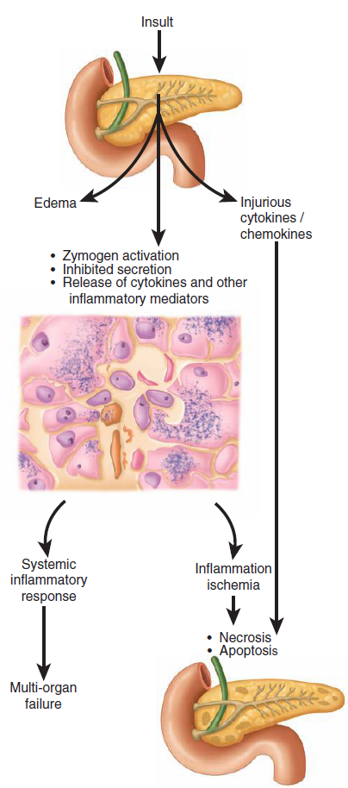
Inflammation
Ischemia
Necrosis
Apoptosis
Systemic inflammatory response
Multi-organ failure

Slide 96
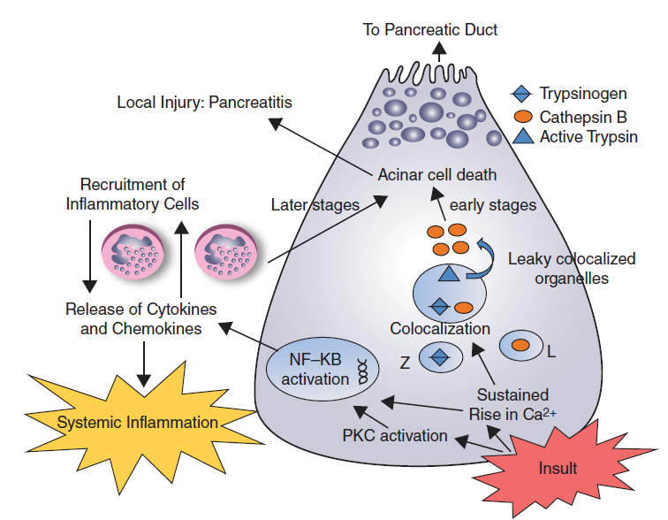
acinar cell events in acute pancreatitis

Slide 97
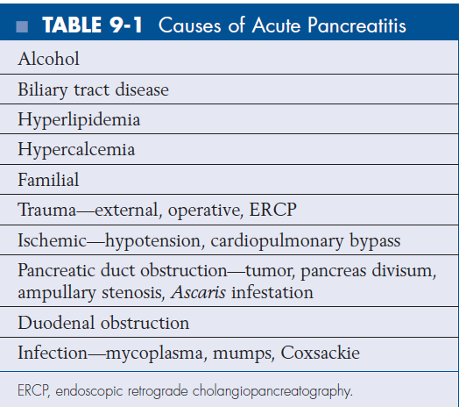

Slide 98
HISTORY
The presentation of acute disease varied, diagnosis may be difficult
Past medical history: prior episodes of pancreatitis, alcoholism, and biliary colic
Upper abdominal pain (often radiating to back), nausea, vomiting, and low-grade fever
Severe attack of pancreatitis: hypotension, sepsis, and multiorgan failure
Patients with alcoholic cause usually experience pain 12 to 48h after alcohol ingestion

Slide 99
Pathology
ACUTE
Mild injury: acinar (exocrine) cell damage, enzymatic spillage, inflammatory cascade activation, localized oedema
Local exudate may lead to increased serum levels of pancreatic enzymes (amylase, lipase)

Slide 100
Pathology
ACUTE
Moderate injury: increasing local inflammation, intra-pancreatic bleeding, fluid collections, spreading local oedema involving mesentery and retroperitoneum
Activation of the systemic inflammatory response leads to progressive involvement of other organs

Slide 101
Pathology
ACUTE
Severe injury: progressive pancreatic destruction, necrosis, profound localized bleeding, fluid collections around pancreas
Spread to local structures and peritoneal cavity may result in mesenteric infarction, peritonitis and intra-abdominal fat ‘saponification’

Slide 102
Pathology
CHRONIC
Recurrent episodes of acute inflammation lead to progressive destruction of acinar cells with healing by fibrosis
Incidental islet cell damage may lead to endocrine gland failure

Slide 103
PHYSICAL EXAMINATION
Upper abdominal tenderness
Usually without peritoneal signs
The abdomen may be slightly distended secondary to a paralytic ileus
Low-grade fever
Tachycardia

Slide 104
DIFFERENTIAL DIAGNOSIS
Acute pancreatitis often difficult to differentiate from other causes of upper abdominal pain
Clinical presentation may mimic perforated peptic ulcer or acute biliary tract disease
Other conditions with similar presentations:
acute intestinal obstruction, acute mesenteric thrombosis and leaking abdominal aortic aneurysm

Slide 105
Clinical features
Mild/moderate pancreatitis: constant upper abdominal pain radiating to back, nausea, vomiting, pyrexia, tachycardia ± jaundice
Severe/necrotizing pancreatitis: severe upper abdominal pain, signs of hypovolaemic shock, respiratory and renal impairment, silent abdomen, retroperitoneal bleeding with flank and umbilical bruising (Grey Turner’s and Cullen’s signs)

Slide 106
Clinical features
Can present at any age but uncommon in childhood and in young adults
Gallstone pancreatitis - middle aged or elderly
Alcohol - related form in patients younger than 40
Pain: rapid onset, severe, constant, usually epigastric and often radiates into back
Patient typically sits forward, and repeated retching is common
Vomiting is early and profuse
The patient may be
shocked with a rapid pulse, cyanosis (indicating
circulatory collapse) and a temperature that may
be either subnormal or raised up to 39.5 ° C (103 ° F).
The abdomen reveals generalized tenderness and
guarding. About 30% of patients are jaundiced
owing to oedema of the pancreatic head obstructing
the common bile duct.

Slide 107
Pain location in chronic pancreatitis

Slide 108
Investigations
Investigations in acute pancreatitis should be
aimed at answering 3 questions:
Is diagnosis of acute pancreatitis correct?
How severe is the attack?
What is the etiology?

Slide 109
Investigations
Diagnosis - on the basis of clinical presentation and elevated serum amylase level
Serum amylase 3-4x above normal indicative of disease
Normal serum amylase level doesn`t exclude acute pancreatitis, particularly if patient has presented few days later
Serum lipase provides slightly more sensitive and specific test than amylase
In doubt, contrast-enhanced CT the best single imaging

Slide 110
Assessment of severity
Important to define group of patients who will develop severe pancreatitis - difference in outcome
Various scoring systems: Ranson and Glasgow scoring systems, APACHE II in intensive care units
Severity stratification should be performed in all patients within 48 hours of diagnosis
Patients with body mass index >30 at higher risk of complications

Slide 111
Assessment of severity
Severe attack
Initial clinical impression of very ill patient
APACHE II score >8
48 hours after onset of symptoms:
Glasgow score >3
CRP>150 mg/L
Worsening clinical state - sepsis or persisting organ failure

Slide 112
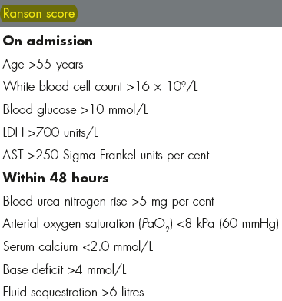
DISEASE SEVERITY SCORES
>3 factors present =
disease classified severe

Slide 113
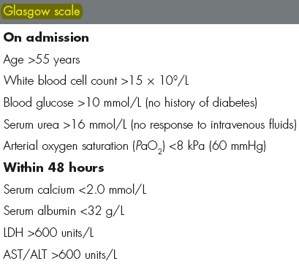
DISEASE SEVERITY SCORES
>3 factors present =
disease classified severe

Slide 114
Imaging
CT may confirm pancreatitis, if amylase normal or diagnosis otherwise unclear
Not necessary for all patients, particularly those with mild attack on prognostic criteria
The severity of pancreatitis on CT may be staged according to the Balthazar criteria
Contrast-enhanced CT indicated in following situations:
Diagnostic uncertainty
In severe acute pancreatitis to distinguish interstitial from necrotising pancreatitis
In first 72h, CT may underestimate extent of necrosis

Slide 115
Imaging
Abdominal X-ray: often no direct help
Absence of free gas or of localized fluid levels assists in diff. dg. (perforated duodenal ulcer or high intestinal obstruction)
‘ Sentinel loop sign ’ - solitary dilated loop of proximal jejunum
Pancreatic calculi in cases of chronic pancreatitis
Ultrasound: associated gallstones and dilatation of common bile duct suggestive of choledocholithiasis
It may show enlargement of pancreas although overlying bowel gas often prevents a good view of the pancreas

Slide 116
Early management of severe acute pancreatitis
Admission to HDU/ICU
Analgesia
Aggressive fluid rehydration
Oxygenation
Invasive monitoring of vital signs, central venous pressure, urine output, blood gases
Frequent monitoring of haematological and biochemical parameters (liver, renal function, clotting, serum calcium, blood glucose)
Nasogastric drainage

Slide 117
Early management of severe acute pancreatitis
Antibiotic prophylaxis can be considered (imipenem, cefuroxime)
CT scan essential if organ failure, clinical deterioration or signs of sepsis develop
ERCP within 72h for severe gallstone pancreatitis or signs of cholangitis
Supportive therapy for organ failure if it develops (inotropes, ventilatory support, haemofiltration, etc.)
If nutritional support is required, consider enteral (nasogastric) feeding

Slide 118
Early management of severe acute pancreatitis
SUPPORTIVE TREATMENT
Analgesia: relief of pain, traditionally with pethidine to avoid the sphincter spasm associated with morphine
Fluid replacement: colloid or blood transfusion, to treat shock and establish diuresis. In less severe cases, electrolyte and water replacement alone may suffice
Resting pancreas by removing stimuli for secretion: patient not allowed to take fluid or food by mouth, NGS started if patient vomiting

Slide 119
Early management of severe acute pancreatitis
SUPPORTIVE TREATMENT
Nutrition: total parenteral nutrition early in severe cases
nasojejunal feeding may be superior to TPN in absence of ileus
Antibiotics (co-amoxiclav) commenced in severe cases and if pancreatitis associated with gallstones
Prophylaxis against gastric erosions with sucralfate or H2 receptor antagonist (ranitidine) or proton pump inhibitor (omeprazole)

Slide 120
Early management of severe acute pancreatitis
SUPPORTIVE TREATMENT
ERCP and endoscopic sphincterotomy early in admission may be indicated:
in severe gallstone pancreatitis
dilated common bile duct
ultrasound associated with deranged liver function tests

Slide 121
Complications OF acute pancreatitis
ACUTE
Pancreatic abscess: usually necrotic pancreas present
Intra-abdominal sepsis
Necrosis of transverse colon
Respiratory (ARDS) or renal (ATN) failure
Pancreatic haemorrhage

Slide 122
Complications OF acute pancreatitis
SUBACUTE/CHRONIC
Pseudocyst formation: may need to be drained internally (endoscopically or surgically) or externally (radiological)
• Chronic pancreatitis.

Slide 123
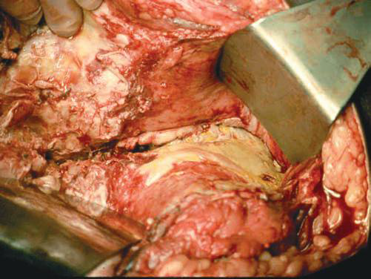
Operative view of infected acute pancreatitis

Slide 124
CHRONIC PANCREATITIS
Chronic and acute pancreatitis are clinically distinct entities
Bouts of acute pancreatitis may occur in the course of the development of chronic pancreatitis
Pathogenesis of chronic pancreatitis has much in common with alcoholic acute pancreatitis
In acute pancreatitis gland is normal before attack and chronic pancreatitis is characterized by gradual destruction of functional pancreatic tissue

Slide 125
CHRONIC PANCREATITIS
Small number of patients with acute pancreatitis progress to chronic pancreatitis
Characterized by persistent inflammation, and destructive fibrosis of the gland
Clinical picture: recurring or persistent upper abdominal pain, evidence of malabsorption, steatorrhea, diabetes

Slide 126
PATHOGENESIS
Chronic pancreatitis categorized in 2 forms:
Calcific pancreatitis, usually associated with persistent alcohol abuse
Obstructive pancreatitis, secondary to pancreatic duct obstruction

Slide 127
PATHOGENESIS
Alcohol induced calcific pancreatitis - the most common form of disease in Western populations
Proposed mechanisms: ductal plugging and occlusion by protein and mineral precipitates, resulting inflammation and patchy fibrosis, parenchymal destruction and eventual atrophy of the gland
Obstructive chronic pancreatitis due to ductal blockage secondary to scarring from acute pancreatitis or trauma, papillary stenosis, pseudocyst, or tumor
This blockage results in upstream duct dilatation and inflammation

Slide 128
HISTORY
Abdominal pain
Principal presenting complaint
The most frequent indication for surgery
Upper abdominal
Intermittent or persistent
Frequently radiates to back
Patients often addicted to narcotic pain relievers
Other symptoms result from exocrine insufficiency (malabsorption) and endocrine insufficiency (diabetes mellitus)

Slide 129
Clinical features
Patient may present with one or more of following:
Asymptomatic (x-ray diagnosis, pancreatic calcification)
Recurrent abdominal pain radiating through to upper lumbar region, relieved by sitting forward
Steatorrhoea due to pancreatic insufficiency, resulting in malabsorption and weight loss
Diabetes due to β - cell damage
Obstructive jaundice - even at operation very difficult to differentiate from carcinoma of the head of the pancreas

Slide 130
DIAGNOSTIC EVALUATION
Best made using imaging techniques that detect pancreatic morphologic changes rather than tests of glandular function
Radiologic signs of chronic pancreatitis include heterogeneously inflamed or atrophied gland, dilated and strictured pancreatic duct, and presence of calculi
Ultrasonography and CT useful initial imaging
ERCP - the most accurate means of diagnosing chronic pancreatitis, clearly defines pathologic changes of pancreatic ductal system and the biliary tree

Slide 131
Treatment
Principal treatment: remove causative factors such as alcohol consumption
Analgesics : often warrant opiate analgesia, long-term use may result in addiction, often one of the most difficult aspects of management
Diet : low-fat diet with pancreatic enzyme supplements (pancreatin) by mouth
Insulin when diabetes mellitus occurs

Slide 132
Treatment
Surgery for very frequent attacks or severe pain
Partial pancreatectomy
Drainage of whole length of pancreatic duct – Puestow
Total pancreatectomy: if consequent diabetes and steatorrhoea
Bypass by Roux-en-Y: for painless obstructive jaundice
Whipple’s operation (pancreaticodoudenectomy): if diagnostic uncertainty or with coincident problem with gastric emptying

Slide 133
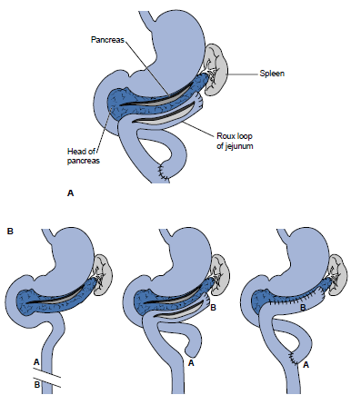
Longitudinal pancreatico-jejunostomy: treatment of chronic pancreatitis

Slide 134
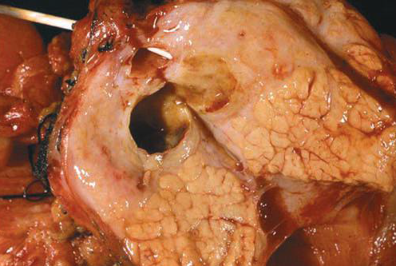
Gross appearance of chronic pancreatitis
Areas of fibrosis and scarring adjacent to areas where lobar architecture is preserved.
Dilated pancreatic duct indicates presence of downstream obstruction.

Slide 135
Pancreatic cysts

Slide 136
Pancreatic cysts
CLASSIFICATION
TRUE (20%)
Congenital polycystic disease of pancreas
Retention
Hydatid
Neoplastic: cystadenoma or cystadenocarcinoma
FALSE - collection of fluid in lesser sac (80%):
after trauma to pancreas
following acute pancreatitis
owing to perforation of posterior gastric ulcer (rare)

Slide 137
Clinical features
Firm, large, rounded, upper abdominal swelling
Initially, cyst apparently resonant because of loops of gass-filled bowel in front of it
With increases in size intestine is pushed away and the cyst becomes dull to percussion

Slide 138
Treatment
True cysts require surgical excision
False cysts are drained
Internally: anastomosis either into stomach or into small intestine
Percutaneously, under ultrasound control

Slide 139
PANCREATIC TUMORS

Slide 140
Classification
Benign
Malignant
Adenoma
Cystadenoma
Islet cell tumour
Zollinger-Ellison tumor
Insulinoma
(β-cell tumor)
Glucagonoma
(α-cell tumor)
Primary:
Adenocarcinoma
Cystadenocarcinoma
Malignant islet cell tumor
Secondary: invasion from carcinoma of stomach or bile duct

Slide 141
pancreatic cancer

Slide 142
Definitions
Pancreatic adenocarcinoma is malignant lesion of the head, body or tail of pancreas
Periampullary carcinomas arise around ampulla of Vater and include tumours arising from pancreas, duodenum, distal bile duct and ampulla.
Neuroendocrine tumours of the pancreas cause variety of syndromes secondary to the secretion of active peptides.

Slide 143
Epidemiology and etiology
Male : female, 2:1
Peak incidence: 50 - 70 years
Incidence increasing in the Western world
Predisposing factors: smoking, diabetes, chronic pancreatitis

Slide 144
Pathology
Site: 55% head of pancreas, 25% body, 15% tail, 5% periampullary region
Macroscopic: growth hard and infiltrating
Histology: 90% ductal carcinoma, 7% acinar cell carcinoma, 2% cystic carcinoma, 1% connective tissue origins
Spread: local into vital structures (portal vein, superior mesenteric vessels), lymphatics to peritoneum and regional nodes via bloodstream to liver and lung
Metastases often present at time of diagnosis

Slide 145
Clinical features
Jaundice, abdominal pain and weight loss
Head or periampullary: painless, progressive jaundice with palpable gallbladder
Courvoisier’s law: palpable gallbladder in presence of jaundice unlikely to be due to gallstones
Duodenal obstruction causing vomiting
Body: back pain, anorexia, weight loss, steatorrhoea
Tail: often presents with metastases, malignant ascites or unexplained anaemia
New onset diabetes may be first presentation (~10%)

Slide 146
Investigations
Ultrasound: mass in head of pancreas and distended biliary tree
Spiral CT: tumour mass, facilitates biopsy, assess involvement of surrounding structures and local lymph node spread, best for staging
EUS ± fine needle biopsy: staging, vascular involvement, tissue diagnosis

Slide 147
Investigations
MRCP/ERCP: accurate in making diagnosis; obtain specimen or shed cells for cytology and stent may be placed to relieve jaundice
Barium meal: widening of the duodenal loop with medial filling defect, the reversed ‘3’ sign
Not used very much anymore
Tumour marker (CA19.9) not diagnostic but useful to monitor treatment response

Slide 148
Essential management
CURATIVE TREATMENT
Rarely (<20%)
Radical surgical resection (Whipple’s procedure) of small tumours of head of pancreas
Curative if lymph nodes not involved
Only indicated for Stage I disease (T1 or T2/N0/M0)

Slide 149
Essential management
PALLIATION
Pancreatic adenocarcinoma usually incurable at time of diagnosis
Jaundice can be relieved by placing stent through tumour endoscopically (at ERCP)
Duodenal obstruction (10%) may be relieved by gastrojejunostomy
Pain should be treated with opioids ± percutaneous cellacoplexus block

Slide 150
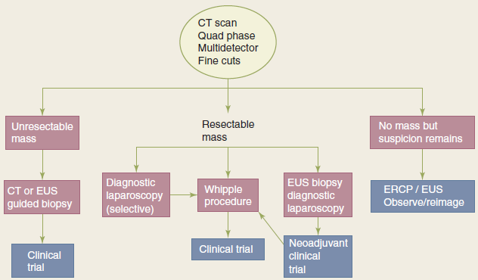
Diagnosis and treatment for pancreatic cancer

Slide 151
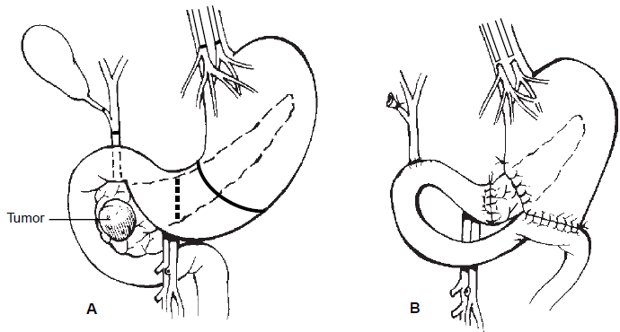
Pancreaticoduodenectomy -Whipple procedure
Preoperative anatomic relationships
Postoperative reconstruction

Slide 152
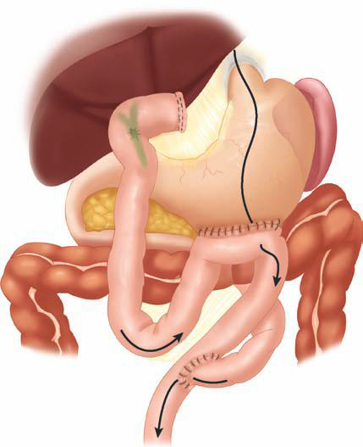
Biliary-enteric bypass – palliation of unresectable pancreatic cancer

Slide 153
Prognosis
90% of patients with pancreatic adenocarcinoma dead within 12 months of diagnosis
5-year survival following radical resection only 10%
Important to obtain histology from tumours around the head of pancreas
prognosis from non-pancreatic periampullary cancers is considerably better
50% 5-year survival following resection

Slide 154
Neuroendocrine tumours
Rare (4-12/1,000,000)
Any age
Male:female 1:1
Classified:
Non-functioning (50%)
Functioning: insulinomas (25%), gastrinomas (15%), VIP-omas, glucagonomas, somatostatinomas (15%)

Slide 155
Neuroendocrine tumours
15-30% of patients with pancreatic endocrine tumors have MEN1:
3 P’s: parathyroid (hyperparathyroidism), pancreas (gastrinoma), pituitary (prolactinoma)
Presentation: non-functioning may be found incidentally
Functioning present with symptoms due to excess production of specific hormone produced
hypoglycaemia with insulinoma, peptic ulcer with gastrinoma

Slide 156
KEY POINTS
Alcohol ingestion and gallstone disease are primarily responsible for acute pancreatitis, and alcohol use is primarily responsible for chronic pancreatitis
Ranson criteria are used to predict severity of disease and estimate mortality
Pancreatitis is usually self-limiting and resolves with supportive care

Slide 157
KEY POINTS
Complications such as chronic pseudocyst, abscess, necrosis, or hemorrhage are treated surgically
Surgical treatment includes
Drainage procedures
Longitudinal pancreaticojejunostomy – Puestow
Pancreatic resection (distal pancreatectomy)

Slide 158
KEY POINTS
Most pancreatic cancer is not surgically curable
CT and ERCP are used to determine tumor resectability
Resectable tumors of the head of the pancreas are removed by pancreaticoduodenectomy (Whipple procedure)
Prognosis is generally poor.
Good palliation of jaundice is possible without surgery

Slide 159
Key points
New, chronic back pain and vague symptoms may be the only presenting featureI
In pancreatic cancer, obstructive jaundice, weight loss, and abdominal pain are common findings
Courvoisier sign is jaundice and non-tender palpable gallbladder, indicating tumor obstruction of distal common bile duct

Slide 160
QUESTIONS?

