Slide 1
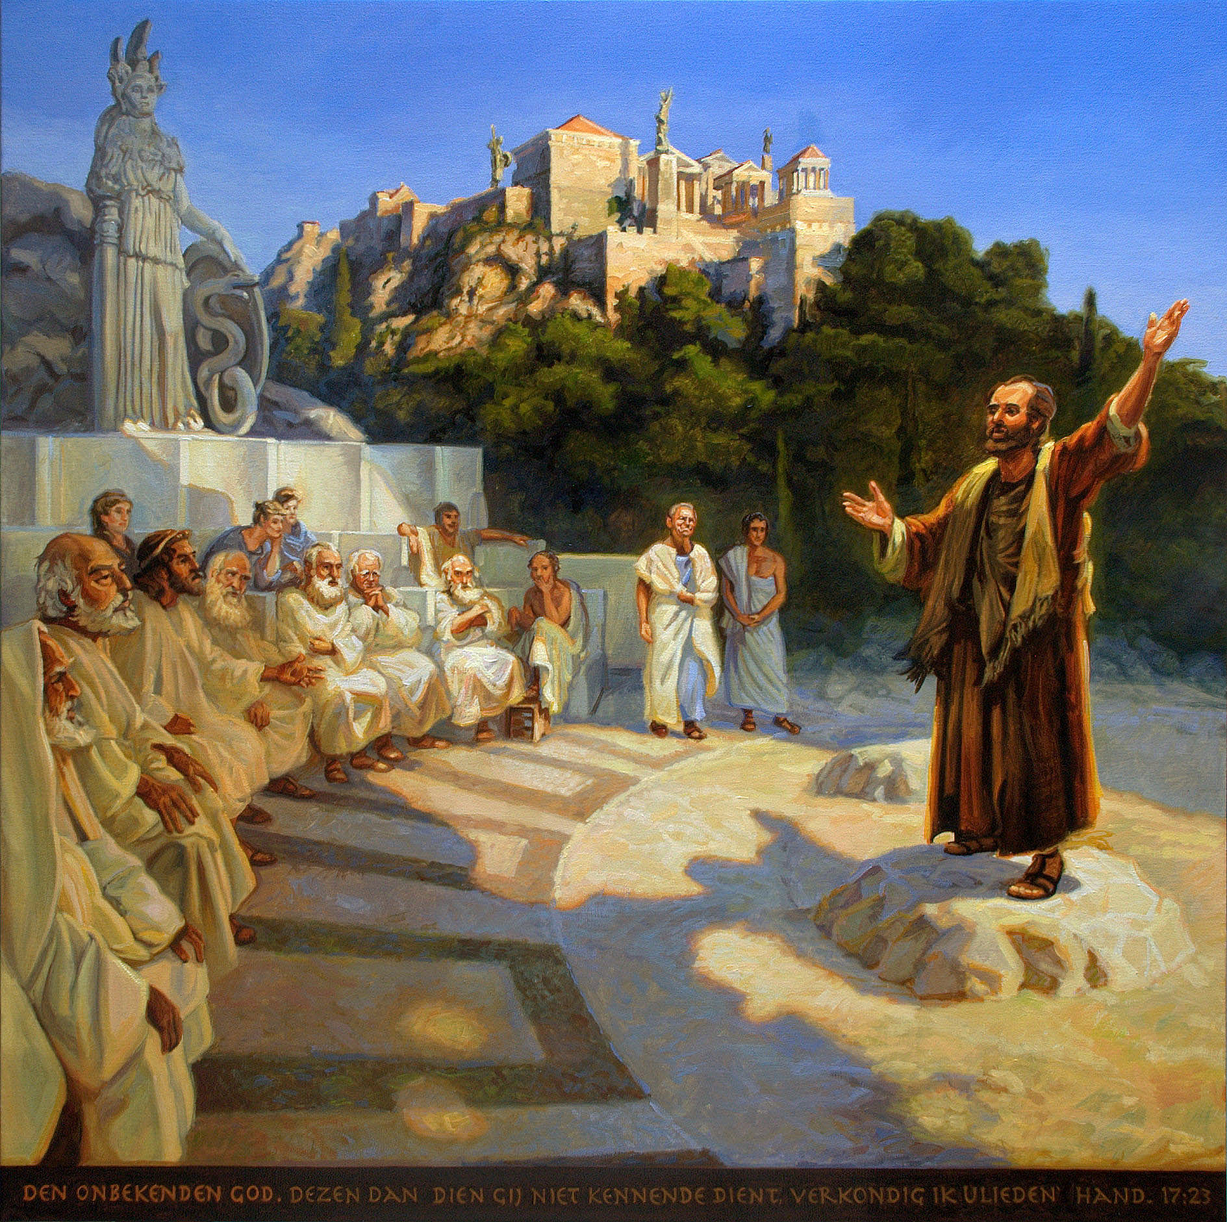
Trinity Evangelical Lutheran Church May 15, 2022
WELCOME!
Notes:
Image: Five Loaves by Caroline Coolidge Brown. Copyright © Caroline Coolidge Brown. All rights reserved. Used by permission of the artist.

Slide 2
Prelude By Darrell Fryman
= Please stand if able
= Please be seated
Office of the Acolyte and Ringing of the Bell
Welcome
Notes:
Image: Five Loaves by Caroline Coolidge Brown. Copyright © Caroline Coolidge Brown. All rights reserved. Used by permission of the artist.

Slide 3
CONFESSION AND FORGIVENESS
All may make the sign of the cross, the sign marked at baptism…
L: We confess our sins before God and one another.
Pause for silence and reflection.
L: Forgiving God…
Notes:
Image: Five Loaves by Caroline Coolidge Brown. Copyright © Caroline Coolidge Brown. All rights reserved. Used by permission of the artist.

Slide 4
CONFESSION AND FORGIVENESS
C: We spend so much of our time doubting you, doubting ourselves, failing to place our trust in you. Our lack of faith causes us to stumble, and when we fall we fall far. Forgive us our sin and lift us so that we can rise to the challenge of carrying out your mission.
Notes:
Image: Five Loaves by Caroline Coolidge Brown. Copyright © Caroline Coolidge Brown. All rights reserved. Used by permission of the artist.

Slide 5
CONFESSION AND FORGIVENESS
L: God is merciful and just. God offers forgiveness for all who ask it. Receive now the entire forgiveness of all your sins and walk with the power of the Holy Spirit, for the sake of Jesus.
C: Amen.
Notes:
Image: Five Loaves by Caroline Coolidge Brown. Copyright © Caroline Coolidge Brown. All rights reserved. Used by permission of the artist.

Slide 6
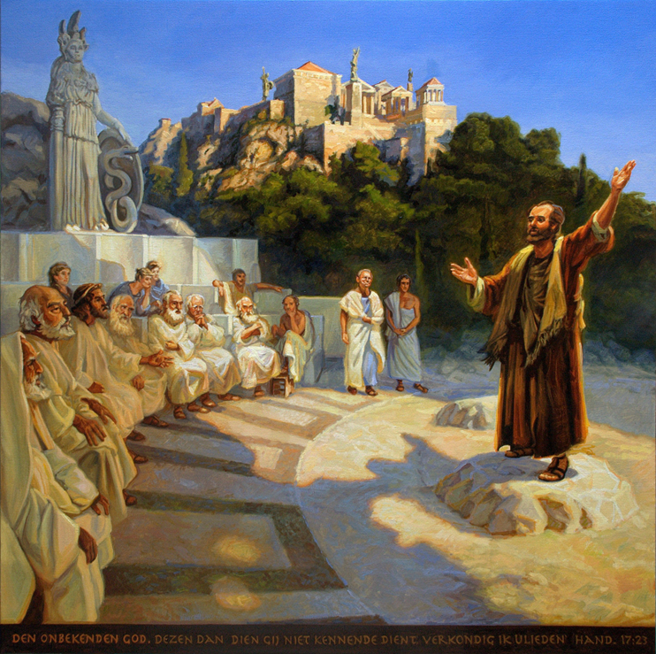
Gathering Song
“Blessed Assurance”
ELW 638
Notes:
Image: Five Loaves by Caroline Coolidge Brown. Copyright © Caroline Coolidge Brown. All rights reserved. Used by permission of the artist.

Slide 7
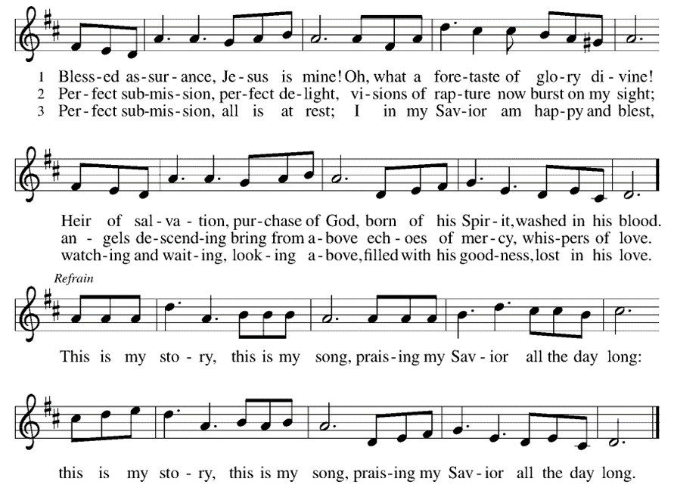
Blessed Assurance ELW 638
Notes:
Image: Preparing yeast dough. Copyright © tomasworks/iStock/Thinkstock. Used by permission.

Slide 8
APOSTOLIC GREETING
P: The grace of our Lord Jesus Christ, the love of God, and the communion of the Holy Spirit be with you all.
C: And also with you.
Notes:
Image: Five Loaves by Caroline Coolidge Brown. Copyright © Caroline Coolidge Brown. All rights reserved. Used by permission of the artist.

Slide 9
KYRIE
A: In peace let us pray to the Lord.
C: Lord have mercy.
A: For the peace from above, and for our salvation, let us pray to the Lord.
C: Lord have mercy.
A: For the peace of the whole world, for the well being of the Church of God, and for the unity of all, let us pray to the Lord.
C: Lord have mercy.
Notes:
Image: Five Loaves by Caroline Coolidge Brown. Copyright © Caroline Coolidge Brown. All rights reserved. Used by permission of the artist.

Slide 10
KYRIE
A: For this Holy House, and for all who offer here their worship and praise, let us pray to the Lord.
C: Lord have mercy.
A: Help, save, and defend us, gracious Lord.
C: Amen.
Notes:
Image: Five Loaves by Caroline Coolidge Brown. Copyright © Caroline Coolidge Brown. All rights reserved. Used by permission of the artist.

Slide 11
PRAYER OF THE DAY
P: Let us pray… God of all wisdom, Paul knew how to sit with people in their own reality before bringing them along the journey of the story of Christ. Teach us to honor people’s journeys with grace and respect.
C: Amen.
Notes:
Image: Five Loaves by Caroline Coolidge Brown. Copyright © Caroline Coolidge Brown. All rights reserved. Used by permission of the artist.

Slide 12
Notes:
Image: Preparing yeast dough. Copyright © tomasworks/iStock/Thinkstock. Used by permission.

Slide 13
Scripture Reading
R: The Scripture reading is from the Book of the Acts of the Apostles, Chapter 17.
C: Glory to you O’ Lord! (Spoken)
Notes:
Image: Five Loaves by Caroline Coolidge Brown. Copyright © Caroline Coolidge Brown. All rights reserved. Used by permission of the artist.

Slide 14
Acts 17:16-31
¹⁶While Paul was waiting for them in Athens, he was deeply distressed to see that the city was full of idols. ¹⁷So he argued in the synagogue with the Jews and the devout persons, and also in the marketplace every day with those who happened to be there. ¹⁸Also some Epicurean and Stoic philosophers debated with him. Some said, “What does this babbler want to
Notes:
Image: Five Loaves by Caroline Coolidge Brown. Copyright © Caroline Coolidge Brown. All rights reserved. Used by permission of the artist.

Slide 15
Acts 17:16-31
say?” Others said, “He seems to be a proclaimer of foreign divinities.” (This was because he was telling the good news about Jesus and the resurrection.) ¹⁹So they took him and brought him to the Areopagus and asked him, “May we know what this new teaching is that you are presenting? ²⁰It sounds rather strange to us, so we would like to know what it
Notes:
Image: Five Loaves by Caroline Coolidge Brown. Copyright © Caroline Coolidge Brown. All rights reserved. Used by permission of the artist.

Slide 16
Acts 17:16-31
means.” ²¹Now all the Athenians and the foreigners living there would spend their time in nothing but telling or hearing something new.
²²Then Paul stood in front of the Areopagus and said, “Athenians, I see how extremely religious you are in every way. ²³For as I went through the city and looked carefully at the objects of your worship, I found among them
Notes:
Image: Five Loaves by Caroline Coolidge Brown. Copyright © Caroline Coolidge Brown. All rights reserved. Used by permission of the artist.

Slide 17
Acts 17:16-31
an altar with the inscription, ‘To an unknown god.’ What therefore you worship as unknown, this I proclaim to you. ²⁴The God who made the world and everything in it, he who is Lord of heaven and earth, does not live in shrines made by human hands, ²⁵nor is he served by human hands, as though he needed anything, since he himself gives to all mortals life and breath and
Notes:
Image: Five Loaves by Caroline Coolidge Brown. Copyright © Caroline Coolidge Brown. All rights reserved. Used by permission of the artist.

Slide 18
Acts 17:16-31
all things. ²⁶From one ancestor he made all nations to inhabit the whole earth, and he allotted the times of their existence and the boundaries of the places where they would live, ²⁷so that they would search for God and perhaps grope for him and find him—though indeed he is not far from each one of us. ²⁸For ‘In him we live and move and have our being’; as even some of your
Notes:
Image: Five Loaves by Caroline Coolidge Brown. Copyright © Caroline Coolidge Brown. All rights reserved. Used by permission of the artist.

Slide 19
Acts 17:16-31
own poets have said, ‘For we too are his offspring.’ ²⁹Since we are God’s offspring, we ought not to think that the deity is like gold, or silver, or stone, an image formed by the art and imagination of mortals. ³⁰While God has overlooked the times of human ignorance, now he commands all people everywhere to repent,
Notes:
Image: Five Loaves by Caroline Coolidge Brown. Copyright © Caroline Coolidge Brown. All rights reserved. Used by permission of the artist.

Slide 20
Acts 17:16-31
³¹because he has fixed a day on which he will have the world judged in righteousness by a man whom he has appointed, and of this he has given assurance to all by raising him from the dead.”
Notes:
Image: Five Loaves by Caroline Coolidge Brown. Copyright © Caroline Coolidge Brown. All rights reserved. Used by permission of the artist.

Slide 21
Sermon
Notes:
Image: Five Loaves by Caroline Coolidge Brown. Copyright © Caroline Coolidge Brown. All rights reserved. Used by permission of the artist.

Slide 22
NICENE CREED
C: We believe in one God, the Father, the Almighty, maker of heaven and earth, of all that is, seen and unseen.

Slide 23
NICENE CREED
C: We believe in one Lord, Jesus Christ, the only Son of God, eternally begotten of the Father, God from God, Light from Light, true God from true God, begotten, not made, of one Being with the Father.

Slide 24
NICENE CREED
C: Through him all things were made. For us and for our salvation he came down from heaven; by the power of the Holy Spirit he became incarnate from the virgin Mary, and was made man. For our sake he was crucified under Pontius Pilate;

Slide 25
NICENE CREED
C: he suffered death and was buried. On the third day he rose again in accordance with the Scriptures; he ascended into heaven and is seated at the right hand of the Father. He will come again in glory to judge the living and the dead, and his kingdom will have no end.

Slide 26
NICENE CREED
C: We believe in the Holy Spirit, the Lord, the giver of life, who proceeds from the Father and the Son. With the Father and the Son he is worshiped and glorified. He has spoken through the prophets. We believe in one holy catholic and apostolic Church.

Slide 27
NICENE CREED
C: We acknowledge one Baptism for the forgiveness of sins. We look for the resurrection of the dead, and the life of the world to come. Amen.

Slide 28
PRAYERS OF INTERCESSION
Each petition will end with the words,
A: Risen Lord,
The congregation will respond with:
C: hear our prayer.

Slide 29
PRAYERS OF INTERCESSION
The prayer concludes…
P: We have indeed received grace upon grace from you, loving God. Accept these our prayers and use them to transform hearts and lives. In Jesus’ name we pray.
C: Amen.

Slide 30
OFFERING PRAYER
Notes:
Image: Five Loaves by Caroline Coolidge Brown. Copyright © Caroline Coolidge Brown. All rights reserved. Used by permission of the artist.

Slide 31
THE GREAT THANKSGIVING
Communion by pre-packaged Communion Cups. All the Baptized are welcome to celebrate this Holy Meal.

Slide 32
DIALOGUE
P: The Lord be with you.
C: And also with you.
P: Lift up your hearts.
C: We lift them to the Lord.
P: Let us give thanks to the Lord our God.
C: It is right to give him thanks and praise.

Slide 33
Preface
P: It is indeed right…
…join their unending hymn

Slide 34
Sanctus
C: Holy, holy, holy Lord, God of power and might: Heaven and earth are full of your glory. Hosanna. Hosanna. Hosanna in the highest. Blessed is he who comes in the name of the Lord. Hosanna in the highest.

Slide 35
Eucharistic Prayer
P: Holy, living, and loving God…
…in your holy Church, both now and forever.
C: Amen

Slide 36
THE LORD’S PRAYER
C: Our Father, who art in heaven, hallowed be thy name, thy kingdom come, thy will be done, on earth as it is in heaven. Give us this day our daily bread; and forgive us our trespasses, as we forgive those who trespass against us; and lead us not into temptation, but deliver us from evil.

Slide 37
THE LORD’S PRAYER
C: For thine is the kingdom, and the power, and the glory, forever and ever. Amen.

Slide 38
INVITATION TO COMMUNION
P: Too often we sit down to eat only with those that are like us. Jesus offers an extraordinary chance to participate in a meal that is shared by people of rich diversity. Come to the table, and as you receive the body and blood of Christ, recognize that you are part of the family of humanity.

Slide 39
POST COMMUNION BLESSING
P: May this Body and Blood of our Lord and Savior, Jesus Christ, strengthen, keep, and unite us, now and forever.
C: Amen.

Slide 40
POST COMMUNION PRAYER
P: Let us pray… We give you thanks, gracious God, for we have feasted on the abundance of your house. Send us to bring good news and to proclaim your favor to all, strengthened with the richness of your grace in your Son, Jesus Christ.
C: Amen

Slide 41
ANNOUNCEMENTS
Notes:
Image: Five Loaves by Caroline Coolidge Brown. Copyright © Caroline Coolidge Brown. All rights reserved. Used by permission of the artist.

Slide 42
SENDING BLESSING
P: God, the Author of life, Christ, the living Cornerstone, and the life-giving Spirit of adoption, bless you now and forever.
C: Amen.

Slide 43
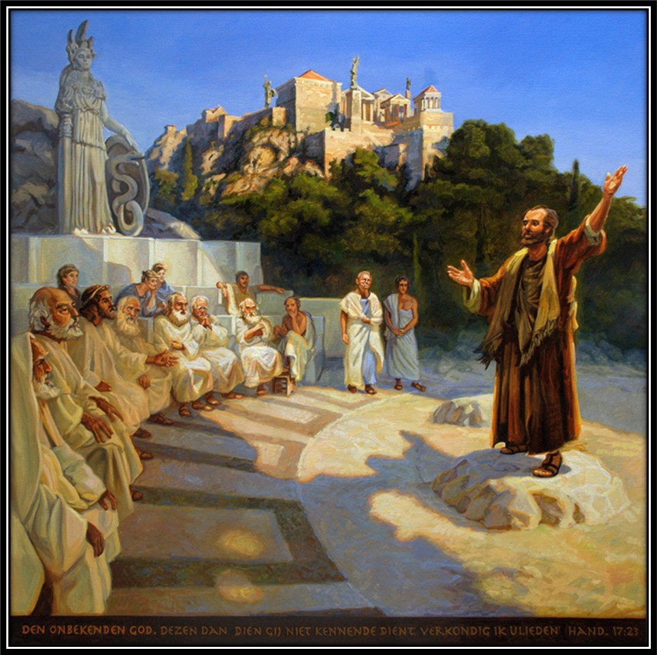
Sending Song
“In Christ There Is No East or West”
LBW 359
Notes:
Image: Five Loaves by Caroline Coolidge Brown. Copyright © Caroline Coolidge Brown. All rights reserved. Used by permission of the artist.

Slide 44
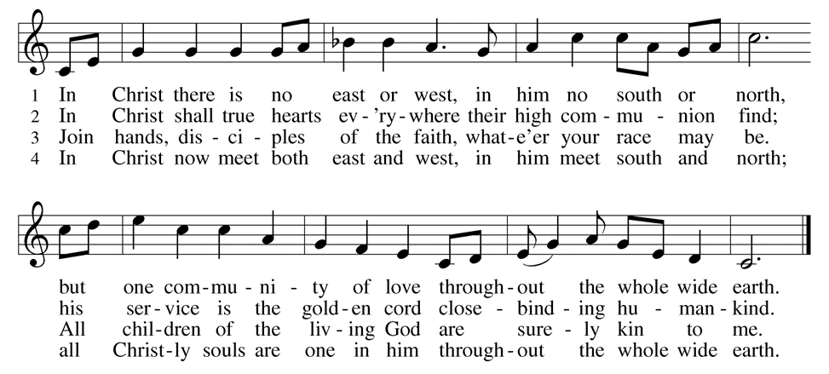
In Christ There Is No East or West--LBW 359
Notes:
Image: Five Loaves by Caroline Coolidge Brown. Copyright © Caroline Coolidge Brown. All rights reserved. Used by permission of the artist.

Slide 45
DISMISSAL
P: … depart in Christ’s Love.
C: Seeking, welcoming, and serving all. Amen!
POSTLUDE
By
By Darrell Fryman
From sundaysandseasons.com. Copyright © 2022 Augsburg Fortress. All rights reserved. Reprinted by permission under Augsburg Fortress Liturgies Annual License #SAS023830. New Revised Standard Version Bible, Copyright © 1989, Division of Christian Education of the National Council of the Churches of Christ in the United States of America. Used by permission. All rights reserved. Revised Common Lectionary, Copyright © 1992 Consultation on Common Texts, admin Augsburg Fortress. Used by permission.

