Slide 1
Female Physiology Before Pregnancy and Female Hormones
Prof. dr. Zoran Valić
Department of Physiology
University of Split School of Medicine

Slide 2
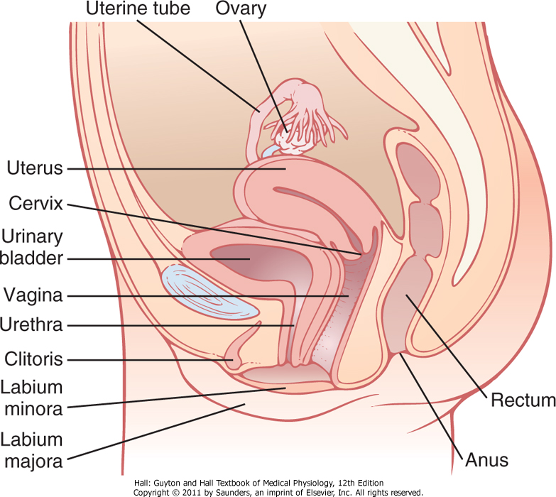

Slide 3
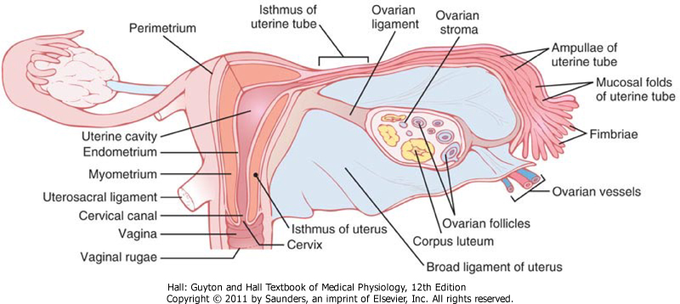

Slide 4
Physiologic Anatomy
during all reproductive years of adult life (13 and 46 years), 400 to 500 of the primordial follicles develop enough to expel their ova-one each month, the remainder degenerate (become atretic)
at menopause only a few primordial follicles remain in ovaries and even these degenerate soon thereafter

Slide 5
Female Hormonal System
GnRH
FSH & LH
estrogen and progesterone
various hormones are secreted at drastically differing rates during different parts of the female monthly sexual cycle
GnRH is secreted in short pulses averaging once every 90 minutes, as occurs in male

Slide 6
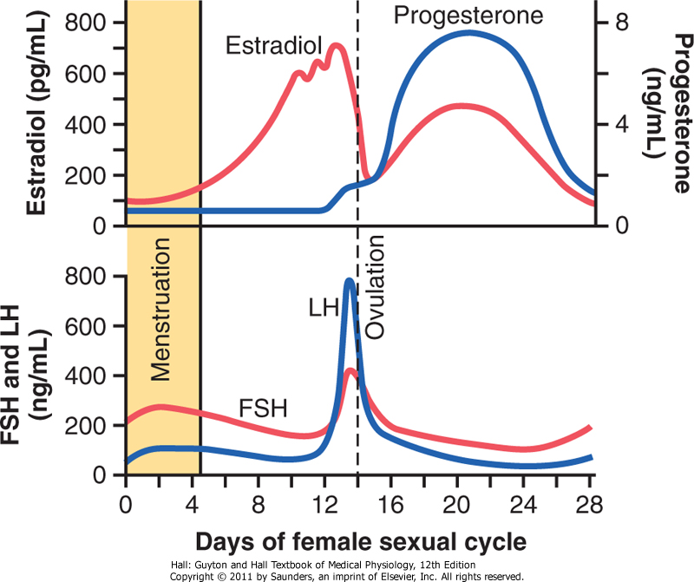

Slide 7
Monthly Ovarian Cycle
female monthly sexual cycle (menstrual cycle)
duration of cycle averages 28 days (20-45 days, decreased fertility)
single ovum – single fetus
uterine endometrium is prepared in advance for implantation

Slide 8
Gonadotropic Hormones and Their Effects on the Ovaries
ovarian changes depend completely on FSH and LH (glycoproteins, 30000)
without them ovaries remain inactive (childhood)
time of first menstrual cycle – menarche
cyclical increase and decrease of FSH and LH (highly specific receptors – cAMP)

Slide 10
Ovarian Follicle Growth-"Follicular" Phase
after birth each ovum is surrounded by a single layer of granulosa cells – primordial follicle (prophase stage of meiotic division)
GC – provide nourishment and secretion of an oocyte maturation-inhibiting factor
first stage of follicular growth – growth of ovum itself (2-3x), growth of additional layers of GC – primary follicles

Slide 11
first few days of cycle –  LH & FSH (FSH slightly greater and earlier; accelerated growth of 6 to 12 primary follicles, rise of many more layers of GC and theca cells (from interstitium)
theca interna – epithelioid characteristics (secrete estrogen and progesterone)
theca externa – capsule (highly vascular connective tissue)

Slide 12
GC secretes a follicular fluid (high concentration of estrogen) – antrum
early growth of primary follicle up to antral stage is stimulated mainly by FSH alone
greatly accelerated growth – vesicular follicles (FSH & LH)

Slide 13
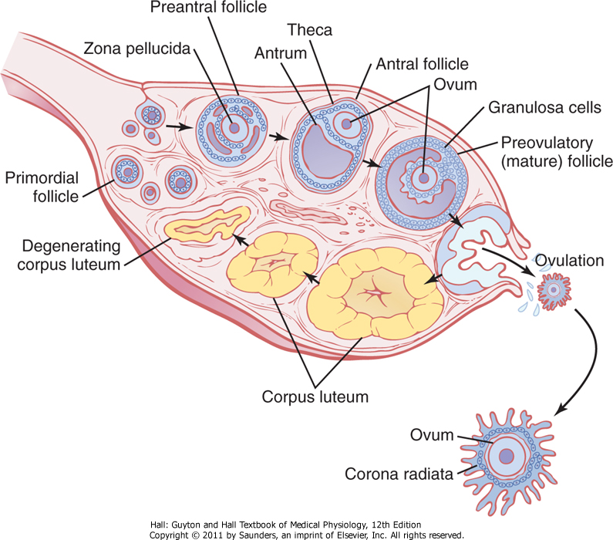

Slide 14
E is secreted into the follicle ⇨  numbers of FSH receptors on GC (positive feedback)
FSH & E ⇨  LH receptors on the original GC
⇧ E &  LH ⇨ proliferation of the follicular thecal cells and increase their secretion
growth of antral follicles occurs almost explosively
diameter of ovum  3-4x (total ovum diameter  10x, mass  1000x)

Slide 15
one of follicles begins to outgrow all others (remaining 5 to 11 developing follicles involute – atresia; cause of the atresia is unknown; large amounts of E from most rapidly growing follicle depress further enhancement of FSH secretion)
mature follicle (1-1.5 cm)

Slide 16
Ovulation
usually occurs 14 days after the onset of menstruation
stigma, protrudes like a nipple – after 30 min fluid begins to ooze from stigma – 2 minutes later stigma ruptures
ovum surrounded by a mass of several thousand small GC, called corona radiata

Slide 17
LH is necessary for final follicular growth and ovulation
2 days before ovulation rate of LH secretion increases markedly (6-10x, peaking about 16 hours before ovulation)
FSH also increases (2-3x)
LH converts granulosa and theca cells into progesterone-secreting cells (E , P )

Slide 18
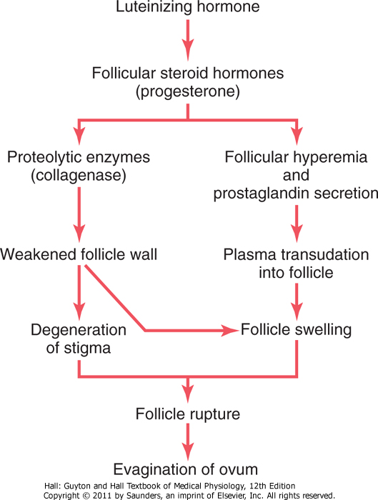
theca externa

Slide 19
Corpus Luteum-"Luteal" Phase
granulosa and theca interna cells change rapidly into lutein cells (LH)
diameter  2x, lipid inclusions – yellowish appearance – luteinization – corpus luteum
development of smooth ER – formation of large amounts of progesterone and estrogen
theca cells – androgens – conversion by aromatase into E in GC
grows to 1.5 cm (7-8 days after ovulation)
corpus albicans (12 days after ovulation, inhibin)

Slide 20
Functions of Ovarian Hormones
estrogens – ovaries, adrenal cortices, placenta: estradiol, estrone (from androgens secreted by the adrenal cortices and by ovarian thecal cells; 12x weeker) & estriol (oxidative product derived from both estradiol and estrone, liver, 80x weeker) – proliferation and growth, secondary sexual characteristics

Slide 21
progestins – corpus luteum: progesterone, hydroxyprogesterone, placenta – prepare uterus for pregnancy and the breasts for lactation
synthesized mainly from cholesterol derived from the blood but also to a slight extent from acetyl coenzyme A

Slide 22
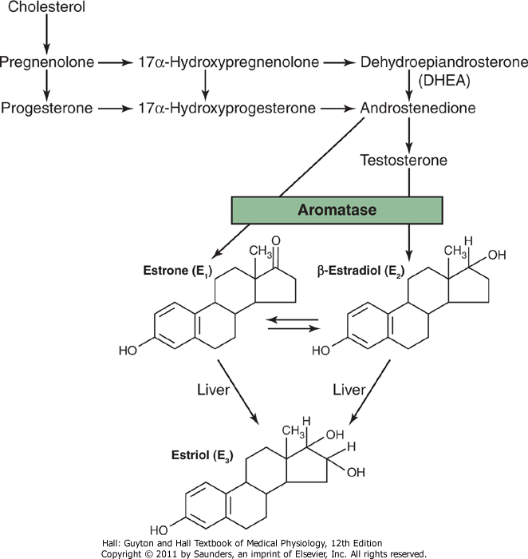

Slide 23
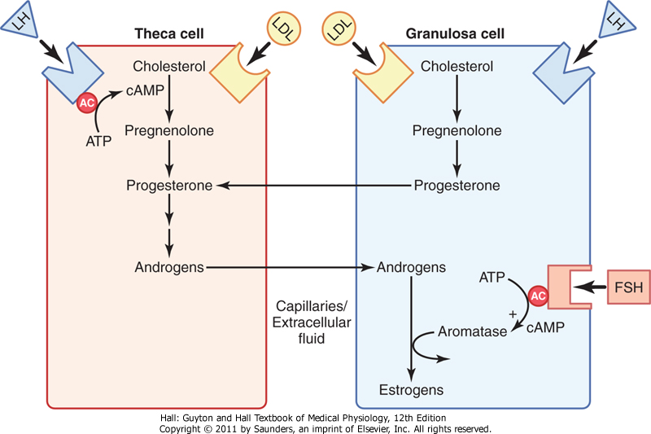

Slide 24
both E & P are transported in blood bound mainly with plasma albumin and with specific estrogen- and progesterone-binding globulins; binding is loose (30 min)
liver – conjugation of E to glucuronides and sulfates (conversion into estriol)
progesterone ⇨ pregnanediol (10% in urine)

Slide 25
Functions of the Estrogens
at puberty secretion  20x, ovaries, fallopian tubes, uterus, and vagina increase several times; external genitalia enlarge, deposition of fat in mons pubis and labia majora, enlargement of labia minora; change vaginal epithelium from cuboidal into stratified; proliferation of endometrial stroma & development of endometrial glands
fallopian tubes – proliferation of glandular tissues &  number of ciliated epithelial cells as well as activity of the cilia

Slide 26
masculine breast can produce milk; E develops stromal tissues, growth of an extensive ductile system and deposition of fat – external appearance
E inhibit osteoclastic activity, growth in height at puberty, uniting of the epiphyses (much stronger than T – lower than males), female eunuch grows taller than normal female (10 cm); osteoporosis
slight increase in total body protein
⇧ BM (1/3 effect of T, deposition of fat – buttocks and thighs)

Slide 27
do not greatly affect hair distribution
soft and usually smooth texture of skin; more vascular (increased warmth), greater bleeding
slight sodium and water retention by the kidney tubules (except during pregnancy)

Slide 28
Functions of Progesterone
in uterus – promote secretory changes in the uterine endometrium during second half of menstrual cycle, decreases the frequency and intensity of uterine contractions
promotes increased secretion by mucosal lining of fallopian tubes (nutrition of the fertilized ovum)
promotes development of the lobules and alveoli of the breasts, causes the breasts to swell

Slide 29
Monthly Endometrial Cycle and Menstruation
proliferative (estrogen) phase – stromal cells and epithelial cells proliferate rapidly (re-epithelializeation 4-7 days), endometrium is 3 to 5 mm thick at the time of ovulation
secretory (progestational) phase – corpus luteum – progesterone and estrogen (swelling and secretory development), thickness 5-6 mm
menstruation – involution of corpus luteum,  E & P:  stimulation of endometrial cells – involution of endometrium;  spasticity of blood vessels – prostaglandins – endometrium necrosis

Slide 30
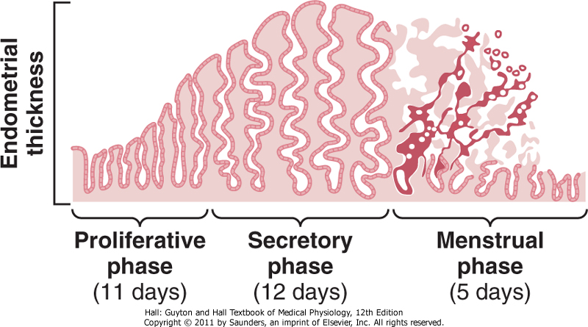

Slide 31
40 mL of blood and 35 mL of serous fluid
menstrual fluid is normally nonclotting – fibrinolysin
sometimes it is clotting (excessive bleeding)
menstrual bleeding lasts for 4-7 days
leukorrhea – release of tremendous numbers of leukocytes during menstruation – uterus is highly resistant to infection during menstruation

Slide 32
Regulation of the Female Monthly Rhythm
hypothalamus secretes GnRH (decapeptide, arcuate nuclei, preoptic area and limbic system) which stimulates pulsatile release of LH & FSH from the anterior pituitary gland (continuous infusion does not have an effect)
pulsatile release of GnRH also causes intermittent output of LH secretion about every 90 min

Slide 33
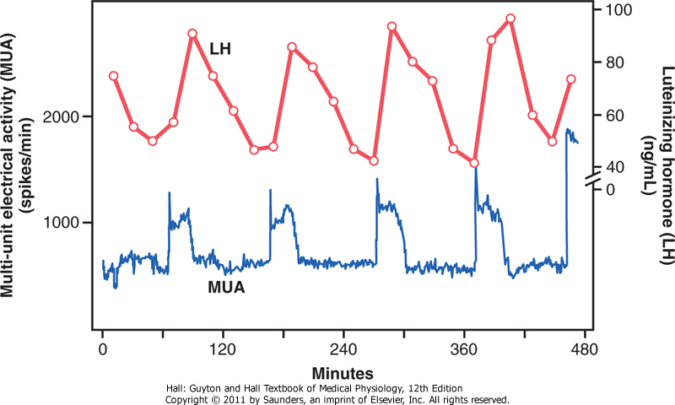

Slide 34
negative feedback effects of E & P to decrease LH & FSH secretion (directly, and on hypothalamus)
inhibin (from GC) inhibiting secretion of FSH
positive feedback effect of E on LH ( ovulation)
peculiar positive feedback effect of stimulating pituitary secretion of LH
GC begin to secrete small but increasing quantities of progesterone

Slide 36
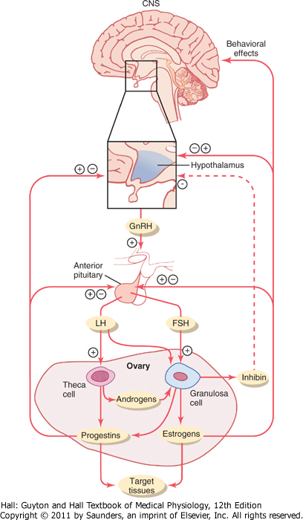

Slide 37
Anovulatory Cycles – Sexual Cycles at Puberty
if surge of LH is not of sufficient magnitude – no ovulation (anovulatory cycle):
failure of development of corpus luteum
no secretion of progesterone
cycle is shortened by several days, but the rhythm continues
first few cycles after the onset of puberty and few last ones

Slide 38
Puberty and Menarche
puberty – onset of adult sexual life
menarche – beginning of the cycle of menstruation

Slide 39
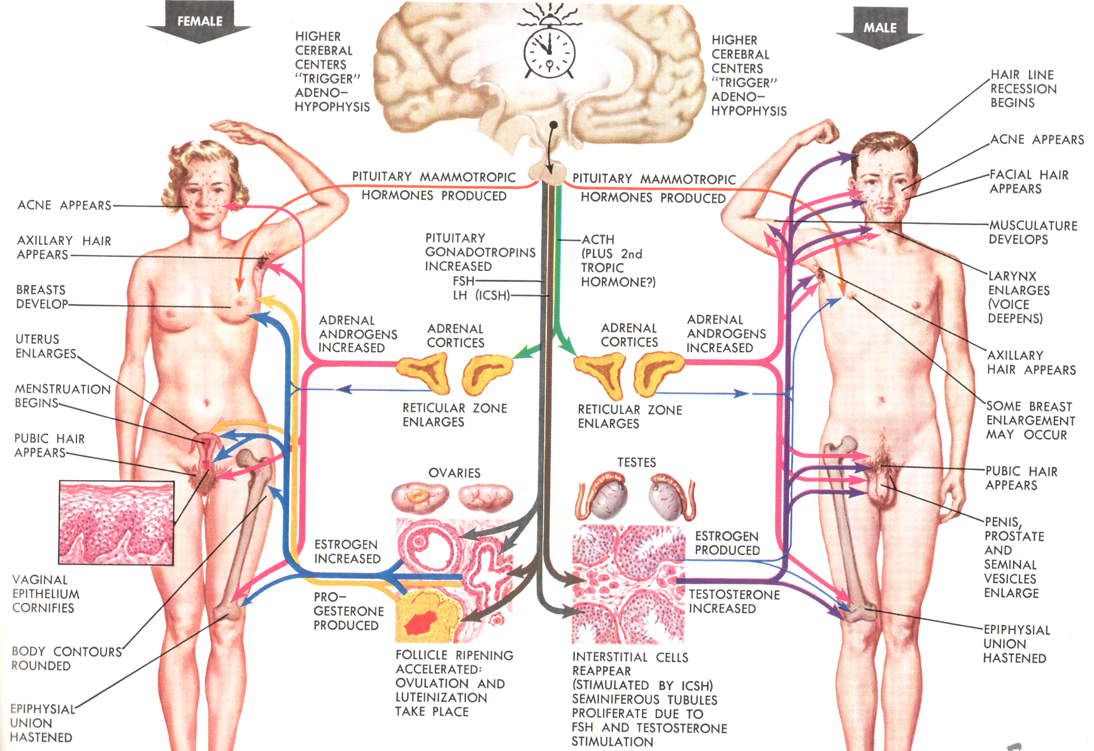

Slide 40
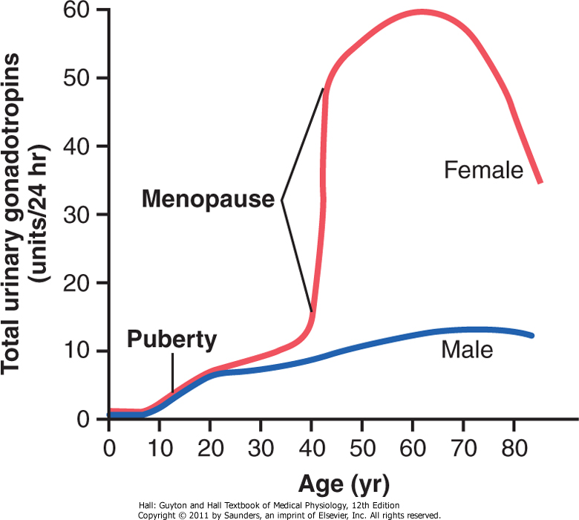

Slide 41
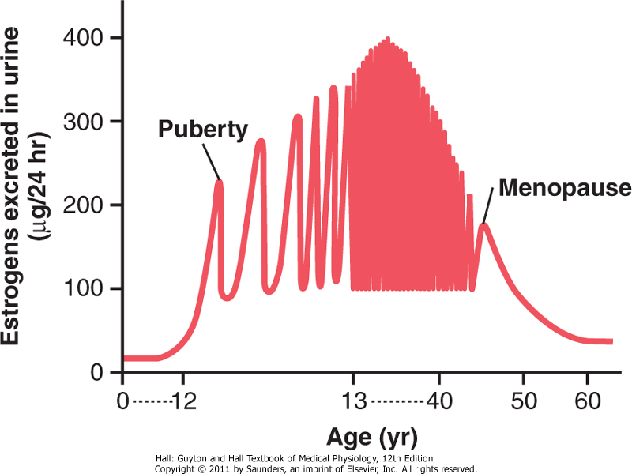

Slide 42
Menopause
40-50 years – sexual cycle usually becomes irregular (ovulation fails to occur)
"burning out" of the ovaries (15% – treatment)
"hot flushes" – extreme flushing of the skin
psychic sensations of dyspnea
irritability
fatigue
anxiety
decreased strength and calcification of bones

Slide 43
Abnormalities of Secretion
hypogonadism (before puberty – female eunuchism; after puberty – sexual organs regress (same as in menopause))
irregularity of menses
amenorrhea
hypersecretion by ovaries (rare clinical entity (due to negative feedback), usually when feminizing tumor develops – irregular bleeding in menopause)

Slide 44
Female Sexual Act
successful performance of the female sexual act depends on both psychic stimulation and local sexual stimulation; thinking sexual thoughts can lead to female sexual desire, desire also changes during the monthly sexual cycle, reaching a peak near the time of ovulation (estrogen)
clitoris is especially sensitive for initiating sexual sensations

Slide 45
erection and lubrication (located around the introitus and extending into the clitoris; parasympathetic nerves: acetylcholine, NO, VIP; Bartholin glands, mucus secreted by the vaginal epithelium)
female orgasm – female climax; analogous to emission and ejaculation in male, may help promote fertilization – increase uterine and fallopian tube motility, dilation of the cervical canal, oxytocin; relaxed peacefulness (resolution)

Slide 46
Female Fertility
fertile period (ovum – 24h, sperm up to 5 days; fertile period during each month is short 4-5 days)
rhythm method of contraception – difficulty in predicting the exact time of ovulation (avoidance of intercourse for 4 days before the calculated day of ovulation and 3 days afterward prevents conception)

Slide 47
"The Pill", appropriate administration of either of E or P can prevent the preovulatory surge of LH, which is essential in causing ovulation; challenge was to develop appropriate combination of E & P; combination of synthetic estrogens and synthetic progestins – can resist this destructive propensity of the liver

Slide 48
Sterility
about 5-10% of women are infertile
most common cause of female sterility is failure to ovulate
in the absence of progestational effects, the cycle can be assumed to be anovulatory
analysis of urine for a surge in pregnanediol, charting body temperature ( 0.3 °C or 0.5°F)

Slide 49
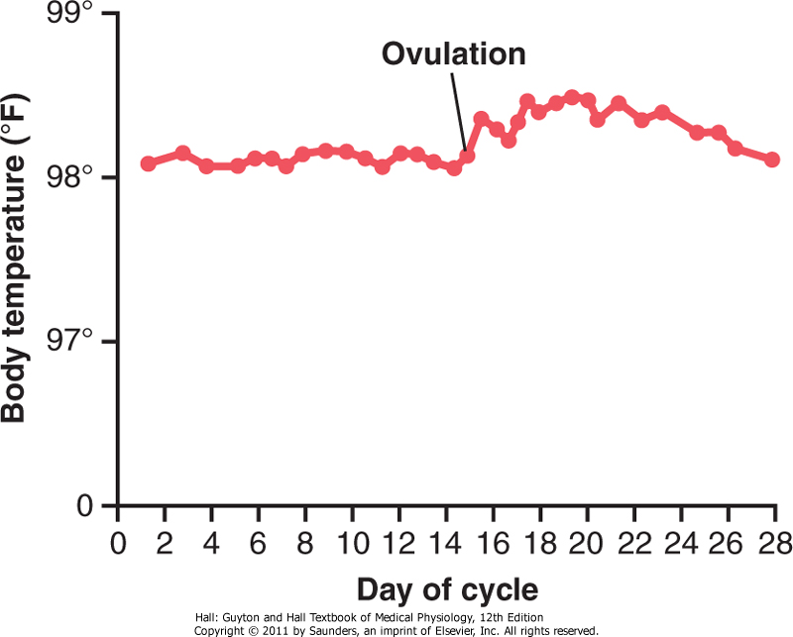

Slide 50
hyposecretion of LH & FSH (treatment – administration of HCG – multiple births)
endometriosis – endometrial tissue grows and even menstruates in pelvic cavity, enshrouds the ovaries, occludes the fallopian tubes
salpingitis – inflammation of the fallopian tubes (gonococcal infection)
secretion of abnormal mucus by uterine cervix

