Slide 1
Independent personal pronouns and inclusory constructions in Kove
Hiroko Sato
Fellow of NEH – NSF
University of Hawaiʼi at Mānoa

Slide 2
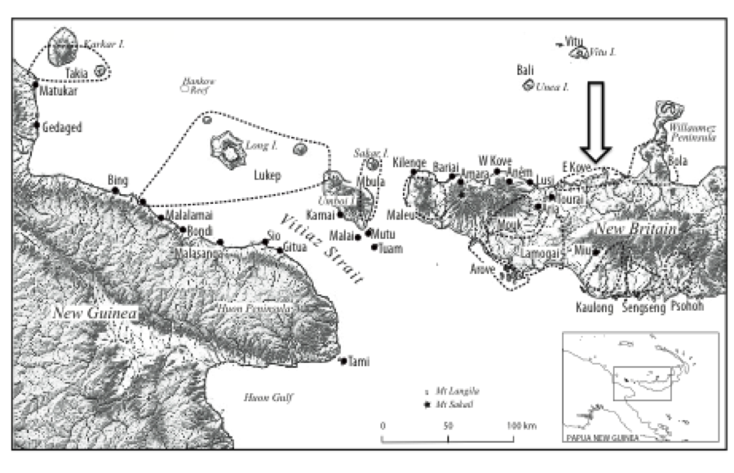
(Cited from Ross 2013)

Slide 3
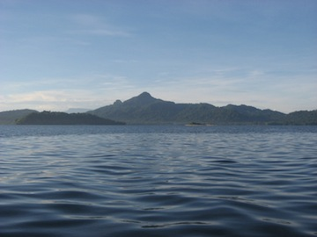
Kove area (known as Kombe)
Austronesian language
Subject – predicate
(1) _{sbj}[Kekele Kapo ai-a] _{prep}[i-eno].
child Kapo 3sg.poss-a.poss 3sg.sbj-sleep
‘A child from Kapo will sleep/is sleeping/sleeps/slept.’
(2) [Mate ai-a watai-nga] [tangi-ra
death 3sg.poss-possa.mrk know-nmlz cry-nmlz
taule ti-pupu].
trumpet.shell 3pl.sbj-blow
‘The sound of the trumpet shell is a sign of death’ (lit., ‘Knowing of death is the cry of a trumpet shell.’)
SV and AVO
Nominative – accusative patter

Slide 4
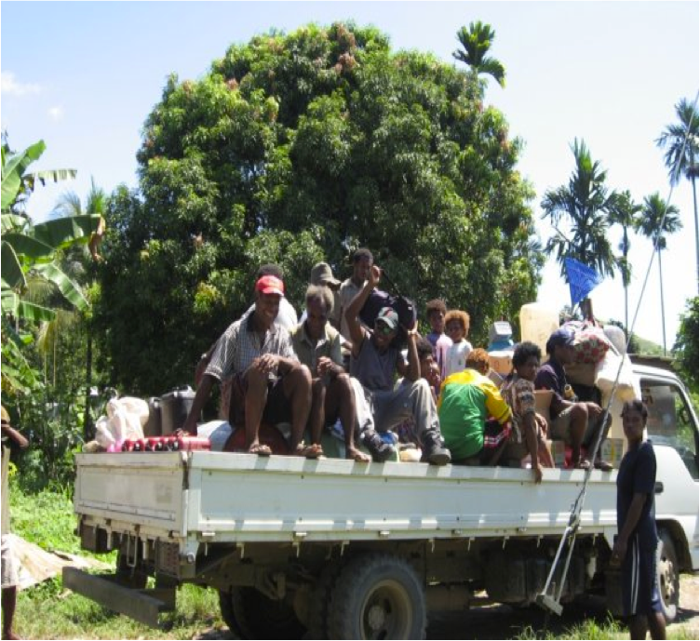
(Yau) nga-so-sohi moe.
1sg 1sg.sbj-red-remove pandanus
‘I am removing the edge of pandanus leaves.’ (lit., ‘I am removing pandanus.’)’
Avava i-lua-i gha i-nama.
Avava 3sg.sbj-return-intr svu 3sg.sbj-come
‘Avava came back.’
Malo i-kua.
clothes 3sg.sbj-wet
‘The clothes became wet.’
Malo ti-kua.
clothes 3pl.sbj-wet
‘The clothes became wet’

Slide 5
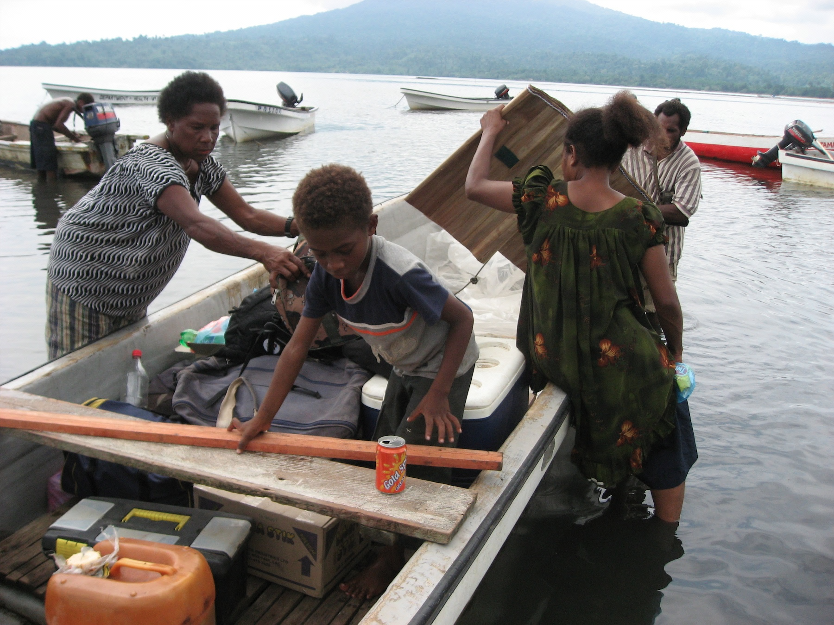
(7) Neti i-hau-ghau noha.
Neti 3sg.sbj-hit-1sg.obj yesterday
‘Neti hit me yesterday.’
(8) Yau nga-lua-ghau gha nga-nama noha.
1sg 1sg.sbj-return-1sg.obj svu 1sg.sbj-come yesterday
‘I came back yesterday.’
(9) Neti i-pa-ghau niu noha.
Neti 3sg.sbj-give-1sg.obj coconut yesterday
‘Neti gave me a coconut yesterday.’
(10)Neti i-pasolani vula pa-ghau noha.
Neti 3sg.sbj-show shell.necklace prep-1sg.obj yesterday
‘Neti showed a shell necklace to me yesterday.’

Slide 6
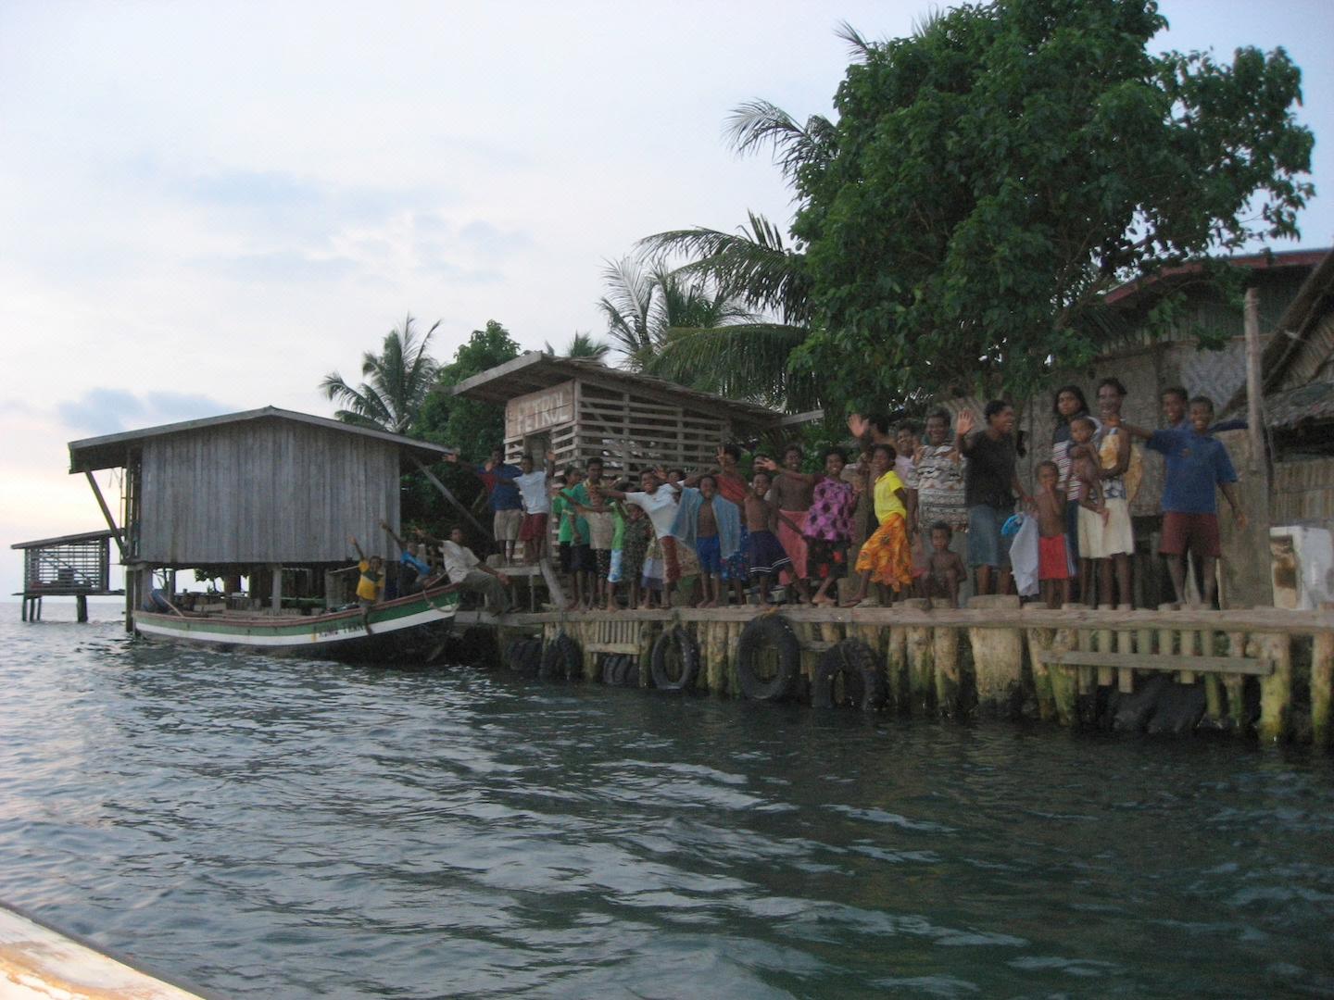
Neti i-hau veai noha.
Neti 3sg.sbj-hit 3sg yesterday
‘Neti hit him / her yesterday.’
(12) Yau nga-pa-ni niu noha.
1sg 1sg.sbj-give-3sg.obj coconut yesterday.
‘I gave him / her a coconut yesterday.’
(13) Yau nga-pasolani vula pa-ni noha.
1sg 1sg.sbj-show shell.necklace prep-3sg.obj yesterday
‘I showed a shell necklace to him / her yesterday.’

Slide 7
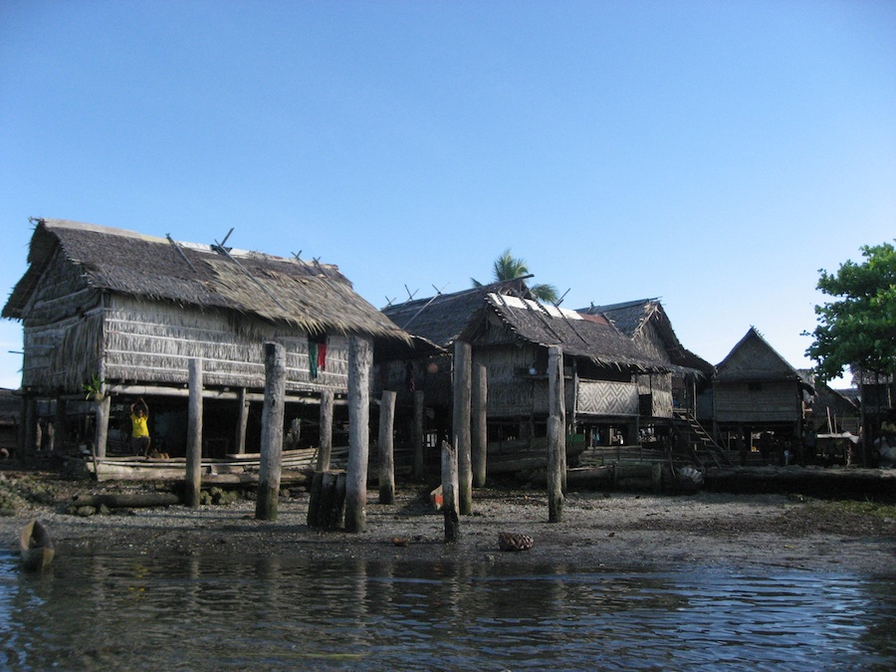
*Neti i-hau-ghau yau noha.
Net 3sg.sbj-hit-1sg.obj 1sg yesterday
(‘Neti hit me yesterday.’)
* Neti i-pasolani vula pa-ghau yau noha.
Neti 3sg.sbj-show shell.necklace prep-1sg.obj 1sg yesterday
(‘Neti showed a shell necklace to me yesterday.’)
(16) Neti i-hau-ri pana Kapo noha. Neti 3sg.sbj-hit-3pl.obj people Kapo yesterday
‘Neti hit people from Kapo village yesterday.’
(17) Neti i-pasolani vula pa-ri
Neti 3sg.sbj-show shell.necklace prep-3pl.obj
pana Kapo.
people Kapo
‘Neti showed a shell necklace to people from Kapo.’

Slide 8
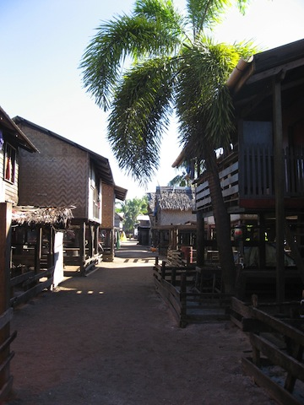
(yau) ahe-ghu
1sg leg-1sg.poss
‘my leg’
tamine ai-ahe
woman 3sg.poss-leg
‘a woman’s leg’

Slide 9
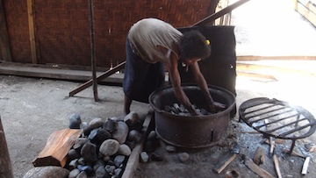
(20) (Yau) a-ghu haninga
1sg a.poss-1sg.poss food
‘my food (for eating)’
(21) luma ai-a galaru
house 3sg.poss-a.poss floor
‘the floor of a house’
(22) (Yau) le-ghu malo
1sg le.poss-1sg.poss clothes
‘my clothes’
(23) tamine e-le uraghe
woman 3sg.poss-le.poss knife
‘a woman’s knife/the woman’s knife’

Slide 10
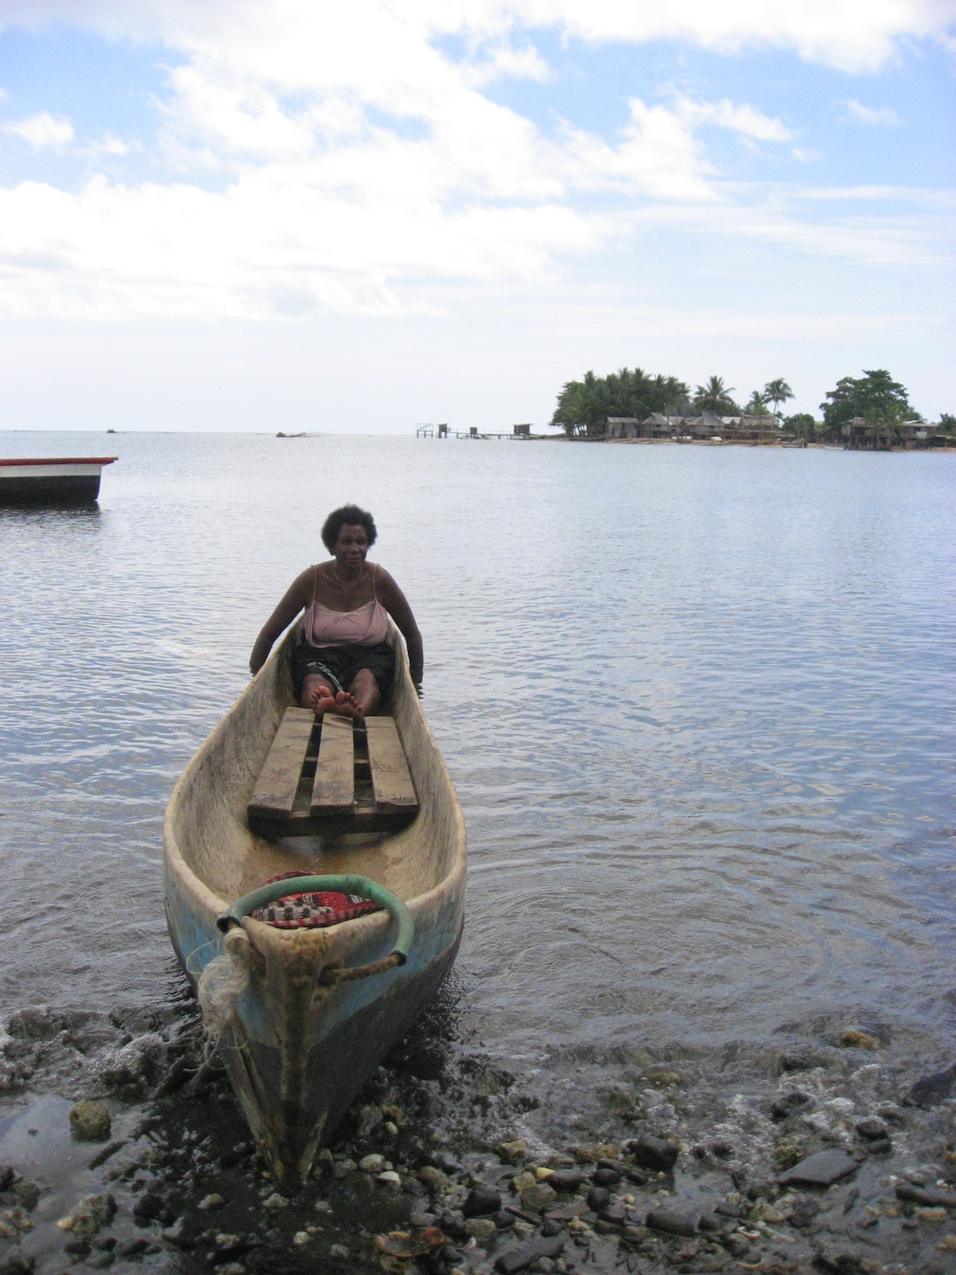
(24) Veai i-hau Neti noha.
3sg 3sg.sbj-hit Neti yesterday.
‘He / She hit Neti yesterday.’
(25) Veai tamine Kove ai-a.
3sg woman Kove 3sg.poss-a.poss
‘She is from Kove.’ (lit., ‘She is a woman of Kove.’)
(26) Veai ai-tama
3sg 3sg.poss-father
‘his / her father’

Slide 11
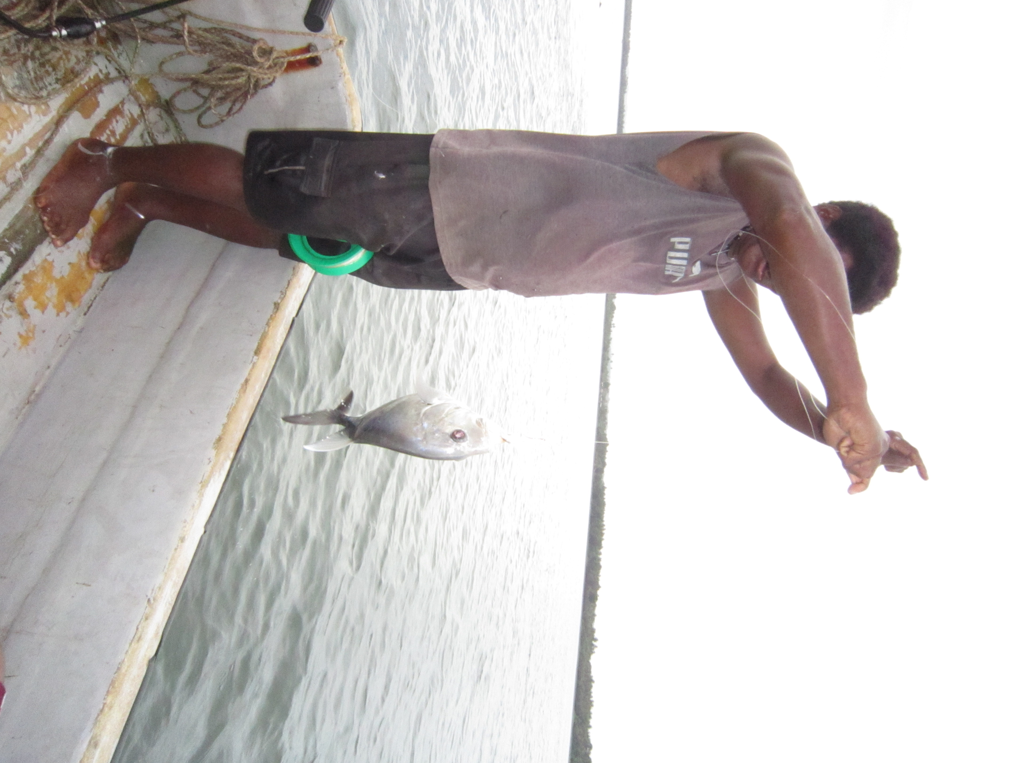
(27) Neti i-hau veai noha.
Neti 3sg.sbj-hit 3sg yesterday
‘Neti hit him / her yesterday.’
(28) *Neti i-hau yau noha.
Neti 3sg.sbj-hit 1sg yesterday
(‘Neti hit me yesterday.’)
(29) *Neti i-oli tue pa yau noha.
Neti 3sg.sbj-buy clam prep 1sg yesterday
(‘Neti bought clams from me yesterday.’)

Slide 12
(30)Ta yangera ya-la Kimbe.
fut 1group.excl 1pl.excl.sbj-go Kimbe
‘We will go to Kimbe.’ (‘we’ = members of different families)
(31) Ta yai ya-la Kimbe.
fut 1pl.excl 1pl.excl.sbj-go Kimbe
‘We will go to Kimbe.’
(‘we’ = members of one family)
(32) Yahua le-mai kaua.
1du.excl le.poss-1pl.excl dog
‘Our (dual) dog.’

Slide 13
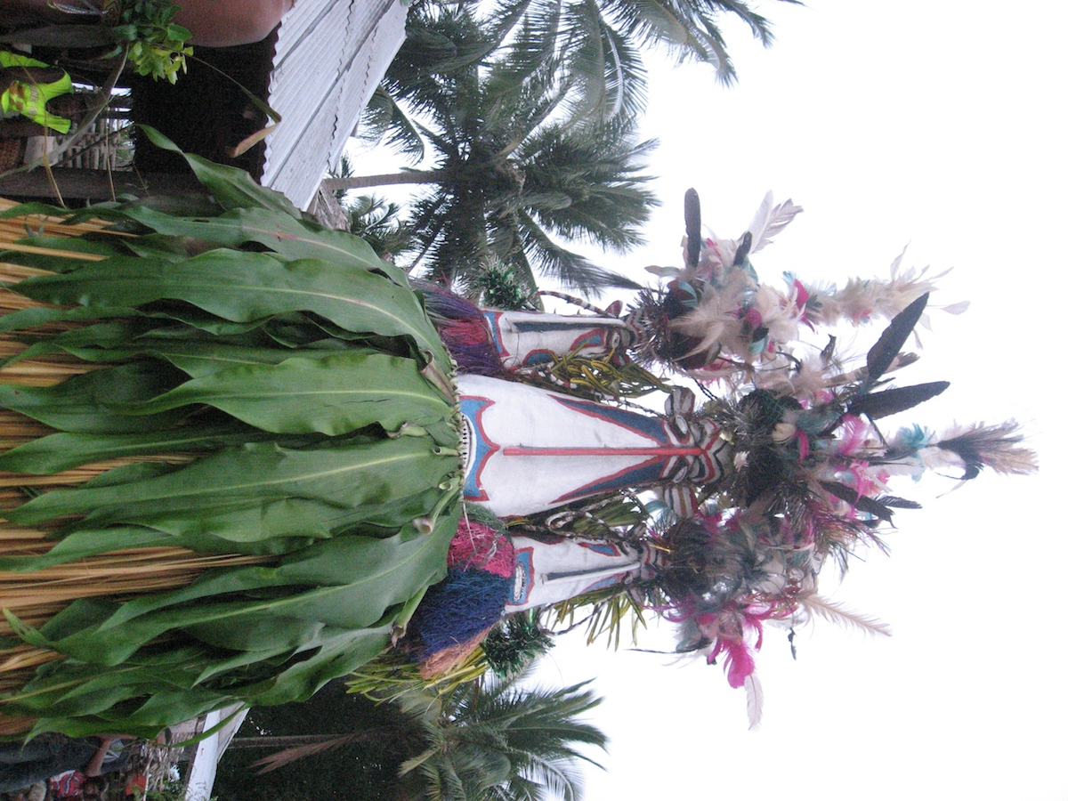
*Neti i-hau-ghau yau noha.
Neti 3sg.sbj-hit-1sg.obj 1sg yesterday (‘Neti hit me yesterday.’)
*Neti i-pasolani vula pa-ghau
Neti 3sg.sbj-show shell.necklace prep-1sg.obj
yau noha
1sg yesterday
(‘Neti showed a shell necklace to me yesterday.’)
Neti i-hau-gh ai yahua noha.
Neti 3sg.sbj-hit-1pl.excl.obj 1du.excl yesterday
‘Neti hit the two of us yesterday.’
Neti i-pasolani vula pa-ghai
Neti 3sg.sbj-show shell.necklace prep-1pl.excl.obj
yangera noha.
1group.excl yesterday
(‘Neti showed a shell necklace to me yesterday.’)

Slide 14
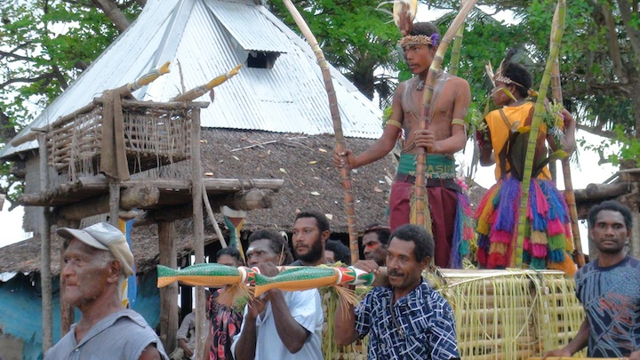
(37) *?Neti i-hau yai noha.
Neti 3sg.sbj-hit 1pl.excl yesterday
(‘Neti hit the two of us yesterday.’)
Yai yangera ya-hau-ri
1pl.excl 1group.excl 1pl.excl-hit-3pl.obj
pana Nutu.
people Nutu
‘We hit people from Nutu.’

Slide 15
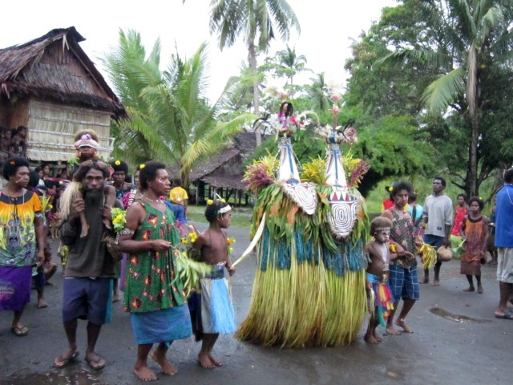
yahua Neti
1du.excl Neti
‘Neti and I’
Yangera Neti ya-la tuanga yai.
1group.excl Neti 1pl.excl-go village loc
‘We, including Neti, went to a village.’
(41) *Neti yahua
Neti 1du.excl
(42) Yangera kaua ya-la tuanga yai.
1du.excl dog 1du.excl-go village loc
‘We, including a dog, went to the village.’

Slide 16
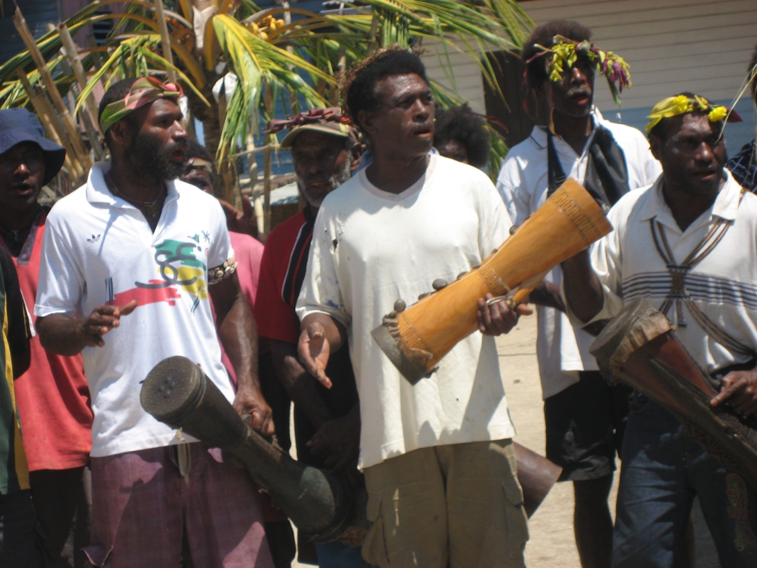
Pana Nutu ti-hau-gha yangera Talawa.
people Nutu 3pl.sbj-hit-1pl.excl.obj1group.excl Talawa
‘People from Nutu hit us, including people from Talawa.’
(44) Yahua Neti ya-la Kimbe.
1du.excl Neti 1pl.excl-go Kimbe
‘Neti and I went to Kimbe.’
(45) Amihua sei a-nama?
2du who.sg 2pl.sbj-come
‘Who did you come with?’ (lit., ‘You including who came?’)

Slide 17
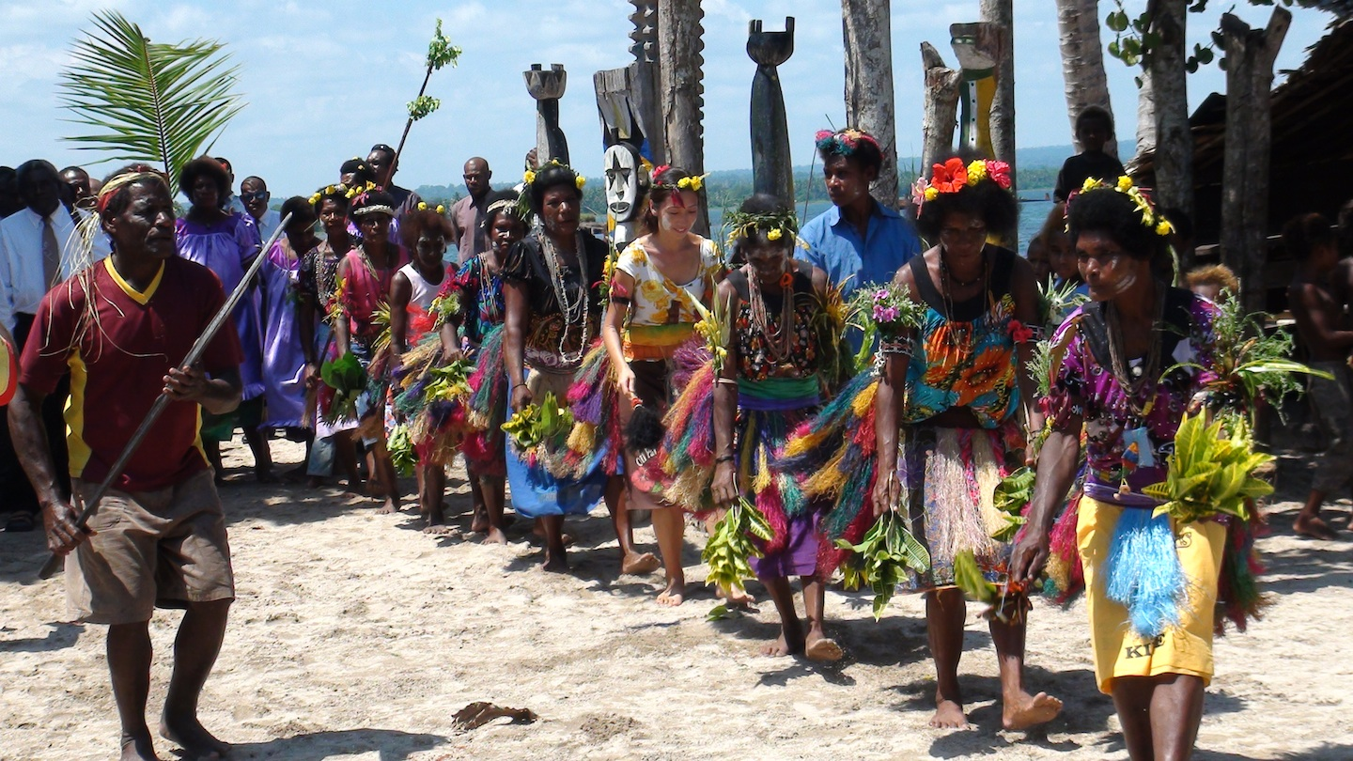
(46) Donga i-pasolani-ghai yahua Neti Donga 3sg.sbj-show-1pl.excl.obj 1du.excl Neti
nga Hawaii ai-anunu.
prep Hawai‘i 3sg.poss-picture
‘Donga showed Neti and me a picture of Hawai‘i.’
(47) Atoa i-pa-ri asihua Neti tue.
grandmother 3sg.sbj-give-3pl.obj 3du Neti clam
‘The grandmother gave him / her and Neti clams.’
Yau nga-oli tue pa-ri
1sg 1sg.sbj-buy clam prep-3pl.obj
asingera Elsi.
3group Elsi
‘I bought clams for them, including Elsi.’

Slide 18
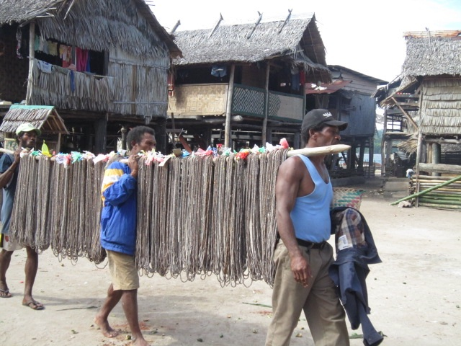
(49) tangera Neti a-ra tue
1group.incl Neti a.poss-1pl.incl.poss clam
‘Our (including Neti’s) clams’
(50)*Asiri ti-roa-ri asingera Neti?
3pl 3pl.sbj-sit.down-3pl.obj 3group Neti
(‘Did they, including Neti, sit down?’)

Slide 19
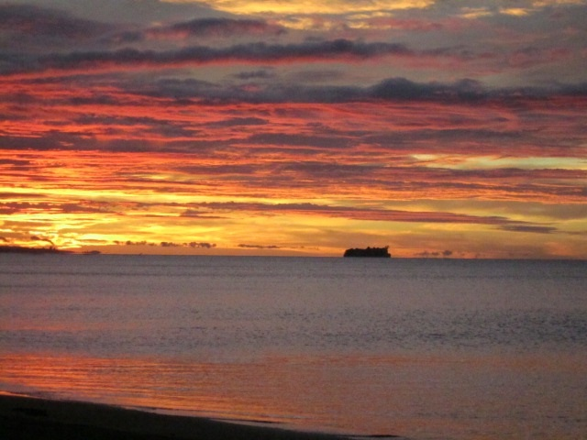
References
Blust, Robert A. 2009. The Austronesian languages. Canberra: Pacific linguistics.
Bhat, Darbhe Narayana Shankara. 2004. Pronouns. Oxford and New York: Oxford University Press.
Lichtenberk, Frantisek. 2000. Inclusory pronominals. Oceanic linguistics 39: 1-32.
Ross, Malcolm. 2013. Reconstructing the history of contact in northwest New Britain: inheritance and contact. The journal of historical linguistics 3.

