Slide 1
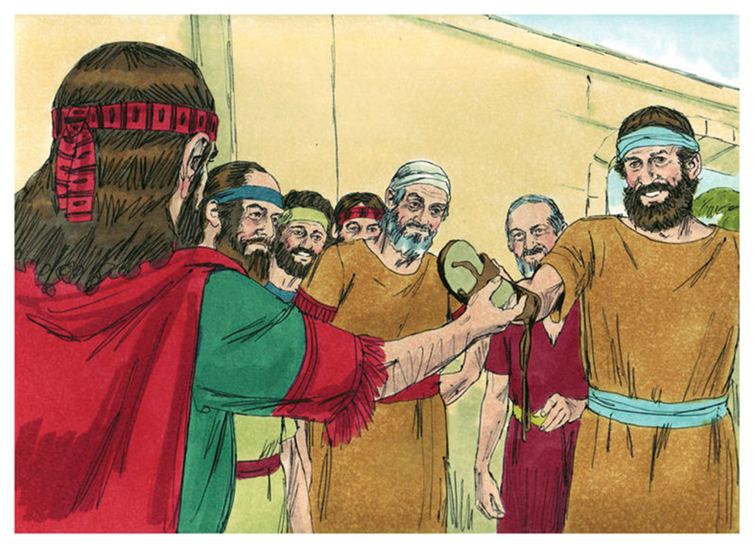
Trinity Evangelical Lutheran Church Announcements for September 4, 2022

Slide 2
Body, Mind, Spirit
BODY: Take a long walk
MIND: Read a self-help book
SPIRIT: Pray for schools

Slide 3
Our Office Secretary Is Sharon Fourman
Church Office Schedule
Tuesday – Thursday
8:00 am – 12:00 Noon
Church Office: 937 692-5670
Email: secretary@pitsburgtlc.org

Slide 4
The Trinity Trumpet
A Monthly Newsletter
Published by Trinity Lutheran Church,
Pitsburg, OH
We’re looking for stories and pictures of Trinity people in action!
Submit to Secretary, Sharon Fourman at secretary@pitsburgtlc.org
Articles and Info due on or about the 15th of each month

Slide 5
We’re Online!
www.pitsburgtlc.org
Sermons and announcements are posted weekly
Trinity Trumpet is Posted here too!
The ‘Official’ Trinity Calendar is available for you to see!
Pictures, Videos and more!
Also, like us on FaceBook at
facebook.com/pitsburgtrinitylutheran.church

Slide 6
We’re Online!
www.pitsburgtlc.org
We now have our own QR Code!
Scan this code with your Smartphone and you will connect to all our Online media (Facebook, YouTube, and our own Church Website)

Slide 7
Online Giving
www.pitsburgtlc.org
Click the “Give to Trinity” Button
Stay current in your giving even when you can’t make it to Worship!
Separate Giving Categories for:
General Treasury
Building Fund
Annual Christmas Auction
Donald K. Lucas Memorial Fund

Slide 8
Church
Council
Trinity Church Council
Next Meeting:
September 21st
@ 7:00 pm

Slide 9
Trinity’s Team Meetings
Next Meeting
Wed, Sept 15th
@ 6:00 pm
On the Agenda – Preparing the proposed 2022 budget

Slide 10
Please Pass the Pew Pads
(We now track Communion on the Pads)

Slide 11
Worship Team
Next Meeting:
TBD

Slide 12
Mutual Ministry Team
Julie Kossler
Joe Netzley
Peggy Didier
Please see one of them with your comments and suggestions
Next Meeting - TBD

Slide 13
To: All Kids returning to school
If you see any of the following:
Another student struggling to make friends
Another student being bullied
A student who is shy or not with the “in” crowd
A student who eats lunch by themselves
Please be a leader!
Say Hi. Smile at them.
Ask if you can sit with them at their lunch table.
Include them in ANY activity.
You never know what that person might be facing inside or outside of school.
Your kindness will make a HUGE difference in someone’s life!
Trinity4Kindness

Slide 14
Christian Education
Sunday School Teachers and Helpers Needed!!!
New, easy to use curriculum
Can you give one Sunday per month for our Children?

Slide 15
Trinity Trumpet
Your Trinity Trumpet Newsletter for September is available!
Please take your copy before you leave today!

Slide 16
Trinity Trumpet
Newsletter Deadline is Tuesday, September 20th
Please turn in all your newsworthy items to Sharon Fourman at:
secretary@pitsburgtlc.org

Slide 17
Choice FISH Pantry
Please join us every Friday @ 3:30 pm
400 Markwith Dr, Greenville OH
Most Needed Items
Kidney Beans
Canned Peas
Hamburger Helper
Pork & Beans
Canned Mixed Veggies
Large Cans of Soups
Applesauce
Boxed Meals
(i.e. Rice a Roni)

Slide 18
Next Meeting:
September 7, 2022
@ 11:30 am
Please note the time change!!!

Slide 19
WELCA FUNDRAISER PROJECT
Silent Auction
Please pick up your items and make payments to Linda Baker
Thank you for bidding on these wonderful items and enjoy your winnings!

Slide 20
Prayers and Squares
Quilting Ministry
September 8 @ 10:00 am
September 27 @ 10:00 am

Slide 21
Ladies and Gents Luncheon
Thursday, Sept 15, 2022 @ 11:30 am
Where: Tolly's Gastropub
644 Wagner Ave, Greenville, OH For Reservations:
See Linda Baker or call her at (937) 547-0975

Slide 22
Confirmation Classes
All 7th and 8th Grade Students
Parent/Student Meeting after Worship September 11th after Worship…

Slide 23
Confirmation Program
Weekly Worship attendance is required (In person or via FaceBook)
Worship Notes may be emailed to pastor@pitsburgtlc.org or placed in Pr Mel’s mailbox outside the Church Office
Confirmands are encouraged to take turns as Acolyte

Slide 24
Please sign up for Acolyte Duty on the chart by the Church Office!
Confirmation Students are Highly Encouraged to perform Acolyte duty…
Please sign up today!

Slide 25
Commemorate special days like Anniversaries, Birthdays, Baptisms and more…
Please sign up for Altar Flowers on the chart by the Church Office or see Shirley Rhoades

Slide 26
Trinity’s Team Meetings
Christian Education Team
Next Meeting

Slide 27
Holy Communion – Today!
Communion Elements are prepackaged by TruVine, a division of Concordia Church Supply Co.
Safe for all humans (Especially sinners)
Holy Communion Schedule will resume our Pre-Covid Schedule
First and Third Sundays each month
All White and Red Sundays of the Church Year

