Slide 1
Trinity Evangelical Lutheran Church Announcements for December 18, 2022

Slide 2
Body, Mind, Spirit
BODY: Dance and sing around the house
MIND: Watch a Christian documentary
SPIRIT: Watch the Chosen

Slide 3
Our Office Secretary Is Sharon Fourman
Church Office Schedule
This Week Only
Wednesday, Thursday, & Friday
8:00 am – 12:00 noon
Church Office: 937 692-5670
Email: secretary@pitsburgtlc.org

Slide 4
The Trinity Trumpet
A Monthly Newsletter
Published by Trinity Lutheran Church,
Pitsburg, OH
We’re looking for stories and pictures of Trinity people in action!
Submit to Secretary, Sharon Fourman at secretary@pitsburgtlc.org
Articles and Info due on or about the 15th of each month

Slide 5
We’re Online!
www.pitsburgtlc.org
Sermons and announcements are posted weekly
Trinity Trumpet is Posted here too!
The ‘Official’ Trinity Calendar is available for you to see!
Pictures, Videos and more!
Also, like us on FaceBook at
facebook.com/pitsburgtrinitylutheran.church

Slide 6
We’re Online!
www.pitsburgtlc.org
We now have our own QR Code!
Scan this code with your Smartphone and you will connect to all our Online media (Facebook, YouTube, and our own Church Website)

Slide 7
Online Giving
www.pitsburgtlc.org
Click the “Give to Trinity” Button
Stay current in your giving even when you can’t make it to Worship!
Separate Giving Categories for:
General Treasury
Benevolence/Mission Support
Building Fund
Annual Christmas Auction
Donald K. Lucas Memorial Fund
Thrive Capital Campaign

Slide 8
Church
Council
Trinity Church Council
Next Meeting:
January 18, 2022
@ 7:00 pm

Slide 9
Trinity’s Team Meetings
Next Meeting
TBD
@ 6:00 pm
On the Agenda – Preparing the proposed 2023 budget

Slide 10
Please Pass the Pew Pads
(We now track Communion on the Pads)

Slide 11
Worship Team
Next Meeting:
TBD

Slide 12
Mutual Ministry Team
Julie Kossler
VACANT
Peggy Didier
Please see one of them with your comments and suggestions
Next Meeting - TBD

Slide 13
To: All Kids
If you see any of the following:
Another student struggling to make friends
Another student being bullied
A student who is shy or not with the “in” crowd
A student who eats lunch by themselves
Please be a leader!
Say Hi. Smile at them.
Ask if you can sit with them at their lunch table.
Include them in ANY activity.
You never know what that person might be facing inside or outside of school.
Your kindness will make a HUGE difference in someone’s life!
Trinity4Kindness

Slide 14
Christian Education
Sunday School Teachers and Helpers Needed!!!
New, easy to use curriculum
Can you give one Sunday per month for our Children?

Slide 15
Trinity Trumpet
Your Trinity Trumpet Newsletter for December is available!
Please take your copy before you leave today!

Slide 16
Funeral Arrangements for Sharon Wirrig
Visitation
Kreitzer Funeral Home, Arcanum
4:00 pm to 7:00 pm Today
Funeral Service
Kreitzer Funeral Home, Arcanum
Monday, December 19th at 10:30 am
Burial at Abbotsville Cemetery
There will not be a luncheon at the Church

Slide 17
Trinity Trumpet
Newsletter Deadline is Tuesday, December 20th
Please turn in all your newsworthy items to Sharon Fourman at:
secretary@pitsburgtlc.org

Slide 18
Choice FISH Pantry
Please join us every Friday @ 3:30 pm
400 Markwith Dr, Greenville OH
Most Needed Items
Kidney Beans
Canned Peas
Hamburger Helper
Pork & Beans
Canned Mixed Veggies
Large Cans of Soups
Applesauce
Boxed Meals
(i.e. Rice a Roni)

Slide 19
Next Meeting:
January 4, 2023
@ 11:30 am
Please note the time!!!

Slide 20
Prayers and Squares
Quilting Ministry
January 12 @ 10:00 am
January 31 @10:00 am

Slide 21
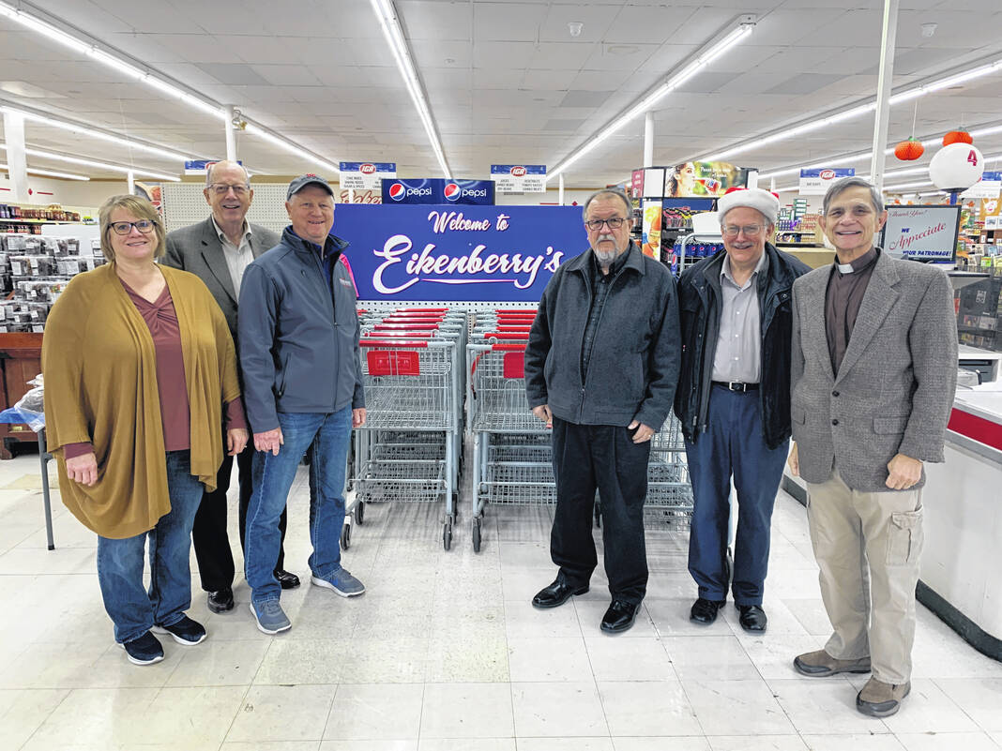
Darke County Christmas Bell Ringers
Thank you to all who helped by manning the Bucket and ringing the bell!!!

Slide 22
Ladies and Gents Luncheon
Date: To Be Determined (TBD)
Where: TBD
For Reservations:
See Linda Baker or call her at (937) 547-0975

Slide 23
Confirmation Program
All 7th and 8th Grade Students
Second and Fourth Wednesdays @ 6:30 pm
Next Class: January 11, 2023

Slide 24
Confirmation Program
Weekly Worship attendance is required (In person or via FaceBook)
Worship Notes may be emailed to pastor@pitsburgtlc.org or placed in Pr Mel’s mailbox outside the Church Office
Confirmands are encouraged to take turns as Acolyte

Slide 25
Please sign up for Acolyte Duty on the chart by the Church Office!
Confirmation Students are Highly Encouraged to perform Acolyte duty…
Please sign up today!

Slide 26
New Member Class
We are forming a “New Member” Class for anyone who wants to learn more about Being Lutheran and what Being a member of Trinity entails
Classes will begin January 8th
Classes start at 12:00 Noon or as soon after Worship as possible
Please see Pastor Mel if Interested in attending

Slide 27
Commemorate special days like Anniversaries, Birthdays, Baptisms and more…
Please sign up for Altar Flowers on the chart by the Church Office or see PJ Musser

Slide 28
Trinity’s Team Meetings
Christian Education Team
Next Meeting
September 14th @ 6:00 pm
Purpose -- plan for Fall Festival
Please come if you can!

Slide 29
Blood Pressure Screening
BP Screening
Resuming in January
2nd & 4th Sundays
After Worship In The Nursery
Notes:
Cover: Sermon on the Mount by Laura James. Copyright © Laura James. All rights reserved. Used by permission of the artist.

Slide 30
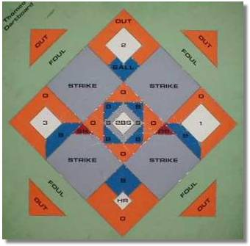
DARTBALL
Monday @ 7:30 pm
Home Game
Please come early to help set up!

Slide 31
Holy Communion
Returning to Pre-Covid Communion Practices
Also - Returning to Pre-Covid Offering Collection Practice
When: December 4th 2022

Slide 32
Holy Communion – Today!
Communion Today is “By Station”
Safe for all humans (Especially sinners)
Holy Communion Schedule
First and Third Sundays each month
All White and Red Sundays of the Church Year

Slide 33
Early Service @ 4:00 pm
Midnight Service @ 10:00 pm
Notes:
Cover: Sermon on the Mount by Laura James. Copyright © Laura James. All rights reserved. Used by permission of the artist.

Slide 34
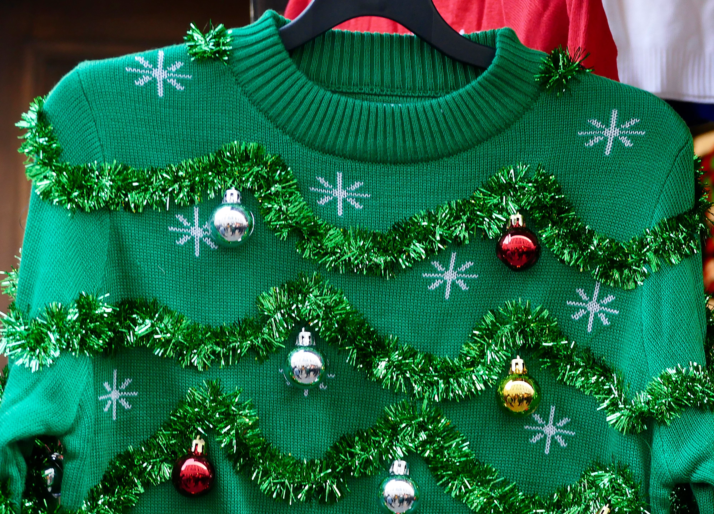
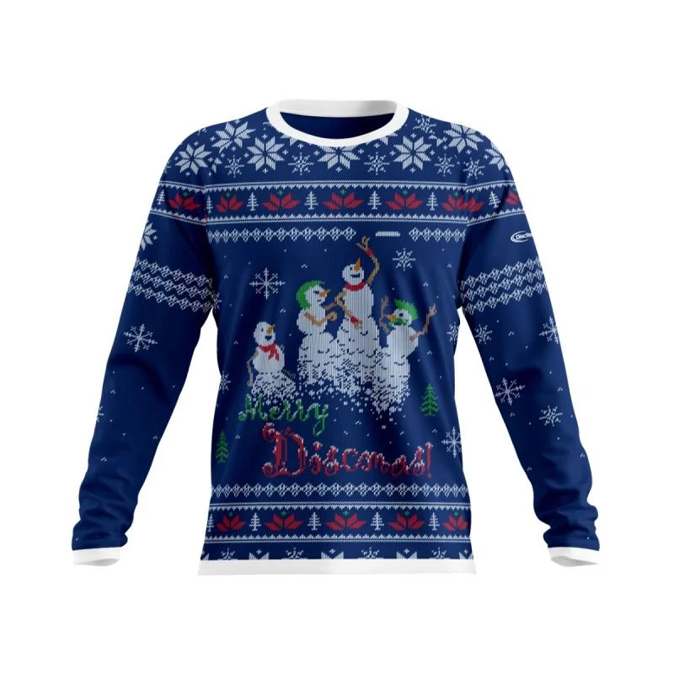
Ugly Christmas Sweater
Come As You Are Casual
Sunday
December 25, 2022
Notes:
Cover: Sermon on the Mount by Laura James. Copyright © Laura James. All rights reserved. Used by permission of the artist.

Slide 35
Sunday
January 1st, 2023
Full Sunday Worship
Baptism Scheduled to kick off the New Year!!!
Notes:
Cover: Sermon on the Mount by Laura James. Copyright © Laura James. All rights reserved. Used by permission of the artist.

