Slide 1
Von Willebrand Factor: Friend or Foe TMA, TTP, aHUS, STEC-HUS, MAHA, PLEX, TIC, ADAMTS13, VWF What Does it All Mean?
George A. Fritsma MS, MLS
The Fritsma Factor, Your Interactive Hemostasis Resource
george@fritsmafactor.com--fritsmafactor.com
Notes:
Hello, and welcome to “Von Willebrand Factor, Friend or Foe,” a title I’ve taken from a 2021 presentation by Dr. Long Zheng, the Russell J. Eilers, MD Endowed Professor and Chair of Department of Pathology & Laboratory Medicine at the University of Kansas Medical Center that is available on the BioMedica Diagnostics Website. I’m George Fritsma, proprietor of The Fritsma Factor, Your Interactive Hemostasis Resource, sponsored by Precision BioLogic, Inc, Dartmouth, Nova Scotia.

Slide 2
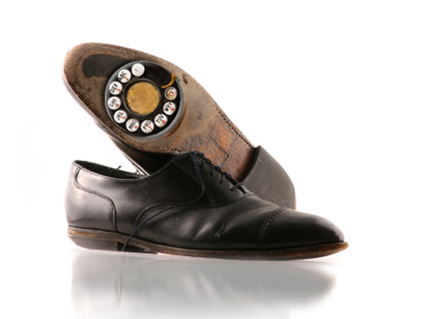
Thrombotic Microangiopathies [TMAs]
Thrombotic thrombocytopenic purpura [TTP]
Rx Cablivi®
Shiga-toxin producing E. coli hemolytic-uremic syndrome [STEC-HUS]
Childhood traumatic brain injury
Rx: ADAMTS13
Atypical hemolytic-uremic syndrome [aHUS]
Rx Soliris®
HELLP Syndrome
Rx Soliris®?
Please silence your phone
Notes:
This is not a talk about von Willebrand disease. Instead, we will examine the involvement of VWF in the thrombotic microangiopathies and will sort out the alphabet soup of TMA, TTP, aHUS, STEC-HUS, MAHA, PLEX, TIC, ADAMTS13.

Slide 3
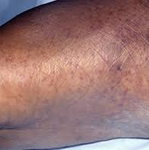
Nineteen-YOA Woman with TMA
A 19 YOA African-American woman came to the ED experiencing rapid onset fever, headache, confusion and weakness. The ED nurse recorded petechiae on her extremities and arranged for laboratory assays.
Notes:
A 19 YOA African-American woman came to the ED experiencing rapid onset fever, headache, confusion and weakness. The ED nurse recorded petechiae on her extremities and arranged for laboratory assays.

Slide 4
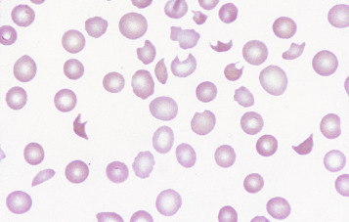
19-YOA ♀ TMA Relevant Labs
Test | Result | RI
HGB | 9.8 g/dL | 12.0–15.0 g/dL
HCT | 31% | 35–49%
MCV | 78 fL | 80–100 fL
PLT | 21,000/dL | 150–450,000/dL
LD | 420 U/L | 140–280 U/L
Creatinine | 1.1 mg/dL | 0.6–1.2 mg/dL
RBC morphology |  | 2+ schistocytes
Microangiopathic hemolytic anemia [MAHA], schistocytes
Notes:
The schistocytes in her peripheral blood film were the product of microangiopathic hemolytic anemia, or MAHA, reflected in her HGB, HCT, and MCV deficiencies plus elevated lactate dehydrogenase, the product of damaged RBCs. Thrombocytopenia is pathognomic of TTP.

Slide 5
19 YOA ♀ Presumptive Diagnosis
Thrombotic thrombocytopenic purpura [TTP]
Moschcowitz, 1924, described a 16-YO ♀ with petechiae, thrombocytopenia, hemiparesis and pulmonary edema
70/30 ♀︎, typical of autoimmune disorders
“Classic pentad:” marked thrombocytopenia, MAHA, neurologic changes, fever, renal insufficiency
Now defined by MAHA with elevated lactate dehydrogenase [LD] and thrombocytopenia
“Ultra”-rare; 2/million new cases/year
Once 90% fatal, now 20% fatal
Lopez JA, Chen J, Ozpolat HT, Moake JL, Chung DW. Ch 34: Thrombotic thrombocytopenic purpura and related thrombotic microangiopathies. In Kitchens CS, Kessler CM, Konkle BA, Strieff MB, Garcia DA. Consultative Hemostasis and Thrombosis, 4th Edition. Elsevier 2019.
Notes:
Her presumptive diagnosis is thrombotic thrombocytopenic purpura or TTP, first described by Moschcowitz in 1924, in a 16-YO ♀ with petechiae, thrombocytopenia, hemiparesis [muscular weakness or partial paralysis restricted to one side of the body] and pulmonary edema. TTP strikes women over men 70/30 ♀︎, typical of autoimmune disorders. Moschowitz described the “Classic pentad” of marked thrombocytopenia, MAHA, neurologic changes, fever, renal insufficiency. TTP is now defined by MAHA with elevated lactate dehydrogenase [LD] and thrombocytopenia. TTP is “Ultra”-rare; 2/million new cases/year and was once 90% now 20% fatal.
[Prevalence is a statistical concept referring to the number of cases of a disease that are present in a particular population at a given time, whereas incidence refers to the number of new cases that develop in a given period of time.]

Slide 6
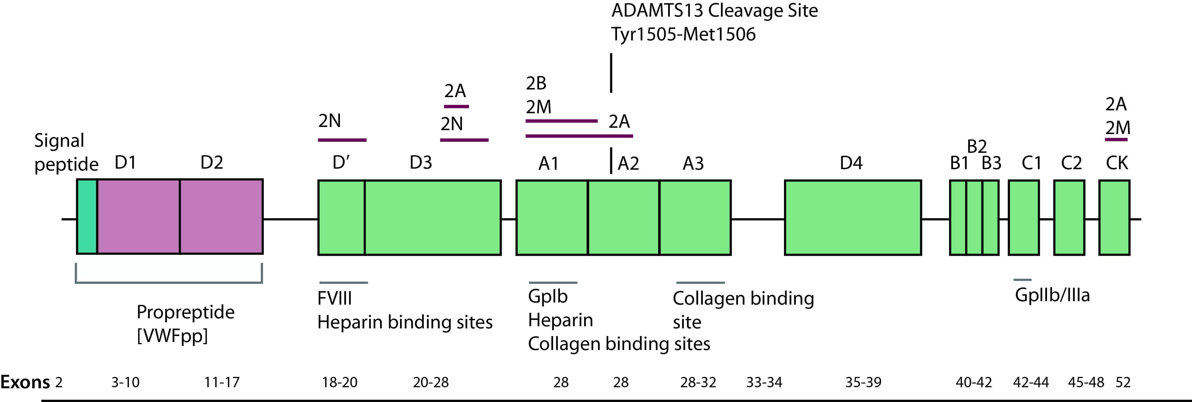
The TMA Culprit: VWF
Chromosome 12p13; 31,178 kb, 52 exons
mRNA specifies polypeptide of 2814 amino acids made of…
22-aa signal peptide, 742-aa propeptide, and 2050-aa monomer
Notes:
The culprit in the TMAs is VWF, produced from a chromosome 12 gene as a 2814 AA polypeptide with a short signal peptide, a propeptide, and a 2050 AA monomer.

Slide 7
VWF Polypeptide
VWFpp
GPIb binding site
ADAMTS13 cleavage site
GPIIb/IIIa binding site
VWD 2a: point mutations
VWD type 1: point mutations
VWD 2b: point mutations
VWD 2a: point mutations
7
Notes:
The VWF polypeptide’s domains support platelet binding sites that are ligands for GP1b and GP IIb/IIIa. Several locations on the protein are the sides for various forms of VWD. Important is the ADAMTS13 cleavage site that we will discuss in the next series of slides.

Slide 8
Monomer Assembly in Endothelial Cells
22-aa signal peptide is cleaved in endoplasmic reticulum after translation
742-aa propeptide-containing monomers dimerize via disulfide linkage of Cys residues near the C-terminus
In Golgi apparatus, propeptides catalyze D3 region disulfide bonds, creating long multimers composed of dimers arranged head-to head
The propeptide is then cleaved and the resultant ultra-large VWF [ULVWF] multimers are packaged in Weibel-Palade bodies
Measurable plasma propeptide [VWFpp]
2792 aa monomers
20 mD ULVWF
742 aa propeptides
Notes:
The 22-aa signal peptide is cleaved in the endothelial cell’s endoplasmic reticulum after translation. The 742-aa propeptide-containing monomers dimerize via disulfide linkage of Cys residues near the C-terminus in the Golgi apparatus. The propeptides catalyze D3 region disulfide bonds, creating long multimers composed of dimers arranged head-to head. The propeptide is then cleaved and the resultant ultra-large VWF [ULVWF] multimers are packaged in EC Weibel-Palade bodies. The cleaved plasma propeptide [VWFpp] are measureable as a plasme protein immunoassay.

Slide 9
Endothelial Cell Secretes ULVWF
Il-6; Il-8
Viruses
Injury
Thrombin
Histamine
Endothelial Cell
ULVWF
DDAVP
Epinephrine
Oxidants release ULVWF and render it uncleavable by ADAMTS13 plus they inactivate ADAMTS13
TNF- α
Superoxides
Notes:
A series of inflammatory cytokines induce the release of ULVWF to plasma, The ULVWF is the key TMA culprit, as it becomes uncleavable by ADAMTS. Oxidants also inactivate ADAMTE13.

Slide 10
ULVWF Secreted from Endothelium
PLT
PLT
ULVWF in plasma
PLT
ULVWF bound to endothelial cells via P-selectin
EC
EC
EC
EC
EC
SMC
FB
SMC
FB
SMC
In high shear-stress arterioles ULVWF strands are released to the plasma or remain attached to ECs via P-selectin and other adhesion molecules. Whether in plasma or bound, they bind platelets via glycoprotein [GP] Ib, a subunit of GP Ib/IX/V, with little platelet energy expended.
Notes:
In high shear-stress arterioles ULVWF strands are released to the plasma or remain attached to ECs via P-selectin and other adhesion molecules. Whether in plasma or bound, they bind platelets via glycoprotein [GP] Ib, a subunit of GP Ib/IX/V, with little platelet energy expended.

Slide 11
VWF-Platelet Interaction
GP Ia/IIa
Collagen receptor
PLT
FVIII binding site
VWF binds GPIb portion of GP Ib/IX/V
SMC: Smooth muscle cell FB: Fibroblast Lines: Collagen
VWF
VIII
Internal Elastic Lamina
SMC
FB
SMC
FB
SMC
Notes:
Besides serving as the FVIII carrier, VWF binds the GP1b portion of GP Ib/IX/V to promote platelet adhesion to subendothelial collagen.

Slide 12
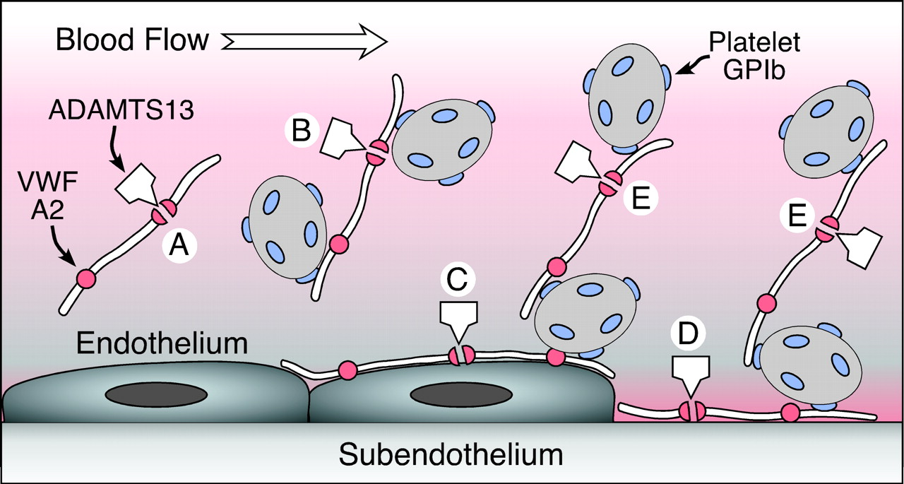
Platelet Strings
ULVWF is released from ECs and diffuses into the circulation [A and B] or adheres to the EC [C]. ULVWF also binds connective tissue exposed at sites of vascular injury [D]. Under high shear stress, platelets adhere to VWF in solution [B] or on surfaces [C and D] through their GPIb receptor. ULVWF also binds to previously adhering platelets [E]. ADAMTS13 cleaves a Tyr–Met bond in the A2 domain of the ULVWF subunit. This reaction is slow for VWF in solution [A] but occurs rapidly owing to conformational changes induced by tensile force on the ULVWF multimer.
Notes:
To reiterate, ULVWF is released from ECs and diffuses into the circulation [A and B] or adheres to the EC [C]. ULVWF also binds connective tissue exposed at sites of vascular injury [D]. Under high shear stress, platelets adhere to VWF in solution [B] or on surfaces [C and D] through their GPIb receptor. ULVWF also binds to previously adhering platelets [E]. ADAMTS13 cleaves a Tyr–Met bond in the A2 domain of the ULVWF subunit. This reaction is slow for VWF in solution [A] but occurs rapidly owing to conformational changes induced by tensile force on the ULVWF multimer.

Slide 13
ULVWF Bind Platelets in High Shear Stress Areas
PLT
PLT
PLT
PLT
PLT
PLT
PLT
PLT
PLT
PLT
PLT
PLT
PLT
PLT
PLT
PLT
PLT
PLT
PLT
PLT
PLT
EC
EC
EC
EC
EC
SMC
FB
SMC
FB
SMC
Platelets bind ULVWF, forming beaded strings. The strings stack and associate with collagen through platelet collagen receptors and may occlude the vessels. String length is attenuated by high density lipoproteins.
Notes:
Platelets bind and stack up on collagen to occlude vessels. HDLPs may help shorten string length and moderate occlusion.

Slide 14
What Prevents Occlusion? ADAMTS13
“A disintegrin and metalloprotease with thrombospondin-1 repeats member 13.” One of a family of 18 ADAMTSs
CUB
Active MP domain
Thrombospondins
CUB = “complement components C1r/C1s, embryonic sea urchin protein endothelial growth factor, and bone morphogenic protein”
Notes:
So what is this ADAMTS13? The initialism stand for “A disintegrin and metalloprotease with thrombospondin-1 repeats member 13” Indicating a VWF-cleaving protein that is one of a family of 18 ADAMTSs. The ADAMTS13 molecule is an assembly of several unique domains, including on the amino end, CUB = “complement components C1r/C1s, embryonic sea urchin protein endothelial growth factor, and bone morphogenic protein”. We will soon forget the names of the various domains.

Slide 15
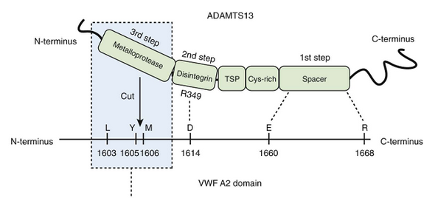
ADAMTS13
Synthesized from chromosome 9q34 in liver, 190,000 Daltons
ULVWF A2 domain stress exposes Tyr 1605–Met 1606.
ADAMTS13 attaches in “zipper” fashion and digests ULVWF
BTW, ULVWF A2 mutations enhance digestion, causing VWD subtype 2A
Notes:
ADAMTS 13 is synthesized from chromosome 9 from the liver, is 190,000 Daltons. ULVWF A2 domain stress exposes Tyr 1605–Met 1606., whereupon ADAMTS13 attaches in “zipper” fashion and digests ULVWF
As an aside, ULVWF A2 mutations enhance digestion, causing VWD subtype 2A

Slide 16
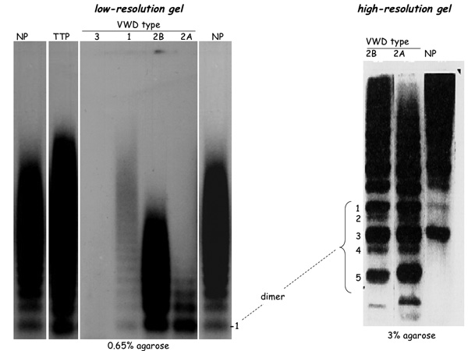
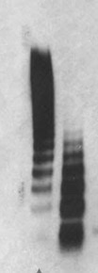
TTP: Reduced ADAMTS13
Plasma ULVWF reflected in VWF multimer analysis
Normal
Small
Intermediate
Large
Ultra-large
Ultra-large
Notes:
We’ve used the time-honored electrophoretic VWF multimer analysis to diagnose the VWD subtypes 2a and 2b. In the low-resolution gel, TTP plasma displays excess ULVWF multimers when compared to normal plasma. The ULVWF multimers migrate slowly compared to the normal range of ADAMTS13 digested multimers.

Slide 17
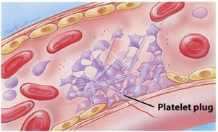
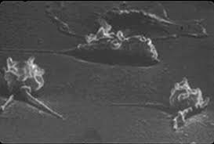
TTP: ADAMTS13 <10%
Platelets do not bind ADAMTS13-digested plasma VWF [mechanism under study]
Familial recurrent “rTTP”—10% of cases: congenital ADAMTS13 abnormality or deficiency, <5% activity detected in assay. ULVWF consistent in plasma, childhood symptoms, remission is temporary
Autoimmune “iTTP”—90%: episodic deficiency of ADAMTS13 and rise of ULVWF, remission usually sustained
Accumulated ULVWF/PLT complex occludes vessels, consumes and activates PLTs and splits RBCs, accounting for thrombocytopenia and MAHA
Notes:
In TTP, the ADAMTS13 level is <10%. Platelets do not bind ADAMTS13-digested plasma VWF [mechanism under study].
In familial recurrent “rTTP”—10% of cases: ADAMTS13 congenital abnormality or deficiency, there is <5% activity detected in assay. ULVWF consistent in plasma, childhood symptoms, remission is temporary
Autoimmune [idiopathic] “iTTP”—90%: episodic deficiency of ADAMTS13 and rise of ULVWF, remission usually sustained
Accumulated ULVWF/PLT complex occludes vessels, consumes and activates PLTs and splits RBCs, accounting for thrombocytopenia and MAHA

Slide 18
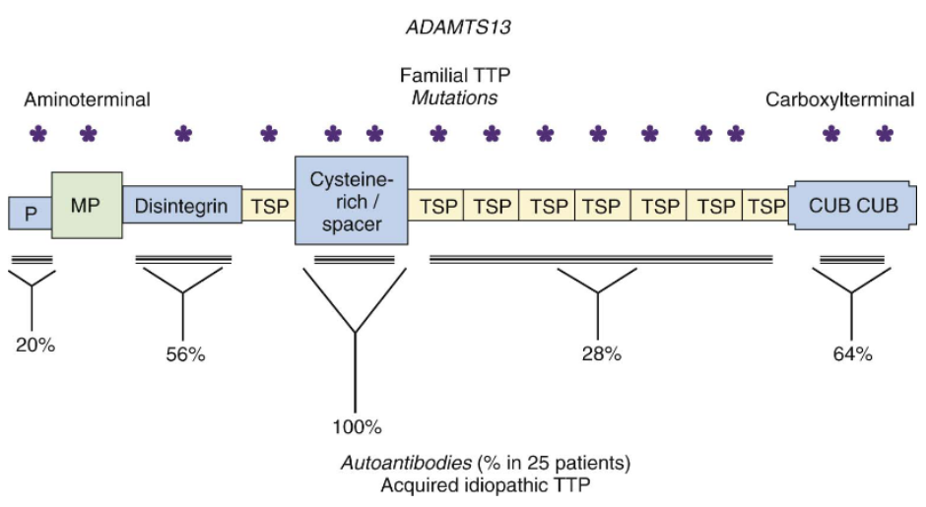
Congenital Vs. Acquired [Immune] TTP
ADAMTS13
rTTP 15 Mutations
iTTP: Polyclonal autoantibody targets
Thrombospondins
IgG 4 autoantibodies, possible familial distribution, all bind the cysteine-rich spacer residues
Notes:
At least 15 mutations have been described in congenital TTP. In autoimmune TTP. Polyclonal autoantibodies may bind any location along the molecule wherever there are cysteine-rich sequences. Acquired TTP may havea familial distribution.

Slide 19
19-YOA ♀, Presumptive TTP Differential Diagnosis: Various TMAs
Shiga toxin E. coli-triggered hemolytic-uremic syndrome [STEC-HUS]
Atypical hemolytic-uremic syndrome [aHUS]
Hemolysis, elevated liver enzymes, low platelets [HELLP]
Disseminated intravascular coagulation [DIC]
Familial recurrent thrombotic thrombocytopenic purpura [rTTP]
Acquired autoimmune thrombotic thrombocytopenic purpura [iTTP]
Notes:
In considering their differential diagnosis, the provider includes these six possibilities.

Slide 20
19-YOA ♀, Presumptive TTP “PLASMIC” Score
Criteria | Patient | Points
Platelet count <30,000/uL | 15,000.uL | 1
Hemolysis [MAHA, LD] | LD 420 U/L | 1
No active cancer in previous year | ✅ | 1
No solid organ or stem cell transplant | ✅ | 1
MCV <90 fL | 78 fL | 1
INR <1.5 | 1.2 | 1
Creatinine <2.0 mg/dL | 1.1 mg/dL | 1
Maximum 7 points, 6–7 indicates TTP, <6 suggests HUS or HELLP
Li A, Khalighi PR, Wu Q, et al. External validation of the PLASMIC score: a clinical prediction tool for TTP diagnosis and treatment. J Thromb Haemost. 2018;16:169–9.
Notes:
The provider applies the PLASMIC score to differentiate TTP from HUS and HELLP.

Slide 21
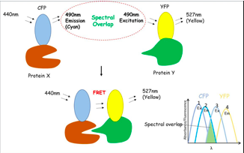
ADAMTS13 Activity Assay FRET-rVWF71
Fluorescence resonance energy transfer
Synthetic VWF peptide: 71 aa from the A2 domain
Serum, heparinized or citrated plasma, not EDTA
No bilirubin, HGB, or plasma VWF multimer interference
Does not measure shear force effects
Jones GA, Bradshaw DS. Resonance energy transfer: From fundamental theory to recent applications. Frontiers in Physics. 2019;7:100. doi:10.3389/fphy.2019.00100.
Notes:
The FRET [Fluorescence resonance energy transfer] provides a synthetic VWF peptide: 71 aa from the A2 domain.

Slide 22
Fluorescence Resonance Energy Transfer
Fluorophore CFP excites at wavelength 440nm, emits at 490nm [cyan]
Fluorophore YFP excites at 490nm, emits at 527nm [yellow]
Emission is a function of distance between the fluorophores
Photon [non-radioactive] exchange between fluorophores when adjacent
ADAMTS13 [Protein X] binds target VWF71 [Protein Y]
Emission intensity is linear with ADAMTS13 activity
Notes:
The first fluorophore CFP excites at wavelength 440nm, emits at 490nm [cyan]. The second fluorophore YFP excites at 490nm, emits at 527nm [yellow] and emission is a function of distance between the fluorophores. There is a non-radioactive photon exchange between fluorophores when adjacent ADAMTS13 [Protein X] binds target VWF71 [Protein Y] and emission intensity is linear with ADAMTS13 activity.

Slide 23
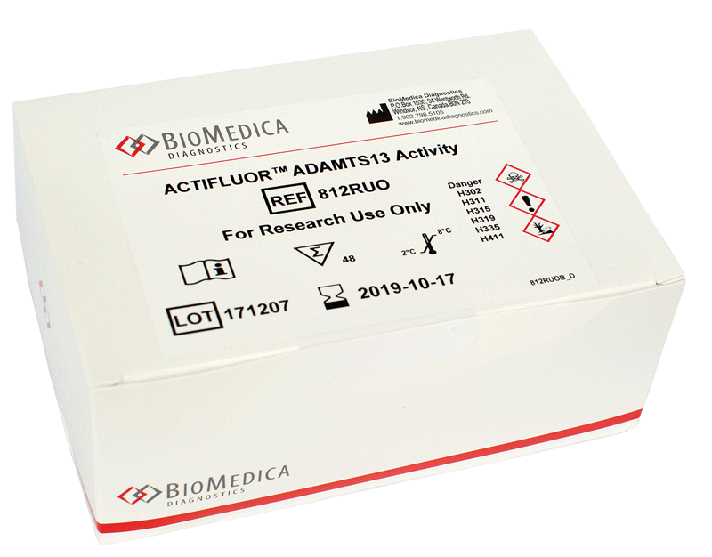
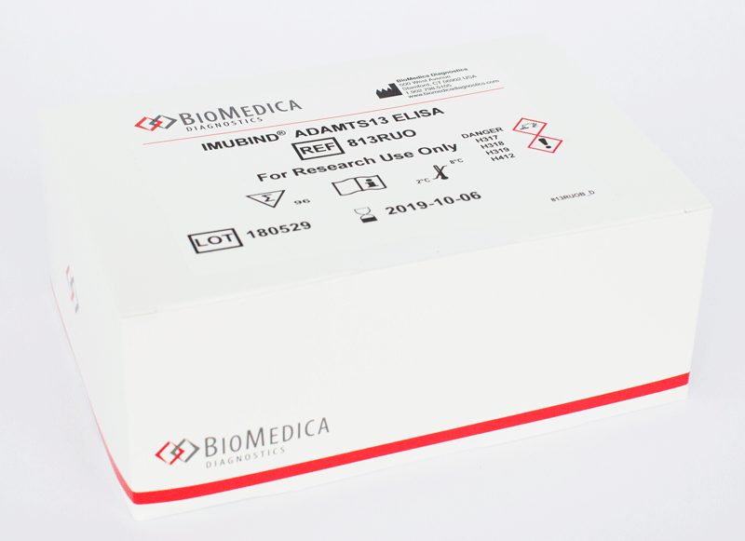
ADAMTS13 Antigen Enzyme Immunoassays
~Seven solid-phase polyclonal or monoclonal EIAs available
WHO international ADAMTS13 standard 12/252, two 2015 surveys
Mean ADAMTS13 activity 0.91 U/mL, CV 12.4%
Mean ADAMTS13 antigen 0.92 U/mL, CV 16.3%
Large CVs reflect antigen epitope recognition and avidity differences
Notes:
There are at least seven solid-phase polyclonal or monoclonal EIA kits available plus, QCd using the WHO international ADAMTS13 standard Two 2015 surveys
Mean ADAMTS13 activity 0.91 U/mL, CV 12.4%
Mean ADAMTS13 antigen 0.92 U/mL, CV 16.3%
Large CVs reflect antigen epitope recognition and avidity differences

Slide 24
Auto-anti-ADAMTS13 Immunoassay
Heat-inactivated patient plasma
Non-antibody ADAMTS13 inhibitors
HGB, IL-6, thrombospondin 1, all block the A2 domain
Not detected in the auto-anti-ADAMTS13 assay
Solid Phase
Plasma
ADAMTS13
Chromophore
Notes:
The autoantibody ADAMTS solid phase immunoassay uses an ADAMTS13 target treated with non-antibody blockers. The plasma is identified by an enzyme that catalyzes the chromophore whose color intensity is proportional to antibody activitly.

Slide 25
19-YOA ♀ TMA Diagnosis
ADAMTS13 activity by FRET: <5%
ADAMTS13 concentration by antigen assay: <5%
Auto-anti-ADAMTS13 immunoassay: 1:64
Diagnosis: iTTP
Notes:
Read the slide.

Slide 26
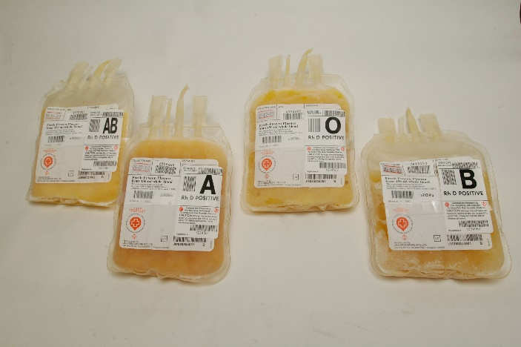
Familial TTP Therapy
1970s: fresh-frozen plasma [FFP] and cryosupernatant restored normal VWF multimers and reversed symptoms
Relapse in three weeks, repeated infusions
1990s: plasma exchange [PLEX]
Byrnes JJ, Khurana M. Treatment of thrombotic thrombocytopenic purpura with plasma. N Engl J Med. 1977;297:1386–89.
Moake JL, Brnes JJ, Troll JH, et al. Effects of fresh-frozen plasma and its cryosupernatant fraction on von Willebrand factor multimeric forms in chronic relapsing thrombotic thrombocytopenic purpura. Blood. 1985;65:1232–6.
Notes:
Read the slide.

Slide 27
Standard iTTP Therapy: PLEX
D/C triggers: ticlopidine, clopidogrel, quinine
Emergency: Plasma at 30 mL/kg/day until PLEX is started
High-dose glucocorticoids or rituximab [Rituxan®] anti-CD20
PLEX daily, BID if refractory, Rituxan® post-PLEX
Follow efficacy daily w/ PLT counts & LD
Assess remission: PLT counts, LD, MAHA, HGB
Continue PLEX 3 days post-remission
PLEX + Rituxan® 80–90% effective
Remeasure ADAMTS13 when in remission
Notes:
D/C triggers: ticlopidine, clopidogrel, quinine have been shown to trigger iTTP. The first step is to provide plasma at 30 mL/kg/day until PLEX is started, adding high-dose glucocorticoids or rituximab [Rituxan®] anti-CD20. PLEX daily or twice a day if refractory and continue Rituxan® post-PLEX. Follow efficacy daily w/ PLT counts & LD and assess remission using PLT counts, LD, MAHA, and HGB. Continue PLEX 3 days post-remission. PLEX + Rituxan® is 80–90% effective, remeasure ADAMTS13 when in remission.

Slide 28
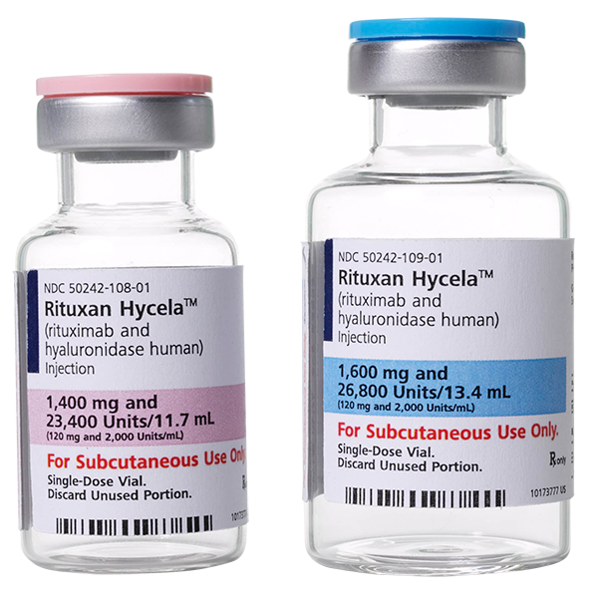
Rituxan®
TTP care with PLEX alone associates with a median 8.2-year reduction in life expectancy and a total cost of $389K direct care and $259K indirect cost including loss of productivity and early mortality.
Rituxan® [anti-CD20] raises the total cost by $13K but provides a 2.6-year improvement in life expectancy.
Notes:
Rituxan: Anti-CD20 immunotherapy suppresses B cells. Read slide.

Slide 29
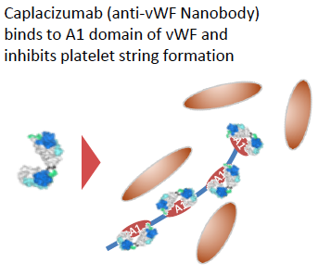
Caplacizumab [Cablivi®] for iTTP
HERCULES trial, phase III
FDA-approved Jan 2019, Sanofi; world’s first nanobody Rx
Binds VWF A1 region, blocks PLT string formation
Prevents microthrombi
Nanobody
Scully M, Cataland SR, Peyvandi F, et al. Caplacizumab treatment for acquired thrombotic thrombocytopenic purpura. N Engl J Med. 2019;380:335–46
Notes:
Cablivi is the world’s first nanobody. It binds VWF’s A1 region and blocks platelet string formation to prevent microthrombi. What is a nanobody? Stand by for the answer.

Slide 30
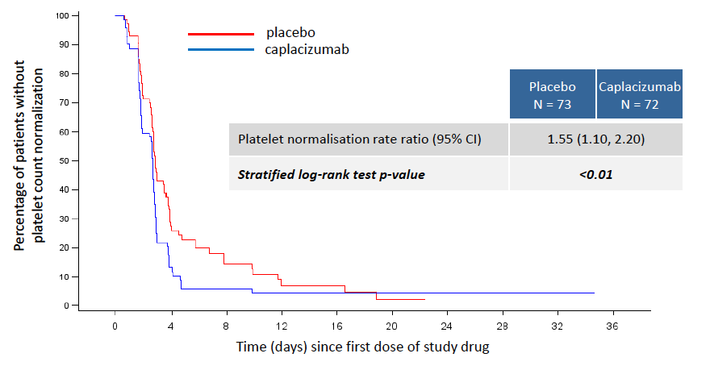
Cablivi® Surrogate Endpoint: Time to PLT Response
Defined as initial platelet count ≥150,000/uL, subsequent daily PLEX D/C within 5 days
Notes:
But first, Cablivi shortens the time to platelet count recovery at 150,000 to 3 days, PLEX is D/Ced within 5.

Slide 31
HERCULES End Points
Subjects N [%] | Current Rx N = 73 | Cablivi N=72
iTTP-related death | 3 [4.1%] | 0
iTTP exacerbation [during therapy] | 28 [38.4%] | 3 [4.2%]
iTTP recurrence long-term | 28 [38.4%] | 9 [12.7%]
Refractory iTTP—continued thrombocytopenia | 5 [7%] | 0
Major thromboembolic event [VTE or arterial] | 6 [8.2%] | 6 [8.5%]
First four endpoints: P > 0.05
Notes:
Read the slide.

Slide 32
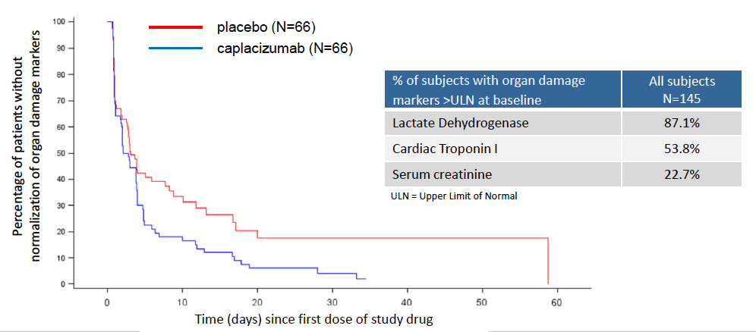
HERCULES Time to Normalization of Organ Damage Markers
Notes:
This chart shows the percentage of patients who achieve normalization of LD, Cardiac troponin 1, and creatinine within ten days.

Slide 33
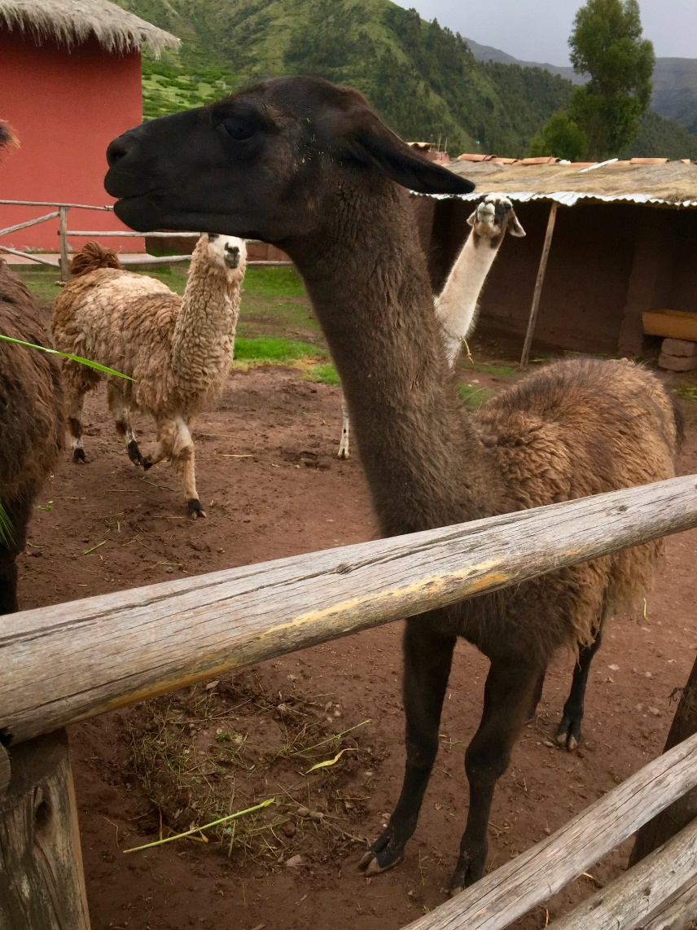
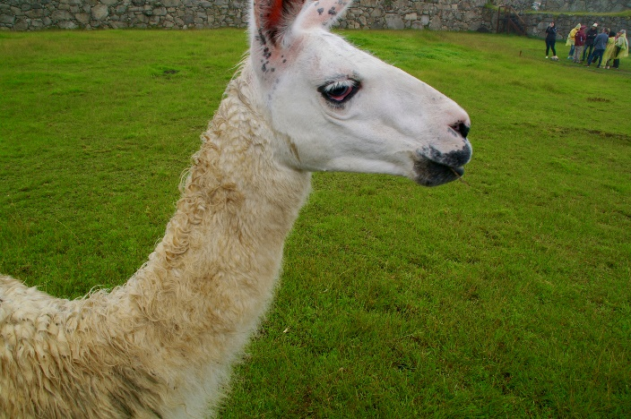
Camalid Nanobody
Alpaca
Vicuna
Llama
Notes:
Nanobodies are antibodies that are produced in camalids such as a Llama, Alpaca, or Vicuna.

Slide 34
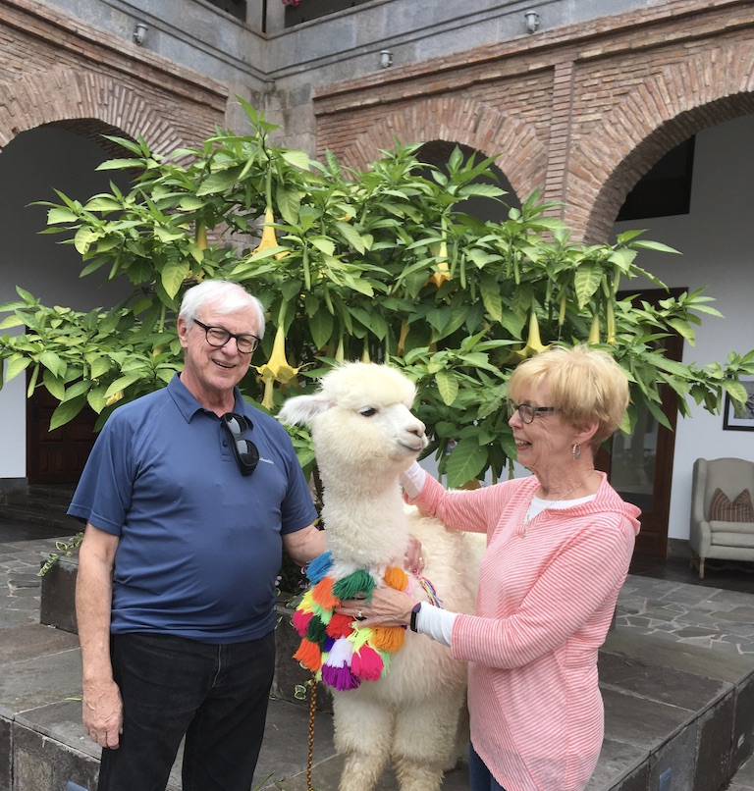
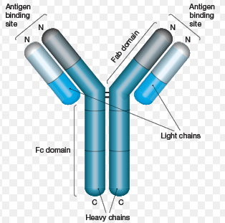
What is a Nanobody?
Camelids: camels, llamas, alpacas, vicunas make heavy chains with no light chains, no VH1 region, direct connection to hinge region
VH1
Notes:
These are antibodies that make heavy chains with no light chains, no VH1 region, direct connection to hinge region.

Slide 35
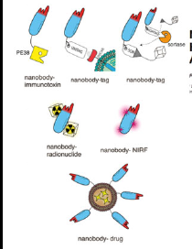
Nanobody Features
High affinity, specificity
Short half‐life, thermostable
Soluble, penetrate tissues
Small molecule are non-immunogenic, no heterophile ABs
Penetrate small molecular pockets
Cross the blood-brain barrier
But they don’t bind small molecules or carbohydrates
Notes:
Here are the features of nanobodies.

Slide 36
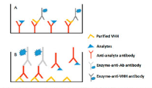
Experimental Nanobody Applications
Antiviral [HIV, HSV, RSV], camel flu, coronavirus by inhaler [C19!]
Anti-allergens
Antitumor Rx
Anti-angiogenesis
Anti-inflammatory
Neutralize venoms
IL-6‐R for rheumatoid arthritis Rx
Radiolabeled for Her2+ tumor imaging
Diagnostic: viral, fungal, mycotoxins in food, trypanosomes
Stroke diagnosis and inactivation
Sasisekharan R. Preparing for the future—nanobodies for Covid-19? N Engl J Med 2021; 384:1568–71
Notes:
Nanobodies are being developed for several applications. Therapeutic applications inclue [read from list], diagnostic applications include [read from list].

Slide 37
Caleb
2013 Geico prize-winning “Hump Day” ad.
Notes:
Caleb the camel won the commercial of the year 2013 advertising Geico insurance.

Slide 38
rADAMTS13 Concentrate SHP655
A phase 2, multicenter, randomized, placebo-controlled, double-blind study in patients with rTTP to evaluate the pharmacokinetics, safety and efficacy of rADAMTS13 [SHP655] administered in addition to standard of care treatment. ClinicalTrials.gov Identifier: NCT03922308
Takeda Pharmaceuticals acquired Shire in January 2019, Shire was Baxalta, Baxalta was Baxter, Chicago
Or rADAMTS13 modified to evade iTTP autoantibody
Or rADAMTS13 in platelet concentrate to evade iTTP autoantibody
Jian C, iao J, Gong I, et al. Gain-of-function ADAMTS13 variants that are resistant to autoantibodies against ADAMTS13 in patients with acquired thrombotic thrombocytopenic purpura. Blood 2112; 119: 3836–43.
Abdelgawwad MS, Cao W, Zheng L, Kocher NK, Williams LA, Zheng XL. Transfusion of platelets loaded with rADAMTS13 is efficacious for inhibiting arterial thrombosis associated with thrombotic thrombocytopenic purpura. Arterioscler Thromb Vasc Biol. 2018;38:2731–43
Notes:
Read the phase 2 trial information. Phase 3 trials are now ongoing. The investigators have discontinued efforts to use rADAMTS13 in iTTP, but continue with familial recurrent TTP patients using either a prophylaxis or on demand approach.

Slide 39
Childhood Trauma
Children’s Hospital of Alabama Level 1 Trauma Center
106 Pts 2014–16, median 9 YO, blunt & penetrating trauma
Injury severity score median 33; $≥15:72; ≥25:46$
Measures: PT Ratio vs ADAMTS13, VWFag, VWFac, HNP 1–3
Human neutrophil peptide
Endothelial activation occurs in trauma or sepsis and can induce an inflammatory procoagulant state associated with microvascular injury and thrombosis.
Russell RT, McDaniel JK, Cao W, Zheng XL, et al. Low plasma ADAMTS13 activity is associated with coagulopathy, endothelial cell damage and mortality after severe pediatric trauma. Thromb Haemost. 2018; 118: 676–87.
Notes:
In 2018, Zheng and colleagues reported the use of rADAMTS13 on 106 severely injured blunt and penetrating trauma on 106 children, measuring their response by prothrombin time ratio, ADAMTS13 ratio, VWF antigen and activity, and human neutrophil peptide on the principle that Endothelial activation occurs in trauma or sepsis and can induce an inflammatory procoagulant state associated with microvascular injury and thrombosis.
.

Slide 40
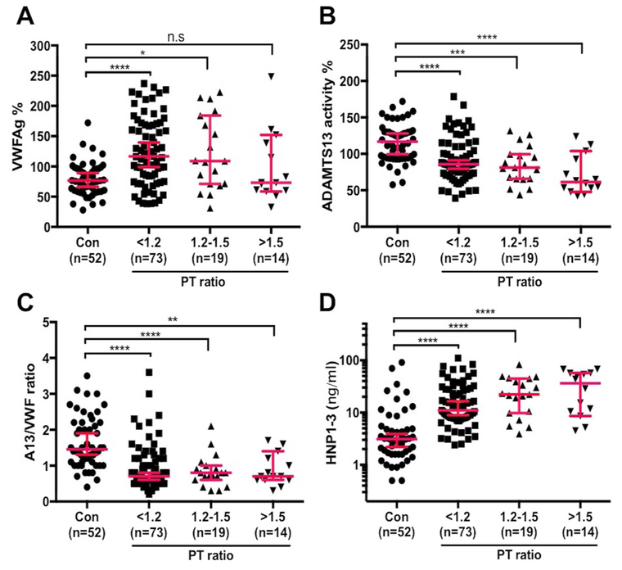
Childhood Trauma Results by ADAMTS13/VWFag ratio
↓ ADAMTS13
↓ ADAMTS13/VWFag ratio
↑ HNP 1–3
So what?
Notes:
They measured ADAMTS13/VWFag ratio and illustrated its dose-related response.

Slide 41
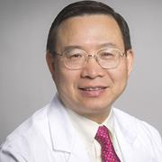
ADAMTS13, VWF, HNP 1–3 in Traumatic Brain Injury
33 adult TBI victims 2010–14 Vs 33 controls
Blood collected at 0, 1, 2, 3, & 5 days
Traumatic microvascular injury in brain and other organs
VWFag, VWFac, HNP 1–3 rise over 5 days Vs control
ADAMTS13 reduces over 5 days compared to controls
Changes most profound in severe cases
Long Zheng, MD PhD
Kumar MA, Can W, Pham HP, Zheng XL, et al. Relative deficiency of plasma ADAMTS13 activity and elevation of human neutrophil peptides in patients with traumatic brain injury. J Neurotrauma 2018; 36. https://doi.org/10.1089/neu.2018.5696
Notes:
Dr. Zheng also measured ADAMTs13, VWF, and HNP in 33 adult traumatic brain injury patients and reported a rise in VWF ag and VWF ac, with a drop in ADAMTS13 over 5 days, with levels most profoundly affected in severe cases.

Slide 42
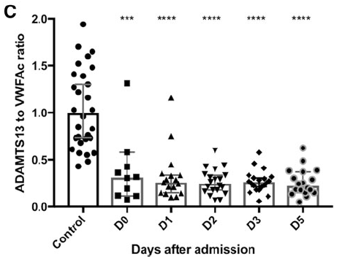
ADAMTS13/VWFac
Notes:
Dr. Zheng’s ADAMTS13/VWFac ratios in TBI patients.

Slide 43
ADAMTS13 Concentrate TBI Therapy?
“We conclude that the elevated plasma levels of VWF, reduced ADAMTS13 activity, and elevated HNP 1–3 in patients post-TBI may explain the underlying mechanism of microvascular thrombosis found in vessels of brain parenchyma and other organ tissues despite a seeming hypocoagulability revealed by other routine laboratory tests, including low PLT count, prolonged PT and PTT. Our findings may provide a rationale for supporting future clinical trials with rADAMTS13 as a novel therapy in patients with TBI.”
Notes:
Dr. Zheng;s conclusion.

Slide 44
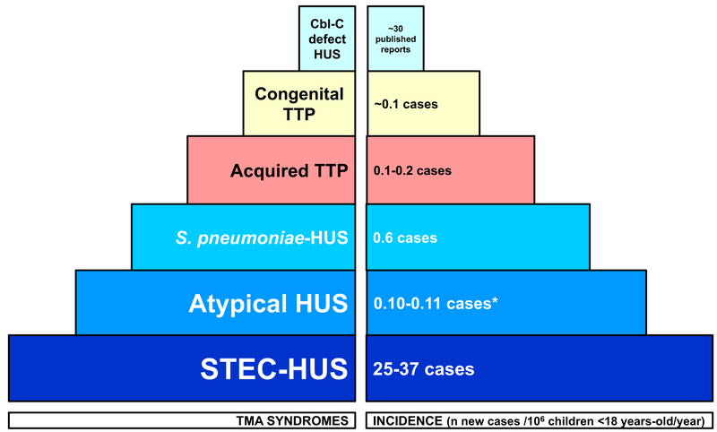
TMA Incidence in Childhood
University of Cincinnati
Berangere SJ, Zheng XL, Veyradier A. Understanding thrombotic microangiopathies in children. Intensive Care Med. 2018; 44:1536–8.
Notes:
This 2018 University of Cincinnati study documented the annual incidence of TMAs in childhood, indicating that STEC-HUS, S. pneumoniae HUS, and aHUS were by far the most presentations. STEC-HUS is Shiga toxin-producing Escherichia coli-triggered HUS, which is usually treateable.

Slide 45
STEC-HUS Vs. TTP
 | HUS | TTP
Patient | Child | All ages
Organ | Renal | Several [CNS]
Episodes | Single | Recurrent
Thrombocytopenia | Moderate | Severe
MAHA | 2+ | 4+
ADAMTS13 | Broadly normal | Absent
Clinical and laboratory observations cross boundaries, obscuring diagnosis
Notes:
This table is used to sort out STEC-HUS from TTP. Clinical and laboratory observations cross boundaries, obscuring diagnosis, however the availability of fast-TAT ADAMTS13 levels or ADAMTS13/VWFag ratios will provide definitive laboratory support.

Slide 46
aHUS
A recurrent TMA with MAHA, thrombocytopenia, creatinine >2.25 mg/dL, but ADAMTS13 activity >13%
Pathophysiology: excessive activation of the alternate pathway complement [APC] system
Related to mutations in APC regulatory proteins genes for H, I, thrombomodulin, and membrane cofactor protein
However, these mutations exist in non-aHUS individuals
Two-hit hypothesis: mutation + pregnancy, inflammation, surgery, or autoimmune disorder
Could also be acquired aHUS, autoimmune
Symptoms appear at median 18 YOA, severe, recurring

Slide 47
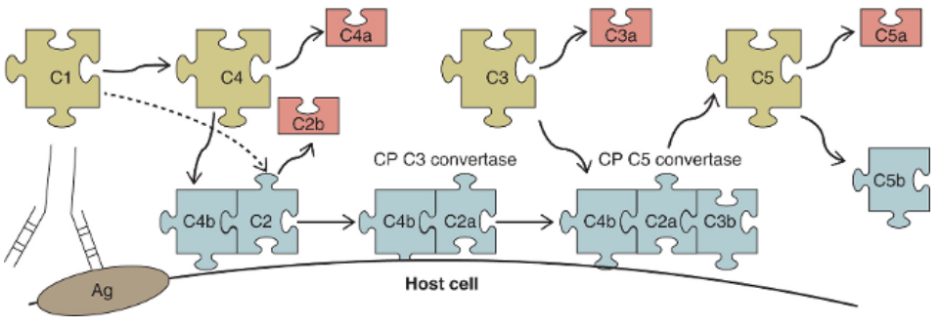
Classical Complement Pathway
Anaphylatoxin [cytokine]
Catalyzed by IgM or 6 IgGs
C5a may increase inflammatory cytokines, downregulate ADAMTS-13, generates tissue factor and PAI1, decreases protein S and increases protein C resistance because of increased factor VIII activity, and, most importantly, activates thrombin.
Notes:
IgM or multiple IgG isotype antibodies catalyze C1 to form C4, which splits into C4a and C4b. C4b on a cell surface combines with C2, splitting off C2b, The C4b-C2a complex bind c3, splitting off C3a, C5b, and c5a. C3a and C5a are cytokines involved in anaphylaxis. C5a may increase inflammatory cytokines, downregulate ADAMTS-13, generates tissue factor and PAI1, decreases protein S and increases protein C resistance because of increased factor VIII activity, and, most importantly, activates thrombin.

Slide 48
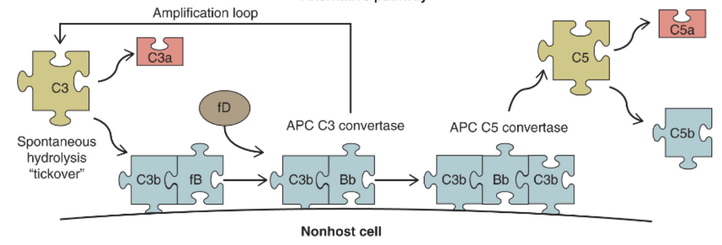
Alternate Complement Pathway [APC]
Courtesy Gavriilaki E, Brodsky RA. Complement-mediated coagulation disorders: PNH and aHUS. In Kitchens CS, Kessler CM, Konkle BA, Streiff MB, Garcia DA. Consultative Hemostasis and Thrombosis, fourth Edition. Elsevier 2019
Notes:
The alternate complement pathway begins with Ce and also produces C5a.

Slide 49
Membrane Attack Complex [MAC]
Courtesy Abbas AK, Lichtman AH, Pillai S. Cellular and Molecular Immunology Edition 6. Elsevier. 2010:272–88.
Notes:
C5b joins with C6, 7, 8, and 9 together forming the cylindrical membrane attack complex that causes hemolysis.

Slide 50
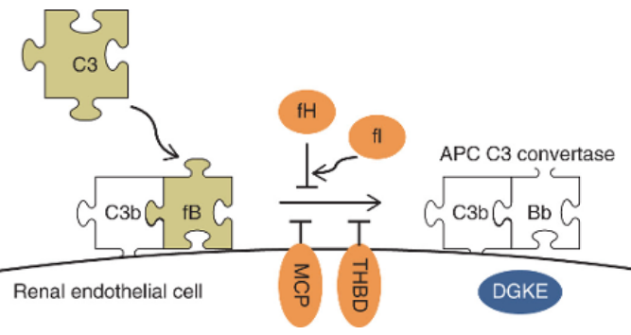
Alternative Pathway Dysregulation in aHUS
Activation results from loss-of-function mutations in regulatory factors H [fH], fI, membrane cofactor protein [MCP] and thrombomodulin [THBD] shown in orange, gain-of-function mutations of C3 and factor B shown in green. Renal ECs are primary aHUS targets.
Notes:
The dysregulation in the alternate pathway activation results from loss-of-function mutations in regulatory factors H, I, membrane cofactor protein [MCP] and thrombomodulin [THBD], gain-of-function mutations of C3 and factor B shown in green. Renal ECs are primary aHUS targets.. diacylglycerol kinase ɛ [DGKE] disrupts membrane phospholipids.

Slide 51
How to Test for aHUS
Really?
No reliable complement protein tests
Urinary C5b–9?
Modified Ham test PNH RBCs incubated with aHUS serum, cells retain dye if complement MAC induces death
Notes:
In the Modified Ham test PNH-like cultured RBCs are incubated with aHUS serum, cells retain dye if complement MAC induces death.

Slide 52
aHUS Differential Diagnosis
DIC: MAHA, tpenia, PT/INR and PTT prolonged, D-dimer markedly elevated
Misc. TMAs: malignancy, PNH, organ transplant, therapeutics
Therapeutics: quinine, mitomycin, cyclosporin, chemotherapy
TTP: ADAMTS13 <10%
STEC-HUS: Shiga toxin testing
Notes:
Read the slide

Slide 53
aHUS Treatment
PLEX: temporarily and partially effective
50% progression to end state renal disease
Complement inhibition, nanobody eculizumab [Soliris®]
World’s second nanobody therapy
Cost, relapse?, D/C?, close monitoring
Eculizumab
Notes:
Soliris (eculizumab) is an immunosuppressant used for Hemolytic Uremic Syndrome and Myasthenia Gravis costing about 6000 per dose.

Slide 54
HELLP Syndrome in Pregnancy
Hemolysis, elevated liver enzymes, low platelets
Pre-eclampsia spectrum, severe risk to mother and fetus
Hypertension, proteinuria, end organ ischemia
MAHA, renal dysfunction, altered mental status, seizures
Rx: manage hypertension, Mg for seizures, early delivery
Urine C5b–9 elevation, mutations
Assay: modified Ham test, Rx eculizumab in trials

Slide 55
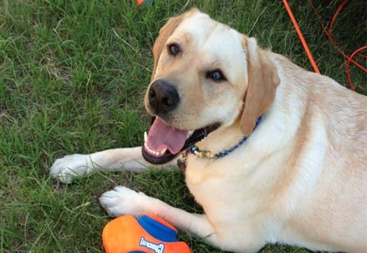
HELLP; The Lab Saved my Life
Asa [Now 7 YOA]
Mama
Not this Lab
Notes:
A friend went for a routine prenatal checkup. Labs revealed HELLP syndrome, and her provider called her on her ride home to tell her to turn around and induce labor. Little Asa is now 7 and in good health. I gave Asa and his mom each a bag saying, “The lab saved my life.”

Slide 56
Thrombotic Microangiopathies [TMAs]
Thrombotic thrombocytopenic purpura [TTP], Rx Cablivi®
Shiga-toxin producing E. coli hemolytic-uremic syndrome [STEC-HUS]
Childhood traumatic brain injury Rx ADAMTS13
Atypical hemolytic-uremic syndrome [aHUS], Rx eculizumab [Soliris®]
HELLP Syndrome, Rx Soliris®?
Notes:
Here is a review of the TMAs Thanks for listening.

