Slide 1
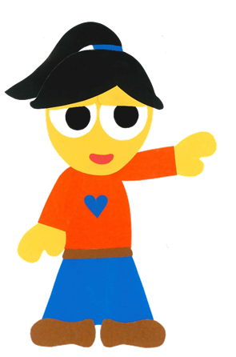
WE
CAN
READ
Donald Joyce
www.teacherdonald.com

Slide 2
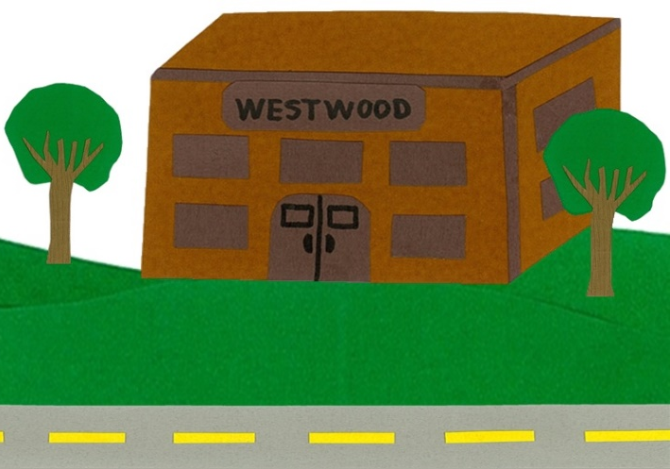
How Do You Go
To School?
By:
Donald Joyce
WE CAN READ

Slide 3
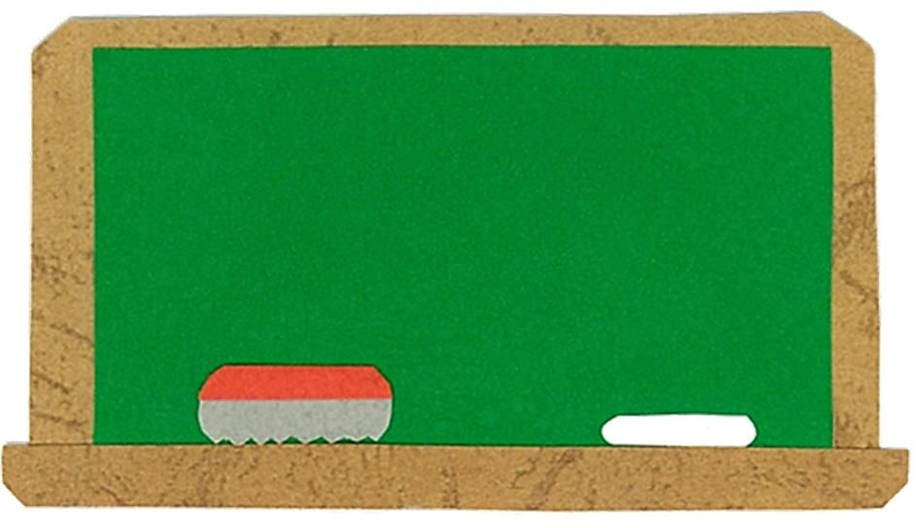
Let’s
Talk!

Slide 4
How do you go to school?
I go to school by ___.
Me too!

Slide 5
Let’s
Learn!

Slide 6
bicycle
scooter
car
taxi
bus
helicopter

Slide 7
Let’s
Read!

Slide 8
How Do You Go
To School?
By:
Donald Joyce
WE CAN READ

Slide 9
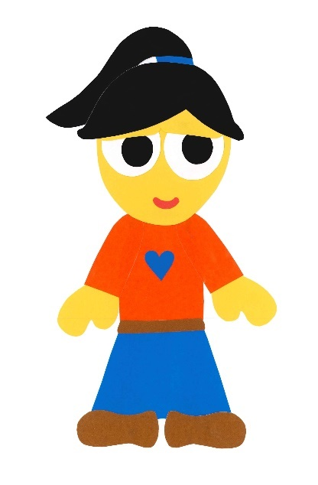
How do you
go to school?

Slide 10
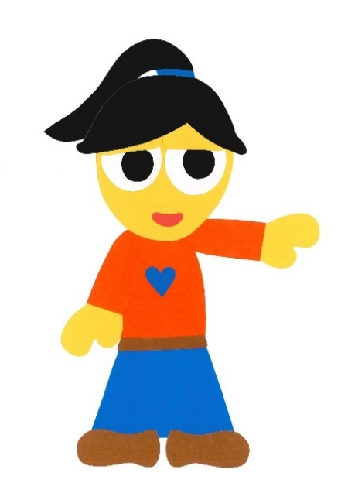
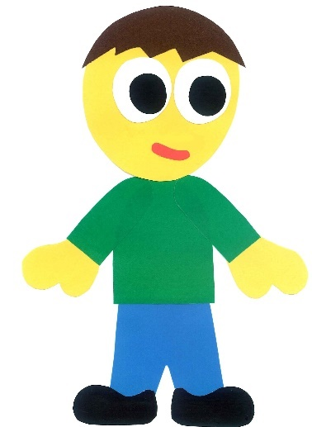
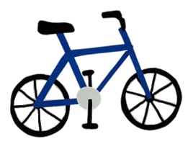
I go to school
by bicycle.

Slide 11
How do you
go to school?

Slide 12
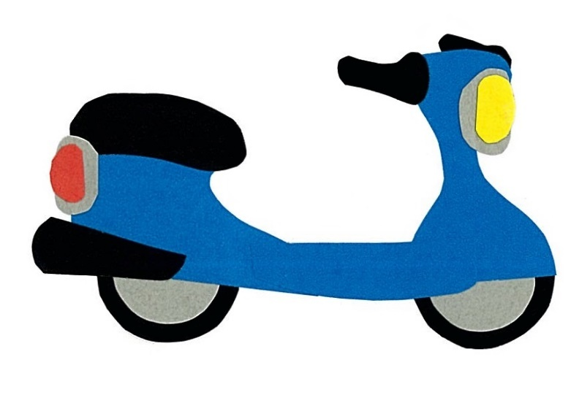
I go to school
by scooter.

Slide 13
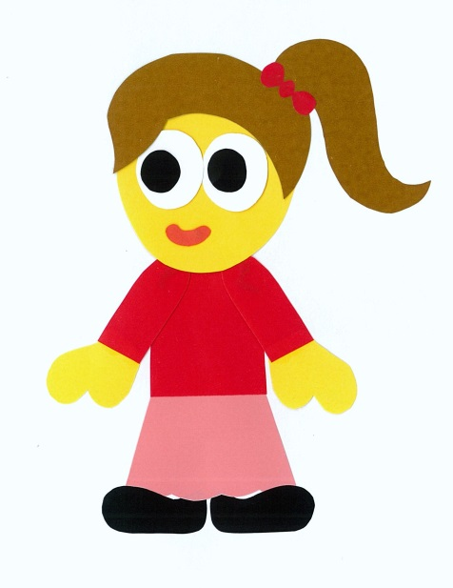
How do you
go to school?

Slide 14
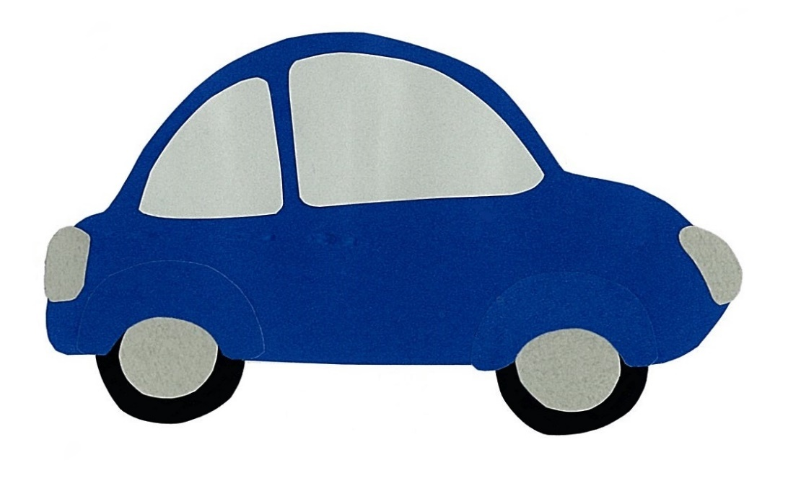
I go to school
by car.

Slide 15
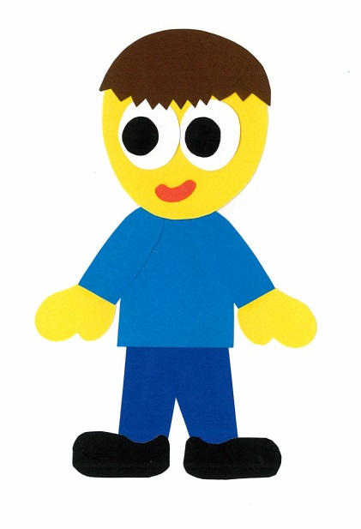
How do you
go to school?

Slide 16
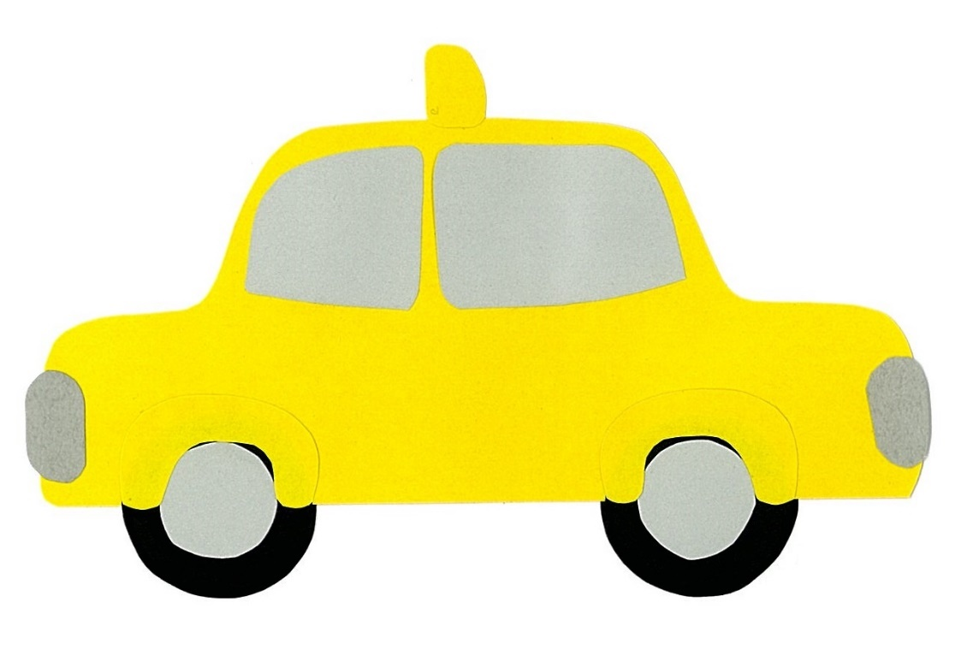
I go to school
by taxi.

Slide 17
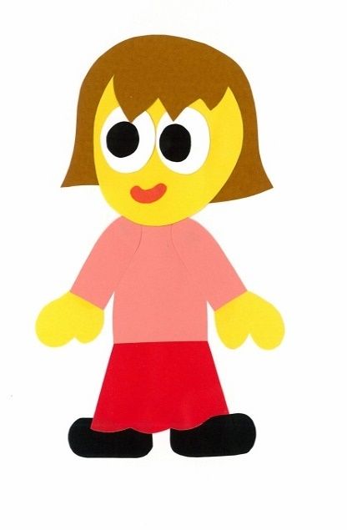
How do you
go to school?

Slide 18
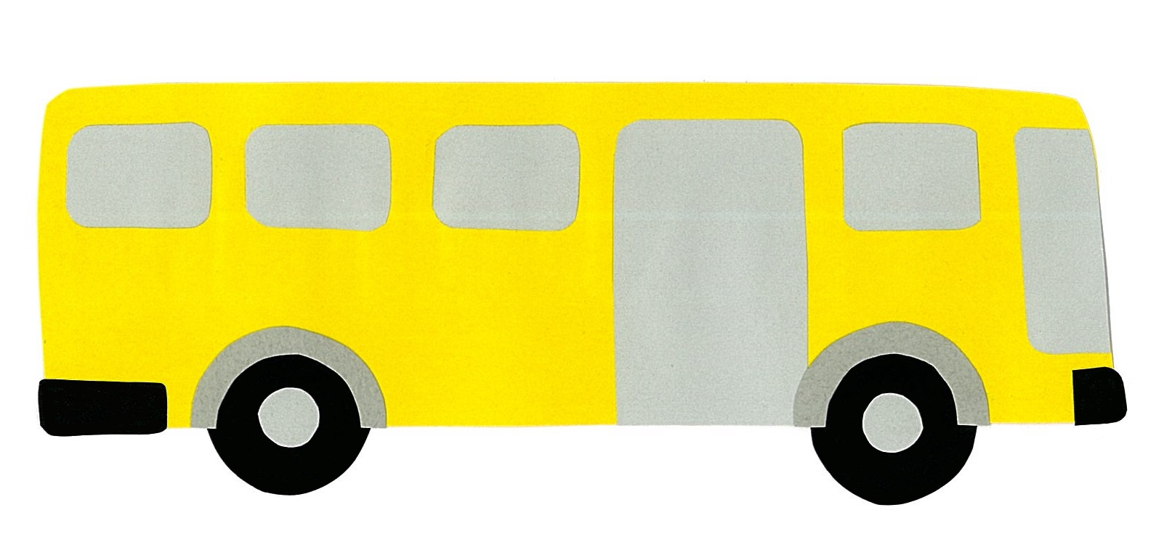
I go to school
by bus.

Slide 19
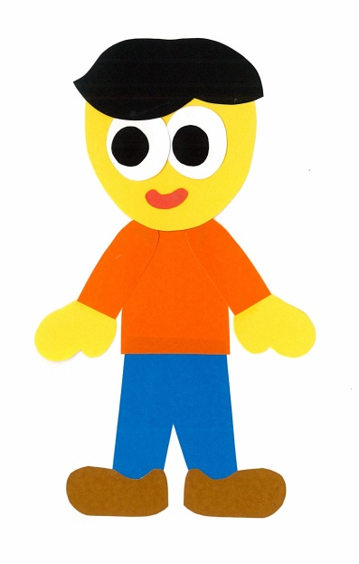
How do you
go to school?

Slide 20
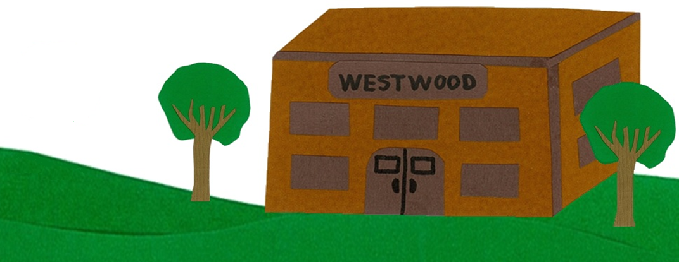
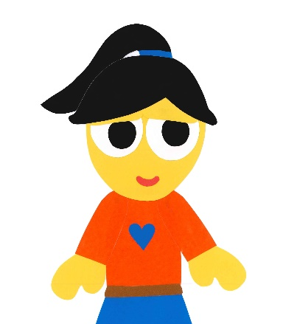
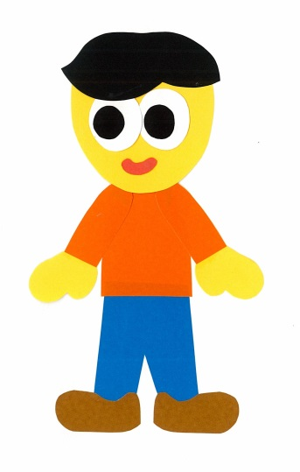
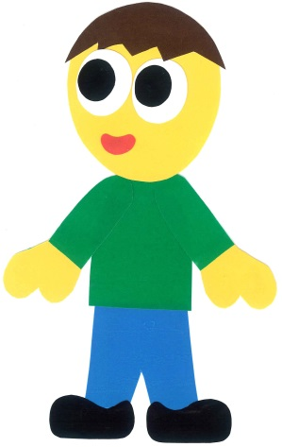
I go to school
by helicopter.

Slide 21
How Do You Go
To School?
By:
Donald Joyce
WE CAN READ

Slide 22
Let’s
Review!

Slide 23
She goes to school by bicycle.

Slide 24
He goes to school by scooter.

Slide 25
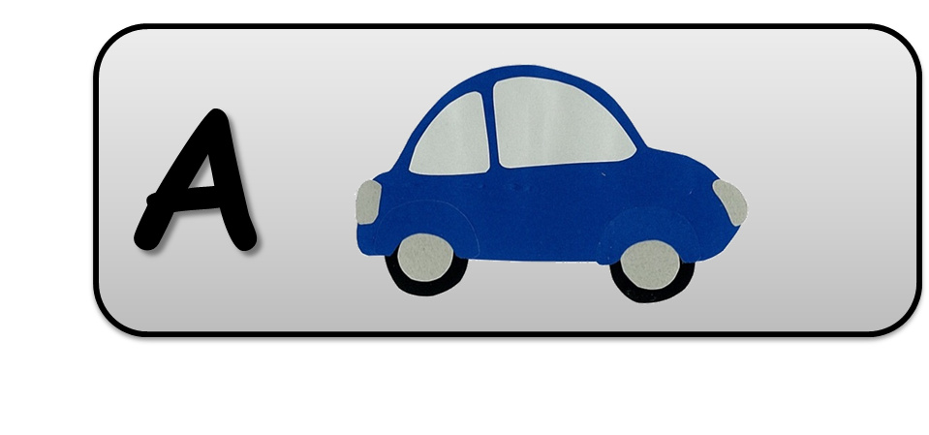
She goes to school by car.

Slide 26
He goes to school by taxi.

Slide 27
She goes to school by bus.

Slide 28
He goes to school by helicopter.

Slide 29
Let’s
Connect!

Slide 30
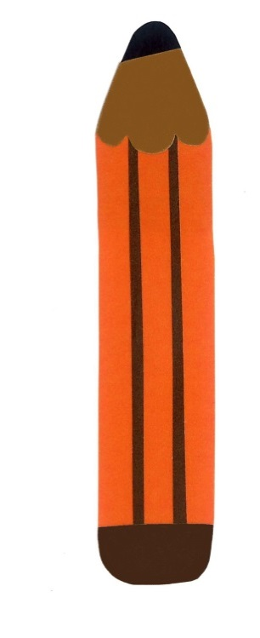
Get a pencil and paper!

Slide 31
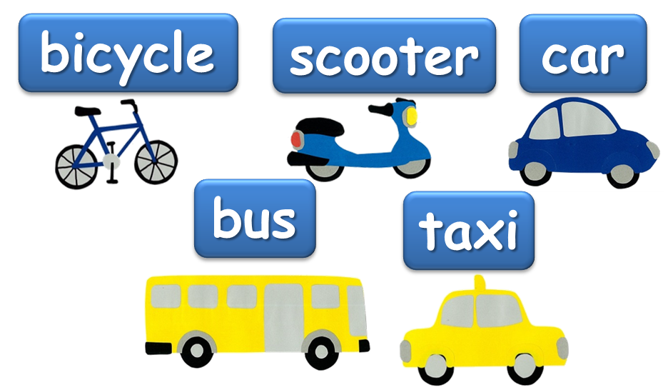
How do you go to school?
I go to school by ___.
I walk to school.

Slide 32
How do you go to school?
I go to school by ___.
I walk to school.

Slide 33
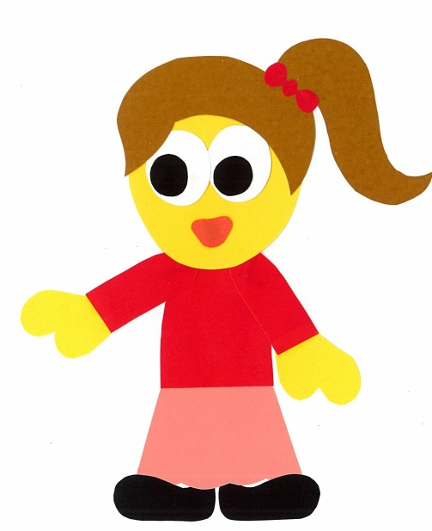
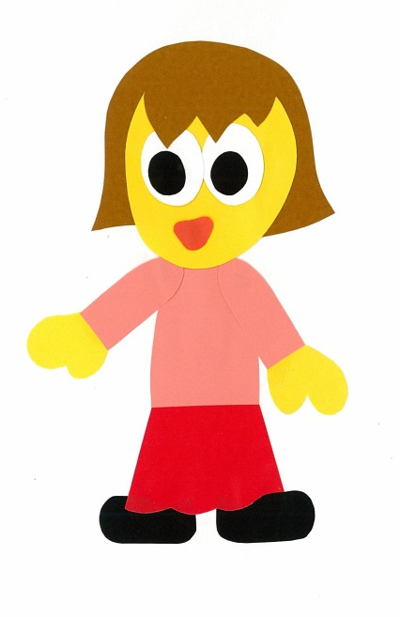
Find a friend. Play a guessing game.
Do you go to school by car?
No, I
do not.

Slide 34
Do you go to school by ___?
Yes, I do.
No, I do not.

Slide 35
WE
CAN
READ
Donald Joyce
www.teacherdonald.com

