Slide 1
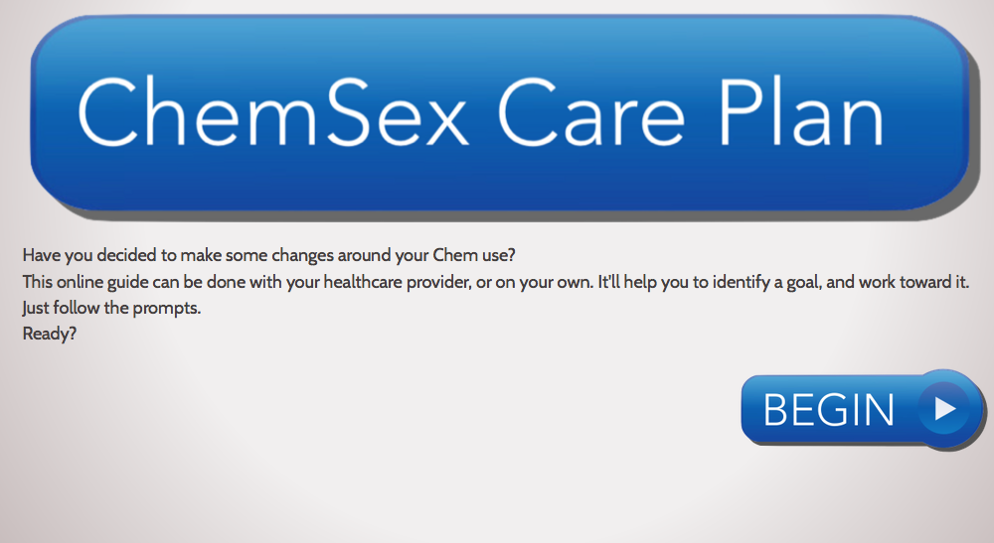
Making changes; a Care Plan
www.davidstuart.org/care-plan

Slide 2
Choose a goal

Slide 3
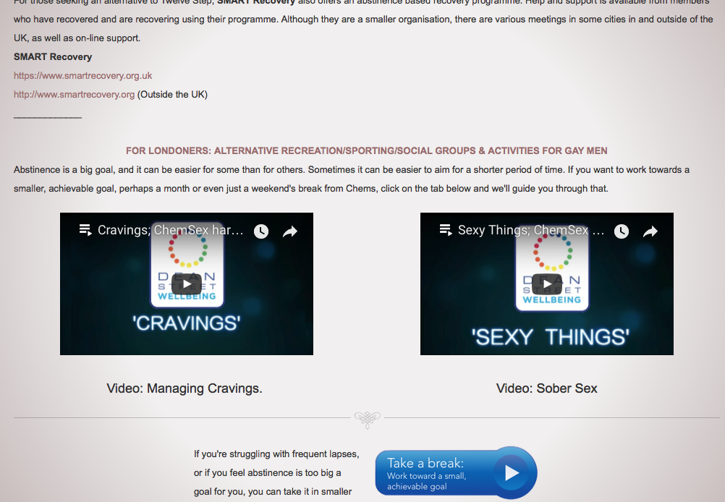
Support with abstinence
Staying stopped
Anticipating triggers
1 day at a time
Support networks
Managing cravings
Relapse prevention
Smart Recovery
Twelve Step programmes

Slide 4
Choose a goal

Slide 5
Play more safely
Safer ChemSex
Crystal meth
GHB/GBL
Mephedrone
Sexual wellbeing
Safer injecting
Safer sex
Safer App use
The law

Slide 6
Choose a goal

Slide 7
Reflecting on drug use/behaviour

Slide 8
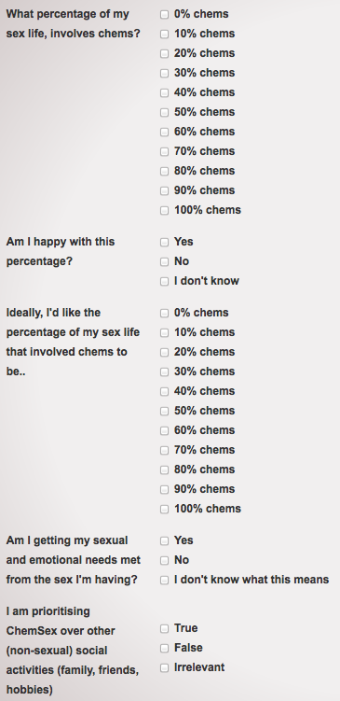
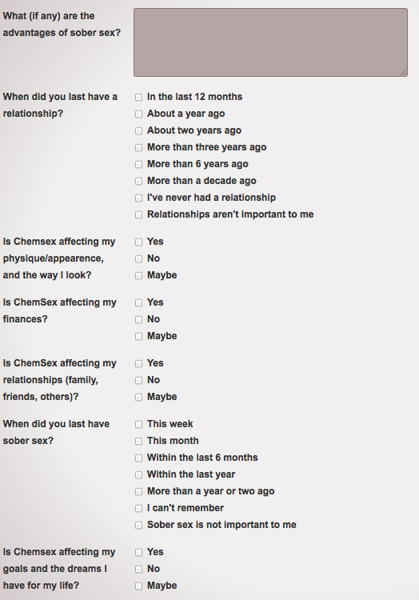

Slide 9
Reflecting on drug use/behaviour

Slide 10
Choose a goal

Slide 11
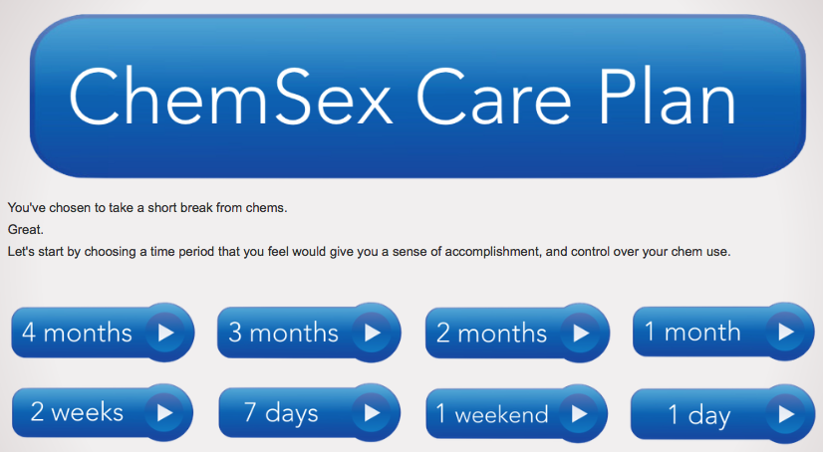
Take a break/identify a goal

Slide 12
Rate your own confidence
-decisional balance

Slide 13
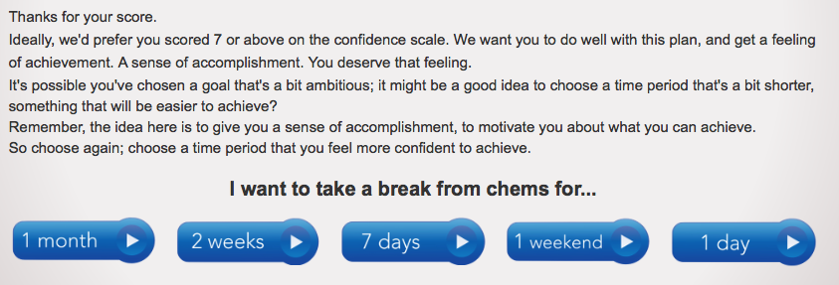
Not very confident?
Choose a more achievable goal

Slide 14
Now rate confidence level again

Slide 15
How important is it to you?

Slide 16
Not very important?
Come back another time

Slide 17
Rate how important it is to you
(-decisional balance)
But perhaps it IS important......

Slide 18
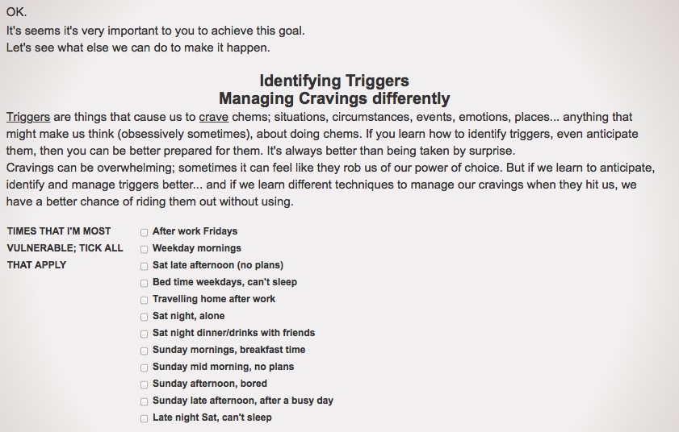
Identify your most vulnerable times

Slide 19
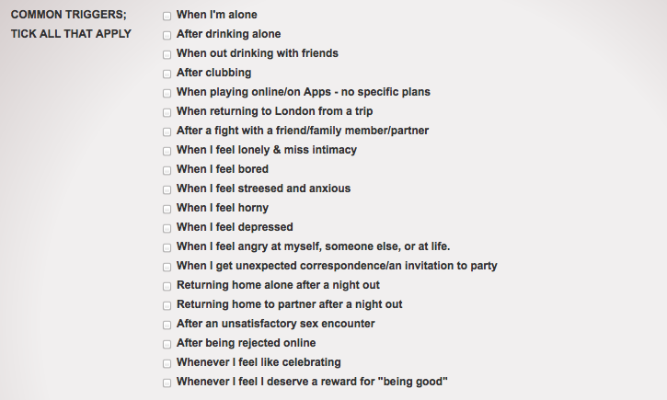
Identifying triggers

Slide 20
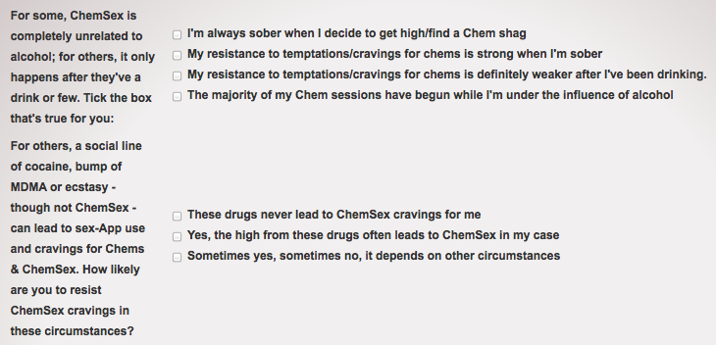
OTHER TRIGGERS;
ALCOHOL? NON-CHEMSEX DRUGS?

Slide 21
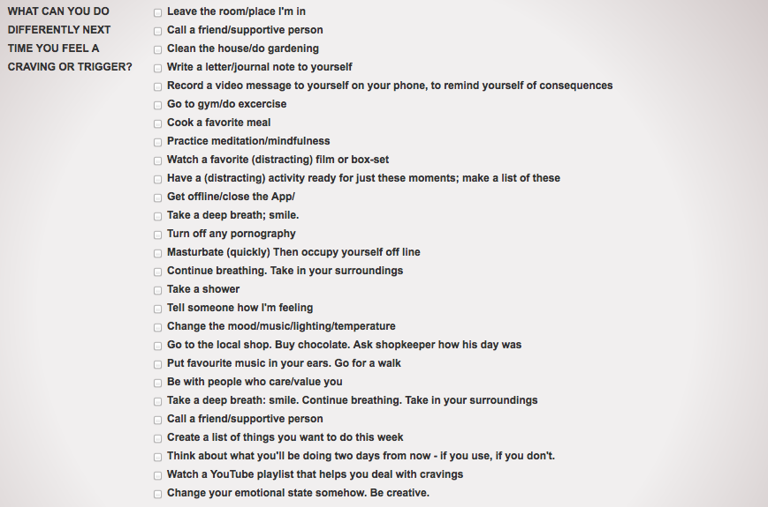
Managing cravings differently

Slide 22
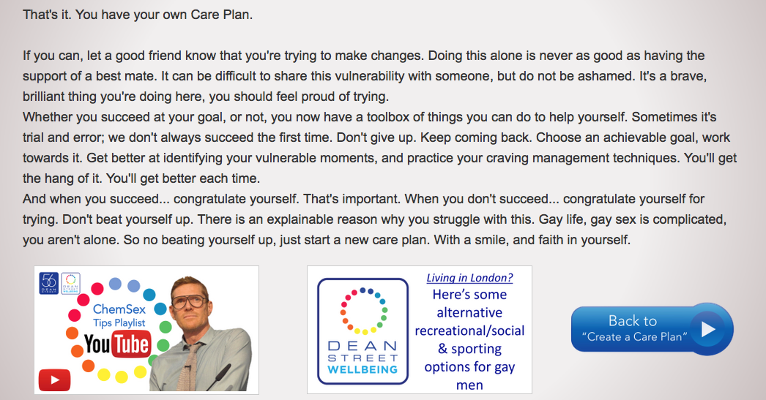
DONE! Online Care Plan created

Slide 23
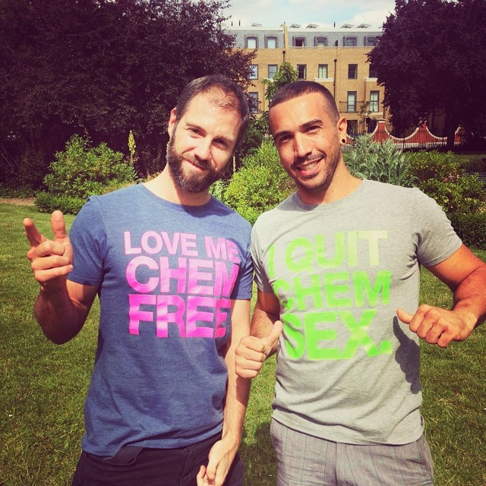
FOR PROFESSIONALS
www.davidstuart.org/professionals
@davidastuart
DS16

Slide 24
FOR CHEM USERS
www.DavidStuart.org/care-plan
@davidastuart
DS17

