Slide 1
Supporting Students with Executive Function Deficits
Sheri A. Wilkins, Ph.D.
Wilkins, S.A. & Burmeister, C. (to be published summer 2014). FLIPP the Switch: Powerful Strategies to Strengthen Executive Function Skills. Mission, KS: Autism Asperger Publishing Company

Slide 2
Outline
What is Executive Function?
Main components
EF Deficits
EF in specific disabilities
Five strategies for five components

Slide 3
What is Executive Function?

Slide 4
Components of EF
FLIPP

Slide 5
Flexibility
Leveled Emotionality
Planning
Impulse Control
Problem Solving
The ability to change your mind and make changes to your plans as needed
The ability to emotionally self-regulate when things don’t go your way
The ability to control your impulses, such as waiting to speak until called upon
The ability to make plans and keep track of time so that work is finished on time
The ability to keep track of many things at one time and to ask for help or get more information when needed

Slide 6
What do EF Challenges Look Like?
EF Challenges
Planning & Prioritizing
Task Completion
Storage & Retrieval of info from memory
Seeking more info if needed
Adapting to change

Slide 7
Disabilities with EF Deficits
Attention Deficit Disorders
Anxiety
Autism
Depression
Fetal Alcohol Syndrome Disorder
Obsessive Compulsive Disorder
Schizophrenia
Specific Learning Disability
Tourette's Syndrome
Traumatic Brain Injury
Social Communication Disorder

Slide 8
What’s the Problem?

Slide 9
Flexibility The ability to change your mind and make changes to your plans as needed

Slide 10
Problems with Flexibility
Resists change in routine
Experiences difficulty making transitions
Has difficulty shifting topic/activity
Demonstrates concrete thought processes
Sees only one solution to a problem
Has difficulty coping with unseen events

Slide 11
Flexibility Tools
Visual Scales
Wait Card
Countdown Timer
Power Card
Situational Expectation Narrative

Slide 12
FLEXIBILITY: Visual Scales
1 2 3 4 5

Slide 13
Leveled Emotionality The ability to emotionally self-regulate when things don’t go your way

Slide 14
Problems with
Leveled Emotionality
Extreme reactions to seemingly minor events
Low tolerance for frustration
Difficulty tolerating mistakes
Behavioral outbursts
Poor coping strategies

Slide 15
Leveled Emotionality Tools
Choice Cards
I Can Calm Myself
Break and Help Cards
Chunking
Social Stories™

Slide 16
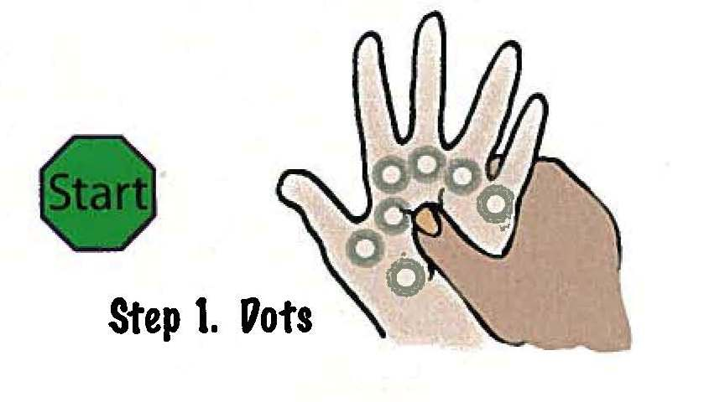
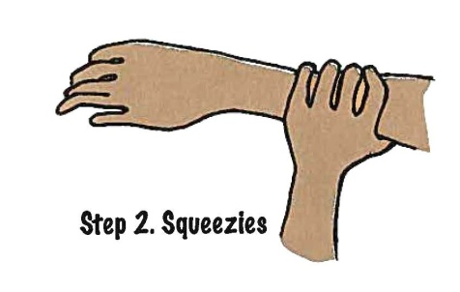
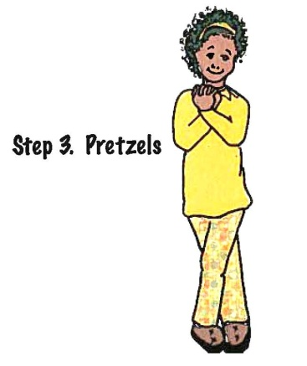
LEVELED EMOTIONALITY: I Can Calm Myself
From S’Cool Moves, Wilson, D.

Slide 17
Impulse Control The ability to control your impulses, such as waiting to speak until called upon

Slide 18
Problems with Impulse Control
Does not self-monitor
Interrupts others
Does not consider consequences before acting
Unaware of how his/her actions affect others
Difficulty focusing attention on what is relevant

Slide 19
Impulse Control Tools
Positive Behavior Interventions and Supports
Reminder Cards
Reinforcement Systems
Social Autopsy
Cognitive Scripts

Slide 20
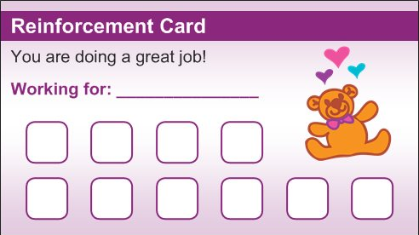
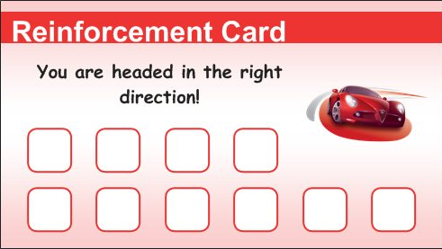
IMPULSE CONTROL: Reinforcement

Slide 21
Planning The ability to make plans and keep track of time so that work is finished on time

Slide 22
Problems with Planning
Difficulty completing long-term projects
Difficulty estimating time needed for task completion
Has a disorganized binder/backpack/desk/locker
Does not bring necessary materials to class or home
Does not turn in completed homework
Difficulty organizing thoughts

Slide 23
Planning Tools
First-Then Boards
Video Modeling
Master Binder System
Contingency Mapping
Project Mapping

Slide 24
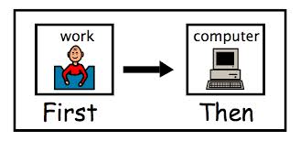
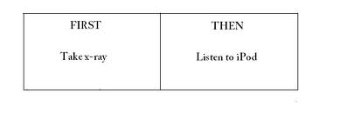
PLANNING: First/Then

Slide 25
Problem Solving The ability to keep track of many things at one time and to ask for help or get more information when needed

Slide 26
Problems with
Problem Solving
Difficulty with tasks that require more than one step
Loses place in sequence when interrupted
Difficulty keeping track of assignments and expectations of multiple teachers
Difficulty generalizing skills and knowledge to other situations and environments

Slide 27
Problem Solving Tools
Work Systems
Checklists
Task Analysis
Priming
Meta-Cognitive Problem-Solving

Slide 28
PROBLEM SOLVING: Meta-Cognitive Problem-Solving (MCPS)
1. Identify/understand the view of the child about the problem to be solved.
2. Identify/share the concerns the adult has about the problem
3. Brainstorm solutions together.
4. Assess possible solutions and choose a mutually satisfactory and realistic solution.
Adapted from Collaborative Problem Solving, Massachusetts General Hospital.

Slide 29
Summary
What is Executive Function?
Main components
EF Deficits
EF in specific disabilities
Five strategies for five components

Slide 30
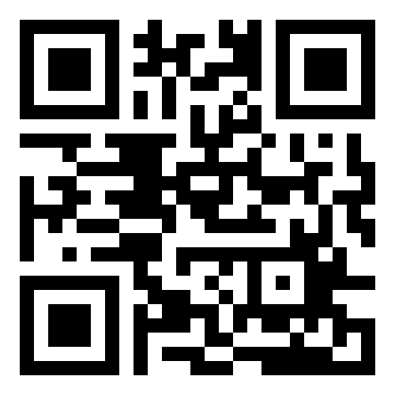
For copies of this presentation and to receive more information:
http://www.inedsolutions.com

Slide 31
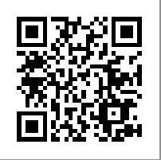
To register for a full-day training on this content:
FLIPP the Switch: Powerful Strategies to Strengthen
Executive Function Skills in the Common Core Classroom
Riverside County Office of Education
March 4, 2014

