Slide 1
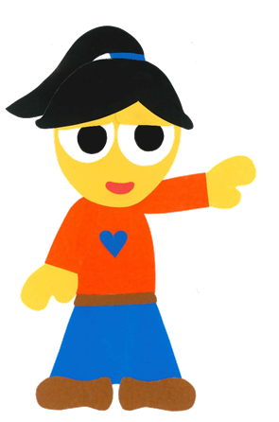
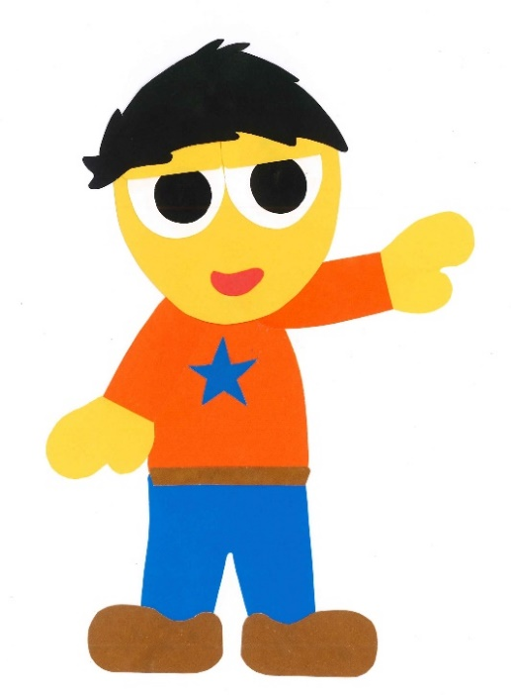
WE
CAN
READ
Donald Joyce
www.teacherdonald.com

Slide 2
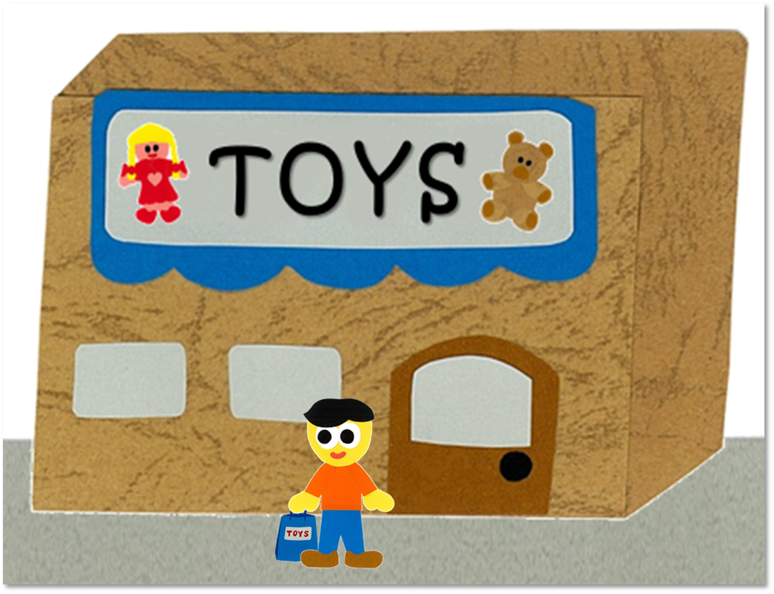
At The Toy Store
By:
Donald Joyce
WE CAN READ

Slide 3
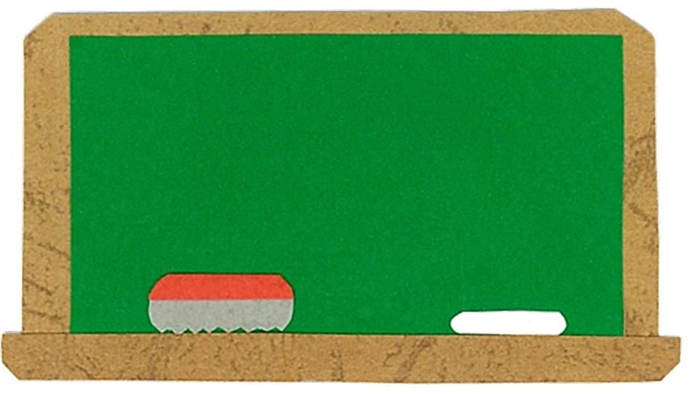
Let’s
Talk!

Slide 4
What can you buy
at a toy store?
I can buy a/an ___.

Slide 5
What toy do you want?
I want a/an ___.
Me too!

Slide 6
Let’s
Learn!

Slide 7
baseball
robot
skateboard
teddy bear
puzzle
doll

Slide 8
Let’s
Read!

Slide 9
At The Toy Store
By:
Donald Joyce
WE CAN READ

Slide 10
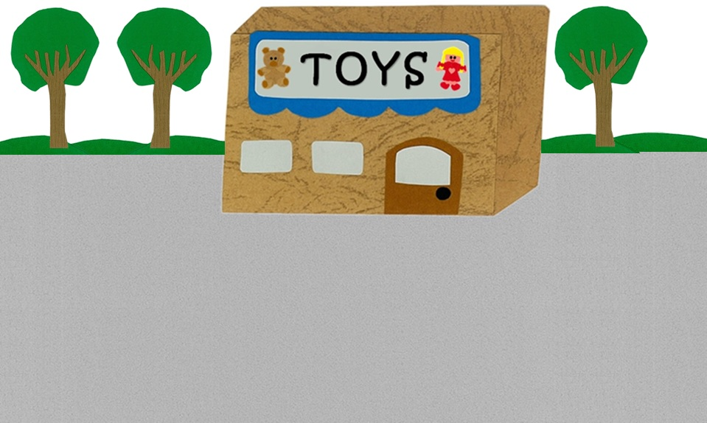
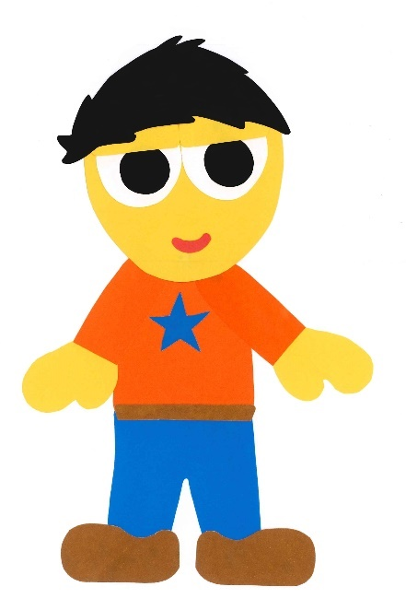
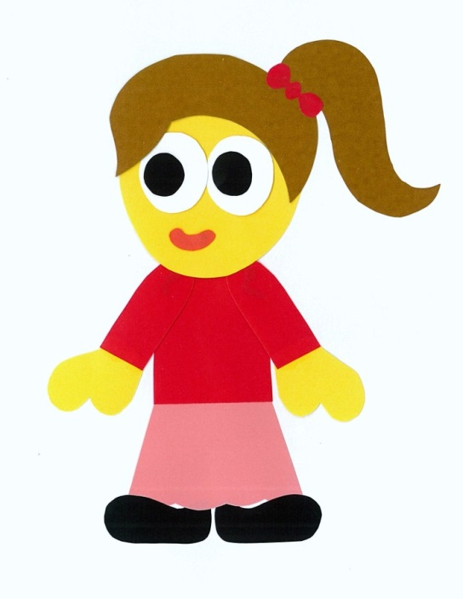
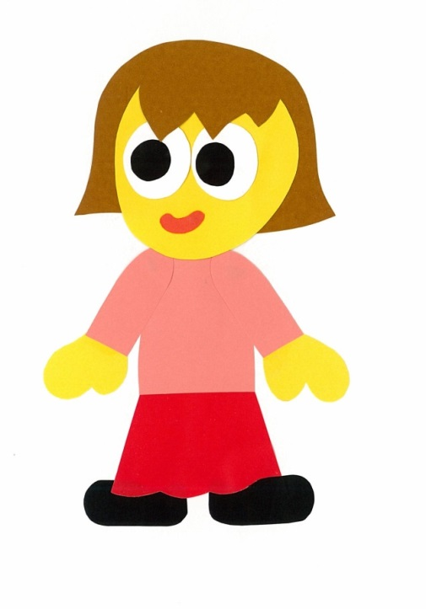
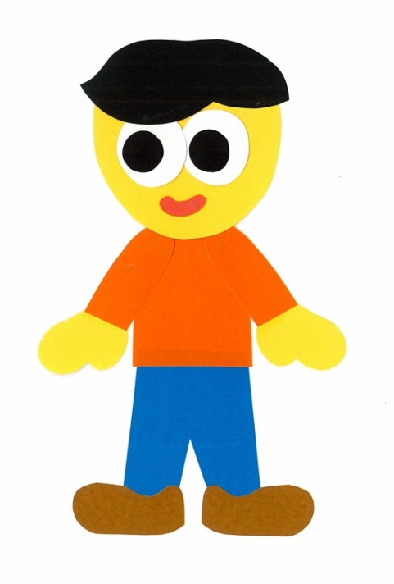
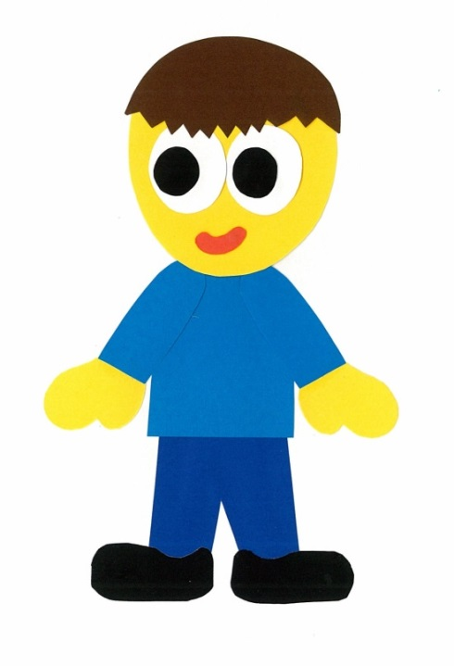
What did you buy
at the toy store?

Slide 11
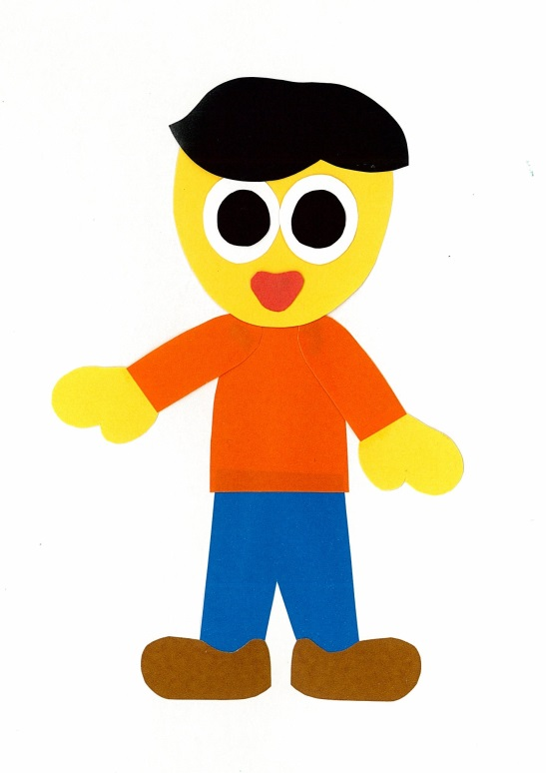
I bought a baseball.

Slide 12
What did you buy?

Slide 13
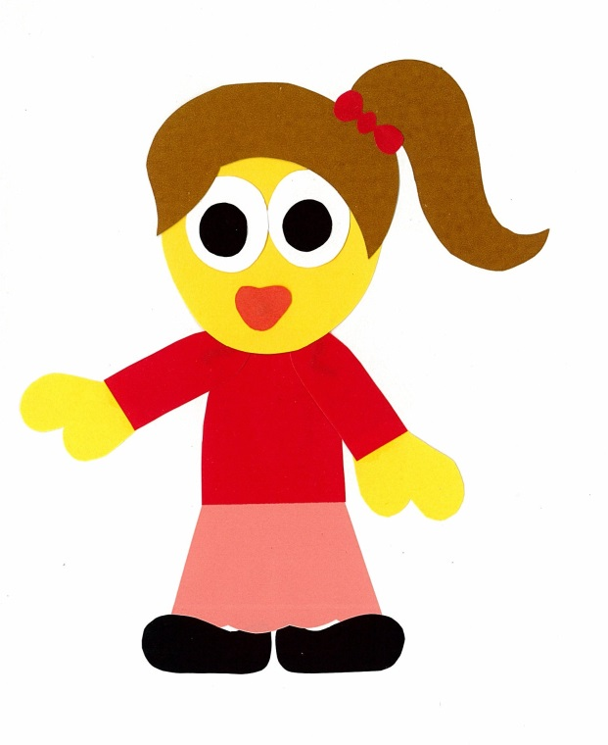
I bought
a teddy bear.

Slide 14
What did you buy?

Slide 15
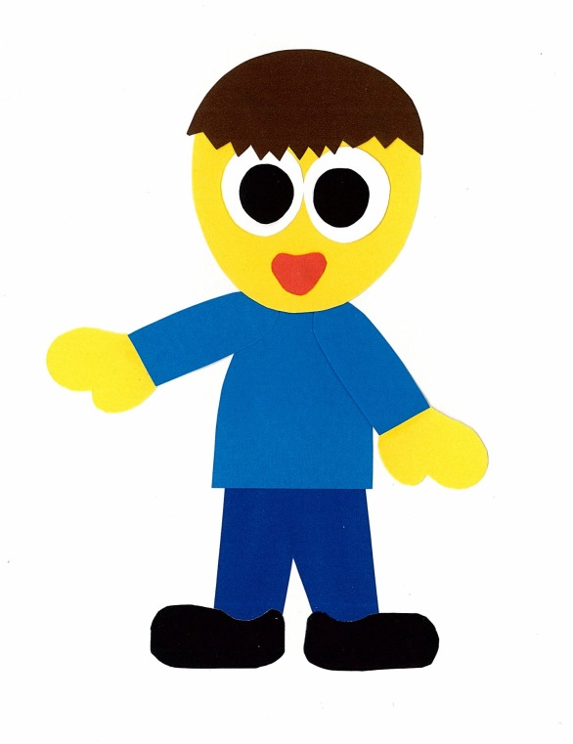
I bought
a skateboard.

Slide 16
What did you buy?

Slide 17
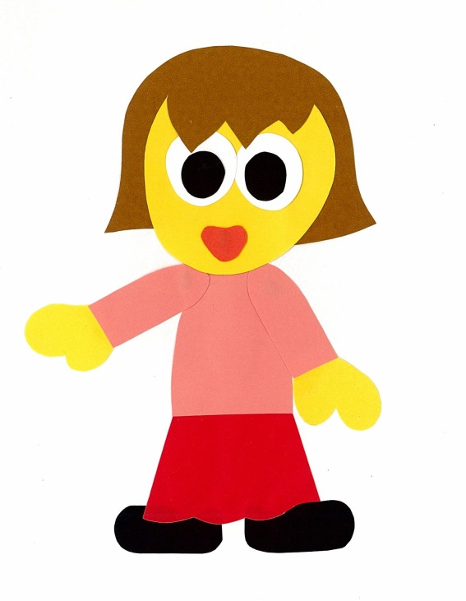
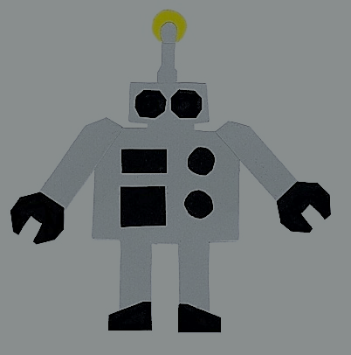
I bought a robot.

Slide 18
What did you buy?

Slide 19
I bought a puzzle.

Slide 20
What did you buy?

Slide 21
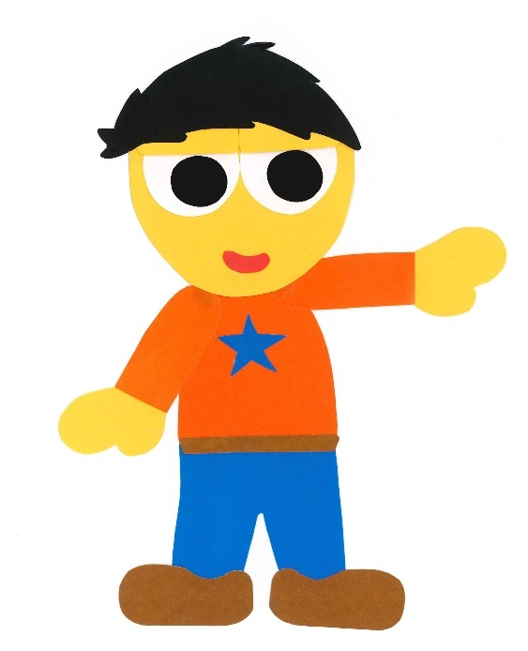
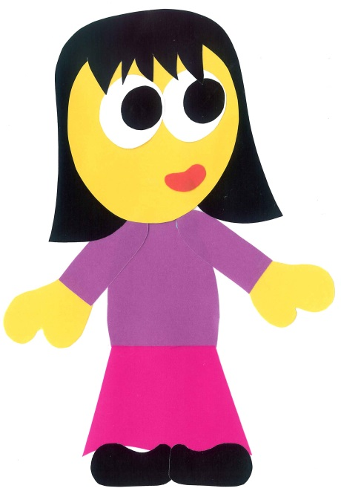
I bought a doll.

Slide 22
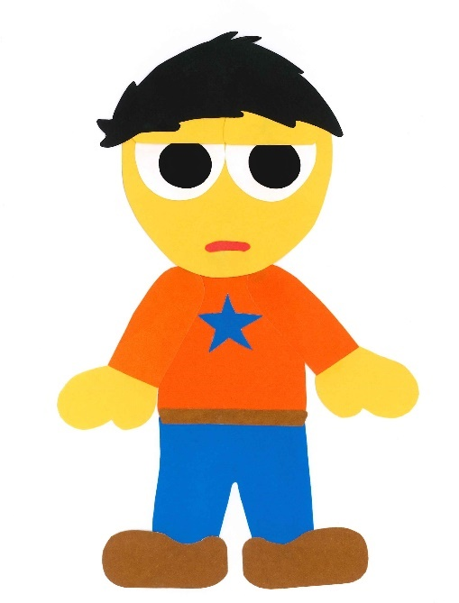
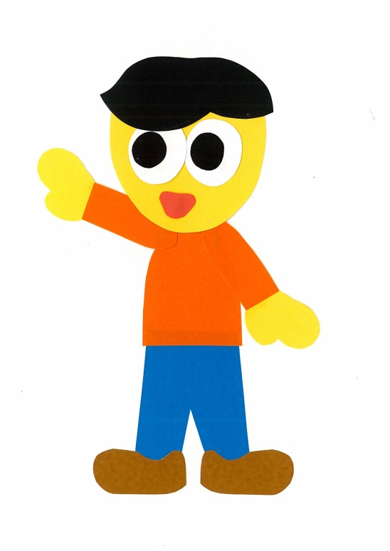
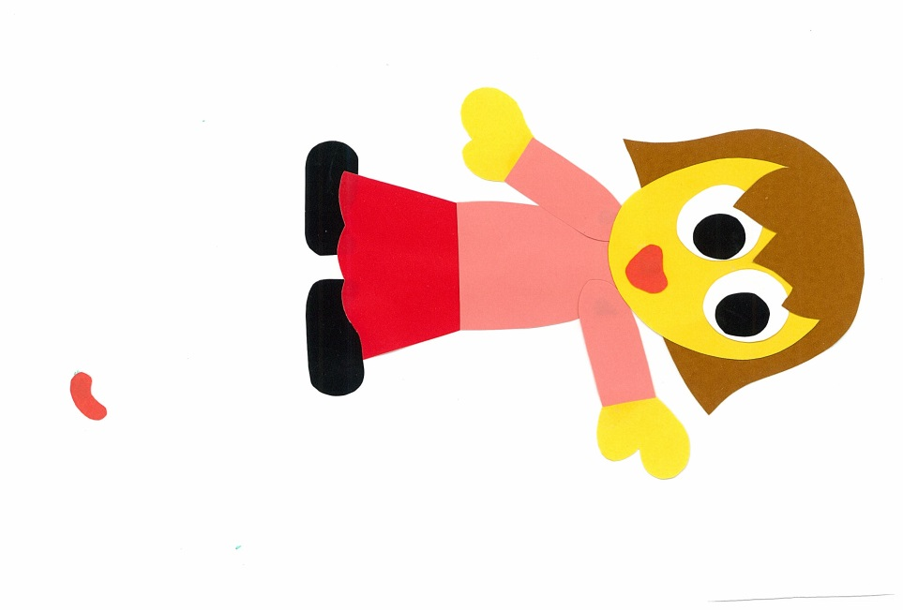
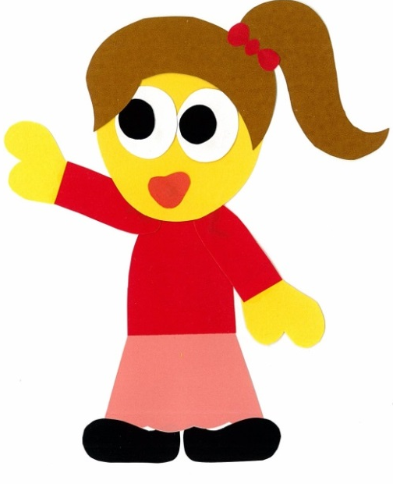

Slide 23
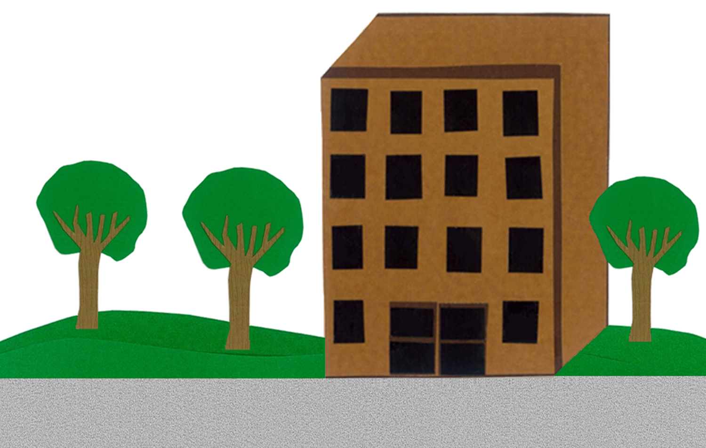
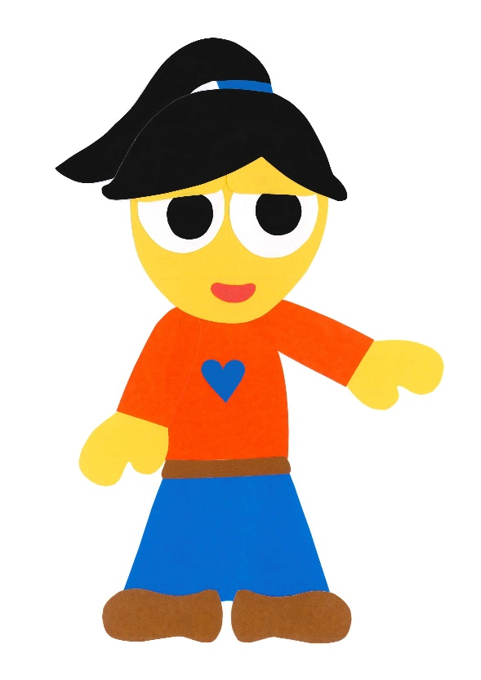
What did you buy
at the toy store?

Slide 24
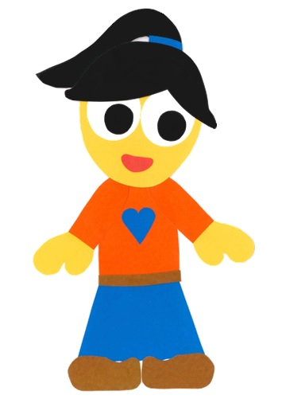
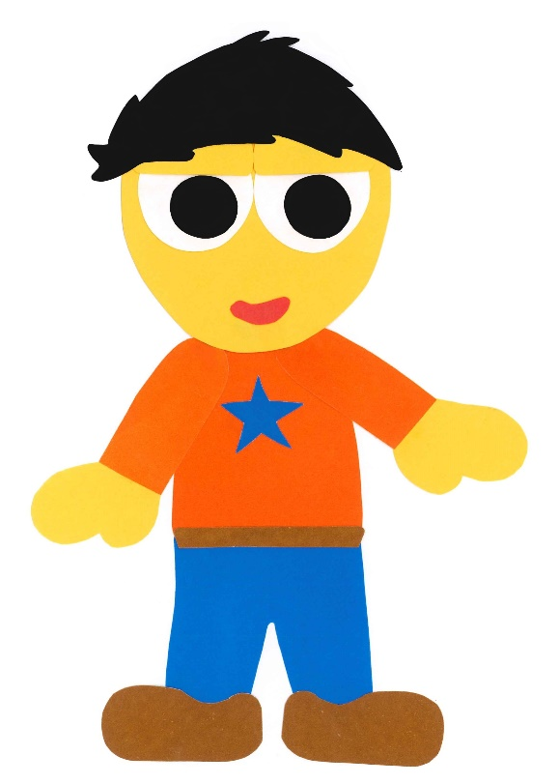
I bought a doll
for you!

Slide 25
At The Toy Store
By:
Donald Joyce
WE CAN READ

Slide 26
Let’s
Review!

Slide 27
What did he buy?
A
?
B

Slide 28
What did she buy?
A
?
B

Slide 29
What did he buy?
A
?
B

Slide 30
What did she buy?
A
?
B

Slide 31
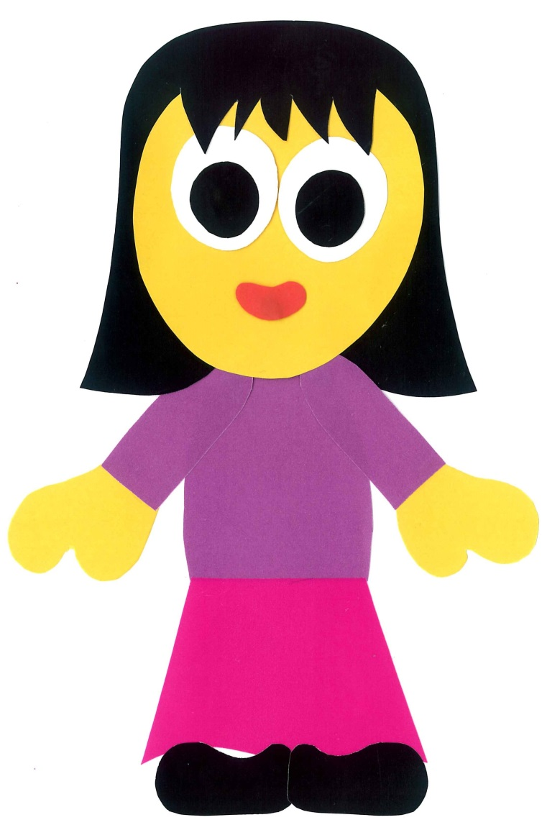
What did she buy?
A
?
B

Slide 32
What did he buy?
A
?
B

Slide 33
Let’s
Connect!

Slide 34
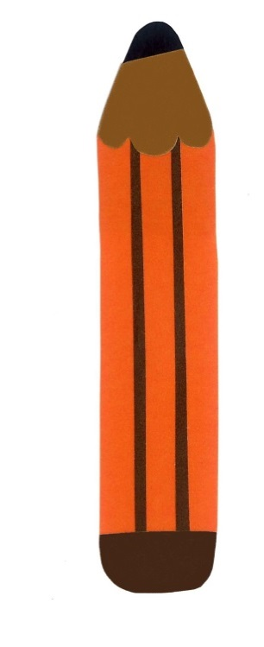
Get a pencil and paper!

Slide 35
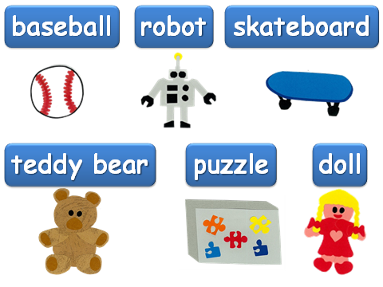
Here is $100 to buy a toy…
60
90
90
70
60
80

Slide 36
What did you buy?
I bought a ____.

Slide 37
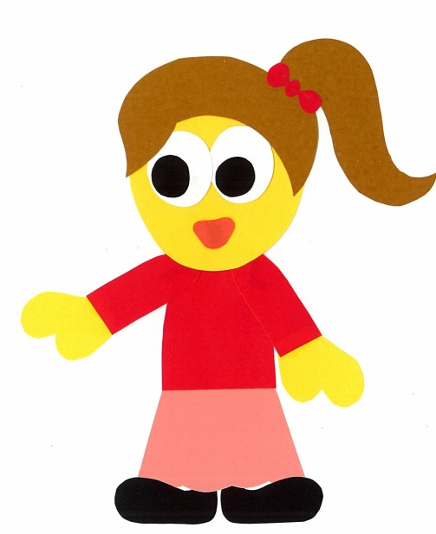
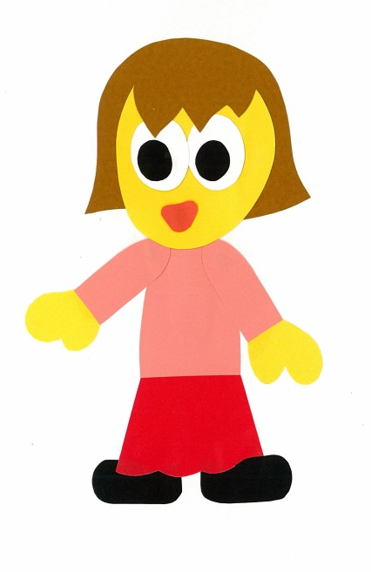
Find a friend. Play a guessing game.
Did you buy a doll?
No, I didn’t.

Slide 38
Did you buy a ___?
Yes, I did.
No, I didn’t.

Slide 39
WE
CAN
READ
Donald Joyce
www.teacherdonald.com

