Slide 1
FASHION DESIGN – DAY 2
Every day is a Fashion Show & the World is the Runway. - Coco Channel
Gigi Morris, NAFD (Nevada Association of Fashion Design)

Slide 2
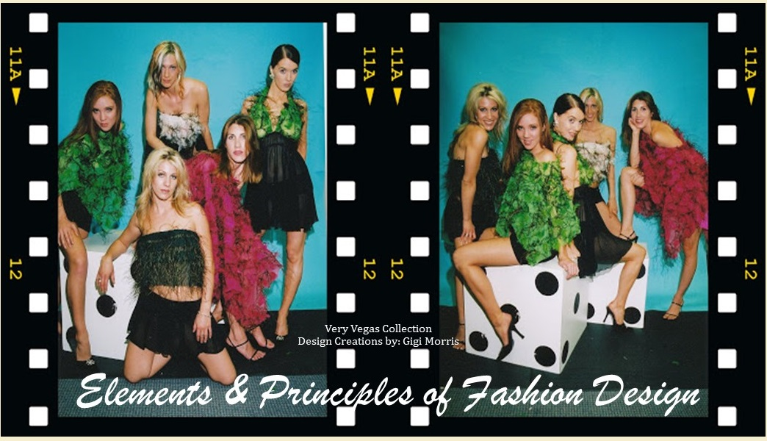
Notes:
Good evening – welcome to the our Fashion Design class, which focuses primarily on the Elements & Principles of Design.
My name is Gigi Morris and I am your instructor and trainer in this class. Although I would really rather call myself the facilitator of your learning in this class. Yes, I will be providing you lots of information about the Elements and Principles of Fashion Design – that is for sure and that comes with a guarantee. I have tucked more than 20 years of professional experience in the industry plus my lifelong learning experience related to it.
But your learning will really depend on how you respond to these information. How you participate in the class learning and activities, how you interact with other co-learners and with what you do with those information by working on your project sheets and assignments.
We will be together for the next eight meetings in the span of four weeks. Too much time together, huh? So let us learn from each other, let’s “ideate” together. My students in the home décor class will tell you that I always say that one ability that will help you be successful in this industry relies on your ability to “visualize” your design ideas. It is a skills that can take a while but it is a competency that you can acquire. But just like in any other skills, you have to practice and work on it. That part will come from you.
When you are starting it is always a good idea to work with others … bounce off ideas with each other. I have created several design teams in my career and I will use some of the strategies I used on them in product development, so you can simulate what happens in product development department.
So to start off … let me turn the table on you first

Slide 3
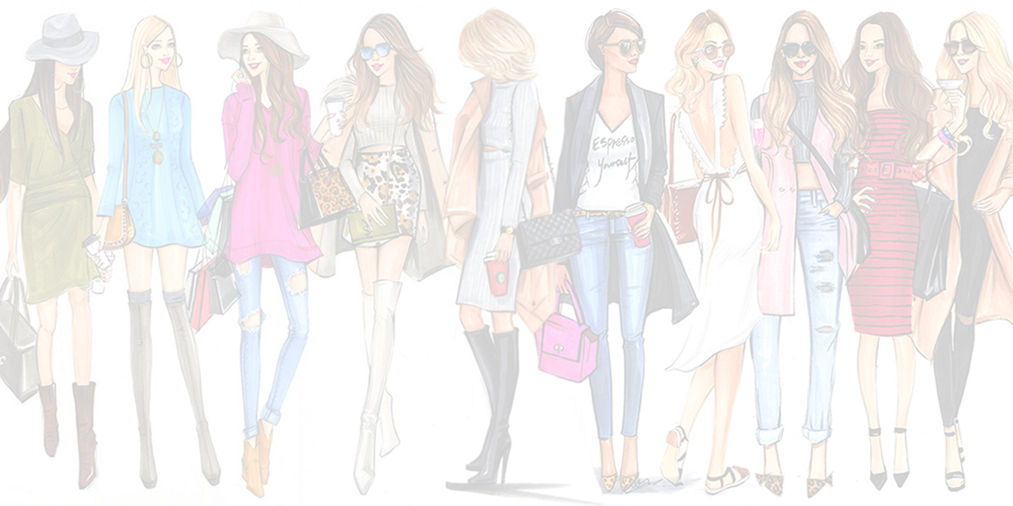

Slide 5
Notes:
The chambre syndicale de la haute couture is defined as "the regulating commission that determines which fashion houses are eligible to be true haute couture houses". Their rules state that only "those companies mentioned on the list drawn up each year by a commission domiciled at the Ministry for Industry are entitled to avail themselves" of the label haute couture.^{[6]} The Chambre Syndicale de la Couture Parisienne is an association of Parisian couturiers founded in 1868 as an outgrowth of medieval guilds that regulate its members in regard to counterfeiting of styles, dates of openings for collections, number of models presented, relations with press, questions of law and taxes, and promotional activities.

Slide 18
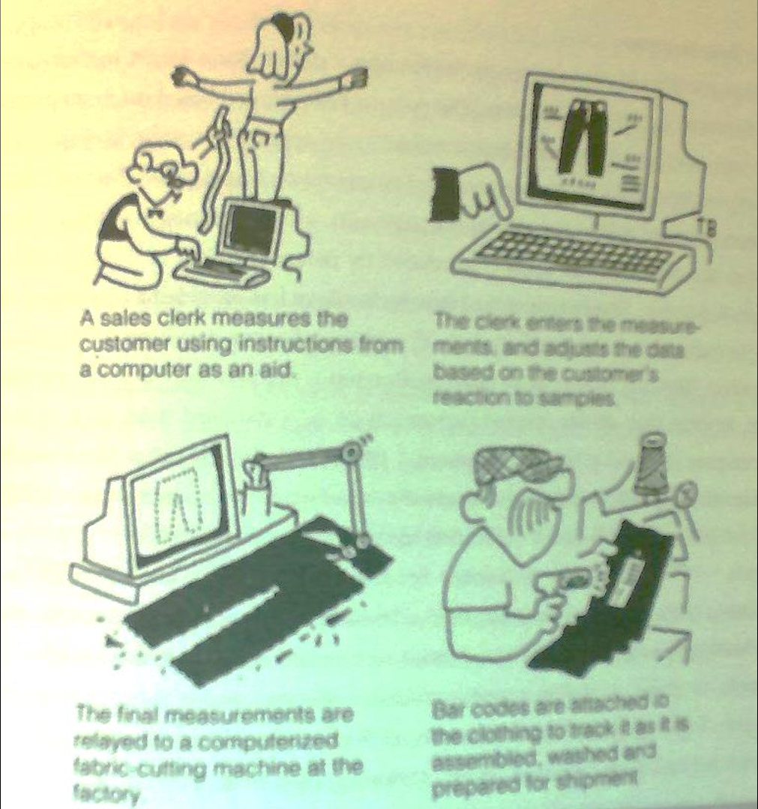

Slide 19
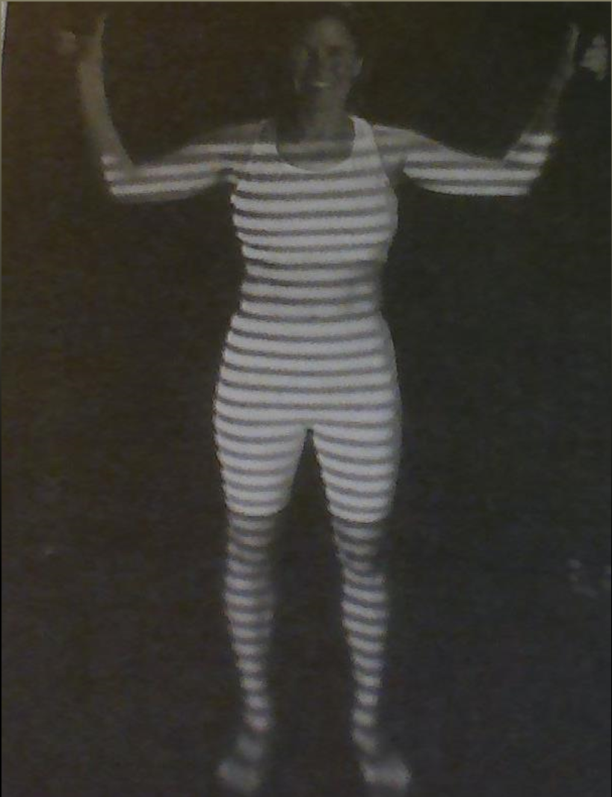
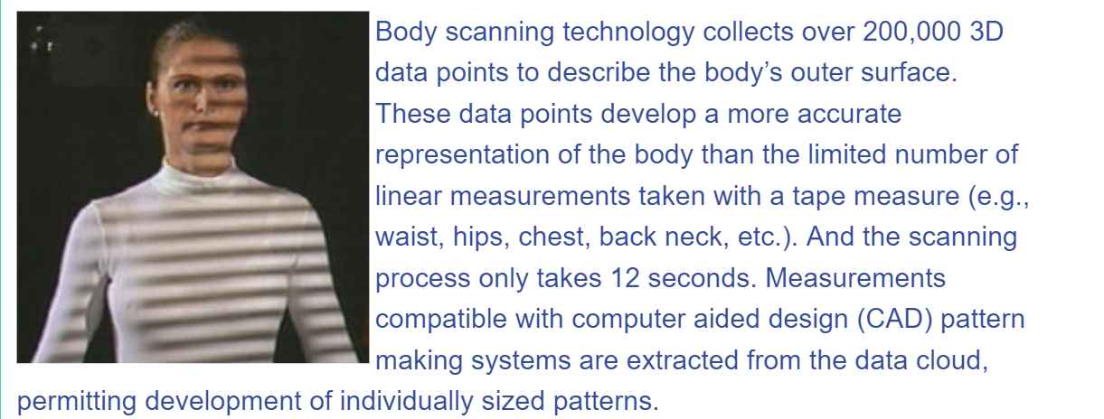

Slide 20
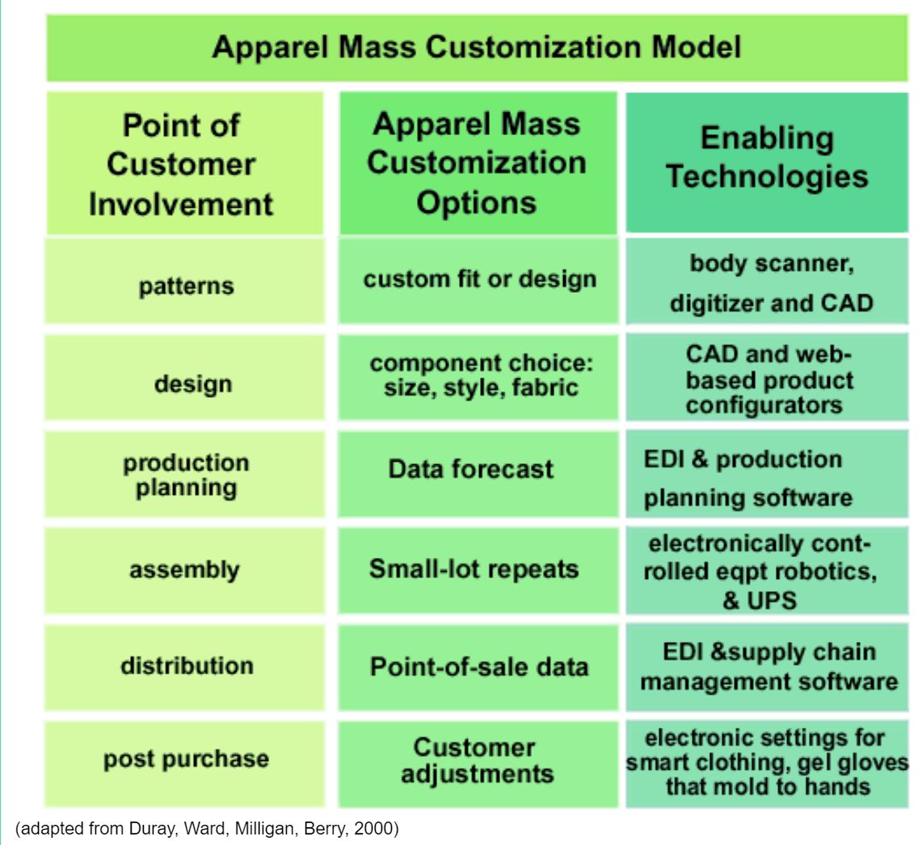

Slide 21
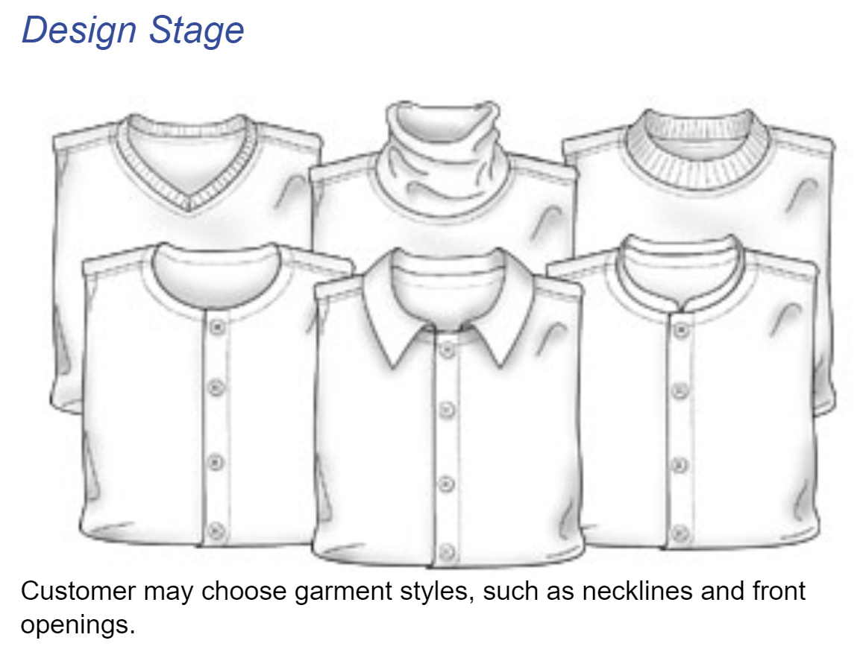

Slide 22
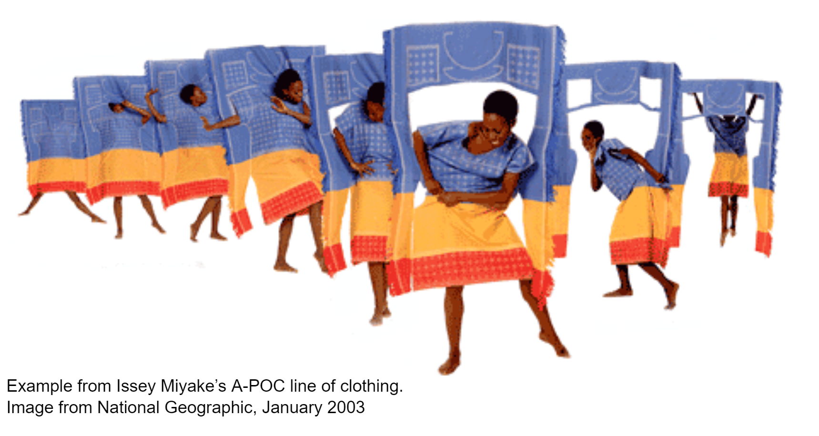

Slide 23
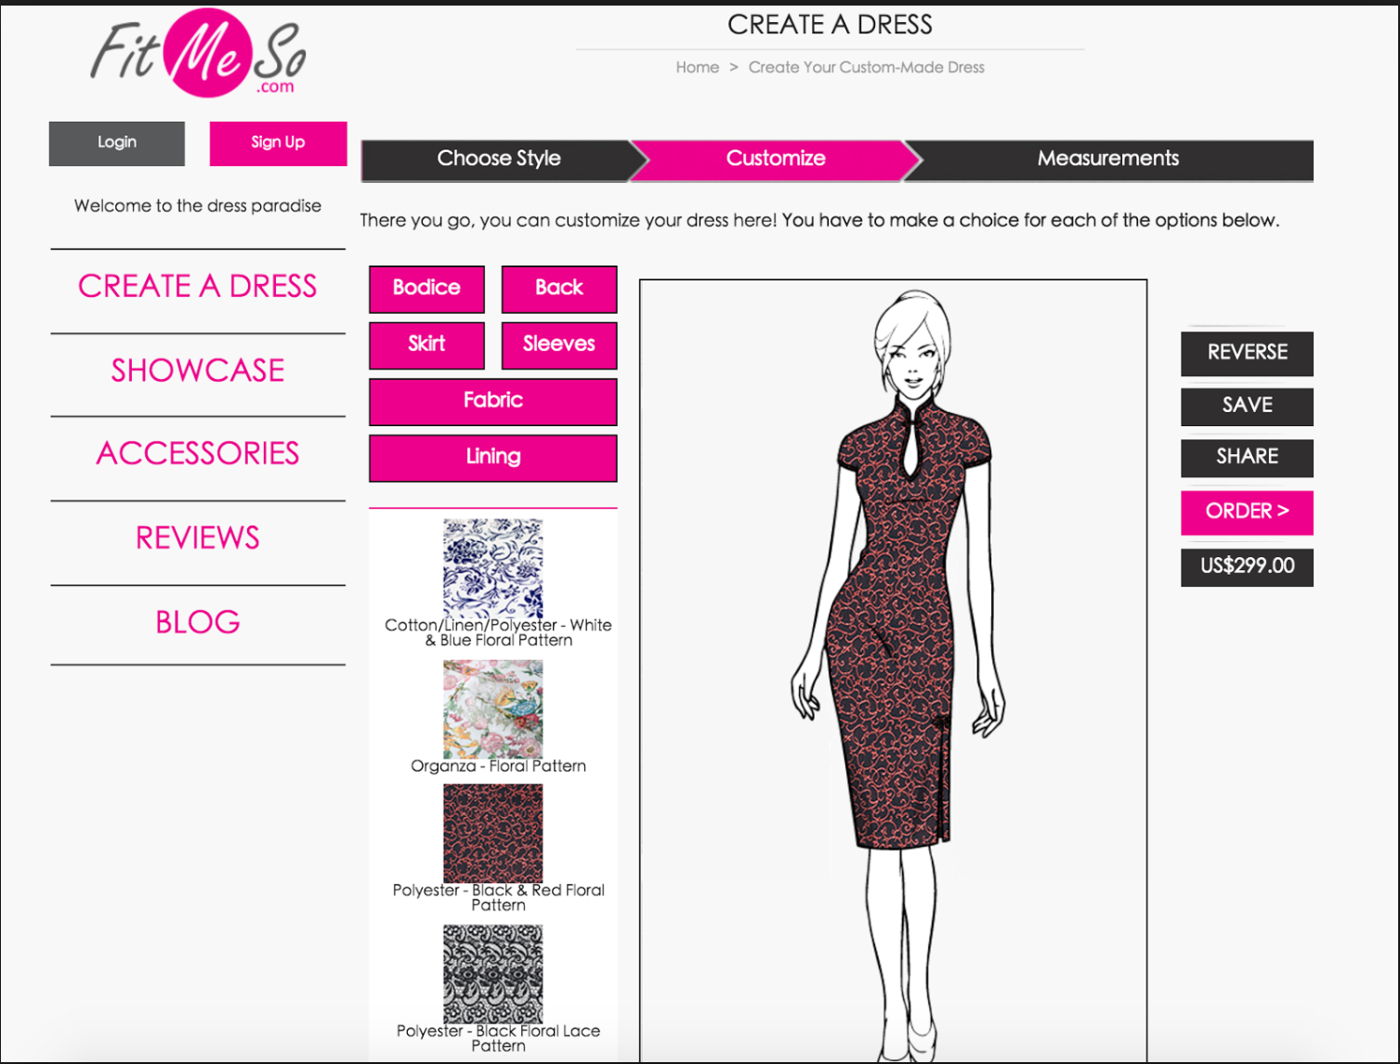

Slide 24
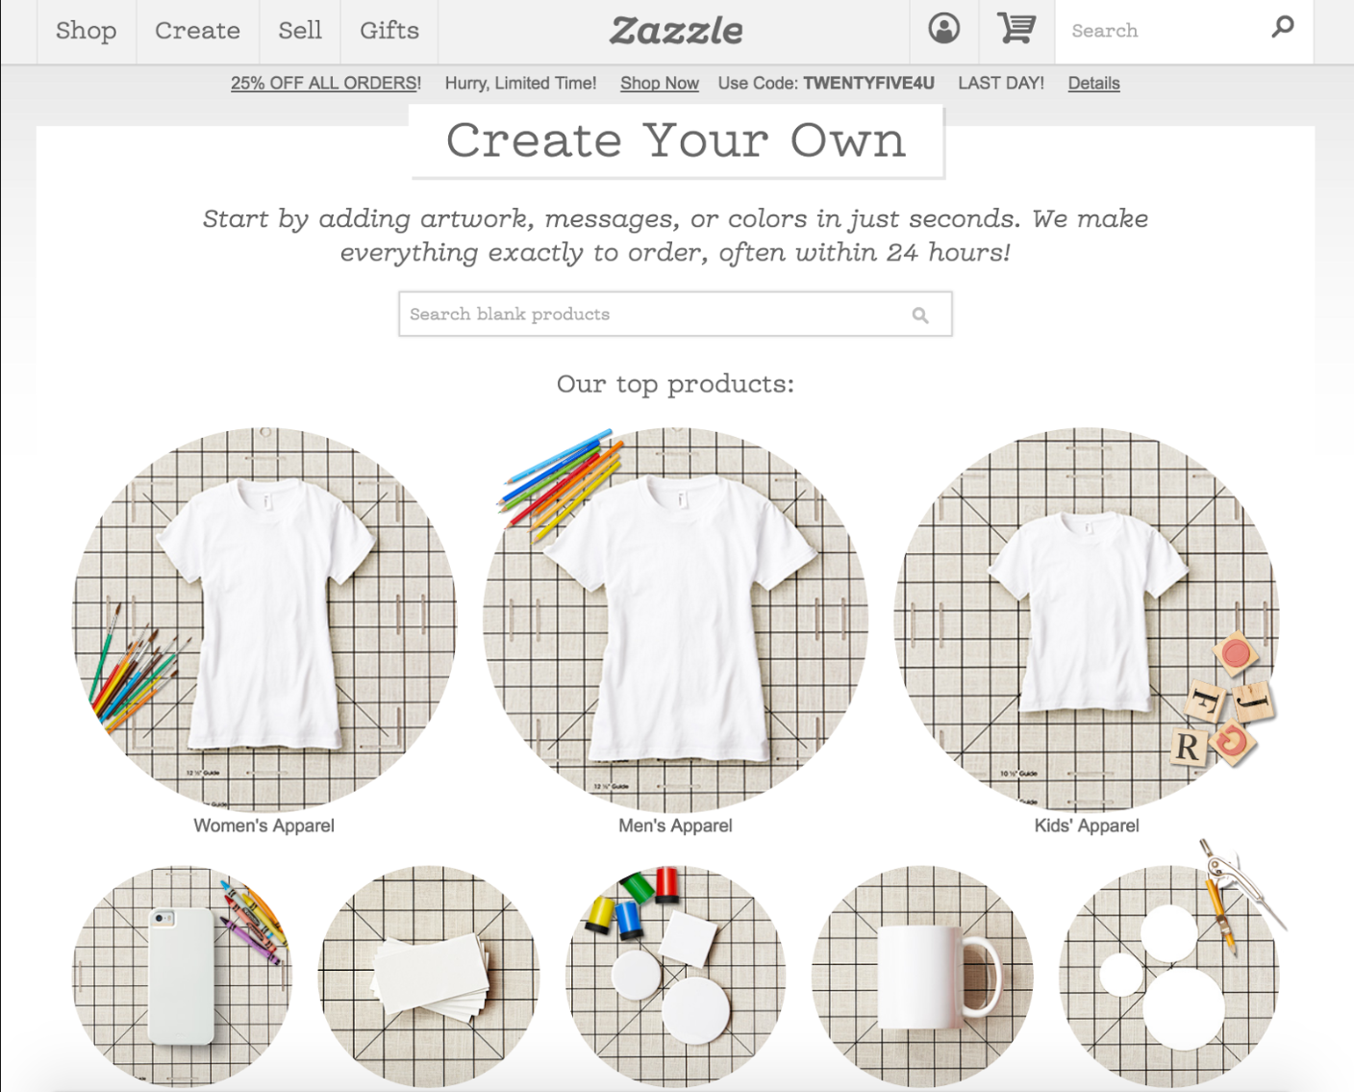

Slide 29
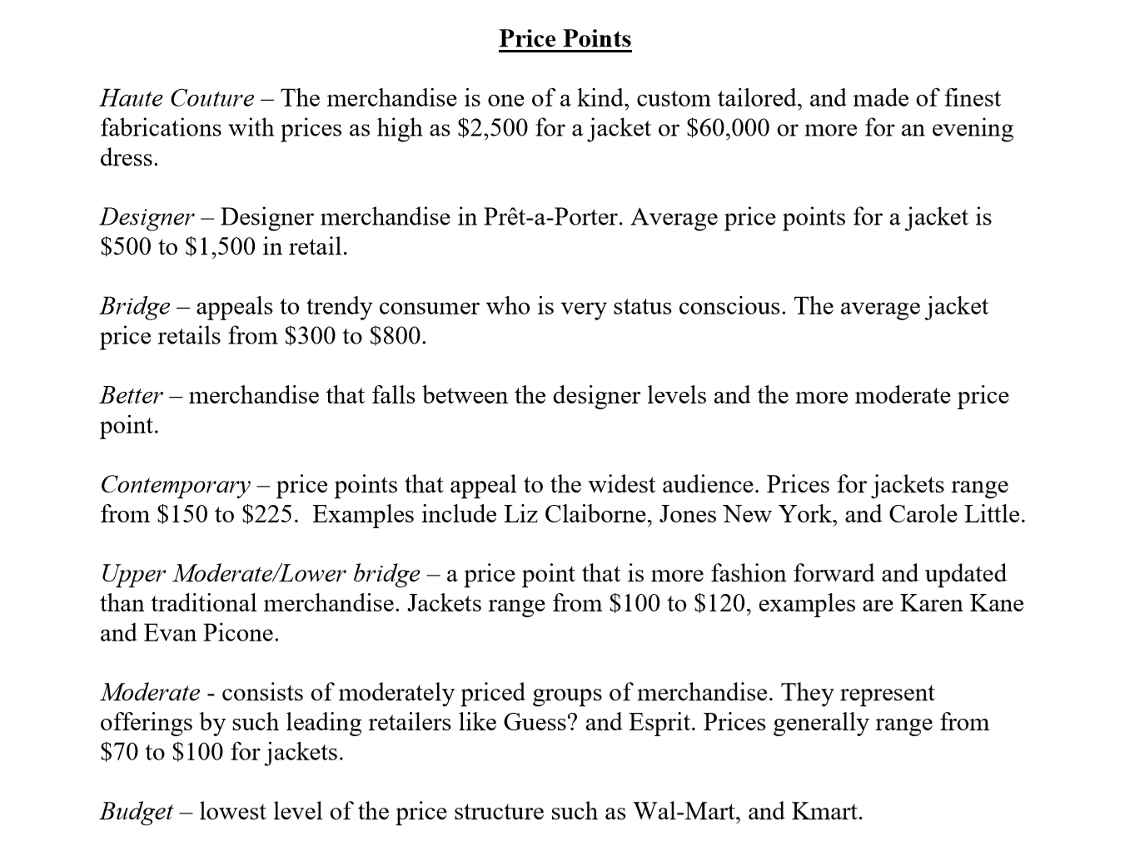
$750-2,000
$500-1,000
$200-500
$100-200

Slide 30
HAUTE COUTURE
Haute Couture is a designation used by design houses that currently meet the strict standards of Syndicale Chamber for Haute Couture in Paris.

Slide 31
DESIGNERS
In the Prêt-a-Porter category, apparel belonging to this price point is the most expensive. Just like in Haute Couture, they are seen on top fashion runways and targeted to the very wealthy client.
They are sold in fashion houses like Armani, Chanel and Donna Karan.

Slide 32
BRIDGE
BRIDGE – This category costs more than the “Better” category but less than the “Designer” category; thus the term “Bridge”. This line is targeted to clientele who want designer lines but don’t want to pay, or sometimes can’t afford to pay, for its price tag. It is for the client who can afford or able to pay more than the “Better” line price tag.

Slide 33
Reasons?
It is a way to “segment” your customer base.
When a popular designer notices that their audience for truly expensive clothes starts to shrink, designers seek salvation by creating their own secondary lines.
There is a large amount of competition in this apparel price range category because the garments are at a lower cost then the designer label but they have the similar brand recognition and possible prestige.
In today’s world of fashion, just about every designer has a bridge line.

Slide 34
EXAMPLE:
Dolce and Gabbana would be a designer line and their bridge brand is D&G
Ralph Lauren would be a designer line and Lauren by Ralph Lauren is their bridge brand
Donna Karan would be the designer line and DKNY line is their bridge line
Emmanuel Ungaro is the designer line and Emmanuel line
Joseph Abboud for the designer line and JOE for the bridge line
Isaac Mizrahi for the designer line and ISAAC for his bridge line

Slide 35
BETTER
“Better” lines are nationally known brands that cost more than an average price point but less expensive than Designer and Bridge categories. Anne Klein, Liz Claiborne, Jones New York are examples of Better category price points. Private label merchandise carrying a retailer’s name or its own unique line like J C Penney’s “Worthington” or Nordstrom’s “Talbot” lines fall into this category as well.

Slide 36
BETTER
“Better” lines are nationally known brands that cost more than an average price point but less expensive than Designer and Bridge categories. Anne Klein, Liz Claiborne, Jones New York are examples of Better category price points.
Private label merchandise carrying a retailer’s name or its own unique line like J C Penney’s “Worthington” or Nordstrom’s “Talbot” lines fall into this category as well.

Slide 37
MODERATE
MODERATE – “Moderate” lines are typically sold by many nationally known sportswear brands such as Guess?, Levi’s, Gap, and Banana Republic.
Many times these companies also make “Better” lines.
Retailer’s also carry “Private Label” merchandise that fall into the “Moderate” price point like Macy’s “Charter Club” line.

Slide 38
EXAMPLE: JCPENNEY
St. John's Bay, casual men's and women's clothing and shoes
The Original Arizona Jean Company, casual clothing and sandals for men, women, and children
Xersion, active and athletic clothing for men, women and children
Stafford, men's tailored clothing and shoes
J. Ferrar, (JF), men's full line of clothing
Worthington, women's formal and casual clothing and shoes
a.n.a, young women's urban clothing and shoes
Ambrielle, women's sleepwear, intimates, and swim
JCPenney Home, home goods

Slide 39
BUDGET or MASS
This line is usually sold by mass merchandisers and by discount stores. The price tag is the least expensive of the price points.
Mass retailers carry private merchandise sold in this price range like Kmart’s “Jaclyn Smith” line. Production of apparel lines belonging to this price point are in the greatest quantities.

Slide 40
STYLE FOR THE MASSES
"Designers have decided to go to where the money is, and the money is at places like Target, Kohl’s and other retailers.” - Kurt Barnard, president of Barnard's Retail Consulting Group in Upper Montclair, N.J.
Sign of times.
When fashion designer Halston did a line of low-priced clothing for J.C. Penney in 1982, the top-end stores that once favored the revolutionary stylist's designs suddenly dropped them from their racks.
Fast forward, today, it is considered a “smart business”
Isaac Mizrahi, Mossimo Giannulli, Todd Oldham, Stephen Sprouse, Marc Ecko and more are making themselves “relevant”.
Many in the industry refer to this now as the “democratization of fashion design”

Slide 41
EXAMPLE: TARGET
Wild Fable, a low-cost clothing and accessories brand for teenage and young adult women;
Original Use, a male-focused brand with an urban feel.
Cat & Jack, children apparel line, was a mammoth $2 billion brand, roughly as big as Lululemon Athletica.
Home goods like Pillowfort,
Men’s clothes such as Goodfellow & Co

Slide 42
EXAMPLE: WALMART
Time and Tru is a women’s brand with a size range from XS to XXXL.
Terra & Sky is a plus-size brand for sizes 14W to 30W.
Wonder Nation is a kid’s brand available in sizes 4 to 18.
George is a men’s brand available in sizes S through XXXL.

Slide 43
CUSTOM
Any clothing that is custom-made, but not done in Haute Couture houses, falls into this category. These are oftentimes clothing made one-at-a-time for specific clients by independent fashion designers.
The price range for this varies but expect it to be usually at a higher end because it takes time to developed and create one-of-a-kind designs.

Slide 44
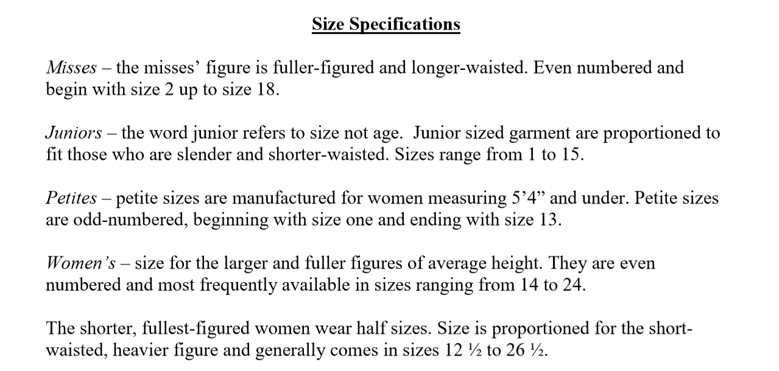

Slide 46
