Slide 1
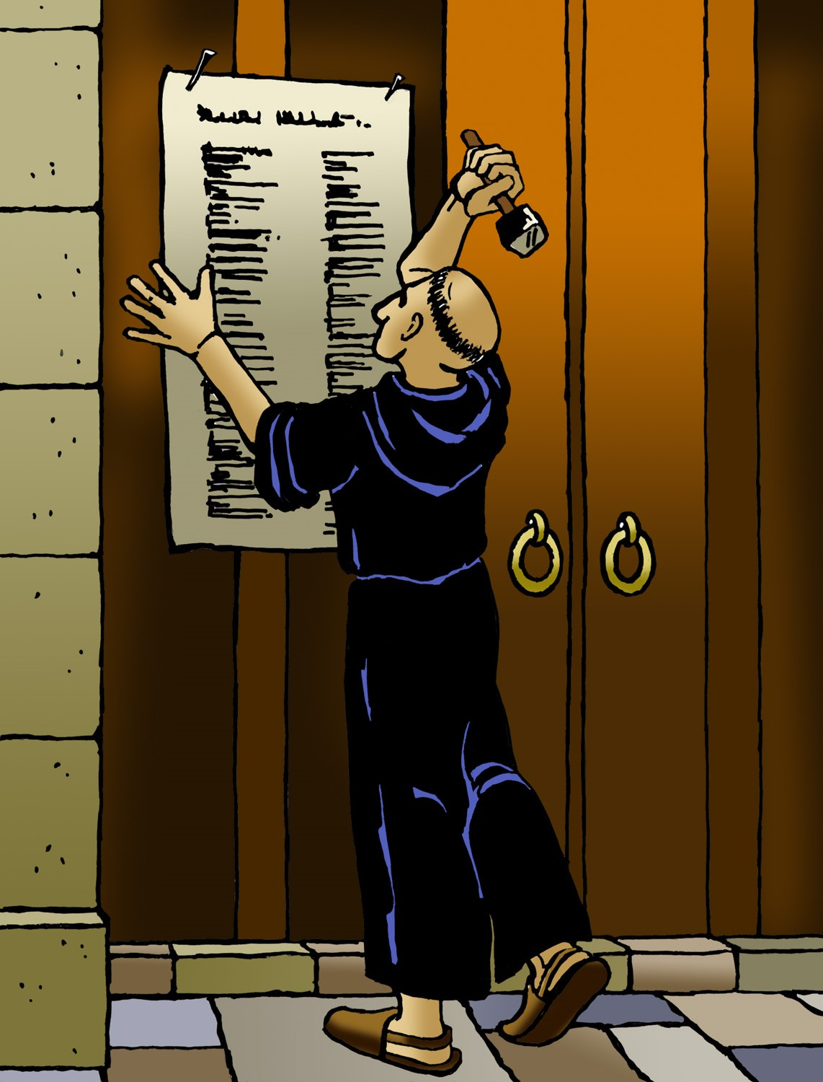
REFORMATION
SUNDAY
Notes:
Image: Five Loaves by Caroline Coolidge Brown. Copyright © Caroline Coolidge Brown. All rights reserved. Used by permission of the artist.

Slide 2
Prelude by Roxanne Groff
Office of the Acolyte
And
Ringing of the Bell
Welcome in the name of The Triune God
Notes:
Image: Preparing yeast dough. Copyright © tomasworks/iStock/Thinkstock. Used by permission.

Slide 3
Confession and Forgiveness
All may make the sign of the cross, the sign marked at baptism, as the presiding minister begins.
P: We confess our sins before God and one another.
Pause for silence and reflection.
P: Gracious God,
Notes:
Image: Preparing yeast dough. Copyright © tomasworks/iStock/Thinkstock. Used by permission.

Slide 4
Confession and Forgiveness
C: We have sinned against you and our neighbors. We have taken what is not ours, and justified our actions. We have turned away from your wisdom. We have not done justice, loved kindness, nor walked humbly with you.
Notes:
Image: Preparing yeast dough. Copyright © tomasworks/iStock/Thinkstock. Used by permission.

Slide 5
Confession and Forgiveness
C: Forgive us for the harms we have caused through word and action, and restore us to the joy of following your will for us.
Notes:
Image: Preparing yeast dough. Copyright © tomasworks/iStock/Thinkstock. Used by permission.

Slide 6
Confession and Forgiveness
P: God knows our every weakness and yet loves us without ceasing. Rejoice and be glad, for the God of grace and mercy forgives you all your sins, for the sake of our savior Jesus Christ.
C: Amen.
Notes:
Image: Preparing yeast dough. Copyright © tomasworks/iStock/Thinkstock. Used by permission.

Slide 7
Hymn of Praise
“Be Thou My Vision”
ELW 793

Slide 8
Be Thou My Vision ELW 793
1 Be thou my vision, O Lord of my heart;
naught be all else to me, save that thou art:
thou my best thought both by day and by night,
waking or sleeping, thy presence my light.

Slide 9
Be Thou My Vision ELW 793
2 Be thou my wisdom, and thou my true word;
I ever with thee and thou with me, Lord.
Thou my soul's shelter, and thou my high tow'r,
raise thou me heav'nward, O Pow'r of my pow'r.

Slide 10
Be Thou My Vision ELW 793
3 Riches I heed not, nor vain, empty praise,
thou mine inheritance, now and always:
thou and thou only, the first in my heart,
great God of heaven, my treasure thou art.

Slide 11
Be Thou My Vision ELW 793
4 Light of my soul, after victory won,
may I reach heaven's joys, O heaven's Sun!
Heart of my own heart, whatever befall,
still be my vision, O Ruler of all.

Slide 12
GREETING
P: The grace of our Lord Jesus Christ, the love of God, and the communion of the Holy Spirit be with you all.
C: And also with you.
Notes:
Image: Preparing yeast dough. Copyright © tomasworks/iStock/Thinkstock. Used by permission.

Slide 13
PRAYER OF THE DAY
P: Let us pray… Generous God, you promised Solomon whatever he wanted, and he asked you only for the wisdom to serve you. Grant us that same wisdom, that we might work for your justice in the world.
C: Amen.
Notes:
Image: Preparing yeast dough. Copyright © tomasworks/iStock/Thinkstock. Used by permission.

Slide 14
Notes:
Image: Preparing yeast dough. Copyright © tomasworks/iStock/Thinkstock. Used by permission.

Slide 15
Scripture Reading
R: Our scripture reading is from the Book of 1st Kings, Chapter 3.
C: Glory to you O’ Lord! (Spoken)
Notes:
Image: Five Loaves by Caroline Coolidge Brown. Copyright © Caroline Coolidge Brown. All rights reserved. Used by permission of the artist.

Slide 16
1 Kings 3:4-9, [10-15], 16-28
⁴The king went to Gibeon to sacrifice there, for that was the principal high place; Solomon used to offer a thousand burnt offerings on that altar.
⁵At Gibeon the Lord appeared to Solomon in a dream by night; and God said, “Ask what I should give you.” ⁶And Solomon said, “You have shown great and steadfast love to your servant my father David, because he
Notes:
Image: Preparing yeast dough. Copyright © tomasworks/iStock/Thinkstock. Used by permission.

Slide 17
1 Kings 3:4-9, [10-15], 16-28
walked before you in faithfulness, in righteousness, and in uprightness of heart toward you; and you have kept for him this great and steadfast love, and have given him a son to sit on his throne today. ⁷And now, O Lord my God, you have made your servant king in place of my father David, although I am only a little child; I do not know how to go out or come in. ⁸And your servant is in the midst of the people whom you
Notes:
Image: Preparing yeast dough. Copyright © tomasworks/iStock/Thinkstock. Used by permission.

Slide 18
1 Kings 3:4-9, [10-15], 16-28
have chosen, a great people, so numerous they cannot be numbered or counted. ⁹Give your servant therefore an understanding mind to govern your people, able to discern between good and evil; for who can govern this your great people?”
[¹⁰It pleased the Lord that Solomon had asked this. ¹¹God said to him, “Because you have asked this, and have not
Notes:
Image: Preparing yeast dough. Copyright © tomasworks/iStock/Thinkstock. Used by permission.

Slide 19
1 Kings 3:4-9, [10-15], 16-28
asked for yourself long life or riches, or for the life of your enemies, but have asked for yourself understanding to discern what is right, ¹²I now do according to your word. Indeed I give you a wise and discerning mind; no one like you has been before you and no one like you shall arise after you. ¹³I give you also what you have not asked, both riches and honor all your life; no
Notes:
Image: Preparing yeast dough. Copyright © tomasworks/iStock/Thinkstock. Used by permission.

Slide 20
1 Kings 3:4-9, [10-15], 16-28
other king shall compare with you. ¹⁴If you will walk in my ways, keeping my statutes and my commandments, as your father David walked, then I will lengthen your life.” ¹⁵Then Solomon awoke; it had been a dream. He came to Jerusalem where he stood before the ark of the covenant of the Lord. He offered up burnt offerings and offerings of well-being, and provided a feast for all his servants.]
Notes:
Image: Preparing yeast dough. Copyright © tomasworks/iStock/Thinkstock. Used by permission.

Slide 21
1 Kings 3:4-9, [10-15], 16-28
¹⁶Later, two women who were prostitutes came to the king and stood before him. ¹⁷The one woman said, “Please, my lord, this woman and I live in the same house; and I gave birth while she was in the house. ¹⁸Then on the third day after I gave birth, this woman also gave birth. We were together; there was no one else with us in the house, only the two of us were in the house. ¹⁹Then this woman’s son
Notes:
Image: Preparing yeast dough. Copyright © tomasworks/iStock/Thinkstock. Used by permission.

Slide 22
1 Kings 3:4-9, [10-15], 16-28
died in the night, because she lay on him. ²⁰She got up in the middle of the night and took my son from beside me while your servant slept. She laid him at her breast, and laid her dead son at my breast. ²¹When I rose in the morning to nurse my son, I saw that he was dead; but when I looked at him closely in the morning, clearly it was not the son I had borne.” ²²But the other woman said, “No, the living son is
Notes:
Image: Preparing yeast dough. Copyright © tomasworks/iStock/Thinkstock. Used by permission.

Slide 23
1 Kings 3:4-9, [10-15], 16-28
mine, and the dead son is yours.” The first said, “No, the dead son is yours, and the living son is mine.” So they argued before the king. ²³Then the king said, “The one says, ‘This is my son that is alive, and your son is dead’; while the other says, ‘Not so! Your son is dead, and my son is the living one.’” ²⁴So the king said, “Bring me a sword,” and they brought a sword before the king. ²⁵The king said, “Divide the living
Notes:
Image: Preparing yeast dough. Copyright © tomasworks/iStock/Thinkstock. Used by permission.

Slide 24
1 Kings 3:4-9, [10-15], 16-28
boy in two; then give half to the one, and half to the other.” ²⁶But the woman whose son was alive said to the king — because compassion for her son burned within her — “Please, my lord, give her the living boy; certainly do not kill him!” The other said, “It shall be neither mine nor yours; divide it.”
Notes:
Image: Preparing yeast dough. Copyright © tomasworks/iStock/Thinkstock. Used by permission.

Slide 25
1 Kings 3:4-9, [10-15], 16-28
²⁷Then the king responded: “Give the first woman the living boy; do not kill him. She is his mother.” ²⁸All Israel heard of the judgment that the king had rendered; and they stood in awe of the king, because they perceived that the wisdom of God was in him, to execute justice.
Notes:
Image: Preparing yeast dough. Copyright © tomasworks/iStock/Thinkstock. Used by permission.

Slide 26
1 Kings 3:4-9, [10-15], 16-28
P: This is the Word of the Lord.
C: Praise to You, O Christ (Spoken)
Notes:
Image: Preparing yeast dough. Copyright © tomasworks/iStock/Thinkstock. Used by permission.

Slide 27
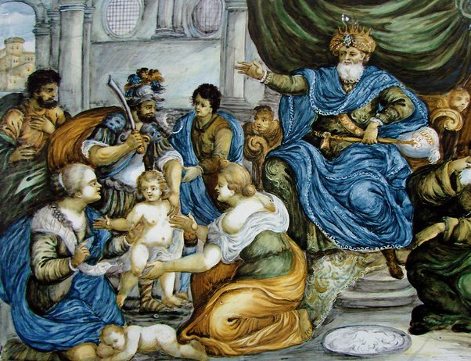
SERMON
Notes:
Image: Preparing yeast dough. Copyright © tomasworks/iStock/Thinkstock. Used by permission.

Slide 28
AFFIRMATION OF BAPTISM
PRESENTATION OF CONFIRMANDS
Robert Arling
RENUNCIATION OF EVIL

Slide 29
PROFESSION OF FAITH
P: Do you believe in God the Father?
C: I believe in God, the Father almighty, creator of heaven and earth.

Slide 30
PROFESSION OF FAITH
P: Do you believe in Jesus Christ, the Son of God?
C: I believe in Jesus Christ, his only Son, our Lord. He was conceived by the power of the Holy Spirit and born of the virgin Mary. He suffered under Pontius Pilate, was crucified, died, and was buried. He descended into hell.*

Slide 31
PROFESSION OF FAITH
C: On the third day he rose again. He ascended into heaven, and is seated at the right hand of the Father. He will come again to judge the living and the dead.

Slide 32
PROFESSION OF FAITH
P: Do you believe in God the Holy Spirit?
C: I believe in the Holy Spirit, the holy catholic Church, the communion of saints, the forgiveness of sins, the resurrection of the body, and the life everlasting. Amen

Slide 33
PRAYERS
Each petition will end with the words,
A: Merciful God,
C: You hear our prayer.

Slide 34
PRAYERS OF INTERCESSION
The prayer concludes…
P: We lift all for whom we pray into your loving arms, O God, in the name of Jesus, our savior.
C: Amen.

Slide 35
AFFIRMATION OF BAPTISM
COMMITMENT
PRAYER OF BLESSING
LAYING ON OF HANDS
MENTOR COMMENTS
QUILT SQUARE PRESENTATION

Slide 36
SHARING OF THE Peace
The Sharing of the Peace that began when the congregation arrived is now shared with the Pastor at this time...
P: The peace of the Lord be with you always.
C: And also with you.

Slide 37
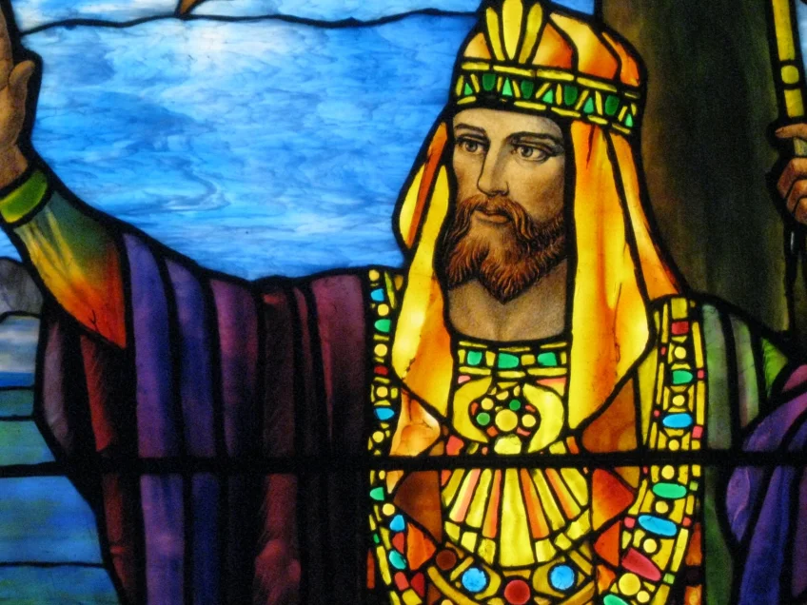
OFFERING PRAYER
Notes:
Image: Preparing yeast dough. Copyright © tomasworks/iStock/Thinkstock. Used by permission.

Slide 38
DIALOGUE
P: The Lord be with you.
C: And also with you.
P: Lift up your hearts.
C: We lift them to the Lord.
P: Let us give thanks to the Lord our God.
C: It is right to give him thanks and praise.

Slide 39
EUCHARISTIC PRAYER
P: We praise you, all-holy God…
…today, tomorrow, and forever..
C: Amen.

Slide 40
THE LORD’S PRAYER
C: Our Father, who art in heaven, hallowed be thy name, thy kingdom come, thy will be done, on earth as it is in heaven. Give us this day our daily bread; and forgive us our trespasses,

Slide 41
THE LORD’S PRAYER
C: as we forgive those who trespass against us; and lead us not into temptation, but deliver us from evil. For thine is the kingdom, and the power, and the glory, forever and ever. Amen.

Slide 42
INVITATION TO COMMUNION
P: God provides a feast for all servants of God’s beloved son, Jesus. Come and celebrate with all people everywhere, for you are invited to the table.

Slide 43
POST COMMUNION PRAYER
P: Let us pray together…
C: We give you thanks, gracious God, that you have once again fed us with food beyond compare, the body and blood of Christ. Lead us from this place, nourished and forgiven, into your beloved vineyard to wipe away the tears of all who hunger and thirst, guided by the example of the same Jesus Christ and led by the Holy Spirit, now and forever. Amen.

Slide 44
Announcements
Notes:
Image: Preparing yeast dough. Copyright © tomasworks/iStock/Thinkstock. Used by permission.

Slide 45
SENDING BLESSING
P: God, who gives life to all things and frees us from despair, bless you with truth and peace. And may the holy Trinity, one God, guide you always in faith, hope, and love.
C: Amen.

Slide 46
Sending Hymn
A Mighty Fortress Is Our God
LBW 229

Slide 47
A Mighty Fortress LBW 229
1 A mighty fortress is our God,
a sword and shield victorious;
he breaks the cruel oppressor's rod
and wins salvation glorious.
The old satanic foe
has sworn to work us woe!
With craft and dreadful might
he arms himself to fight.
On earth he has no equal.

Slide 48
A Mighty Fortress LBW 229
2 No strength of ours can match his might!
We would be lost, rejected.
But now a champion comes to fight,
whom God himself elected.
You ask who this may be?
The Lord of hosts is he!
Christ Jesus, mighty Lord,
God's only Son, adored.
He holds the field victorious.

Slide 49
A Mighty Fortress LBW 229
3 Though hordes of devils fill the land
all threat'ning to devour us,
we tremble not, unmoved we stand;
they cannot overpow'r us.
Let this world's tyrant rage;
in battle we'll engage!
His might is doomed to fail;
God's judgment must prevail!
One little word subdues him.

Slide 50
A Mighty Fortress LBW 229
4 God's Word forever shall abide,
no thanks to foes, who fear it;
for God himself fights by our side
with weapons of the Spirit.
Were they to take our house,
goods, honor, child, or spouse,
though life be wrenched away,
they cannot win the day.
The kingdom's ours forever!

Slide 51
DISMISSAL
P: Until we gather again as God’s people to offer our worship and praise, depart in Christ’s Love,
C: Seeking, welcoming, and serving all. Amen!
Postlude by Roxanne Groff
Copyright © 2022 Augsburg Fortress. All rights reserved. Reprinted by permission under Augsburg Fortress Liturgies Annual License #SAS023830. New Revised Standard Version Bible, Copyright © 1989, Division of Christian Education of the National Council of the Churches of Christ in the United States of America. Used by permission. All rights reserved. Revised Common Lectionary, Copyright © 1992 Consultation on Common Texts, admin Augsburg Fortress. Used by permission.

