Slide 1
Mountain Community Chorus
40th Anniversary
1974 - 2014

Slide 2
History
The choir was established in 1974, at the urging of the Clay County Arts Council. For several years it was offered as a course at Tri-County Community College.
The aim was to provide an artistic outlet for choral performers in the mountain communities of Northeast Georgia and western North Carolina and for the cultural enrichment of all who enjoy the performances.

Slide 3
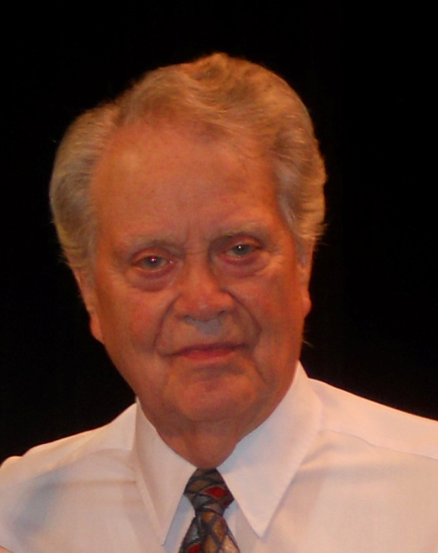
Directors
Dr. James Carley (now deceased), retired Professor of Church Music, Christian Theological Seminary, was hired as director in 1974 and held the position until 1985.
William H. Fox, then head of the music department of Young Harris College, accepted the directorship, which he held from 1986 to 2012.

Slide 4
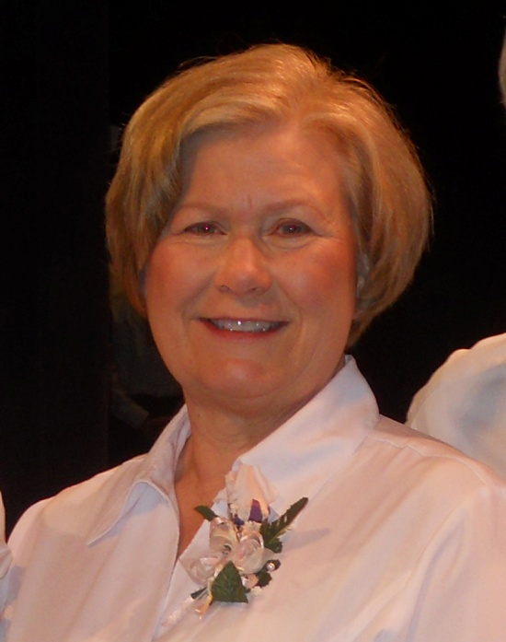
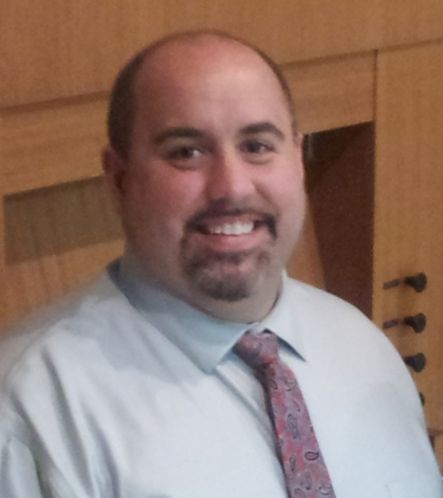
Laura Stooksbury, assistant director since 1999, took over as Director when Bill retired in 2012.
Dr. John Wayman, director of music education at Young Harris College, currently serves as Assistant Director.
In recent years the chorus has also enjoyed guest conductors from within its talented membership.

Slide 5
Keith House at the JC Campbell Folk School was the early site of most rehearsals and concerts.

Slide 6
After Bill Fox became Director, rehearsals and joint concerts with the Young Harris College choir were held in the Clegg Fine Arts Building at Young Harris College

Slide 7
Concerts were also held in Sharp Memorial UMC’s beautiful sanctuary for many years.

Slide 8
Concerts have also been held Murphy, Andrews, Blairsville, and Hayesville. Pictured is the choir being seated at Hayesville First United Methodist Church.

Slide 9
Community Choir
1974 – 1984
Under the direction of
Dr. James Carley

Slide 10
Singers of the First Concert Dec. 8 & 9, 1974
SOPRANO
Mary Byrd
Zandra Casey
Eugenia Danners
Rosemary Entz
Deborah Garrison
Gladys Holland
Cindy Howell
Lou Ellen Howell
Rosemary Kelischek
Sabine Kelischek
Wilma Kennedy
Price McKeever
Jane Moore (Hindsman)
Annette Potts
Gertrude Price
Marcia Waters
Carol Weber
Deborah Wood (Sellers)
Jennifer Wood

Slide 11
ALTO
Isabel Carley
Maxine Chastain
Theresa El-Khouri
Paula Gruenert
Anita Gunter
Ingrid Weber
TENOR
Hans Beerkens
Lynn Gault
Joseph Katz
George Kelischek
Jeffry Kofsky
Robert Minor
BASS
Clark Corwin
Donald Davis
Michael Greschefski
Jack Gruenert
Timothy Gunter
Stanley Kramer
Joe Potts
Frank Turner

Slide 12
Deborah Wood Sellers 1974
I was one of the original members of the Community Choir, and I always looked forward to rehearsal every week.
I continued singing in church choirs until very recently.
Congratulations on your 40th anniversary!

Slide 13
Theresa El-Khouri Martin 1974
I was a member at the beginning of the chorus until I moved away in 1984. Dr. Carley was intense but excellent. I learned so much about choral music from him and the members.
I still have the cassette tapes of some of our concerts – used to love listening to them in my car.
The picture is from 2009 and is of me, my husband, 2 sons and daughter-in-law.

Slide 14
Debbie Garrison 1974
I was taking voice lessons from James Carley when he was forming the Mountain Community Chorus back in 1974. I had to give it up in Jan. 1975 when I started teaching at Young Harris College.
I am still singing. I was a Sweet Adeline for 9 years – and now I am in a trio, SATB quartet, Choir at Shepherd Church – and I sing solos.
Music is back to being a big part of my life. But I lost the ability to sing from 1985 through 2001.
Congratulation to your organization for your 40 years of singing~!

Slide 15
Jane Moore Hindsman 1974
My tenure was from 1974 through the Spring Concert in 1982 when I was 8 months pregnant.
Not only was I introduced to wonderful pieces of music and composers, but I learned how to sing better… and I also learned some history.
For the Bicentennial in 1977, I particularly remember a work that was all about the signing of the Magna Carta. A few years ago I visited the site of the signing and, thanks to MCC (not my school history classes), I knew something about it!

Slide 16
Dr. James Carley was an amazing and animated teacher, director and interpreter, and I still recall his admonishments to not “plant potatoes” when we sing.
His talented wife, Isabel, had a great alto voice and she was a leading authority on Orff methodology. The Chorus often had accompaniment with varied and unique instruments by Isabel and/or the Kelischeks.
Mountain Community Chorus truly enriched my mind, my spirit, my life! Great music, great memories, great fun!
Jane Hindsman

Slide 17
MADRIGAL DINNERS While not an official function of the Choir, we supplied vocal music for several Renaissance dinners at the Folk School . L to R: Jane Moore Hindsman, James Carley, Karen Brinke, Rudy Davenport, Barbara Wood, and unidentified bass.

Slide 18
A later madrigal dinner, featuring Diane Baker, David Setzer (the only king who didn’t sing), Rachel Baughn, Karl Swenson (deceased), and Karen Brinke.

Slide 19
Janice Moore 1974
I was a member for over twenty years. I remember the excitement of singing music by Handel, Bach, and other classical composers that Dr. Carley thought we could master.
In 1976 we gave a series of bi-centennial concerts, dressing in early American clothing. I wonder now how we all crowded on to the tiny stage at the Folk School to give those early concerts.
I enjoyed every minute of my time in the choir, both with Dr. Carley and Bill Fox.

Slide 20
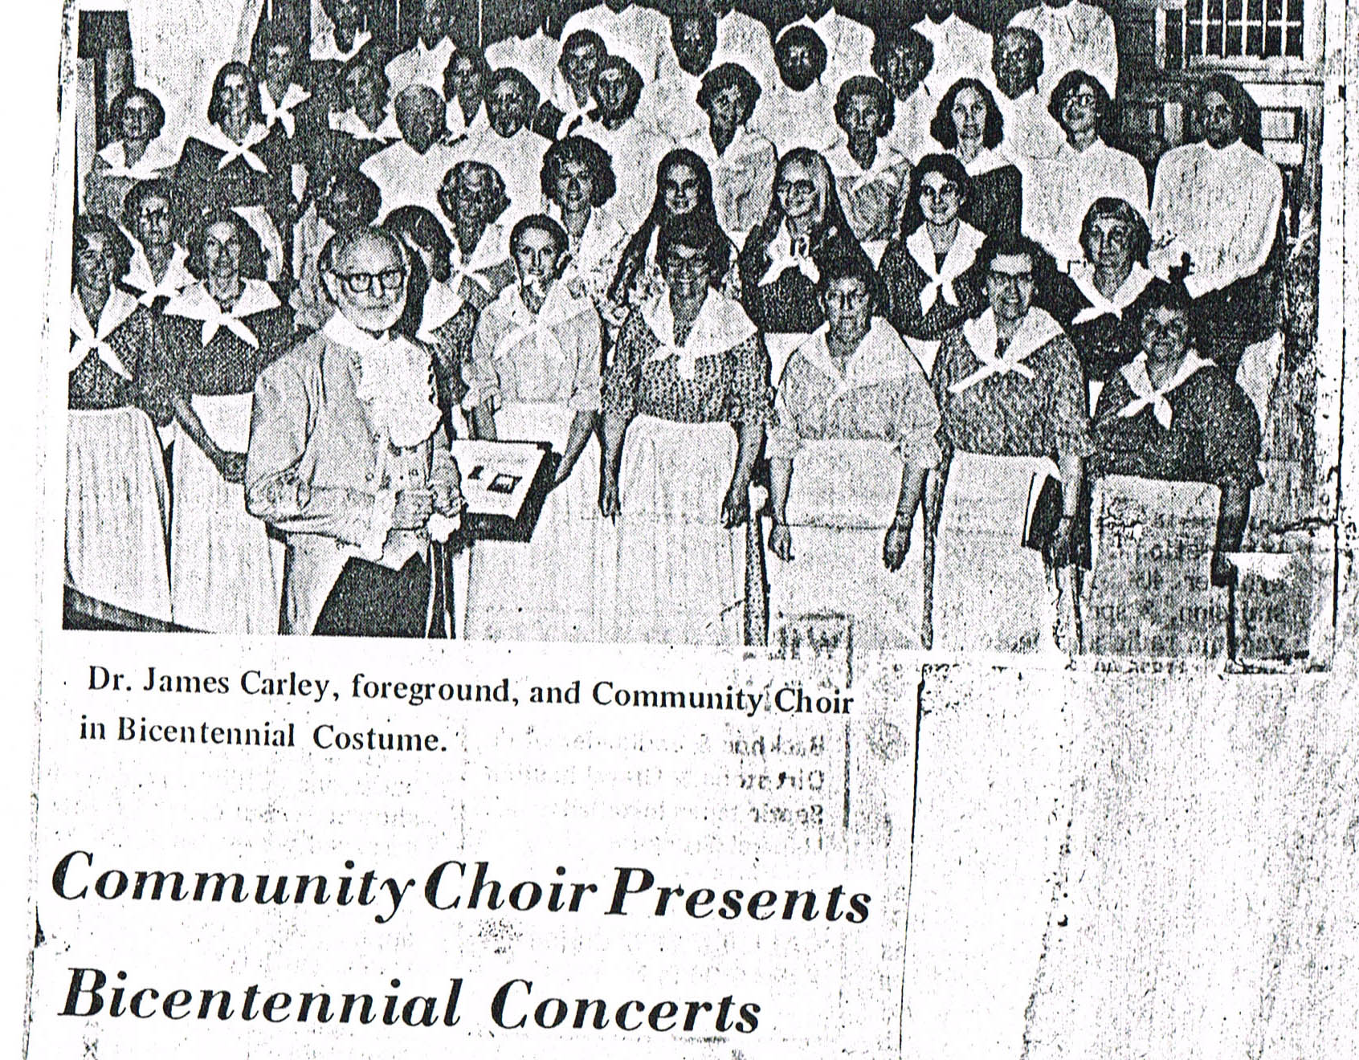

Slide 21
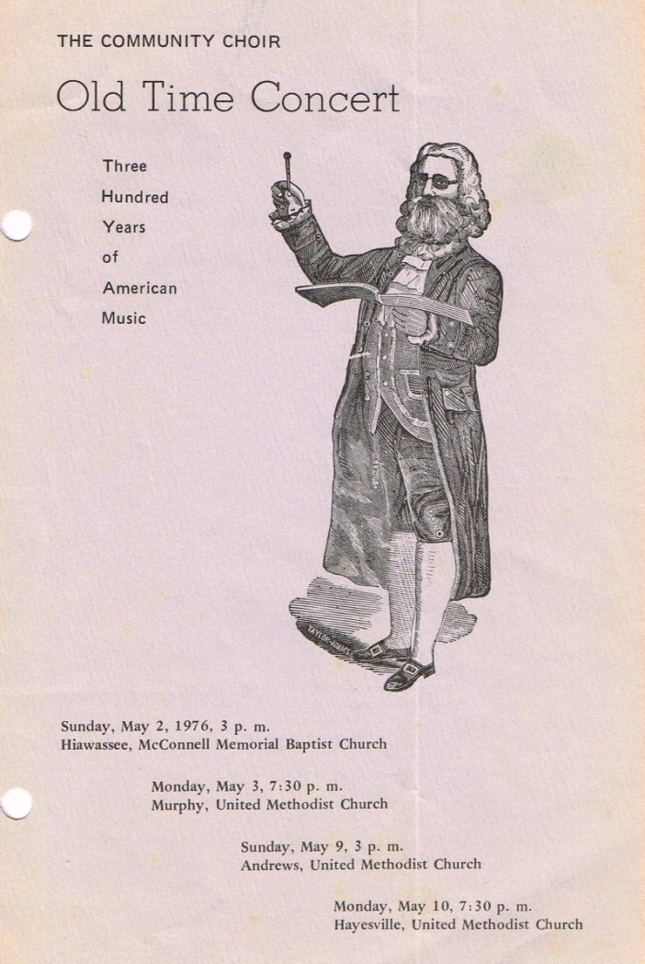
Old Time Concert
In honor of the Bicentennial, the Spring 1976 concert was a concert of Americana. The men wore homemade ruffles. The one belonging to Dave Thomas is displayed in our scrapbook.

Slide 22
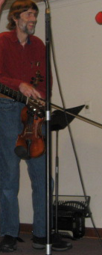
David L. Thomas 1976
Well, the high point for me may have been three Bicentennial performances we gave in 1976, with great tunes and pride in country and in ourselves as a chorus.
The most fun session might have been the Mexican Christmas carols we learned in Spanish, and we had our own band as well
The most challenging session was learning Te Deum Laudamus in Latin, for which I was totally unprepared.
I did enjoy recording and making cassette tape copies for folks of a couple of performances.

Slide 23
Rachel Baughn, current
1976
I first sang with the choir at Christmas 1976 on a visit to my mother, Evelyn Thomas, and my brother Dave. I joined the tenor section since I already knew the Hallelujah Chorus.
For many years, I taped rehearsals to learn my part. I not only memorized those pieces, but I can still tell you exactly where the director would stop to correct us!

Slide 24
My only formal voice lessons were one summer voice class led by James Carley. But, receiving choral and vocal instruction from directors the caliber of Bill Fox for a $20 membership fee is a bargain!
Over the past 38 years I have held most of the offices on the Board. Now, as the person with the most longevity, it’s appropriate that I’m the historian!
Rachel Baughn

Slide 25
Kelley Hayes Rathman 1976
I was in high school back in the late ‘70s when my mom, Virginia “Ginger” Evans brought my sister Lynn and me to join MCC. Our director was James Carley. He could be tough but really got great results from us and we always had such fun (sometimes at his chagrin).
It was that experience that helped foster my love of music and choral experience, so much so that I continue that love today, and I am still singing with a community chorus in Massachusetts, and with my church choir.

Slide 26
I will always hold that time with the MCC (we were just Community Chorus back then) near and dear to my heart!
I'd love to know how many members there have been over the years!
[Answer: 584]

Slide 27
Barry L. Watson, DDS 1976
I was a member of the chorus in the late ‘70s and ‘80s. In fact, I was the president for a while.
Some of the people I sang with that I remember besides James and Isabel Carley were Carol Weber, Don Phillips and the Kelisheck's.
I remember also that we worked very hard preparing for concerts!

Slide 28
Sandra Mazza 1977
I sang with the chorus in its earliest years, and I have been a loyal supporter and audience member. I look forward to the two concerts each year and make it a point to attend.
I remember car-pooling from Hayesville to TCCC where we rehearsed in the lecture hall. Dr. Carley was a perfectionist who prodded us singers into stretching our musical tastes and reaching beyond our own expectations.
Performances at the Folk School tested our abilities to stand for long periods of time and to endure the heat generated without falling off the risers!

Slide 29
After a hiatus necessitated by my own academic pursuits and professional obligations, I re-joined the MCC. Bill Fox had begun his tenure.
Again, family and professional obligations led to my abandoning the MCC as a participant. I truly miss it and think each season that I will try to sing.
If not, I can continue to support and to enjoy the music and the tradition of the MCC.
Sandra Mazza

Slide 30
1978
Rosemary Kelischek, Edmund Spiller, and Evelyn Thomas play croquet at the one and only Community Choir summer picnic event ever held. It was hosted by Dr. Spiller.

Slide 31
Rosemary Surles 1978
This is a photo of me just before a spring concert in the early 80’s. I was in the chorus for 10 years under Dr . Carley.
Two young children and the change of practice venue caused me to drop out. We met at the folk school. Barbara Wood was our accompanist. It was a small friendly group.
I sang first alto. I really enjoyed it a lot. Best wishes!

Slide 32
Barbara Wood 1978
I joined Community Chorus sometime in the late 1970’s. For three decades the Chorus was an important and enriching part of my life…
Throughout the years I most dearly remember the sheer joy when in our performances we really got it right; the music was so ethereal, so beautiful, that it would bring tears to my eyes while we sang.

Slide 33
One especially memorable concert was in 1979 – a contemporary jazzy Christmas cantata titled Emmanuel, composed by a colleague of Dr. Carley’s.
That cassette tape was a Christmas tradition around our house for many years. Our kids called it “Taxies, Taxies” for the catchy Chorus line “Taxes, taxes, everybody’s taxes.”
This performance was delightful from beginning to end, with admirable solos by Karen Brinke (Mary), Barry Watson (Joseph), Jane Hindsman, Virginia Evans, (and others I’ve surely missed), accompanied by Rudy Davenport’s wonderful jazzy piano.
Barbara Wood

Slide 34
Christmas 1979 2nd world performance of Emmanuel by Dorothy Davidson Hausske

Slide 35
Erik C. Brinke, guest singer 1979
[Erik’s mother Karen sang the part of Mary in Emmanuel].
I sang some part that called for a child to sing. I remember being scared to death! I had to invest several afternoons rehearsing with Dr. James and Isabel Carley when I would rather have been outside playing.
Looking back I am glad I have that memory and experience, though, and glad I was able to sing with the group.

Slide 36
Marsha El-Khouri Shiver 1979
My time in MCC was during the Fall 1979 - Spring 1980.
Besides the enjoyment of practices, rehearsals, and performing, the most remarkable part of my membership in the Chorus was that a very nice woman introduced me to her grandson at our Christmas reception.
This nice young man became my husband! We have now been married for almost 33 years. We have two grown sons.

Slide 37
Sylvia Thomas 1979
Sylvia remembers that we had trouble mastering a weird piece called Gamelan which was nothing but “ding, dang, dong.” My daughter, who was around 2 yrs old, imitated it perfectly!
Sylvia went on to sing in a Russian chorus for 20 years and plays concertina for Morris dances in Columbus, Ohio.
(Rachel Baughn, sister)

Slide 38
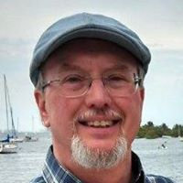
Harry Baughn 1982
My early memories of singing in Mountain Community Chorus are the rehearsals in the Keith House at the Folk School under Dr. Carley.
At the end of rehearsals we would stack the folding chairs in the huge wooden drawers underneath the stage. Then it took some effort to push the loaded drawers back in.
For about 20 years Rachel and I continued the tradition started by her brother David of making cassette tape recordings of choir concerts.

Slide 39
Bob Grove 1981
Singing with our choral group provided warmth of partnership and satisfaction of musical sensitivity.
I'm pleased to see that Mtn. Community Chorus continues to provide enjoyment for the singers and the audience after 40 years of performance to the greater community.

Slide 40
Bud and Carmen Fitton 1982
Bud and I were members until 2007. We were members of the Ensemble, Bud was librarian and I was fortunate to study with Bill Fox for 10 years.
We cherish our memories of singing for 23 years under Dr. Carley and Bill Fox and wish you all well.

Slide 42
Bill Fox 1982; Music Director 1985-2012
I remember those cold winter rehearsals in the Keith House at the Campbell Folk School in Brasstown. But the acoustics in that room were glorious, as they still are, the best and most natural to be found anywhere.
In the Spring of 1985 Dr. Carley asked me to sub for him as director while he was out of the country. When he returned, he asked me to continue directing, while he sang with the chorus as a valuable tenor until he moved to Asheville in the late ‘80s.
At my own retirement in 2012, I asked Laura Stooksbury, my assistant director for ten years, to take the reins.

Slide 43
During my tenure MCC performed twelve joint concerts with the YHC choir.
We have had in our audiences people who traveled as much as two hundred miles to attend our concerts. So much has happened over these forty years that reflect the immeasurable impact of great choral music performed well and in proper context, by our evolving membership of amateur singers.
I always recall Robert Shaw's comments on amateurs; he said something like, "I always enjoy working with AMATEUR choirs, because they do it because they LOVE doing it as opposed to professionals who do it as a profession." AMATEUR is from the Latin which means "Love."

Slide 44
So has my tenure been with MCC, so many years of commitment to and inspiration from working with the many members of Mountain Community Chorus.

Slide 45
Anne Wells 1983
I was a member of Mountain Chorus under direction of James Carley and his sweet wife Isabel. We met at Folk School. Dr. Carley directed the choir at First United Methodist Church.
I graduated from Young Harris Junior (then) College and Bill Fox was in the Music Department. We had a wonderful time.
Wonderful years!

Slide 46
1984 Christmas concert
We performed ‘Twas the Night Before Christmas using Orff Instruments. The “reindeer” were local children, and Virginia Evans played Santa Claus!

Slide 47
Mountain Community Chorus
1985 – 1994
Under the direction of
William H. Fox beginning 1986
The name was changed to MCC in 1989

Slide 48
Edie Kleinpeter 1986
I enjoyed the years I spent as a member of the Community Choir under the direction of Bill Fox. We had a weekly rehearsal at the Folk School and peformed at Sharp Memorial Church. I learned so much from Bill and Mary Anne. This was definitely a highlight in my life!

Slide 49
Earle Seaverns 1987
Yes, 40 yrs is a long time. I remember well – Sally and I started in ’87. James Carley was director and I think Barbara Wood accompanied.
When Bill Fox took over, James was a tenor as I was. He would berate me, because he thought I was using a pen to mark the music -- I was using a mechanical pencil, which he finally realized.
After Sally died, I spent most Spring sessions in the South, but did not miss a concert – always enjoyed them so much.

Slide 50
Sally Roberson 1987
My time with the Community Chorus was the early 1990s.
My fondest memory is a Christmas Concert at Sharp Memorial Methodist Church. Singing with an orchestra and among the very talented singers was a very moving experience for me.
I felt it to be a true time of worship and praise.

Slide 51
Elaine K. Fatora Delcuze 1988
The mid 1980's were a time of personal and family crises for me. Several church choir members suggested that I join the Community Choir to relieve the stress and readjust my focus. It was one of the most positive actions I have ever taken.
Having been a church accompanist, high school and church choir member, and coming from an extended family of church and school choir accompanists, it was the perfect fit.
Though I am no longer a member of the choir, I never miss a concert. Happy 40th!

Slide 52
Janet Paul 1989
Three of us drove over from Andrews United Methodist Church – Laqueta Carroll, Margaret Young, and me. We practiced at the Folk school at that time and had concerts twice a year. It was fun.
We stayed with them for a while even after they moved the venue to Young Harris College.
It was great fun.

Slide 53
Bob and Jean Hiler 1990
We were members during the ‘90s. Both of us had previous experience singing in choirs in church, school, and college. Therefore, when one of the members asked us to join, we were delighted.
Singing with the group was a real inspiration! We would probably still be singing with you if it were not for two factors: 1. Aging, and 2. Asthma.
We still like to attend performances, so keep those announcements in the paper!

Slide 54
Don Schneider, current
1995
We are indeed so very fortunate to be able to sing with the Mountain Community Chorus, for the enrichment of our own lives, and for the entertainment of our audience!
I truly consider it an honor to be able to be a part of the Chorus.

Slide 55
Mountain Community Chorus
1996-2005
Under the direction of
William H. Fox

Slide 56
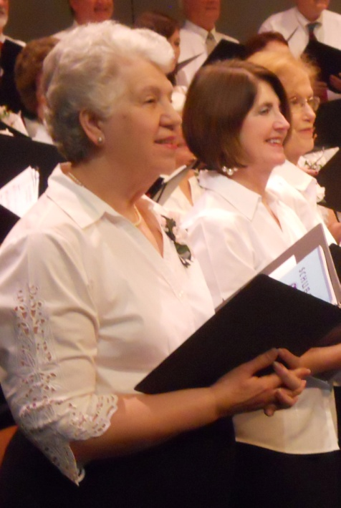
Jo Carolyn and John Beebe 1996
My wife, Jo Carolyn, and I joined the Mountain Community Chorus in 1996 and continued to be members until 2011. I was president from 1998 until 2001.
During that time I wrote, with former president Paul Arnold's help, the Chorus By-laws. I was Treasurer from 2005 to 2008.

Slide 57
Bill Fox was directing the MCC when I joined. I soon learned to appreciate his musical taste and his directing style.
I learned that Bill had sung under the direction of Robert Shaw with the Atlanta Symphony Orchestra Chorus at the same time I did.
Anyone who has sung with Shaw soon realized that his primary motivation was musical excellence. It was obvious to me that Bill was motivated by the same principle. It helped make the Mountain Community Chorus become the excellent ensemble that it is today and gives it a standard to maintain.
John Beebe

Slide 58
1997

Slide 59
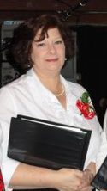
Susanne Parker, current
1997
It is wonderful to have an opportunity to perform more challenging music in our area.
It is interesting that we come together from such varied backgrounds, varied communities and states, and such a wide range of ages for a common love.

Slide 60
Neil Wocell 1997
My husband Neil Wocell passed away in February 2008. However, he loved, loved singing with the MCC, and performed with the group for a number of years! The get-togethers were a great joy for Neil!
Neil loved singing.
I enjoyed the many chorus performances in Young Harris, Hayesville, and here in Murphy, and knowing Bill Fox.
Best wishes to all of you,
Rikki Wocell

Slide 61
1998
Amber Barrett, current
Mountain Community Chorus is a wonderful association and I am eternally grateful to play a small part of its forty years.
The people I have met these past years have influenced my life in ways I could have never foreseen.
The opportunity to sing with such illustrious musicians has been humbling. Music has always been my constant and is the place I go for peace and understanding.
I wish Mountain Community Chorus congratulations on the past forty seasons and hope for forty more.

Slide 62
Laura Stooksbury, Director
1998
When I try to put into words what this chorus means to me, I start crying. So through these tears I’ll try to explain:
It’s my life, it puts breath into my soul.
More than that, I realize that the music is greater than I am, and that this is a chorus of people from all walks of life who come together for something that is greater than they are.
My hope is that we can continue to bring to you a beauty that is beyond any words.

Slide 63
Ann Chenault 1999
My husband, Bill, and I moved to Young Harris in 1998. We attended the MCC Christmas concert and I knew then that I wanted to be a part of it.
My 13 years with the chorus were some of the most precious years of my life. I sang with such wonderful musicians who were so patient with this "old Lady.”
The chorus helped me through the death of my husband. Even through his illness I continued attending practices and singing at the concerts.
Thank you Mountain Community Chorus for 13 wonderful years. JUST KEEP ON SINGING!!!!

Slide 64
Linda Roshaven, current
1999
I believe I've been with MCC for 15 years +/- of this dedicated group, and I look forward to each season!
The inspiration I get, and hopefully portray, is something that will always be a memorable time in my life – not only from the past, but today and continuing into the future.
I feel honored and blessed to be involved with such dedicated people! Thank you for being a substantial part in my life.

Slide 65
Missie Kirkland, current
1999
My years with MCC have been incredible, continually keeping up my craft and being able to share the love of music with an amazing group of people who also love to sing.
This group has been a blessing in my life for 15 years and I look forward to many more years to come.

Slide 66
1999

Slide 68
2000

Slide 69
2000
David Baker, current
My mother has a beautiful soprano voice and she taught me to sing when I was in her womb!
I have sung in choirs since I was a toddler. In college at Lenoir-Rhyne College (a Lutheran college in Hickory) I sang in the A Capella Choir and toured the U.S. It was there that I saw choral music as a force to move an audience.

Slide 70
After seminary in Chicago, I joined the Windy City Gay Mens' Chorus (1979). This showed me that music could be a political force to build bridges between the world of fear and the world of love and unconditional acceptance.
Music has literally saved my life! It has been a light in my dark moments and a safe zone in my scary ones.
Fifteen years ago, I joined the MCC when it was just 25 years old. And today we celebrate 40 years.
Bill Fox nurtured my voice to new heights by helping me discover some hidden potential, and to him I am eternally grateful.
David Baker, MCC President

Slide 71
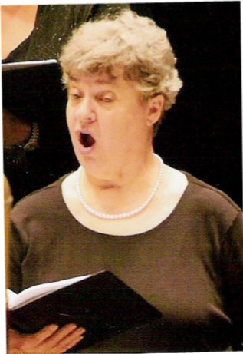
Karen Borchers 2000
I began singing when I was five years old. Choral singing has been a major underpinning of my life. It is so important to me – both for the joy of singing and for the fellowship.
Most of my best friends are choral singers. After all, in choirs, one literally learns to breathe together!
When I moved to North Carolina, a first priority was finding a good community chorus. I was delighted to find the MCC, and thrilled to be part of it for 13 warm, wonderful, and joyful years of singing.

Slide 72
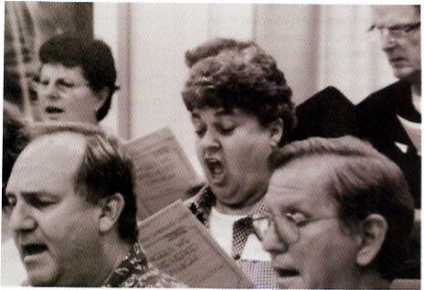
Thank you, Bill! Thank you, Laura Stooksbury and Mary Ann Fox. Thank you, fellow singers.
And thanks to Dr. James Carley, George and Rosemarie Kelischek, and the many others who started MCC 40 years ago!
Karen Borchers

Slide 73
Adelaide Fullilove 2001
MUSIC ALONE SHALL LIVE NEVER TO DIE !!!
I was a member of MCC 2000-2009...Nine wonderful UNFORGETTABLE years
So many happy memories made.

Slide 74
Kathy Worley Tant 2001
I was a member of MCC when my schedule permitted, between 2001-2006. I truly enjoyed singing with MCC. I learned a great deal about choral singing under the direction of Bill Fox and Laura Stooksbury.
I greatly admire all those who have been long-time MCC members and who have supported this wonderful endeavor to provide quality choral music.
Congratulations MCC on your 40th Anniversary, and keep up the great singing!

Slide 75
Jack Parrish 2004
My experience singing with Bill and the group was one of life’s late middle aged highlights.
I joined in 2004 and was able to sing through 2009. We did some wonderful music, mainly due to the professionalism of the group and the quality of the conducting.
Faure’s Requiem was one of the best for me, and the Gospodi also, which I first heard sung by the old Don Cossack chorus. I suggested it to Bill and was delighted when he agreed.
Were it not for the increase in a hearing nerve problem I would still be there, even at 86. It is a wonderful and talented group. Best wishes for the 40th celebration!

Slide 76
Charles Walls, current
2004
Every season I rave that this concert is the best ever. The variety and contrast of the selections we sing are so exciting and challenging.
And I am one who finds every rehearsal as exciting and fulfilling as the concerts. I love to sing with all of you guys!

Slide 77
Mountain Community Chorus
2006-2014
William H. Fox, director until 2012
Laura Stooksbury, beginning 2012

Slide 78
Faye Hobbs, current
2002
My years singing with the Mountain Community chorus have been most enjoyable. I’ve loved working with Bill Fox and Laura and Wayne and especially Lindsey Cope (can't wait to see what wonderful things she does with her talents!).
It's been great to be with old friends and make new ones while all the time making beautiful music together.
May this tradition live for at least another 40 years. Good Job everyone.

Slide 79
Joan Smith 2004
Joan really misses the concerts and at least once a week laments of how she misses all of the folks.
She is more in memory loss than when we left two years ago. The Lord has blessed us with good health and family.
Joan will always have a fond memory to cherish.
Tom Smith

Slide 80
Lindsey Cope 2004
My time singing and being a guest conductor with MCC was an amazing experience. I could always count on those rehearsals to lift me up if I had a bad day, because I found so many friends who shared a common passion in music.
I miss you all and think of you often!

Slide 81
Bobbi Umbach 2004
I loved my time with the chorus and miss it but have no idea how I would ever fit it in again. :o(
I DO love attending the concerts where I can actually HEAR all the parts! :o) Will definitely be at the May concert. I miss YOU!

Slide 82
Elizabeth Gilbert 2007
Talent, music education, family, friends, laughter, tears, work, and fun are words that come to mind when I reminisce about my time with Mountain Community Chorus.
I miss you all and pray I will be able to rejoin my fellow singers soon!

Slide 83
2007
Marolyn Hanson, as oldest member of the 2007 season, pictured with 7th grader Jesse Somervell, youngest of the season, and Director Bill Fox.

Slide 84
Laura Schnabel, current
2007
My experience singing with Mountain Community Chorus has been many things: learning, working, sharing, joining, laughing, making friends.

Slide 85
The most special part of belonging to MCC has been making friends. Meeting new people and making friends as we get older isn’t always easy; the friends we meet and make are truly a gift.
To make friends who share your love of music and singing is like the gift being wrapped beautifully and tied with a huge bow.
MCC is a beautifully wrapped gift for me. Thanks for all the good memories.
Laura Schnabel

Slide 86
Barry Beall 2007
My husband, Barry Beall, passed away in 2009.
I can tell you that he said to me the chorus was a very professional organization and he felt honored to be a part of it. He praised Bill Fox and felt he was an excellent director.
My husband loved to sing. He was a voice major in college and I had urged him for years to join the Community Chorus, but he worked at the golf course after his retirement and couldn’t always get off for rehearsal.
Happy anniversary to you all.
Glenda Beall

Slide 87
2008

Slide 88
Marynell Yahl, current
2009
I joined MCC in 2009 after several years of watching the performances and I so wanted to be a part of this wonderful group.
Not only does singing heal the heart, it fills my soul with joy and it has become my therapy. Even if we never put on a concert, just to be in rehearsal hall every Monday night is healing!
I can truthfully say that singing with the MCC has enabled me to face all of the tribulations that come with caring for an ailing spouse. It is heaven on earth!!!

Slide 89
John & Judith Rathbone 2010
We loved our time with MCC. The music was well chosen, the directors inspiring and the singers were truly a "chorus.” Every rehearsal was a wonderful time shared with friends to learn how to touch the listener with our voices. Simply stated, singing with MCC was a joy!
I wish only good things for MCC. I miss everyone so-o much! Hopefully, I/we will return at some point....not that you need sopranos. Thanks for the opportunity to share our love of MCC!

Slide 90
Carlene Dockery 2010
The first time I attended a concert, I was so moved by the music that I could only think how wonderful it would be to have the opportunity to learn pieces like the ones I heard performed that evening.
With the support of a friend in the Chorus, I summoned the courage to audition.
During the next months, I literally “lived” for Monday evening rehearsals. Memories of the joys of chorus class in school were rekindled, and I felt younger and happier than I had in many years.

Slide 91
The directors and the singers taught me so much. Sometimes the music was so beautiful, it was difficult to hold back tears and sing my part! Every new season brought a new selection of music which challenged me but made me thankful for the privilege of learning it.
One evening in the presence of these talented musicians, I understood that the Mountain Community Chorus was, for me, a divine gift-- an instrument of praise and thanksgiving to God with each well-sung note!
Carlene

Slide 92
MCC Board of Directors 2011

Slide 93
2011 Directors
Wayne Hundley
Lindsey Cope
Laura Stooksbury
Bill Fox

Slide 94
Jerry Hobbs 2012
My brief time with the MCC was truly memorable, and I was filled with a sense of accomplishment. It is something I'll always remember. Laura, your ability as a director is, in my opinion, flawless.
You are not only an excellent director but also a leader. To stand in front of sixty musicians and have them give their best week after week has to give you a sense of pride. It's no wonder that between you and past directors, the choir has lasted forty years and is still going strong.
I also applaud the spirit and vivacity that David Baker provides as the president.

Slide 95
MCC boasts singers in their 80s and as young as 13 – the age of Carli Kidd when she first joined the chorus. Now a YHC student, she’s pictured here with fellow singer Cameron LeJeune.

Slide 96
Best practices modeled by our directors (notice the pencils…)

Slide 97
Jim Brown, current
2009
I have been singing in choral groups, both large and small, starting with high school and church choirs, for over 60 years.
I had always thought that I would love to have the opportunity to sing with such a talented group of singers. At the earliest opportunity I auditioned, and was welcomed into the MCC.
It has been a very pleasant learning and challenging experience being with some wonderful singers and it has been FUN.
I am hopeful that my voice will hold out for a while longer so I can continue to sing with the group.

Slide 98
2009
Lucy Cole Gratton, current
I remember the first rehearsal quite vividly. I was extremely nervous and made to feel quite welcome by Charles Walls.
The first time Bill Fox asked us to read a piece of music, I was floored. It didn’t sound to me like anyone there needed to practice. It was glorious.
Later I thought I would not be able to sing when John Beebe left the chorus. I had depended on him to keep me on track as a first tenor. But, I’m still here!

Slide 99
Mary Golnitz, current
2009
I love to sing! I have sung in or directed choirs all of my life.
In college I got to know my future husband touring the United States in the Concordia Chorale.
What an awesome opportunity we have to sing together in the Mountain Community Chorus with such great musicians!

Slide 100
Darrell Golnitz, current
2010
I developed a lasting relationship with my future wife through singing in the touring Concordia College Chorale 46 years ago.
Every time I sing in the Mountain Community Chorus I am reminded of how blessed I truly am.

Slide 101
Judith Facemire, current
2010
We expected to find great arts and crafts, mountain and blue grass music when we moved to this area in 2009, and we did.
Finding the Mountain Community Chorus was an unexpected bonus we've enjoyed ever since 2010.
Thanks to the hard work and sacrifice of dedicated, talented and knowledgeable choir directors, officers, board members, and musicians, classical music lives on..! I'm lovin' it!

Slide 102
Harry and Katie Gilbert 2011
We had known about the choir for a number of years, but work schedules prohibited our participation until Fall 2011.
We thoroughly enjoy the challenge of choral singing with others who love what they do and are striving for excellence.
An unfortunate accident in January 2014 has prevented our attendance for rehearsals this spring, but we will be returning in the fall.
We miss everyone and wish MCC a Happy Fortieth!

Slide 103
Kathy Toews, current
2012
In the summer of 2012 I moved from Massachusetts to North Carolina. Although I love being in the mountains, I was very concerned about not finding a choral group in which to sing. A new acquaintance mentioned MCC.
Even though it was late, I called Laura and to my great joy she told me I could start singing right away.
Thank you for this wonderful group -- I am truly blessed to have an opportunity to sing with MCC.

Slide 104
2012
Cathy and Mike Smith,
current
MCC is a wonderful music outlet in the North Georgia Mountains and we look forward to practice and the performances very much. Very glad to be a part of it.

Slide 105
2013 Directors
Dr. John Wayman Wayne Hundley Laura Stooksbury Harry Gilbert

Slide 106
Indispensable people…
Suzanne Major, MCC’s accompanist until 2012.
David Baker, current Board Chair, and Mary Ann Fox, associate accompanist

Slide 107
Carol Smucker 2014
MCC’s new accompanist

Slide 108
Joan Grashof, current
2014
I am enjoying being back in a “directed” choir. It’s been 16 long years!

Slide 109
Laurie Colombo, current
2014
As a new member of the group, it is refreshing to see such commitment to quality sound. I look forward to being a part of the magic.

Slide 110
Big Kisses to our audience!

Slide 111
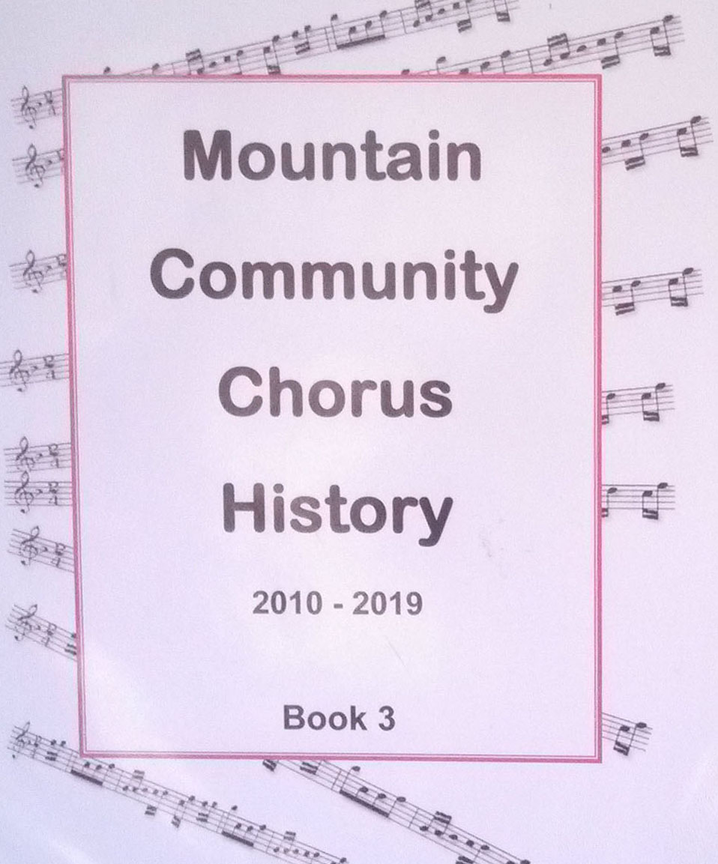
The Song Goes On … … but only with the support of our generous and faithful audiences!

Slide 112
Some thoughts going forward… from David Baker, president
In the MCC music is an energy to bring together community: A community of singers, each of whom has their own personal journey of how they arrived here to this present moment.
A community of listeners (the audience) who go into the community and describe their experience of hearing the Mountain Community Chorus and what it meant to them.
And it takes a community to offer us a space to rehearse and to perform.
We are all interdependent on each other to succeed.

Slide 113
I was elected to the role of President of the choir in 2008. The community of the choir, the music directors, and the Board of Directors keep this "jewel" alive in the tri-state area (NC, GA, TN).
On 12/5/2008 we became incorporated in the State of Georgia.
On Feb. 5, 2009 we received our 501-C3 status.
We are supported by your donations, membership fees, Sponsor a Song Programs, and Dynamic Donor Programs.

Slide 114
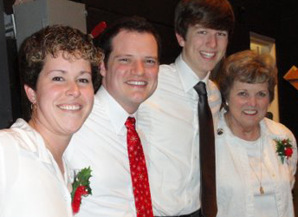
In the Fall of 2014 we will offer a scholarship to one to two students who are majoring in Music Education at Young Harris College.
I challenge you, the Community, to keep MCC alive.
Music is eternal – from that was born the Mountain Community Chorus.
Sing on, Sing on!

Slide 115
Happy 40th Anniversary, Mountain Community Chorus !

