Slide 1
When Is Good…Good enough?
Brian Wikle – HIT Client Service Manager
October 16, 2020

Slide 2
What duplicate Percent helps make you sleep at night?

Slide 3
What have you been promised by your EHR Vendor lately?

Slide 4
The Cost of Duplicate & Errors
30 – 90% of true duplicates are missed by EHR systems
4% of duplications = an impact @ $1,100 per duplicate
A 35% reduction in duplicate rate = 20% decrease in AR days
35% of all denied claims are caused by patient misidentification
Denied claims cost an average of $1.2M per year
http://www.hfma.org 2016 National Patient Identification Report 12/2016

Slide 5
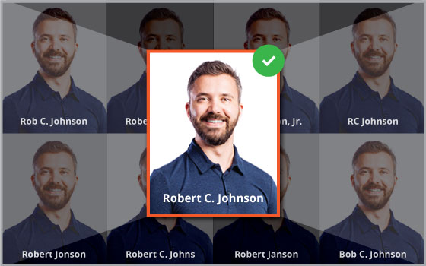
What is the End-Game?
Who is the real Robert C. Johnson?
Notes:
One patient, one record. The Patient-Centric view.

Slide 6
The U.S. House of Representatives has voted 246 to 178 to approve the Foster-Kelly Amendment to HR 2740, which overturns the longtime ban on federal funding for a national patient identifier. This is a major victory for supporters of a unique patient identifier.
Jun 13, 2019

Slide 7
Today’s Challenges: Linking Clinical & Claims Data
Lack of high volume, real-time transactional systems across the continuum of care
No ‘Universal Patient ID’
Lack of data standards for normalizing patient demographics (such as postal addresses, phone numbers, email addresses, etc.)
Too many legacy MPIs that lack increased speed, precision & simplification of the patient matching process
Lack of a frictionless interoperability platform to facilitate the exchange of complete clinical & claims data
Too many legacy health management systems that are expensive to acquire, maintain and do not solve the matching and clinical data integration problem

Slide 8
How can the Health IT Community solve this challenge?
Private and public sectors needs to agree on how we handle the lack of a ‘Universal Patient ID’ and making such an ID readily available (in real-time) for all types of healthcare organizations.
The ability to quickly & securely search for the ID of each patient and not be limited to basic demographic attributes to further increase the overall match rate in our disparate data silos
We must have access to standardized demographics to further match and integrate clinical & claims history
We must create a frictionless platform to securely exchange clinical & claims data for each patient identity

Slide 9
How to Improve Patient Matching: 4 Proven Methodologies
Implement Modern-Day MPI Technology
Data Standardization
Data Enrichment
Data Stewardship Management

Slide 10
Implement Modern-Day MPI Technology
Patient matching must be performed in real-time transactional mode – not batch mode
eMPI must assign a universal patient ID to identify disparate patient records
eMPI must accurately identify patient data among healthcare delivery organizations across multiple data sources

Slide 11
Overlaps
Patient records in more than one data source/location
Dangerous; reviewing treatment plans and coordinating care with missed important clinical information (blood types & allergies)
Tests repeated; major financial impact on Payers & ACOs
Delayed treatment
Overlays
Two or more patients have the same MRN in same data source/location
Very dangerous; huge patient safety risk – treating one patient with another person’s record
Quality of care problems numerous and extremely dangerous
Did you know? It can take as much as 500 hours to fix one electronic record overlay?
Especially Pediatric patients; who can’t speak for themselves
Notes:
Dirty data in = dirty data out?
Overlaps – records in more than one data source/location
Can be very dangerous
Missed important clinical information (blood types & allergies)
Tests repeated
Financial impact on ACOs
Delayed treatment
Overlays – two or more people have the same MRN in the same data source/location
Cause a huge patient safety risk – treating one patient with another person’s record
Quality of care problems created are numerous and extremely dangerous.
Did you know? It can take as much as 60 to 100 hours to fix one electronic record overlay!
May 2014
Patient Identification in an HIE Environment — Where Everyone Doesn’t Necessarily Know Your Name By Susan Chapman For The Record Vol. 26 No. 5 P. 10

Slide 12
Data Standardization
USPS address normalization must become a minimum industry data standardization requirement – call to action with ONC
Address normalization is now a proven methodology to improve data quality and decrease duplication rates by up to 4%

Slide 13
Master Data Enrichment
Enhance demographic data – using sophisticated third-party referential data sources
Ensure there are enough data attributes to precisely match – on each unique identity – in overall scoring and matching processes
Curate missing & historical data available – on each matched identity

Slide 14
Data Stewardship Management
use a combination of sophisticated scoring and rules engine
Skilled data management personnel
Master referential matching & data enrichment
Auto-merge technology to resolve exact matches & quickly decrease probable matches to <1%

Slide 15
If this was your grandmother and she had an incident, wouldn't you want to be guaranteed that the physician is viewing the most up to date clinical record, so he knows her complete medical history?

Slide 16
Brian Wikle
bwikle@briljent.com
317-219-8824

