Slide 1
Orthotic Devices

Slide 2
Orthotic Devices -Definition
An orthosis is a mechanical device that applies
forces to the body in an effort to:
support
limit
stabilize moving parts
assist and improve motion
correct and align deformities
prevent and protect susceptible areas.
Notes:
The word orthotic is derived from the Greek word “orthos,” meaning straight, normal, or true. Orthotics, also called braces or splints, have been known since the ancient Egyptian era. Their use continues till today; however, changes and advances in materials and techniques of fabrication, interrelated with newer surgical procedures and medical treatments, have expanded their applications.

Slide 3
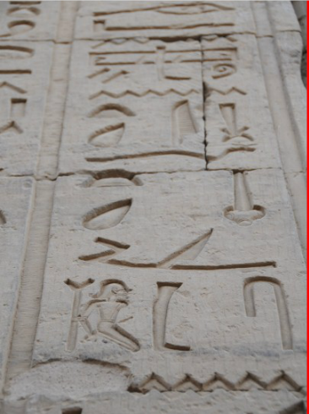
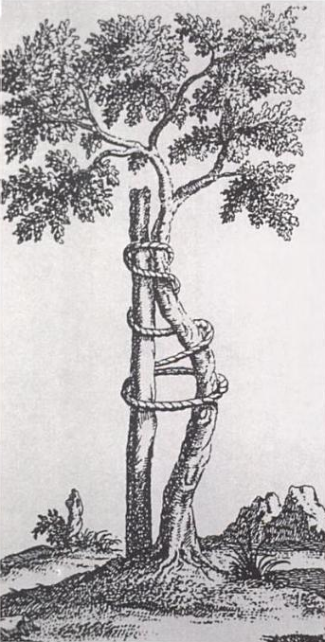
Orthotic Devices -Definition
“orthos” - straight, normal, or true.
Notes:
The word orthotic is derived from the Greek word “orthos,” meaning straight, normal, or true. Orthotics, also called braces or splints, have been known since the ancient Egyptian era. Their use continues till today; however, changes and advances in materials and techniques of fabrication, interrelated with newer surgical procedures and medical treatments, have expanded their applications. Delisa

Slide 4
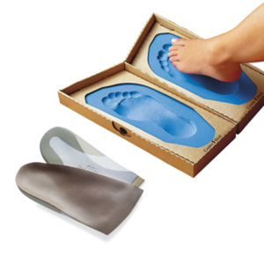
Orthotic Devices -Classification
Prefabricated
Custom molded
Notes:
Orthoses can be prefabricated to fit a large variety of patients or custom molded to a specific patient. Their effectiveness is directly dependent upon the proper fit and alignment of the components as well as proper use and compliance by the patient. The physician and orthotist should prepare a detailed prescription together in order to avoid delivering the wrong device. Once delivered each should be present to “check out” the device in order to ensure proper fit. Delisa

Slide 5
Orthotic Device -Prescription
The prescription of an orthosis requires an
understanding of the pathology of the disorder to
be treated and must take into account:
Goals to be achieved
Knowledge of anatomy, biomechanics, and
kinesiology
Understanding of the indications (positive effects)
and limitations (negative effects) of the orthosis

Slide 6
Upper Limb Orthosis-Classification
Static
Dynamic
Hybrid
Notes:
All upper limb orthoses can be classified into one of three categories: static, dynamic, or hybrid. Static orthoses have no movable joints incorporated into the design. However, a static orthosis may allow active joint motion in one direction, but block motion in another direction (static with block). A static orthosis may also be changed or adjusted to alter the motion allowed or alter the pressure across a joint for stretching purposes (progressive static). Dynamic orthoses have movable joints that can limit motion (block), increase motion through traction, or substitute for weak muscles using supplemental force (assist). Hybrid orthoses will incorporate features of both static and dynamic orthoses into one device. This type of orthosis will cross multiple joints with the intention of limiting or stopping motion at some joints, but allowing or augmenting motion at other joints. Delisa

Slide 7
Upper Limb Orthotic - Goals
It is the preservation or restoration of hand function that we strive for with upper limb orthotics.
Notes:
The primary purpose of all upper limb orthoses, and the rehabilitation program related to their prescription, is to regain or to preserve prehension of the hand. The upper limb is vastly different from the lower limb because of the unique and critical functioning of the hand. The lower limb simply maintains our body weight as we move through space, and lower limb orthoses primarily prevent us from falling. Conversely, it is the role of the shoulder, elbow, and wrist to position the hand properly in space to provide the essential function of gross motor grasp and fine motor skills. It is the preservation or restoration of this hand function that we strive for with upper limb orthotics. Delisa

Slide 8
Upper Limb Orthotic Goals
Five common goals for upper limb orthotics: 1. Substitute for weak or absent muscles 2. Protect damaged or diseased segments by limiting load or motion 3. Prevention of deformity 4. Correction of contracture 5. Attachment of other assistive devices
Notes:
Delisa

Slide 9
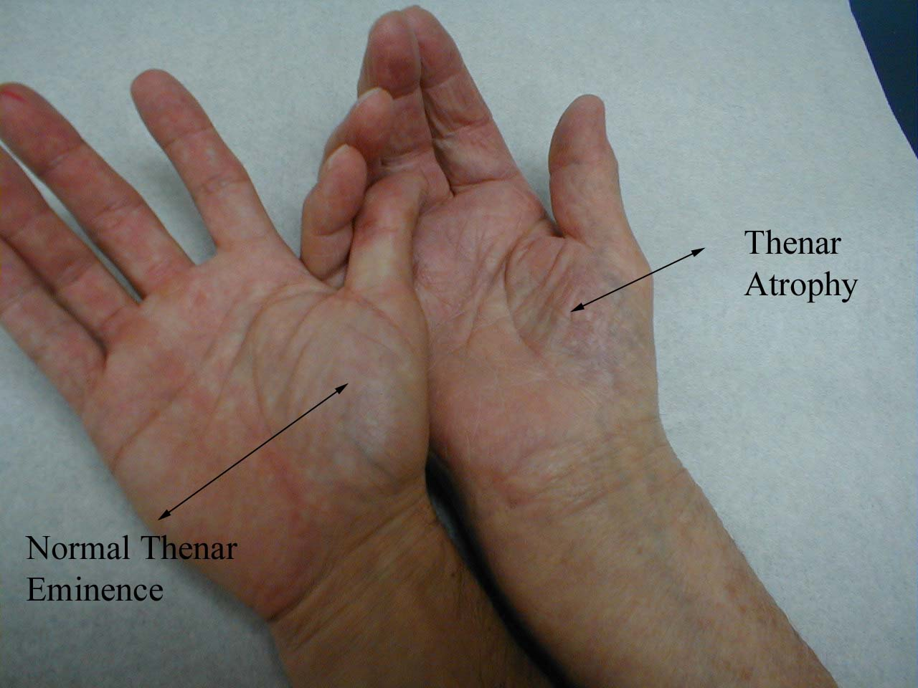
Upper Limb Orthotic Goals
1. Substitute for weak or absent muscles
Notes:
The first goal is a very common indication for upper limb orthotics. In this case, we substitute for weak or absent muscles at the wrist, elbow, or shoulder that fail to properly position the hand, or we substitute for weak musculature within the hand itself that fails to provide proper prehension. Common clinical examples would include cervical spinal injury, brachial plexus injury, or peripheral nerve injury to the median, ulnar, or radial nerves. Delisa

Slide 10
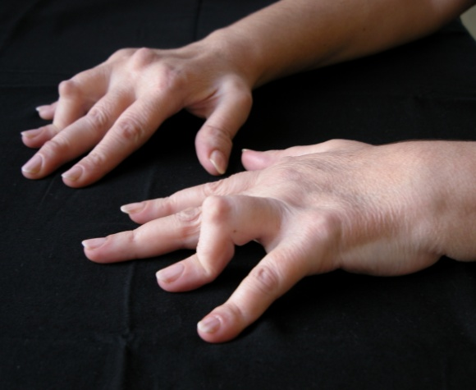
Upper Limb Orthotic Goals
2. Protect damaged or diseased segments by limiting load or motion
Notes:
The second goal is to protect damaged or diseased segments such as those commonly seen in cases of surgical repairs, trauma, rheumatoid arthritis, etc. With trauma or surgical repair, the orthosis is designed to control loading across damaged bony segments or sprained/strained soft tissues, to promote proper healing. This goal is commonly achieved through a series of progressive static or dynamic orthoses, each allowing increasing loads or movements across a joint. In the case of rheumatoid arthritis and other progressive diseases, such as scleroderma, loads or motions are controlled with the goal of slowing the progression or natural course of the disease. In these conditions, orthoses are also used as an adjunct in pain control when inflamed joints must be temporarily immobilized and then slowly progressed over time. Delisa

Slide 11
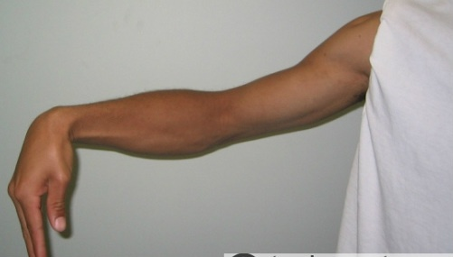
Upper Limb Orthotic Goals
3. Prevention of deformity
Notes:
The third goal of upper extremity orthoses is the prevention of deformity. There are many clinical situations of upper and lower motor neuron disease or injury (brain injury, stroke, spinal cord injury, brachial plexus injury, peripheral nerve injury) where proper positioning of the upper extremity is critical to prevent contracture or deformity. In these cases, there is no actual disease or injury to the segment included in the orthosis, but there has been proximal neurological injury creating the risk of deformity or contracture. Delisa

Slide 12
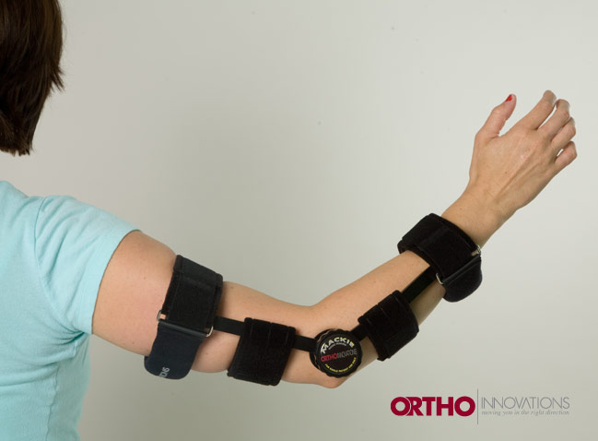
Upper Limb Orthotic Goals
4. Correction of contracture
Notes:
The fourth goal of upper limb orthoses is the correction of contracture, which may have occurred as a result of disease or immobilization. Very commonly, clinicians are forced to immobilize upper limb segments or joints following a fracture or other significant injury to promote soft-tissue and bony healing. Subsequently, normal range of motion at these joints must be regained through progressive stretching orthoses. This can be achieved through a series of progressive static or dynamic orthoses that are modified on a regular basis. The aggressiveness of the orthotic treatment program is determined by the degree and duration of contracture, and appropriate identification of the soft tissue involved. Delisa

Slide 13
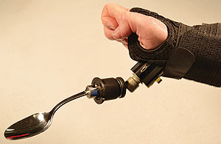
Upper Limb Orthotic Goals
5. Attachment of other assistive devices
Notes:
The fifth goal of upper limb orthoses is to provide a base for attachment of other assistive devices. The simplest example of this would be a universal cuff, which wraps around the hand to provide positioning of a spoon, fork, or other eating utensils. Universal cuffs have also been commonly used for writing or keyboard devices or other grooming devices. In contrast, the clinician should recognize that the balanced forearm orthosis (BFO) is simply a wheelchair-mounted accessory, which then attaches to a forearm trough. The BFO provides enormous assistance to the patient with spinal cord injury to carry out activities of daily living (ADLs), such as feeding, grooming, and even access to household technologies (light switch, telephone, television remote control).

Slide 14
Orthotic Devices -Bimechanical Principles
The five principles include: 1. Three-point control concept 2. Tissue tolerance to compression and shear
forces 3. The biomechanics of levers and forces 4. Selection of materials 5. Static versus dynamic control
Notes:
There are five critical concepts that must be understood to appreciate the proper design and fabrication of upper limb orthoses. Failure to understand and integrate these principles into the upper limb orthosis may produce less than optimum functional outcome or even injury to the patient. Delisa

Slide 15
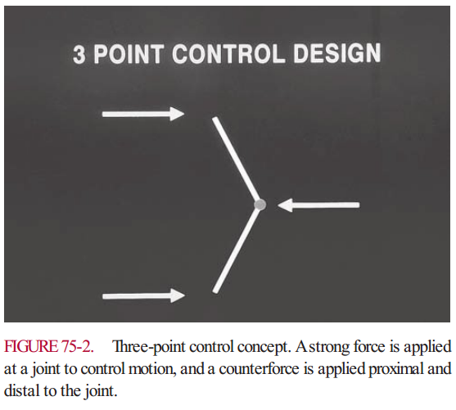
Bimechanical Principles
1. Three-point control concept
Notes:
The three-point control concept is the basis of nearly all upper and lower limb orthotic designs (Fig. 75-2). Generally, a strong force is applied at a joint and a counterforce applied proximal and distal to that joint. The location of the force and counterforce may be clearly identified as a specific loop or bar in the orthotic design. However, in many instances the force and counterforces may be obscurely hidden into the design of the orthotic device. The precise point of application and the magnitude of the force and counterforce are critical to achieve the goal of controlling that joint. Delisa

Slide 16
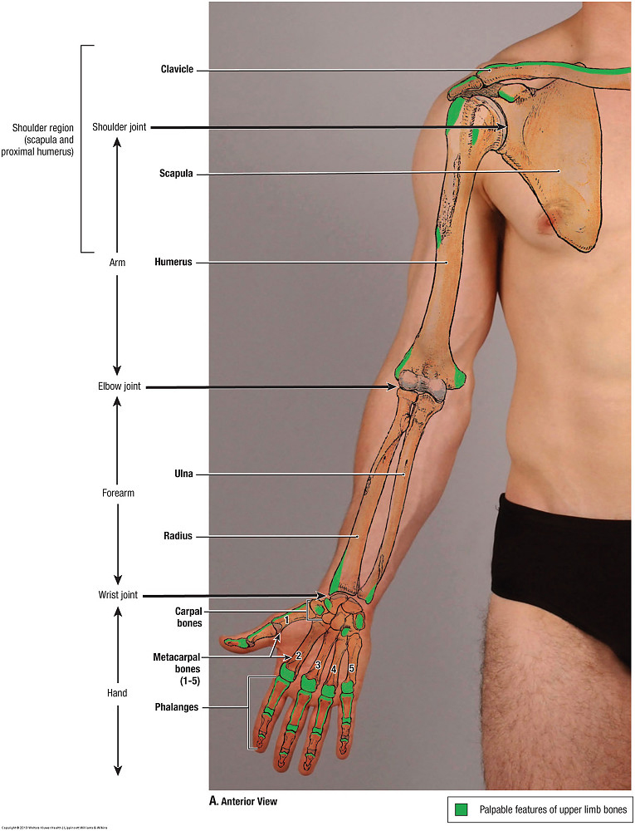
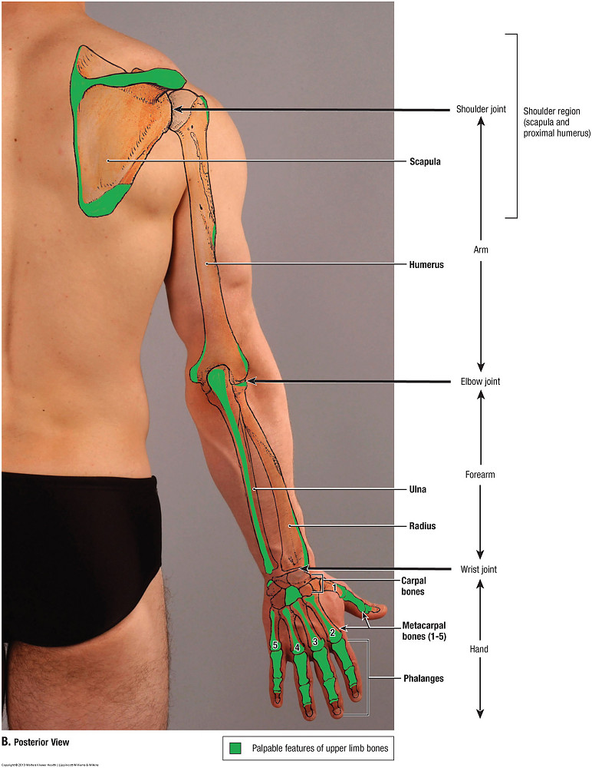
Bimechanical Principles
2. Tissue tolerance to compression and shear forces
Notes:
The tissue tolerance to both compressive and shear forces must be understood if the orthosis is to be designed and fabricated safely. There are more than 30 pressure-sensitive bony prominences in the wrist, hand, and fingers alone. Avoiding prolonged, excessive pressure over these bony prominences will preserve skin integrity and patient comfort. Pressure duration curves adopted from other rehabilitation fields (such as seating systems) have indicated that higher pressures of 100 to 300 mm Hg are tolerated for only 2 to 4 hours continuously, whereas lower pressures of 20 to 50 mm Hg are tolerated for up to 12 hours a day continuously. If high pressures are anticipated at a joint or bony prominence, then a proper wearing schedule should clearly delineate the duration of time and the frequency of use throughout the day or night. Although a longer stretching time will reduce a contracture more rapidly, the risk of skin breakdown increases steadily with wearing duration. The clinician should also remember that distribution of pressure over a larger surface area is better tolerated than a small focused pressure. It is also important to remember the natural position of the transverse and longitudinal arches of the hand, especially in static positioning orthoses. Delisa

Slide 17
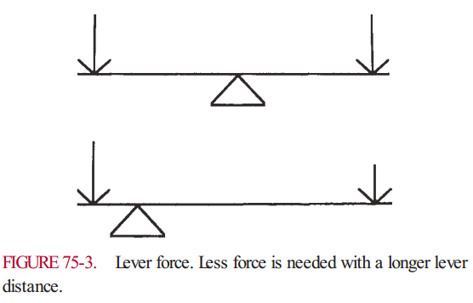
Bimechanical Principles
3. The biomechanics of levers and forces
Notes:
The biomechanical forces applied in upper limb orthotics are most analogous to a class one lever, commonly known as a seesaw. Most individuals recognize that a seesaw has a force applied at both ends with a central fulcrum. Rehabilitation specialists should also understand that a relationship exists between the magnitude of the pressure applied (force) and the distance to the fulcrum (lever). In essence, the farther from the fulcrum or from the joint, the less pressure needed to generate a fixed force across the joint. If tissue tolerance is a concern due to the required magnitude of pressure, one can simply move the point of pressure application farther from the joint to decrease the magnitude of the applied pressure. In other words, by increasing the lever distance, less pressure can generate the same force across the joint (Fig. 75-3). The angle of pull of force is also very important to produce effective control of the identified joint, and to prevent damage to collateral ligaments. If the angle of pull is not perpendicular to the joint, the orthosis may overstretch collateral ligaments and create mediolateral instability at the joint. As an example, stretching a flexion contracture across the MCP joint or interphalangeal (IP) joint requires a direction of pull perpendicular to the finger. If the pull is at an
angle to the finger, then less effective stretching of the flexor tendon is achieved and unwanted stretching of collateral ligaments may occur (Fig. 75-4). The clinician must also understand that forces will impact the design of the device and help determine the materials that will be used to provide structural stability to the orthosis. For example, a long outrigger attached to a small platform on the dorsum of the hand may provide an inadequate base of support and lead to bending or deformity of the outrigger or the orthosis. A more stable outrigger and longer base of support will provide good biomechanical stability to the orthosis and provide the adequate stretch necessaryDelisa
Delisa

Slide 18
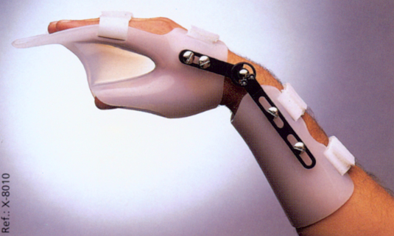
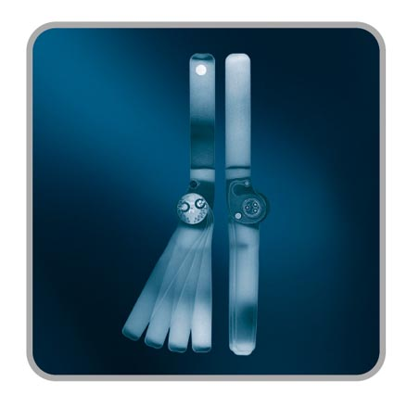
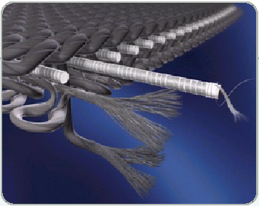
Bimechanical Principles
4. Selection of materials
Notes:
The selection of materials for upper limb orthoses depends on the flexibility, strength, and durability of the material necessary to achieve the proper outcome. Most upper limb orthoses are fabricated of thermoplastics for the structural design. Low temperature thermoplastics are commonly used because they can be easily shaped or formed to the patient’s limb without the need for high-temperature ovens. They can also be easily modified by a common heat gun. However, these devices may also deform under exposure to common heat sources such as the sun or radiators. High-temperature thermoplastics may be indicated for certain longer-term or high-stress devices. Various metals are still used for parts of upper limb orthoses where a lightweight, strong, and compact design is indicated. This includes aluminum frames, joints, and spring wire materials. Ultimately, carbon fiber materials can be used for very strong and very light designs, but manufacturing these orthoses requires specialized equipment and training. Foam materials are commonly used as padding to improve tissue tolerance in high-pressure areas. Delisa

Slide 19
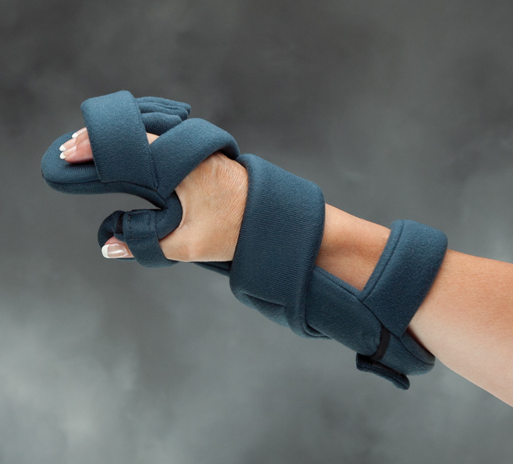
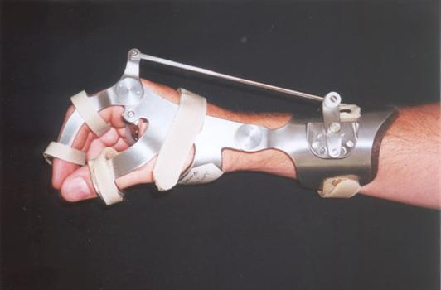
Bimechanical Principles
5. Static versus dynamic control
Notes:
Finally, the overall biomechanics of any upper limb orthosis can be defined as static, dynamic, or hybrid. A traditional static orthosis will simply stabilize or fix one or multiple joints. Generally, a static positioning splint for a flaccid limb will create very low tissue pressures and very low forces at joints. This is tolerated well and can be worn nearly continuously without concern of skin breakdown. However, static positioning splints for an upper limb with an increased tone will certainly generate much higher tissue pressures and the design should incorporate additional padding in these situations. A wearing schedule is also much more important when increased tone is encountered. A dynamic orthosis allows or enhances movement across a joint. Dynamic orthoses generally have fairly low tissue pressures unless external forces are applied such as stretching of a contracture, or in the case of an abnormal increased tone from upper motor neuron injury. In cases of a dynamic orthosis with an external force applied, the biomechanical stresses within the orthosis and the tissue compression will be high. Delisa

Slide 20
Anatomical principles
Notes:
Proper upper limb positioning requires an understanding of multiple anatomical issues, particularly when a joint is to be immobilized. The wrist should be immobilized in slight extension and neutral pronation/supination. This position facilitates hand prehension activities to reach the face and midline trunk for ADLs. The IP joints of the fingers should be immobilized in extension, but the MCP joints should be immobilized in flexion to maintain the length of the collateral ligaments. The IP and MCP joints should be mobilized as soon as possible to prevent contracture and adhesions of the long flexor and extensor tendons. The thumb should be immobilized opposite the fingers in palmar abduction and extension. The web space should be maximized to maintain both gross grasp and fine motor pinch (Fig. 75-5). The hand itself has two transverse arches (proximal and distal metacarpals) with two different radii. These arches must be preserved to maintain proper finger positioning. As each finger is flexed individually, its fingertip points to the scaphoid bone, because of the distal arch. An orthosis that provides traction in finger flexion must also follow this same angle to the scaphoid. As mentioned earlier, traction across a finger or any segment should be perpendicular to that segment and follow the anatomical angle of the joint involved. Delisa

Slide 21
Common upperlimb orthotic devices
Hand finger orthosis
Notes:
The term “thumb spica” refers to a handfinger orthosis, which is based on the hand and extends circumferentially around the thumb to fix the thumb in opposition (Fig. 75-11). This is most commonly used for inflammatory conditions affecting the thumb such as rheumatoid arthritis, or de Quervain’s tenosynovitis, as well as for osteoarthritis. This can also be used for fracture of the first metacarpal to maintain the thumb in a functional position. Delisa

Slide 22
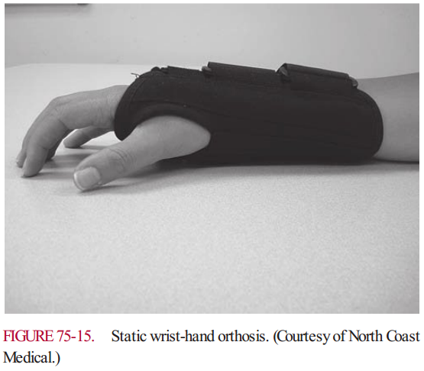
Common upperlimb orthotic devices
Wrist-Hand-Finger Orthosis
Notes:
Today, static wrist-hand orthoses are most commonly used for the treatment of carpal tunnel syndrome. This orthosis includes wrist positioning in neutral (i.e., 0 degrees of extension) and allows full freedom of thumb and finger movement (Fig. 75-15). Carpal tunnel syndrome commonly results from the overuse of the wrist and hand causing inflammation within the carpal tunnel. Therefore, immobilization of the wrist for part or all of the day and night often helps to resolve symptoms. Delisa

Slide 23
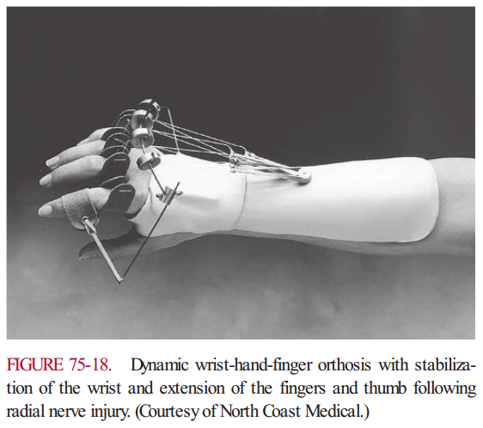
Common upperlimb orthotic devices
Wrist-Hand-Finger Orthosis
Notes:
Radial nerve injury also often requires a wrist-hand-finger orthoses to assist wrist and finger extension. This is accomplished with dynamic orthoses, with rubber bands or spring wire providing extension at the wrist and outriggers with rubber bands providing extension at the fingers. An outrigger or C-bar must also be incorporated to maintain the thumb in opposition (Fig. 75-18). Delisa

Slide 24
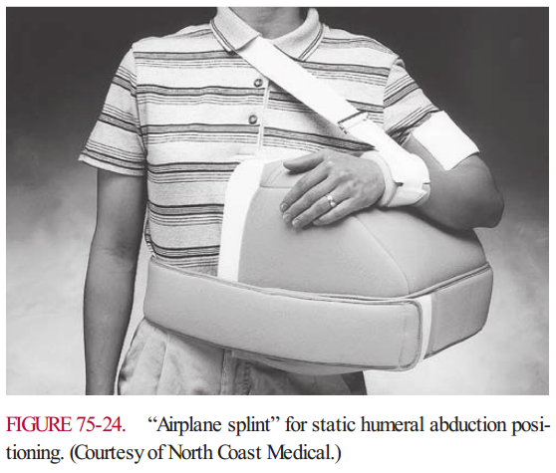
Common upperlimb orthotic devices
Shoulder orthoses
Notes:
A true static shoulder-elbow-wrist-hand orthosis, such as the airplane splint or arm abduction orthosis, can prevent movement across the glenohumeral joint by stabilizing the arm in abduction (Fig. 75-24). This is done for shoulder dislocation, shoulder surgery (e.g., rotator cuff repair), and some proximal fractures. Care must be taken to mobilize the glenohumeral joint as soon as possible to prevent adhesive capsulitis. elisa

Slide 25
Common upperlimb orthotic devices
Notes:
A universal cuff or hand orthosis is used to attach a swivel spoon or other device, which would then allow independent feeding by the patient (Fig. 75-25).

Slide 26
Upperlimb orthotic devices
Notes:
The concept of neural integration has recently been incorporated into upper limb orthoses. Commercially available devices are now being used to create prehension or gross grasp in the paralyzed limb. These devices detect a myoelectric signal from an intact proximal muscle, and then send a signal to distal paralyzed muscles. The paralyzed muscles are stimulated to contract via surface-based electrical stimulation. Stimulating electrodes over the finger flexor and extensor muscle groups create grasp and release maneuvers. The orthotic device itself supports the wrist as a wrist-hand orthosis. The usefulness of these devices is variable, and is dependent upon physical factors such as muscle tone, target muscle excitability, and the presence of contractures. Good strength at the shoulder and elbow greatly enhances the functionality of these devices. Delisa

Slide 27
Radial nerve palsy What could possibly go wrong?
Ana Poljičanin, MD. PhD.^{1,2} , PMR resident
Mentor: Asja Tukić, MD. MSc.¹
Department of Physical Medicine and Rehabilitation
University Hospital Split, Croatia¹
School of Medicine University of Split, Croatia²
AAF Salzburg, June 2015.
Notes:
Traumatic peripheral nerve injuries may cause significant disability and have a serious impact on the patients life. Therefore, early diagnosis, accurat and timely management, and close folow-up are warrented
Traumatske ozljede perifernog živca mogu uzrokovati značajnu onesposobljenost te imati ozbiljan utjecaj na život bolesnika. Upravo zbog toga potrebna je rana dijagnoza, pravovremeno i točno zbrinjavanje te pažljivo praćenje bolesnika.

Slide 28
Case characteristics
Male, 32 years
05.2014. high speed motor vehicle accident
Polytrauma
Humeral shaft fracture
Left arm paralysis:
Brachial plexus contusion
Radial nerve transection
II-IV left carpometacarpal joint subluxation
Fracture of left proximal phalanx of index finger
Notes:
Naš pacijent je muškarac u svojim ranim tridesetim, koji je sudjelovao u prometnoj nesreći kao vozač motorkotača te zadobio politraumatske ozljede. Tijkom dijagnostičke obrade i kliničkog pregleda na hitnom kirurškom prijemu ustanovljen je paraliza lijeve ruke uzrokovana kontuzijom brahijalnog pleksusa i transekcijom radijalnog živca. Također je imao prijelom dijafize nadlakatne kosti te subluksaciju II-IV karpometakarpalnog zgloba i prijelom proksimalne falange lijevog kažiprsta.

Slide 29
Humeral mid-shaft fracture
represent 1 to 3% of all fractures.
Bimodal age distribution:
first peak males/ 30yr/ high velocity trauma
second peak females/ 70yr/low velocity falls
N.B. 32 yr – 14.05.2014. X –ray of left antebrachuim
Notes:
Fractures of the humeral shaft are quite common and represent 1 to3% of all fractures. They occure in all age groups, but show a bimodal distribution: The first peak is seen in the third decade in males and is often associated whit high velocity trauma; the second peak is noted in females in the seventh decade and is associated with low velocity falls.
Kao što sam već rekla naš pacijent imao je prijelom lijeve nadlaktične kosti koji je čest u toj dobi.
Prijelomi nadlaktične kosti su vrlo česte i predstavljaju 1 do 3% svih prijeloma.

Slide 30
Humeral shaft fracture
Early nerve exploration indications:
1. Vascular injury
2. High velocity gunshot
wounds
3. High suspicion of nerve
laceration
4. Severe soft tissue injury
5. Sharp/penetrating injury
Elton SG. J Reconstr Microsurg 2008;24:569–574.
Notes:
The course of the nerve and its intimate relationtship to the humerus results in neurological injury complicating up to 22% of humeral shaft fractures. Ljungquist
Zbog visoke sumnjom na ozljedu živca i teškog oštećenja mekog tkiva traumatolozi su se odlučili na zbrinjavanje prijeloma osteosintezom-Koristili su anterolateralni pristup

Slide 31
Humeral shaft fracture
Plating is the most common form of internal fixation of humeral fractures and preferred in patients with concomitant nerve injury because the nerve may be explored during the procedure..
Elton SG. J Reconstr Microsurg.2008;24:569–574.
Notes:
In that way they were able to easily explore status of radial nerve wich is higly susceptible to injury when there is significant displacement of mid humeral fractures as this one was due to anatomical position of radial nerve in spiral groove of the humerus.
Na taj način oni su bili u mogućnosti da lako istražiti status radijalnog živca koji je vrlo osjetljiv na ozljede kada postoji značajan pomak sredine nadlaktičnih prijeloma, jer to je bio zbog anatomskom položaju od radijalnog živca u spiralnim žlijebom nadlaktične kosti.

Slide 32
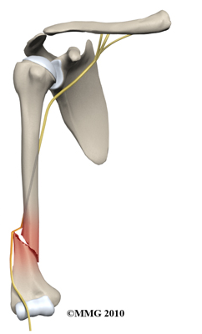
Humeral shaft fractures
Notes:
In that way they were able to easily explore status of radial nerve wich is higly susceptible to injury when there is significant displacement of mid humeral fractures as this one was due to anatomical position of radial nerve in spiral groove of the humerus.
Na taj način oni su bili u mogućnosti da lako istražiti status radijalnog živca koji je vrlo osjetljiv na ozljede kada postoji značajan pomak sredine nadlaktičnih prijeloma, jer to je bio zbog anatomskom položaju od radijalnog živca u spiralnim žlijebom nadlaktične kosti.

Slide 33
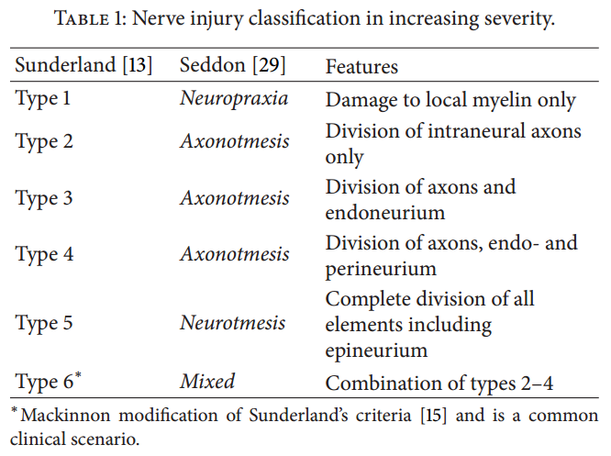
Radial nerve palsy
75 – 90% of radial nerve injuries at presentation are neuropraxias that resolve without intervention.
Grinsell D.BioMed Research International.2014. ID 698256
Notes:
They found out that unfortunatelly for our patient the radial nerv was totaly transected referd as neurotmesis according to Mackinnon modification of Sunderlands classification of nerve injury
Approximately 75 to 90 percent of radial nerve injuries at presentation are neurapraxias that resolve without intervention [13].
Neurotmesis — Neurotmesis most often occurs in association with severe lesions, such as sharp injuries, traction injuries, percussion, or exposure to neurotoxic substances. The axon, myelin sheath, and surrounding stroma are all irreversibly damaged. The external continuity of the injured nerve is usually disrupted. No significant regeneration occurs with such a lesion, unless surgical re-anastomosis is performed.
Mechanisms of functional recovery — Despite the clear pathophysiologic distinctions described above, nerve lesions in most traumatic injuries are mixed. Thus, a single traumatic event will cause a combination of neurapraxia, axonotmesis and neurotmesis in various degrees. The final outcome depends on the ratio between the individual components of the injury (ie, the predominant pathophysiologic feature).
With complete neurotmesis, such as in a nerve transection, disruption of the axon as well as its supporting structures occurs. Spontaneous reversal of the changes is impossible as the nerve regenerates in a disorganized proliferation of axons, Schwann cells, and perineural cells within a collagenous stroma called a neuroma (picture 1). With surgical intervention (scarring debridement and approximation of the nerve ends or interposing of a nerve graft), the axon may grow along the endoneurial tubes of the distal segments. This process may take months to years until useful function is achieved. In neurotmesis, muscle recovery can only occur by axonal regeneration.
Recovery will also depend upon the integrity of the muscle when the nerve reaches it. The muscle remains viable for reinnervation for approximately 12 to 24 months post injury. However, fibrosis develops beyond that time. Therefore, the result of a nerve repair is likely to be poor if the denervation interval is beyond one to two years [3,12,14].
These mechanisms of nerve regeneration affect motor and sensory fibers in a similar fashion. However, as the end organs for the sensory fibers do not degenerate (as the muscle does) the sensory recovery may continue for longer periods of time than motor system recovery [3].
This evaluation may be performed early, at 7 to 10 days, to obtain a baseline study and information regarding localization. However, conduction block cannot be distinguished from axonotmesis or neurotmesis for up to one week, and evidence of muscle denervation is often not present until approximately three weeks post injury. Thus, repeat electrodiagnostic testing at three weeks post injury is often indicated to determine the pathophysiology of the injury.
Evidence for nerve regeneration may be sought anytime after two months. Six months is usually regarded as the latest time for successful surgical anastomosis, and is a useful time for reevaluation to assess nerve recovery For open traumatic injuries with a lesion that is not in continuity, surgical nerve repair is recommended, but the timing differs according to the mechanism of trauma [4]:
●With sharp laceration/transection, immediate primary end-to-end suture repair is recommended.
●With blunt transection, a delayed surgical repair is suggested after approximately two to three weeks to allow scar formation with clear delineation of the healthy nerve ends; this may require a second exploration, as the original injury may mandate non-neural repair. The surgery involves resection of the intraneural scar segment and subsequent nerve repair with or without graft.
The main goal of surgery is to restore motor and sensory neurologic function [14,41]. End-to-end repair entails approximating the nerve ends after mobilizing them. This is the preferred approach in nerve transections when the gap between the nerve ends is small enough to avoid suture tension.
Ongoing research to improve surgical techniques includes avoidance of sutures and their complications by use of autologous fibrin glue [47], and reducing scar formation by laser welding [48]. Other investigational methods to improve surgical outcomes include application of pharmacologic agents that reduce scar formation [48], laser phototherapy, and tissue engineering techniques such as bioscaffolds, neurotrophic factors, and cell sources that provide an environment favorable for nerve regeneration [49]. uptodate

Slide 34
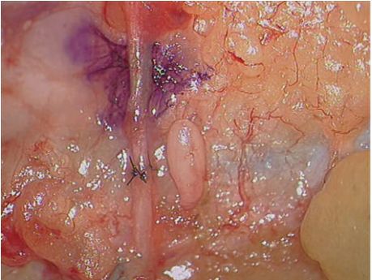
Radial nerve reconstruction
Direct nerve repair with epineural microsutures is still the gold standard surgical treatment for severe axontomesis and neurotmesis.
Grinsell D.BioMed Research International.2014. ID 698256

Slide 35
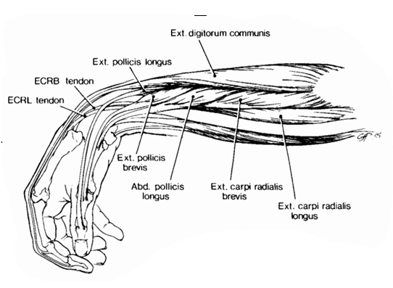
Radial nerve palsy
Colditz JC. J Hand Therapy. 1987; 1: 18-23.
The hallmark of a radial nerve injury is wrist drop.
Notes:
When patient showed at our department he had weakness of wrist, finger, and thumb extension and some weakness of elbow supination. He also had sensory loss on the dorsum of the hand
Which is refferd to as wrist drop -The hallmark of a radial nerve injury .

Slide 36
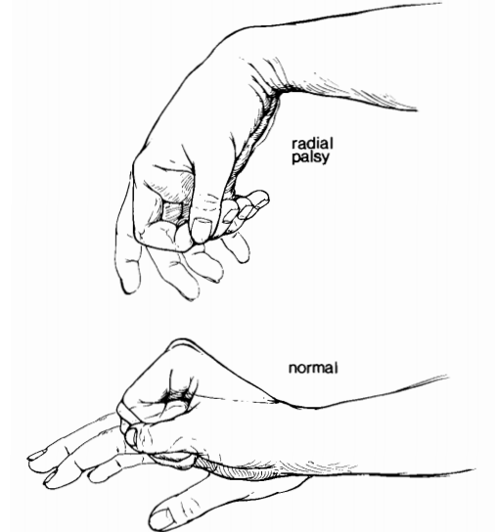
Radial palsy rehabilitation
Colditz JC. J Hand Therapy. 1987; 1: 18-23.
Comparison of the normal tenodesis of the hand and
the altered grasp/release pattern of radial nerve palsy.
Notes:
Because of the extensor weaknes he had altered grasp release pattern

Slide 37
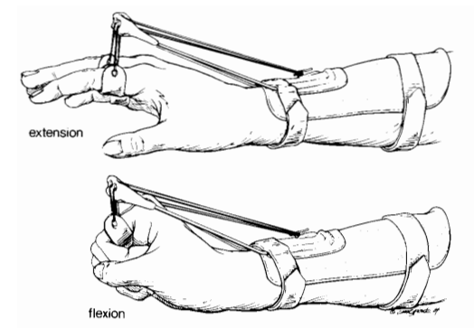
Radial nerve palsy splinting
Colditz JC. J Hand Therapy. 1987; 1: 18-23.
Recreates harmony of tenodesis action: Finger extension
with wrist flexion and wrist extension with finger flexion.
Notes:
Since is very important for this individual to sustain normal tenodesis of the hand apart from kineziotherapy and electrostimulation of the nerve we aplyed dynamic and static orthosis

Slide 38
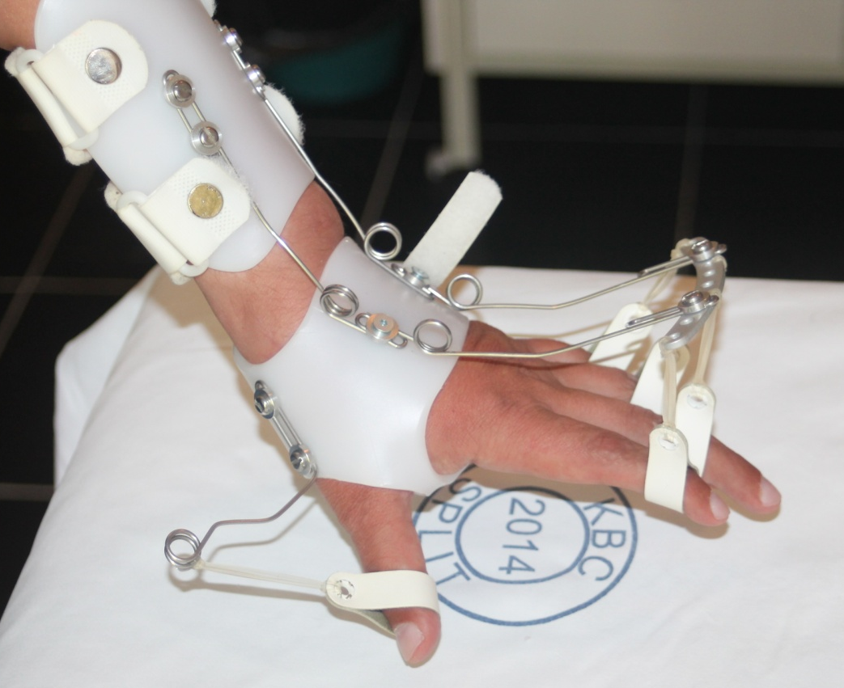
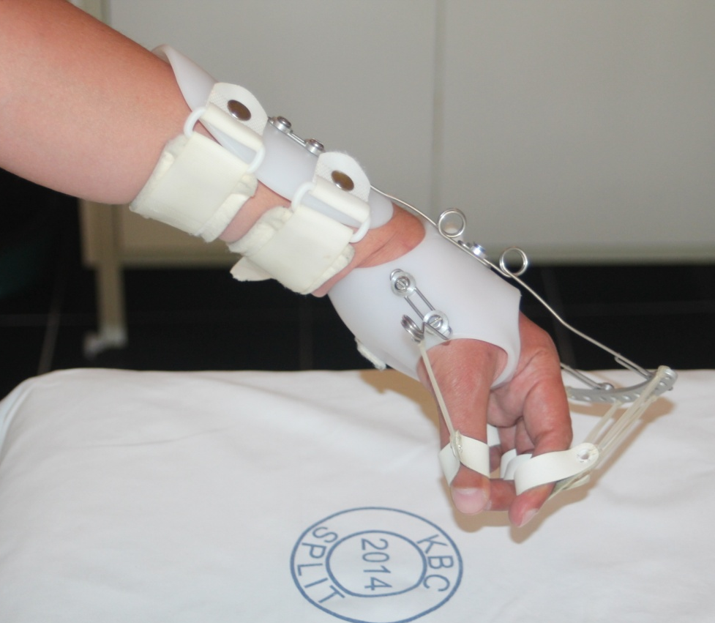
Radial nerve palsy splinting

Slide 39
Radial nerve palsy
Recovery timeline
EMG follow up
2mo
Complete denervation
4mo
Complete denervation
11mo
Complete denervation
Reinervation typically occur at this stage

Slide 40
Recovery complications
Brachial plexus contusion

Slide 41
Erb´s palsy -recovery timeline
EMG follow up
2mo
4mo
Reinervation
11mo
Reinervation
Complete denervation

Slide 42
Recovery complications:
Humeral shaft fracture
Four surgical approaches:
1. Posterior
2. Anterolateral
3. Anterior
4. Anteromedial

Slide 43
Recovery complications:
Humeral shaft fracture
Different operation techniques performed in treating humeral shaft fractures resulted from different incidences of postsurgical radial nerve palsies which varied from 0% to 5.1%
Kirin I. Wien Klin Wochenschr (2011) 123: 83–87.

Slide 44
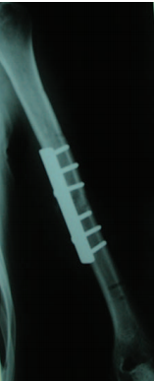
Recovery complications:
Humeral shaft fracture
Four surgical approaches:
1. Posterior
2. Anterolateral
3. Anterior
4. Anteromedial

Slide 45
Recovery complications:
Humeral shaft fracture
None of the patients who had osteosynthesis by using plate on anteromedial humeral surface had lesions of the radial nerve.
Kirin I. Wien Klin Wochenschr (2011) 123: 83–87.

Slide 46
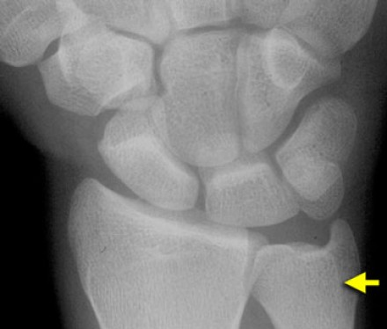
Recovery complication: Hand injury
http://www.radiologyassistant.nl/en/p42a29ec06b9e8/wrist-carpal-instability.html
Trapezoid dislocations are missed in up to 30% of patients on initial assessment.

Slide 47
What the future brings?
Removal of osteosynthetic material
Intensive rehabilitation
How long should we wait for nerve recovery to occur?
When should we consult plastic surgeon?

Slide 48
Gait Aids – Canes and Crutches
When properly positioned, can decrease the amount of muscle force necessary to stabilize a joint.
This in turn leads to attenuation of joint reaction forces and decreased pain symptoms.
Notes:
Canes, crutches, and walkers are often prescribed to assist walking in persons with joint, muscle, and sensory functional losses (Fig. 76-18). Canes serve many functions. They are an important component in the management of persons with balance deficits. Cane use can increase the anteroposterior and mediolateral base of support. They provide an important safety-related function, providing information related to the position of the limb in space, and assist the individuals with vision-impairment such that they can use the device to scan the environment. Increased joint force reaction has been associated with subjective discomfort at a joint, this is likely further compounded by weakness. A cane, when properly positioned, can decrease the amount of muscle force necessary to stabilize a joint. This in turn leads to attenuation of joint reaction forces and decreased pain symptoms. Muscle weakness may also be offset with cane use, where gait deficits such as excessive knee or hip flexion may be overcome. Pathological conditions affecting the upper limbs may interfere with the use of canes or crutches, and may warrant the prescription of specially designed gait aids. In the patient with hemiplegia, the cane should be held in the less-affected hand, and the patient instructed to advance the cane and weaker leg simultaneously to attain a three-point gait pattern. When ascending stairs the same patient advances the lessaffected (stronger) leg first. The reverse pattern is recommended when descending stairs, with the weaker limb plus cane leading. When treating hip joint pain or hip muscle weakness, the cane should be held on the opposite side whilst for the knee it may be held on the same side. A single-point cane weighs less, which is important for individuals with decreased functional reserve or upper limb weakness. It is less intrusive, and may be easier to negotiate in cramped spaces. Where stability is compromised, a wide-based cane may provide a greater base of support. The rationale for crutch prescription is similar to canes. The clinical deficits, however, are usually more pronounced. Good upper extremity strength, joint integrity, and ROM are essential to maximize benefit with crutch use. Shoulder flexors and depressors, elbow and wrist extensors, and finger flexors must have normal or good strength. Most commonly, crutches are prescribed to decrease loading, with muscle weakness or joint pain. Where “push-off” is limited in locomotion, crutch use may aid in forward propulsion. Crutches provide sensory feedback and increase the base of support. Yet they are less commonly prescribed for balance deficits compared to canes. Crutch types include axillary, Lofstrand, Canadian elbow extensor (i.e., triceps crutch), and forearm support (platform crutch). Axillary crutches are the most common. Total length and handle height are the main considerations. Axillary crutch length should approximate the distance from anterior fold of axilla to: (a) bottom of heel (plus 3 to 5 cm) or (b) a point 6 in. in front of the anterolateral border of the foot. Drawbacks include increased assistive device mass and restriction of hand use. Some patients may have trouble coordinating gait pattern with crutches. Additionally, patients who lean on the axillary crutches may experience neurological compression injury in the axillary area (i.e., crutch palsy).
The Lofstrand crutch consists of a molded hand piece, a molded forearm piece bent posteriorly just above the hand piece, and a single, length-adjustable aluminum tubular shaft. The forearm piece extends 4 to 5 cm below the elbow. A forearm cuff with a narrow anterior opening is attached at this site. Lofstrand crutches are, typically, lighter in weight, and the hand piece can be released without losing the crutch. The result is that the hands are freed up to perform some activities, which is a significant advantage. Good upper extremity strength and adequate trunk balance are minimum requirements for safe use of Lofstrand crutches. Delisa Delisa

Slide 49
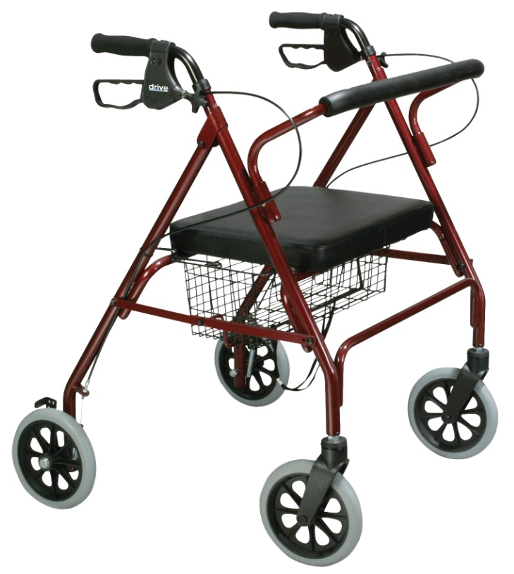
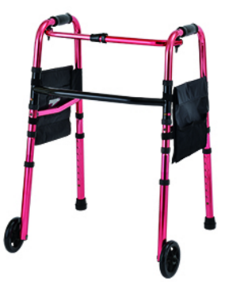
Gait Aids -Walker
Notes:
A walker is a frame device that is inherently stable. There are different types of walkers, the most common of which are made of aluminum, have four posts, and may have small front or rear wheels. The person pushes or lifts the walker in front of himself or herself while walking. Walkers have advantages and disadvantages, all of which should be considered when prescribing such an assistive device. Walkers provide a wider base of support than either canes or crutches, resulting in increased stability. They may be prescribed for patients requiring maximum assistance for balance or with severe sensory deficits, ataxic conditions, and persons with substantial fear of falling. They may be useful during rehabilitation, but care should be taken to assure that the patient does not become too reliant or emotionally dependent on the stability provided by the walker. Proper use requires bilateral grasp and arm strength. They are bulky in appearance, may be difficult to maneuver in tight quarters, and interfere with the development of reciprocal gait. The use of a walker may tax the endurance of the user’s arms. To cope with fatigue, four-wheeled walkers exist and may be outfitted with a seat to make it possible to have intermediate periods of rest. This practice is not risk-free, and the walker should ideally be fitted with hand brakes. Most walkers are too light for individuals with incoordination. When coupled with good upper extremity strength, weight may be added to this type of walker to attenuate this problem. Walkers can be instrumented with wheels to promote better gait timing without having to stop each cycle to advance the walker. Wheels help patients with incoordination or weakness of the upper extremity, where lifting crutches or walkers and placing them forward may be difficult. The rolling (wheeled) walker does not require as much strength and balance to maneuver, compared to non-wheeled walkers, as the user does not have to lift it from the floor. However, the instability introduced by the wheels, if allowed to roll uncontrolled or to swivel, may prove dangerous. Delisa

Slide 50
Spinal Orthosis
Notes:
Spinal orthotics are prescribed for a variety of reasons (Table 77-1). They are designed to protect the spinal column and supporting structures (ligaments and muscles) from loads and stresses that can cause pain or progression of angular and translational deformity. The physiologic mechanisms responsible for this protection are control of motion, trunk support, and spinal alignment (2). Delisa

Slide 51
Control of Motion
Notes:
Control of Motion The control of motion depends on the flexibility of the device. Numerous studies have attempted to quantify the degree of motion restriction. The most minimal limitation in gross movement likely occurs because the device acts as a physical and kinesthetic reminder to the patient not to move in harmful ways. Braces such as soft collars or lumbar corsets are examples of these. These types of devices also serve to provide warmth and heat to the patient, which may reduce spasm and pain. More restrictive braces act to limit intersegmental spinal motion and further, inhibit flexion-extension, lateral bending, and axial rotation

Slide 52
Trunk Support
Trunk support is achieved by an increase in the
intra- abdominal pressure.
Notes:
Trunk Support Trunk support is achieved by an increase in the intra- abdominal pressure. An increase in the thoracoabdominal pressure reduces the demand on the spinal extensor musculature and the vertical loading on the thoracolumbar spine and the intradiscal pressure. Delisa

Slide 53
Spinal Alignment
Notes:
Spinal Alignment Spinal alignment is achieved by the application of the threepoint force system inherent in all bracing. The corrective component ideally is located midway between the opposing forces above and below it. These systems shift forces from diseased areas to more healthy segments and prevent unopposed forces from causing deformity.

Slide 54
Spinal Orthosis
Notes:
Spinal orthotics are divided into groups by the joints they encompass. Within each group, there are many different designs (Table 77-2). Delisa

Slide 55
Negative Effect of Orthotic Devices
Weaknes, atrophy and contracture
Skin irritation
Impaired ambulation and balance
Decrease in pulmonary capacity
Psyhological dependence
Notes:
It is essential to be aware of the negative effects of bracing. Weakness, atrophy, and contracture may follow restriction of motion and muscular activity. Skin irritation from poor fit, hygiene, and pin site shear and pressure, can result in ulceration, pain, and infection. Impaired ambulation and balance can result from the limitation in motion and weight of the device such as with a halo device, which in turn, may make an individual more dependent in their activities of daily living. Eating and swallowing may become compromised due to the position of the head and neck. There can be a decrease in pulmonary capacity due to the restricted chest wall motion and an increase in energy consumption. Psychological dependence on the brace can also develop. This should all be taken into account when prescribing these braces because patients with certain medical conditions (e.g., neuromuscular disease), body types, and personalities may not be able to tolerate them.

Slide 56
Clinical Uses for Spinal Orthotics
Notes:
Spinal bracing is a common modality used for treatment in a variety of conditions affecting the spine (Table 77-5). There are no definitive recommendations when choosing a particular orthosis for a given condition and considerable variability exists among practitioners. If motion restriction for pain relief is the goal, and stability is not in question, as in cases of arthritis, sprain, strain, degenerative disc disease, osteoporosis, and even tumors or infections without neurologic impairment or instability, then corsets, collars, and binders may be adequate. This must be balanced with mobilization and proper exercise. The length of its use must be discussed with the patient and tailored based on variables such as age, concomitant conditions, and chronicity of complaints.

Slide 57
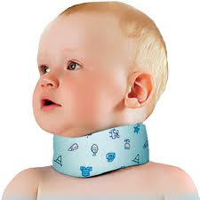
Cervical orthoses - Schantz Collar
Notes:
Given its soft material construction, the soft collar can only provide warmth, psychological reassurance, and kinesthetic reminders to limit cervical range of motion; it cannot provide structural support. Essentially, this orthoses reminds the patient not to move. Its use may be appropriate to treat mild muscular spasms associated with arthritic changes and mild soft-tissue injuries. Soft collars are often prescribed for the early management of whiplash injuries. The effectiveness of its therapeutic use is under scrutiny. Delisa

Slide 58
Biomechanics of the Spine
Notes:
Biomechanics
In the thoracolumbar spine there are three biomechanical regions. The upper thoracic region (T1-T8) is rigid due to the ribcage which provides stability. The transition zone T9-L2 is the transition between the rigid and kyphotic upper thoracic part and the flexible lordotic lumbar spine. This is where most injuries occur. Finally we have the L3-Sacrum zone which is flexible and this is the region where axial loading injuries occur.
http://www.radiologyassistant.nl/en/p4906c8352d8d2/spine-thoracolumbar-injury.html

Slide 59
Biomechanics of the Spine
Notes:
In the upper thoracic spine the center of gravity is anterior to the spine. Axial loading will result in compressive forces anteriorly and tensile forces posteriorly. This will result in flexion-type of injuries. In the lumbar spine due to the lordosis, the center of gravity is posteriorly. Flexion type of injuries will straigthen the lumbar spine and result in axial loading. In this area we will see many burstfractures.

Slide 60
Denis Spinal Columns
Notes:
Denis divided the vertebral column into three vertical parallel columns based on biomechanical studies related to stability post traumatic injury. Instability occurs when injuries affect two contiguous columns (i.e. anterior and middle column or middle and posterior column).
Stability
On the left the three column model of Denis. This model is used to predict the soft tissue injury from bone injury. Spinal stability is dependent on at least two intact columns. When two of the three columns are disrupted, it will allow abnormal segmental motion, i.e. instability. So a simple anterior wedge fracture or just sprain of the posterior ligaments is a stable injury. However a wedge fracture with rupture of the interspinous ligaments is unstable, because the anterior and the posterior column are disrupted. A burst fracture is always unstable because at least the anterior and middle column are disrupted. Criteria to predict soft-tissue injury from bony injury are:
Angulation greater than 20 degrees.
Translation of 3.5 mm or more.

Slide 61
Fracture Classification
Notes:
Compression fractures are classified according to whether they are caused by anterior or lateral flexion. These injuries cause anterior column compression and sometimes associated posterior column distraction.
Burst fractures are classified according to whether the fracture was caused by an axial load alone, or whether flexion, rotation, or lateral flexion was also involved. These injuries cause anterior and middle column compression, and may sometimes also produce associated posterior column distraction.
Seat belt fractures are defined by their distinctive flexion-disruption mechanism of injury. The anterior column may be intact or distracted, but the middle and posterior columns are distracted.
Fracture-dislocations are classified according to whether the dislocation involves rotation, shear, or flexion-distraction. These injuries can produce any pattern of column involvement.
http://bestpractice.bmj.com/best-practice/monograph/820/basics/classification.html

Slide 62
Fracture Classification
Notes:
http://bestpractice.bmj.com/best-practice/monograph/820/basics/classification.html
First-degree instability (Denis type I) is seen in compression fractures. In these cases, only the anterior column is affected. The middle column’s structural integrity remains intact and is therefore considered a stable fracture. Conservative treatment will suffice in the majority of these injuries and tends to include hyperextension bracing or body jacket. When the compression is 30% or less, no external support is required, and early ambulation was reported to be as effective as bracing intervention (88). Orthosis had no effect on back pain or eventual disability in a retrospective review by Folman and Getstein, in stable thoracolumbar fractures with kyphosis less that 20 degrees and compression less than 50% (89). There exists, however, a subset of these lesions that can progress and lead to a posttraumatic kyphosis. According to Ferguson and Allen (90), this occurs when the compression is greater than 50% of the original body height and is the result of posterior ligamentous injury. Frequent monitoring is required. Tezer et al. believe that compression fractures with kyphosis greater that 30 degrees require evaluation of the posterior ligamentous complex and if damaged then surgery should be considered even in the neurologically intact patient (91). Second-degree instability is typical of the burst fracture (Denis type II), a compression injury of the anterior and middle columns. These fractures may behave more like fracture/ dislocation injuries, making categorization in terms of “burst” variable. This has resulted in considerable controversy in treating these fractures. Nevertheless, two-column instabilities that are neurologically intact can be treated conservatively with a Jewett, CASH, or custom-molded TLSO appliance (92,93). Wood et al, in a prospective study, found that operative treatment of thoracolumbar fractures provided no major long-term advantage compared with nonoperative treatment with bracing (93). Fractures with posterior element instability (threecolumn injury) will likely require surgery. Seat belt injuries (Denis type III) may heal (about 50% of these injuries) with a hyperextension TLSO if the fracture line passes through bone, the so-called Chance fracture (94). However, if the fracture passes through the soft tissues, known as a slice fracture, then surgery is required. Fracture/dislocation injury (Denis type IV) is an unstable fracture and frequently results in paralysis. This always requires surgery unless there are other contraindications (73) Delisa

Slide 63
Spinal Orthosis- Jewwett Orthosis
Notes:
The flexion control orthosis is also referred to as an anterior hyperextension brace, which functions to extend the thoracolumbar region. It uses a a three-point pressure system without any abdominal compression. The Jewett brace consists of a metal anterior and lateral frame. Attached to the frame are two lateral pads, a sternal pad, a suprapubic pad, and a posterior thoracolumbar pad. The pads exert pressures over a small area and therefore may cause discomfort. It is designed to prevent only flexion and do not limit lateral and rotary movements. It has been used to aid in the treatment of osteoporosis and anterior compression fractures. However, it has not been found to decrease kyphosis and have been found to cause excessive hyperextension forces on the posterior elements, inducing fracture. They are contraindicated in unstable fractures or in cases where extension must be prohibited, such as spondylolisthesis. Delisa

Slide 64
Spinal Orthosis- Jewwett Orthosis
Notes:
The thoracolumbosacral orthosis (TLSO) is a spinal orthosis that provides fixation at the extremes of the pelvis and the shoulders in an attempt to immobilize the thoracolumbar spine in varying directions. All trunk orthoses produce their desired effect by applying anterior abdominal compression, restricting trunk/intervertebral motion, and supporting/aligning the spine Delisa

Slide 65
Spinal Orthoses- Taylor´s Brace
Notes:
Flexion-Extension Control Orthosis The Taylor brace, designed in 1863, for the treatment of Pott’s disease, consists of two thoracolumbosacral posterior uprights attached inferiorly to a pelvic band and superiorly to an interscapular band that also serves as an attachment for axillary straps (Fig. 77-6). Anteriorly, there is a corset for abdominal compression. The axillary straps extend over the shoulders and pass under the axillae, buckling at each end of the interscapular band. This brace limits the trunk extension, primarily in the mid-to-lower thoracic and upper lumbar areas with a compensatory increase in motion at the upper thoracic, lower lumbar, and lumbosacral junction. The straps must be tight in order for the brace to be effective and thereby may cause shoulder pain limiting the patient’s compliance. In addition, the straps may restrict end-range shoulder motion.

Slide 66
Spinal Orthosis- Body Jacket
Notes:
Plastic Body Jacket The custom-molded plastic body jacket is the orthotic apparatus of choice when maximum immobilization is necessary (Fig. 77-8). Fabricated from polypropylene through a plaster cast taken from the patient, body jackets provide total contact to soft tissues with reliefs over bony prominences, thereby distributing forces over a large area for greater comfort, support, and motion control. The superior and inferior portions of the anterior section restrict flexion in the thoracolumbar and lumbosacral segments. The superior and inferior forces from the posterior shell and the forces from the abdominal area in the anterior component resist extension. The upper and lower portions of the lateral aspects of the jacket limit lateral trunk motion. And lastly, these forces combine to limit the thoracolumbar rotation. Abdominal compression also alleviates pressure on the vertebrae and discs and reduces myoelectric activity of erector spinae musculature. Proper fit requires that the inferior border of the anterior shell rest one-half inch above the pubic symphysis, the trim follows the inguinal fold when the patient is sitting, and the superior border encompasses the sternal notch. If the anteriorinferior border is too long, the patient will have difficulty sitting forward and performing sit-to-stand transfers, as the brace would block the forward motion required to transfer. If during transfer training, as the therapist attempts to guide and position the trunk forward in preparation to transfer, the patient complains of pain in and around the pubis, the orthotist must be contacted to trim the brace. Posteriorly, the shell should extend from the spine of the scapula to the sacrococcygeal junction with the upper gluteal mass contained and the axillae and trochanter free (77). Extra precautions must be taken when fitting a jacket to an insensate patient; however, since the jackets are total contact in design, they are better tolerated. Plastizote lining and ventilation holes make the jackets even more comfortable and breathable. They can be washed and modified as needed; they can even be modified to accommodate a drain. The jackets can be made into lumbosacral orthoses (LSOs) and cervical thoracolumbosacral orthoses (CTLSOs) when the upper thoracic spine needs immobilization. They should be worn at all times when on an incline greater that 30 degrees, though this is often modified by the surgeon (e.g., to allow the patient to shower). Foam designs with rigid stays may be beneficial in those cases where postural forces exacerbate curves and positioning is the main desired goal. Restrictions of activity and brace wearing must be individualized for each patient’s needs. Delisa

Slide 67
Milwaukee Brace

Slide 68
ana.poljicanin@mefst.hr

