Slide 1
Trinity Evangelical Lutheran Church February 12, 2023
WELCOME!
1. Gather
2. Word
3. Meal
4. Sending
Notes:
Image: Five Loaves by Caroline Coolidge Brown. Copyright © Caroline Coolidge Brown. All rights reserved. Used by permission of the artist.

Slide 2
= Please stand if able
= Please be seated
1. Gather
Prelude – Roxanne Groff
Office of the Acolyte
Ringing of the Bell
Welcome
Notes:
Image: Five Loaves by Caroline Coolidge Brown. Copyright © Caroline Coolidge Brown. All rights reserved. Used by permission of the artist.

Slide 3
1. Gather
THANKSGIVING FOR BAPTISM
All may make the sign of the cross, the sign marked at baptism, as the presiding minister begins.
P: Blessed be the holy Trinity, ☩ one God, the fountain of living water, the rock who gave us birth, our light and our salvation.
C: Amen.
Notes:
Image: Five Loaves by Caroline Coolidge Brown. Copyright © Caroline Coolidge Brown. All rights reserved. Used by permission of the artist.

Slide 4
1. Gather
THANKSGIVING FOR BAPTISM
The presiding minister addresses the assembly.
P: Joined to Christ in the waters of baptism, we are clothed with God’s mercy and forgiveness. Let us give thanks for the gift of baptism.
Notes:
Image: Five Loaves by Caroline Coolidge Brown. Copyright © Caroline Coolidge Brown. All rights reserved. Used by permission of the artist.

Slide 5
1. Gather
THANKSGIVING FOR BAPTISM
Water may be poured into the font as the presiding minister gives thanks.
P: We give you thanks, O God, for in the beginning your Spirit moved over the waters and by your Word you created the world, calling forth life in which you took delight. Through the waters of the flood you delivered Noah and his family
Notes:
Image: Five Loaves by Caroline Coolidge Brown. Copyright © Caroline Coolidge Brown. All rights reserved. Used by permission of the artist.

Slide 6
1. Gather
THANKSGIVING FOR BAPTISM
P: Through the sea you led your people Israel from slavery into freedom. At the river your Son was baptized by John and anointed with the Holy Spirit. By water and your Word you claim us as daughters and sons, making us heirs of your promise and servants of all. We praise you for the gift of water that sustains life, and above all we praise you for the gift of new life in Jesus Christ
Notes:
Image: Five Loaves by Caroline Coolidge Brown. Copyright © Caroline Coolidge Brown. All rights reserved. Used by permission of the artist.

Slide 7
1. Gather
THANKSGIVING FOR BAPTISM
P: Shower us with your Spirit, and renew our lives with your forgiveness, grace, and love. To you be given honor and praise through Jesus Christ our Lord in the unity of the Holy Spirit, now and forever.
C: Amen.
The service continues with gathering song.
Notes:
Image: Five Loaves by Caroline Coolidge Brown. Copyright © Caroline Coolidge Brown. All rights reserved. Used by permission of the artist.

Slide 8
GATHERING SONG
1. Gather
“Gather Us In”
ELW 532
Notes:
Image: Five Loaves by Caroline Coolidge Brown. Copyright © Caroline Coolidge Brown. All rights reserved. Used by permission of the artist.

Slide 9
1. Gather
Gather Us In ELW 532
1 Here in this place the new light is streaming,
now is the darkness vanished away;
see in this space our fears and our dreamings
brought here to you in the light of this day.
Notes:
Image: Preparing yeast dough. Copyright © tomasworks/iStock/Thinkstock. Used by permission.

Slide 10
1. Gather
Gather Us In ELW 532
1 Gather us in, the lost and forsaken,
gather us in, the blind and the lame;
call to us now, and we shall awaken,
we shall arise at the sound of our name.
Notes:
Image: Preparing yeast dough. Copyright © tomasworks/iStock/Thinkstock. Used by permission.

Slide 11
1. Gather
Gather Us In ELW 532
2 We are the young, our lives are a myst'ry,
we are the old who yearn for your face;
we have been sung throughout all of hist'ry,
called to be light to the whole human race.
Notes:
Image: Preparing yeast dough. Copyright © tomasworks/iStock/Thinkstock. Used by permission.

Slide 12
1. Gather
Gather Us In ELW 532
2 Gather us in, the rich and the haughty,
gather us in, the proud and the strong;
give us a heart, so meek and so lowly,
give us the courage to enter the song.
Notes:
Image: Preparing yeast dough. Copyright © tomasworks/iStock/Thinkstock. Used by permission.

Slide 13
1. Gather
Gather Us In ELW 532
3 Here we will take the wine and the water,
here we will take the bread of new birth,
here you shall call your sons and your daughters,
call us anew to be salt for the earth.
Notes:
Image: Preparing yeast dough. Copyright © tomasworks/iStock/Thinkstock. Used by permission.

Slide 14
1. Gather
Gather Us In ELW 532
3 Give us to drink the wine of compassion,
give us to eat the bread that is you;
nourish us well, and teach us to fashion
lives that are holy and hearts that are true.
Notes:
Image: Preparing yeast dough. Copyright © tomasworks/iStock/Thinkstock. Used by permission.

Slide 15
1. Gather
Gather Us In ELW 532
4 Not in the dark of buildings confining,
not in some heaven, light years away—
here in this place the new light is shining,
now is the kingdom, and now is the day.
Notes:
Image: Preparing yeast dough. Copyright © tomasworks/iStock/Thinkstock. Used by permission.

Slide 16
1. Gather
Gather Us In ELW 532
4 Gather us in and hold us forever,
gather us in and make us your own;
gather us in, all peoples together,
fire of love in our flesh and our bone.
Notes:
Image: Preparing yeast dough. Copyright © tomasworks/iStock/Thinkstock. Used by permission.

Slide 17
1. Gather
APOSTOLIC GREETING
P: The grace of our Lord Jesus Christ, the love of God, and the communion of the Holy Spirit be with you all.
C: And also with you.
Notes:
Image: Five Loaves by Caroline Coolidge Brown. Copyright © Caroline Coolidge Brown. All rights reserved. Used by permission of the artist.

Slide 18
1. Gather
PRAYER OF THE DAY
P: Let us pray… Gracious God, your Son spoke to us in parables about the nature of your reign. Give us ears to hear and hearts to understand that we might be instruments of your peace and justice.
C: Amen.
Notes:
Image: Five Loaves by Caroline Coolidge Brown. Copyright © Caroline Coolidge Brown. All rights reserved. Used by permission of the artist.

Slide 19
Word
Gather
Sending
Meal
Notes:
Image: Preparing yeast dough. Copyright © tomasworks/iStock/Thinkstock. Used by permission.

Slide 20
Word
Notes:
Image: Preparing yeast dough. Copyright © tomasworks/iStock/Thinkstock. Used by permission.

Slide 21
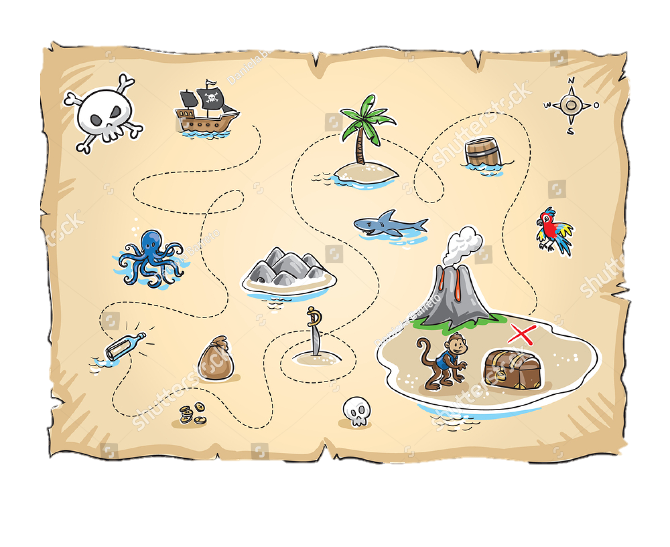
Word
Notes:
Image: Preparing yeast dough. Copyright © tomasworks/iStock/Thinkstock. Used by permission.

Slide 22
Scripture Reading
Word
R: Our scripture reading for this day is from the Gospel according to Matthew, the 13th chapter..
C: Glory to you O’ Lord! (Spoken)
Notes:
Image: Five Loaves by Caroline Coolidge Brown. Copyright © Caroline Coolidge Brown. All rights reserved. Used by permission of the artist.

Slide 23
Word
Matthew 13:24-43
²⁴He put before them another parable: “The kingdom of heaven may be compared to someone who sowed good seed in his field; ²⁵but while everybody was asleep, an enemy came and sowed weeds among the wheat, and then went away. ²⁶So when the plants came up and bore grain, then the weeds appeared as well. ²⁷And the slaves of the householder came and
Notes:
Image: Five Loaves by Caroline Coolidge Brown. Copyright © Caroline Coolidge Brown. All rights reserved. Used by permission of the artist.

Slide 24
Word
Matthew 13:24-43
said to him, ‘Master, did you not sow good seed in your field? Where, then, did these weeds come from?’ ²⁸He answered, ‘An enemy has done this.’ The slaves said to him, ‘Then do you want us to go and gather them?’ ²⁹But he replied, ‘No; for in gathering the weeds you would uproot the wheat along with them. ³⁰Let both of them grow together until the harvest; and at
Notes:
Image: Five Loaves by Caroline Coolidge Brown. Copyright © Caroline Coolidge Brown. All rights reserved. Used by permission of the artist.

Slide 25
Word
Matthew 13:24-43
harvest time I will tell the reapers, Collect the weeds first and bind them in bundles to be burned, but gather the wheat into my barn.’”
³¹He put before them another parable: “The kingdom of heaven is like a mustard seed that someone took and sowed in his field; ³²it is the smallest of all the seeds, but when it has grown it is the greatest of shrubs and becomes
Notes:
Image: Five Loaves by Caroline Coolidge Brown. Copyright © Caroline Coolidge Brown. All rights reserved. Used by permission of the artist.

Slide 26
Word
Matthew 13:24-43
a tree, so that the birds of the air come and make nests in its branches.” ³³He told them another parable: “The kingdom of heaven is like yeast that a woman took and mixed in with three measures of flour until all of it was leavened.” ³⁴Jesus told the crowds all these things in parables; without a parable he told them nothing. ³⁵This was to fulfill what had been spoken
Notes:
Image: Five Loaves by Caroline Coolidge Brown. Copyright © Caroline Coolidge Brown. All rights reserved. Used by permission of the artist.

Slide 27
Word
Matthew 13:24-43
through the prophet: “I will open my mouth to speak in parables; I will proclaim what has been hidden from the foundation of the world.”
³⁶Then he left the crowds and went into the house. And his disciples approached him, saying, “Explain to us the parable of the weeds of the field.” ³⁷He answered, “The one who sows the good seed is the Son of Man; ³⁸the field
Notes:
Image: Five Loaves by Caroline Coolidge Brown. Copyright © Caroline Coolidge Brown. All rights reserved. Used by permission of the artist.

Slide 28
Word
Matthew 13:24-43
is the world, and the good seed are the children of the kingdom; the weeds are the children of the evil one, ³⁹and the enemy who sowed them is the devil; the harvest is the end of the age, and the reapers are angels. ⁴⁰Just as the weeds are collected and burned up with fire, so will it be at the end of the age. ⁴¹The Son of Man will send his angels, and they will collect out of his
Notes:
Image: Five Loaves by Caroline Coolidge Brown. Copyright © Caroline Coolidge Brown. All rights reserved. Used by permission of the artist.

Slide 29
Word
Matthew 13:24-43
kingdom all causes of sin and all evildoers, ⁴²and they will throw them into the furnace of fire, where there will be weeping and gnashing of teeth. ⁴³Then the righteous will shine like the sun in the kingdom of their Father. Let anyone with ears listen!
⁴⁴“The kingdom of heaven is like treasure hidden in a field, which someone found and hid; then in his joy
Notes:
Image: Five Loaves by Caroline Coolidge Brown. Copyright © Caroline Coolidge Brown. All rights reserved. Used by permission of the artist.

Slide 30
Word
Matthew 13:24-43
he goes and sells all that he has and buys that field.” ⁴⁵“Again, the kingdom of heaven is like a merchant in search of fine pearls; ⁴⁶on finding one pearl of great value, he went and sold all that he had and bought it.”
Notes:
Image: Five Loaves by Caroline Coolidge Brown. Copyright © Caroline Coolidge Brown. All rights reserved. Used by permission of the artist.

Slide 31
Word
Matthew 13:24-43
R: This is the Word of the Lord.
C: Praise to You, O Christ (Spoken)
Notes:
Image: Five Loaves by Caroline Coolidge Brown. Copyright © Caroline Coolidge Brown. All rights reserved. Used by permission of the artist.

Slide 32
Sermon
Word
Notes:
Image: Five Loaves by Caroline Coolidge Brown. Copyright © Caroline Coolidge Brown. All rights reserved. Used by permission of the artist.

Slide 33
Word
HYMN OF THE DAY
Lord, Speak to Us That We May Speak
LBW 403

Slide 34
Lord, Speak to Us That We May Speak
LBW 403
Word
1 Lord, speak to us, that we may speak
in living echoes of your tone;
as you have sought, so let us seek
your straying children, lost and lone.

Slide 35
Lord, Speak to Us That We May Speak
LBW 403
Word
2 Oh, lead us, Lord, that we may lead
the wand’ring and the wav’ring feet;
oh, feed us, Lord, that we may feed
your hung’ring ones with manna sweet.

Slide 36
Lord, Speak to Us That We May Speak
LBW 403
Word
3 Oh, teach us, Lord, that we may teach
the precious truths which you impart;
and wing our words, that they may reach
the hidden depths of many a heart.

Slide 37
Lord, Speak to Us That We May Speak
LBW 403
Word
4 Oh, fill us with your fullness, Lord,
until our very hearts o’erflow
in kindling thought and glowing word,
your love to tell, your praise to show.

Slide 38
Word
APOSTLE’S CREED
C: I believe in God, the Father almighty, creator of heaven and earth.

Slide 39
APOSTLE’S CREED
Word
C: I believe in Jesus Christ, his only Son, our Lord. He was conceived by the power of the Holy Spirit and born of the virgin Mary. He suffered under Pontius Pilate, was crucified, died, and was buried.

Slide 40
APOSTLE’S CREED
Word
C: He descended into hell. On the third day he rose again. He ascended into heaven, and is seated at the right hand of the Father. He will come again to judge the living and the dead.

Slide 41
APOSTLE’S CREED
Word
C: I believe in the Holy Spirit, the holy catholic Church, the communion of saints, the forgiveness of sins, the resurrection of the body, and the life everlasting. Amen.

Slide 42
NICENE CREED
Word
C: We believe in one God, the Father, the Almighty, maker of heaven and earth, of all that is, seen and unseen.

Slide 43
NICENE CREED
Word
C: We believe in one Lord, Jesus Christ, the only Son of God, eternally begotten of the Father, God from God, Light from Light, true God from true God, begotten, not made, of one Being with the Father.

Slide 44
NICENE CREED
Word
C: Through him all things were made. For us and for our salvation he came down from heaven; by the power of the Holy Spirit he became incarnate from the virgin Mary, and was made man. For our sake he was crucified under Pontius Pilate;

Slide 45
NICENE CREED
Word
C: he suffered death and was buried. On the third day he rose again in accordance with the Scriptures; he ascended into heaven and is seated at the right hand of the Father. He will come again in glory to judge the living and the dead, and his kingdom will have no end.

Slide 46
NICENE CREED
Word
C: We believe in the Holy Spirit, the Lord, the giver of life, who proceeds from the Father and the Son. With the Father and the Son he is worshiped and glorified. He has spoken through the prophets. We believe in one holy catholic and apostolic Church.

Slide 47
NICENE CREED
Word
C: We acknowledge one Baptism for the forgiveness of sins. We look for the resurrection of the dead, and the life of the world to come. Amen.

Slide 48
PRAYERS OF INTERCESSION
Word
Each petition will end with the words,
A: Merciful God,
The congregation will respond with:
C: You hear our prayer.

Slide 49
PRAYERS OF INTERCESSION
Word
The prayer concludes…
P: Receive our prayers and hold all for whom we pray in your loving arms, in the name of your son, Jesus Christ.
C: Amen.

Slide 50
SHARING OF THE PEACE
Word
(The Sharing of the Peace that began when the congregation arrived is now shared with the Pastor at this time...)
P: The peace of the Lord be with you always.
C: And also with you.

Slide 51
OFFERING
OFFERTORY PRAYER
Gather
Word
Sending
Meal
Notes:
Image: Five Loaves by Caroline Coolidge Brown. Copyright © Caroline Coolidge Brown. All rights reserved. Used by permission of the artist.

Slide 52
THE LORD’S PRAYER
C: Our Father, who art in heaven, hallowed be thy name, thy kingdom come, thy will be done, on earth as it is in heaven.
Meal

Slide 53
THE LORD’S PRAYER
C: Give us this day our daily bread; and forgive us our trespasses, as we forgive those who trespass against us; and lead us not into temptation, but deliver us from evil.
Meal

Slide 54
THE LORD’S PRAYER
C: For thine is the kingdom, and the power, and the glory, forever and ever. Amen.
Meal

Slide 55
ANNOUNCEMENTS
Gather
Word
Meal
Sending
Notes:
Image: Five Loaves by Caroline Coolidge Brown. Copyright © Caroline Coolidge Brown. All rights reserved. Used by permission of the artist.

Slide 56
SENDING BLESSING
P: The God who faithfully brings forth justice and breaks the oppressor’s rod bless, strengthen, and uphold you, today and always. …
C: Amen.
☩
Sending

Slide 57
SENDING SONG
“My Faith Looks Up to Thee”
LBW 479
Sending
Notes:
Image: Five Loaves by Caroline Coolidge Brown. Copyright © Caroline Coolidge Brown. All rights reserved. Used by permission of the artist.

Slide 58
My Faith Looks Up To Thee LBW 479
1 My faith looks up to thee,
thou Lamb of Calvary,
Savior divine!
Now hear me while I pray,
take all my guilt away,
oh, let me from this day
be wholly thine!
Sending
Notes:
Image: Preparing yeast dough. Copyright © tomasworks/iStock/Thinkstock. Used by permission.

Slide 59
My Faith Looks Up To Thee LBW 479
2 May thy rich grace impart
strength to my fainting heart,
my zeal inspire;
as thou hast died for me,
oh, may my love to thee
pure, warm, and changeless be,
a living fire!
Sending
Notes:
Image: Preparing yeast dough. Copyright © tomasworks/iStock/Thinkstock. Used by permission.

Slide 60
My Faith Looks Up To Thee LBW 479
3 While life's dark maze I tread
and griefs around me spread,
be thou my guide;
bid darkness turn to day,
wipe sorrow's tears away,
nor let me ever stray
from thee aside.
Sending
Notes:
Image: Preparing yeast dough. Copyright © tomasworks/iStock/Thinkstock. Used by permission.

Slide 61
My Faith Looks Up To Thee LBW 479
4 When ends life's transient dream,
when death's cold, sullen stream
shall o'er me roll;
blest Savior, then, in love
fear and distrust remove;
oh, bear me safe above,
a ransomed soul!
Sending
Notes:
Image: Preparing yeast dough. Copyright © tomasworks/iStock/Thinkstock. Used by permission.

Slide 62
DISMISSAL
P: … depart in Christ’s Love.
C: Seeking, welcoming, and serving all. Amen!
POSTLUDE
By
Roxanne Groff
From sundaysandseasons.com. Copyright © 2023 Augsburg Fortress. All rights reserved. Reprinted by permission under Augsburg Fortress Liturgies Annual License #SAS023830. New Revised Standard Version Bible, Copyright © 1989, Division of Christian Education of the National Council of the Churches of Christ in the United States of America. Used by permission. All rights reserved. Revised Common Lectionary, Copyright © 1992 Consultation on Common Texts, admin Augsburg Fortress. Used by permission.
Sending

